Slide 1
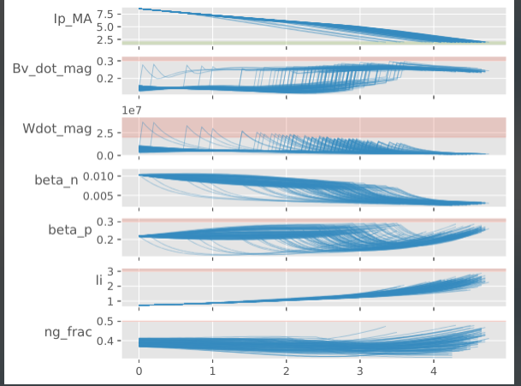
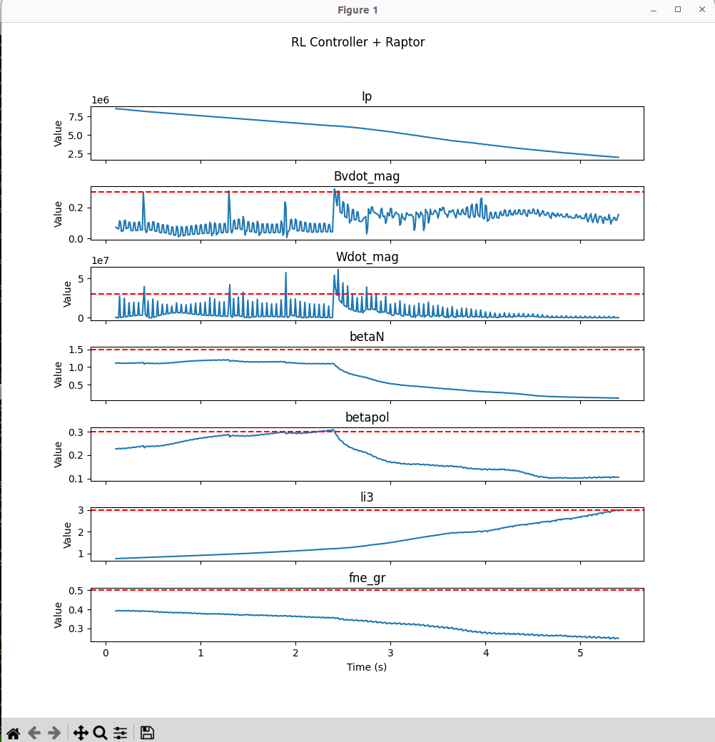
Reinforcement Learning for Rampdown Scenario Design and Active Disruption Avoidance - Allen Wang
Motivations
Disruptions pose a major risk to burning plasma devices
It is desirable to be able to rapidly rampdown the plasma current across a wide range of physics scenarios, while avoiding disruptive limits
Results
We build a differentiable gym environment to apply optimization + RL algorithms to this problem
We demonstrate:
Building a library of rampdown trajectories for different scenarios that can be programmed into am machine like SPARC
Sim-to-sim transfer of the control policy as a first step towards active disruption avoidance experiments
Challenges
Lots of unmodelled physics
Sim-to-real transfer will be challenging
IAEA Workshop on AI for Accelerating Fusion and Plasma Science, 2023 11/28 – 12/1

