Slide 1
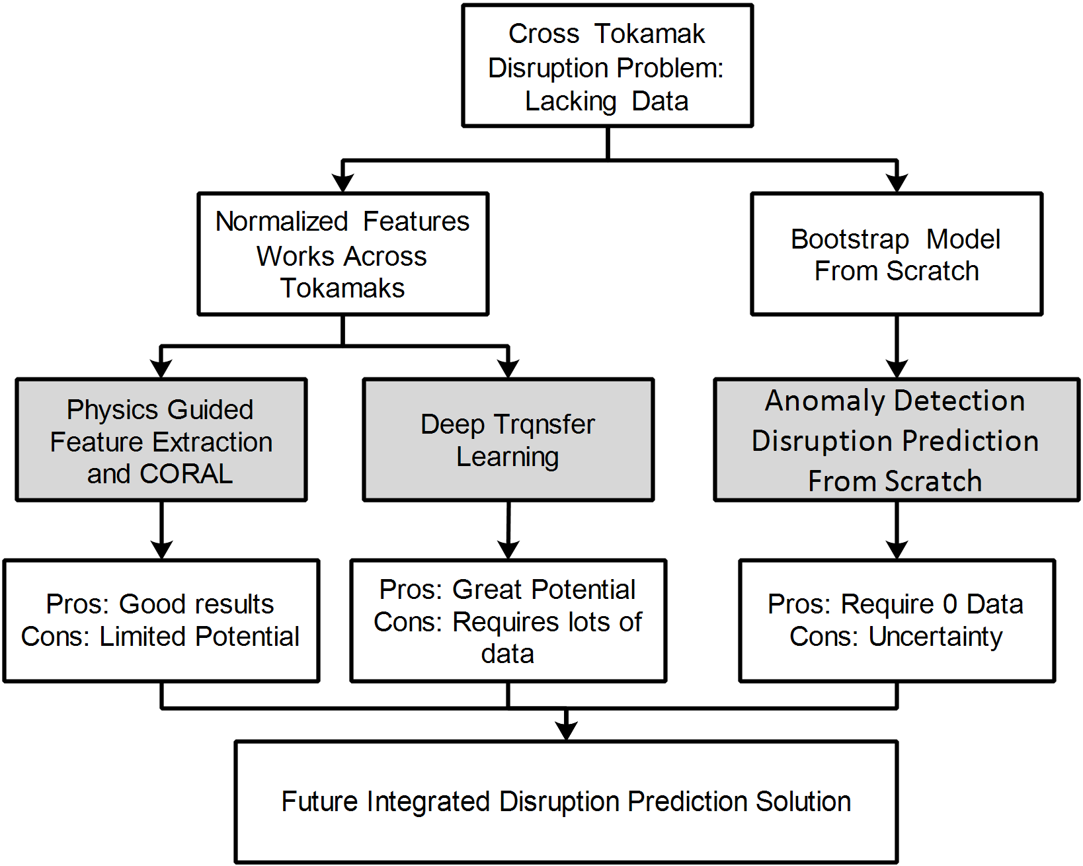
Cross Tokamak Disruption Prediction with Different Methods and from Different Perspectives Wei Zheng
Motivations
Accurate disruption prediction is the key for tokamaks to be commercially viable reactors.
Machine learning disruption predictors exhibit good performance. But, they require lots of data to train while the future reactors cannot provide.
Results
By using physics guided feature engineering, predictors trained with current tokamaks’ data can be transferred to future reactors.
With physics guided deep learning feature extractor and transfer learning, existing predictors can be ported to new machines.
From scratch adaptive model can be bootstrapped with the very first shot from a new tokamak, even without any disruption data.
Challenges
Performance is still not good enough to call the problem solved, but we are getting closer.
More tokamak data is needed, and the diagnostic differences are the major obstacles.
The uncertainty of the future machine make ML based not very trustable.
Trying to tackle the cross tokamak disruption prediction problem from various perspective.
Come to our poster to learn more.
IAEA Workshop on AI for Accelerating Fusion and Plasma Science, 2023 11/28 – 12/1

