Slide 1


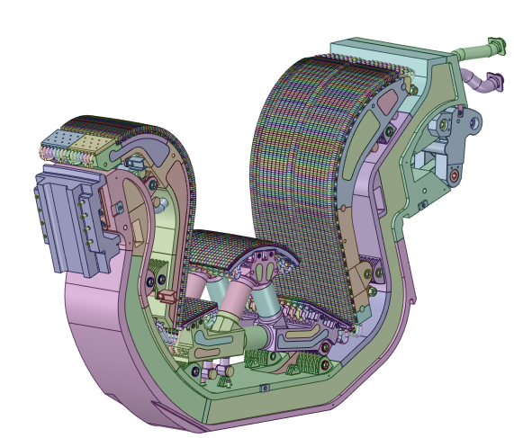
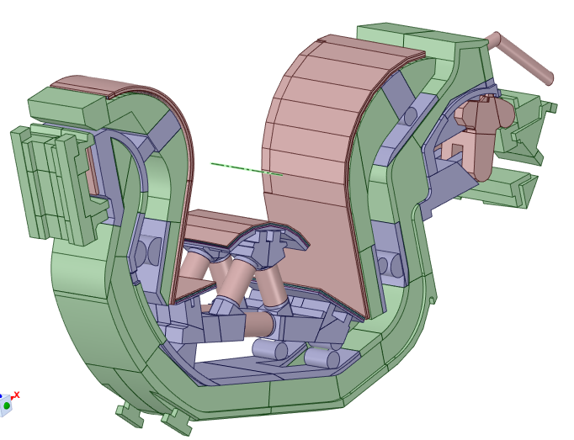
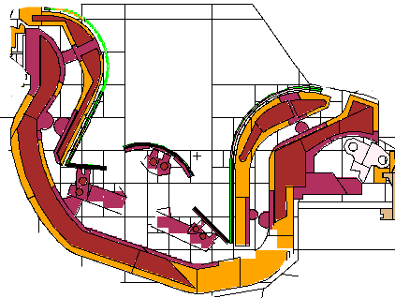
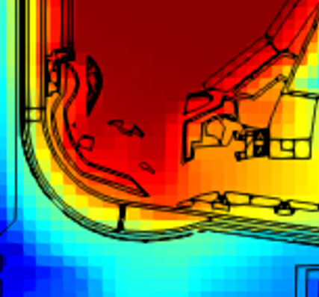




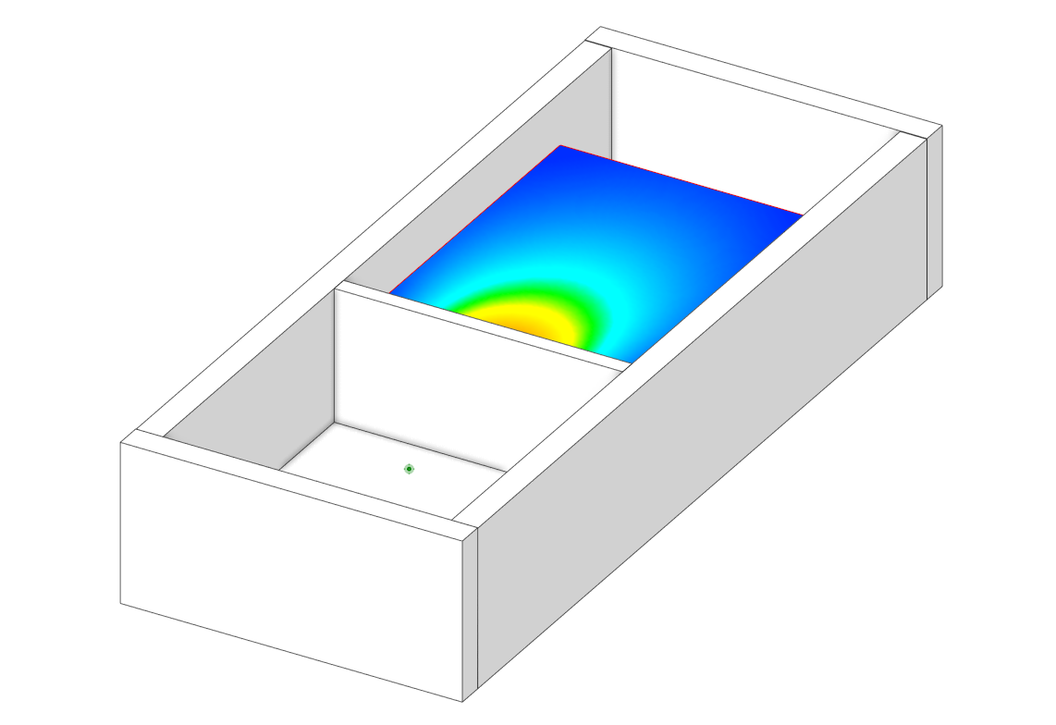

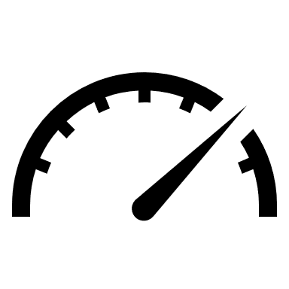
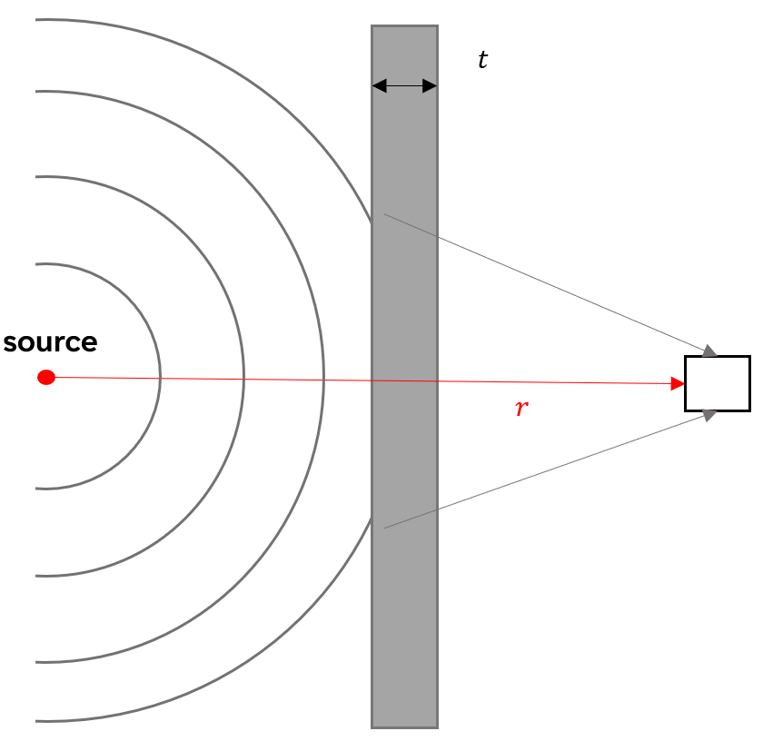
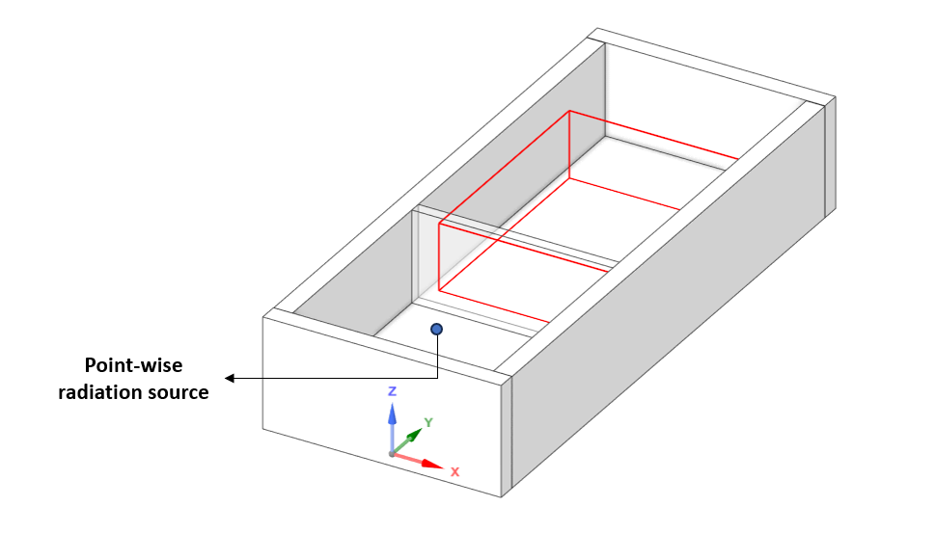
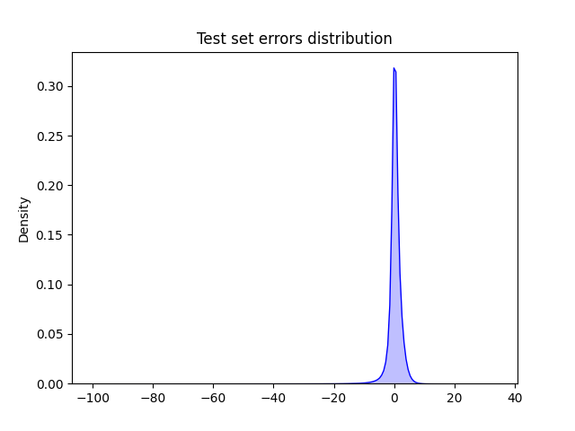
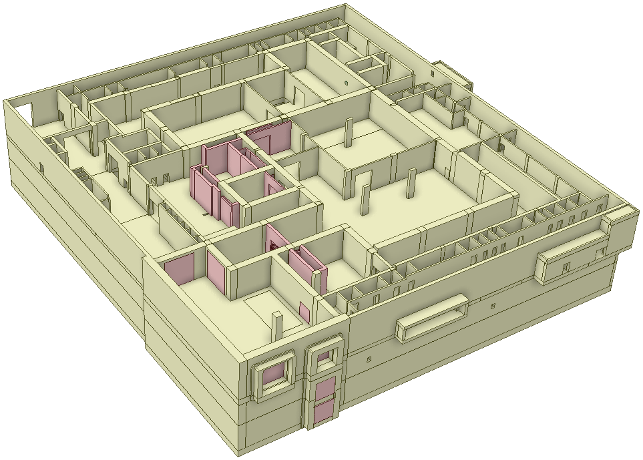
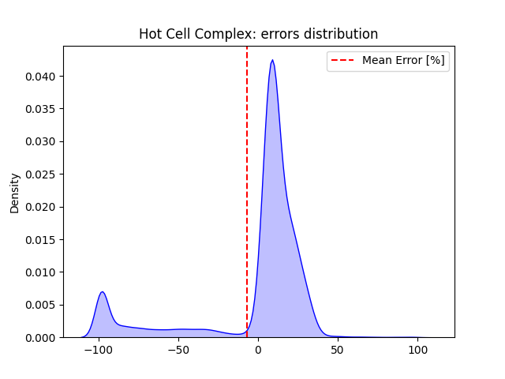
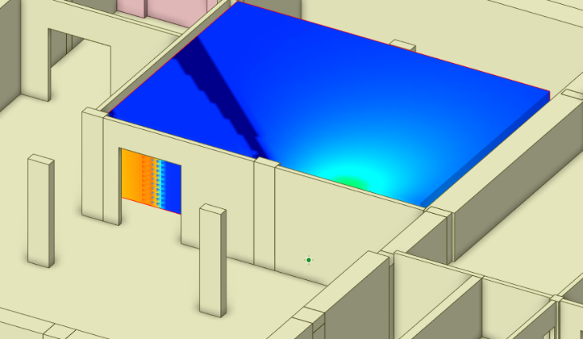
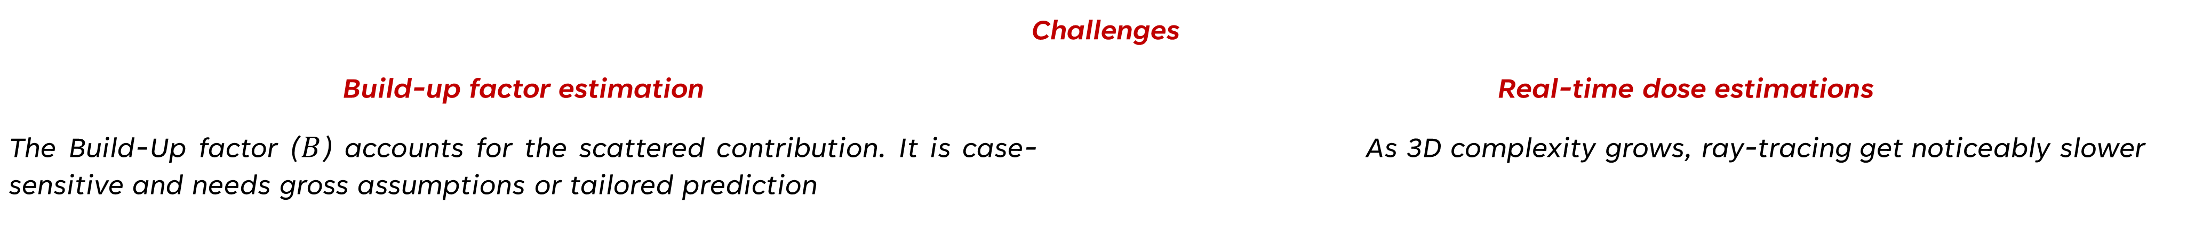
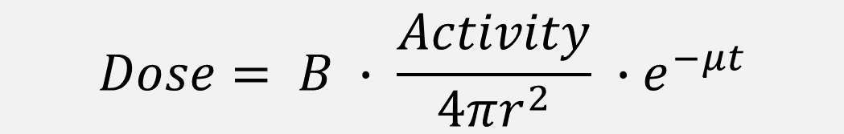

Introducing NACARTE:
Neural Network Assisted CAD-based Real Time dose-Estimator
Mario Belottiª, Javier Aguacil^{a,b}, Rafael Juarezª, Javier Sanzª
ªUNED, Calle de Juan del Rosal 12, Madrid, 28040, Spain, Madrid
^{b} Instituto de Fusión Nuclear “Guillermo Velarde”, Universidad Politécnica de Madrid, Madrid, Spain
Introduction
Current workflow for radiation field prediction
The current workflow for radiation field estimations is MCNP centered, making it:
Very accurate
Very slow
Scheduled, long-term & well-resourced safety-related studies
Scoping, iterative & design conceptualizations (e.g., Hot Cell Complex)
Original CAD
Simplified CAD
MCNP model
Radiation field
NACARTE: Neural Network Assisted CAD-based Analytical Real-Time Estimator
Rough estimations
Real-time calculation
Original CAD
Simplified CAD
Radiation field
Powerful 3D engine: Integration into the CAD software SpaceClaim
Analytical method: Point Kernel
Enhanced accuracy: Neural Network to forecast build-up factor
Point Kernel method
The point-kernel method estimates radiation dose by integrating contributions from point sources using a ray-based kernel function
$$Dose= B ∙ \frac{Activity}{4πr^{2}} ∙e^{−μt}$$
Challenges
Build-up factor estimation |  | Real-time dose estimations
The Build-Up factor ($B$) accounts for the scattered contribution. It is case-sensitive and needs gross assumptions or tailored prediction |  | As 3D complexity grows, ray-tracing get noticeably slower
Neural Network based Build-up factor prediction
Point Kernel implementation into Space-Claim
Two adjacent rooms with a point source contains most of the physics to be covered in most of the radiation shielding cases. This is a template for training
We propose a Multi-layer Perceptron (MLP) that maps the unique features of this configuration to predict a Build-up factor.
SpaceClaim as 3D engine for direct CAD-based estimate → no meshing, no translation to CSG
Ray tracing algorithms - use of accelaration structures (Bounding Volume Hierarchy) to speed-up intersection operations
GPU implementation - thousands of cores available for calculation. CUDA based libraries.
Calculation time reduced by several orders of magnitude compared to a brute application of already built-in functions in Space-Claim for body intersections.
Real-time dose estimation
 | Brute force | Accelerated
N. rays | ≈ 50 | ≈ 500k
Time [s] | ≈ 120 | ≈ 1E-2
Standard radiation scenario
Ray tracing times in an unknown geometry
Training
Database: suite of 2631 MCNP cases with varying wall thickness, source energy and source position.
Loss function:
$$loss=\sum_{i=1}^{N}{{\left(\frac{{\hat{y}}_{i}−y_{i, MCNP}}{σ_{i, MCNP}}\right)}^{2}}$$
Operation | Time (ms)
Ray tracing | 72
Build-up factor calculation | 118
Rendering mesh texture | 1576
Total | 1766
Comparison of build-up factor MLP vs. MCNP
NACARTE performance on a 2 rooms case with a mesh of 64000 voxels
Application to the ITER Hot Cell Complex
NACARTE application
Conclusions
NACARTE shows the capability to predict dose rate estimates in relevant conditions:
Reliability within a factor x2
Real-time calculation (few seconds)
ITER Hot Cell Complex
NACARTE is the position to assist the design of ITER and many other nuclear facilities worldwide in an efficient manner
→ saving thousands € in analysis and securing calendars!
Future work
The future work will be articulated around:
Alternative neural-network architectures to show a better performance beyond the range of training. Particularly in relation to varying geometries.
Extended training once the NN architecture is established. A wider range of cases, including larger spans of wall thickness, source energy, and different shielding shapes.
Lineal, surface and volumetric sources as integration of point sources to represent any sort of radiation source.
Prediction of build-up factor considering multilayered shielding, including different materials and angle between walls.
Application to diverse topics of relevance in ITER and comparison versus MCNP as validation of the tool in pertinent environments
Dose rate estimate with NACARTE
Comparison of dose estimation NACARTE vs. MCNP

