Slide 1
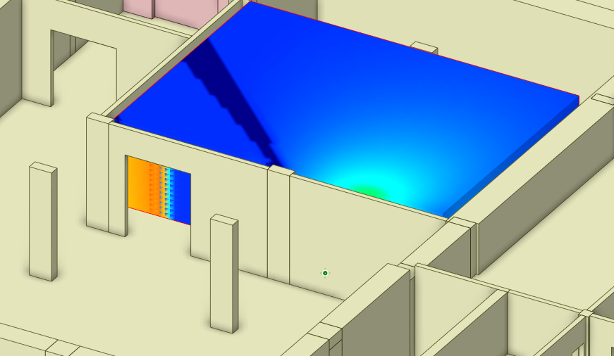

A new Neural Network Assisted CAD-based Analytical Real-Time Estimator (NACARTE) for photon dose assessment – Mario Belotti
Motivations
Monte-Carlo methods are a very accurate tool for estimating the photon dose, allowing safety nuclear plant operations. This approach, however, is limiting in other areas, such as the conceptualization of a building's design, where quick rough estimates are desirable. For this reason, we have introduced a new tool capable of providing real-time dose estimates using neural networks in a CAD environment called NACARTE.
Results
NACARTE was tested in realistic case scenarios in the ITER Hot Cell Complex showing the capability to predict real-time dose rate estimates in relevant conditions with a reliability within a factor x2. NACARTE is in the position to assist the design of ITER and many other nuclear facilities worldwide in an efficient manner.
Challenges
Implementation of 3D photon sources, extension to multi-layered shielding.
IAEA Workshop on AI for Accelerating Fusion and Plasma Science, 2023 11/28 – 12/1

