Slide 1
Canadian Regulator’s Application of Lessons Learned in Updating the Regulatory Framework to Incorporate Sustainability in Decision Making
International Conference on The Safety of Radioactive Waste Management, Decommissioning, Environmental Protection and Remediation
IAEA Headquarters, Vienna, Austria, 6-10 November 2023
Sarah Watt and Kevin Ross
Canadian Nuclear Safety Commission

Slide 2
Overview
Canadian Nuclear Safety Commission (CNSC)
Case Study – Legacy Facilities
Regulatory Framework
Novel Technologies - Small Modular Reactor Readiness
Summary

Slide 3

Canadian Nuclear Safety Commission (CNSC)
3
Independent agency of the Government of Canada – 75+ years of experience
Reports directly to Parliament through the Minister of
Natural Resources
Federal and provincial partners have jurisdiction for related activities

Slide 4











The CNSC Regulates All Nuclear Facilities and Activities in Canada
4
Uranium mines and mills
Uranium fuel fabrication and processing
Nuclear power plants
Nuclear substance processing
Industrial and medical applications
Nuclear research and educational activities
Transportation of nuclear substances
Nuclear security and safeguards
Import and export controls
Waste management facilities

Slide 5
Case Study – Legacy Facilities
5

Slide 6
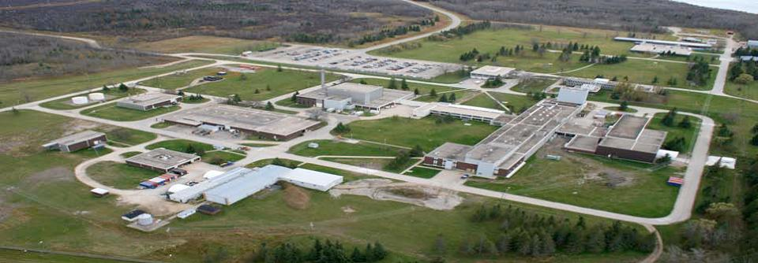
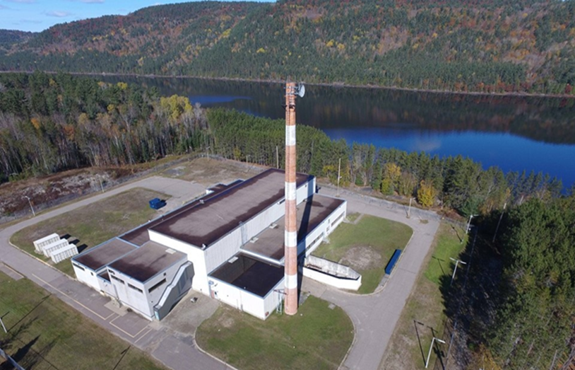
Legacy Facilities
Facilities in Canada that date back to the birth of nuclear technology in Canada
Whiteshell Laboratories
Nuclear Power Demonstration
Photos source: Canadian Nuclear Laboratories

Slide 7
Historical Context of Legacy Facilities
At the time of construction:
  Indigenous Nations and communities and public not consulted at the time of siting and construction of legacy facilities
  No plans for decommissioning or end states
  No financial obligation or funding in place for decommissioning
Lesson learned:
Absence of early planning for decommissioning or consideration of future use placed environmental, societal and financial burden on the current generation

Slide 8
Regulatory Framework
8

Slide 9
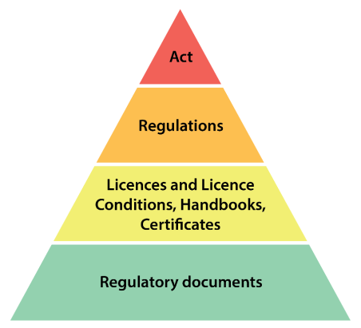
How We Regulate
CNSC’s regulatory framework for waste management
and decommissioning consists of:
Nuclear Safety and Control Act
Regulations, such as:
  General Nuclear Safety and Control Regulations, Class I Nuclear Facilities Regulations,
  Nuclear Substances and Radiation Devices Regulations
Licence conditions to implement and maintain a waste management
program, and to maintain a decommissioning plan and acceptable
financial guarantee
Regulatory documents on waste management and decommissioning
Waste Management and Decommissioning CSA Group standards

Slide 10
CNSC Regulatory Framework and Philosophy
Safety focus at all times; licensees ultimately responsible for safety
Modern, agile, and flexible regulator for new technologies
Pre-licensing activities can help ensure designers understand
CNSC requirements
Regulatory requirements are continually updated based on a systematic and transparent process
  Aligned with IAEA safety standards
  Adoption of national and international standards in regulatory framework
Relationship and trust building are key to social acceptance

Slide 11
How We Regulate Waste Management and Decommissioning
Regulatory documents on waste management and decommissioning:
  REGDOC-2.11, Framework for Radioactive Waste Management and Decommissioning in Canada
  REGDOC-2.11.1, Waste Management, Volume I: Management of Radioactive Waste
  REGDOC-2.11.1, Waste Management, Volume II: Management of Uranium Mine Waste Rock
  and Mill Tailings
  REGDOC-2.11.1, Waste Management, Volume III: Safety Case for the Disposal of Radioactive Waste, Version 2
  REGDOC-2.11.2, Decommissioning
  REGDOC-3.3.1, Financial Guarantees for Decommissioning of Nuclear Facilities and Termination of Licensed Activities
Regulatory documents are technology neutral
and applicable to current and future waste streams

Slide 12
CSA Group Standards
The CSA Group is a not-for-profit organization composed of representatives
from the government, industry and consumer groups.
CSA Group standards on waste management:
  N292.0, General principles for the management of radioactive waste and irradiated fuel
  N292.1, Wet storage of irradiated fuel and other radioactive materials
  N292.2, Interim dry storage of irradiated fuel
  N292.3, Management of low- and intermediate-level radioactive waste
  N292.5, Guideline for the exemption or clearance from regulatory control of materials that contain
  or potentially contain, nuclear substances
  N292.6, Long-term management of radioactive waste and irradiated fuel
  N292.7, Deep geological disposal of radioactive waste and irradiated fuel
  N292.8, Characterization of radioactive waste and irradiated fuel
  N294-19, Decommissioning of facilities containing nuclear substances
Notes:
An additional tool in our regulatory framework are standards drafted by the Canadian Standards Association Group.
There are 8 in the N292 suite of nuclear standards, and one on decommissioning.
The standards are drafted by consensus amongst industry, government, and academia.
CNSC staff can choose to incorporate these documents as compliance verification criteria in licence conditions handbooks.

Slide 13
Regulatory Framework Supporting Sustainability
Sustainability: development that meets the needs of the present without compromising the ability of the future generations to meet their own needs
Regulatory Framework sets requirements and expectations that support sustainability through:
  Waste management programs
  Decommissioning planning from design
  Cost estimates for decommissioning and financial guarantees
  Life-cycle re-assessment
  Early and on-going engagement (Consultation and Engagement Plans)

Slide 14
Radioactive Waste Management
14
The licensee shall implement and maintain a waste management program
All licensees who manage radioactive waste shall:
  Be responsible for its safe management
  Optimize the steps in radioactive waste management to ensure protection of people
  and the environment
  Take into account interdependencies among all steps in radioactive waste management
  Develop, document and implement programs, procedures and instructions
  Use operational experience, lessons learned from other similar facilities or activities,
  and advances in science and technology

Slide 15
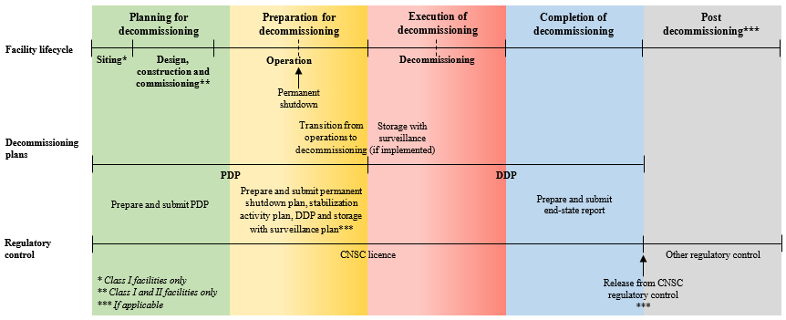
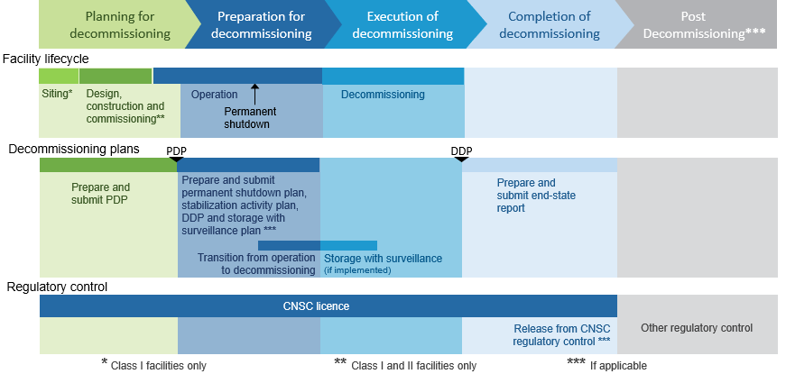
Lifecycle Approach to Decommissioning
Licence Condition: The licensee shall maintain a decommissioning plan

Slide 16
Financial Guarantees for Decommissioning
Financial guarantees are:
  Required as part of licence application and approved
  by the Commission
  Payable to the CNSC
  Separate from a licensee’s assets and can be accessed
  by the CNSC if required
  Required throughout the entire lifecycle of the facility
  To be updated and reviewed every five years
  Subject to annual reporting to demonstrate value and validity
Financial
guarantees cover all decommissioning, dismantling, waste disposal and long-term monitoring

Slide 17
Novel Technologies - Small Modular Reactor Readiness
Commitment to be ready
Waste and Decommissioning Regulatory Framework
  Modernized, risk-informed, evergreen, technology neutral
International collaboration and regulatory harmonization
Building relationships with Indigenous communities and potential host communities
Public Consultation
Responsible & effective solutions – no undue burden on future generations

Slide 18
Summary
Canada has a strong regulatory framework for waste management and the decommissioning of nuclear facilities and related activities
Canada recently modernized its
waste management and decommissioning framework
Regulatory documents are technology neutral and are applicable to current and future waste streams
Early planning, decision making and re-assessment throughout the lifecycle
of a nuclear facility support sustainability

Slide 19





Connect With Us
Join the conversation
nuclearsafety.gc.ca

