Slide 2
RADIOACTIVE WASTE MANAGEMENT FOR SMALL
AMOUNTS OF WASTE
Results from the EURAD ROUTES Project
The results presented have been generated within the European Joint Programme on Radioactive Waste Management (EURAD). EURAD has received funding from the European Union’s Horizon 2020 research and innovation programme under grant agreement No 847593.

Slide 3
Agenda
EURAD Project
ROUTES Work Package
Evaluation of Possible Waste Management Solutions for Small Inventory Member States
The results presented have been generated within the European Joint Programme on Radioactive Waste Management (EURAD). EURAD has received funding from the European Union’s Horizon 2020 research and innovation programme under grant agreement No 847593.

Slide 4
EURAD Project
European Joint Programme on Radioactive Waste Management
The results presented have been generated within the European Joint Programme on Radioactive Waste Management (EURAD). EURAD has received funding from the European Union’s Horizon 2020 research and innovation programme under grant agreement No 847593.

Slide 5
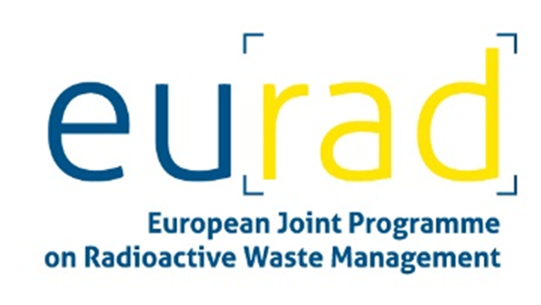
Overview – European Joint Programme on Radioactive Waste Management (EURAD)
EURAD shall support the implementation of the Waste Directive in EU Member-States
  RD&D activities (10 WPs)
  Strategic Studies (2 WPs)
  Knowledge Management (1 WP)
  Interaction with Civil Society (1 WP)
EURAD includes
  Waste Management Organisations (WMOs)
  Technical Support Organisations (TSOs)
  Research Entities (REs)
2019 - 2024
The results presented have been generated within the European Joint Programme on Radioactive Waste Management (EURAD). EURAD has received funding from the European Union’s Horizon 2020 research and innovation programme under grant agreement No 847593.

Slide 6
ROUTES WP
Waste Management Routes from Cradle to Grave
Work Package 9 of EURAD
The results presented have been generated within the European Joint Programme on Radioactive Waste Management (EURAD). EURAD has received funding from the European Union’s Horizon 2020 research and innovation programme under grant agreement No 847593.

Slide 7
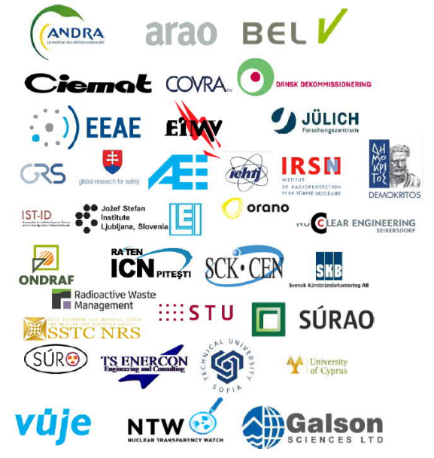
Waste Management Routes from Cradle to Grave (ROUTES)
ROUTES Objectives:
Share experience and knowledge on waste management routes
Identify safety relevant issues and their R&D needs
Identify opportunities for collaboration between Member States
35 participating organisations from 21 countries
The results presented have been generated within the European Joint Programme on Radioactive Waste Management (EURAD). EURAD has received funding from the European Union’s Horizon 2020 research and innovation programme under grant agreement No 847593.

Slide 8
Evaluation of Possible Waste Management Solutions for Small Inventory Member States
The results presented have been generated within the European Joint Programme on Radioactive Waste Management (EURAD). EURAD has received funding from the European Union’s Horizon 2020 research and innovation programme under grant agreement No 847593.

Slide 9
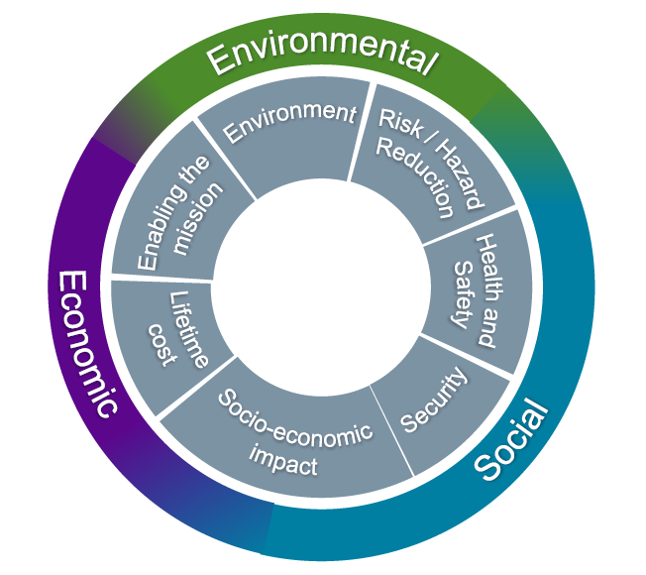
Methodology
NDA Value Framework
  3 pillars
  7 values
Enabling of a comparable assessment of predisposal and disposal options
© NDA Nuclear Decommissioning Authority
The results presented have been generated within the European Joint Programme on Radioactive Waste Management (EURAD). EURAD has received funding from the European Union’s Horizon 2020 research and innovation programme under grant agreement No 847593.

Slide 10
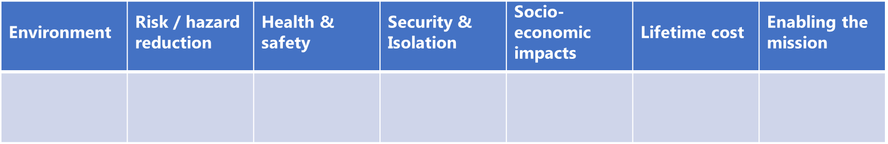
Methodology
© NDA Nuclear Decommissioning Authority
The results presented have been generated within the European Joint Programme on Radioactive Waste Management (EURAD). EURAD has received funding from the European Union’s Horizon 2020 research and innovation programme under grant agreement No 847593.

Slide 11
Methodology
Workshops
Predisposal options for
Disposal options for
SIERs
DSRS
SIERs
DSRS
Metals
Concrete
Metals
Concrete
© NDA Nuclear Decommissioning Authority
D9.21
D9.22
The results presented have been generated within the European Joint Programme on Radioactive Waste Management (EURAD). EURAD has received funding from the European Union’s Horizon 2020 research and innovation programme under grant agreement No 847593.

Slide 12
Methodology
Workshops
Predisposal options for
Disposal options for
Paper
IAEA SnS 2023
SIERs
DSRS
SIERs
DSRS
Metals
Concrete
Metals
Concrete
© NDA Nuclear Decommissioning Authority
D9.21
D9.22
The results presented have been generated within the European Joint Programme on Radioactive Waste Management (EURAD). EURAD has received funding from the European Union’s Horizon 2020 research and innovation programme under grant agreement No 847593.

Slide 13
Methodology
Workshops
Predisposal options for
Disposal options for
Paper
IAEA SnS 2023
SIERs
DSRS
SIERs
DSRS
Metals
Concrete
Metals
Concrete
© NDA Nuclear Decommissioning Authority
D9.21
D9.22
The results presented have been generated within the European Joint Programme on Radioactive Waste Management (EURAD). EURAD has received funding from the European Union’s Horizon 2020 research and innovation programme under grant agreement No 847593.

Slide 14
Results for Spent Ion Exchange Resins
Implications of predisposal route on disposal option
The results presented have been generated within the European Joint Programme on Radioactive Waste Management (EURAD). EURAD has received funding from the European Union’s Horizon 2020 research and innovation programme under grant agreement No 847593.

Slide 15
Results for Spent Ion Exchange Resins
Implications of predisposal route on disposal option
Increase of volume
The results presented have been generated within the European Joint Programme on Radioactive Waste Management (EURAD). EURAD has received funding from the European Union’s Horizon 2020 research and innovation programme under grant agreement No 847593.

Slide 16
Results for Spent Ion Exchange Resins
Implications of predisposal route on disposal option
Reduction of activity concentration
Reduction of volume
The results presented have been generated within the European Joint Programme on Radioactive Waste Management (EURAD). EURAD has received funding from the European Union’s Horizon 2020 research and innovation programme under grant agreement No 847593.

Slide 17
Results for Spent Ion Exchange Resins
Assessment of disposal option
The results presented have been generated within the European Joint Programme on Radioactive Waste Management (EURAD). EURAD has received funding from the European Union’s Horizon 2020 research and innovation programme under grant agreement No 847593.

Slide 18
Results for Spent Ion Exchange Resins
Assessment of disposal option
RN inventory easily accessible
The results presented have been generated within the European Joint Programme on Radioactive Waste Management (EURAD). EURAD has received funding from the European Union’s Horizon 2020 research and innovation programme under grant agreement No 847593.

Slide 19
Results for Spent Ion Exchange Resins
Assessment of disposal option
High degree of isolation
The results presented have been generated within the European Joint Programme on Radioactive Waste Management (EURAD). EURAD has received funding from the European Union’s Horizon 2020 research and innovation programme under grant agreement No 847593.

Slide 20
Thank you!
Contact: MarieCharlotte.Bornhoeft@dmt-group.com
EURAD Webpage: https://www.ejp-eurad.eu/
The results presented have been generated within the European Joint Programme on Radioactive Waste Management (EURAD). EURAD has received funding from the European Union’s Horizon 2020 research and innovation programme under grant agreement No 847593.

