Slide 1
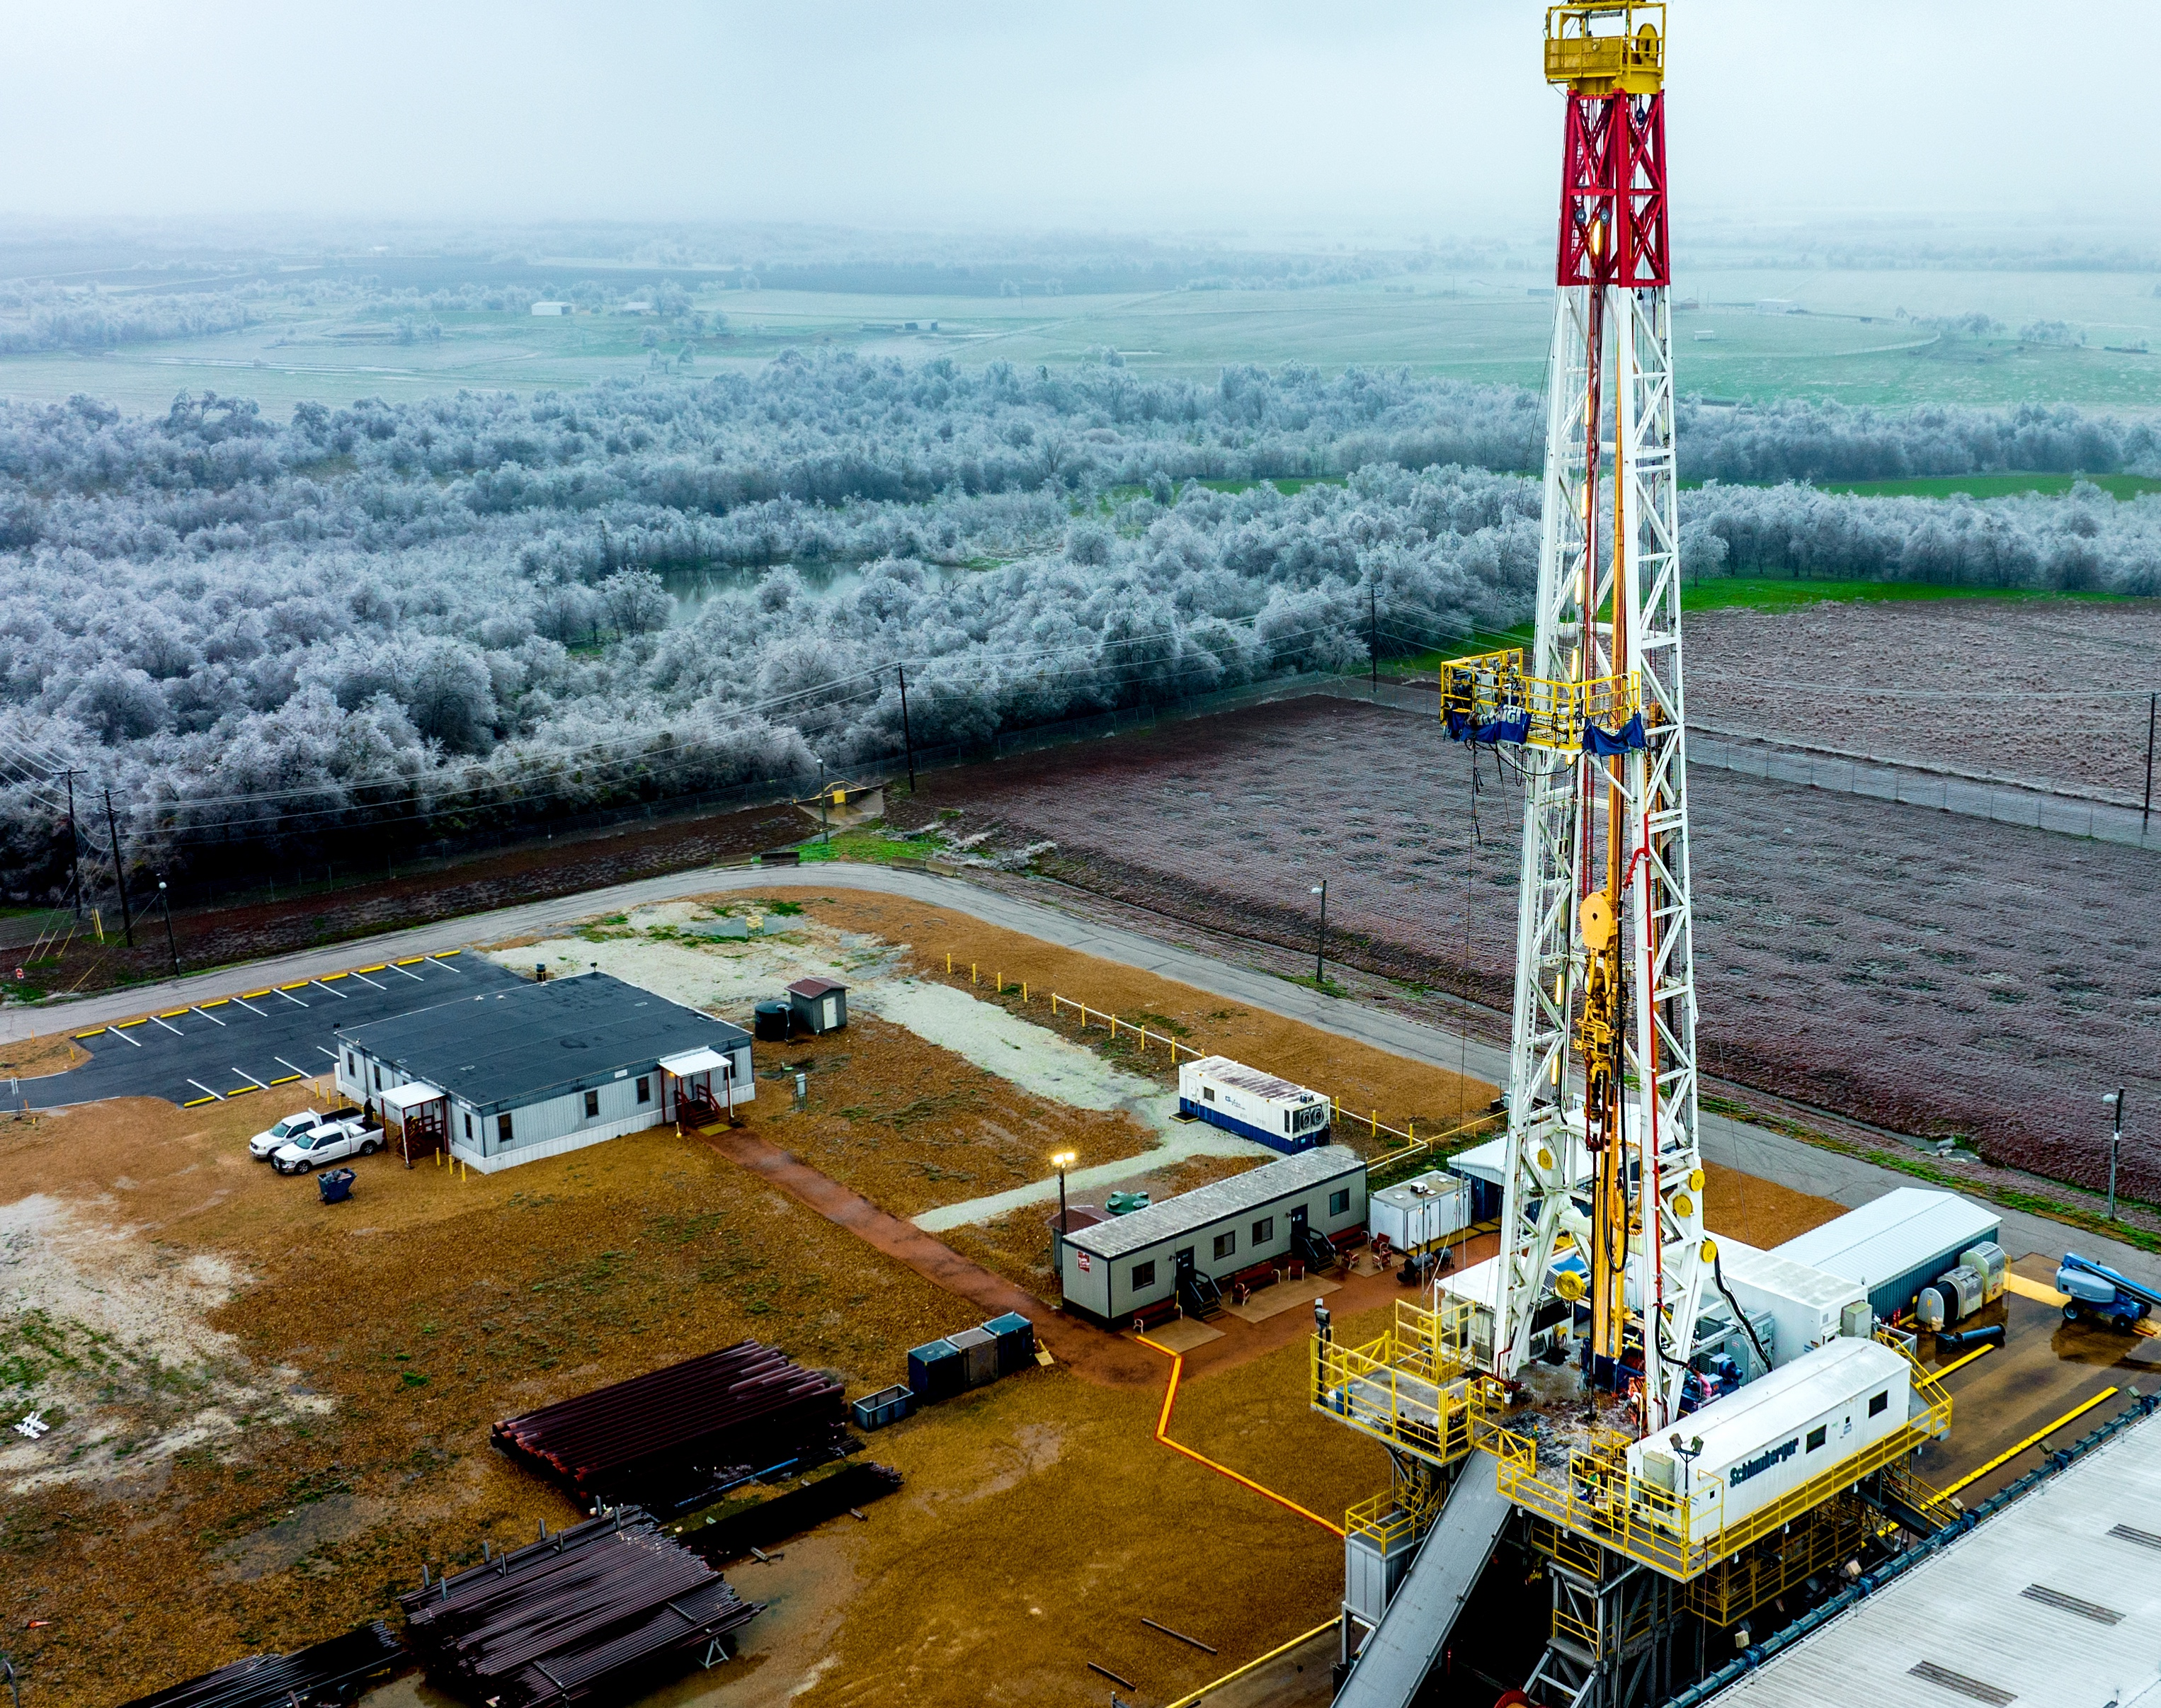

Progress towards the demonstration of deep borehole disposal
IAEA Vienna Nov 2023

Slide 2
What I will cover
The demand for international collaboration on deep borehole disposal
  A recap on the international stakeholder research I presented at this event in 2021
Progress since then:
  Launch and initial work of the Deep Borehole Demonstration Center in 2023
The way forward:
  Current priorities and next steps

Slide 3






International stakeholder research
Deep borehole disposal is a maturing technology offering significant potential benefits – but with a need for full-scale demonstration
2021/22 study of international stakeholder views from the regulatory, policy & waste management communities
Key findings
Research undertaken by:
Sponsored for presentation to IAEA Radwaste Conference Nov 2021 by:
Regulators, policymakers and waste management practitioners see deep borehole disposal (DBD) as a significant opportunity for all types of national radioactive waste management programs
Four key areas of perceived benefit:
4 out of 5 research participants would welcome greater international collaboration on deep borehole disposal
Methodology: mixture of quantitative research through web survey and qualitative research through in-depth interviews, covering 38 participants from 18 countries
Results published at:
Increased choice & siting flexibility
Potential for cost, risk and time reductions in national disposal programmes
Potentially attractive features from perspective of community consent
Potential for economies of scale around regulatory processes
International Conference on Radioactive Waste Management: Solutions for a Sustainable Future, IAEA, Vienna, Austria, November 2021,
Waste Management Symposium 2022, Phoenix, USA, March 2022

Slide 4
Two key priorities for international collaboration
Demonstration
Establishing an end-to-end demonstration of an operational deep borehole repository – the action identified as the most important next step by all research participants
Guidance
Using a demonstration as a focus for international collaboration to develop improved guidance and international consensus around how to demonstrate and standardize the safety case for deep borehole disposal
Regulators, policymakers and waste management practitioners see deep borehole disposal (DBD) as a significant opportunity for all types of national radioactive waste management programs
Four key areas of perceived benefit:
4 out of 5 research participants would welcome greater international collaboration on deep borehole disposal

Slide 5

In February 2023, the Deep Borehole Demonstration Center was launched to respond to that demand
An independent, nonprofit, science-driven organization
- funded on a multinational, public-private-partnership basis -
that aims to advance the maturity of the safety case for deep borehole disposal and the technical readiness levels of the disposal concept

Slide 6
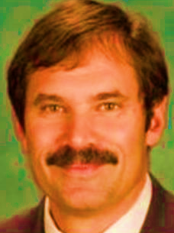






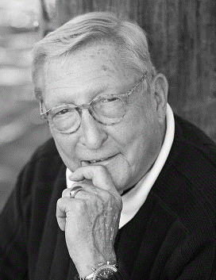


Governance
Deep Borehole Demonstration Center Board
SURO (National Radiation protection Institute, Czechia)
Independent Advisory Committee
Directors:
Southern Company
CEO of Deep Isolation
Richard Esposito
Jitka Mikšová
Liz Muller
  Representatives of the local community and the global scientific community
Observers:
Neil Chapman
EPRI
Danish Decomm-issioning
COVRA (and chair of ERDO Association)
Dan Moneghan
Ole Nielsen
Ewoud Verhoef
Chair of the Center’s Advisory Committee
Emeritus Professor of environmental geology, risk assessment and radioactive waste management at the University of Sheffield
Officers:
Executive Director
Treasurer
Secretary
Ted Garrish
Rod Baltzer
Chris Parker

Slide 7
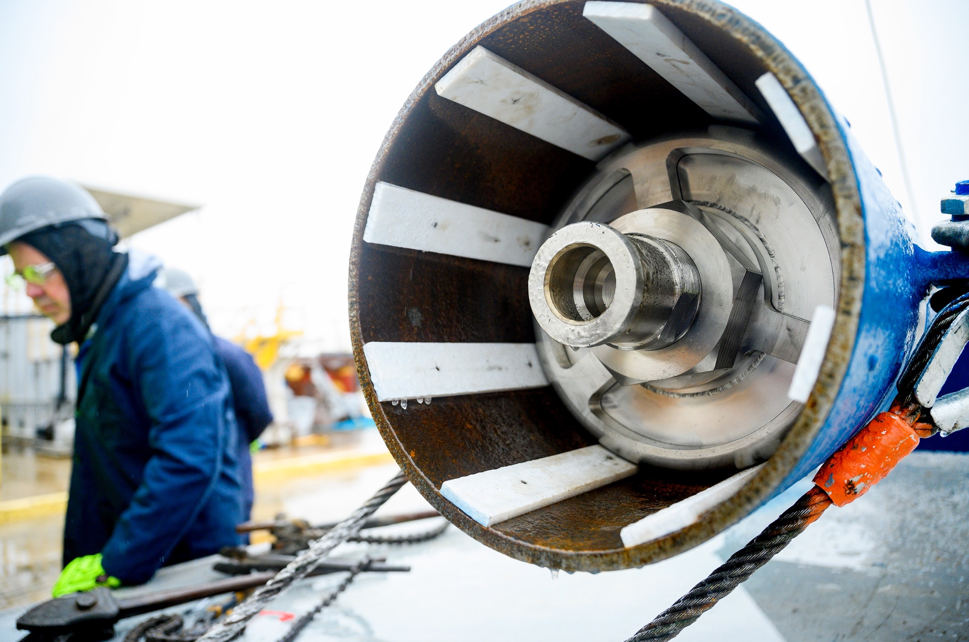
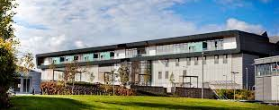

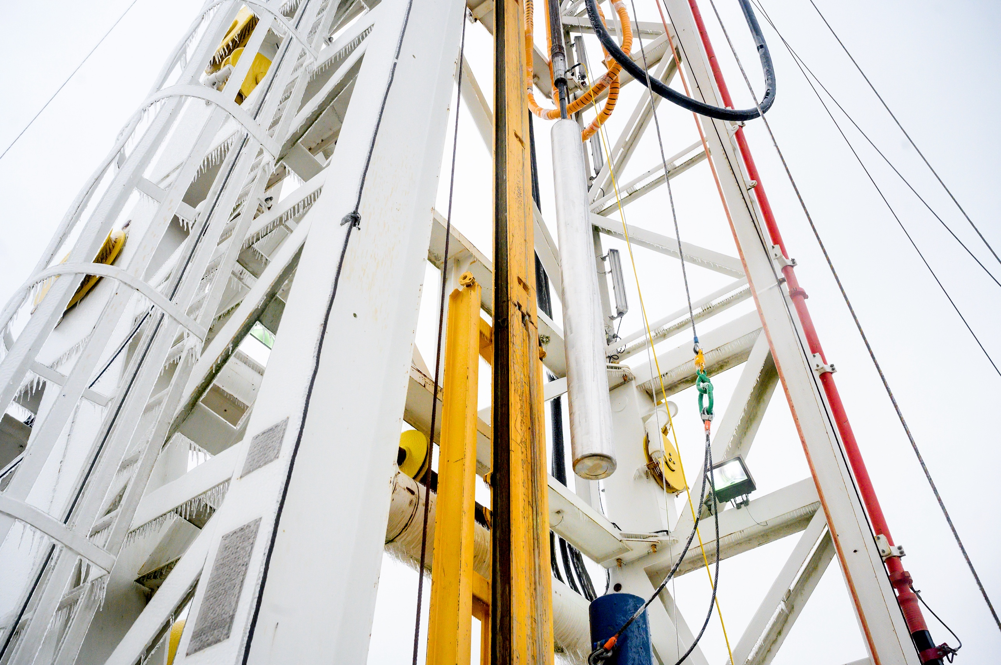
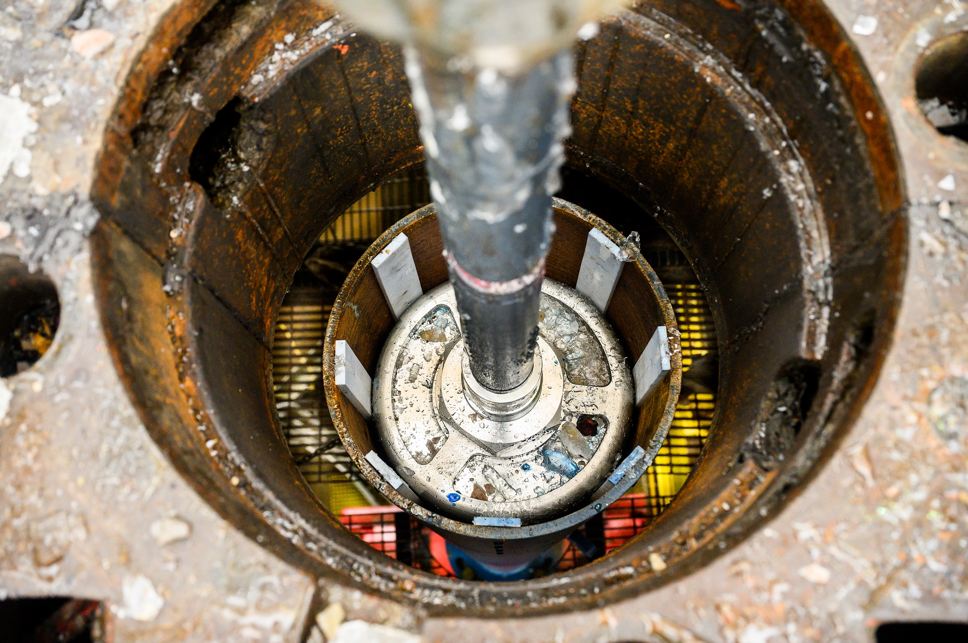
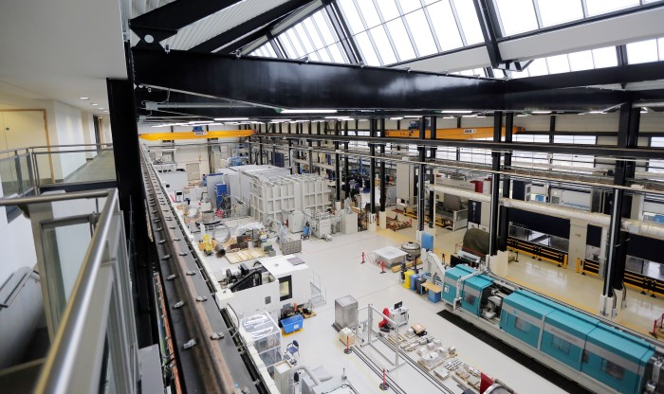
We made a rapid start with our launch in February…..
Initial canister test on February 23 2023
Partnering with UK government to prototype canisters for demonstration at Cameron
The UK government’s Department for Energy Security and Net Zero is providing grant funding for Deep Isolation to partner with Nuclear Advanced Manufacturing Research Center to develop a UK supply chain for Deep Isolation’s disposal canister.
NAMRC will manufacture two TRL7 canisters, for laboratory testing in the UK and field testing at the Deep Borehole Demonstration Center in Texas.
Successfully demonstrated compatibility of a full weight and size PWR disposal canister with standard oil and gas emplacement technology

Slide 8
…. and have been able to refine our strategy in collaboration with Members and project funders
Original approach from Strategic Plan published in February 2023

Slide 9
…. and have been able to refine our strategy in collaboration with Members and project funders
Latest version – as published in today’s paper
An initial program of surface and sub-surface canister testing (using existing wells at Cameron)
Explicit objective of expanding the demonstration program into other geologies and jurisdictions

Slide 10








…. and have been able to refine our strategy in collaboration with Members and project funders
Latest version – as published in today’s paper
Full funding partnership in place
Project Savant
An initial program of surface and sub-surface canister testing (using existing wells at Cameron)
$440k grant funding announced on August 3 2023 for Deep Isolation to demonstrate its Universal Canister System at Cameron
Explicit objective of expanding the demonstration program into other geologies and jurisdictions
Memoranda of Understanding signed

Slide 11
Priorities for 2024 and beyond
The focus of the Deep Borehole Demonstration Center work in 2024 will be three-fold:
  Continuing to grow its membership base and to raise public-private-partnership funding for the long-term, multi-phase, multi-site demonstration program
  Implementing a significant program of surface and sub-surface demonstration and experimentation on deep borehole disposal canisters
  Feeding the learnings from such demonstration into the evolving safety case for deep borehole disposal, including through support to the work of two Coordinated Research Projects now being launched by IAEA:
Please get involved:
  The Deep Borehole Demonstration Center can be contacted at ted.garrish@deepboreholedemo.org.
Challenges, Gaps and Opportunities for Managing
Spent Fuel from Small Modular Reactors
Enhancing Global Knowledge on
Deep Borehole Disposal for Nuclear Waste

