Slide 1
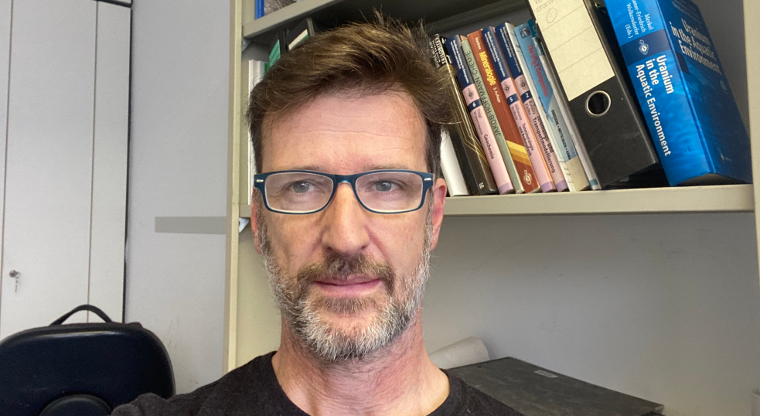
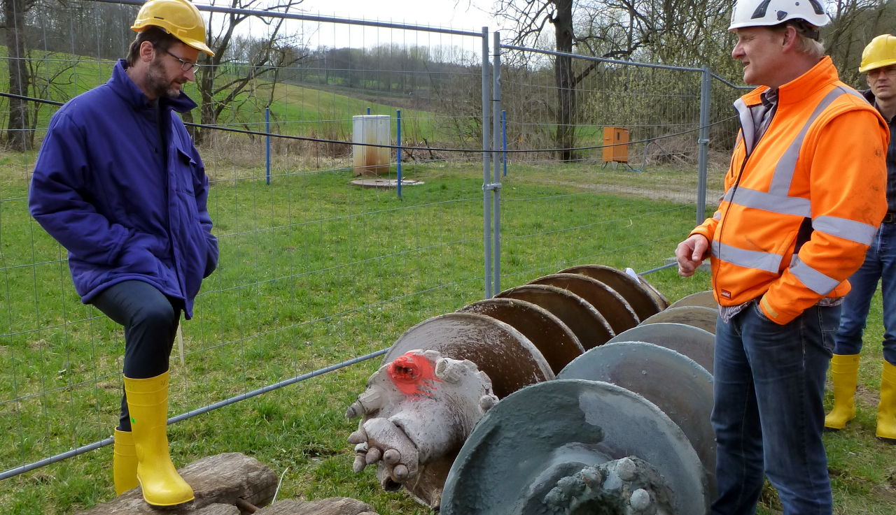
Mr Sven Altfelder
Job/Position: Unit Head, Contaminated sites and Environmental Monitoring
Organization and Country: Federal Institute for Geosciences and Natural Resources, Germany.
PROFILE
PICTURE
Researcher in soil physics and chemistry, soil hydraulic modelling, geostatistics, radiation monitoring with UAVs
Former Remediation Safety Specialist at the IAEA with a focus on the remediation of uranium legacies in Central Asia
Supervisor of the state-owned remediation company WISMUT GmbH on behalf of its owner, the Federal Ministry of Economic Affairs and Climate Action
Team leader for the hydrogeological overburden modelling of the German nuclear waste repositories Morsleben and Asse.
EXTRA PICTURE to illustrate your work (project, robot, reactor, team…)
[not mandatory but nice to have]

