Slide 2
Global Justice as a Cornerstone of Agenda 2030 and its importance in the Evolution of a Safety Culture in Remediation, Decommissioning and Waste Management.
Sven Altfelder

Slide 3
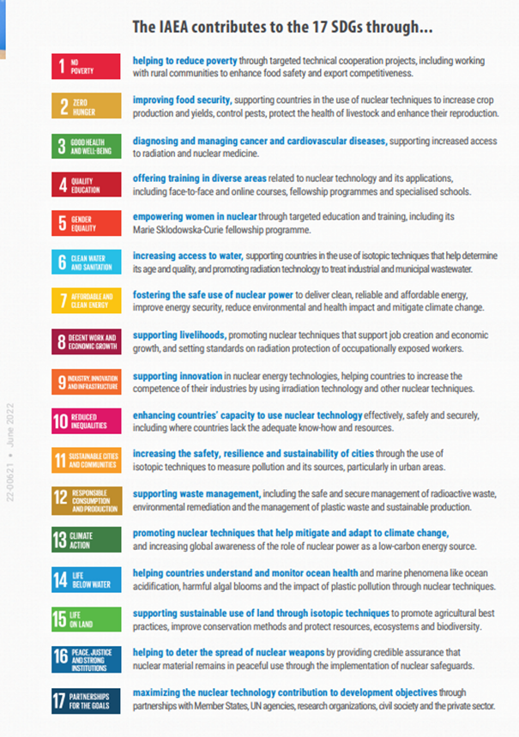
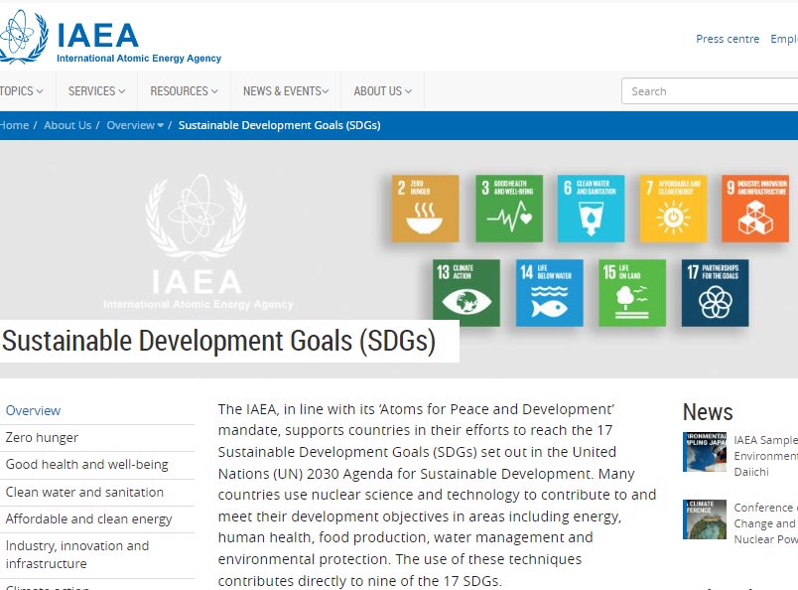

Slide 4
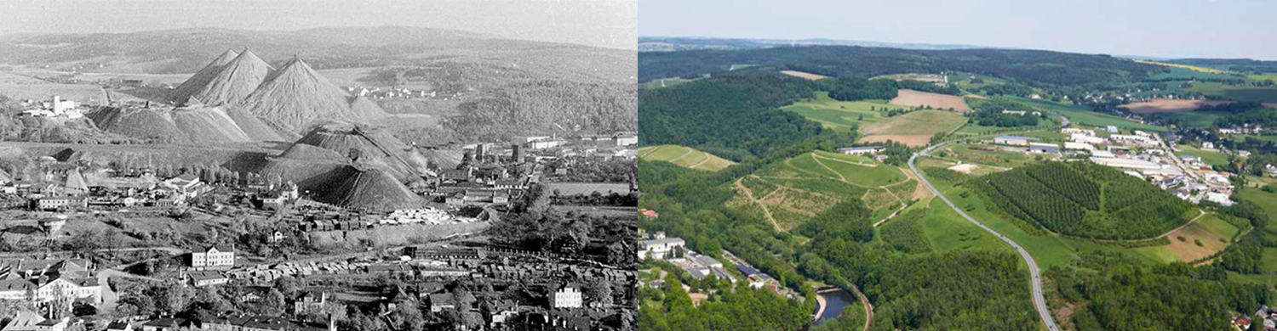
Example: Critically engaging with a local scenario of justification and optimisation through the lens of Agenda 2030.
The German operator (Wismut GmbH) has remediated a large number of heaps from uranium mining at this site as part of a 1 billion € investment in the period 1990-2020 for the remediation of old uranium mining and processing facilities in Aue/Bad Schlema.
→ An international reference for remediation

Slide 5
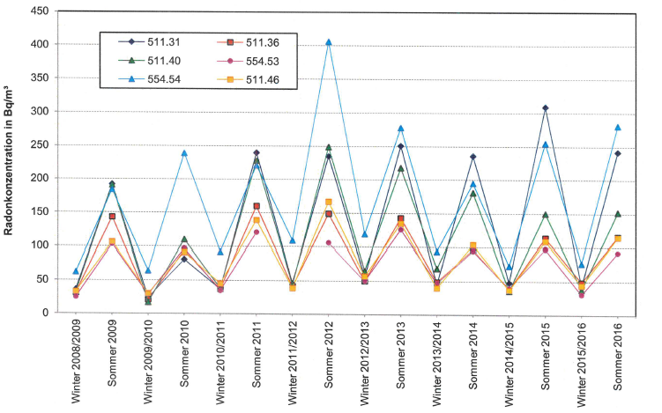
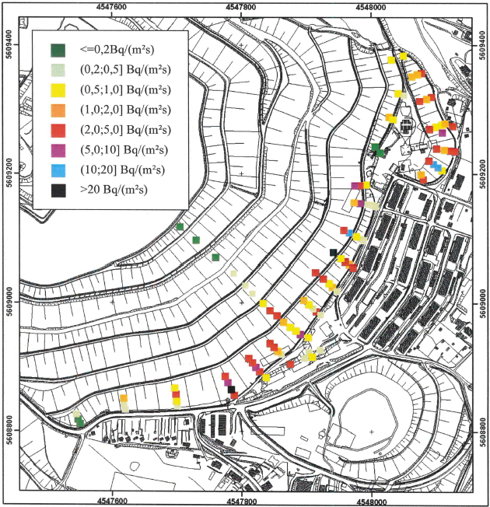
Since completion, radon emissions from the remediated heaps have been continuously monitored
The additional effective dose for the local population at some of the nearest, least favourable exposure sites has settled at 1-2 mSv/a above the reference value of 1 mSv/a for the population, → remediation target in the radiation protection licence for remediation
5

Slide 6
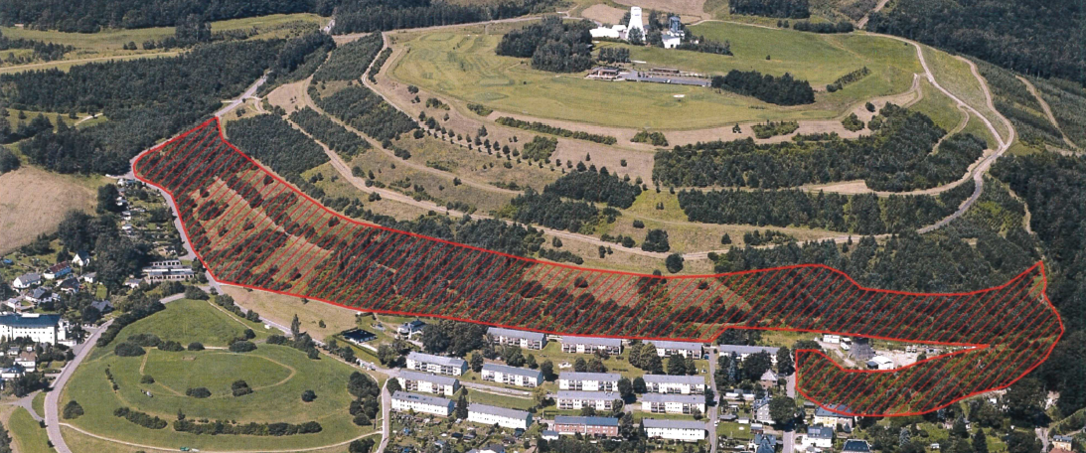
The operator achieves its remediation target of 1 mSv/a for 99% of its legacy objects
The small exceedance of the reference value in Aue/Bad Schlema is spatially limited,
Based on justification and optimisation the regulator favours a renewed remediation of the affected heaps
6

Slide 7
German Calculation Guide Mining (2011):
Entry of radon-containing outdoor air originating from the mine site must be taken into account in the dose calculation
Exposure due to the outdoor radon fraction of the total indoor radon content
German Radiation Protection Act (2017):
Based on the "positive" experience with the decommissioning and remediation of the legacy of uranium ore mining in Saxony and Thuringia, the federal legislator decided on keeping a reference value of 1 millisievert per calendar year this value
He argues that the previous ambitious goals of the clean-up of contaminated sites will thereby be continued and a continuity between previous and future measures will be established.

Slide 8
So what are the implications of this matter in the interplay of safety and sustainability?
The Global North is consuming resources at a rate that would require several Earths if all people worldwide were consuming resources at that rate.
It is impossible to strive for an internationally just future in which global resource consumption is even close to that in Germany today.
The latter, characterizes the current "normal reality" in which the radiation protection authority operates and considers the renewed remediation of heaps mentioned above justified.
8
Notes:
Taking into account the SDGs social, economic and ecological criteria (or within the framework of justification and optimisation), tolerating the discussed spatially limited exceeding of the remediation target by 1-2 mSv/a against the background of international safety standards would be a presumably obvious discretionary decision for many supervisory authorities - especially in the Global South - in view of an expected investment of €30 million to remedy the situation.

Slide 9
So what are the implications of this matter in the interplay of safety and sustainability?
SDG 12 calls for sustainable consumption - resources should not be wasted, but rather recycled, and safely managed.
Taking into account the current overconsumption of ressources in Germany, the current rate must at least be reduced by two thirds. Even if the renewed remediation proposal discussed above may be justified based on safety considerations, what about its justification in terms of the necessary resource consumption for this “second” remediation? (Energy: Just for heap 38neu/208, this is an estimated 80,000 m³ of material that will have to be moved)
SDG 13 calls for urgent action to combat climate change and its impacts.
The carbon footprint of HDPE is 1.80 kg CO2eq per kg product. Just one of the affected heaps (38neu/208) requires 200,000 kg of HDPE foil
9
Notes:
Taking into account the SDGs social, economic and ecological criteria (or within the framework of justification and optimisation), tolerating the discussed spatially limited exceeding of the remediation target by 1-2 mSv/a against the background of international safety standards would be a presumably obvious discretionary decision for many supervisory authorities - especially in the Global South - in view of an expected investment of €30 million to remedy the situation.

Slide 10
So what are the implications of this matter in the interplay of safety and sustainability?
SDG 10 calls for reducing inequalities, including target 10.b, by promoting official development assistance and financial flows to countries where the need is greatest, especially to least developed countries in line with their national plans and programmes.
€30 million would cover approximately 75% of the funds currently still needed to clean up two uranium legacy sites (including Degmay - the largest unremediated uranium mill tailings pond in Central Asia) in Tajikistan under the EBRD/EU international multi-donor funded Envirionmental Remediation Account (ERA) programme.
Germany has not yet participated in this fund, although there are good reasons for doing so. Where to draw the line when it comes to delineating the scope of this justification and optimisation scenario based on this SDG, given the imbalance between the potential benefits of a €30 million investment and the resulting moral implications as in this case?
Notes:
There are of course many ways to make the most of the €30 million in this respect, but let's stick to radioactive waste management safety, environmental protection and remediation.

Slide 11
Conclusion
The example illustrates how radiation safety policy making and application can go beyond the restrictive framework of existing mandates, strategies and administrative boundaries and bring elements of 'whole systems thinking' into the process.
The idea is to stimulate discussion on how the philosophy of the 17 SDGS goals can be integrated into future strategies for safety-related policy and decision-making so that, in addition to safety-related goals, safety culture also contributes appropriately to global justice and sustainable development in line with the 2030 Agenda.

