Slide 2
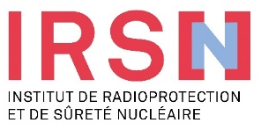

Feedback from technical dialogue set up with civil society on HLW&IL-LL radioactive waste management in France
C. Réaud, E. Bastin, D. Pellegrini, F. Marsal, C. Espivent, S. Charron, A. Lebeau (IRSN)
Y. Lheureux, C. Pineau, K. Basol (Anccli)
L. Faugières, B. Jaquet (Clis de Bure)

Slide 3
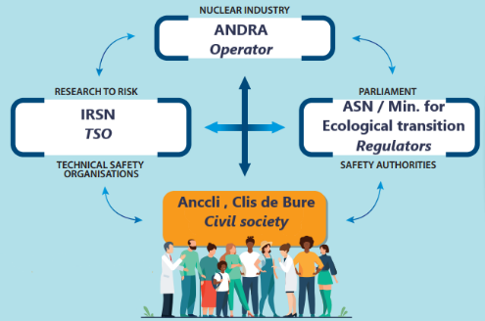

FRENCH CONTEXT IN BRIEF
EUROPEAN AND FRENCH LEGAL CONTEXT
French nuclear governance
2006’s Act on Radioactive waste management
Deep geological repository as reference solution for HLW&IL-LLW
1998’s Aarhus convention:
Right to know,
Right to participate
Right to justice in the environmental field
2006’s Act on transparency and security & 2015’s Act on energy transition for green growth
Transparency, Access to information
Civil society : 4th pillar of French Radwaste management governance
IAEA, ICWEDR, Vienna 11.10.2023

Slide 4
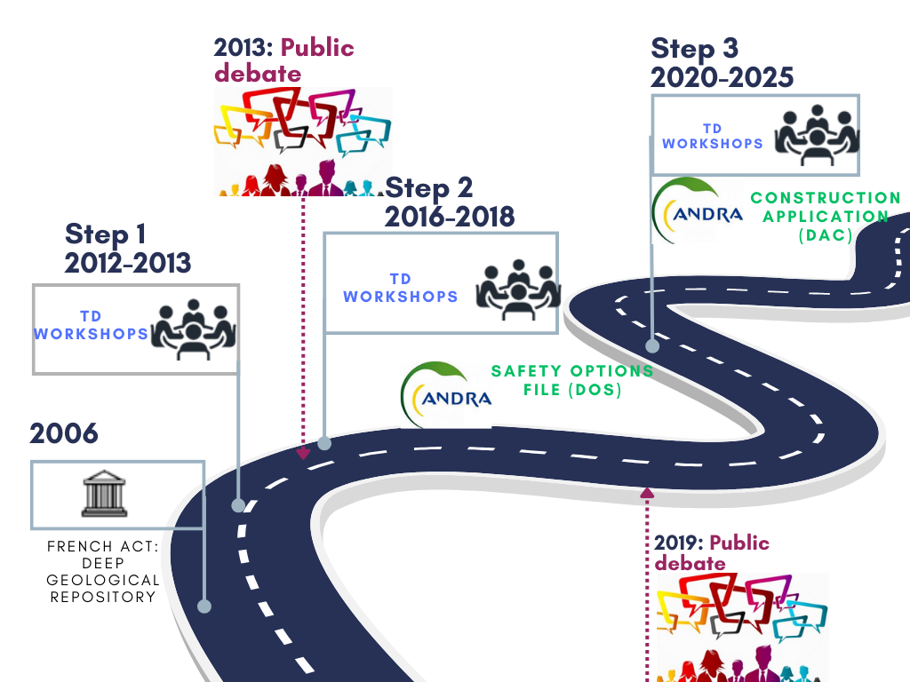

TECHNICAL DIALOGUE WITH CIVIL SOCIETY
Due to high technical and societal challenge and the need for a sustainable approach, ANCCLI & CLIS de Bure asked IRSN to launch an innovative OS initiative on HLW&IL-LL RWM
Cycle of sustainable technical workshops: «Technical dialogue » in association with ANDRA
4
IAEA, ICWEDR, Vienna 11.10.2023
IAEA, ICWEDR, Vienna 11.10.2023

Slide 5
STEP 2 (2016-2018): During technical review of CIGEO’s Safety Option File (DOS)
Cycle of technical workshops in 2016 & 2017 focused on the sharing of IRSN’s expertise on DOS file
Setting up pluralist discussion group of 20 persons: ANCCLI, Clis of Bure, Clis, NGOs, non institutional experts + a panel of citizens involved in Cigéo’s public debate (2013)
Main steps
  Collection, sorting out and classification of questions
  Collective decision about questions to address
  Insights from IRSN and discussion
Benefits for civil society
  Understand technical issues, it clarified role and working method of IRSN
  Participation in the expertise process rather than having a presentation of conclusions from expertise highly appreciated
Benefits for IRSN
  Technical issues relative to CS’s concern more developed in IRSN’ review report than without this initiative (e.g bacterial activity, reversibility…), it enriched IRSN’s expertise
IAEA, ICWEDR, Vienna 11.10.2023

Slide 6



STEP 3 (2020-2025): During technical review of safety case submitted with Licence Construction Application (DAC)
Preparation of DAC’s technical review (2020 -2022) and during the technical review itself (2023-2025)
Same principle but some innovations compared to the last TD
  Serious game, system of color votes, Klaxoon@
  2 levels of participation :
Topic groups
30-50 pax/gp
Occasional, in depth discussions on focused topics
Central group
50 pax
Long lasting participation during the technical expertise (2.5 years)
Central group
50 pax
RW inventory
Ground footprint of repository
Geology
Examples of topics adressed in 2023
Waste package
Industrial pilot phase
Co-construction of scenario
Etc.
Etc.
IAEA, ICWEDR, Vienna 11.10.2023
Notes:
Action innovante citée également à l’oral: co-construction de scénario

Slide 7
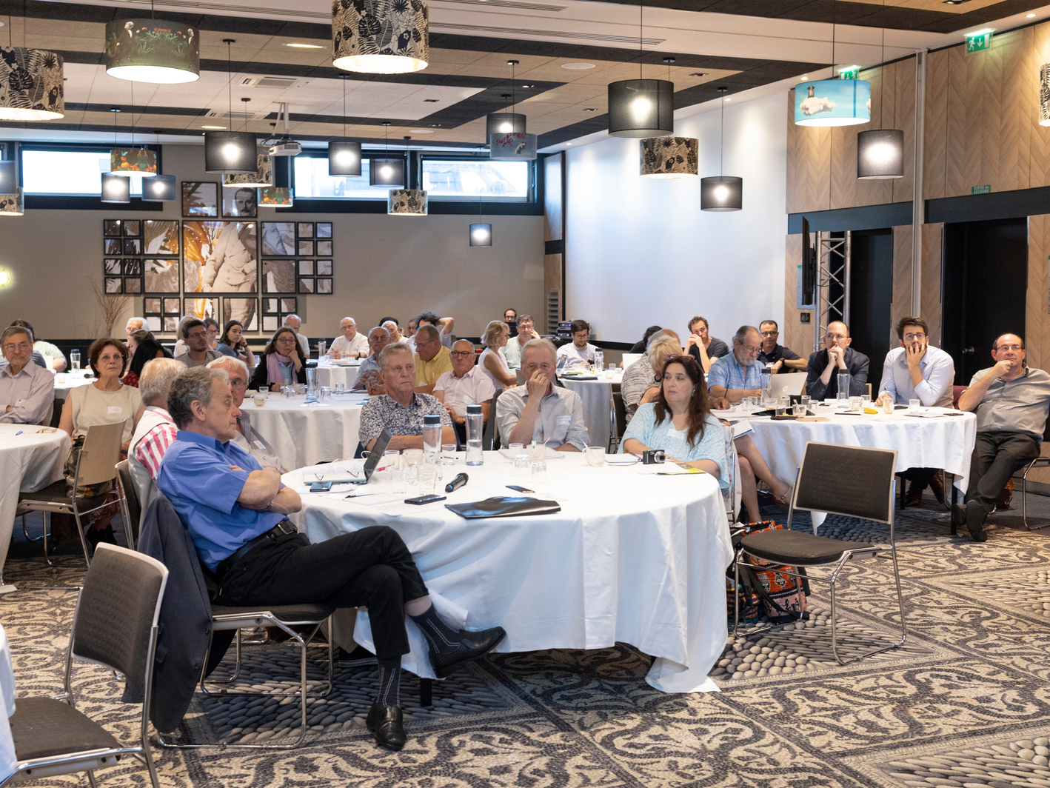
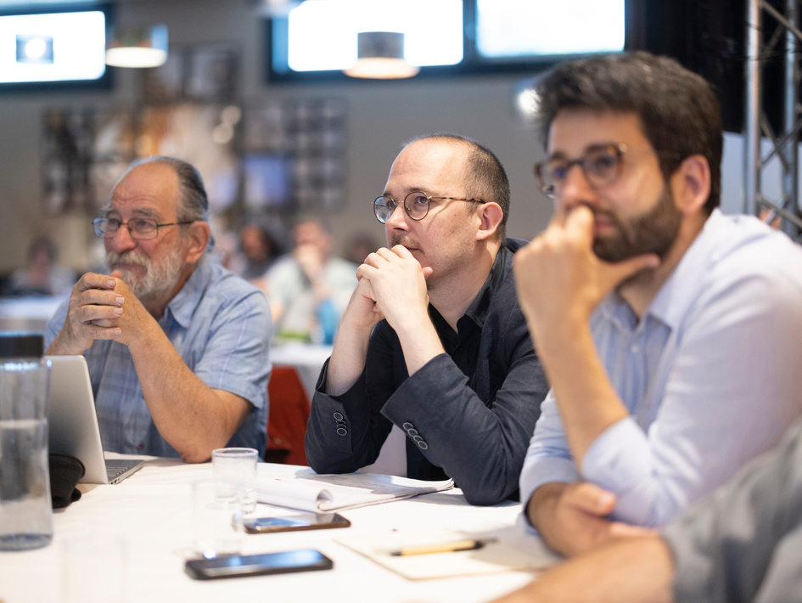
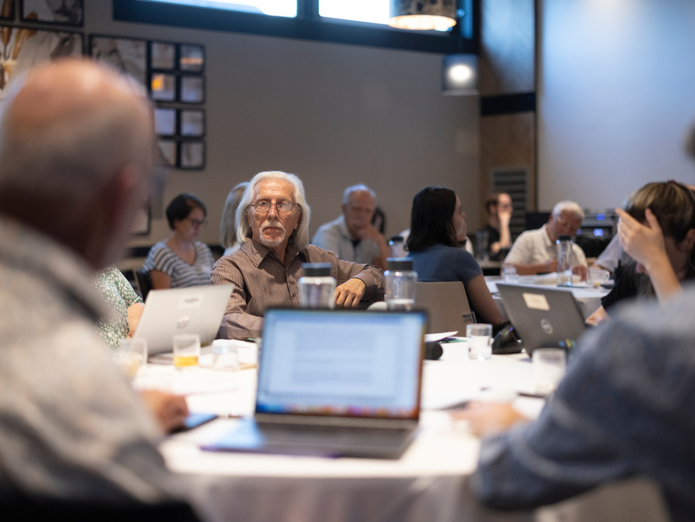
A WIN-WIN PROCESS
  Benefits for civil society
    Allowing civil society to increase its technical skills to actively participate in public decision-making (notably public debates)
    Enhancing safety through citizen vigilance
  Benefits for IRSN
    Enabling IRSN to bolster its own expertise by integrating concerns and questions of civil society,
    Improving stakeholders’ trust in IRSN and the credibility of its actions/activities,
    Another way to value IRSN’s experts and researchers
  => All these elements contribute to the SUSTAINABILITY OF THE TECHNICAL DIALOGUE PROCESS
7
IAEA, ICWEDR, Vienna 11.10.2023
IAEA, ICWEDR, Vienna 11.10.2023

Slide 8
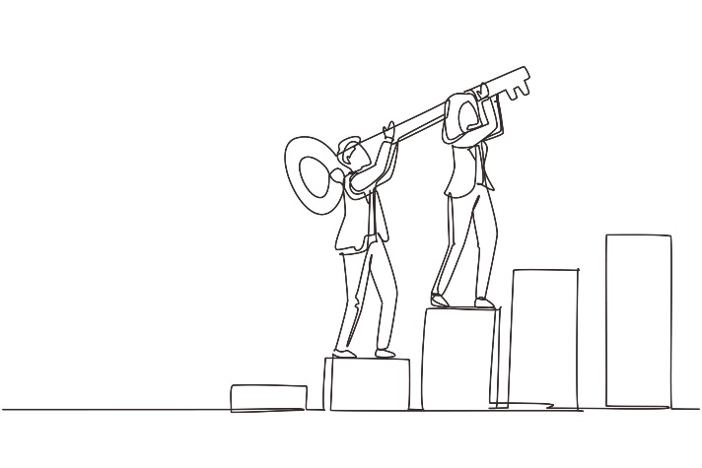

KEY SUCCESS FACTORS AND CHALLENGES TO
OVERCOME
As soon as possible (various options still opened)
Co-construction
Equity, sincerity, mutual benefits
Multidisciplinary and plurality of views
Enough time
Adaptation
Consensus & disagreement
Report back
Key successes
Nevertheless, we must stay vigilant on
Reinforcement of participation (diversity)
Innovative tools
Meet CS expectations on cross-cutting issues (f.i. climate change…)
Assessment study on the impact of openess to society actions on nuclear safety
IAEA, ICWEDR, Vienna 11.10.2023

Slide 9
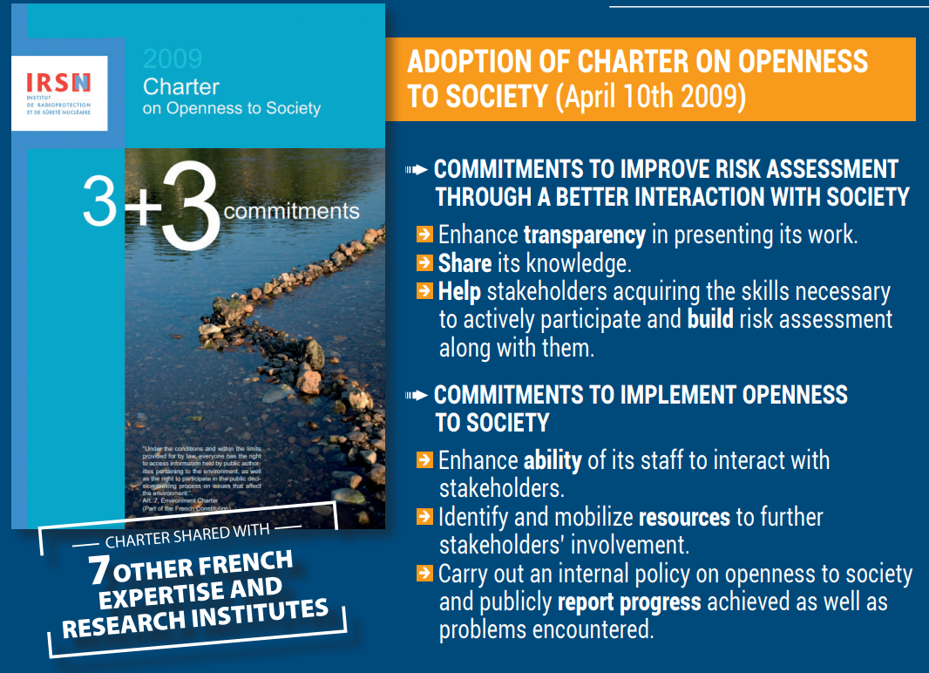
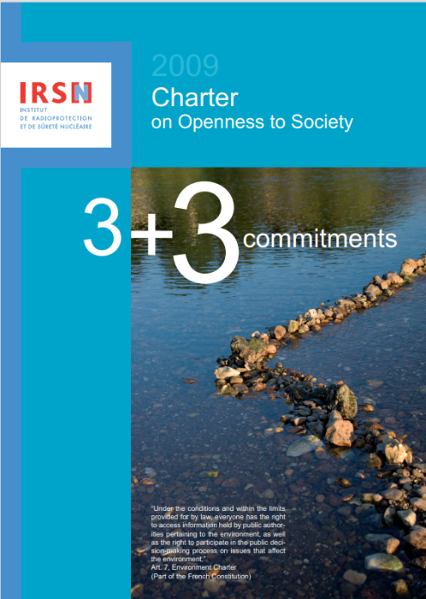
Thank you for your attention
IAEA, ICWEDR, Vienna 11.10.2023

Slide 10
STEP 1 2012-2013: Increasing knowledge and skills of stakeholders
Initiated in 2012 for preparing CS to participate to public debate (in 2013)
Define together technical topics -linked to sustainability goals with societal and environmental concerns- to address (radiactive waste, reversibility, operational safety, risk associated with co-activities as simultaneous nuclear operation activities during galleries) , waste package transportation)
Co-construct a work program to address these issues
Organization of seminars on radioactive waste in general + on specific subjects

Slide 11
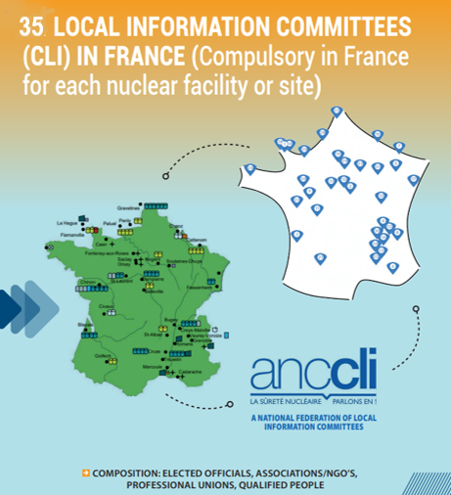
IAEA, ICWEDR, Vienna 11.10.2023

Slide 12
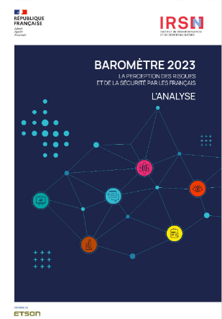
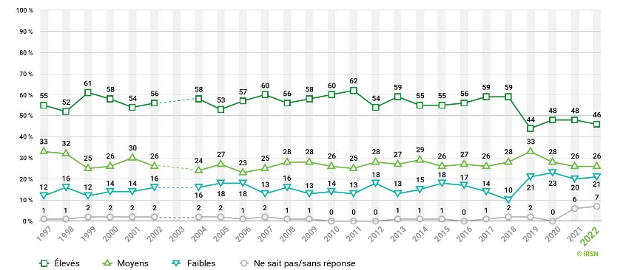
RISK PERCEPTION OF FRENCH POPULATION
IRSN Barometer on risk and security perception by French people:
  yearly study designed to monitor the evolution of risk perception in France since 90’s
  follows more than 30 risks of different types
46% view radwaste risk as “high” or “very high” in the 2023 Barometer (57% average 1997-2018)
Since 2020 top 2 arguments against nuclear power are: radwaste production (31%) and risk of accident (27%).
78%: not well informed on radwastee, more than on NPPs (60%)
In each of the following areas, do you think the risks for the French population in general are: close to null, low, moderate, high, very high? - Radioactive waste (2023 Barometer, in %)

Slide 13
