Slide 1
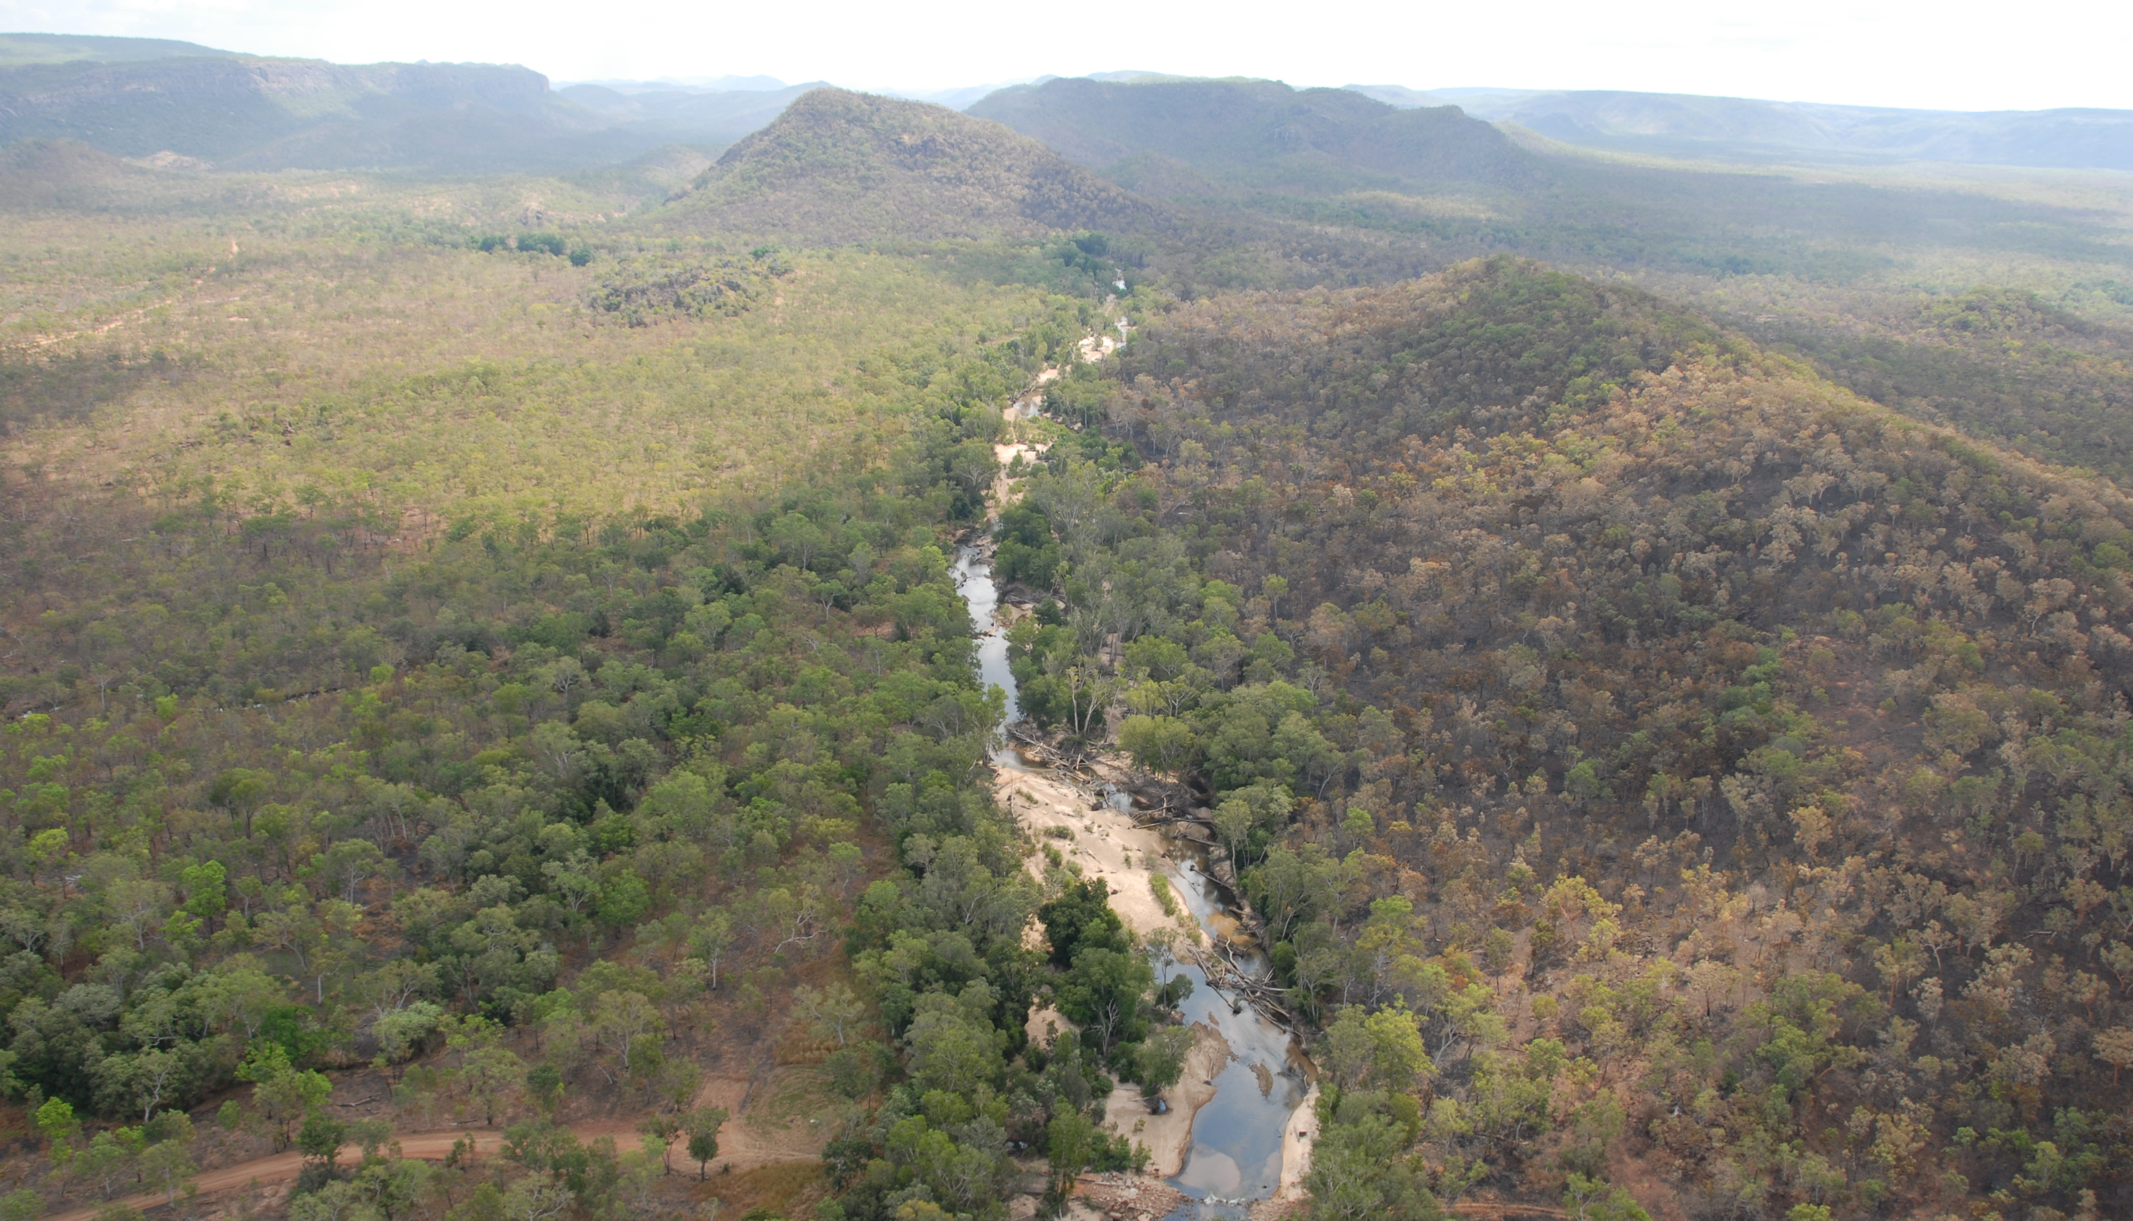
South Alligator Valley remediation:
Safety and sustainability in a National Park
Peter Waggitt
Consultant
Darwin, Australia
International Conference on the Safety of Radioactive Waste Management, Decommissioning, Environmental Protection and Remediation: Ensuring Safety and Enabling Sustainability 6–10 November 2023, Vienna, Austria

Slide 2
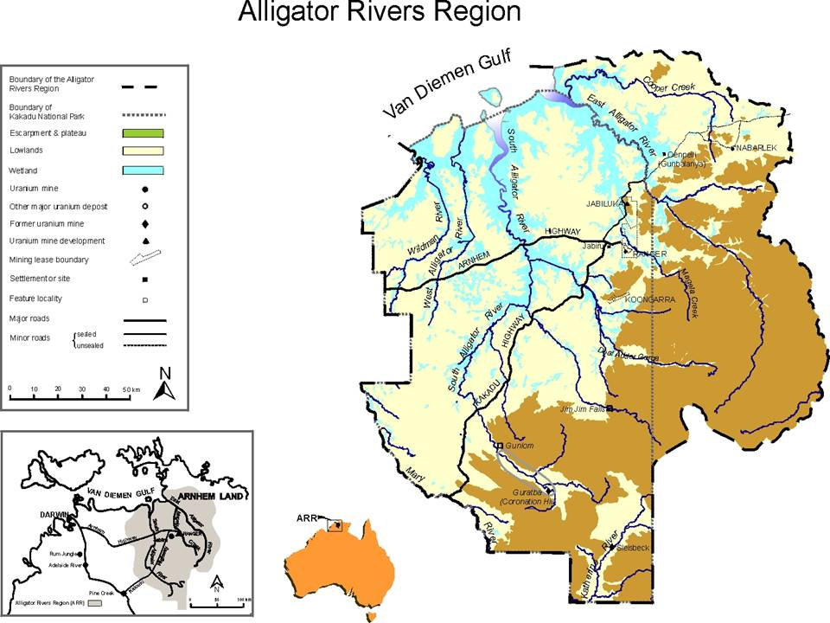

Slide 3
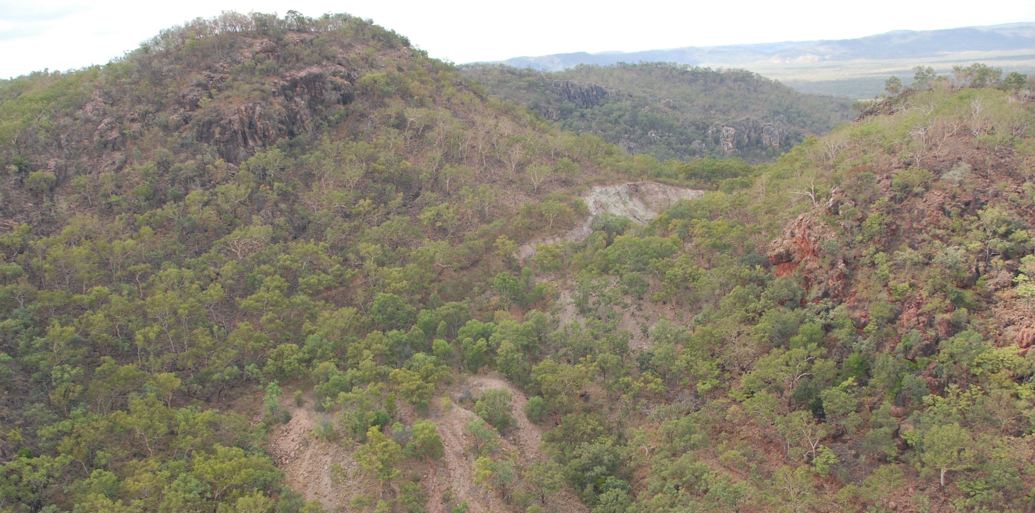
Saddle Ridge minesite -2002
Note: open cut and waste rock dump and access track

Slide 4
South Alligator Valley (SAV) Uranium Field - History
1987 - Area included in Stage III of KNP
1992 - Stage III added to World Heritage Register
1996 - Lease back agreement signed
  Plan to be complete by 2000
  Works to be complete 2015
1997 – Initial planning meeting with Traditional Owners
2001 - Overall Plan agreed in 2 phases:
  Part A – non-radiological sites
  Part B radiologically contaminated sites
2003 - Final location details agreed & final site investigation begins
2007 – Complete designs
2008 & 2009 Dry seasons - works completed
Monitoring & maintenance ongoing
Uranium deposits first discovered in 1952
Mined from 1955-1962 at 13 locations by three companies
Production was 975 t of U3O8 and 312.5 kg (~11k ozs) of gold
No remediation, sites simply abandoned
Area reverted to cattle station – extensive grazing
Promulgation of Kakadu National Park (KNP) to the North in 1979 – SAV to be Stage III
1986 Site survey catalogued sites and hazards
Radiation risks very low, many physical hazards
1992-Hazard reduction works

Slide 5
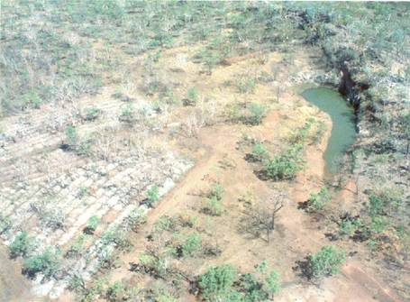
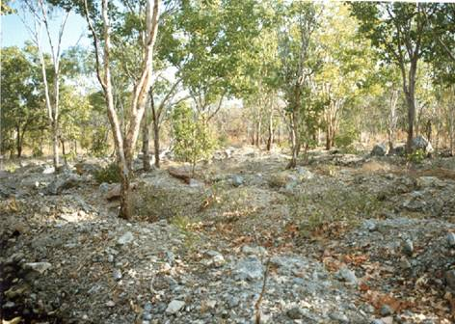
Sleisbeck open cut (Before)
Sleisbeck from the air
Sleisbeck truck dumps & re-growth

Slide 6
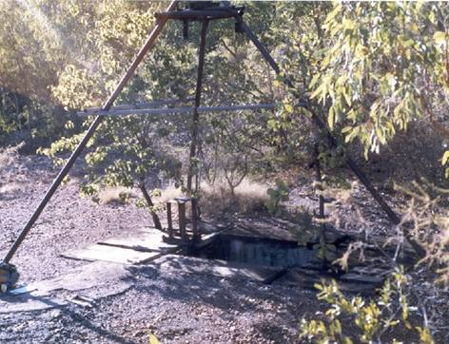
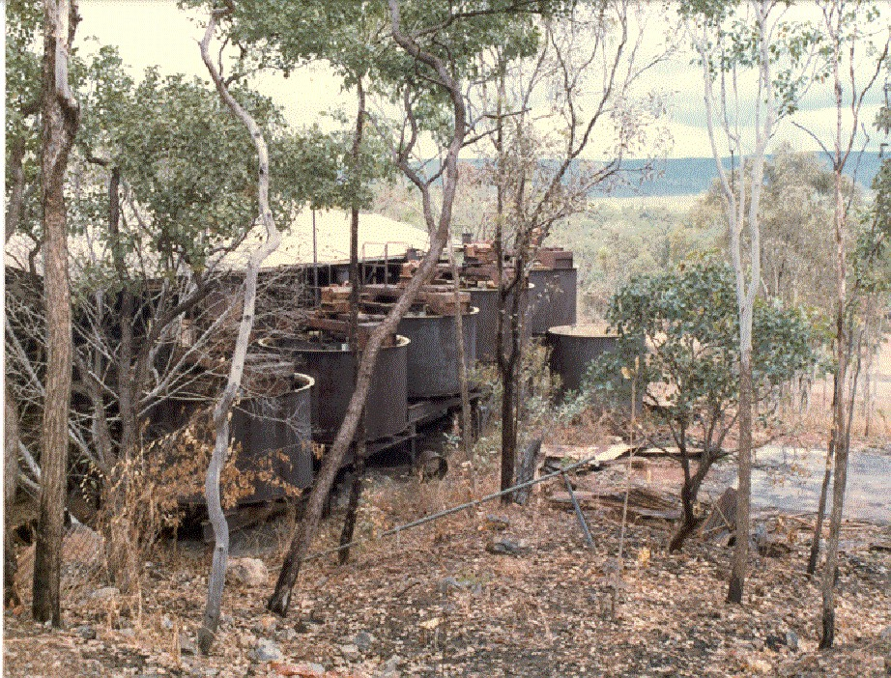
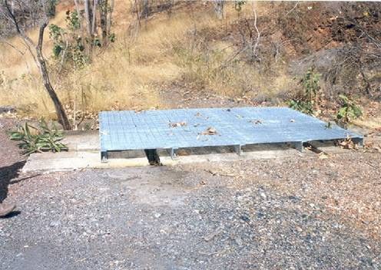
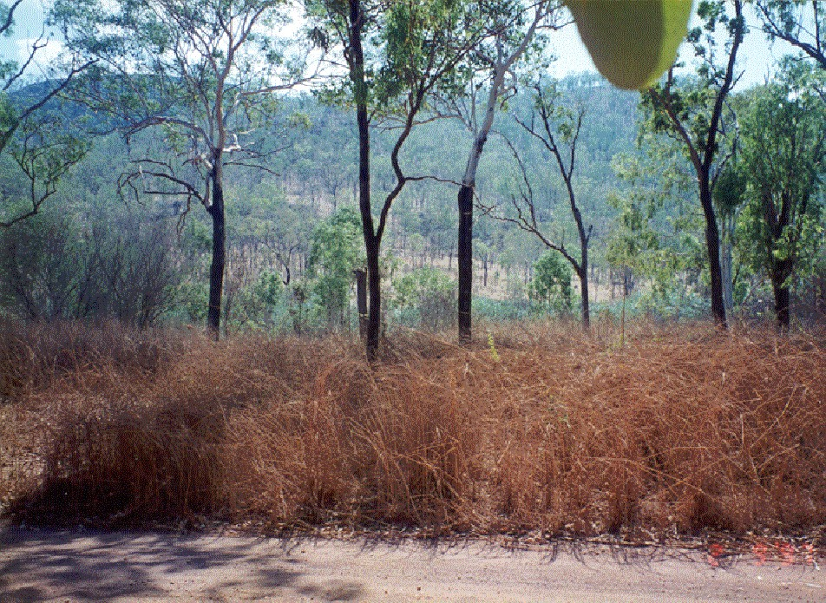
Hazard Reduction
South Alligator Mill
Rockhole Mine Shaft

Slide 7
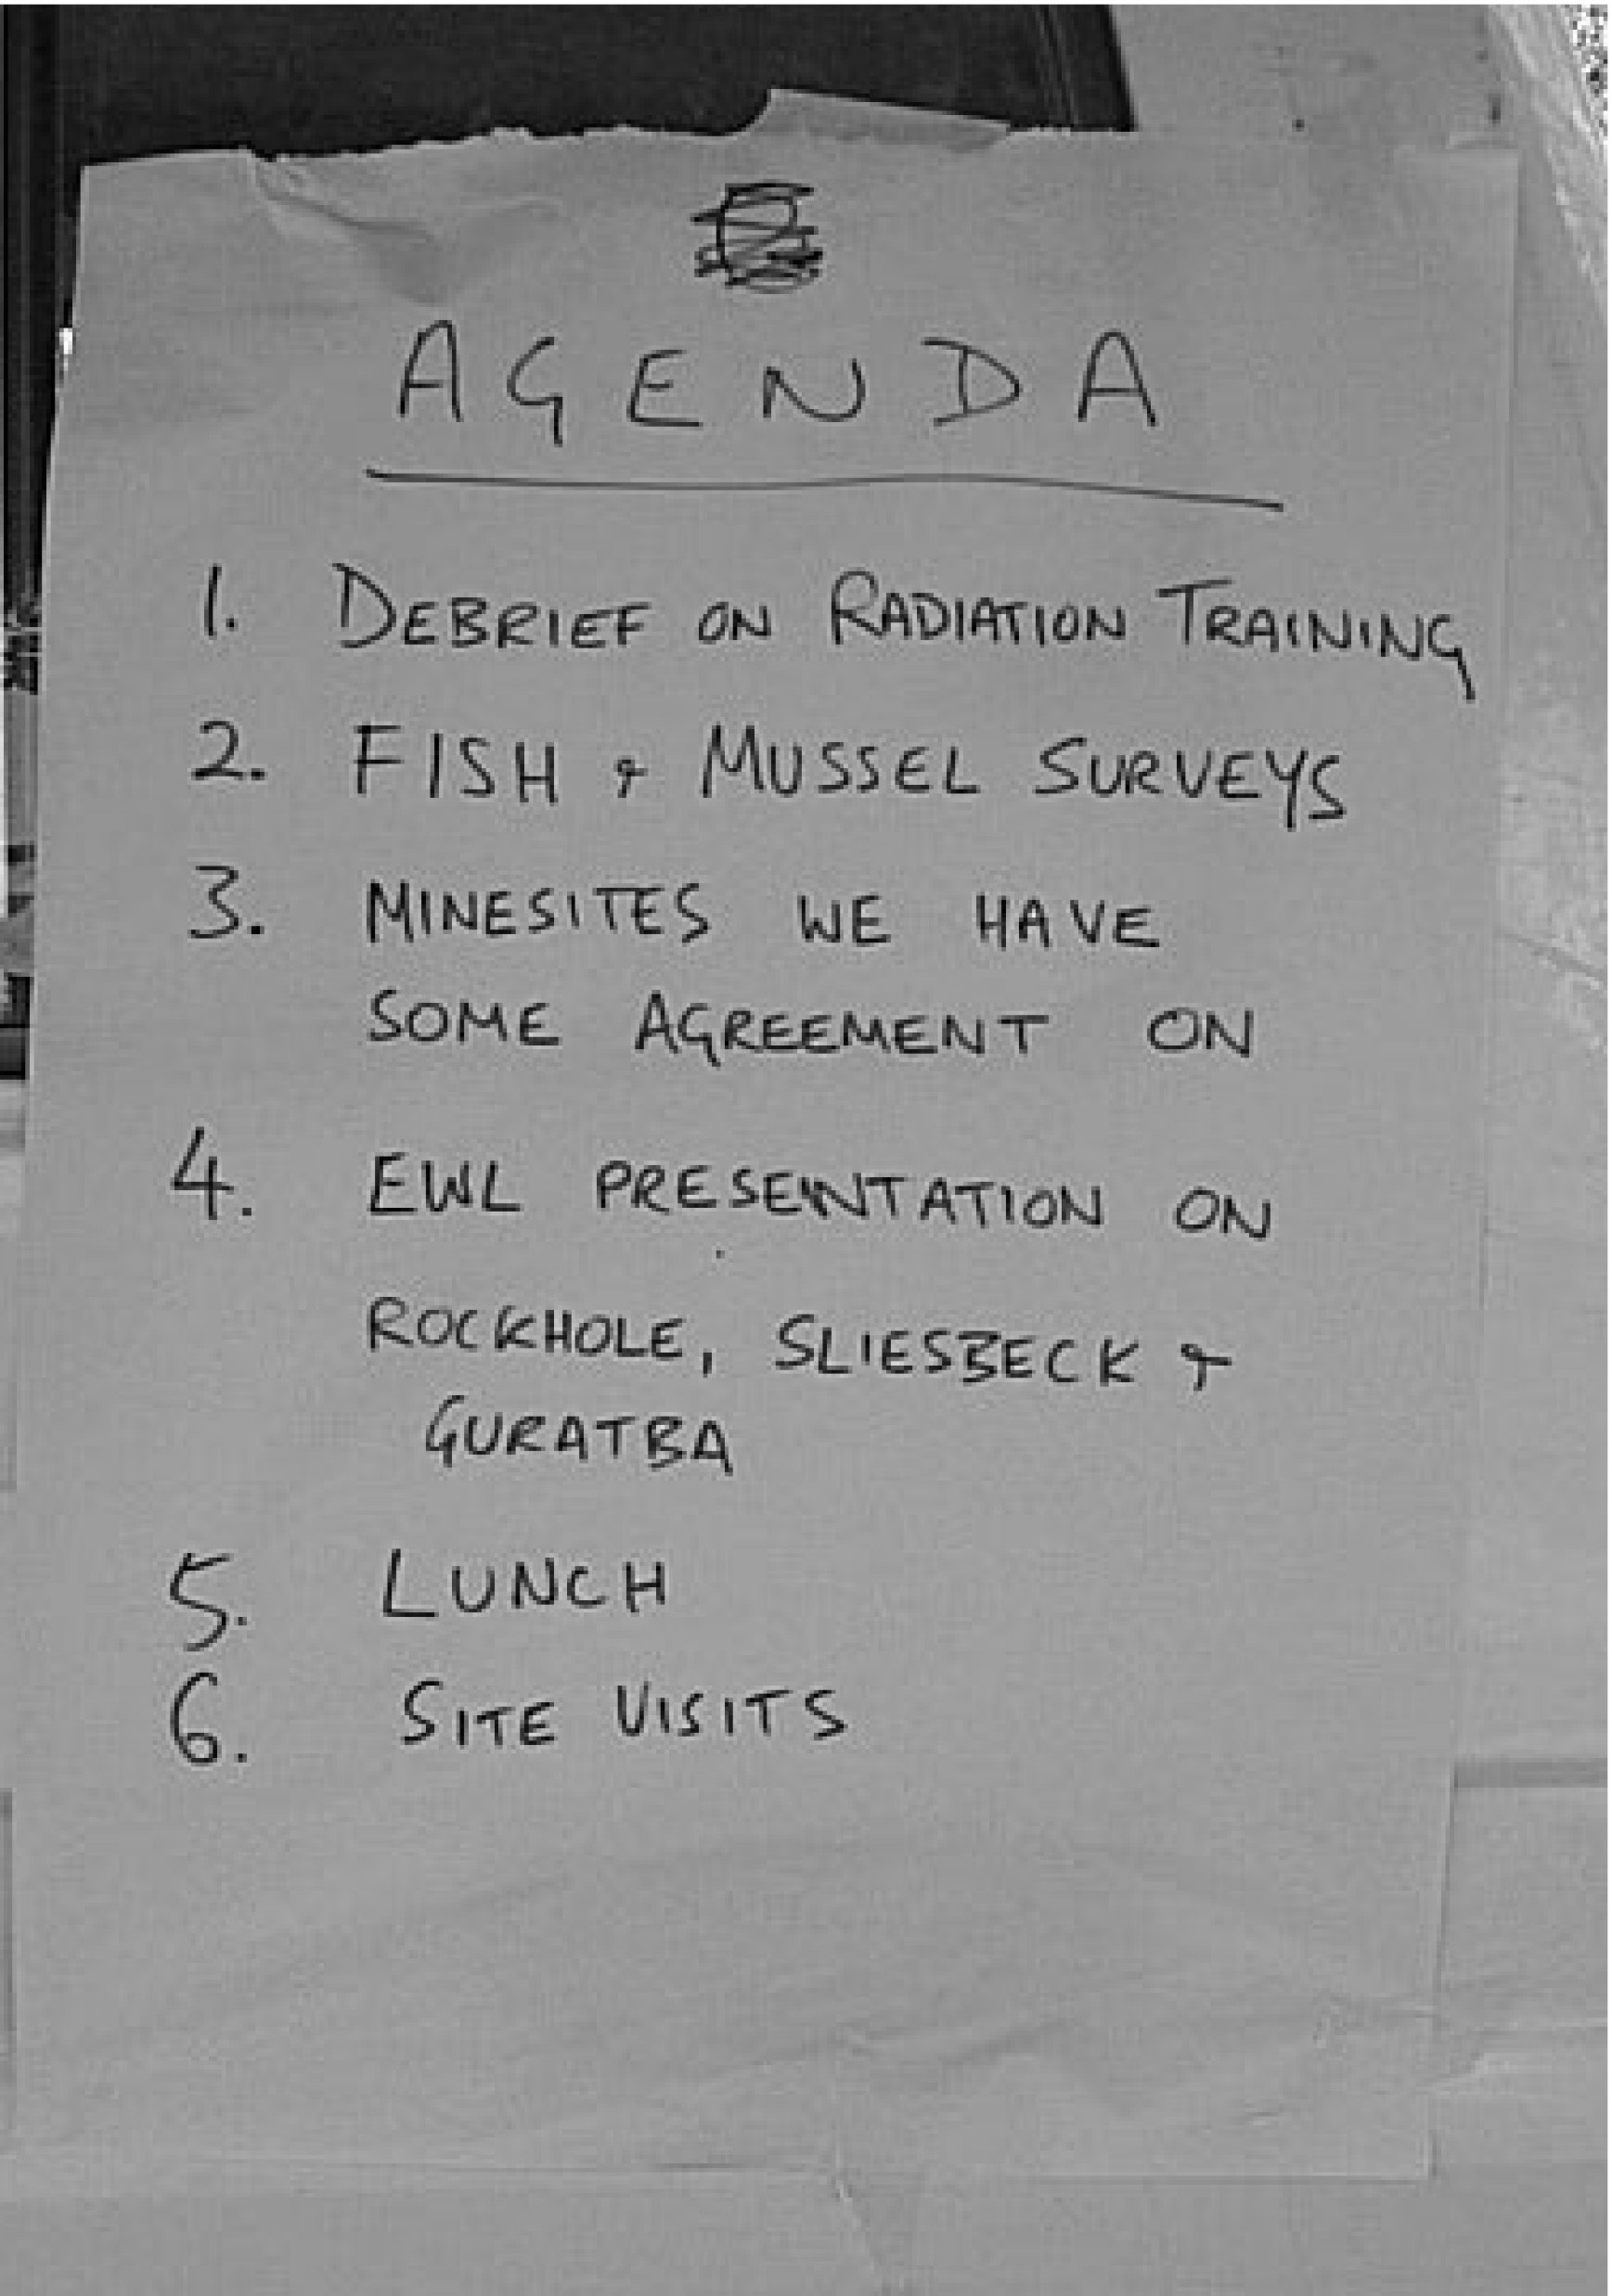
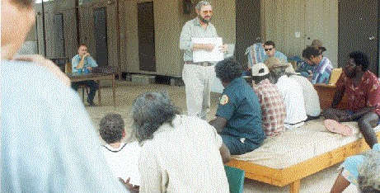
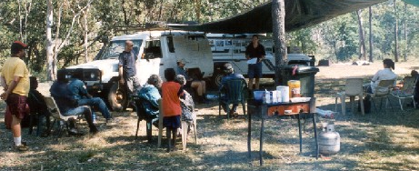
Consultation
1997 onwards
On site in the Valley
Informal setting
Dry season camp
Allow TOs to set the agenda
2-3 days for discussion, site visits and demonstrations
No Rush and minimize pressure
“Instant minutes”

Slide 8
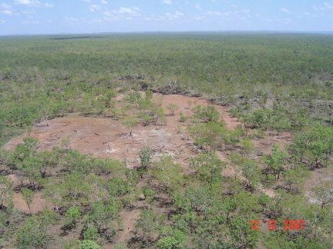
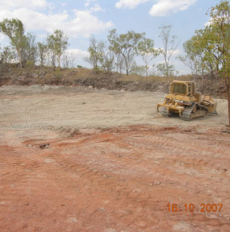
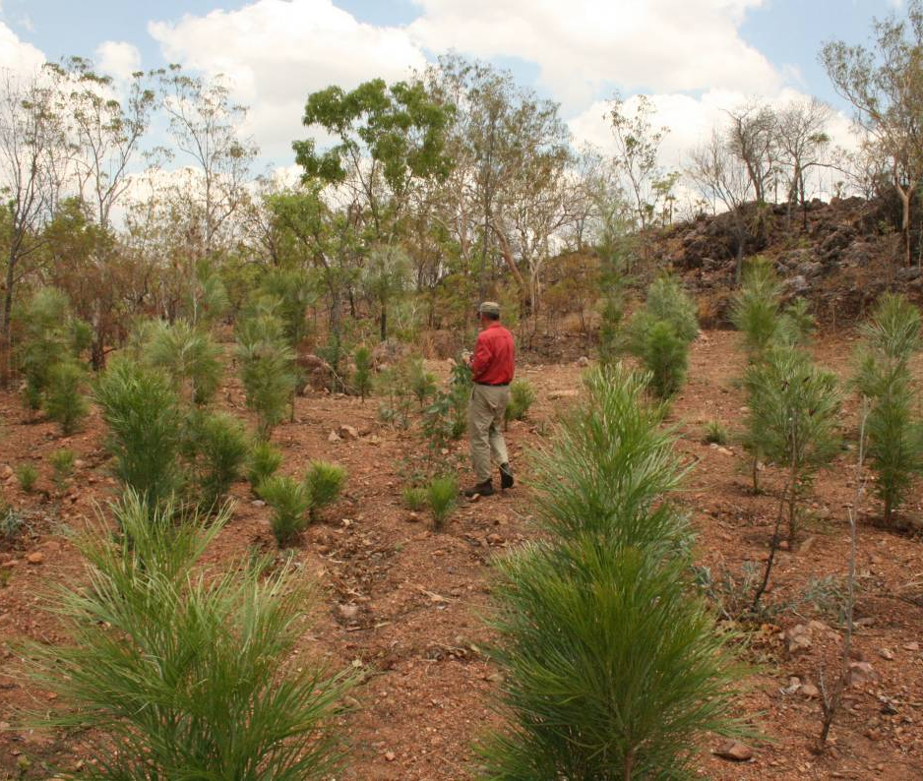
Remediation
Sleisbeck:
Filling the pit and completion
2007
2009

Slide 9
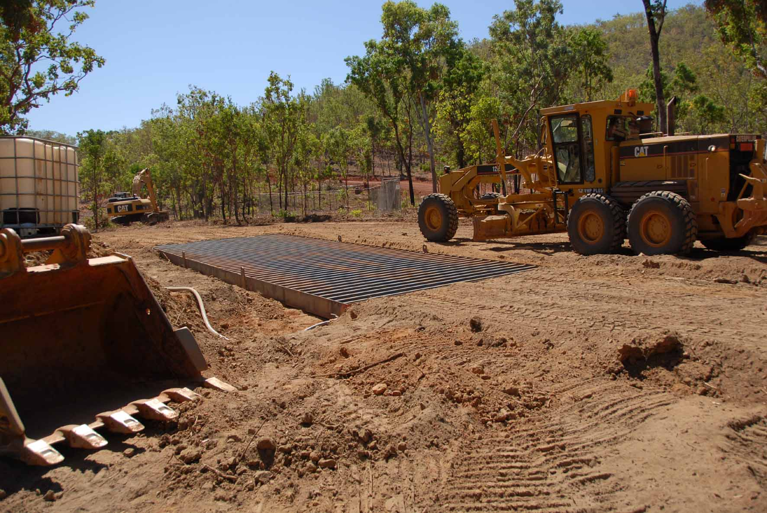
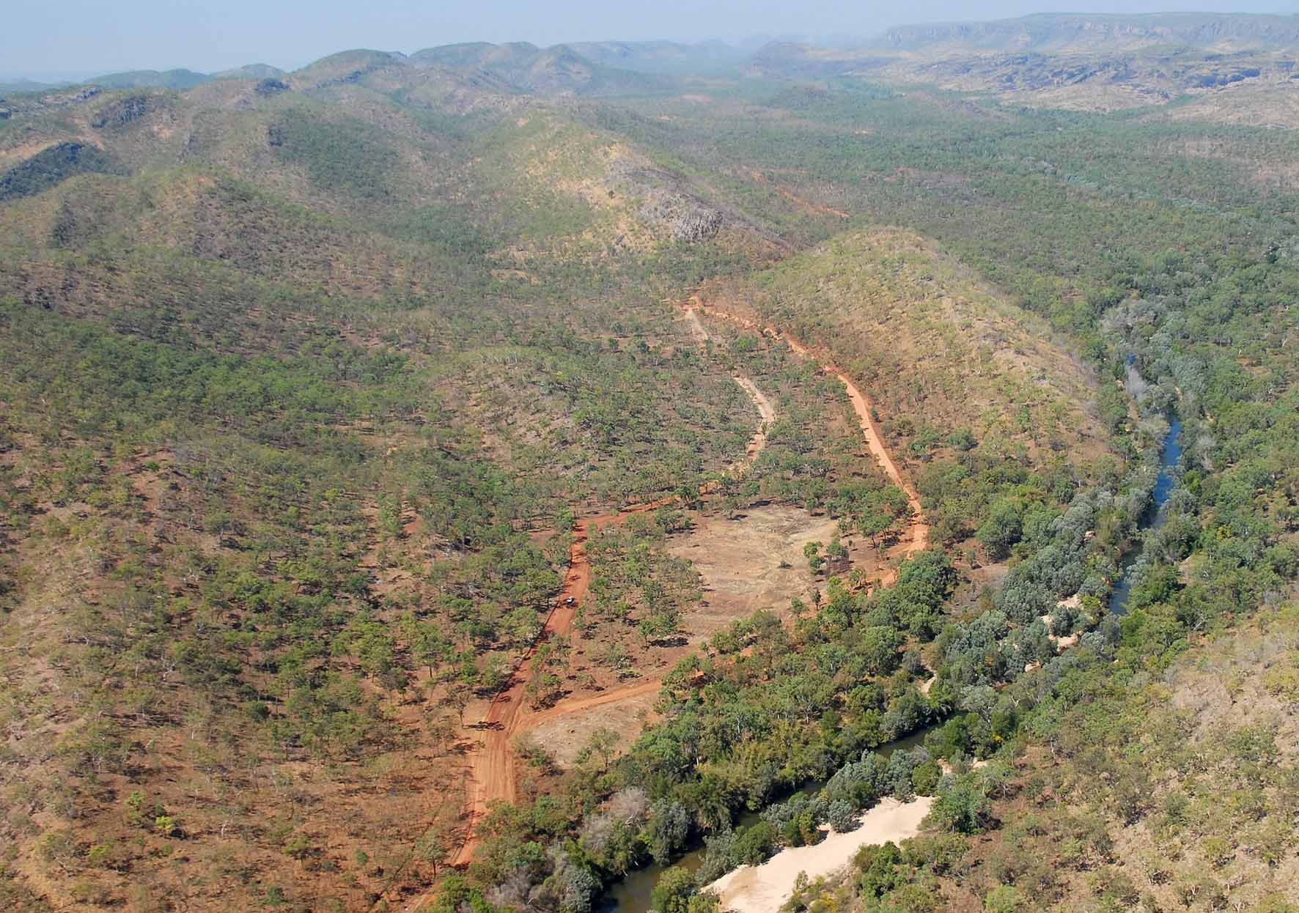
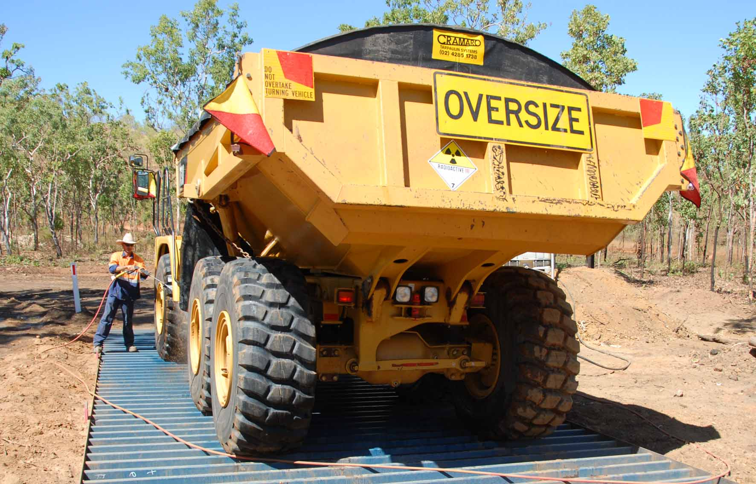
Preparation for final works at mill site

Slide 10
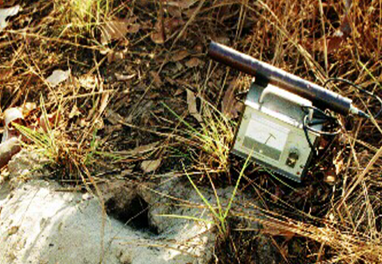
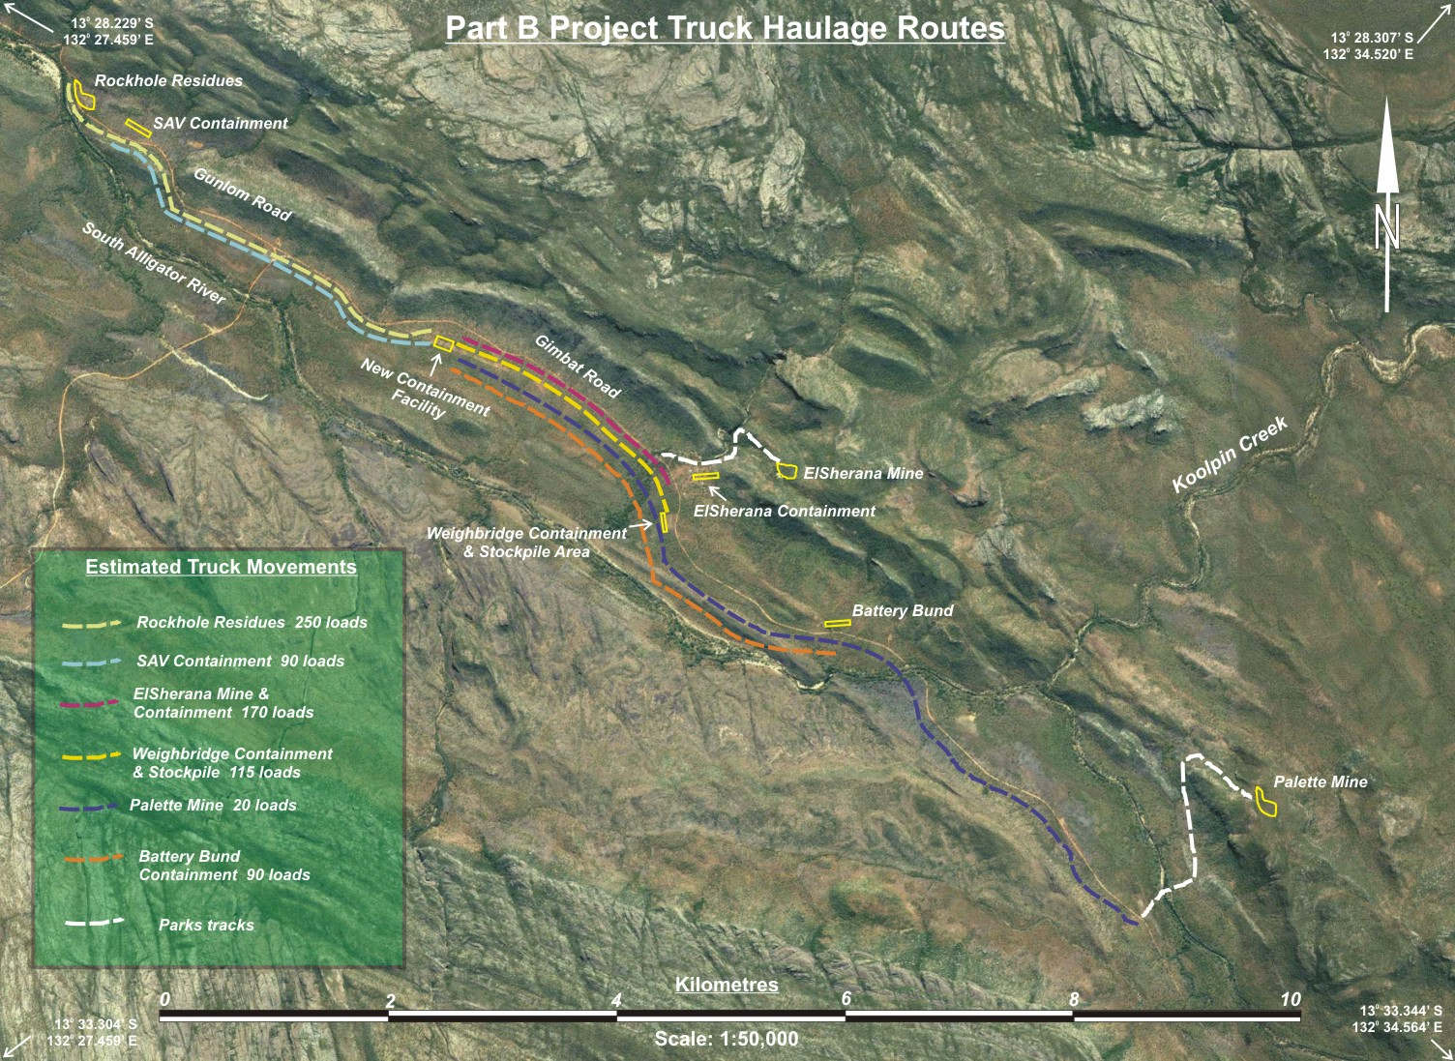
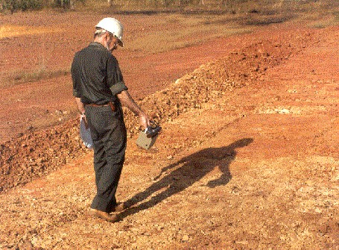
Risk assessment
2003: discovery of old uranium tailings
2007: transport route options and risk levels
1992: clearance check after site cleaning

Slide 11
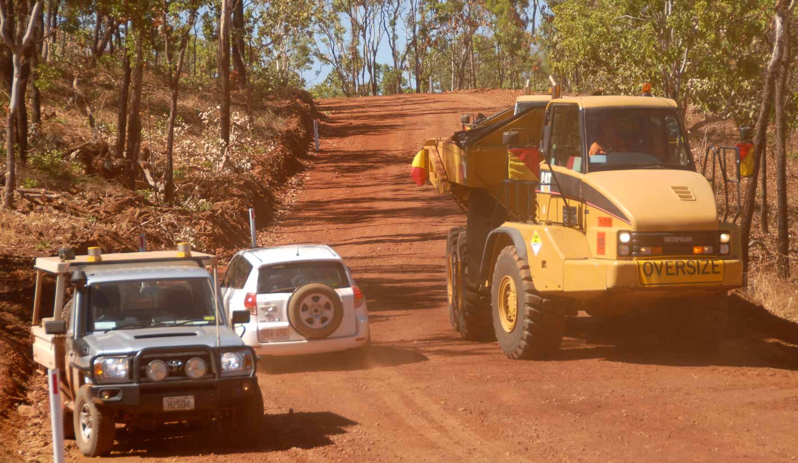
Risk on the ground during works

Slide 12
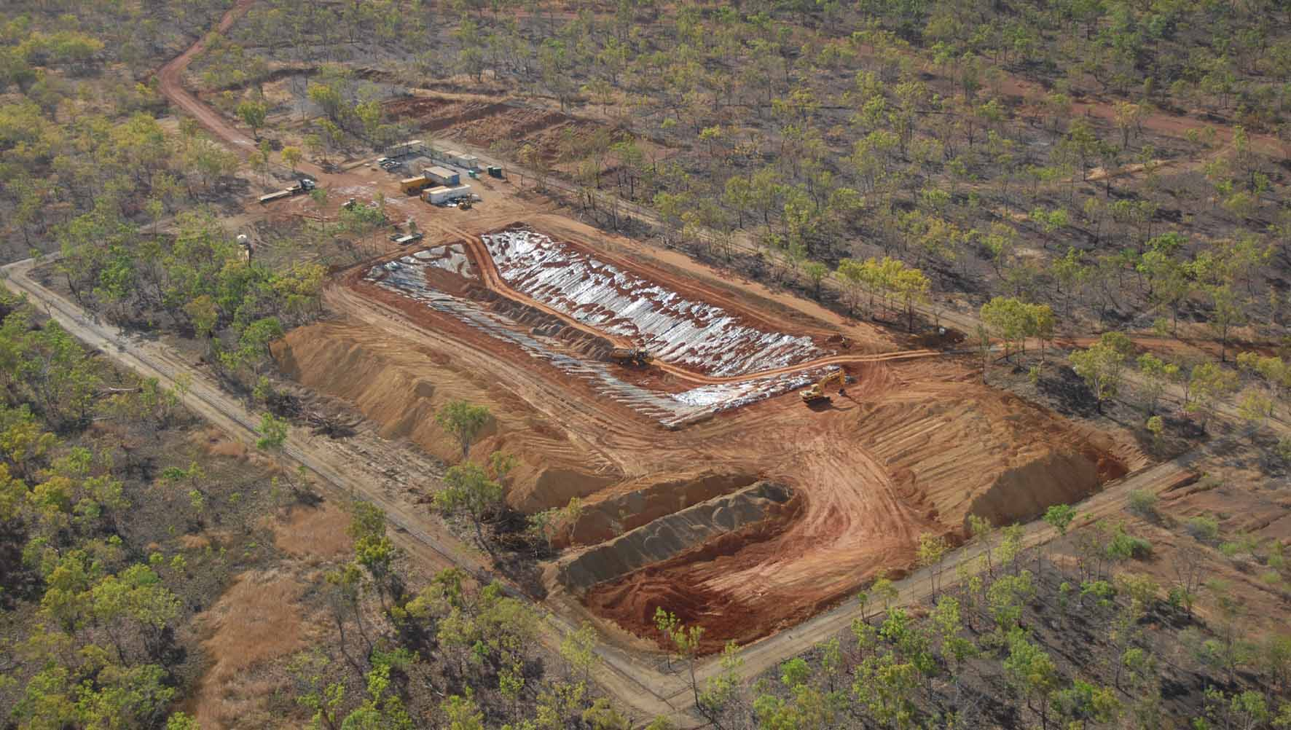
New Containment Facility

Slide 13
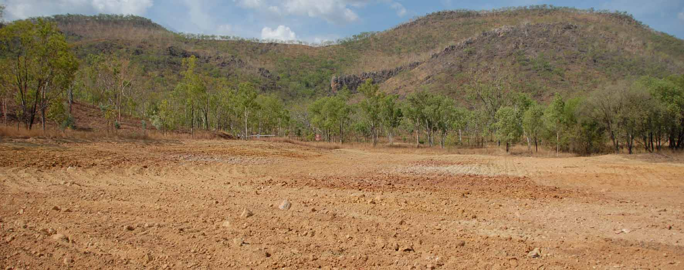
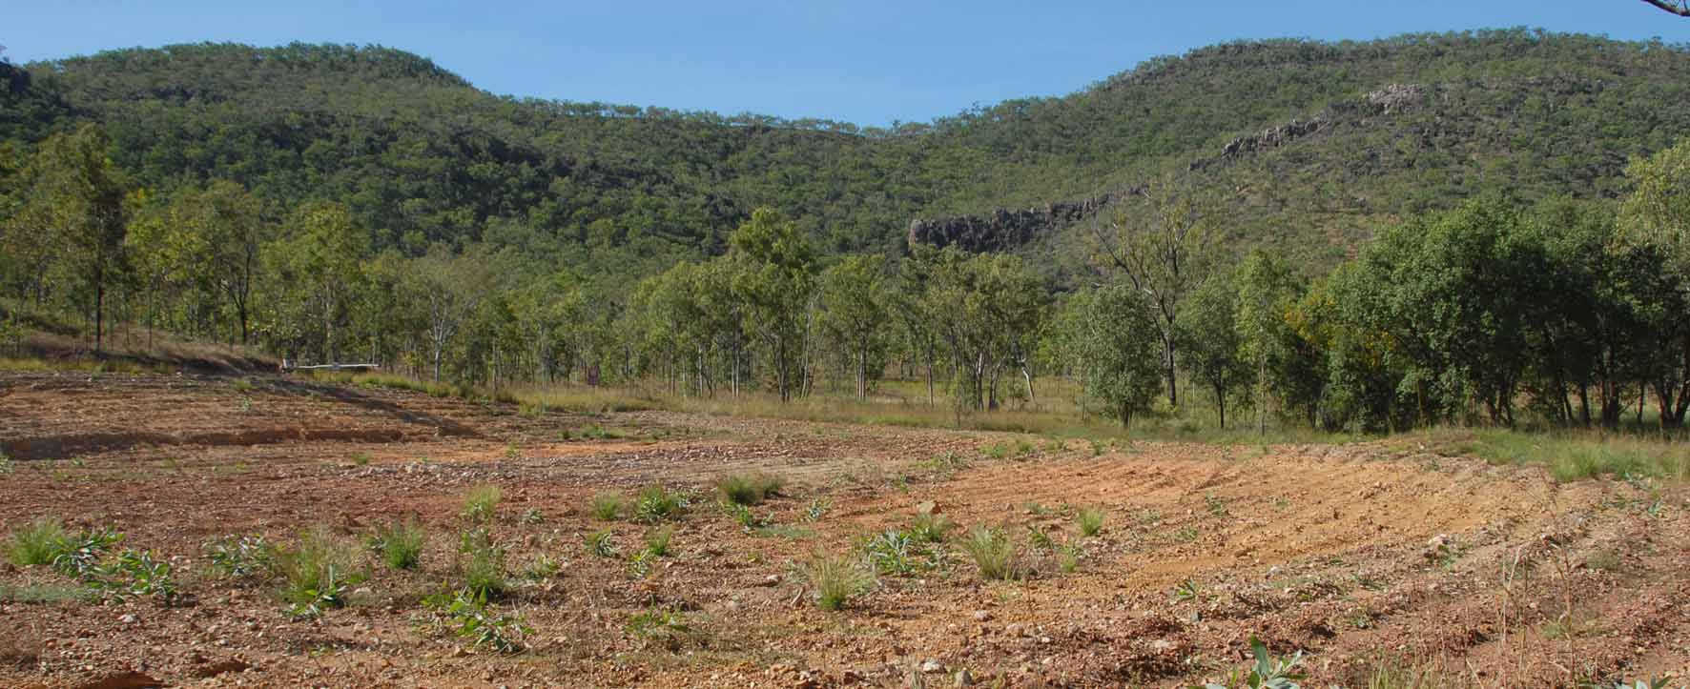
A former containment site - remediated

Slide 14
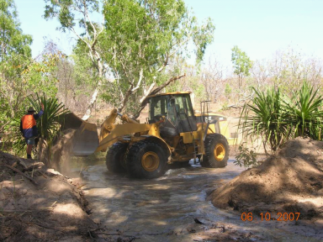
Sustainability
Traditional owners being trained as plant operators on SAV remediation works 2007-8

Slide 15
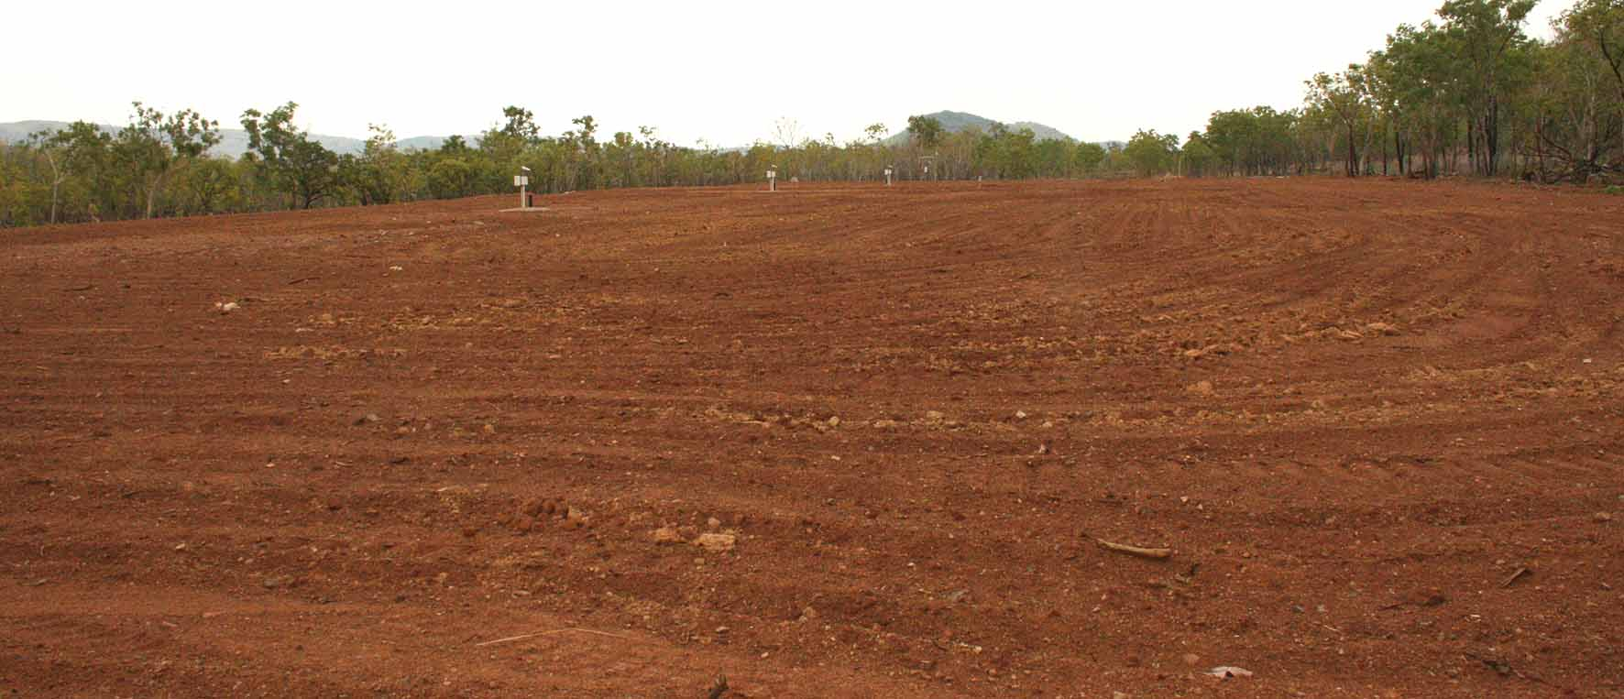
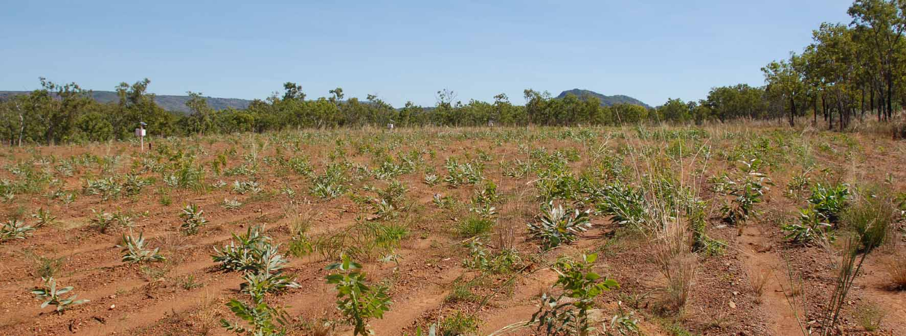
New Containment Facility 2009 - 2010

Slide 16
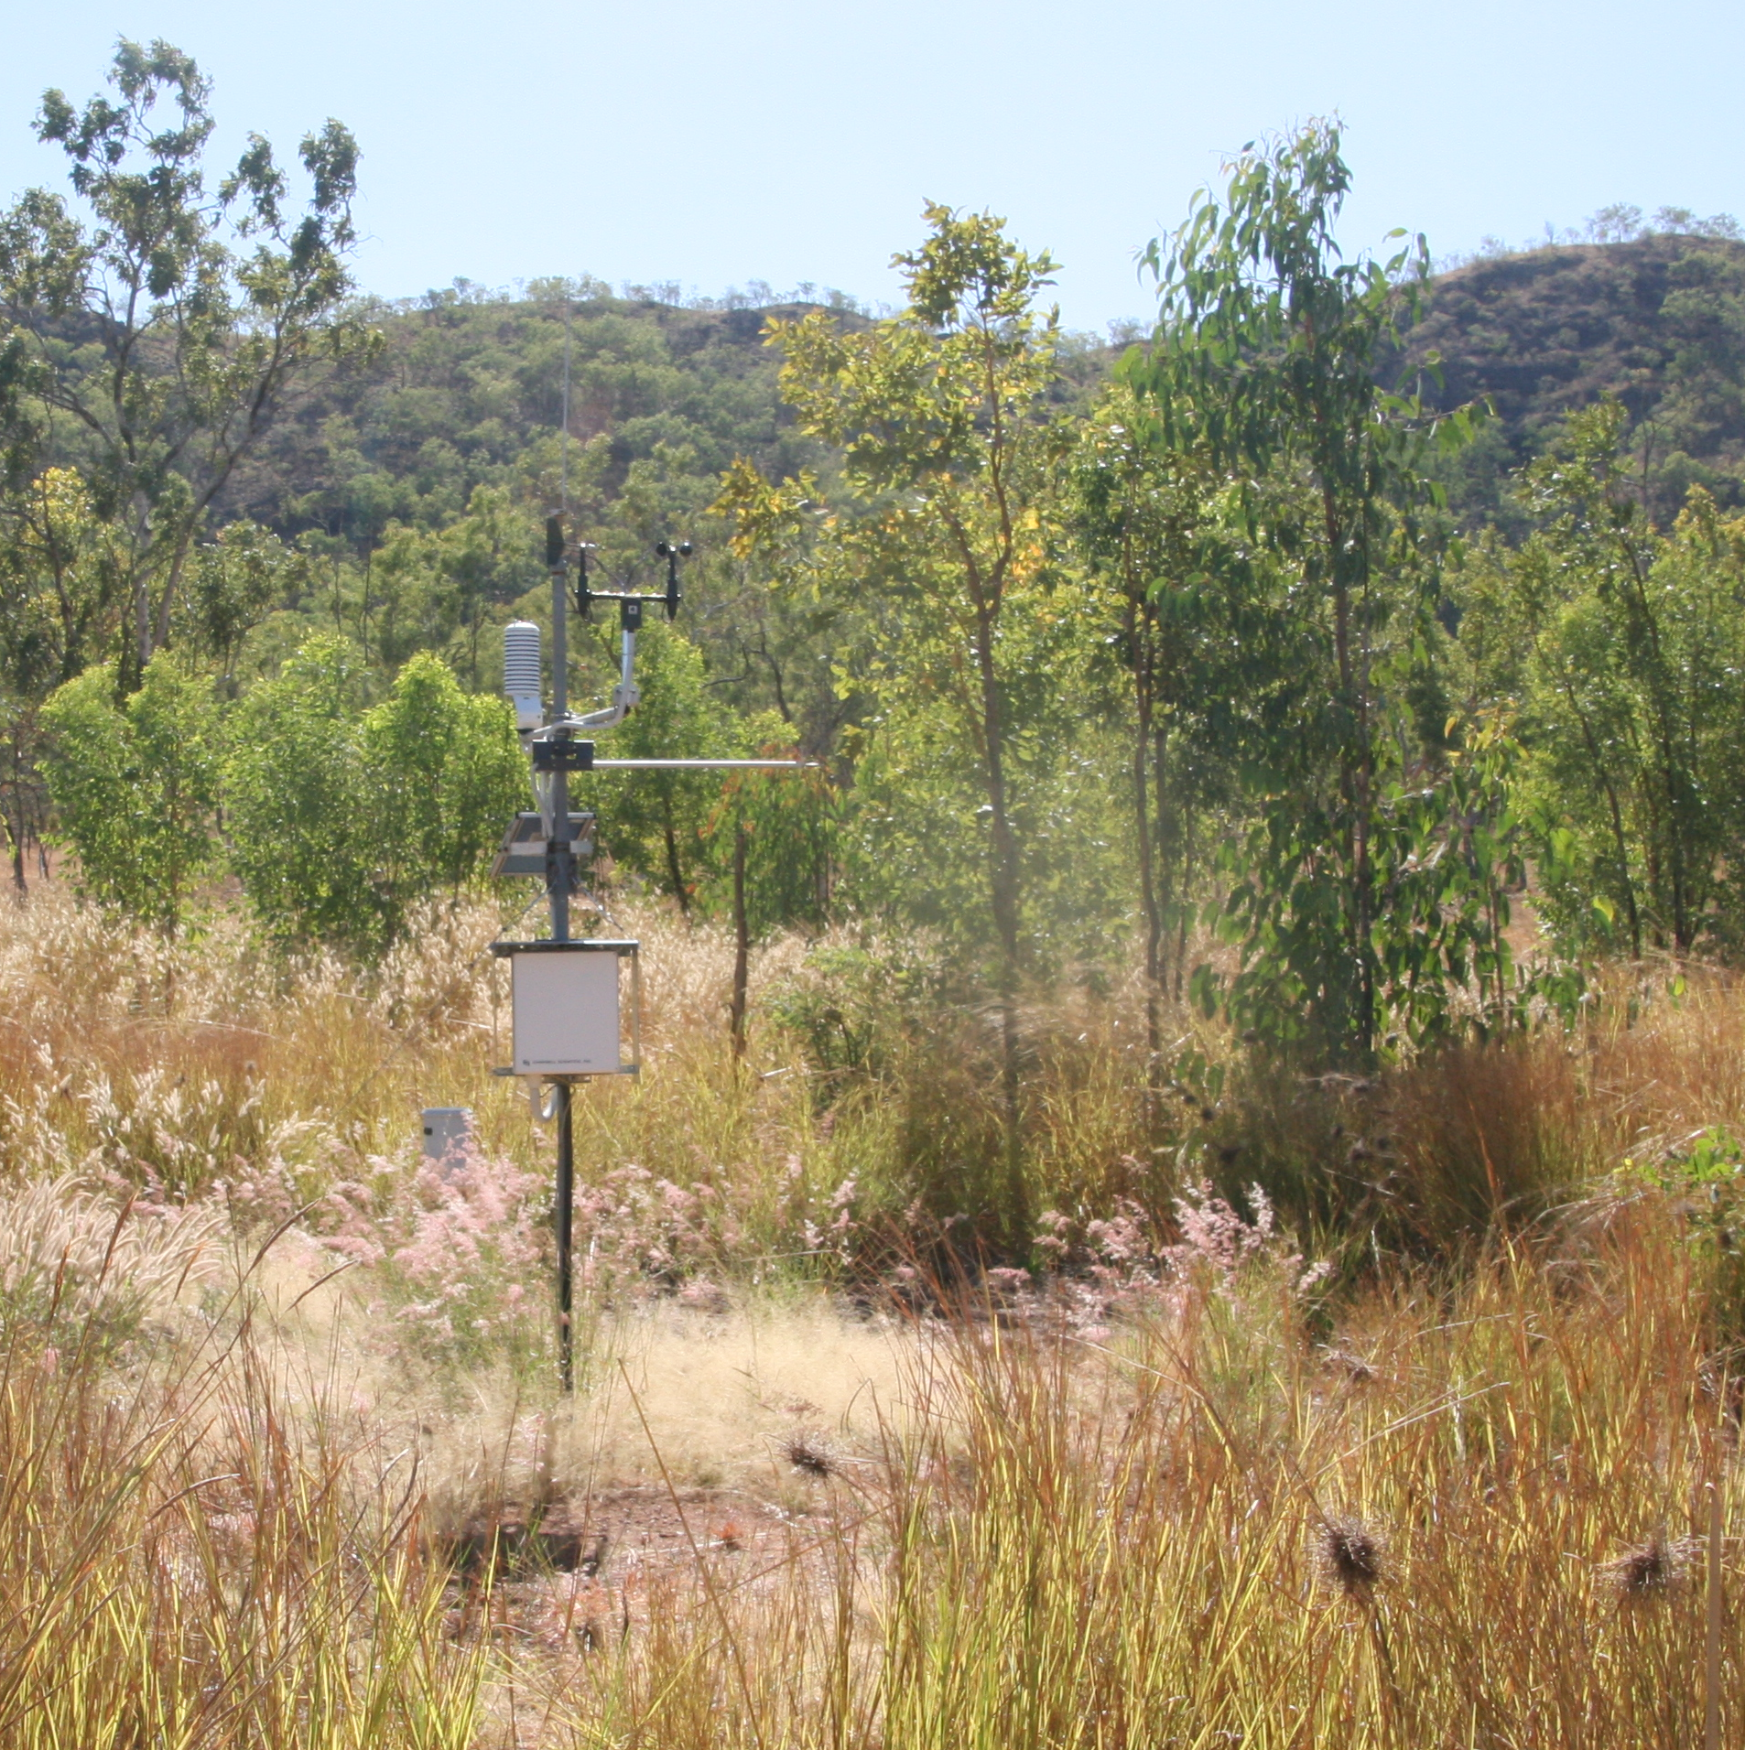
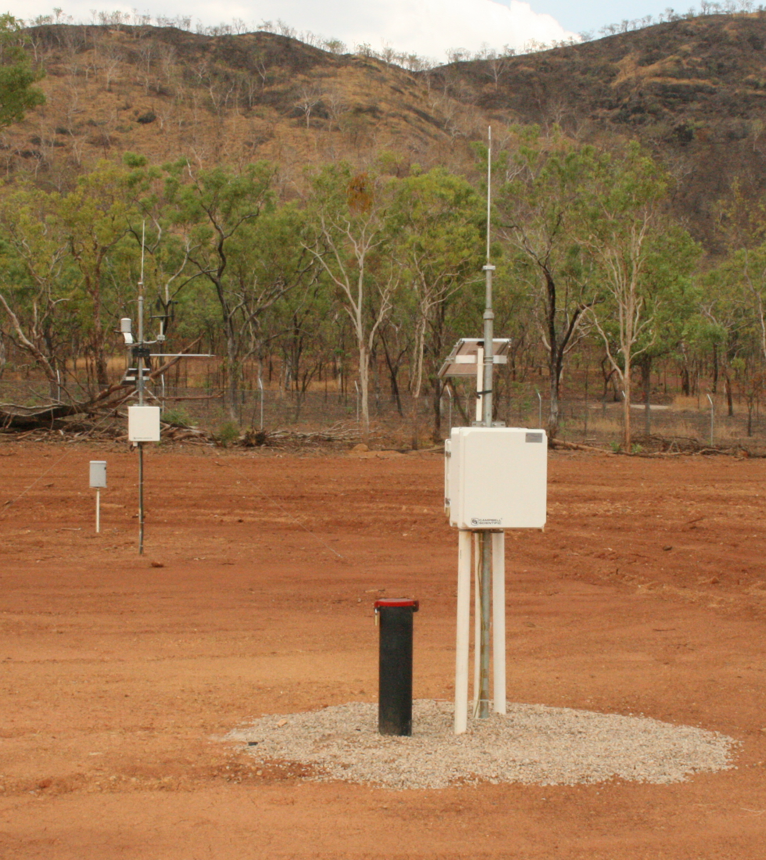
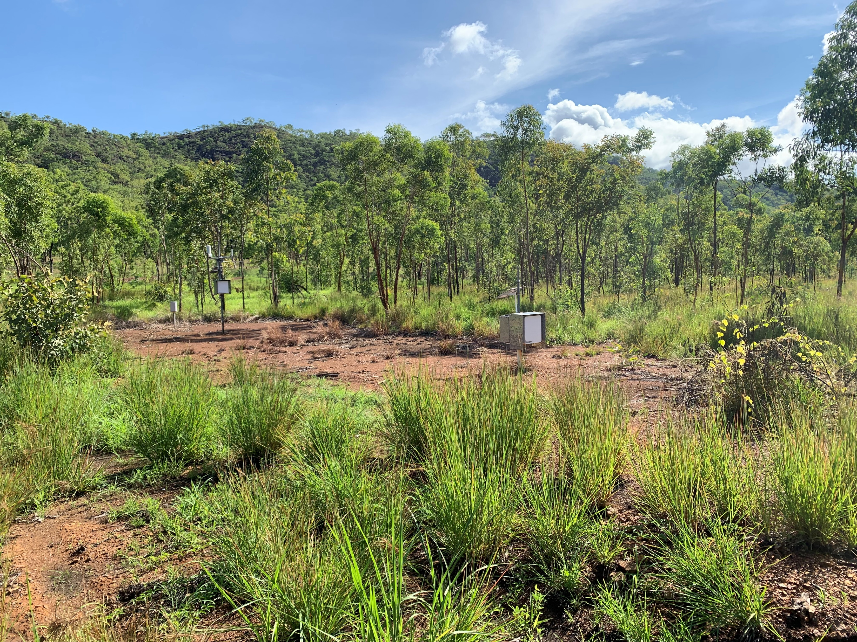
Containment site 2009 – 2020 - 2021
Instrumentation installed
Local provenance seed
Weed infestation
Weed management
Fire management
Vegetation development

Slide 17
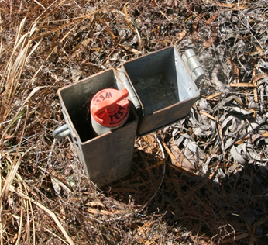
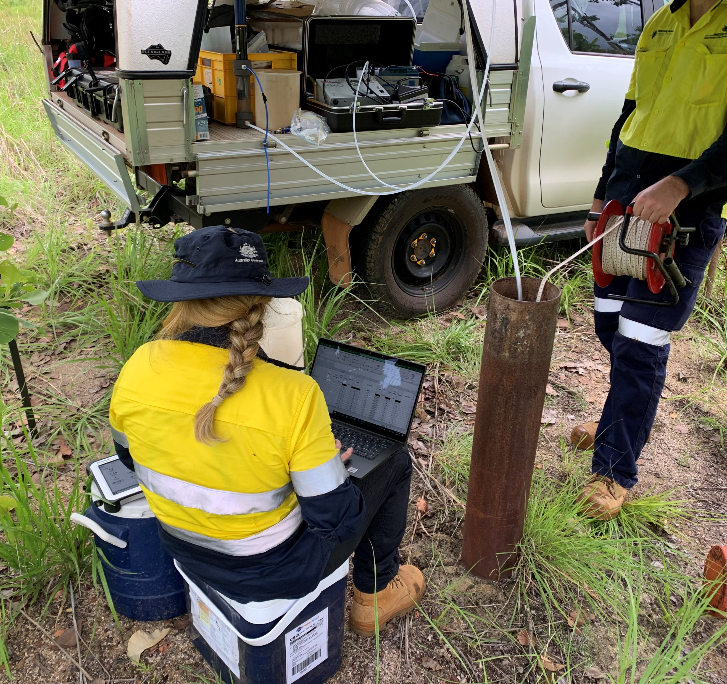
Monitoring
Groundwater sampling 2021
Erosion check
Fence check
Weed check
Ground water check
Lysimeter fluid check
Radiation check
Vegetation health check

Slide 18
Lessons learned
Consultation essential - early and honest
Clear identification of stakeholders at the outset
Clear setting of objectives with stakeholder “buy in” essential
Stay flexible and adapt to circumstances where you can
Establish standards to be used in design and construction
Take time and care to characterise the site and issues
Stay in touch and be honest with stakeholders

Slide 19

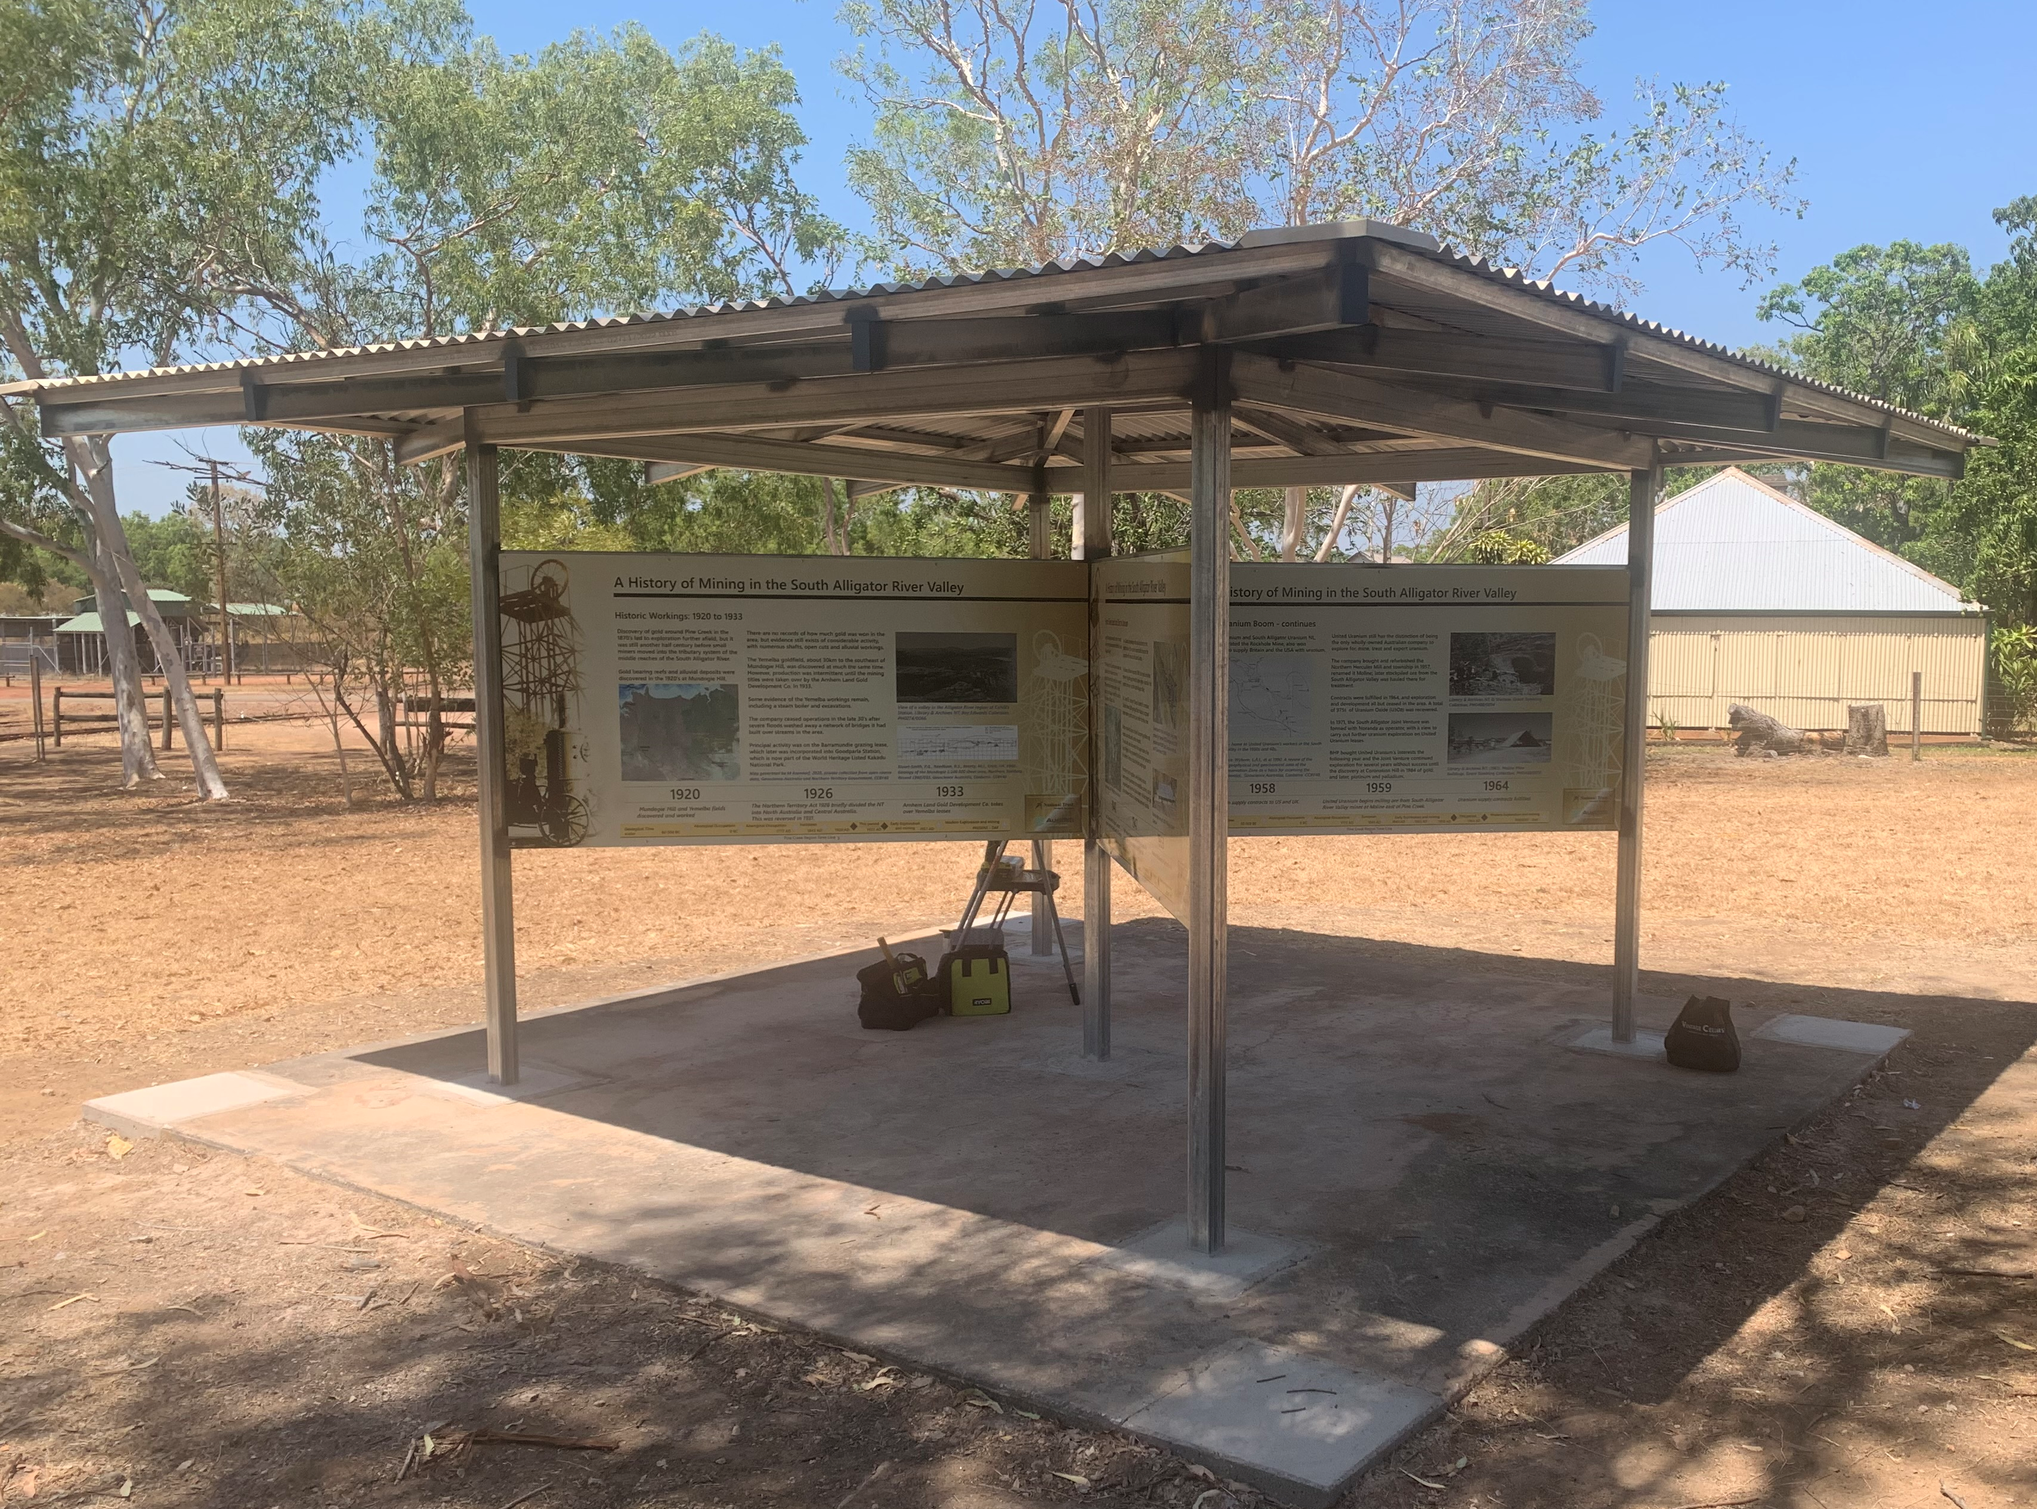
On going activity
Consultation
  Ensure that “customers” are still content
Monitoring
  Ensure that the system is still working
Maintain sustainability for traditional owners and tourists
  Area continues to receive a high volume of visitors and no issues
Improve tourism in the region – attractions and information
  Liaise with surrounding authorities and communities to link attractions
Information display at Pine Creek 90 km from Gunlom
Telling the SAV Uranium story

Slide 20
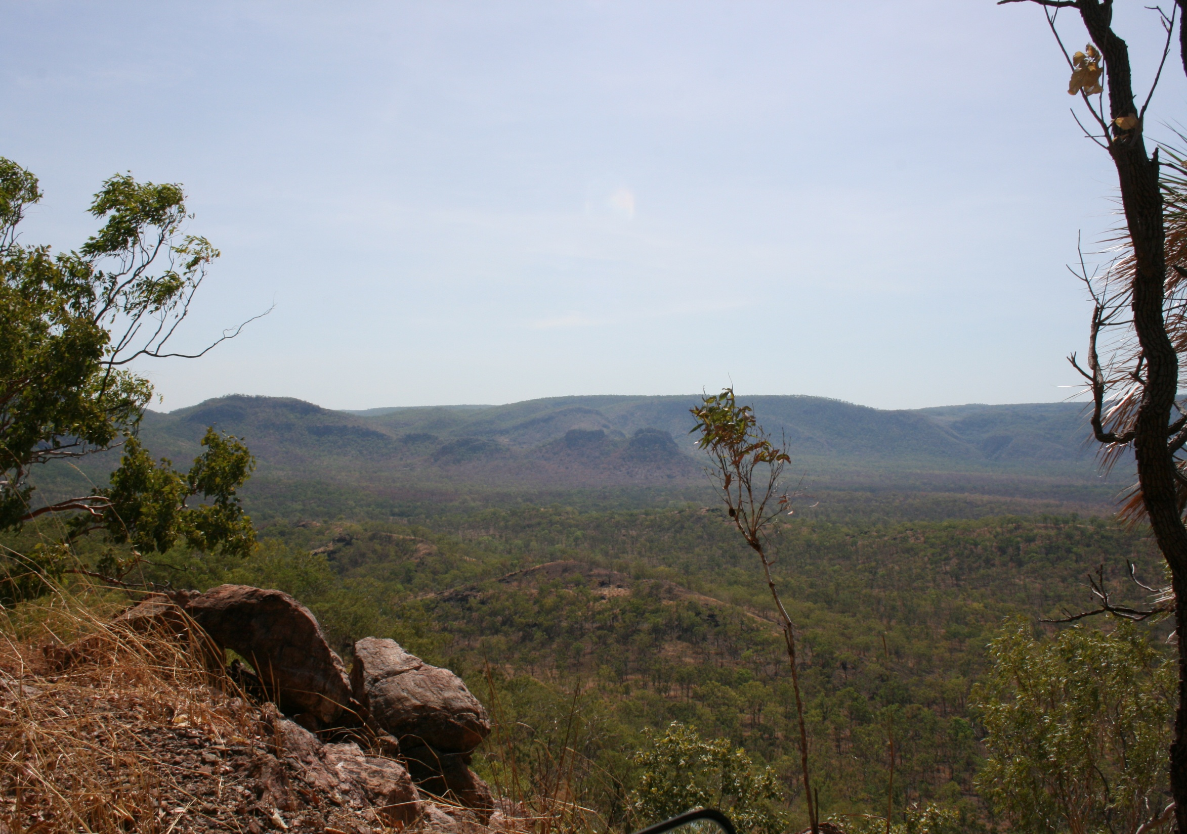
Thank You for your attention
Peter Waggitt: peterwaggitt@hotmail.com

