Slide 2
Integrating the Views of Interested Parties into Decision-Making
Challenges and Opportunities within the Field of Radioactive Waste Management

Slide 3
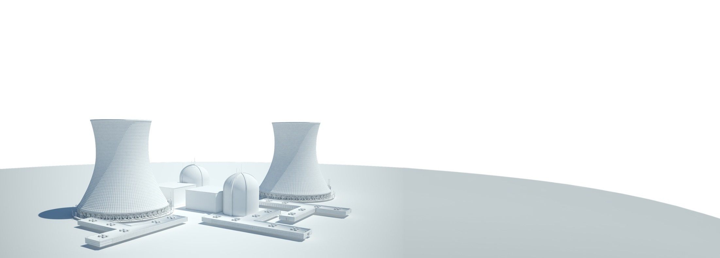
Agenda
Introduction
Context
Overview
Challenges & Opportunities
Case Study – Safety Stepchange
Conclusion & Recommendations

Slide 4
1 Introduction
Introduction
Context
Overview
Challenges & Opportunities
Case Study – Safety Stepchange
Conclusion & Recommendations

Slide 5

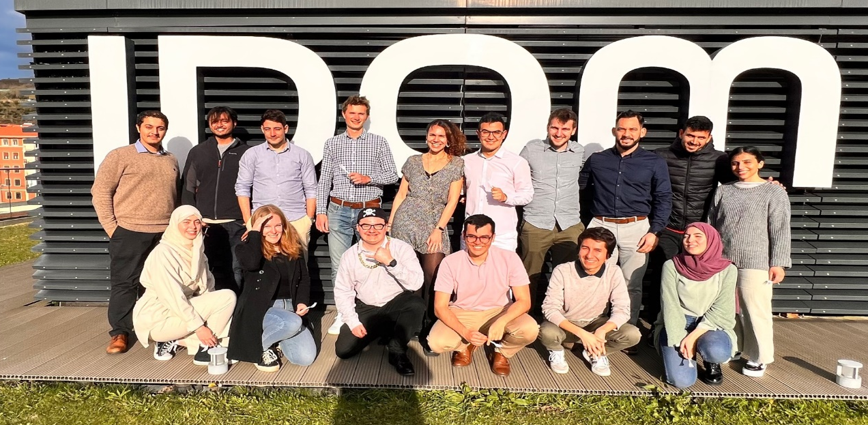
1. Introduction
Presenter
Name: Jonathan James Oliver
Nationality: British
Residence: The Basque Country in Spain
Role: Nuclear Back-End Engineer / Assistant Project Manager
Company: IDOM Nuclear Services

Slide 6
2 Context
Introduction
Context
Overview
Challenges & Opportunities
Case Study – Safety Stepchange
Conclusion & Recommendations

Slide 7
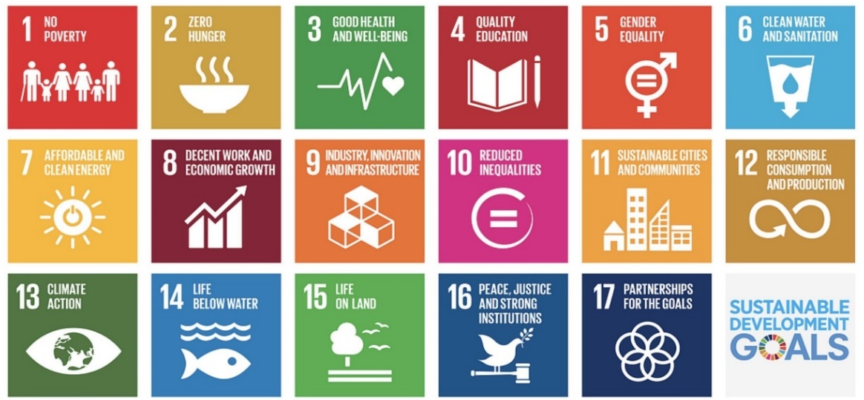
2. Context
United Nations Sustainable Development Goals (UN SDGs) [3]

Slide 8
3 Overview
Introduction
Context
Overview
Challenges & Opportunities
Case Study – Safety Stepchange
Conclusion & Recommendations

Slide 9
3. Overview
The paper covers overarching concepts and principles relevant to safety and sustainability while also bearing cognizance of the UN SDGs through a high-level analysis that covered:
  interdependencies with various assessment categories,
  the identification of challenges and opportunities,
  the elaboration of important factors relevant to the overarching concepts.
Parallel aim to inspire rigorous deliberation and further collaboration in order to aid the optimization of anticipated future developments.

Slide 10
3. Overview
The paper explored, while not exhaustive, which areas of radioactive waste management (RWM):
  could benefit from greater engagement of interested parties,
  may benefit from greater engagement of interested parties,
  would not clearly benefit from greater engagement of interested parties.
The areas of RWM that could benefit from greater engagement of interested parties include:
  waste disposal,
  waste minimization,
  the involvement of interested parties in regulatory decision-making.

Slide 11
4 Challenges
& Opportunities
Introduction
Context
Overview
Challenges & Opportunities
Case Study – Safety Stepchange
Conclusion & Recommendations

Slide 12
4. Challenges
Two challenges facing waste disposal include:
  opposition to / sceptism of disposal solutions,
  misunderstanding of disposal solutions.
Chllanges facing waste minimization include:
  practical implementation,
  opposition to practical solutions.
There are nuanced challenges to involving interested parties in regulatory decision-making with a focus on safety and sustainability.
Wider society, namely public citizens and industry outsiders, have a lack of knowledge about radioactive waste management in general.

Slide 13
4. Opportunities
Waste Disposal
Further and enhanced engagement with interested parties would not only increase trust and transparency but would potentially increase support for waste disposal initiatives.
Greater communication in relation to the following subject areas could be beneficial:
  the fact that not all radioactive waste is dangerous,
  how radioactive waste is regulated,
  that waste disposal facilities can be permanently safe,
  where the responsibility for the safe management of radioactive waste lies.

Slide 14
4. Opportunities
Waste Minimization
Waste from nuclear applications may have properties that make it suitable for further use. This applies, for example, to:
  used radiation sources that can be reused after reprocessing,
  low-level materials that can be used as an additive for concrete to stabilize higher-level waste.
In order to enable or simplify further use, it may be useful to investigate the concept further and consider the potential of designating corresponding materials as radioactive material and not as radioactive waste [1].
Greater engagement between interested parties would help to optimise the approach to waste minimization and could identify target areas for future development.

Slide 15
4. Opportunities
Involvement of interested parties in regulatory decision-making
Greater engagement could help to develop mechanisms to involve interested parties in regulatory decision-making.
Such as:
  exploring the concept of how safe RWM features in national policies, including communicating how radioactive waste is regulated to interested parties,
  how to balance safety and other aspects of sustainability in decision-making,
  considering the processes used in taking account of economic, social and environmental factors when implementing RWM.

Slide 16
5 Case Study
Introduction
Context
Overview
Challenges & Opportunities
Case Study – Safety Stepchange
Conclusion & Recommendations

Slide 17
5. Case Study – Safety Stepchange
ALCOA – The Narrative [9] [10]
An investor´s meeting was held in 1987 with ALCOA´s new CEO, Paul Henry O'Neill.
To everyone´s surprise, instead of talking about profits, Mr O´Neill focused on worker safety.
Mr O´Neill focused on safety because, while ALCOA´s safety record was better than average at the time, every year their workers were injured so badly they would miss days of work.
He wanted to ensure the well-being of workers to further the company´s emphasis on inherent safety.
Investors reacted by advising their clients to sell their stocks.
However, ALCOA´s profits and share price experienced a marked increase during Mr O´Neill´s tenure.

Slide 18
5. Case Study – Safety Stepchange
ALCOA – Lessons Learned
Focusing on keystone habits (procedures) can lead to improved organisational processes.
Decision-making can be based on ingrained routines/habits/processes rather than deliberate decisions.
Focusing on a key-habit or procedure could lead to an exponential increase in efficiency, and expose other parameters that require optimisation.
It is easy to overlook how focusing on an idea such as safety can form part of a global improvement strategy.
Clear synergies between the approach taken and how to integrate the views of interested parties into decision-making.

Slide 19
6 Conclusion & Recommendations
Introduction
Context
Overview
Challenges & Opportunities
Case Study – Safety Stepchange
Conclusion & Recommendations

Slide 20
6. Conclusion & Recommendations
Clear opportunities and benefits that could be gained through greater engagement of interested parties in relation to:
  waste disposal,
  waste minimization,
  the involvement of interested parties in regulatory decision-making.

Slide 21
6. Conclusion & Recommendations
Might be possible to define higher-level safety and sustainability requirements which would support a uniformed international approach.
Focused approaches could be facilitated by:
  linking the requirements to the challenges and opportunities identified,
  which could divulge information based on the overarching parameters. . .
  in a way that is appropriate for the interested parties.

Slide 22
6. Conclusion & Recommendations
Professional collaboration to structure requirements is needed in order to be comprehended by interested parties.
If a harmonised collaborative approach is to be pursued, it will be important to first:
  establish a more robust understanding of the challenges and opportunities identified,
  identify any other challenges and opportunities,
  advance future developments appropriately utilising a system thinking approach.

Slide 23
6. Conclusion & Recommendations
Gaining further understanding should not be limited to specific stakeholders, such as regulators, waste producers, and waste management organisations and other government departments, but should also consider the views of wider society.

Slide 24
References
[1] IDOM Consulting, Engineering, Architecture SAU, BGE Technology GmbH., Study on radioactive waste classification schemes in the European Union, Publication Office of the European Union, Luxembourg, 2023.
[2] World Commission on Environment and Development., Our Common Future (The Brundtland Report), Oxford University Press, 1987.
[3] United Nations., The 17 Goals, https://sdgs.un.org/goals
[4] Castro, C., Trevisan, A., Pigosso, A., Mascarenhas, J., The rebound effect of circular economy: Definitions, mechanisms and a research agenda, Journal of Cleaner Production 345 (2022) 3-4.
[5] The Guardian., UK radioactive waste disposal site search continues despite opposition, https://www.theguardian.com/environment/2015/aug/17/
[6] BBC., UK looks to Sweden for a solution to nuclear waste, https://www.bbc.com/news/business-62677534
[7] OECD-NEA., Management and Disposal of High-Level Radioactive Waste: Global Progress and Solutions, Secretary-General of the OECD, 2020
[8] World Nuclear Association., Radioactive Waste Management, https://world-nuclear.org/information-library/nuclear-fuel-cycle/nuclear-wastes/radioactive-waste-management.aspx
[9] C.Duhigg., The Power of Habit., why we do what we do and how to change, Random House, 2012
[10] Forbes., Have we learned the ALCOA keystone habit lesson? https://www.forbes.com/sites/roddwagner/2019/01/22/have-we-learned-the-alcoa-keystone-habit-lesson/

Slide 25
Thank you / Muchas gracias

