Slide 1

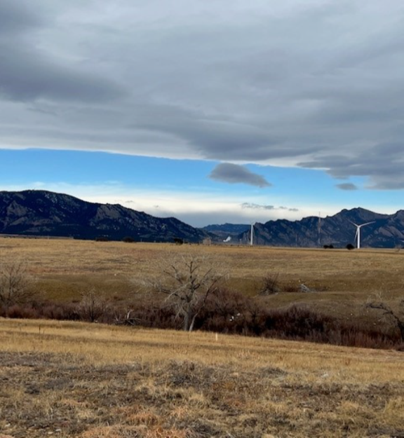
COMMITMENT TO LONG-TERM STEWARDSHIP: AN OVERVIEW OF SAFE AND SUSTAINABLE MANAGEMENT AND REUSE OF LEGACY SITES
Bud Sokolovich, Supervisor, Asset Management Team LM-13
U.S. Department of Energy Office of Legacy Management

Slide 2
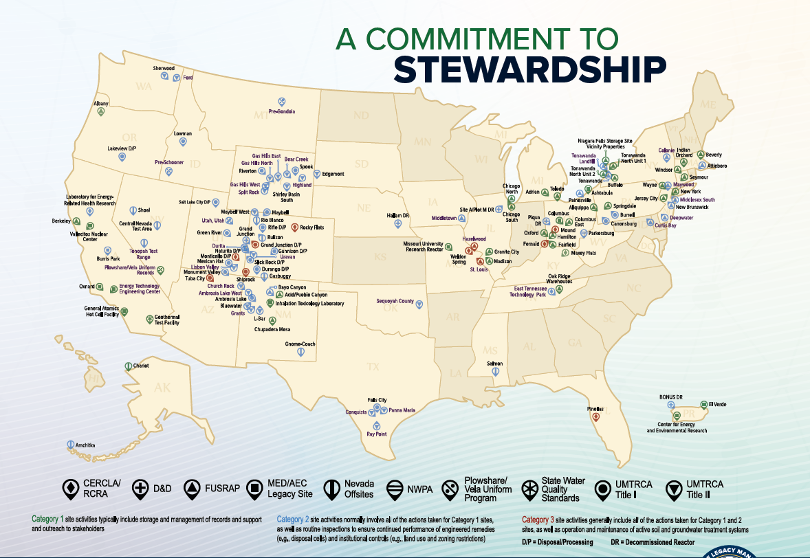
Growing Number of Sites
U.S. Department of Energy’s Office of Legacy Management will be the steward of nearly 130 Sites by 2030.

Slide 3
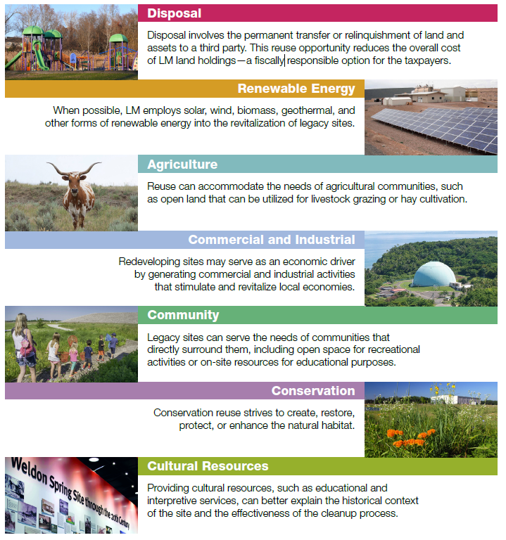
Beneficial Reuse

Slide 4
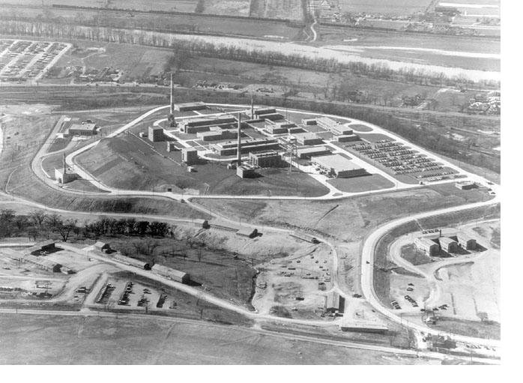
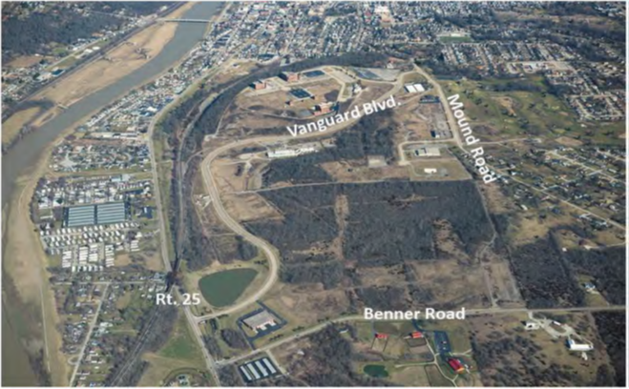
Mound OH Site
1986 — Start of cleanup

Slide 5
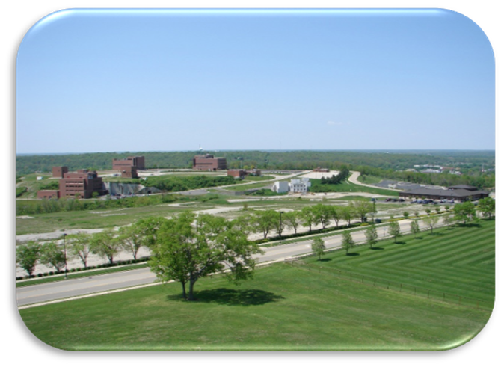
Mound OH Site
1986 — Start of cleanup

Slide 6
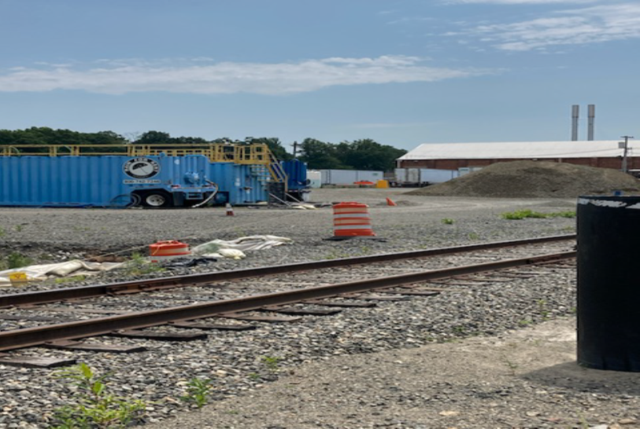
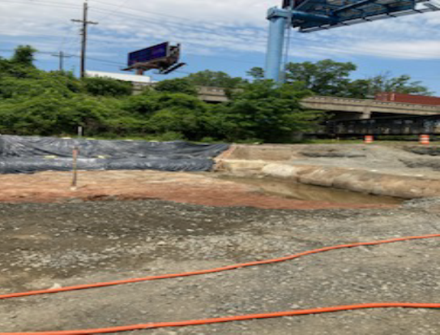
Stewardship and Disposition of Federal Property
FUSRAP, Maywood, New Jersey, Site (Estimated FY2029)

Slide 7
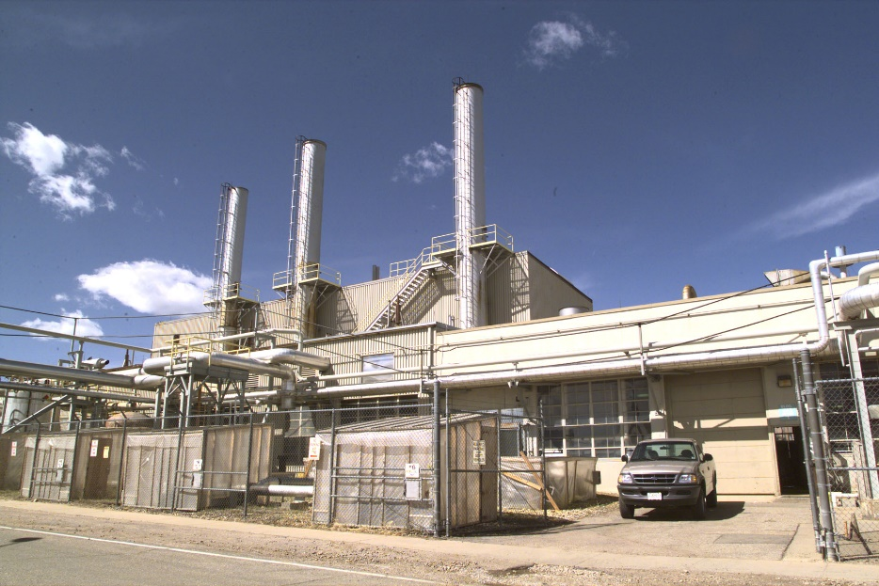
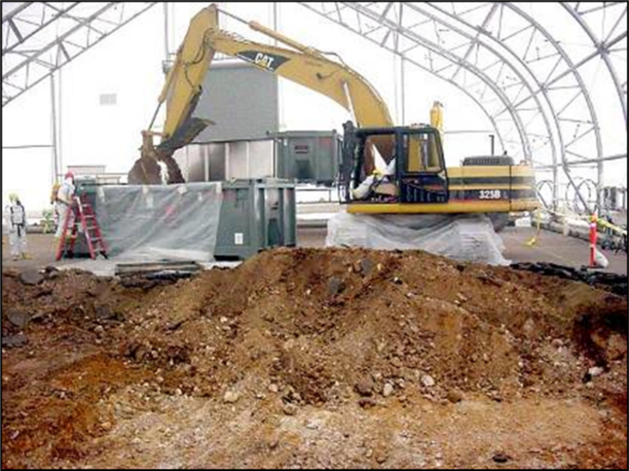
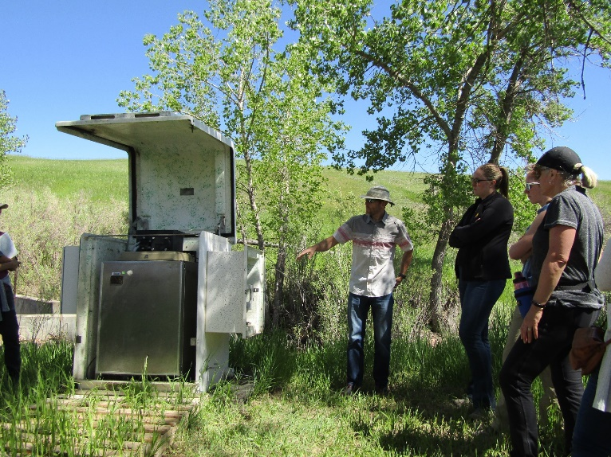
Preserving the Past
Developing the Future – Fernald Ohio Site

Slide 8
Liability Considerations
    Portfolio of assets is aging
    Underlying expectations and assumptions change
      Remedies
      Communities
      Weather
      Workforce
      Regulatory standards
      Emerging contaminants
      Laws, regulations, policies and guidance

Slide 9
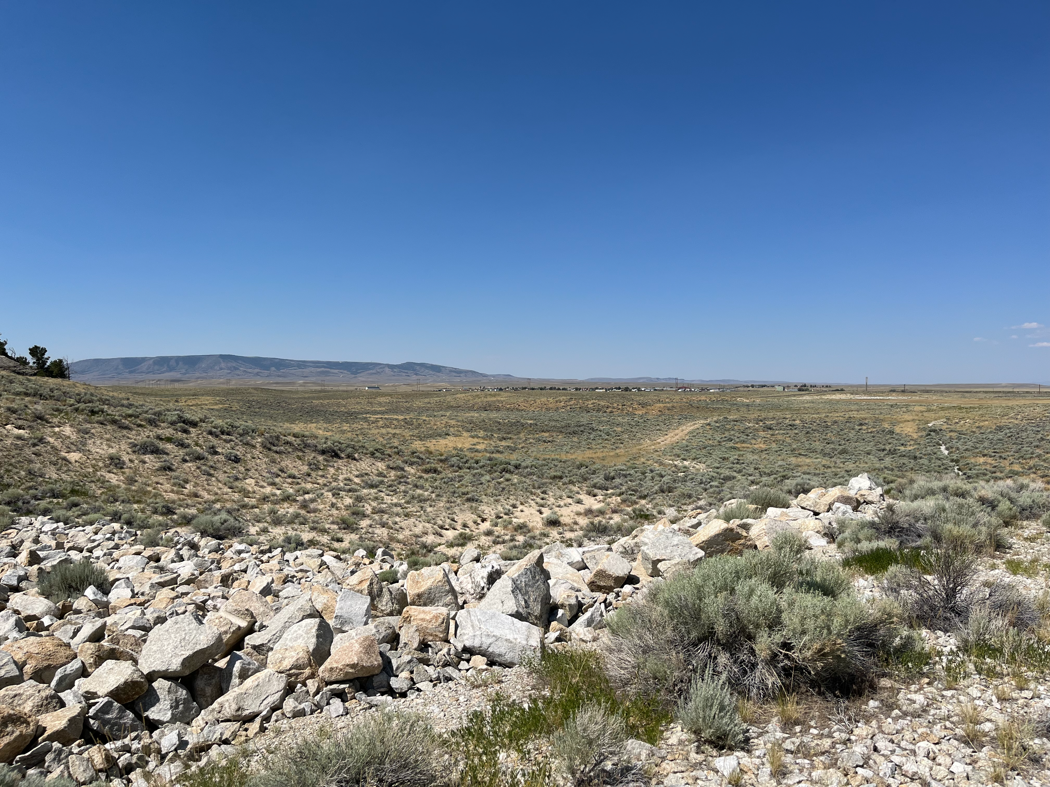
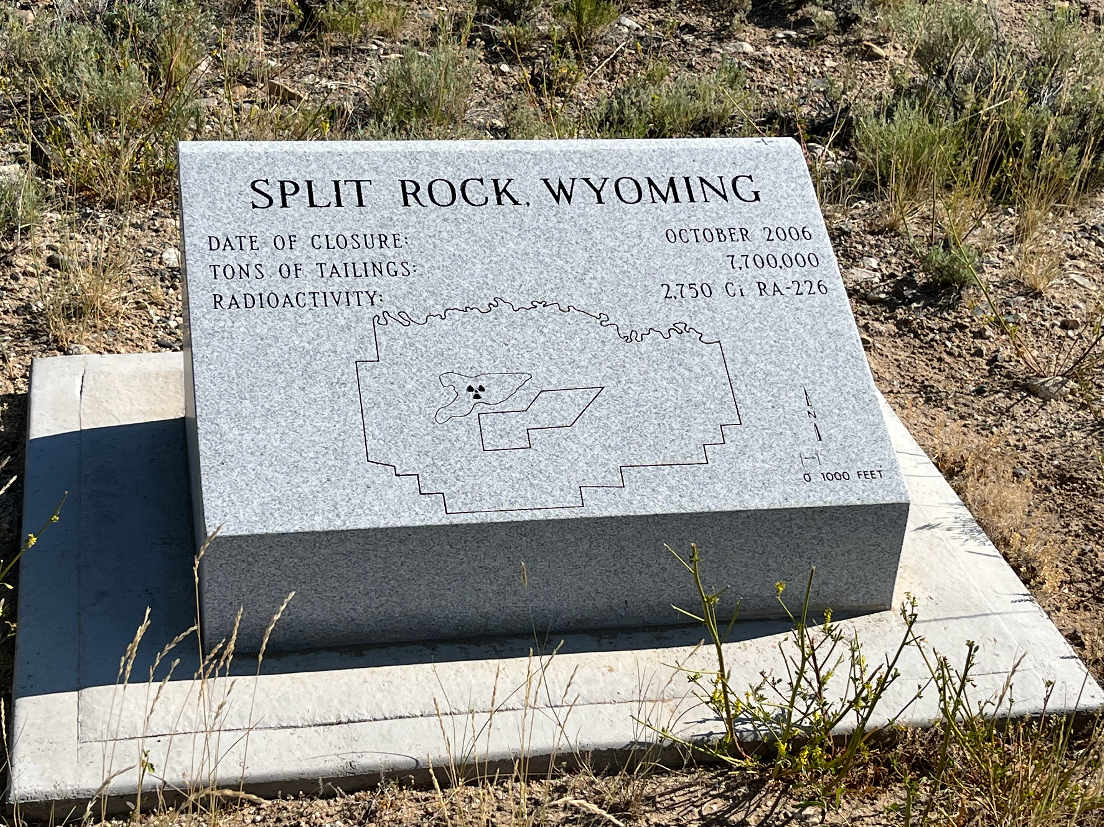
Split Rock WY Site
1986 — Start of cleanup
Uranium Mill Tailings Radiation Control Act (UMTRCA) Title II
Split Rock, WY Long Term Surveillance Boundary with Ownership

Slide 10
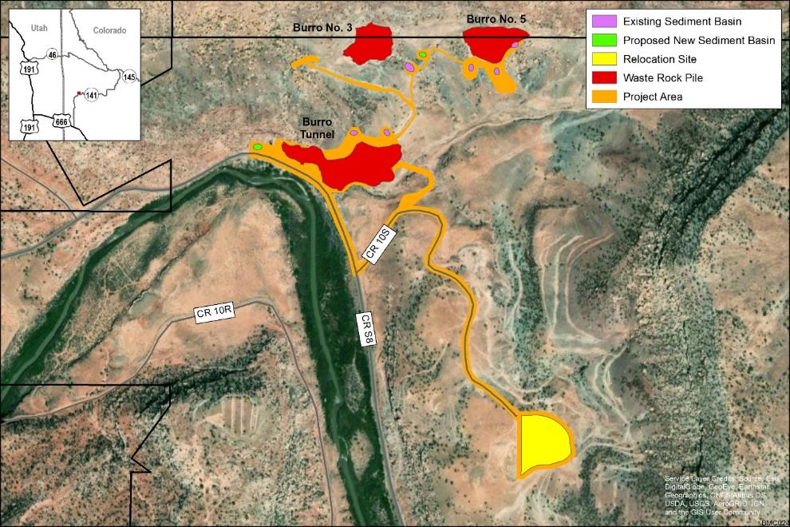
Uranium Lease Program – Burro Mines Reclamation

Slide 11
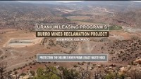
Video

Slide 12

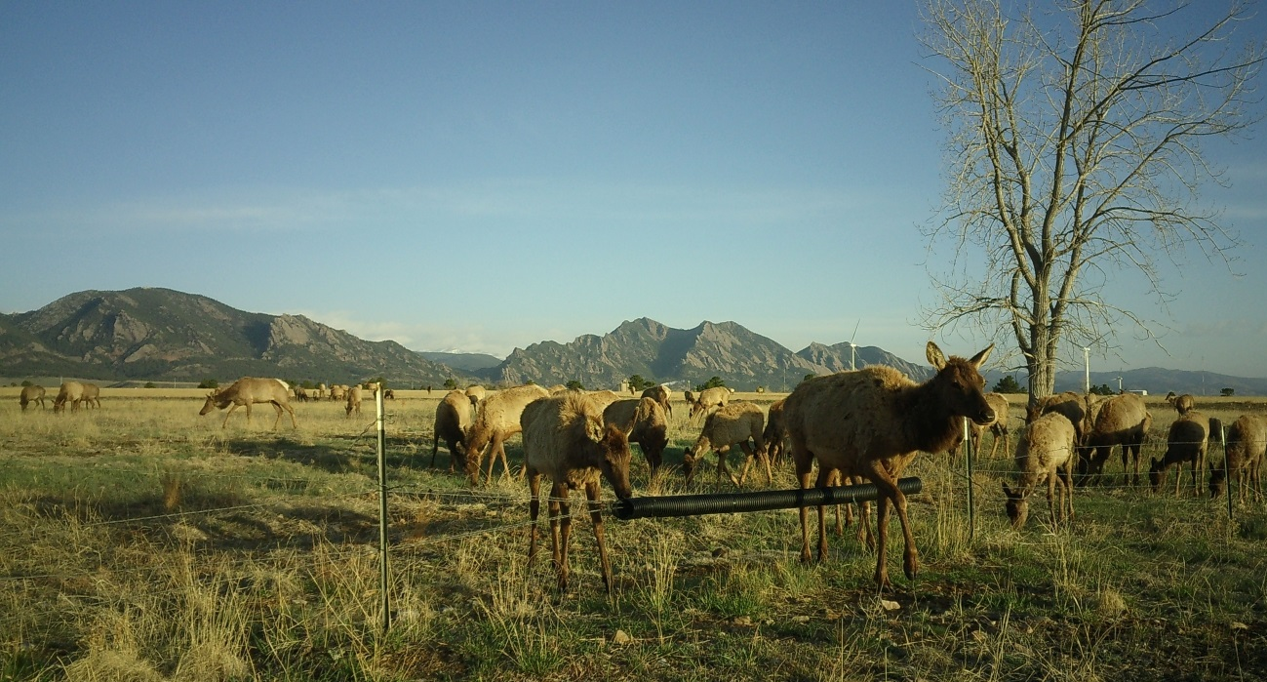
Questions
Tania Smith Taylor, Technical Director
Bud Sokolovich, Supervisor, Asset Management Team LM-13
bud.Sokolovich@lm.doe.gov
United States Department of Energy Office of Legacy Management

