Slide 1
FRENCH LOW-LEVEL LONG-LIVED REPOSITORY PROJECT: ENSURING SUSTAINABILITY FROM THE EARLY STAGES
Sonia GUILLOT, Head of Environment Department
Andra
French Radioactive Waste Management Agency
sonia.guillot@andra.fr

Slide 2
Context
A required project :
By authorities
To meet the radioactive waste disposal needs
The process to choose the site of investigation
1 - National territory screening : safety and environmental criterias.
Ex : argillaceous depth and thickness, environmental protected aeras
2 - Identification of sites
3 - Call for applications : volunteer community to host detailed studies
Further studies are on-going with this community
Notes:
First: present the project and the first steps in environment, but more on the safety angle
A project required to meet radioactive waste disposal needs. No disposal for Long-Lived Low Level waste. And required by the authorities
-A review on the national territory crossing safety and environmental criterias, such as argillaceous depth and wide, early exclusion of environmental protected aeras : SOME EXAMPLES OF ENVT FACTORS
This study led to the identification of dozens of interesting sites
After a call for applications, a community volunteered in the East of France, closed to our Aube’s disposal facilities

Slide 3
Building a sustainable project
Why ?
Major global environmental challenges
Growing public concern and authorities' requirements about environmental impacts
How ?
A collaborative work between facility’s design, safety and environmental teams at an early stage
Notes:
Datas are needed to be able to conduce environmental studies as we will see for the landscape’s study
A collaborative work between facility’s design, safety and environmental teams:
To compare construction’s techniques
To define the implementation
A sample of what we have done: 2 factors: biodiversity and landscape

Slide 4
Avoid / Reduce / Compensate Strategy
French Environmental Code :
Avoid significant adverse effects on the environment or human health
Reduce those effects that cannot be avoided
Compensate, where possible, for significant adverse effects on the environment or human health that could not be avoided or sufficiently reduced. If it is not possible to compensate for these effects, the developer must justify this impossibility.
Notes:
Avoidance: an avoidance measure modifies a project to remove a negative or indirect impact that the project would cause.
Reduce: a reduction measure aims to reduce as far as possible the duration, intensity and/or extent of impacts of a project that could not be avoided.
Compensate: the purpose of a compensation measure is to provide at least an equivalent counterpart to the significant direct or indirect negative effects of the project that could not be avoided or reduced

Slide 5
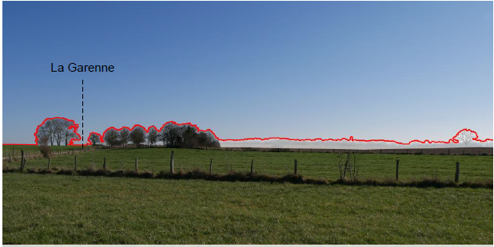
Focus : Landscape (1/2)
A joint work with the design team to define several heights, extents and locations for the disposal
An adapted methodology which crosses :
Landscapes features
Human perception and sensitivity

Slide 6
Focus : Landscape (2/2)

Slide 7
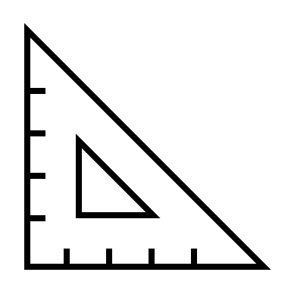
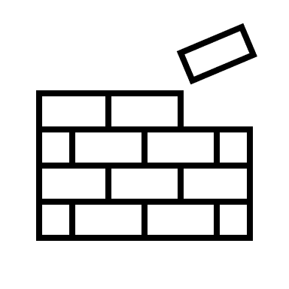
Focus : Biodiversity (1/2)
An adapted methodology to the extent of the aera :
Focus on habitats instead of species
Identification of local ecological stake levels
Relative comparison between ecological levels
This work is necessary for both implementing and making choices about construction techniques.
Notes:
Talk about the impact assessment on wild fauna and flora related to the chemical and radioactive releases

Slide 8
Focus : Biodiversity (2/2)
Notes:
Here, the stakes are at the level of the woodlands; the ponds and surroundings, in particular the ZNIEFF 1 around the pond of Verdat; along the major bed of the watercourse.
In red, a Natura 2000 site.
By the way, you can see on the right below side, the Aube disposal facility. It enables us to have an idea of the extent of a future LLLL waste disposal
The landscape and biodiversity stakes lead to 2 opposite recommendations

Slide 9
Specificities of environmental approach
Avoid, reduce, compensate strategy
Avoidance can be maximized if taken at an early stage
Iterative approach along the life of the project
Global project : geographically and over time
Factors to be considered :
Specific to the environmental approach. Ex : landscape
For safety and environment but with two different points of view. Ex : biodiversity
Traceability of the demonstration to stakeholders
Notes:
Iterative approcach:
Environmental studies start before design studies because environmental issues are necessary information for design studies: basis for avoidance
The environmental studies and the drafting of the impact study are carried out in parallel with the design studies in order to :
Analyze the environmental impact of the design solutions considered and participate in the development of the chosen solution = optimized eco-designed project
Report on the application of the ARC approach in the impact study
Environmental studies continue after the design studies for :
Analyze the residual environmental impact of the selected alternative
Develop additional reduction, compensation and support measures
Plan follow-up actions

Slide 10
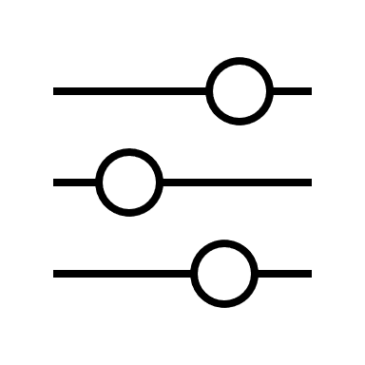
And then ?
Next step :
Production of a report summarizing all the environnmental and safety studies shared with waste producers, local population and institutions; instructed by the French Nuclear Safety Authority
Continue the process :
Involvement of stakeholders
A multi-criteria and multi-stakeholders analysis
Notes:
The acquired knowledge is going to be used as entry data to realise a multicriteria (e.g., social, environmental, economic, technical, etc.) and multi-stakeholder analysis mainly by holding public consultations.

Slide 11
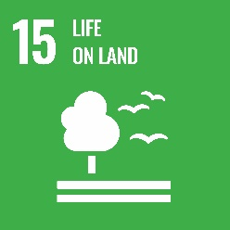
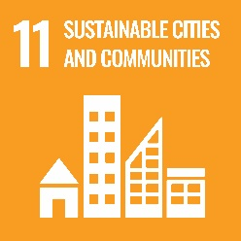
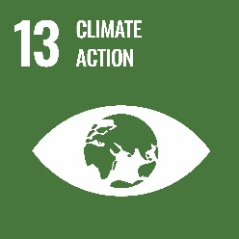
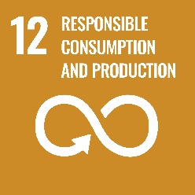
Sustainable Development Goals
Participate in the territorial economic
development
Ensuring human,
flora and fauna protection
Developing sustainable infrastructures
Reduction of the project’s right-of-way
Avoid natural aeras
Participate in a local sustainable project
Through an environmental management plan
Reduce climate impact
Notes:
We check how this project contributes to sustainable development goals

Slide 12
THANK YOU
Mrs Sonia GUILLOT
Head of Environment Department
Andra - French Radioactive Waste Management Agency
sonia.guillot@andra.fr

