Slide 1
Progress in Off-site Environmental Remediation in Japan
MORI Yoshitomo, Ph.D.
Ministry of the Environment, Japan
International Conference on the Safety of Radioactive Waste Management, Decommissioning, Environmental Protection and Remediation: Ensuring Safety and Enabling Sustainability
November 2023

Slide 2
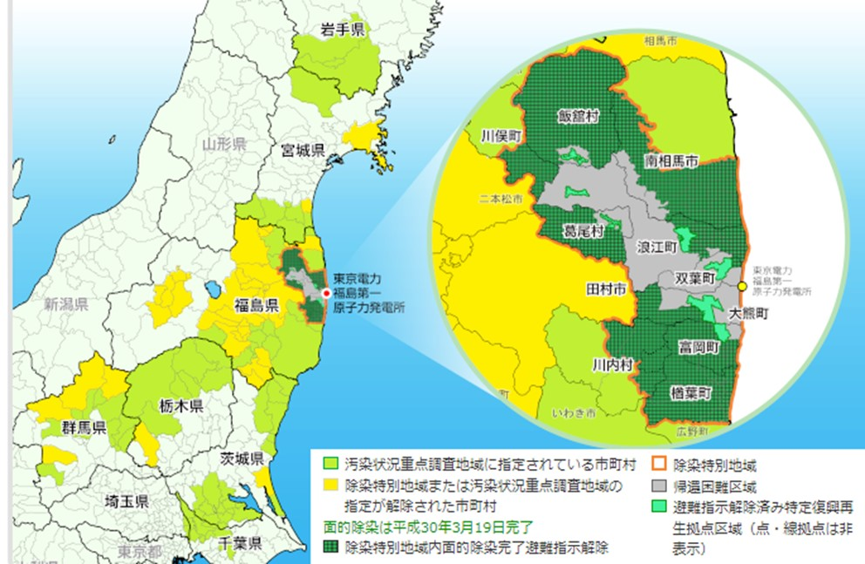
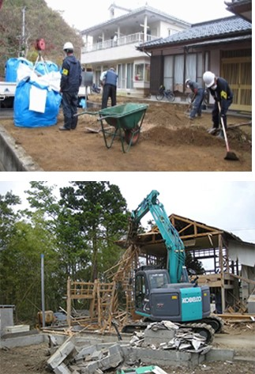
Progress of Decontamination
Full-scale decontamination was completed in 100 municipalities of 8 prefectures both in the Special Decontamination Areas (SDA), and the Intensive Contamination Survey Areas (ICSA), by March 19, 2018, except for the Restricted Areas. In the Restricted Areas, decontamination still continues (e.g. in the Specified Reconstruction and Revitalization Base Areas).
Intensive Contamination Survey Areas
(decontamination implemented by municipalities)
Completed in March 2018
Special Decontamination Areas
(decontamination implemented by the national gov.)
Completed in March 2017
Decontamination of Residents
Demolition of houses, etc.
Municipalities designated as Intensive Contamination Survey Areas
Municipalities where designation of Special Decontamination Areas or Intensive Contamination Survey Areas has been lifted
Full-scale decontamination completed in Special Decontamination Areas
Special Decontamination Areas
Restricted Areas
Specified Reconstruction and Revitalization Base Areas

Slide 3
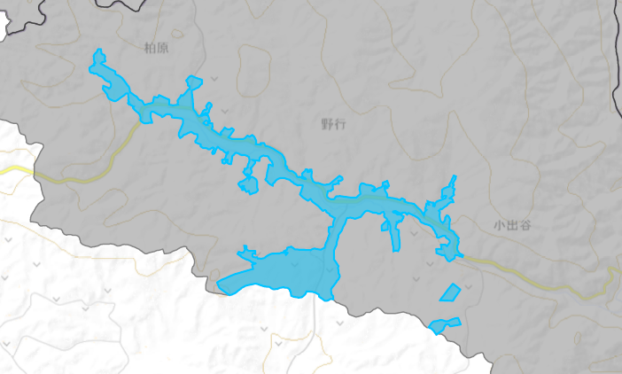
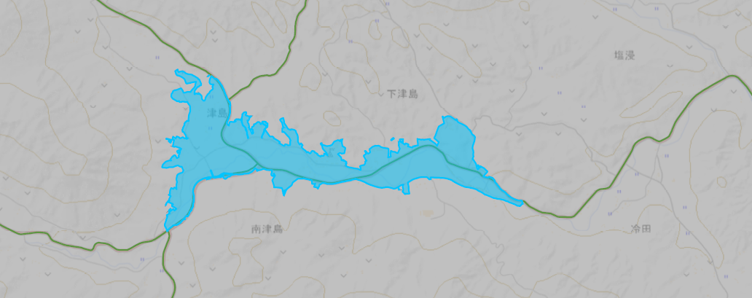
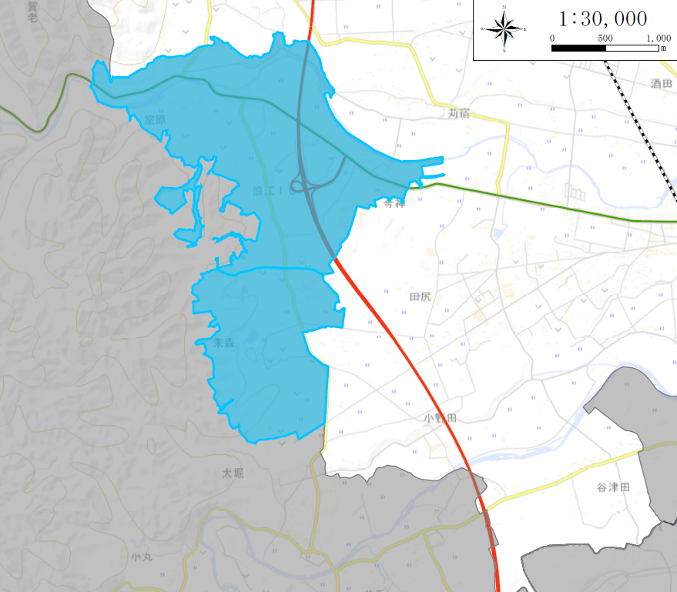
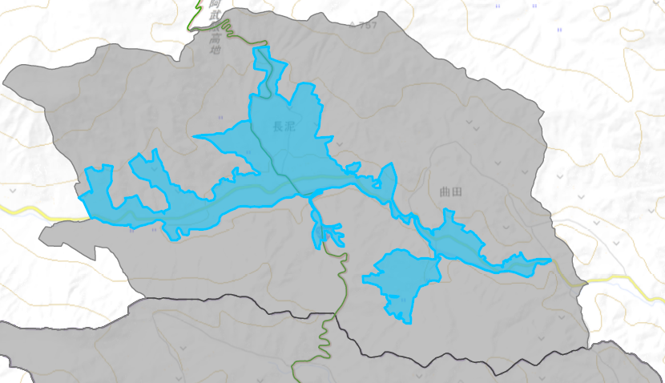

Efforts in the Restricted Areas
(Decontamination, demolition of houses and other buildings in Specified Reconstruction and Revitalization Base Areas)
For the Restricted Areas, mayors of municipalities prepared plans for the areas of the Specified Reconstruction and Revitalization Base Areas (SRRBA) and environmental improvement (e.g. decontamination, infrastructure development) within the areas in accordance with the Act on Special Measures for the Reconstruction and Revitalization of Fukushima.
Based on the plan, decontamination and demolition of houses, etc. have been implemented in the SRRBA, and all evacuation orders in the SRRBA were lifted by May 2023 (Katsurao Village: June 12, 2022, Okuma Town: June 30, 2022, Futaba Town: August 30, 2022, Namie Town: March 31, 2023, Tomioka Town: April 1, 2023, Iitate Village: May 1, 2023), except for some part of roads.
Futaba Town
(approved on Sep. 15, 2017, approx. 560 ha)
Okuma Town
(approved on Nov. 10, 2017, approx. 860 ha)
Katsurao Village
(approved on May 11, 2018, approx. 95 ha)
特定復興再生拠点区域
SRRBA
Restricted Area
SRRBA
特定復興再生拠点区域
帰還困難区域
Restricted Area
帰還困難区域
Interim Storage Facility
FDNPS
Noyuki District
Interim Storage Facility
野行地区
FD
NPS
帰還困難区域
SRRBA
Restricted Area
特定復興再生拠点区域
Evacuation order was lifted on August 30, 2022
Evacuation order was lifted on June 30, 2022
Evacuation order was lifted on Jun 12, 2022
Namie Town
(approved on Dec. 22, 2017, approx. 660 ha)
Tomioka Town
(approved on Mar. 9, 2018, approx. 390 ha)
Iitate Village
(approved on Apr. 20, 2018, approx. 190 ha)
津島地区
室原地区
Tsushima District
Murohara District
長泥地区
特定復興再生拠点区域
Nagadoro District
SRRBA
Suenomori District
末森地区
特定復興再生拠点区域
Restricted Area
SRRBA
帰還困難区域
帰還困難区域
SRRBA
Restricted Area
特定復興再生拠点区域
帰還困難区域
Restricted Area
Evacuation order was lifted on March 31, 2023
Evacuation order was lifted on April 1, 2023
Evacuation order was lifted on May 1, 2023

Slide 4
Treatment of Removed Soil and Waste (within Fukushima Prefecture)
Decontamination
Specified Waste
Waste in the Countermeasure Area
Designated Waste
Removed Soil
Removed Waste
Temporary Storage Sites
Treatment plants
Temporary Storage Sites
Treatment plants
More than
100,000 Bq/kg
100,000 Bq/kg
or less
Interim Storage Facility
Landfill Facility for Specified Waste
For final disposal outside Fukushima Prefecture
Note: Waste other than the Specified Waste will be treated in accordance with Waste Management Law. For particular, categories of waste, approaches in the Act on Special Measures is applied.
For recycling
For recycling

Slide 5
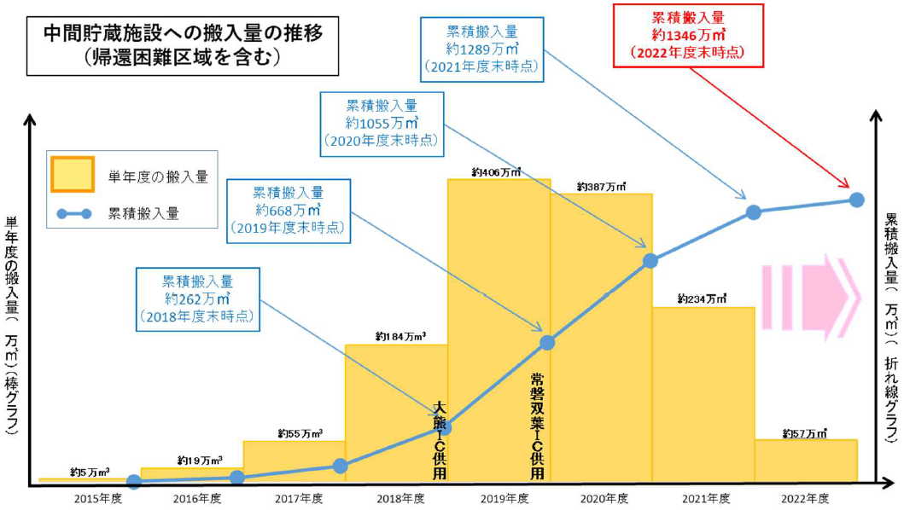

Transportation to the Interim Storage Facility
Transportation of removed soil and waste to the Interim Storage Facility (ISF) has been implemented from FY2015, and almost all of the removed soil and waste have been transported to the ISF, by March 2022, other than the Restricted Areas.
Approximately 13.46 million m³ of removed soil and waste (including those in the Restricted area) have been transported to the ISF (as of the end of Mar. 2023).
Change over time for the volume of removed soil and waste transported to the ISF
Approx. 13,460,000m³
(as of Mar. 31, 2023)
Approx. 12,890,000m³
Approx. 10,550,000m³
Approx. 4,060,000m³
Approx. 3,870,000m³
Approx. 6,680,000m³
Approx.
2,340,000m³
Cumulative transportation volume
(cubic meters) (line graph)
Volume transported in a single year
(cubic meters) (bar graph)
Approx. 2,620,000m³
Approx. 1,840,000m³
Joban Futaba IC in service
Approx.
570,000m³
Approx. 550,000m³
Okuma IC in service
Approx. 50,000m³
Approx. 190,000m³
FY2015
FY2016
FY2017
FY2018
FY2019
FY2020
FY2021
FY2022

Slide 6
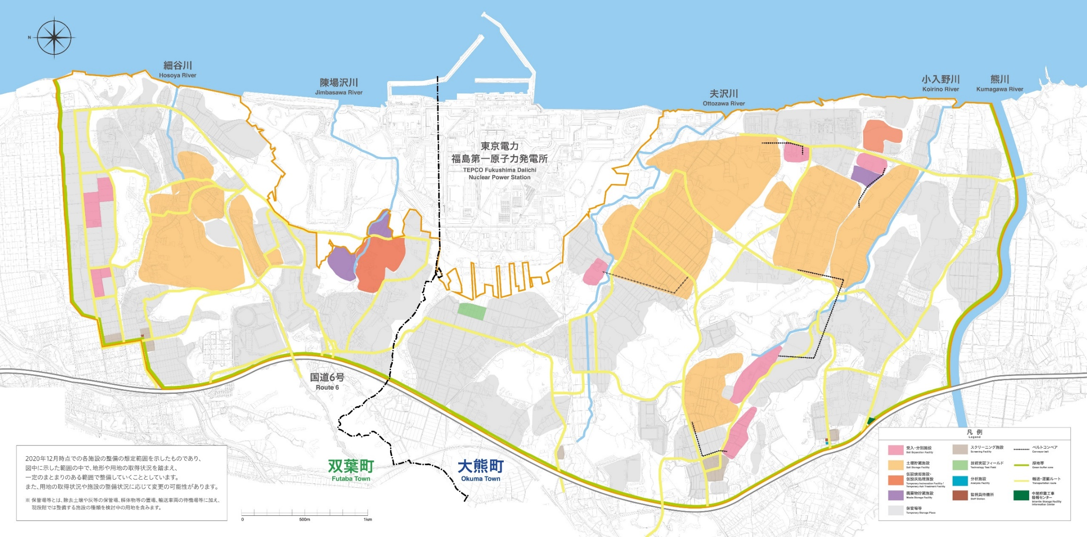
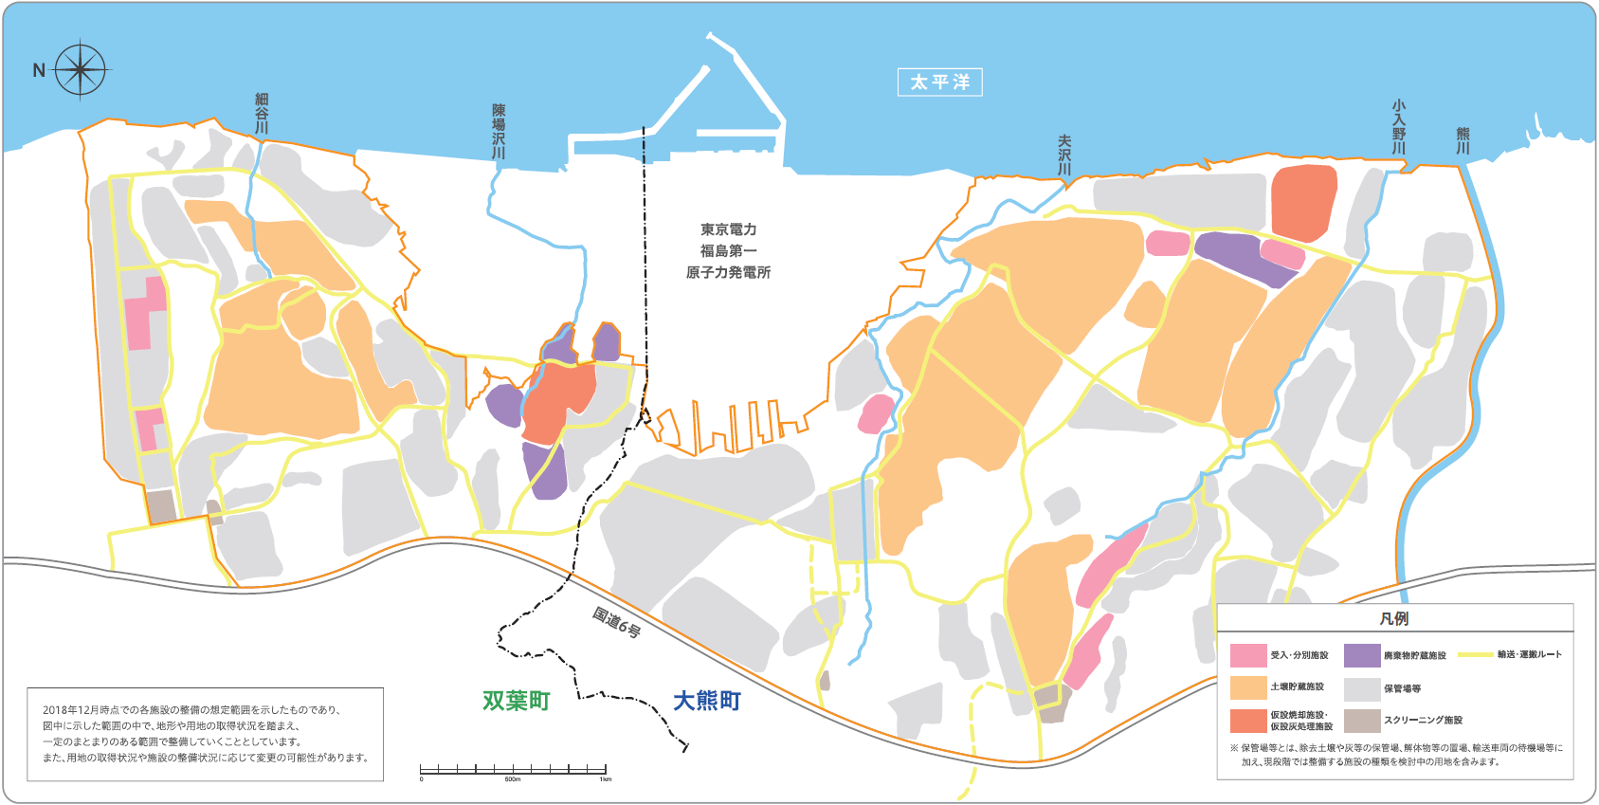
Overview of the Interim Storage Facility
The Interim Storage Facility (ISF) was built to manage and store removed soil and waste arising from decontamination activities in Fukushima Prefecture and incinerated ash (>100,000 Bq/kg), safely and in an integrated manner, until final disposal outside Fukushima Prefecture, which is stipulated in the Japanese law, to be completed within 30 years (by March 2045) from the start of transportation to the ISF.
The ISF occupies around 1,600 ha (almost same area with Shibuya City in Tokyo). Okuma Town and Futaba Town accepted the ISF, by making very difficult decisions. The MOE will continue to work on the ISF project by placing first priority on its safety.
Waste Storage Facility
(Okuma construction area 1)
Soil Storage Facility
(Futaba construction
area 3)
Soil Storage Facility
(Okuma 5 construction area)
Soil Storage Facility, etc.
(Futaba construction area 1)
Soil Storage Facility
(Okuma construction area 4)
Waste Storage Facility
(Futaba construction area 2)
Okuma Temporary Incineration Facility
Waste Storage Facility
(Futaba construction area 1)
Soil Storage Facility
(Okuma construction area 3)
Soil Storage Facility
(Okuma construction
area 2)
Soil Storage Facility, etc.
(Futaba construction area 2)
Futaba Temporary Incineration Facility and Temporary Ash Treatment Facility
(No. 1) (No. 2)
Legend
Soil Storage Facility
(Okuma construction
area 1)
Soil Separation Facility
Waste Storage facility
Soil Storage Facility
Stock Yards
Temporary Incineration Facility and Temporary Ash Treatment Facility
Screening Facility
Transportation and Conveyance route
Conveyer belt

Slide 7

The Interim Storage Facility (1)
Source: Interim Storage Facility Information Center (https://www.jesconet.co.jp/interim_infocenter/index.html)

Slide 8
The Interim Storage Facility (2)
Source: Interim Storage Facility Information Center (https://www.jesconet.co.jp/interim_infocenter/index.html)

Slide 9
The Interim Storage Facility (3)
Source: Interim Storage Facility Information Center (https://www.jesconet.co.jp/interim_infocenter/index.html)

Slide 10
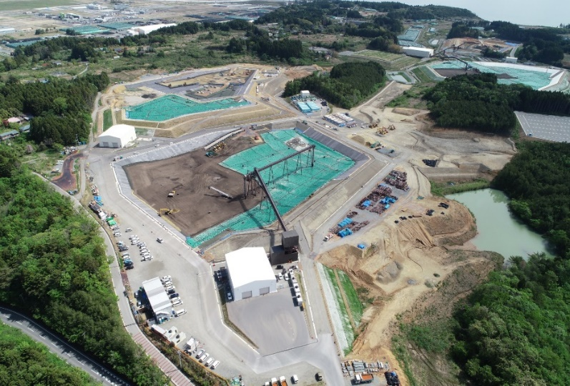
Necessity for Recycling of Removed Soil
Amount of removed soil and waste transported to the Interim Storage Facility:
Equivalents to volume of 11 Tokyo Domes (Baseball park)
Toward final disposal outside the Fukushima Prefecture:
Volume Reduction before the final disposal is a key measure
Distribution of radioactivity concentration in removed soil
Soil with relatively low
radioactivity concentration
8,000 Bq/kg or lower
Approx. 3/4
More than 8,000 Bq/kg
Approx. 1/4
Recycling
After the volume reduction
Recycling under management in public work projects, etc.
Complete final disposal outside Fukushima within 30 years from the start of transportation to the Interim Storage Facility
Covering soil
Recycled soil

Slide 11
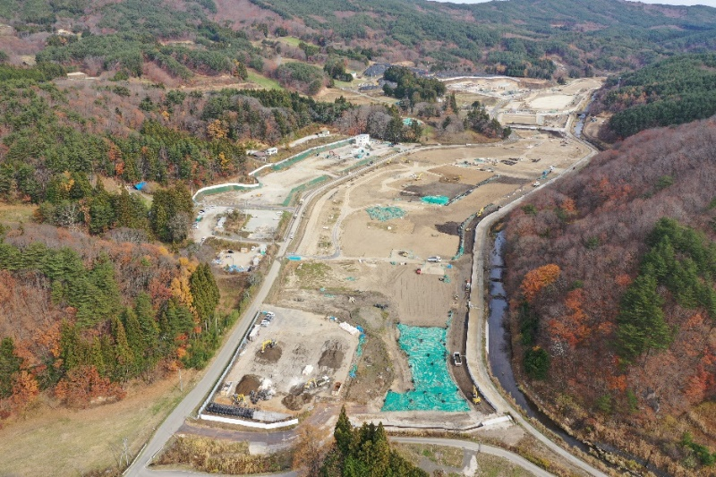
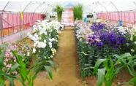
Demonstration Projects for Recycling in Fukushima Prefecture
(Overview)
The following demonstration projects using removed soil as a basis of farmlands has been implemented in Nagadoro District, Iitate Village.
(1) Agricultural land development: In April 2021, large-scale agricultural land development (approx. 22 ha) using removed soil (approx. 230,000 m³) started.
(2) Paddy field tests: Since FY2021, tests have been conducted on the functions required for paddy fields (e.g. permeability, soil strength) and it was confirmed that the results generally fell in within the range of acceptable values.
(3) Demonstrative flower cultivation with local residents
(Results)
The radioactivity in cultivated foods was well below the criterion of 100 Bq/kg (0.1 - 2.3 Bq/kg).
The monitoring results to date have shown no increase in air dose rates, etc. caused by the recycled materials and its safety was confirmed.
(1) Construction section No. 2
Demonstration area
(2) Rice paddies
(3) Flower cultivation
(2) Paddy fields
Recycled soil yard site
(Removed in FY2022)
(3) Flower cultivation
Prefectural
road 62
Hiso River
(1) Agricultural land
development area
As of November 2022

Slide 12
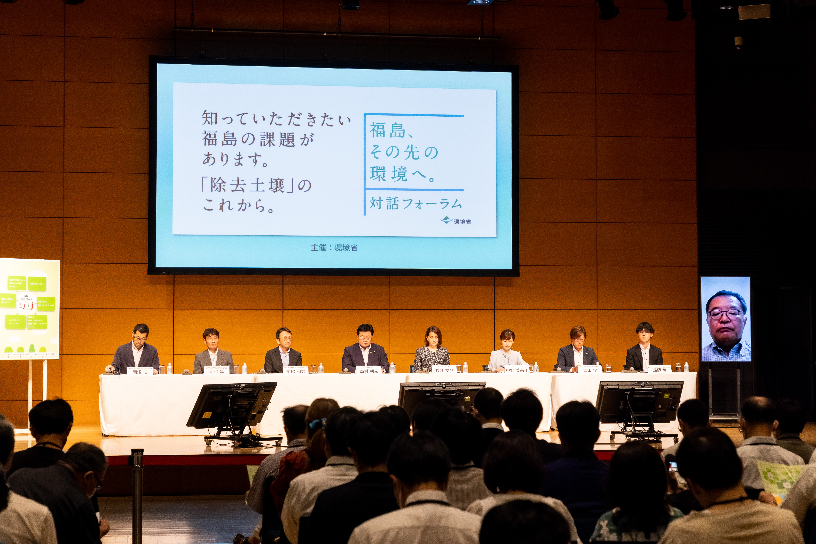
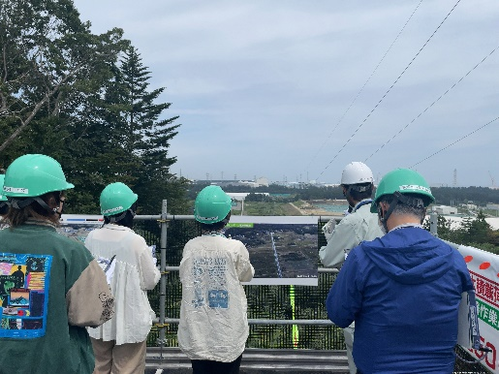
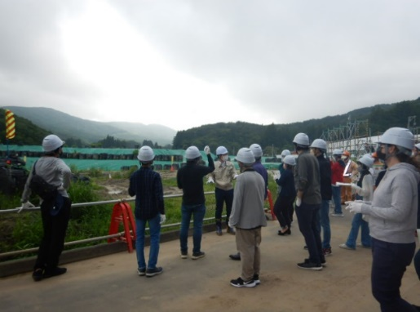
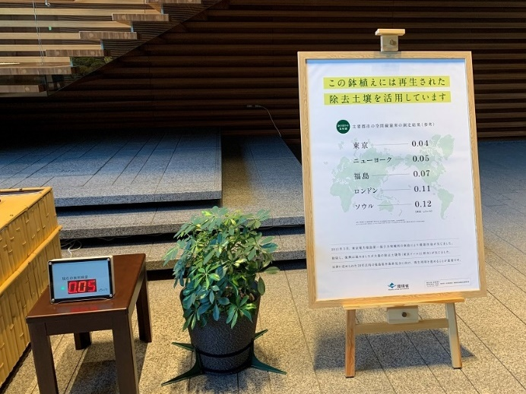
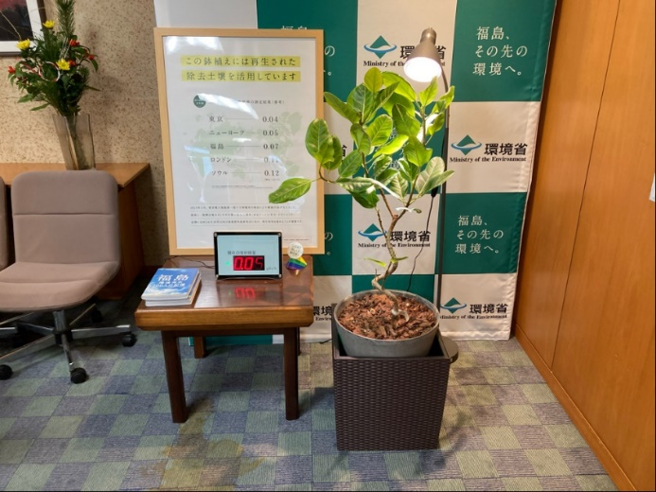
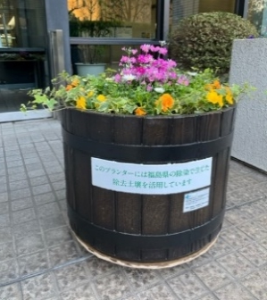
Efforts to Build Understanding toward Final Disposal and Recycling (inside Japan)
Nationwide Dialogue Forum
Site Visits
Site Visit to the Interim Storage Facility
Site Visit to the Demonstration Project Site
University students from outside Fukushima Prefecture
Participants in Davos Meeting
Dialogue forum in Tokyo (Aug. 19, 2023)
Site tours were held for the Soil Storage Sites in the Interim Storage Facility and the demonstration project area in the Nagadoro district of Iitate Village.
Nine meetings have been totally held. All of the dialogues were recorded and available online.
Installation of Potted Plants using Removed Soil
Prime Minister’s Office
Office of the Minister of the Environment
Planter
(MOE Headquarter )
← Removed soil with radioactvity concentration of approx. 5,100 Bq/kg is used.
In FY2022, potted plants using removed soil were installed at METI, MLIT and other relevant ministries and agencies (17 facilities outside Fukushima Prefecture as of the end of January 2023).

Slide 13
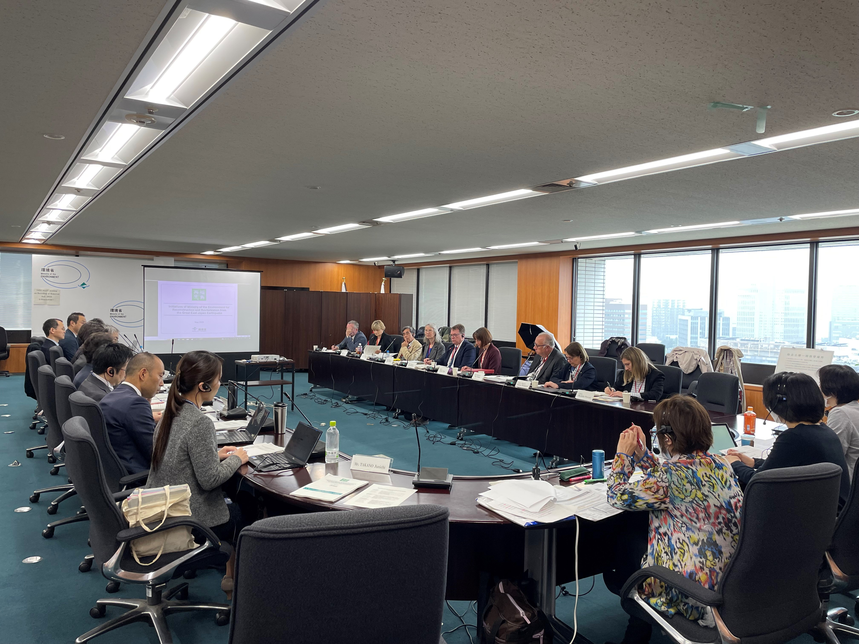
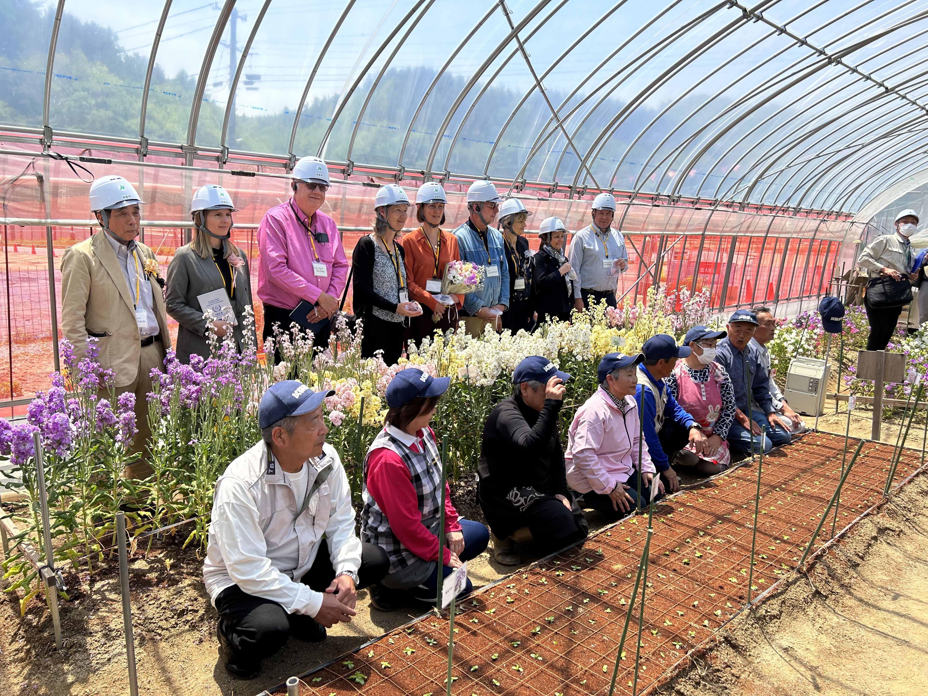
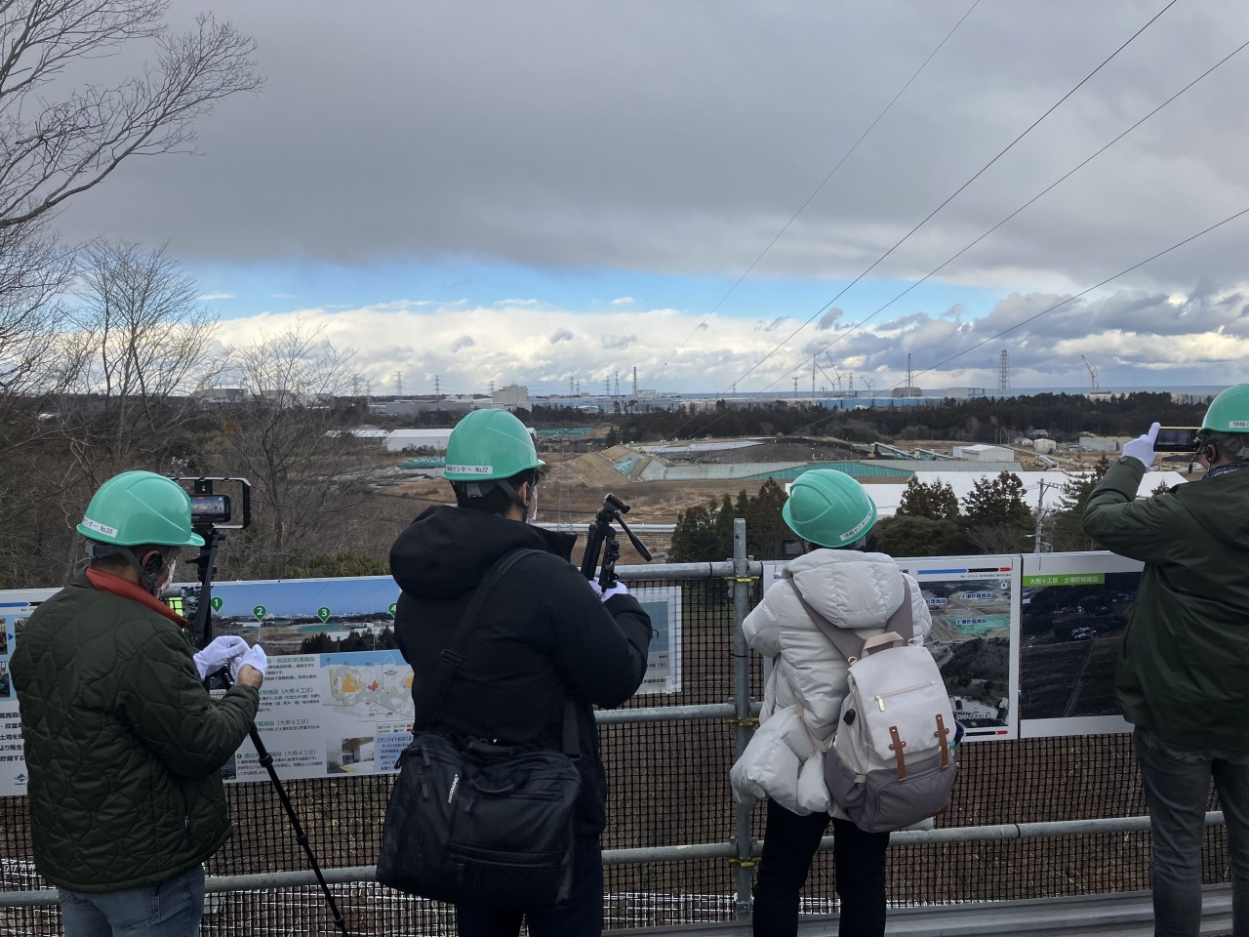
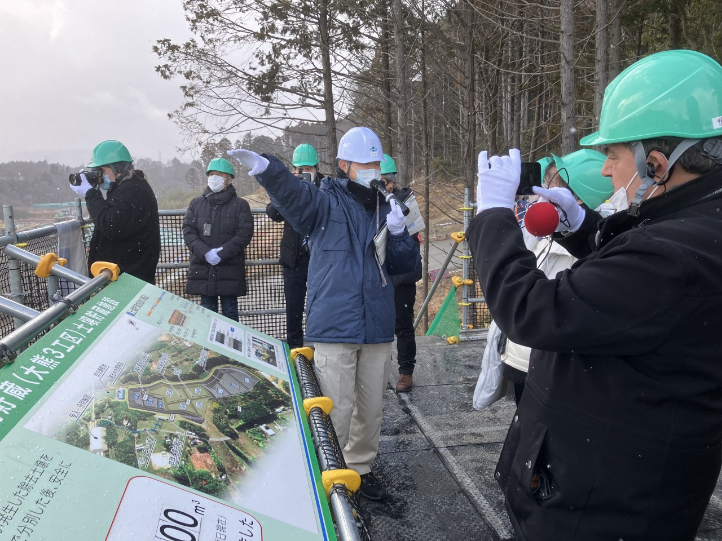
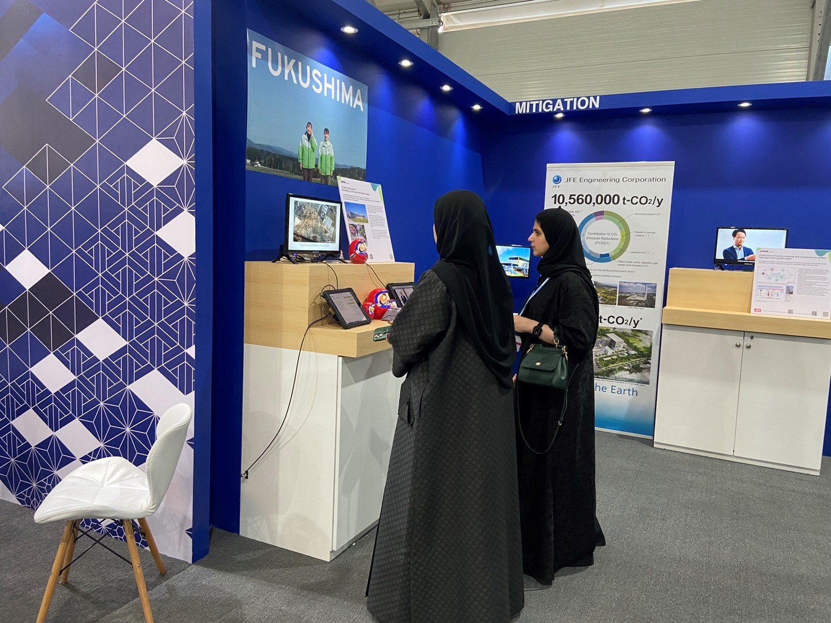
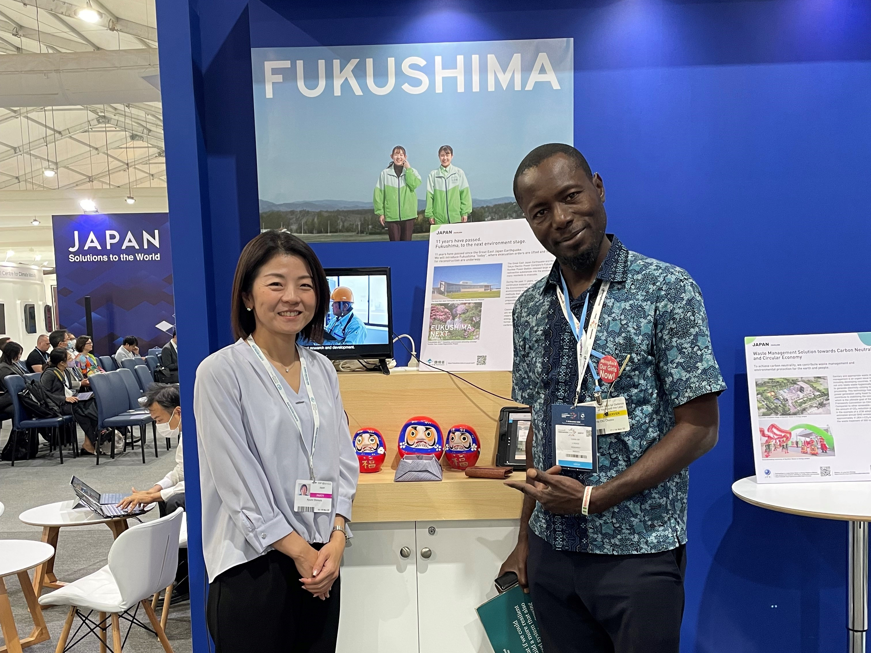
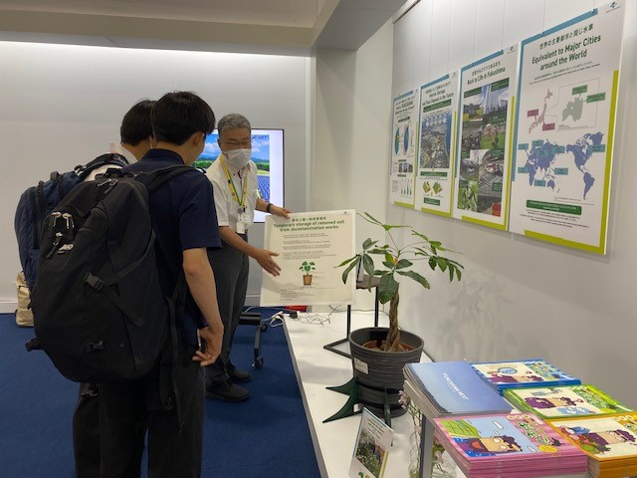
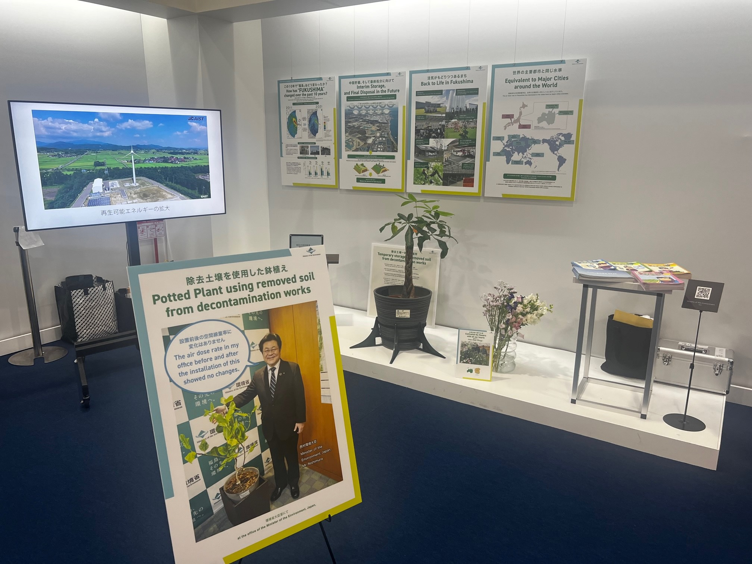
Efforts to Build Understanding toward Final Disposal and Recycling (international)
Since shortly after the accident, the MOE has had a number of opportunities to discuss and exchange views on off-site remediation activities through missions, meetings with the IAEA, and bilateral meeting with countries with experience to address similar challenges.
In 2022 and 2023, tours were held for press of foreign countries to disseminate progress made for decontamination activities and remaining issues to be addressed.
Taking opportunities of international conferences (e.g. The 27th Conference of the Parties (COP27) to the United Nations Framework Convention on Climate Change (UNFCCC), G7 Summit in Hiroshima), reconstruction efforts following the Great East Japan Earthquake and the accident at TEPCO's Fukushima Daiichi Nuclear Power Station were disseminated.
Experts Meeting with the IAEA
Tours for foreign press
Source: Foreign Press Center Japan
COP27 (Egypt)
G7 Summit (Hiroshima)

Slide 14
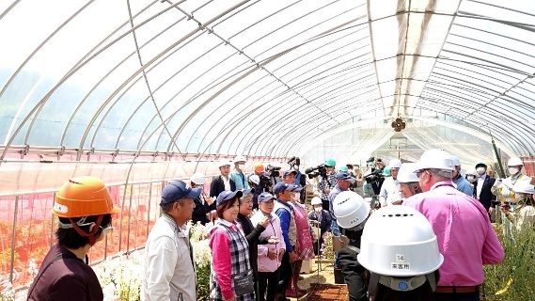
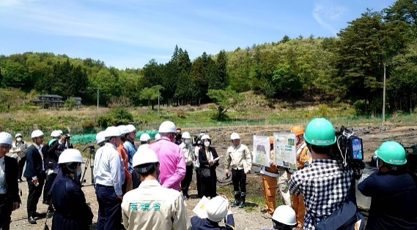
IAEA-MOE Japan 1st Experts Meeting on Volume Reduction and Recycling of Removed Soil
Arising from Decontamination Activities (2023 - )
Background
This meeting was held by the International Atomic Energy Agency (IAEA) upon the request of the Ministry of the Environment (MOE), Japan. The meeting was intended to exchange views concerning the measures taken by the MOE Japan on the recycling of removed soil, final disposal in the future, and to conduct the site visits to the Interim Storage Facility and demonstration area for environmental restoration in Nagadoro District, Iitate Village. Provision of international assessment and advice from technical and social perspectives was expected.
The final report will be produced by the IAEA after the 3rd Experts Meeting.
Overview of the 1st meeting
Main results of the 1st Meeting
Flower and tree cultivation in plastic greenhouses
Date / Place
Schedule: Monday, May 8 - Friday, May 12, 2023
May 8: Meeting with the Ministry of the Environment
May 9-10: Site visit to Fukushima Prefecture (Interim Storage Facility, demonstration area for environmental restoration in Nagadoro District, Iitate Village, discussions with Iitate Village Office staff and Nagadoro District residents, courtesy visits to Iitate Village Mayor, Futaba Town Mayor, and Okuma Town Mayor, etc.)
11th-12th: Meeting with the Ministry of the Environment, courtesy visit to the Minister of the Environment
Site visits
Flower and ornament plant cultivation in greenhouses in the demonstration facility of Nagadoro District
Demonstration of paddy fields
Main statements by the IAEA
We have seen a lot of work already done with a constant commitment to demonstrating safety.
The demonstration project is really important. Through the demonstration project, important information for interested parties can be provided on the recycling of removed soil.
Main agenda
1) Status of progress of recycling and final disposal of removed soil, and promotion of public understanding
2) Progress made on the Technology Development Strategy for Volume Reduction and Recycling of Removed Soil
Note: The summary report of the 1st IAEA-MOE 1st Experts Meeting was published on Sep. 1, 2023 and it is available at: https://www.env.go.jp/en/press/press_01843.html

Slide 15
Summary
  (Decontamination)
  Full-scale decontamination activities were completed by March 2018, other than the Restricted Area (RA). In conjunction with progress of other reconstruction activities, evacuation orders were lifted by March 2020, other than the RA.
  In the RA, decontamination activities have been still in progress, and the evacuation orders in the Specified Reconstruction and Revitalization Base Areas (SRRBA) in 6 municipalities were lifted by May 2023.
  (Transportation, Storage of generated soil and waste)
  Soil and waste arising from the decontamination activities in Fukushima Prefecture have been transported into the Interim Storage Facility (ISF), and almost all of the removed soil and waste had been transported into the ISF by March 2022, other than the RA.
  More than 13 million m³ of soil and waste have been transported into the ISF, and treated soil is stored in the ISF, which are supposed to be transported again out of the ISF, to be finally disposed of outside Fukushima Prefecture by March 2045.
  (Promotion of volume reduction and recycling)
  Taking account of the difficulties to find out the place to accommodate all of the removed soil and waste, as well as high occupancy of removed soil with relatively low radioactivity concentration, volume reduction and recycling of removed soil have been promoted.
  Based on the Strategy, technology development and demonstration projects have been simultaneously promoted, aiming at completion of development of necessary basic technologies by March 2025. Efforts to build nationwide public understanding, as well as sharing information with international communities have been also implemented, taking the opportunities of international meetings, conferences and tours for foreign media.
  (Cooperation with international society)
  The MOE has shared wide range of experience and lessons learned obtained through more than 12-year off-site remediation activities. This effort will be continued through Experts Meeting with the IAEA and bilateral discussion with other countries.

Slide 16
Thank you
For more information: http://josen.env.go.jp/en/
yoshitomo_mori@env.go.jp

