Slide 2
An Overview of the U. S. Nuclear Regulatory Commission Decommissioning Program: PROGRESS
TOWARDS FULFILLING THE SUSTAINABILITY PROMISE!
Bruce A. Watson, CHP
United States Nuclear Regulatory Commission
Office of Material Safety and Safeguards
Division of Decommissioning, Uranium Recovery and Waste Programs
Washington, D.C., U.S.A
Bruce.watson@nrc.gov

Slide 3
Decommissioning Topics
Overview of the US NRC Decommissioning Program
Summary of our Regulatory Framework
Experience with 1997 Regulations “License Termination Rule” and overview of current U.S. Decommissioning Process
Ensuring Safety and Enabling Sustainability in the Regulatory Framework and Inspection Program
Examples of Fulfilling the Promise of Sustainability

Slide 4
Complex Decommissioning Site License Terminations Since 1998

Slide 5
US NRC Decommissioning Program
Present Decommissioning Site Status
17 Power Plants in active decommissioning
8 Power Plants in SAFSTOR
2 Research reactors
8 Complex materials sites
5 Uranium Mill (UMTRCA) Sites in Decommissioning
25 Uranium Mill Sites in DOE Long Term Stewardship

Slide 6
1997 Decommissioning Regulations,
Setting Safe Decommissioning Standards
Decommissioning funding financial assurance requirements for all licensees
License termination criteria for unrestricted use is 25 mrem/y (0.25 mSv/y) and demonstration of ALARA/Dose Optimization Principle
Complex Material Sites with long lived radionuclides are to begin decommissioning within 2 years
Reactor Regulations were based on Lessons Learned from first 3 Power Reactor Decommissionings and allow 60 years to complete decommissioning. The operator decides on the decommissioning strategy, immediate, deferred or a combination of the two

Slide 7
Decommissioning Planning Rule,
Ensuring Safety and Sustainability
In 2011, NRC issued the “Decommissioning Planning Rule,” to help prevent legacy sites.
  The rule requires the ground water monitoring near the potential sources of leaks from the facility to alert the operator of leaks to allow repairs that over the long-term may impact the environment and the cost of decommissioning
In 2012, Reg Guide 4.21, “Decommissioning Planning During Operations,” was issued to provide implementation guidance
Inspection results since 2012 have proven the new regulation is effective

Slide 8
Ensuring Safety - Licensing
Licenses and license amendments
  Decommissioning Plans
  License Termination Plans
  Final Status Survey Reports
Security Plans
Technical Specifications
Environmental Requirements
Safety Culture

Slide 9
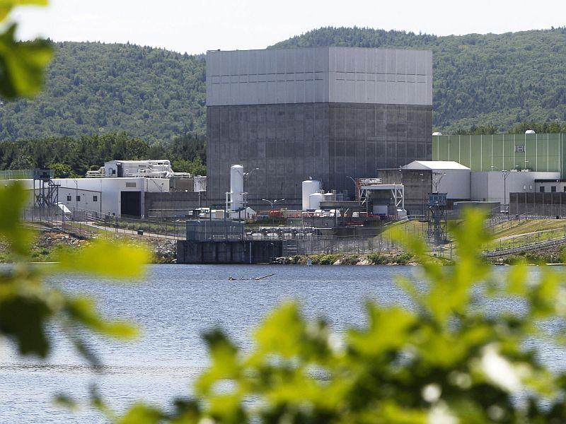
License Transfers, Financial and Technical Qualifications Reviews Ensures Safety
Beginning in 2014:
Vermont Yankee
Oyster Creek
Pilgrim
Indian Point 1, 2, 3
Crystal River
Three Mile Island 2
Kewaunee
Palisades
Vermont Yankee

Slide 10
Ensuring Safety - Inspection Programs
Inspection Manual Chapters:
2561, Decommissioning Power Reactor Inspection Program
2602, Decommissioning Fuel Cycle, Uranium Recovery and Materials Inspection Program
2800, Materials Inspection Program
2801, Uranium Recovery and 11e(2) Byproduct Material Facility Inspection Program

Slide 11
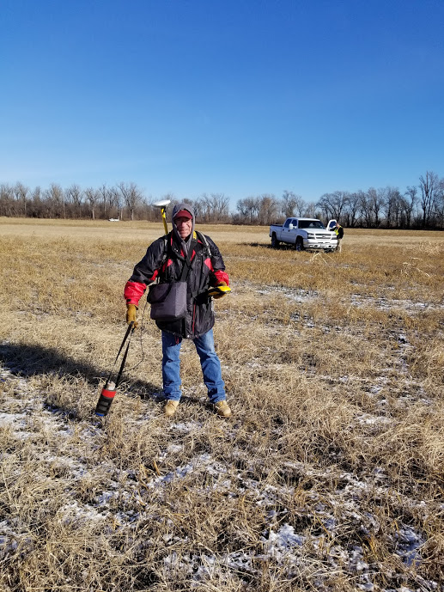
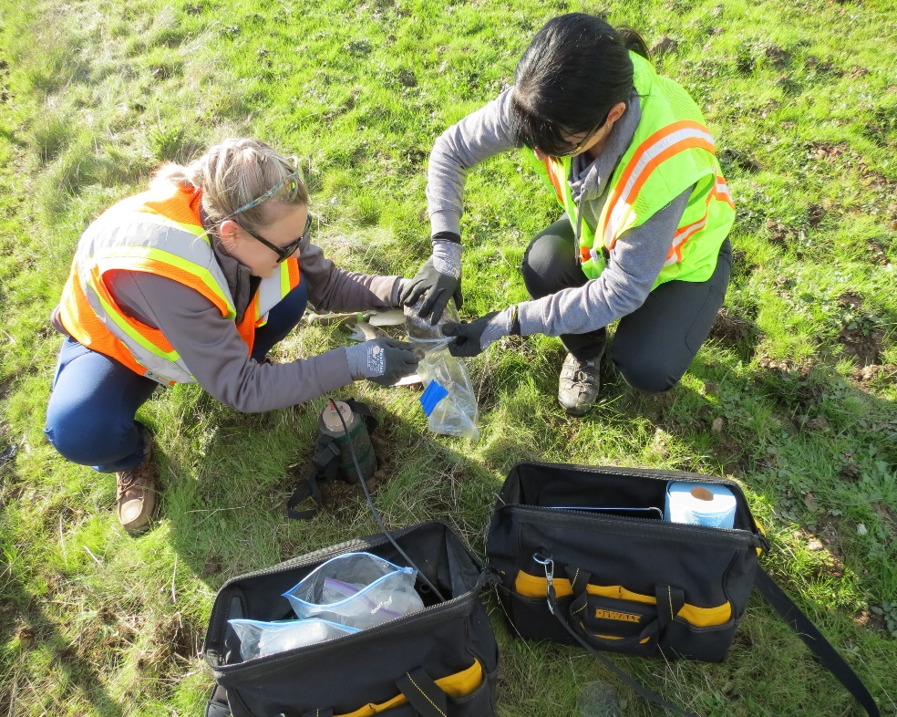
Ensuring Safety – Independent Verification
Confirmatory Surveys and Sampling

Slide 12
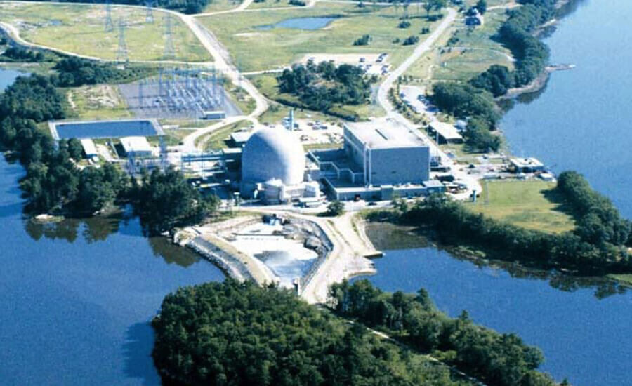
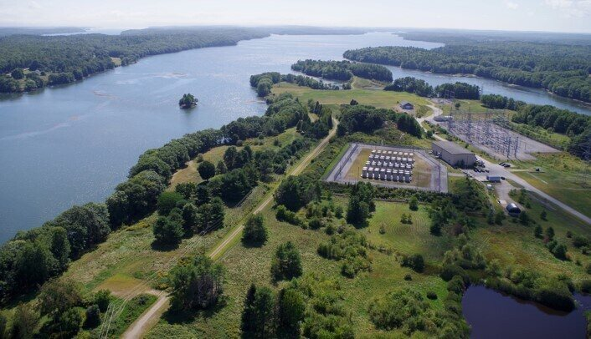
Maine Yankee – Nature Park
Operating Plant Before Decommissioning
A new Community Park and Nature Trail after license termination

Slide 13
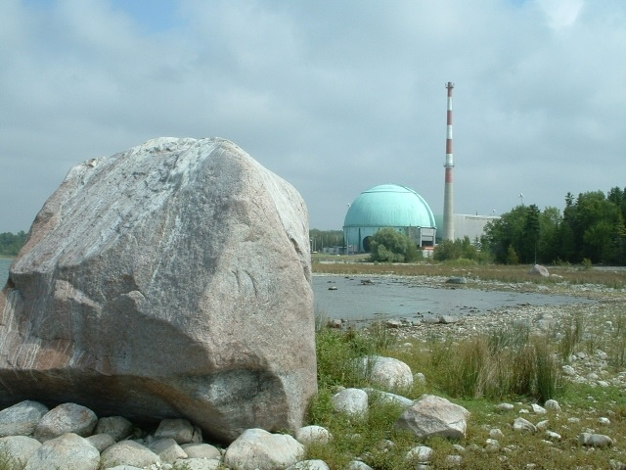
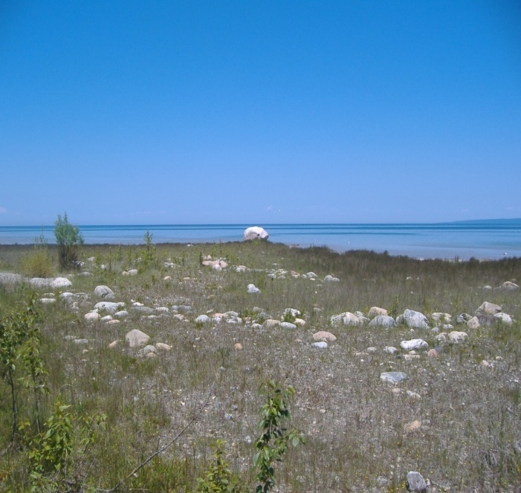
Big Rock Point –
Historical Significance to Native Americans
License Terminated in 2007
The Big Rock Nature Area

Slide 14
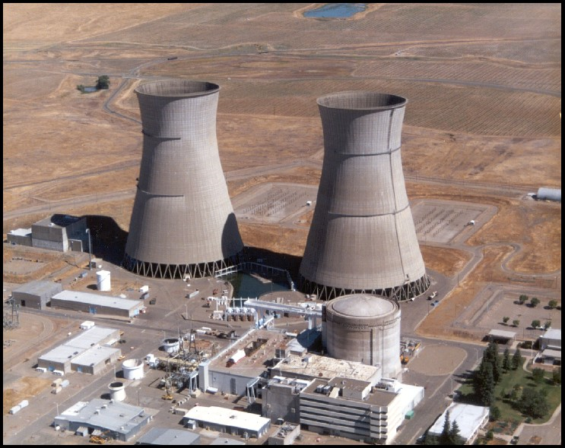
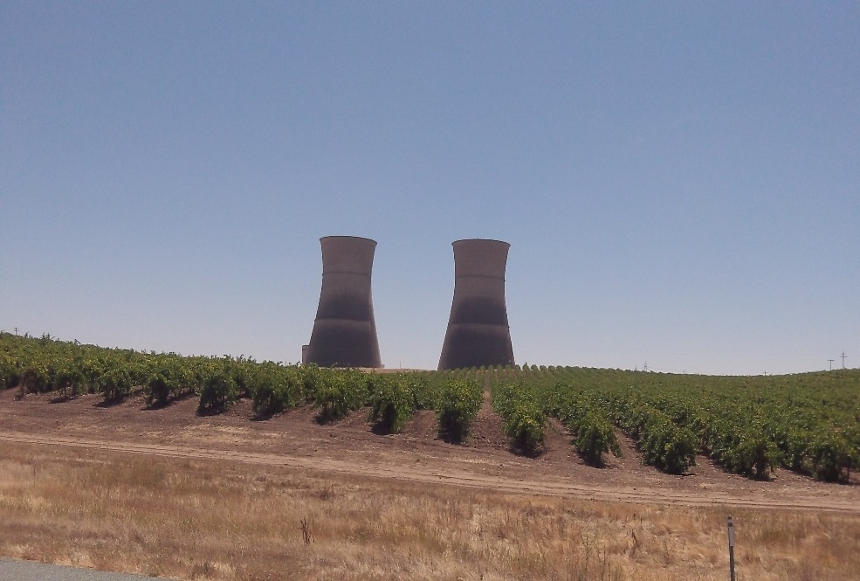
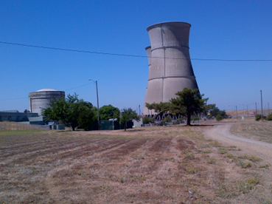
Rancho Seco – Combined Cycle fossil plants and new Zinfandel plants
License Terminated in 2009
New Zinfandel Vines

Slide 15
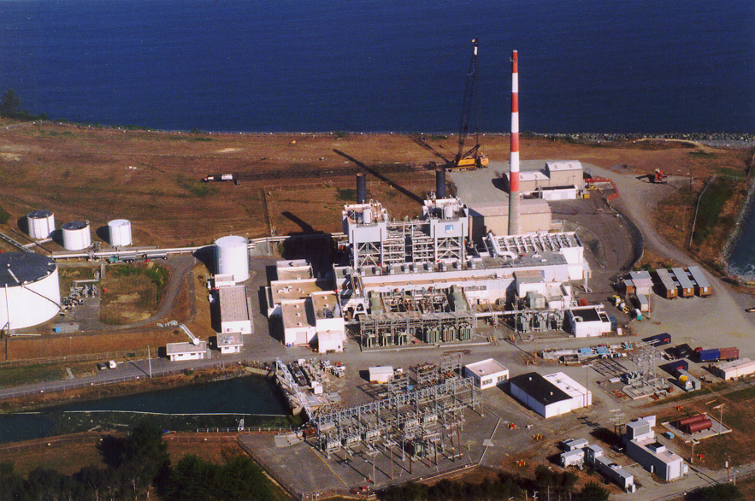
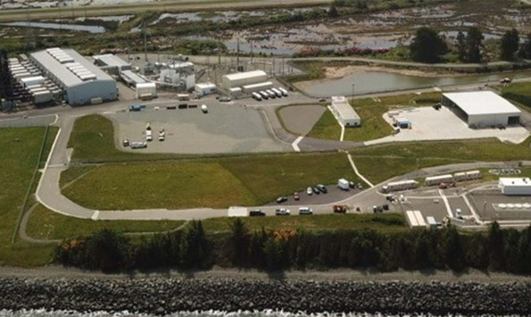
Humboldt Bay – Reuse for Grid Stability and former intake canal will be a Municipal Marina
ISFSI

Slide 16
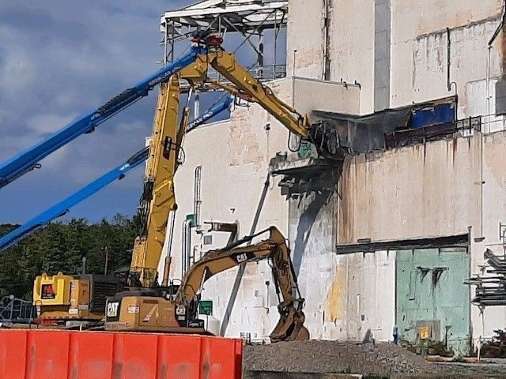
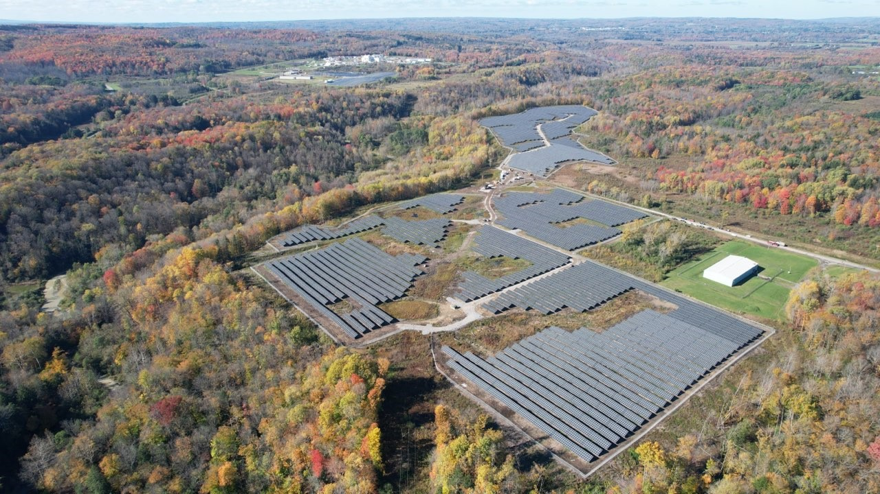
West Valley Demonstration Project
Main Process Plant Demolition
Solar Panels

Slide 17
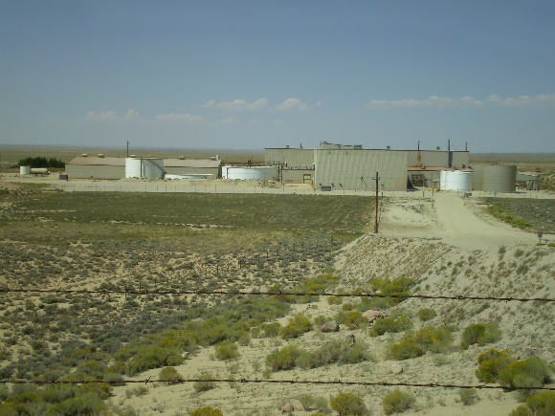
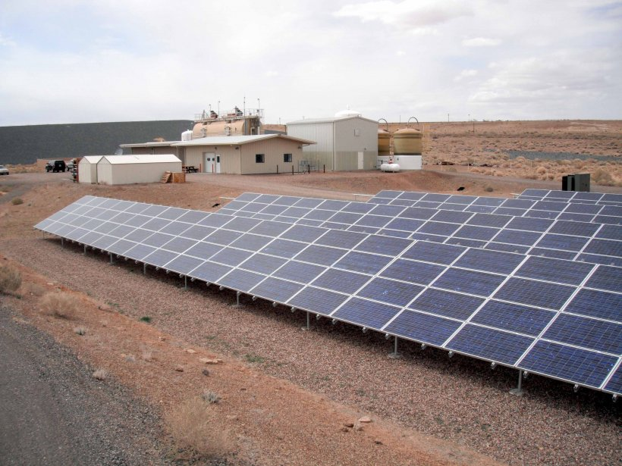
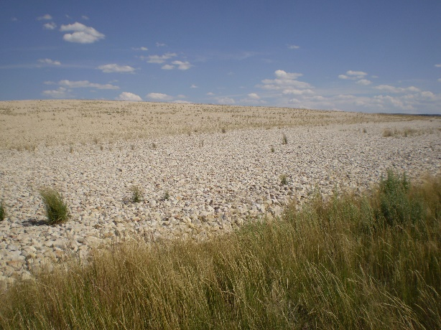
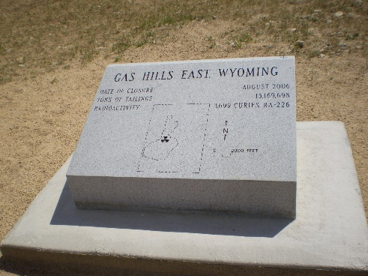
Beneficial Uses at Uranium Mill Tailings Sites
Mill and Mill Tailings Sites
Tuba City

Slide 18
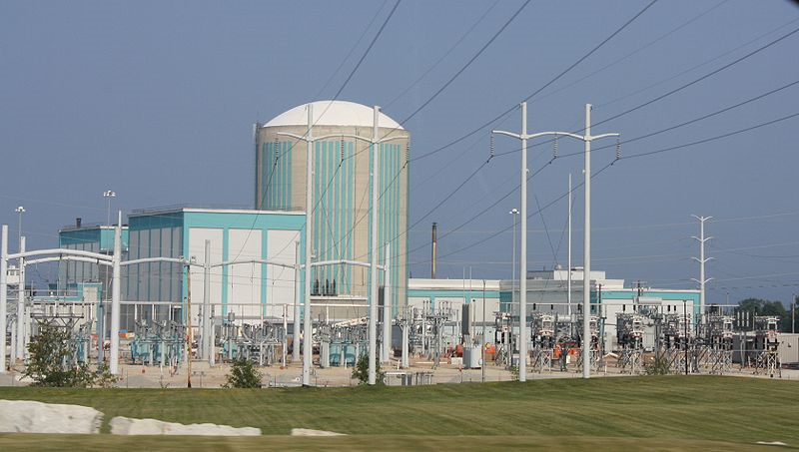
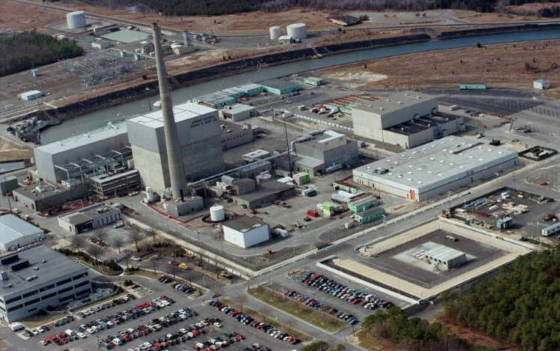
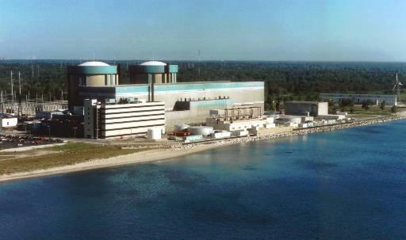
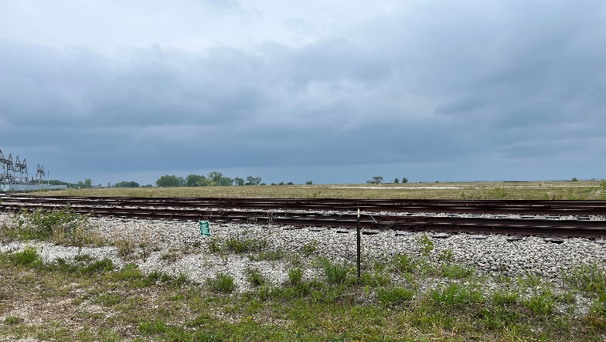
Future Small Modular Reactor Sites?

Slide 19
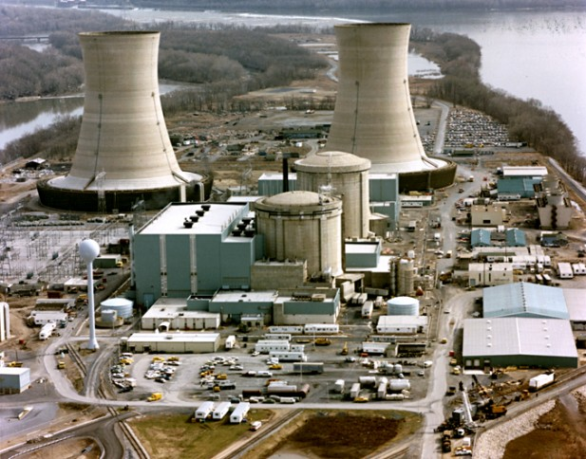
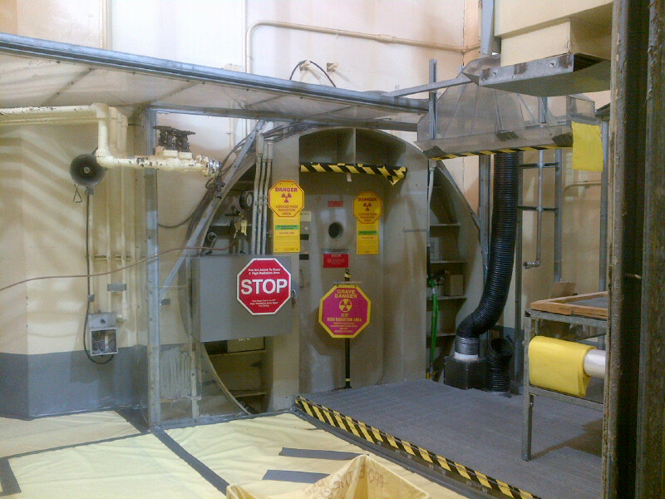
Three Mile Island Unit 2

Slide 20
Final Thoughts
NRC’s Regulatory Framework is flexible, performance-based and risk-informed
Licensing and Inspection Programs ensure safety
Safety leads to sustainability, allowing nuclear sites to be released from regulatory control for unrestricted use
In the U.S., all licenses have been terminated for unrestricted use and are available for economic re-development by the property owner
Some sites will likely house the new generation of reactors, such as Small Modular Reactors

