Slide 1
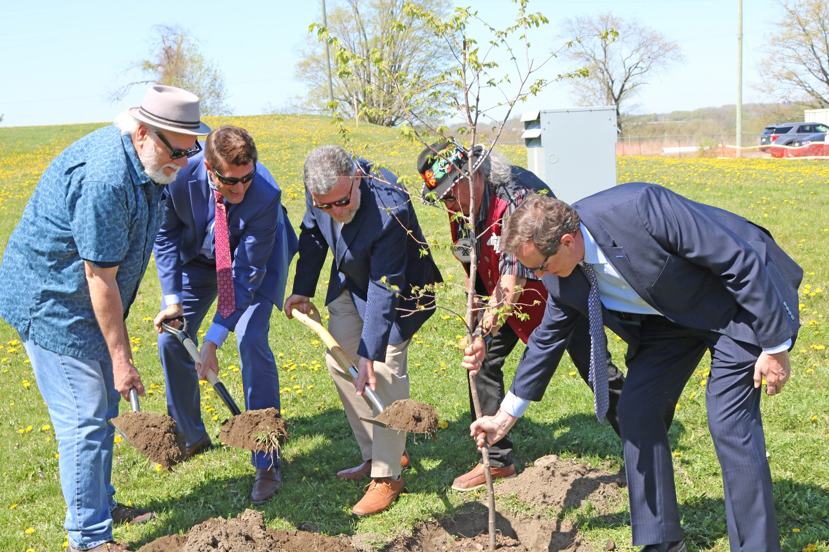
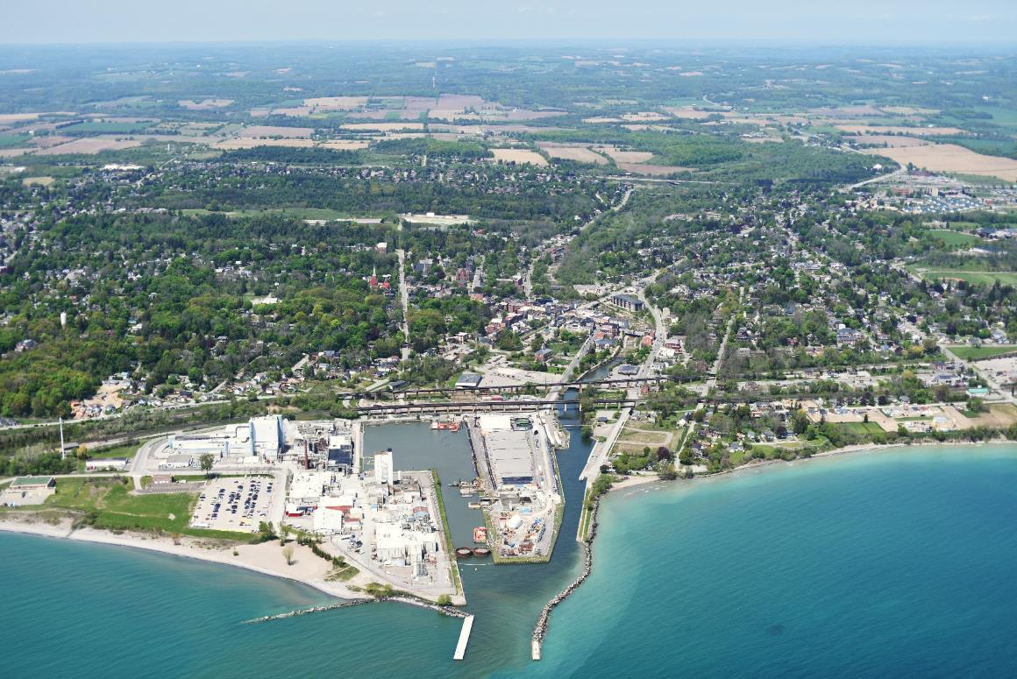
Port Hope Area Initiative
Engaging for Success:
Indigenous Relations
IAEA Conference Ensuring Safety and Enabling Sustainability
November 2023

Slide 2
Sarah Anderson
Manager, Stakeholder & Indigenous Relations
CANADIAN NUCLEAR LABORATORIES Historic Waste Program
Extensive experience in grass-roots community development, sustainable land-use planning and relationship building
15 years delivering government programs and developing strategic projects in northern and rural communities
10 years with CNL fostering Indigenous relations, working with First Nation and Métis communities and organizations in Ontario, Northern Alberta and Northwest Territories, Canada

Slide 3
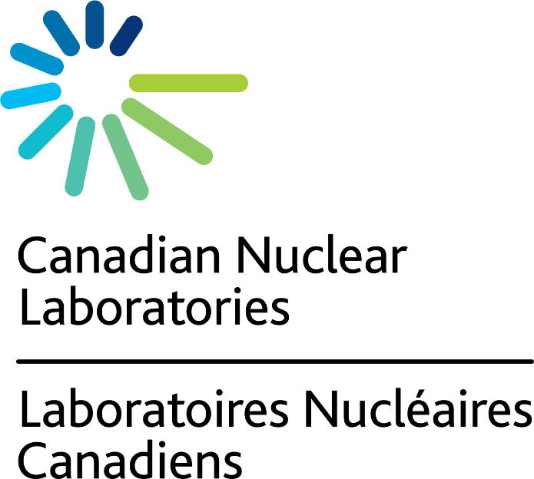
Contributing to the health of Canadians
Clean energy for today and tomorrow
Restore & protect Canada’s environment
The science of tomorrow, today.
Notes:
CNL is Canada’s premier nuclear science and technology organization. Our scientific expertise helps solve some of the world’s biggest problems.
Manage/reduce historic low-level radioactive waste (LLRW) liabilities throughout Canada on behalf of AECL, Government of Canada
Deliver PHAI and interim waste management programs for historic LLRW in Port Hope
Address information needs of Indigenous communities and organizations; stakeholders and the public
Complete PHAI projects safely and compliantly:
Protection of people and the environment remain top priority
Continue to meet all licence and reporting requirements

Slide 4
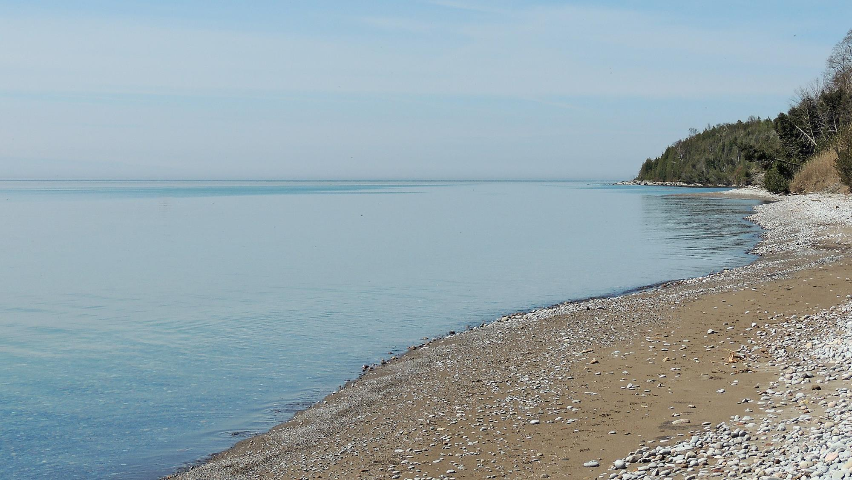
PHAI Land Acknowledgment
Notes:
CNL acknowledgment CNL respectfully recognizes and acknowledges that its various sites are located within the territories of many nations. CNL is thankful to have the opportunity to work on these traditionally and culturally significant lands and waterways.
HWP
I would like to take this opportunity to acknowledge that the Port Hope Area Initiative projects are situated on the traditional and treaty lands of the Williams Treaties First Nations, and more specifically, the Gunshot Treaty signed by the Mississauga nations.
I also want to acknowledge that these lands are home to Indigenous Peoples from across the Province and Canada and CNL is grateful for the opportunity to work on these traditionally and culturally significant lands and waterways.

Slide 5
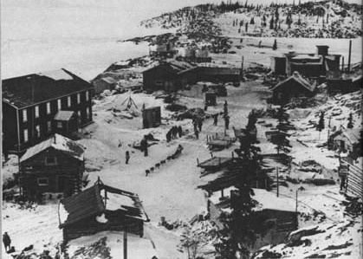
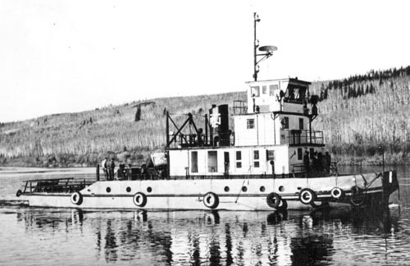
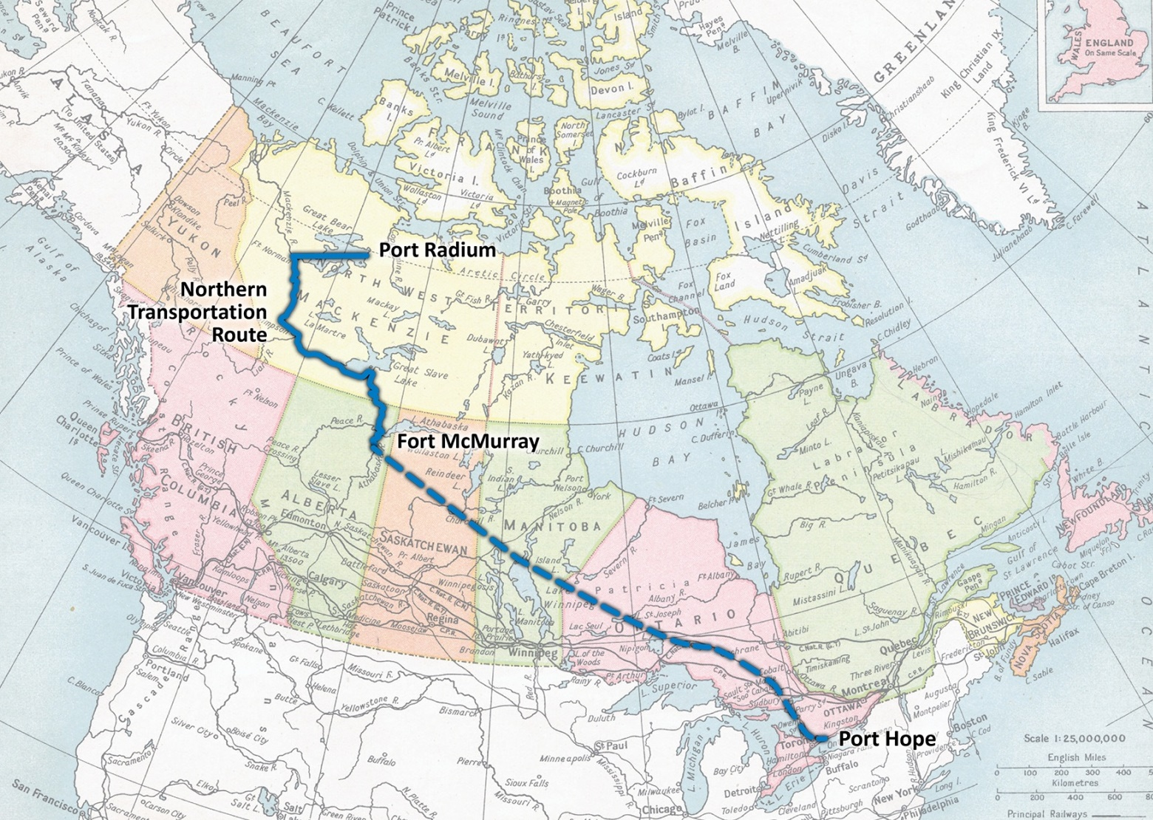
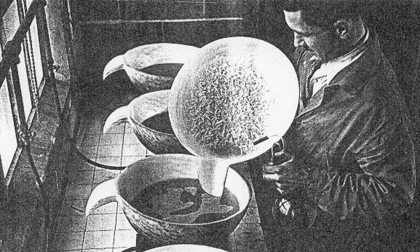
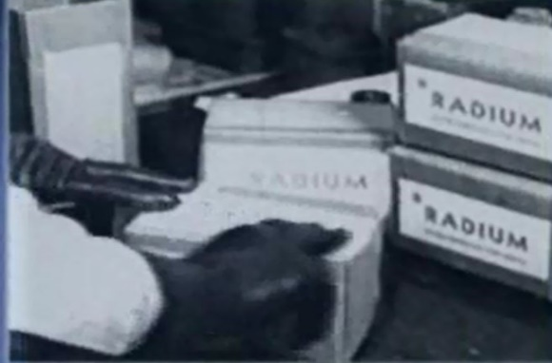
Origins of Low-Level Radioactive Waste in Port Hope
The Northern Transportation Route
Pitchblende
Processing
What is historic low-level radioactive waste?
Soil, contaminated with uranium, radium and arsenic, resulting from past activities involving the refining of radium and uranium by Eldorado Nuclear
Product

Slide 6
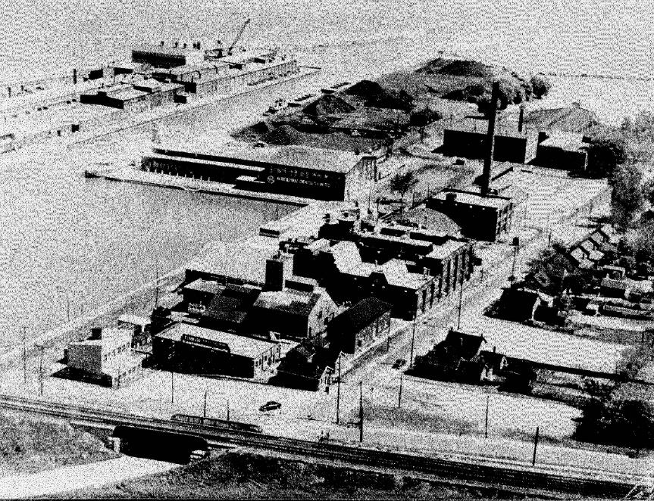
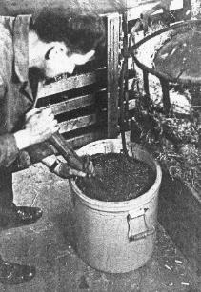
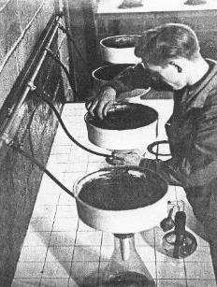
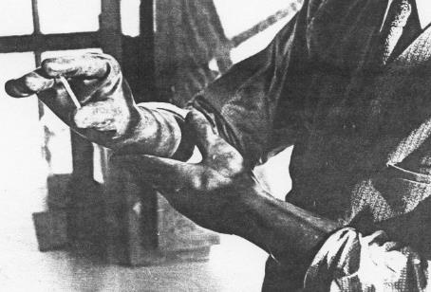
Refining Radium & Uranium in Port Hope
1 Ton of Ore + 10 Tons of Chemicals = less than 1 gram of radium
Mid-1970s LLRW problem identified
1976-82 Initial Cleanup 100,000 m³ to Chalk River
1986-96 Independent Siting Task Force province-wide search unsuccessful
1997-99 Community Solutions brought to federal government
2001 Legal Agreement Canada, Clarington, Town of Port Hope, Hope Township

Slide 7
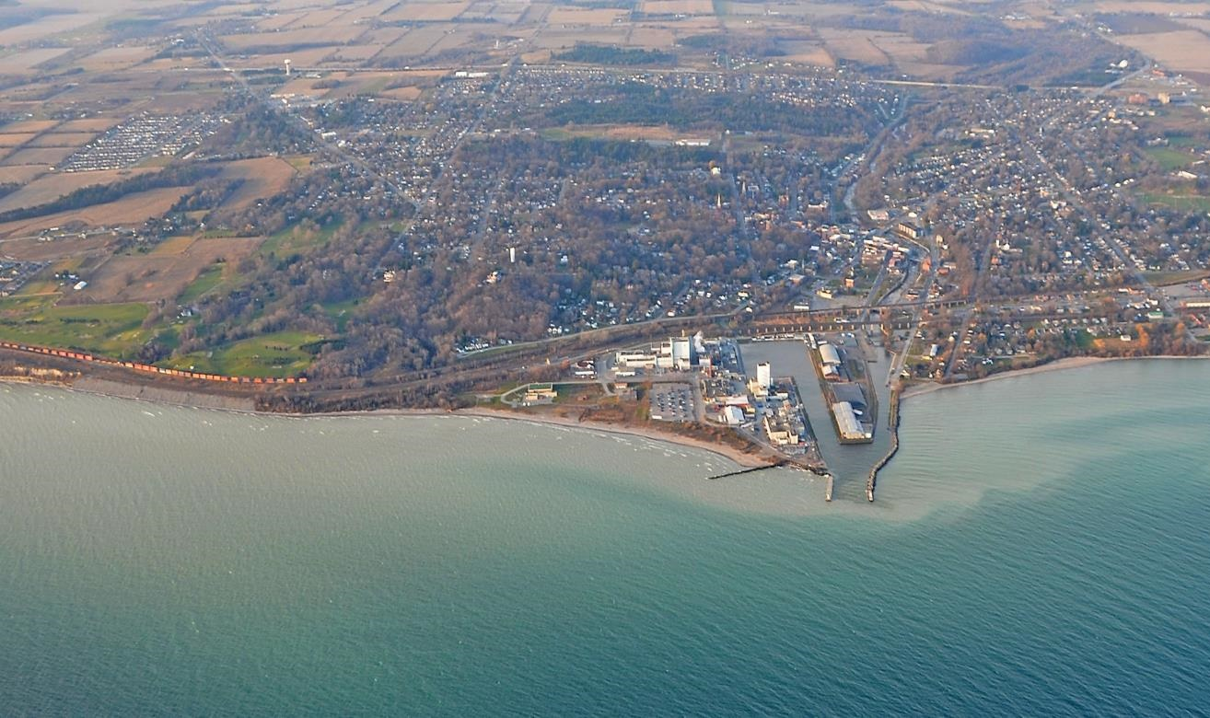
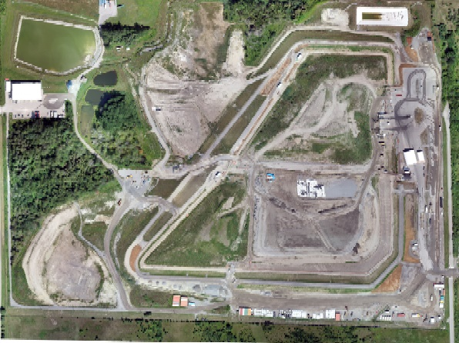
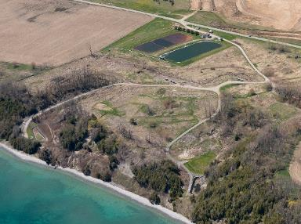
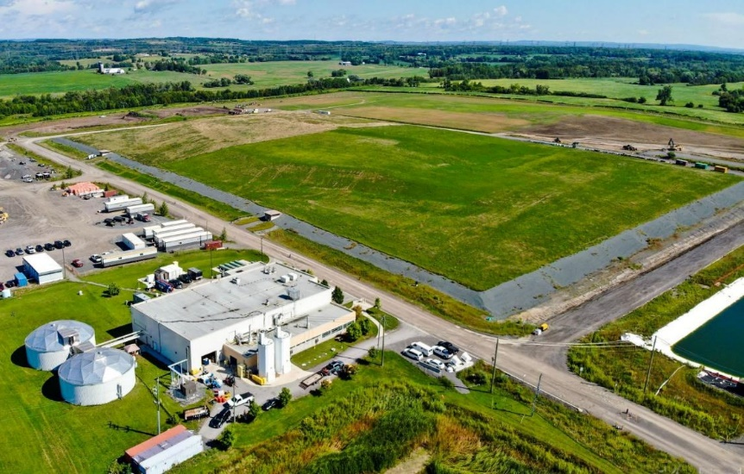
Historic Waste Locations in Port Hope & Port Granby
Port Hope Project Long-Term Waste Management Facility
Planned
Unplanned
After 1955 to Port Granby
Port Granby Project Long-Term Waste Management Facility Capped/Closed in 2021
Notes:
One initiative: two projects

Slide 8
PHAI Foundation and Phases
Legal Agreement
Public communications program
Complaints Resolution Program
Property Value Protection Program
PHASE 1 Planning & Preparation
Environmental Assessments
Waste Excavation Management plans
CNSC licencing process
Environmental Assessments
Community consultation
Business communications plan
Public Attitude Surveys
PHASE 2 Construction/Remediation/Closure
CNSC licences issued
Facility construction/start of remediation
Property Radiological Survey
Foundation
Documents
Project Phases
CNSC Licence
Health, safety, radiation protection
PHAI Public Information Program
Public Disclosure program
PHASE 3 Long-Term Monitoring
Routine inspections
Internal and external monitoring systems
Continue wastewater treatment

Slide 9
Environmental Assessment Follow Up Program
GEOLOGY & GROUNDWATER
Groundwater, storm water, waste water quality; flow, soil quality
INDIGENOUS RIGHTS & INTERESTS
Constitutional and treaty rights, traditional practices and knowledge systems
TERRESTRIAL
Plants and wildlife habitat
AQUATIC
Water quality, flow and sediment quality
ATMOSPHERIC
Air quality and noise
SOCIO-ECONOMIC
Community life, heritage, traffic and transportation

Slide 10
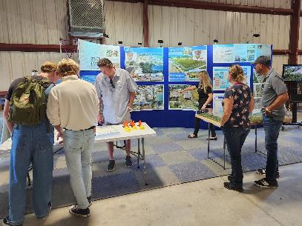
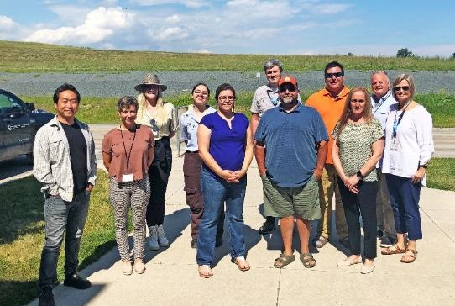
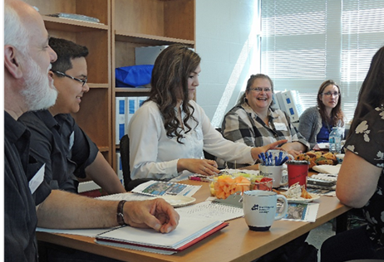
PHAI Community Engagement
Transparently provide access to project information and updates
Engage early to discuss project plans, activities, reports, issues - invite feedback
Focus on two-way dialogue and ongoing information sharing
Public Information Program
Project Information Office
Online communications
Presentations/site tours
Information sessions
Newsletters
Port Hope Fall Fair
Indigenous Relations Program
Engagement meetings/site tours
Mutual information sharing/updates
Participation/observation/demonstrations
Archaeological protocol
Community visits/cultural awareness
PHAI sites tour
Meeting

Slide 11
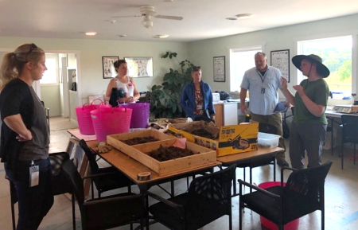
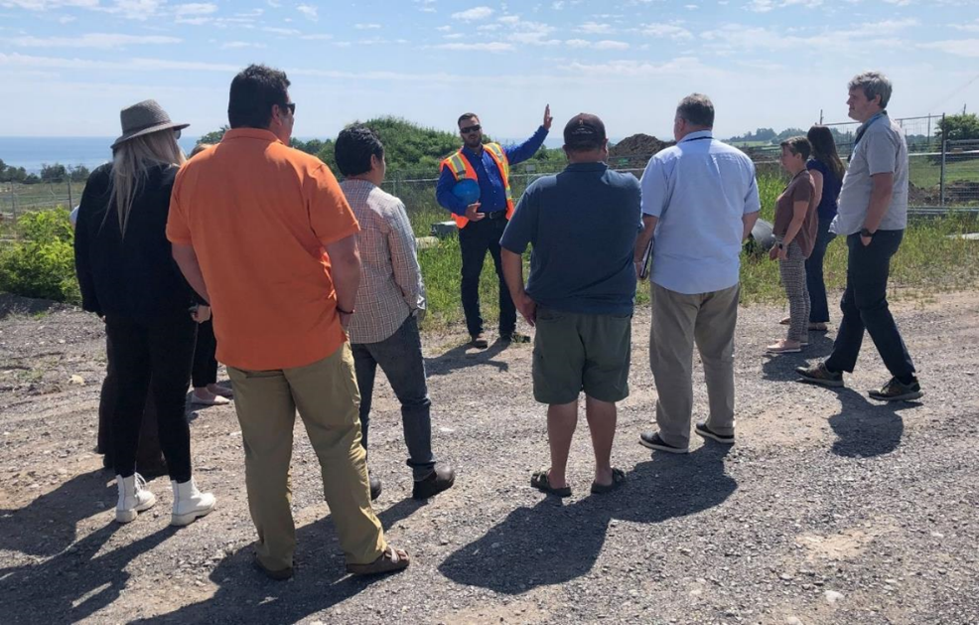
Indigenous Communities and Organizations
Indigenous Communities with Treaty Rights
Alderville First Nation
Curve Lake First Nation
Hiawatha First Nation
Mississaugas of Scugog Island First Nation
Beausoleil First Nation
Chippewas of Georgina Island First Nation
Chippewas of Rama First Nation
Indigenous Communities with Interests
Métis Locals Regions 6, 8
Mohawks of the Bay of Quinte
Indigenous Organizations
Anishinabek Nation
Métis Nation of Ontario

Slide 12
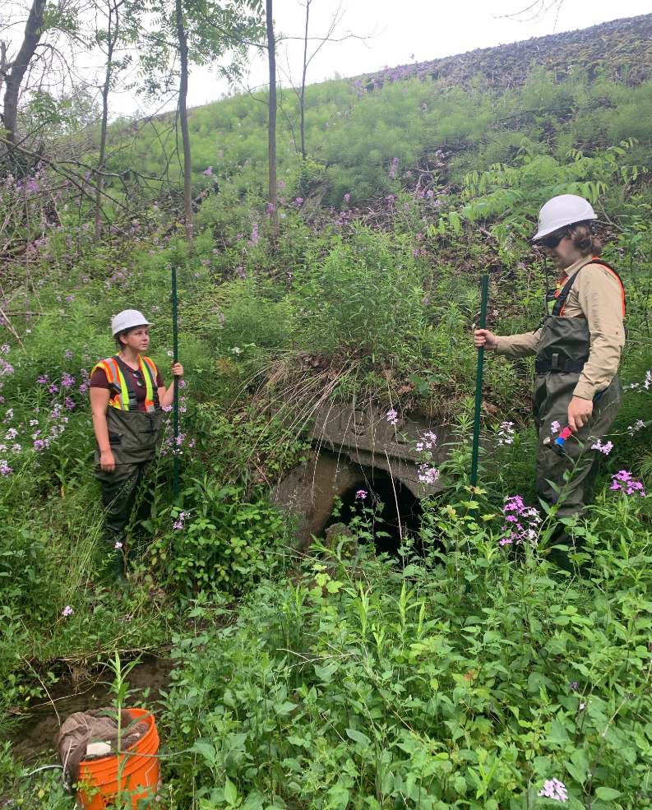
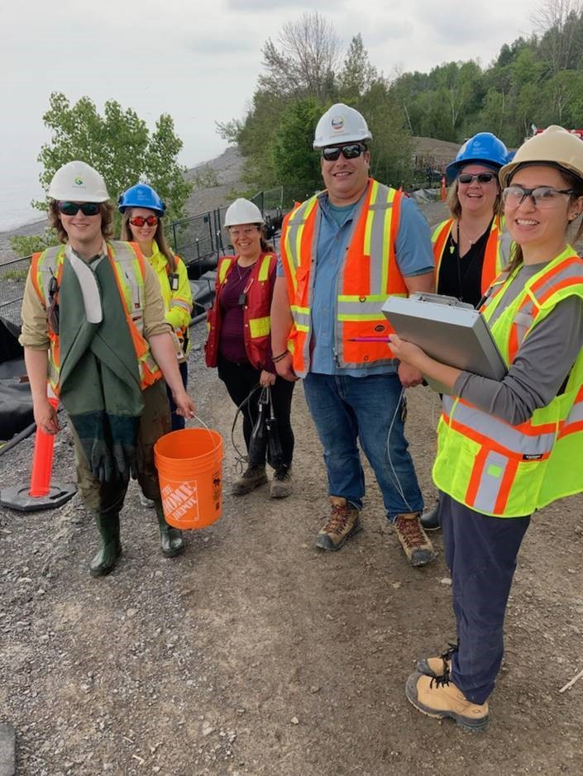
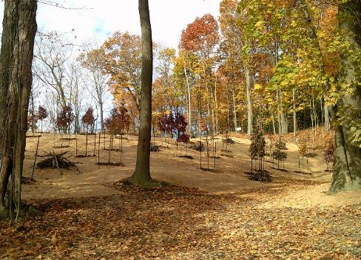
Engagement Priorities
Environmental Protection, Habitat Restoration & Application of Indigenous Knowledge Systems
Water Works West – Fish Rescue
Applying Indigenous knowledge systems

Slide 13
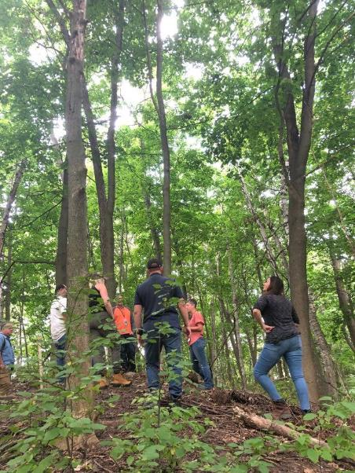
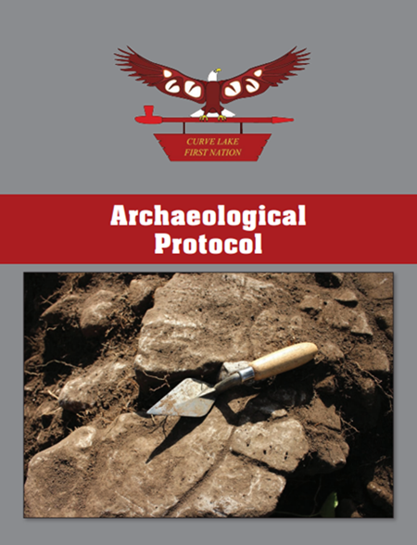
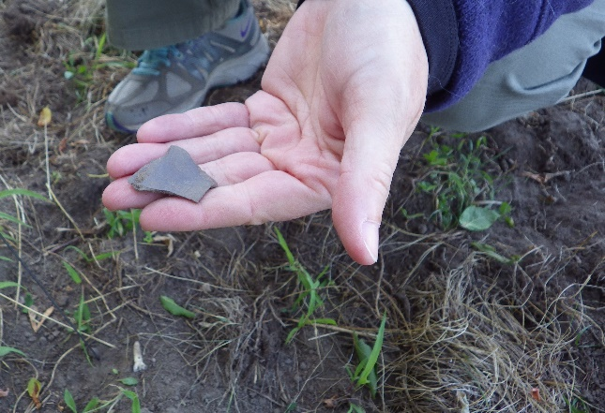
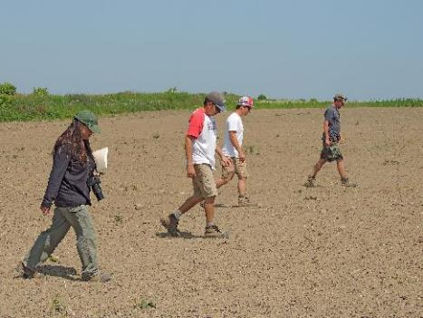
Engagement Priorities
Indigenous Cultural Resource Preservation & Archaeology
Port Granby Archaeological investigation
Archaeology walk down

Slide 14
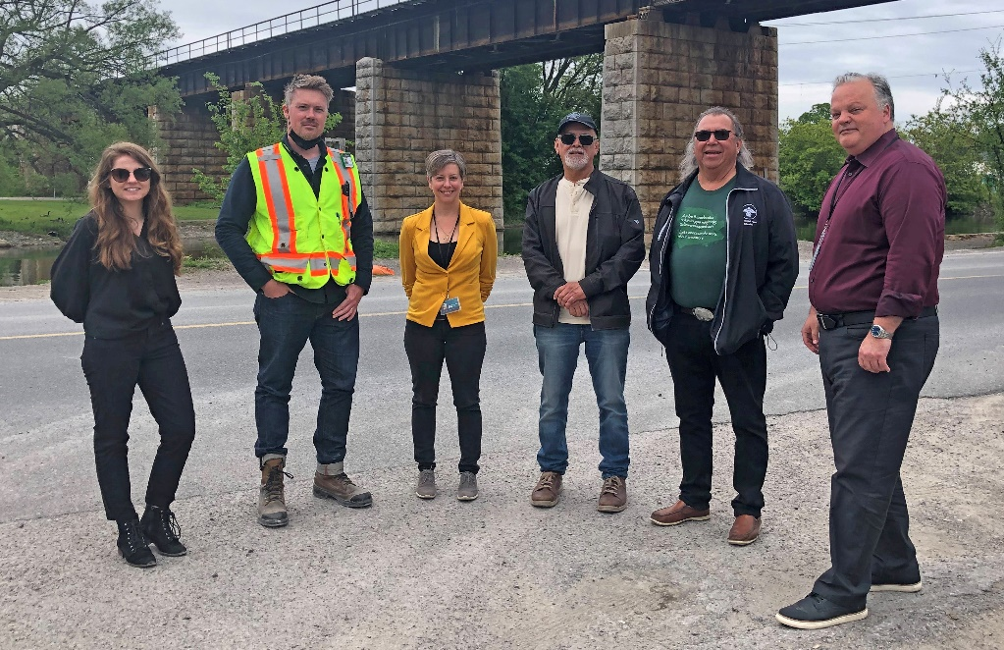
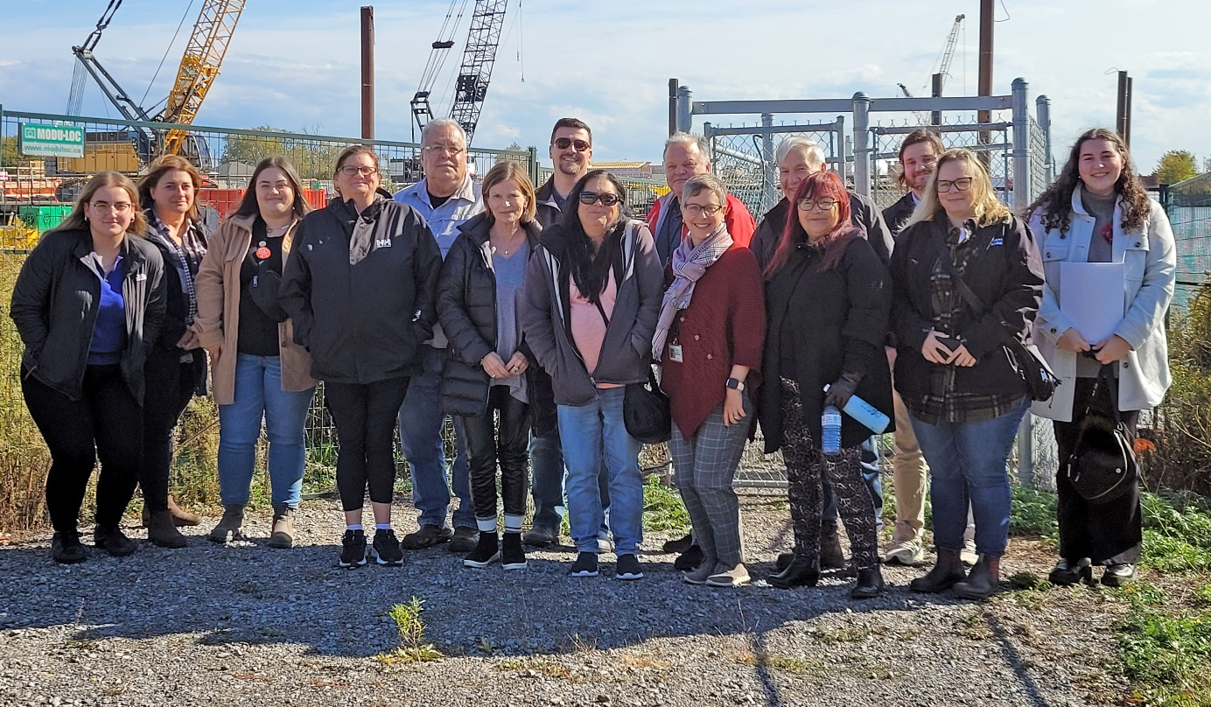
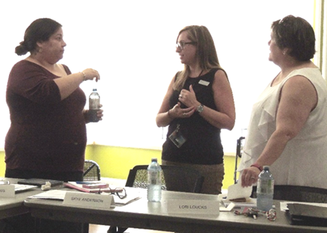
Engagement Priorities
Economic/Business Opportunity, Employment, Skills Development & Community Capacity Building

Slide 15
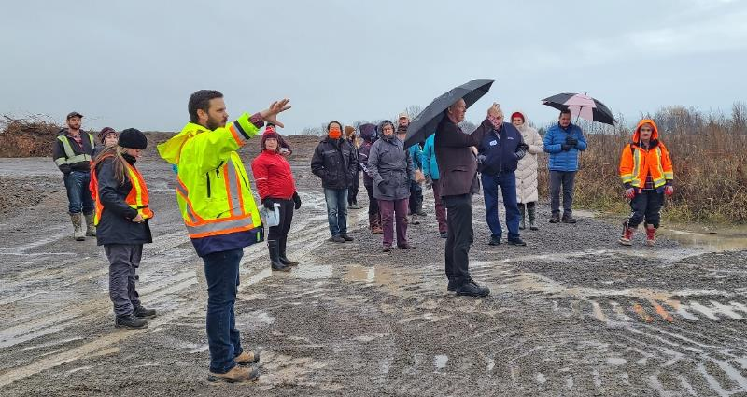
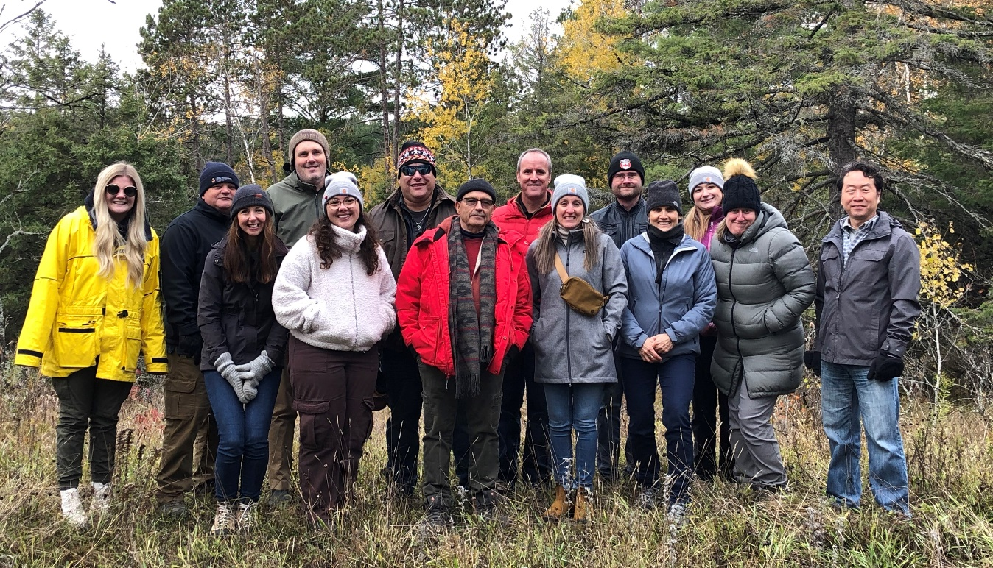
Ongoing Relationship Building
Continued Growth and Project Integration
Respect Constitutional and treaty rights, Indigenous worldviews, interests into project planning
Advance reconciliation through meaningful actions and engagement
Continue to build relationships with Indigenous communities with ongoing learning about values/interests
Evolve inclusion and participation in project activities
Focus project planning on environmental protection, sustainability, in consideration of Indigenous knowledge systems
Enhance communications, plans, reporting with balanced language, acknowledging Indigenous rights/perspectives
Tour of Port Granby lands
Curve Lake First Nation Cultural Sharing Day
Engagement
Engagement meetings, site tours
Information sharing/updates
Newsletters, event invitations, disclosures
Observation/demonstrations
Archaeological protocol

Slide 16
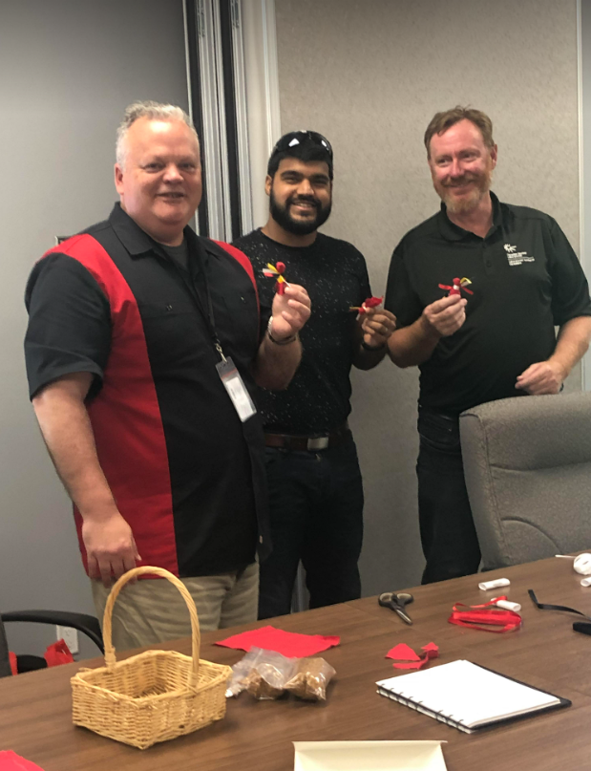
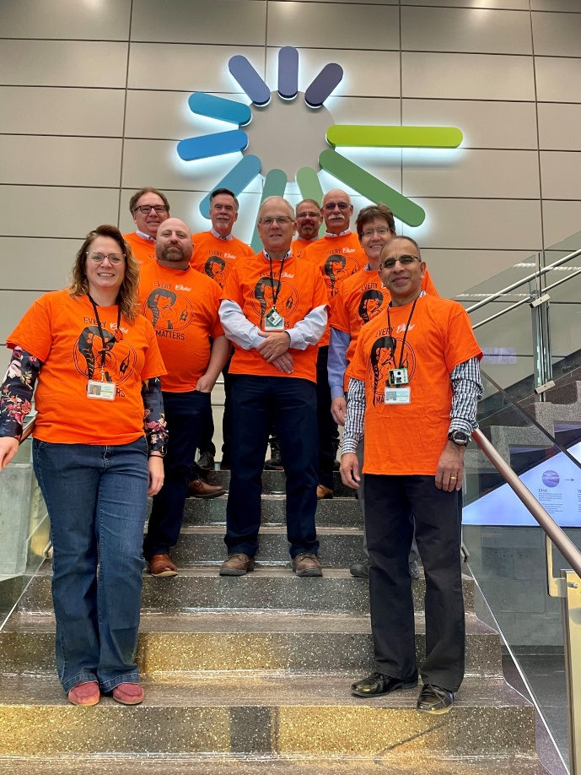
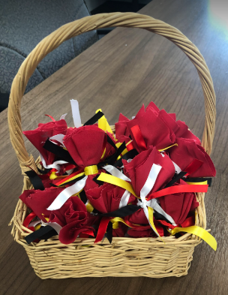
Corporate Commitment
Evolving Journey toward Reconciliation
United Nations Declaration on the Rights of Indigenous Peoples (UNDRIP) – harmonizing with Canadian law
Free, prior and informed consent (FPIC)
Canadian Federal Constitution – Section 35 Rights of Aboriginal Peoples
Crown Duty to Consult (AECL & CNSC)
Truth & Reconciliation Calls to Action (#92)
Treaty Rights
CNL Indigenous Relations Program
Policy creation: Reconciliation Action Plan; Indigenous Relations Procurement Strategy; Engagement Plans
Meaningful actions/consultation in all mission activities and departments
Indigenous Relations leadership, team, and integration through Diversity, Equity & Inclusion objectives, staff education and awareness
Establishing long-term relationship agreements with Indigenous communities and organizations, support sustainable capacity building, skills training and economic development opportunities

Slide 17
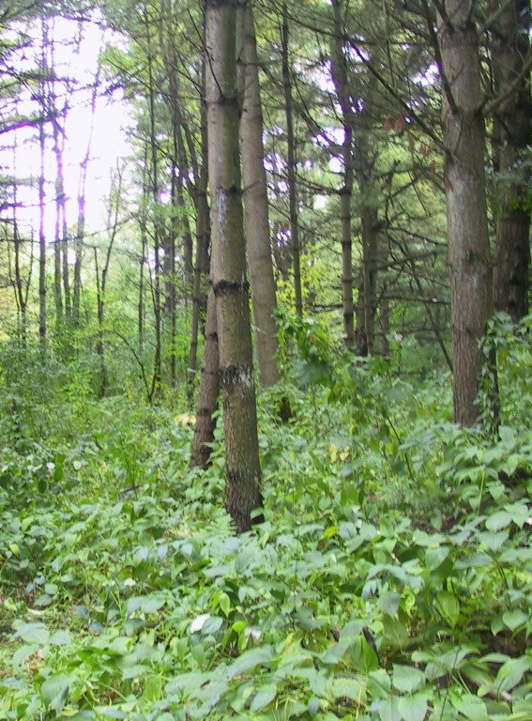
Sustainable Solutions for Success
Recognize Indigenous peoples are stewards of land - working with Indigenous communities plays a key role in environmental protection
Embrace Indigenous philosophy - decisions made today should result in a sustainable world for seven generations into future
Balance commitment to remove contaminated soils with the protection of lands and waters
Engage on plans/activities to incorporate Indigenous knowledge systems - protect environment, responsibly manage legacy waste
Collaborate to fulfil project objectives to complete the PHAI projects safely and compliantly while protecting people and the environment
Work toward a cleaner environment “healing the earth” and restoring the land for future generations as path toward reconciliation

Slide 18
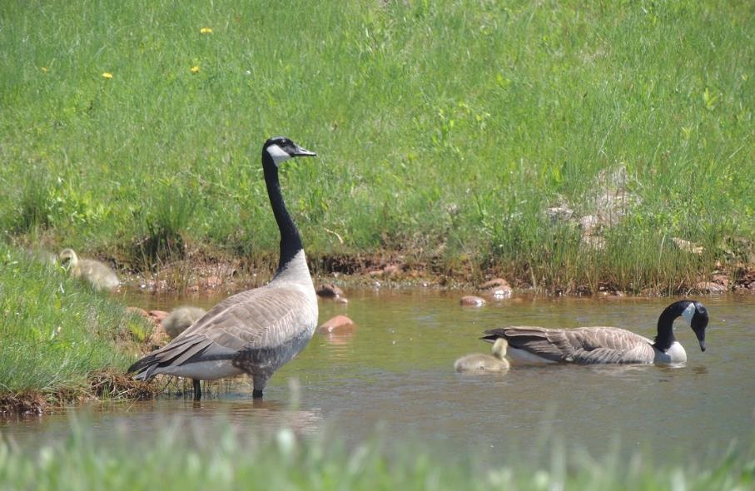
Miigwetch | Thank you | Merci
info@phai.ca
PH.Area.Initiative
@PHAI_PORT_HOPE
PHAI.ca
Phai_porthope
CNL’s Port Hope Area Initiative
Notes:
CLOSE

