Slide 1
IS INTEGRATION ON RADIOACTIVE WASTE MANAGEMENT IN INDONESIA
Liya Astuti
Pandu Dewanto
Evin Yuliati
BAPETEN(Nuclear Energy Regulatory Agency)
Indonesia
2023

Slide 2
Table of content
01
02
03
Radioactive waste management in Indonesia
Policy and strategy related to radioactive waste management
Current status, strategy, and approach on the IS integration
04
05
06
Challenges in IS Integration
Lesson learned and approach
Conclusion

Slide 3
Radioactive Waste Regulation Infrastructure
Regulations and policies
Act 10 Year 1997
GR No. 61 Year 2013
GR No. 5 Year 2021
PR No. 60 Year 2019
GR no. 29 Year 2008
GR 2 year 2014
BAPETEN CR No 16/2012
BAPETEN CR No. 8/2016
Minister of Health Regulation No. 7/2019
INDONESIA
Notes:
The first infrastructure is regulations and policies.
And this is the hierarchy of the Radioactive Waste Regulation infrastructure

Slide 4
POLICIES FOR RADIOACTIVE WASTE:
Radioactive Waste Regulation Infrastructure
ACT No. 10 year 1997 on Nuclear Energy
GR No 5 year 2021 on Risk Based Licensing
GR No 58 year 2015 on Radiation Safety and Security on the Transport of Radioactive Source
GR No 2 year 2014 on Licensing of Nuclear Installations and Nuclear Material Utilization
GR No 61 year 2013 on Management of Radioactive Waste
GR No 54 year 2012 on Safety and Security of Nuclear Installation
GR No 29 year 2008 on Licensing of Utilizing on Ionizing Radiation Sources and Nuclear Material
GR No 45 year 2023 on Safety of Ionizing Radiation and Security of Radioactive Material
President of Republic of Indonesia Regulation (PR) No. 84 Year 2010 on Ratification of Joint Convention On The Safety Of Spent Fuel Management And On The Safety Of Radioactive Waste Management
Act No. 10 of 1997
PR No 84 of 2010
GR No 5 of 2021
GR No 61 of 2013
GR No 2 of 2014
GR No 54 of 2012
GR No. 29 of 2008
GR No 45 of 2023
BAPETEN CHAIRMAN REGULATIONS
Minister of Health Regulation No. 7/2019
REGULATION OF INDONESIA
Notes:
ACT No. 10 year 1997
Responsibility sharing of Regulatory and Executig Body
Radioactive Waste Classification: LLW, ILW and HLW
Centralized System for radioactive waste management by Executing Body
There is no final repository facility for spent fuels.
GR No 5 year 2021
GR No 2 year 2014
GR No 54 year 2012
GR No 29 year 2008
GR No 33 year 2007
Regulates detailed evaluation of licensing process
GR No 61 year 2013
RW Classification has adopted GSG-1
Reuse and Recycle of DSRS by BATAN
GR No 58 year 2015
Adopt to SSR-6 and NSS-9
BCR No 16 year 2012
Conditional and unconditional clearance
Not applies to sealed source
BCR No 8 year 2016
Requirements for pre-disposal of LLW and ILW
Peraturan Presiden (PERPRES) tentang Pengesahan Joint Convention On The Safety Of Spent Fuel Management And On The Safety Of Radioactive Waste Management (Konvensi Gabungan tentang Keselamatan Pengelolaan Bahan Bakar Nuklir Bekas dan tentang Keselamatan Pengelolaan Limbah Radioaktif)

Slide 5
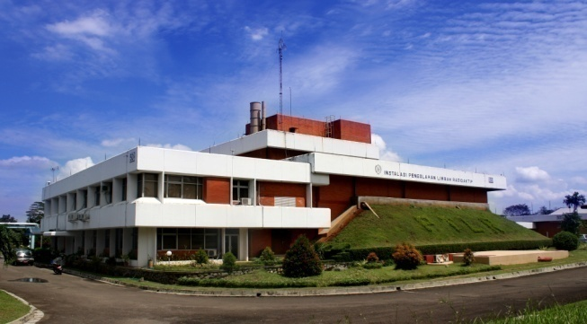
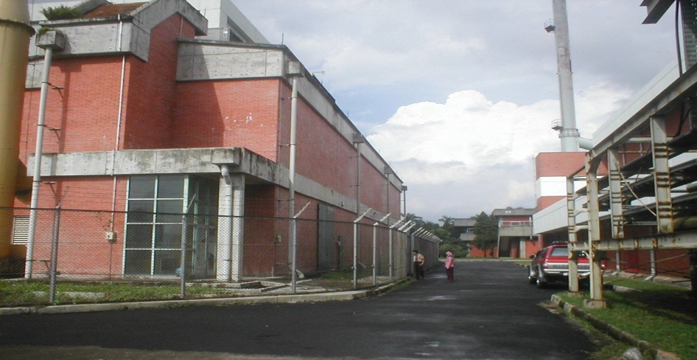
Radioactive waste treatment facilities
Radioactive waste treatment installation
Radioactive waste treatment for the contaminated material (Solid/liquid/semi liquid)
Management of Disused sealed radioactive source
Storage of radioactive sources (Internal radioactive waste survey and transport)
Technical and educative training for the radioactive waste management
Pool storage for the spent fuel
Spent fuel treatment
Irradiation target transfer through the connecting channel
Internal radioactive waste survey and transport
Technical and educative training for the radioactive waste management

Slide 6
The Policy-Program Plan in PR 60/2019 Regarding The Radioactive Waste Management
Program plan | Main Sector | Supporting Sector | Period and output
 |  |  | 2020-2024 | 2025-2029 | 2030-2035
Development of nuclear technology applications for constructing and operating low, medium, and high-level radioactive waste storage facilities. (respectively: in near-surface storage, medium-depth storage, and final disposal facilities) | BATANª | KemenRistekDikti^{b}, KemenPUPR^{c}, Kemen ATR/BPN^{d}, KLHK^{e}, Kemenkes^{f}, KemenPerin^{g}, BAPETEN^{h} | Implementing nuclear technology applications for constructing and operating low, medium, and high-level radioactive waste storage facilities. (respectively, in the form of near-surface storage, medium-depth storage, and final disposal facilities)
Developing a nationally integrated IS for monitoring radioactivity levels of radioactive waste from nuclear installations and radiation facilities. | BATAN | KLHK, Kemenkes, KemenPerin, KemenESDM^{i}, BAPETEN | A nationally integrated IS is available to monitor radioactive waste and radioactivity levels from nuclear installations and radiation facilities. | Implement a nationally integrated IS for monitoring radioactive waste and radioactivity levels from nuclear installations and radiation facilities. | The improvement of nationally integrated ISs related to monitoring radioactive waste and radioactivity levels from nuclear installations and radiation facilities

Slide 7
The Policy-Program Plan in PR 60/2019 Regarding The Radioactive Waste Management
Program plan | Main Sector | Supporting Sector | Period and output
 |  |  | 2020-2024 | 2025-2029 | 2030-2035
Formulate a national policy concept for radioactive waste management | BATAN | KemenRistekDikti, KLHK, Kemenkes, KemenPerin, KemenESDM, BAPETEN | The formulation of a national policy conception of radioactive waste management
Establish periodic inter-ministerial/LPNK^{j} communication forums related to regulatory of nuclear and radiation safety in radioactive waste management. | BAPETEN | KLHK, Kemenkes, KemenPerin, KemenESDM, BATAN | Formation of periodic inter-ministerial/LPNK communication forums related to the supervision of nuclear and radiation safety of radioactive waste

Slide 8
National coordination on the radioactive waste
The national coordination already commenced 2 times (2002 and 2023)
Begin with preliminary meeting to identify the problem from stakeholders
Agreed on several urgent radioactive waste management issues, including the information system issues.
Provided in road map of 5 years plan

Slide 9
Road map
The legislation still states that the implementing agency is BATAN, while BATAN is now part of BRIN.
Radioactive waste management carried out by waste producers that endanger workers, society and the environment
The IS for radioactive waste accounting is not adequate
Radioactive waste transport has not been following the current legislation.
Insufficient development of human resources source for radioactive waste management and regulatory
Interim storage is currently not following the legislation
Coordination with the stakeholder has not explicitly discussed radioactive waste management

Slide 10
Previous integration of eLIRA and BALIS
Background :frequent mismatch serial number data between in the license and transport clearance
Need to synchronize the licensee data between the BALIS and eLIRA
Need to obtain data of the licensee using third party for the radioactive waste transport
Need ot ensure the data validity, and support effective and efficient radioactive waste management process.
The radioactive waste license helps projecting the future radioactive waste interim storage capacity and future submission.

Slide 11
Integration measure-IS identification and status
Facility data
License number
Data of ionizing radiation source
Licensing
Infara SMILE
Radioactive waste data
Minutes of receipt of waste
Data of reuse or recycled radioactive waste
eLIRA
Total waste mass produced (kg, per month)
Validation of the availability waste treatment
(incinerator, autoclave, third party)
Medical facility code
Waste produced daily (in kg)
Garbage dump license data
Manifest number
Freight data/info
Waste processor data/info
(transactional/real time)

Slide 12
Integration measure-IS integration plan
Kemenkes
SIKELIM
meSMILE
Facility data
License number
Data of ionizing radiation source
Medical facility clearance data
BAPETEN
Licensing
Infara
SMILE
Radioactive waste data
Minutes of receipt of waste
Data of reuse or recycled
radioactive waste
Transport permit for radioactive waste
BRIN
SIMLIRA
eLIRA/ELSA
Kemenhub
SPIONAM
SALT (radioactive waste inventory)

Slide 13
Another status and development of IS Integration Prospect
Development of SALT, then integration with BALIS and eLIRA
Meanwhile, eLIRA and BALIS preliminary discussion for the integration
RADMON and BALIS SMILE. BALIS SMILE is still developing.
Integration of BALIS, SIKELIM and meSMILE
SPIONAM and BALIS→ need further follow up post national coordination

Slide 14
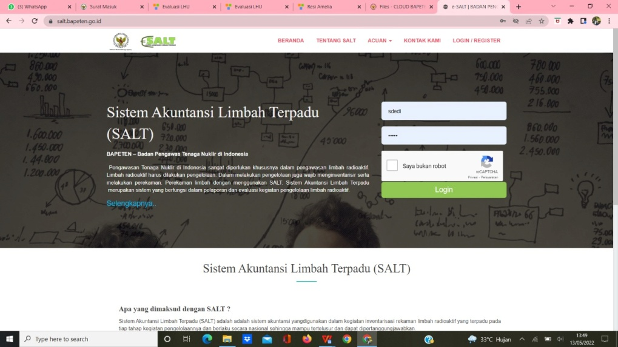
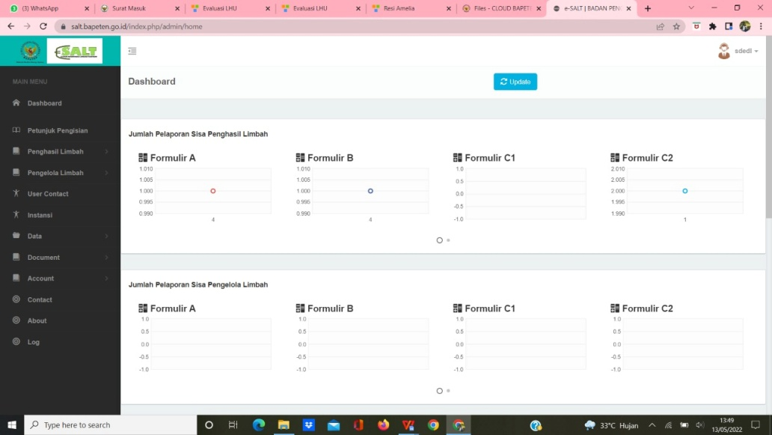
Development of SALT (Integrated Waste Accounting System)
Previous version of SALT is developed by third party
To find out the amount of waste that is produced and sent to DPFK-BRIN
To find out the amount of waste that is treated, clearanced, dan reused
To find out the waste journey from producer to DPFK-BRIN
The new version of SALT is developing
Notes:
Balis & Salt dikembangkan Bapeten. Deskripsi Balis & Elira.
Elira & Simlira dikembangkan Batan.
Diagram alir pengiriman limbah yang memperlihatkan integrasi elira & Balis.
Diagram integrasi salt & simlira.

Slide 15
Conclusion
The integration of IS related to radioactive waste management is urgent, for safety of radiation dan security of radioactive material purpose.
A set of national strategy and policy and following regulation is required for specific measure and framework in terms of radioactive waste management.
Importance of coordination between stakeholders for tackling the challenges in integrating the IS.

Slide 16
Thank you

