Slide 2
APPROCHES IN THE SUSTAINABLE MANAGEMENT OF RADIOACTIVE WASTE AND DISUSED SEALED RADIOACTIVE SOURCES IN ZIMBABWE
Amos MUZONGOMERWA & Ernest MAKONI
Radiation Protection Authority of Zimbabwe

Slide 3
OUTLINE
Introduction
Key Challenges and Opportunities
Management Measures
Recommendations

Slide 4
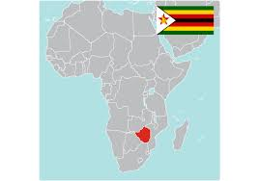
Legislative Framework
Zimbabwe national safety policy to ensure the protection of people and environment against the hazards of ionizing radiation are provided for through the Radiation Protection Act [Chapter 15:15] No.5/2004.
The Act is administered by the Office of the President and Cabinet and reserved for the President as from January 2011 moving from the Ministry of Health and Child-Care as per Statutory Instrument 162 of 2012.
The Act establishes the Radiation Protection Board (RPB) and the Radiation Protection Authority of Zimbabwe (RPAZ) as the regulatory body. Operationalized in 2009.

Slide 5

Regulatory Infrastructure
An effective authorization and inspection programme exists for the safety and security of radioactive sources. Radiation sources in Zimbabwe are used in industrial and manufacturing applications, medicine, research, construction, and in mining. No nuclear facilities and Zimbabwe does not manufacture radiation sources.
Return to supplier requirements in place prior to import, arrangements and cooperation with Customs in place to ensure the same.
Responsibility of managing orphan sources is with RPAZ.
Zimbabwe has in its part made political commitment to implementing the Code of Conduct on the Safety and Security of Radioactive Sources. Commitment ahs also been made for the two guidance documents supplement to the Code (Import and Export and Disused Sources).
Contracting Party to the Joint Convention on the Safety of Spent Fuel Management and on the Safety of Radioactive Waste Management

Slide 6
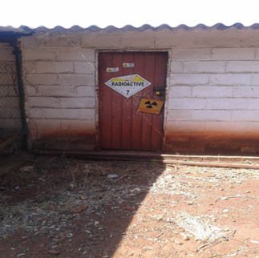
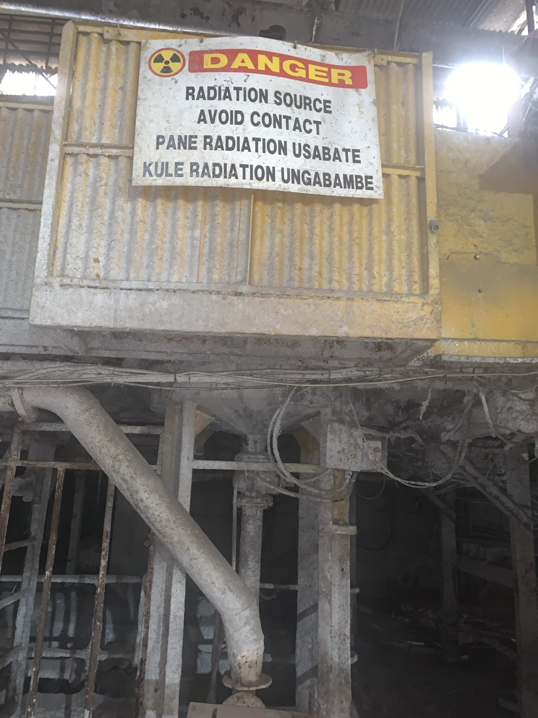
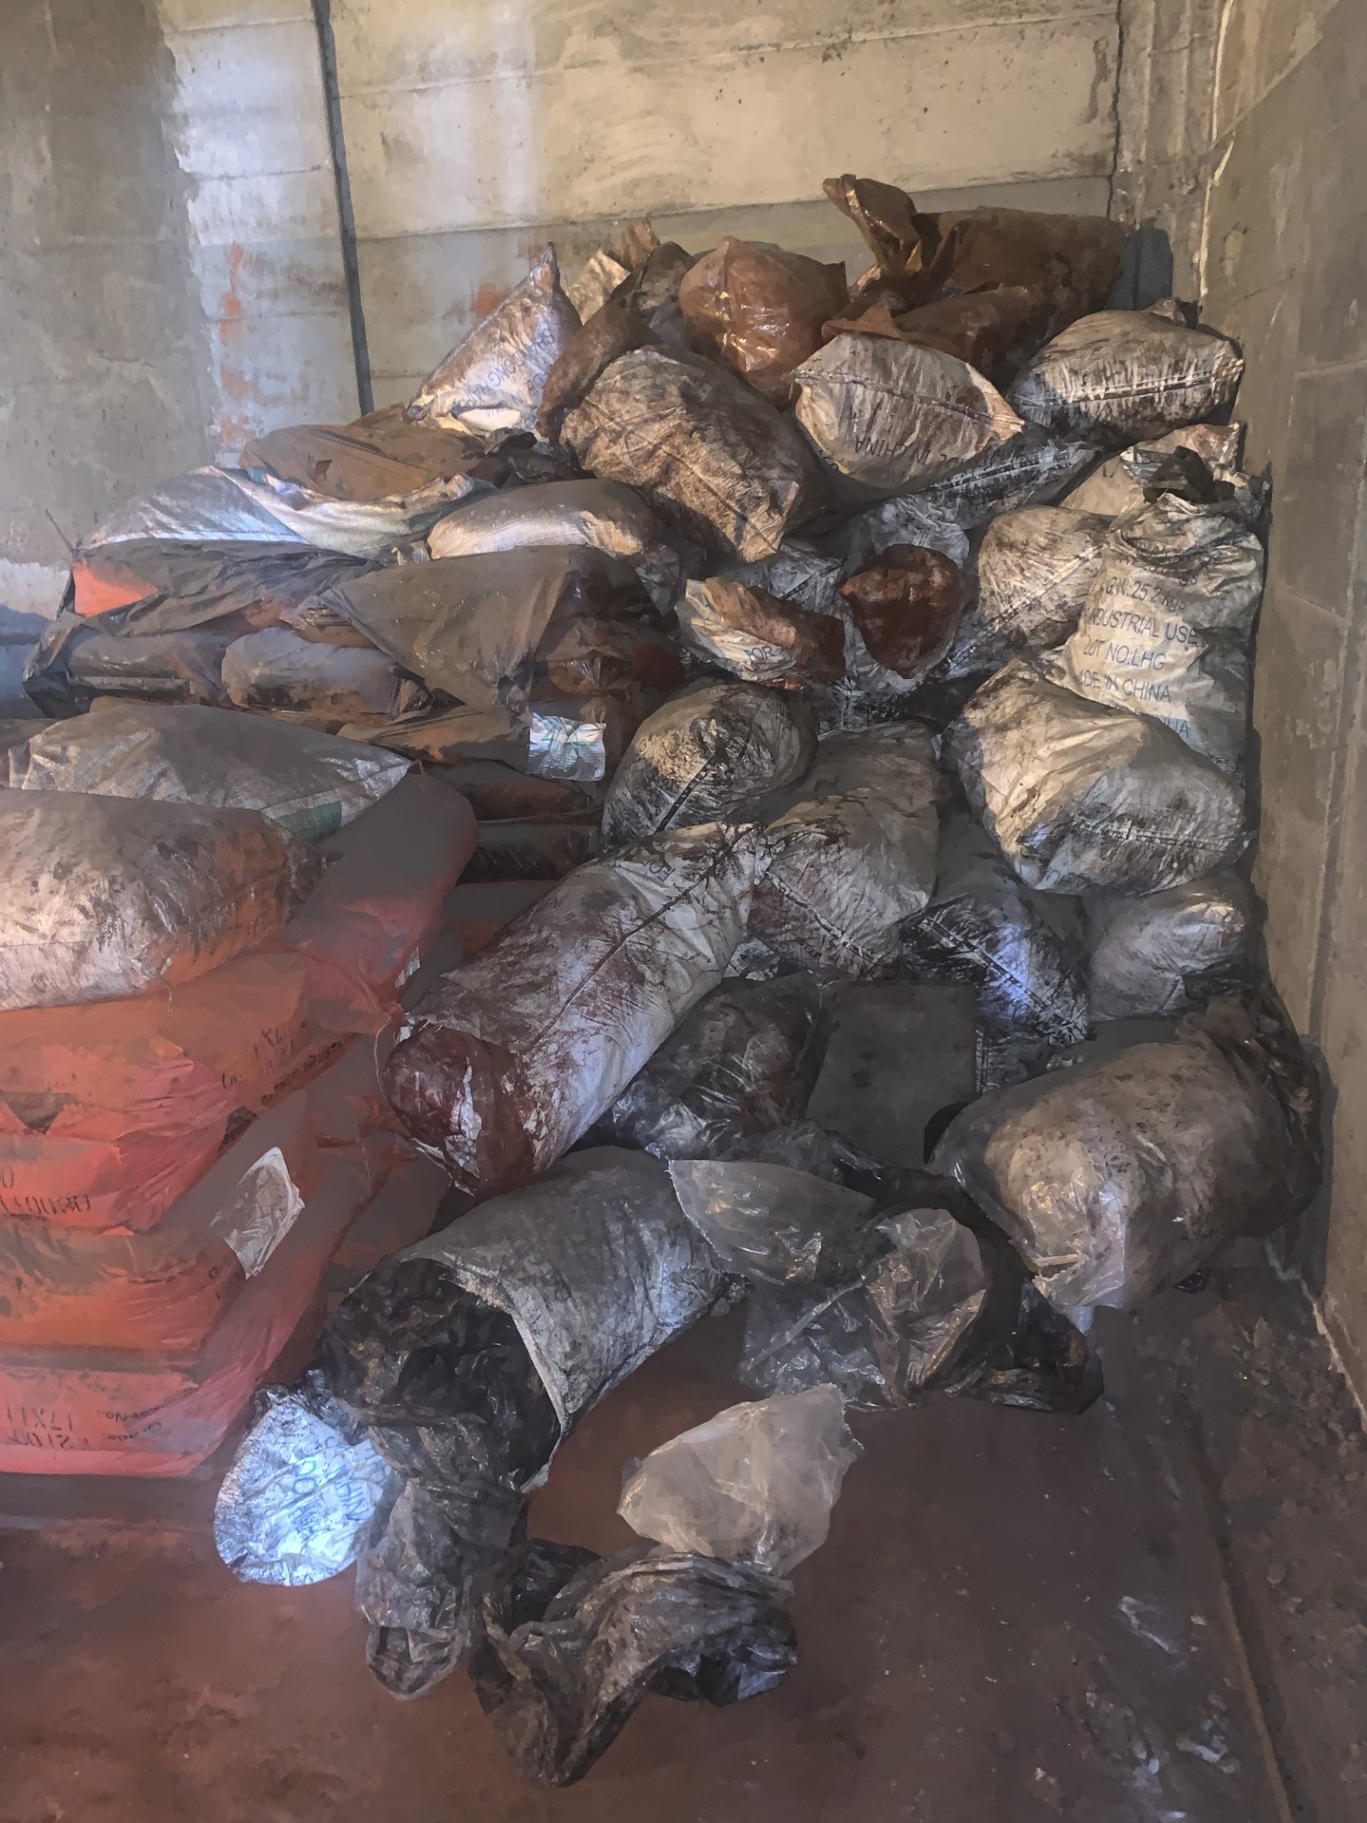
Challenges and Issues
Challenges with legacy sources that were brought in before the formation of the regulatory body and at times the costs associated with their return.
Other sources belonging to entities that have folded and became incapacitated over the years.
Disused sources continue to be stored for long term at facilities and under regulatory control.
The safety of personnel and possibility of source’s vulnerability to theft, loss, or inappropriate management exists even in the presence of regulatory provisions
Financing mechanism for management of orphan sources

Slide 7
Measures
Strengthening Storage Measures at Facilities
Government set out to strengthen the management of disused sealed radioactive sources from facility to national level as set out by the Supplementary Guidance on the Management of Disused Sources, the Radiation Protection Act (Chapter 15:15) and the General Regulations.
1.
Setting up an Interim Facility for Orphan and Vulnerable Sources
2.
Establishment of a centralised long-term Storage Facility
3.
4.
Inclusion of Financial Provisions on Rad. Waste

Slide 8

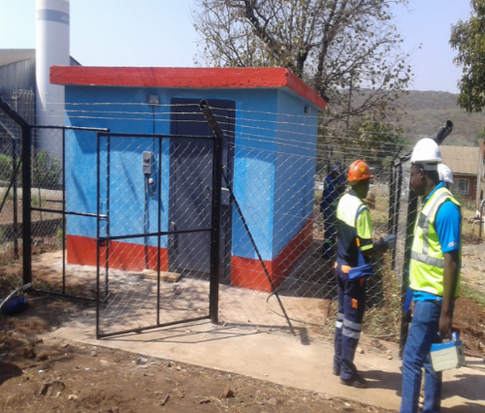
Strengthening Storage within Facilities
The Regulatory Body’s Technical Services Department has been providing guidance on set up of adequate temporary storage to facilities for the safe storage of disused sealed radioactive sources to promote compliance to regulatory requirements.
Facilities have also been assisted with processes to return sources to the supplier. This has significantly reduced the risk of loss, theft, and inadequate control of the sources and improving the safety of workers.

Slide 9
Set Up of Interim Facility
An interim facility to manage orphan sources was set up by the regulatory body at its Head Office site, with capability for receiving, processing, and conditioning of sources.
This consisted of 3 ISO containers, one for source recovery from devices, and another for encapsulation and conditioning of recovered sources and the third for final storage of the sources.
Zimbabwe as part of the IAEA AFRA Project RAF9062 the now RAF9069 was able to get assistance in design and procedures for the mobile tool kit.

Slide 10
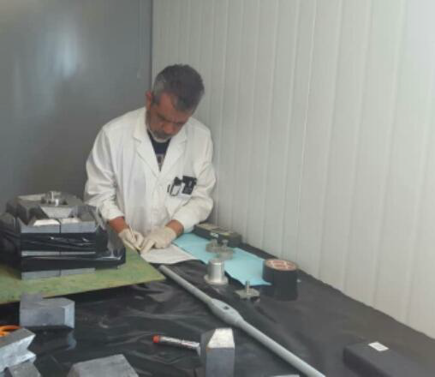
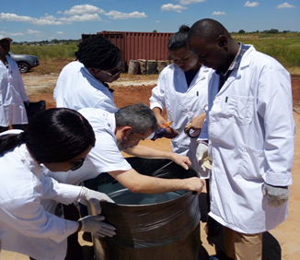
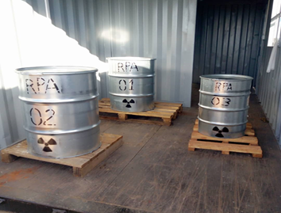
Conditioning Operation
Through IAEA AFRA Project RAF9062, Zimbabwe had been briefed on the new procedures on recovery and conditioning of disused sources that can be carried out by national experts and under the supervision of the IAEA expert.
Local personal had received prior training on recovery and conditioning of similar sources in Morrocco, Egypt and Senegal.
Managed to condition spent Co-60 from a local hospital and Am-231 sources for road construction that had been damaged by a fire.
Encapsulation of Low Activity Sources in a stainless-steel capsule followed by placing the capsule in a steel lined lead container and placing the package in such a way that future retrieval of the capsule for disposal is possible.

Slide 11
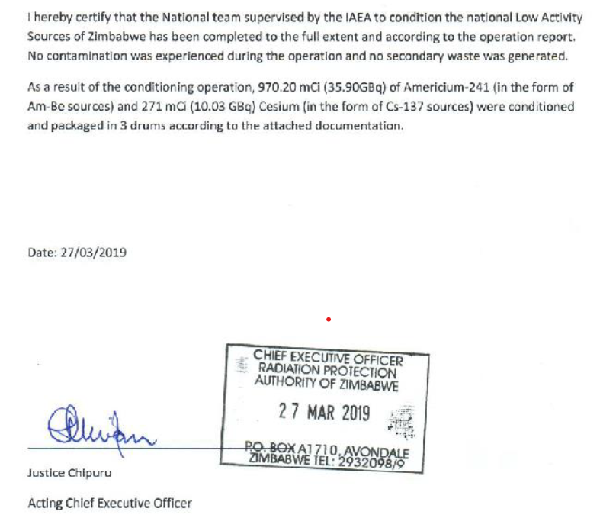
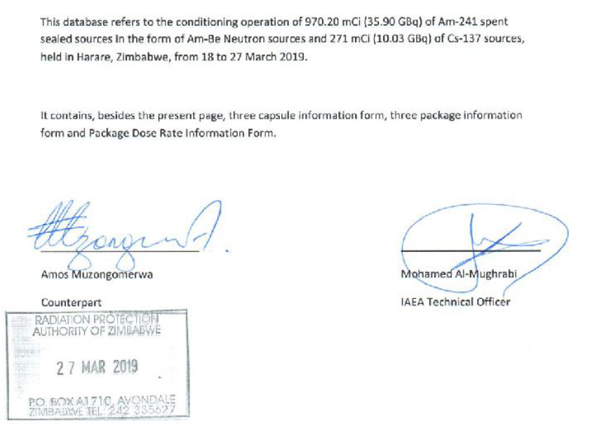
Conditioning Operation

Slide 12
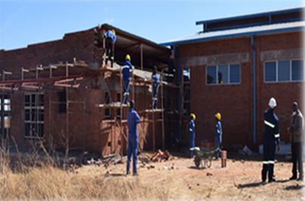
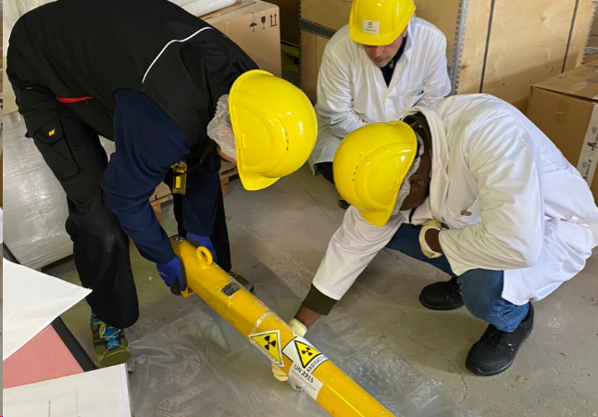
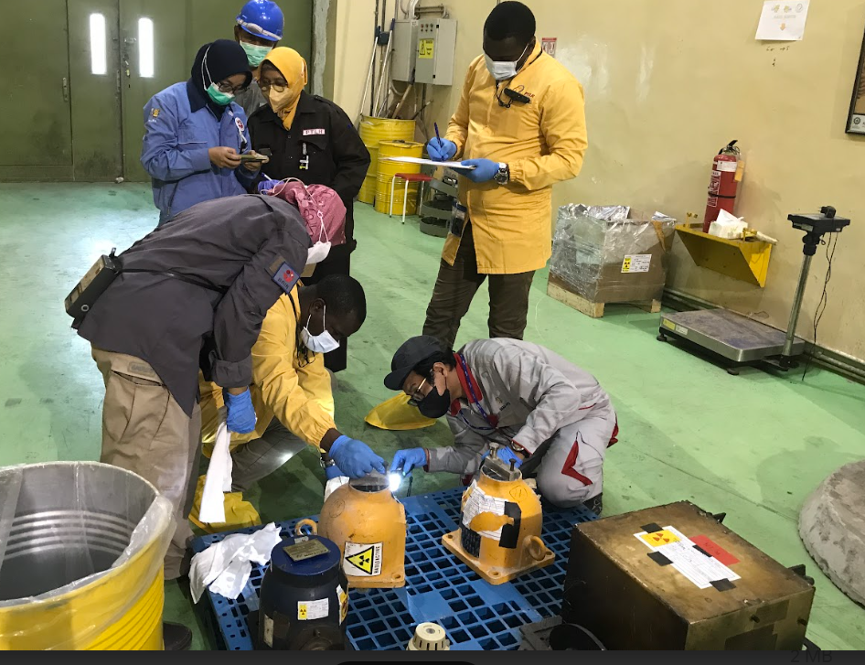
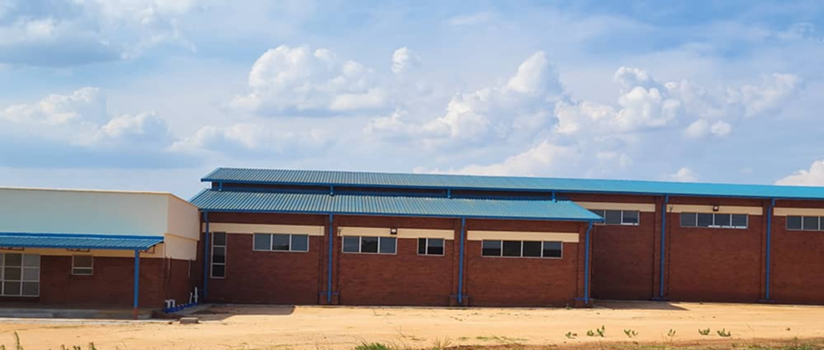
Establishment of a Centralised Storage Facility
A centralized waste facility is under construction with funding from central government appropriate to the inventory. IAEA expert support in design, evaluation of construction.
Arrangements for physical protection upgrades underway with Agency assistance and funding.
Assistance in ensuring competence of both regulatory and also operational side of the facility through IAEA National Project ZIM9007
Active involvement of young professionals

Slide 13
Other Options
Spent Ra226 sources for medical practices conditioned back in the year 2000 through IAEA, we have there 1457.8 mg of Ra226.
Three drums are there and stored with no conclusive solution/disposal pathway.
Government has expressed interest in the IAEA Global Radium-226 recycling initiative, as an option for the safe management of disused sealed radioactive sources. Discussions with potential takers underway.
Waste Management Fund to be put in place as surcharge of license fees, managed by Board of Trustees with the regulatory body responsible for its implementation. Included in the Radiation Protection Amendment Bill.

Slide 14
Conclusions
Provisions for strengthening management of disused sealed radioactive sources in Zimbabwe allowed for the development of adequate infrastructure for receiving, recovery, processing, and storage of disused sources. The interim storage facility allowed for immediate arrangements for improving safety and security of sources while the centralised radioactive waste management facility presents opportunity for long term measures. The recycling option provides opportunity for sustainable end point management. It is expected that proposed financial provisions shall ensure sustainable funding of operations. The implementation of provisions in the supplementary guidance on the management of disused sources has been essential. IAEA support through the relevant projects and programmes mentioned in this presentation has been able to sustain the strategies and management options the government of Zimbabwe took.

