Slide 2
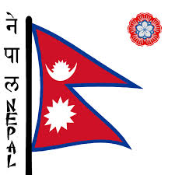
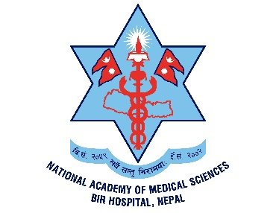
Radioactive waste management in Nepal
Kanchan P. Adhikari
Associate Professor Medical Physics
National Academy of Medical Sciences, Bir Hospital
Kathmandu, Nepal
Email: kanchanadhikari@gmail.com

Slide 3
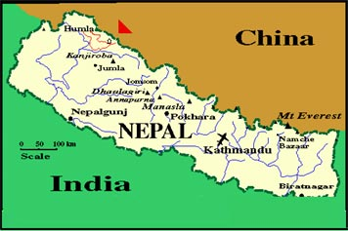
Background
Area: 147,181 Sq. Km
Population of 26.6 million (census 2012)
Federal Democratic Republic since 2008
IAEA member country since July, 2008.
Partnership with USDOE ORS on security of radioactive sources since June, 2008.

Slide 4
History: Radioactive materials
1976: Brachytherapy service was first introduced by using radium needle in the Maternity Hospital.
1988: NAMS, Bir Hospital introduced First Nuclear Medicine service.
1991: NAMS, Bir Hospital introduced First Radiotherapy unit with Tele Cobalt-60 machine.
2002: B.P. Koirala Memorial Cancer Hospital, Bharatpur First HDR Brachytherapy in Nepal.
2015: First Blood Irradiator was installed at Civil Servant Hospital of Nepal.

Slide 5
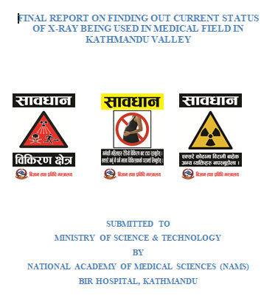
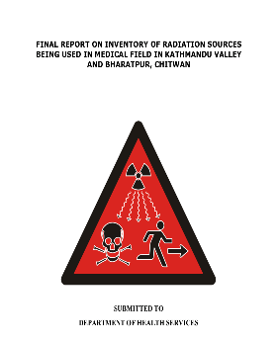
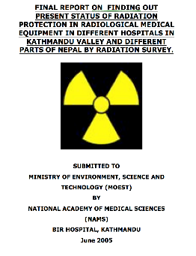
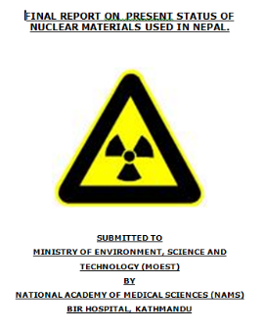
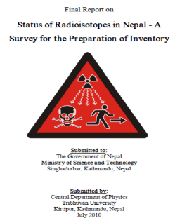
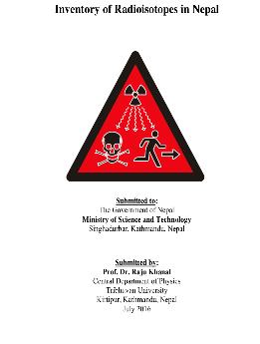
Inventory of Radiation Sources in Nepal
X-rays
Cobalt-60, Irridium-192, Caesium-137
Technetium - 99^{m}
For Calibration of dosimetry equipment in medical field: Strontium 90
2004 2005 2010 2016 2017 2020

Slide 6
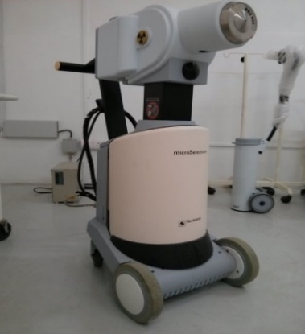
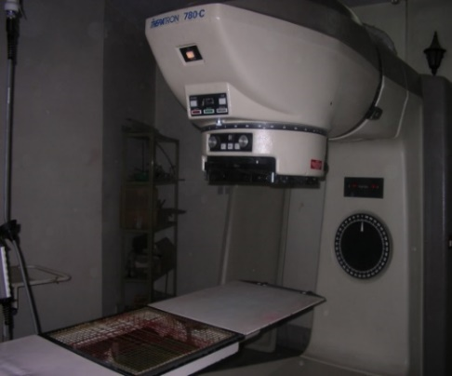
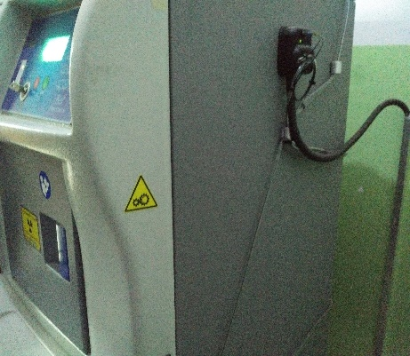
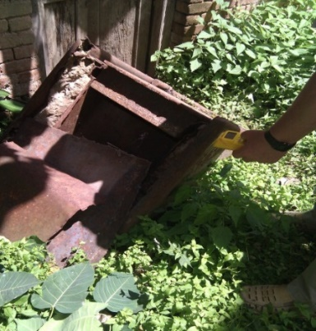
Current Status
Radioactive materials are mainly used in medical field and radioactive waste are mainly from radiation Therapy disused source.
Small quantity, micro curie level radioactive sources are being used in other sectors.
Notes:
Tremendous development has taken place in the field of diagnostic radiology. Newer modalities are being introduced in major hospitals and latest radiological equipment are being imported. This quantitative increment may have a positive impact on the health service of the country; but the lack of control is a serious problem.

Slide 7
Status of Radioactive Source & Waste
Diagnostic & Therapeutic Equipment | Total number of Equipment
External Beam Therapy (Cobalt-60) | Three disuse sources One operational One Under installation process
HDR Brachytherapy | 1 cobalt-60 operational 5 Irradium-192 operational 1 not operational
Blood Irradiator | 1 (Caesium-137)
Radium | Disused
Notes:
Use of cobalt-60 is in decreasing phase, because alternative technology like Linear Accelerator has major advantage especially in radiation therapy for better treatment technique for the benefit for our cancer patients. We were not able to find any type of radioactive materials used in industry or other sector. Our conclusion was this might be not correct because there must be some type of radioactive materials being used in industrial sector. This might be because of lack of knowledge of people working in industry

Slide 8
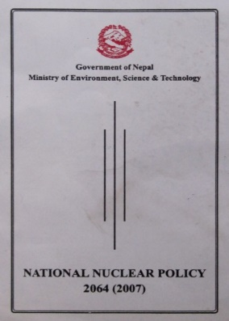
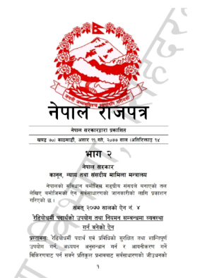
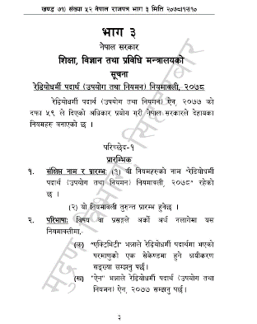
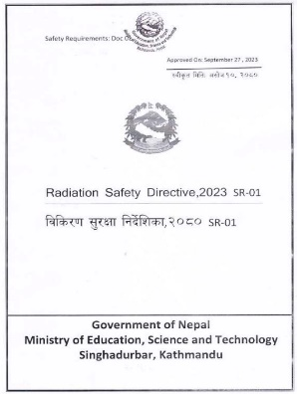
Current Status: Policy, Law, Regulation & Directives
Mission of Nuclear Policy is to make proper use of nuclear energy by its development, research and necessary control for peaceful utilization.
The most essential “Radioactive Substances (Utilization & Regulation) Act has materialized effective as of July, 2020.
Radioactive materials (Utilization & Regulation) Rules 2022 was published in Nepal Gazette in March 2022.
Radiation Safety Directive was approved on September 2023.

Slide 9

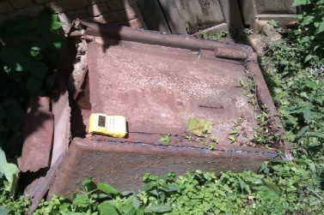
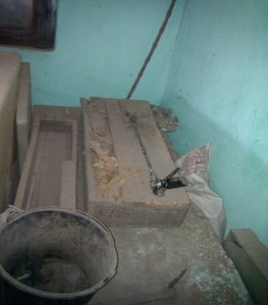
Issues: Management of Radioactive Waste
According to the report*, two crates of Radium in the form of tubes were donated to Nepal from American Institute in 1975 were buried at the premises of the Teku Hospital. Interaction with the concerned staff at the site, enabled us to discover some lead blocks and forceps for handling the source.
Those sources was buried after radiation sickness complaint by one of the staff at that time.
I.S Sundera Rao, WHO short term consultant, Assignment report 6 – 17 April, 1977. WHO Project: NEP HSD 001
Teku Hospital, Kathmandu.
Notes:
In this case also we were unable to find any relevant data.

Slide 10
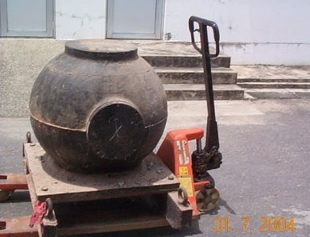
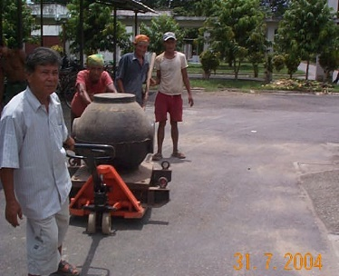
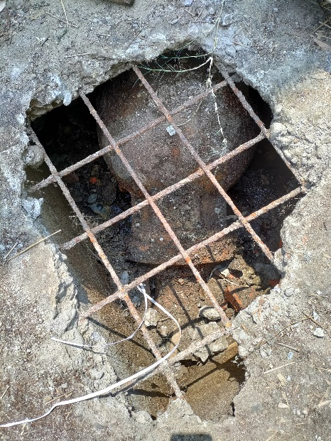
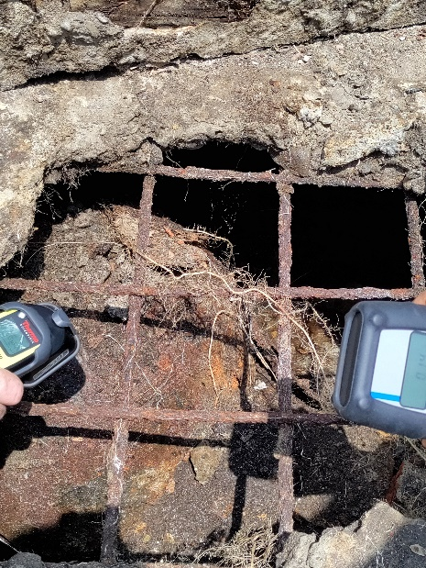
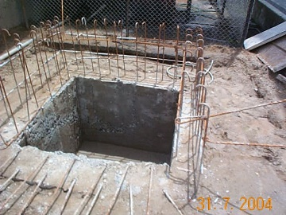
Issues: Management of Radioactive Waste
B.P. Koirala Memorial Cancer Hospital, Bharatpur, Chittwan, Nepal
Notes:
In this case also we were unable to find any relevant data.

Slide 11
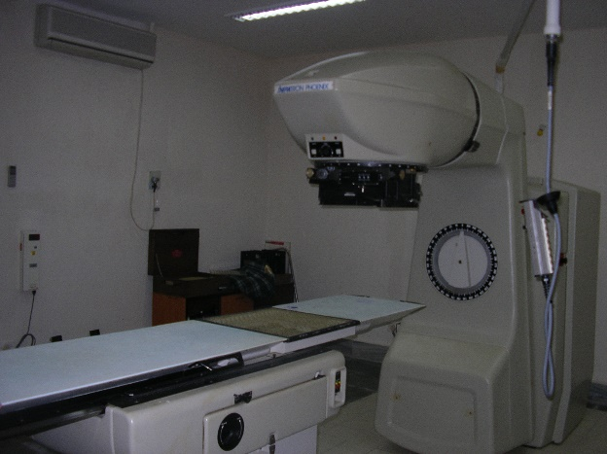
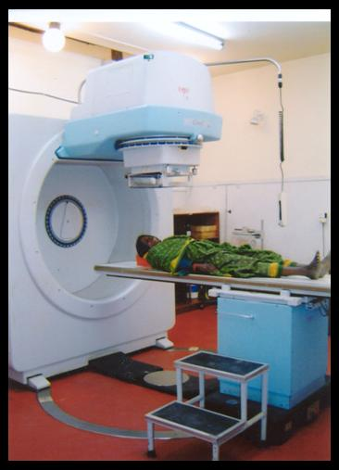
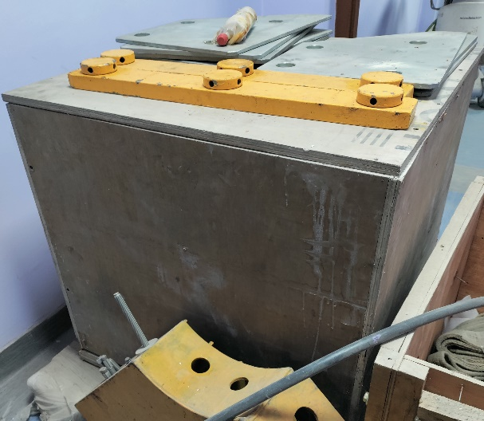
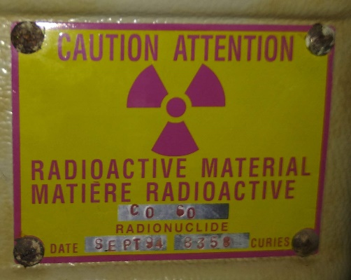
Issues: Management of Radioactive Waste
Bhakatpur Cancer Hospital, Kathmandu
Pokhara Manipal College of Medical Sciences, Pokhara

Slide 12
Challenges
Regulatory Framework & Capacity: While Nepal has taken steps to establish a regulatory framework, there might be gaps or shortcomings in the regulatory structure that need to be addressed to effectively manage radioactive waste. Establishing and maintaining a competent regulatory body for radioactive waste management requires specialized expertise.
Challenges in recruiting and training professionals with the necessary skills to oversee the safe handling, storage, and disposal of radioactive materials.
Financial & Technological Infrastructure Limitations: Effective management of radioactive waste requires advanced technologies for safe storage, transportation, and disposal. Nepal might face limitations in accessing and implementing such technologies financial constraints and technological infrastructure.
Transportation Safety: As a landlocked country, to ensure safe cross-border movement of radioactive materials.
Notes:
: Proper storage and disposal facilities for radioactive waste are crucial to prevent contamination and exposure.

Slide 13
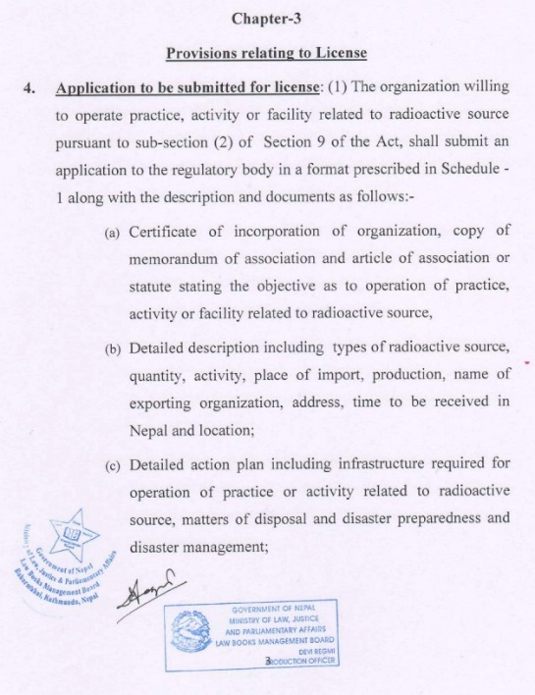
Integrating Sustainability : Laws and Regulations
In Radioactive Substances (Utilization & Regulations) Rules 2022, Chapter 3, Rule 4, mandates comprehensive plans for the safe storage, transportation, and disposal of radioactive waste, along with emergency preparedness & response plans to ensure minimal impact on ecosystems and communities.
In Radioactive Substances (Utilization & Regulations) Act, 2020, Chapter 7, Article 32 requires Disaster Preparedness and Disaster Management Plans.

Slide 14
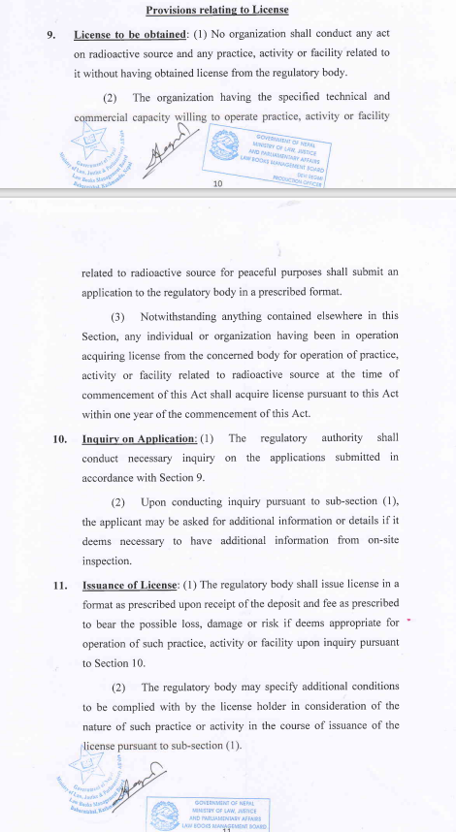
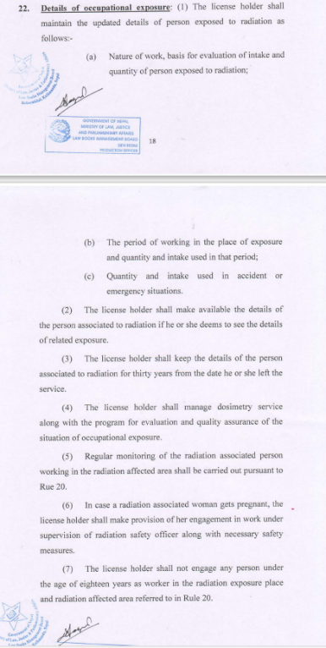
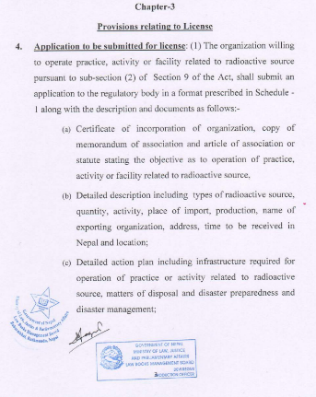
Integrating Sustainability : Laws and Regulations
Licensing and Permitting: In Law, Chapter 3, with provisions related to licenses from Article 9 to 21.
Chapter 3 of Regulation, Rules No: 4 to 10 pertain to licensing. Before approving a new facility that uses radioactive materials, regulatory agencies require a thorough assessment of facilities including waste management practices.
Monitoring and Reporting: Chapter 4, Article 22 of law, and reporting detailing radioactive waste generation and in Chapter 3, Rule 4 of the regulations.

Slide 15
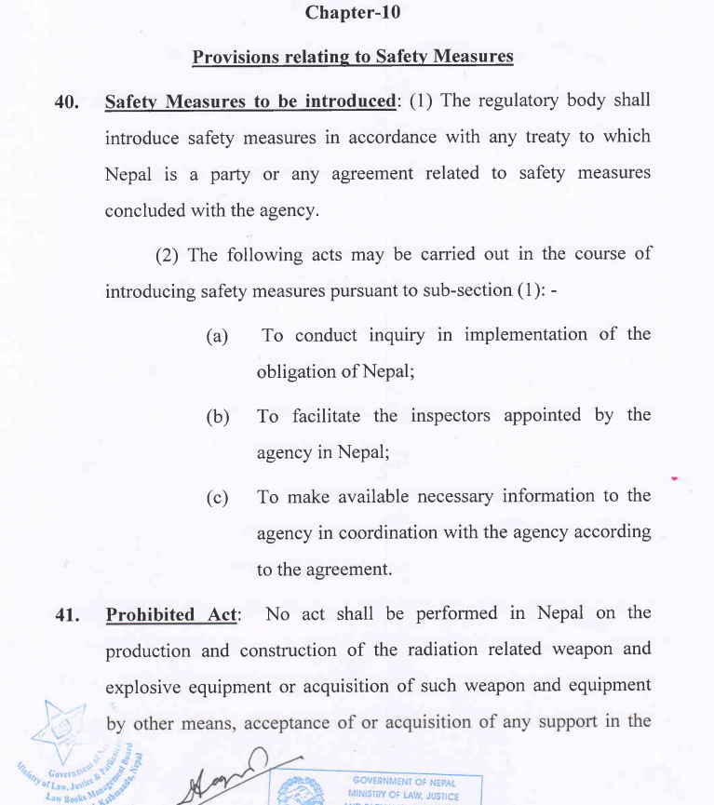
Integrating Sustainability : Laws and Regulations
International Collaboration: Chapter 10 of our laws clearly states in Article 40 that collaboration with the International Atomic Energy Agency (IAEA) is required for managing radiation sources and sharing expertise to promote sustainable practices.
Notes:
Collaboration between countries can lead to the development of harmonized standards and best practices for radiation safety.

Slide 16
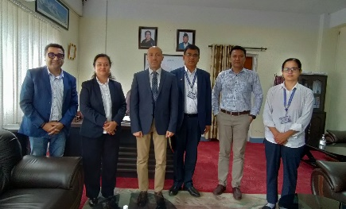
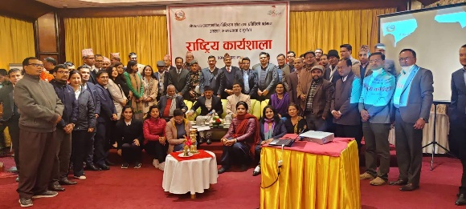
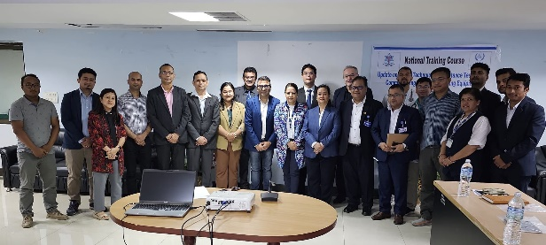
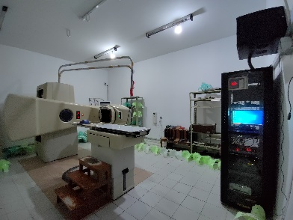
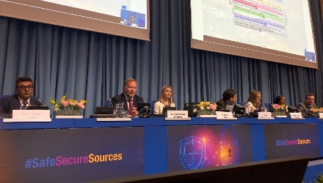
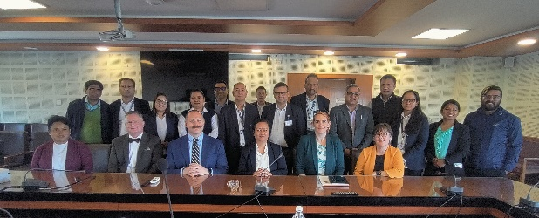
Way Forward
Though we still do not have fully functional regulatory body, but majority of radioactive waste are kept in well-regulated environments (e.g licencing, inspection & disposal) for managing radioactive waste through Nuclear Materials Management Division, MoEST.
Various IAEA Technical Projects are currently underway, focusing on strengthening regulatory efforts through training, expert missions, equipment donations, and support in the development of rules, regulations, and standards.
US Department of Energy's Office of Radiological Security (ORS) has supported Physical Protection Management System (PPSM) for Security of all Category 1 sources in Nepal and expressed its interest in assisting Nepal with the management of disused radioactive sources.

Slide 17
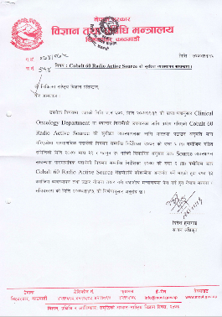
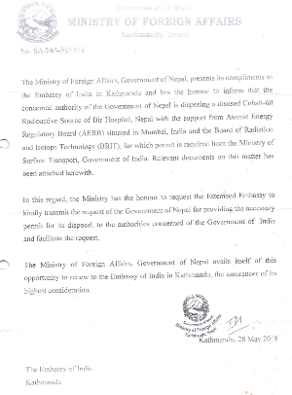
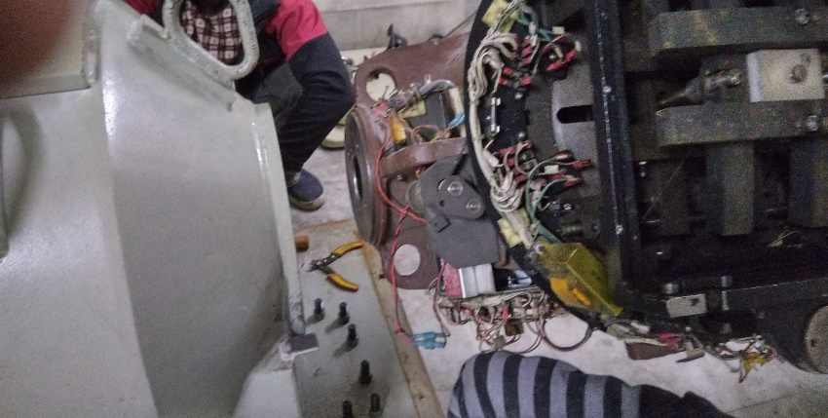
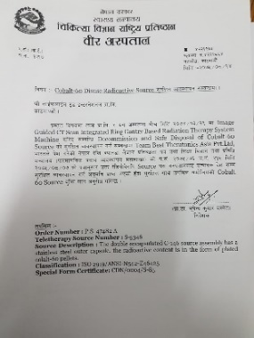
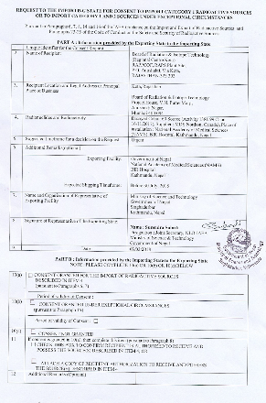
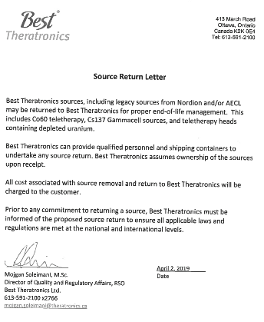
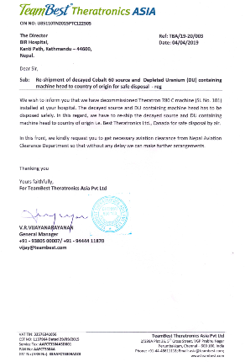
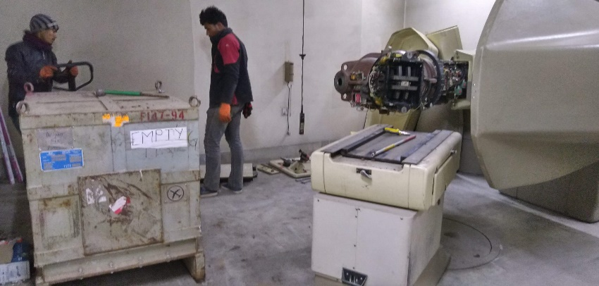
Success Story: Repatriation of Cobalt-60

Slide 18
Conclusion
Still to have fully functional regulatory body, but majority of radioactive waste are kept in well-regulated environments through Nuclear Materials Management Division, MoEST. Addressing these challenges requires a coordinated effort involving government agencies, regulatory bodies and collaboration and partnership with international organizations for technical assistance and knowledge sharing. Developing a comprehensive strategy that considers regulatory, technical, safety, and social considerations is essential for effectively managing radioactive waste in Nepal. Several strategies and actions should be implemented like strengthening regulatory framework, capacity building, infrastructure development, adoption of newer technology, public outreach, developing comprehensive short term & long-term storage management strategy.
Despite the challenges of establishing a regulatory body and ensuring the availability of competent experts, Nepal is making progress in the management of radioactive waste, including high-activity radioisotopes. Various IAEA Technical Projects are currently underway, focusing on strengthening regulatory efforts through training, expert missions, equipment donations, and support in the development of regulations. Additionally, the United States Department of Energy's Office of Radiological Security (ORS) has expressed its interest in assisting Nepal with the management of disused radioactive sources.
By incorporating sustainability principles into radiation safety policies, strategies, legislation, and regulatory frameworks, societies can ensure that radiation-related activities are conducted responsibly, minimizing their impact on the environment and public health over the long term.

Slide 19
References
Adhikari et al. Status of radiation protection at different Hospitals in Nepal. Journal of Medical Physics. 2012; 37(4): 240-244.
Adhikari K.P. Radiation Regulation in Nepal: A Challenging Journey. Radiation Regulator. 2012; 1(1): 6-10.
Poudel, S.K., Adhikari K.P., “Nuclear Safeguards in Nepal”, Symposium on International Safeguards: Reflecting on the Past and Anticipating the Future, IAEA, Vienna, Austria, 31 October to 4 November 2022
Radioactive Substances (Utilization and Regulation) Act, 2020
Radioactive Substances (Utilization and Regulation) Rules, 2022
“Inventory of Radioisotopes in Nepal” Submitted to Ministry of Science and Technology by Central Department of Physics, Tribhuvan University, Kirtipur , 2016
“Final Report on Present Status of Nuclear Materials used in Nepal”, Submitted to Ministry of Environment Science and Technology by NAMS, Bir Hospital, Kathmandu, 2006.

Slide 20
Challenges and issues of safety, security, and safeguard of radioactive waste have no national boundary. Thus a collaborative effort is required for management of radioactive waste and peaceful uses of nuclear technology for betterment of mankind.
Notes:
Before I finish my presentation I would like to say …

Slide 21
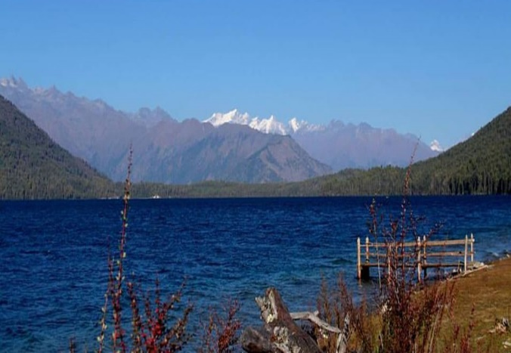
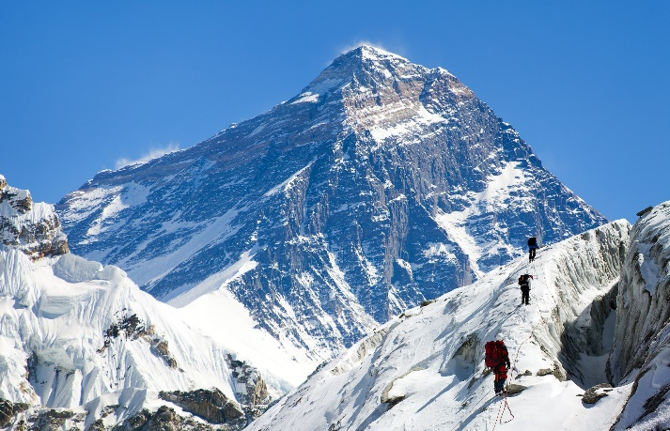
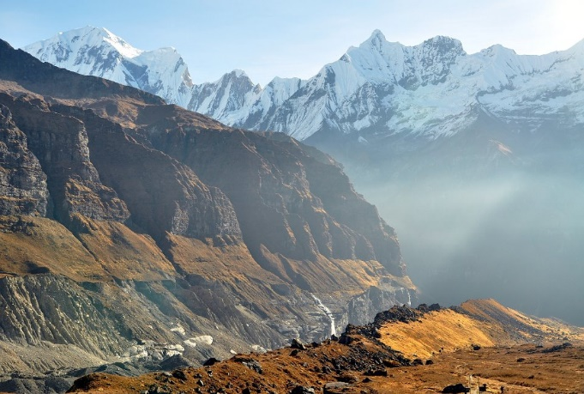



Thank you

