Slide 2
EMBEDDING SUSTAINABILITY INTO NUCLEAR SITE DECOMMISSIONING STRATEGY AND SITE RESTORATION DELIVERY – AN EXAMPLE FROM THE WINFRITH SITE IN THE UK
Ellanor Joyce
End State Manager
Nuclear Restoration Services

Slide 3
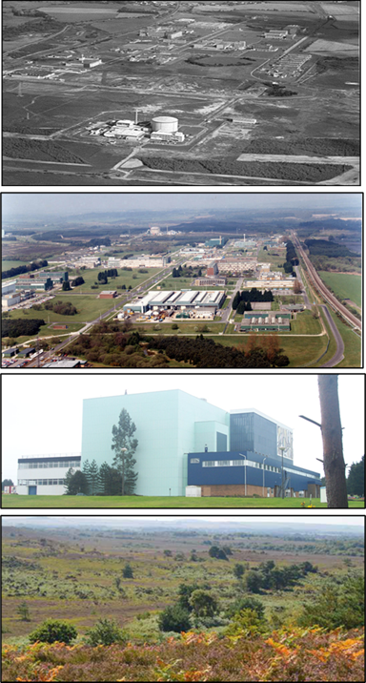
NRS Winfrith
Established in 1957 as a nuclear power research and development centre.
Nine experimental reactors and numerous laboratories.
Operations ceased early 1990s
Decommissioning commenced in 1992:
  Fuel free in 2016
  7 reactors and majority of buildings decommissioned
  Over 40% of land released for redevelopment
On-going work:
  Preparing to remove two remaining cores
  On-going liquid effluent and solid waste management
Where next?
  Delivering the NDA and Magnox missions - ‘Heathland with public access of amenity value to the local community…’

Slide 4
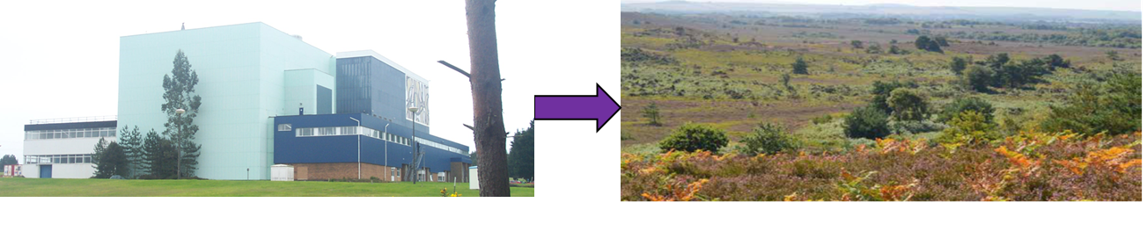
Defining the preferred approach to decommissioning
How do we decommission and manage waste sustainably to deliver the next planned land use?
  Assess available options using a range of ‘attributes’
  Balance benefits and detriments / risks in short and long term
  Decision making with input from the local community
  Safety remains our core mission, but it needs to be proportionate and balanced

Slide 5
New approaches to decommissioning decision making
Assess a range of potential decommissioning and waste management options
  Not restricted by previous practice
  Proportionate regulatory approach allows for consideration of new options
Revised regulation, policy and guidance
  Allows proportionate management for radiological risk
  Identifies need for community buy-in
Options assessed by technical teams and community representatives through a staged, multi-year process
  All options must meet safety and environmental objectives
Sustainability principles incorporated through community engagement, including carbon footprint, nuisance and social value

Slide 6
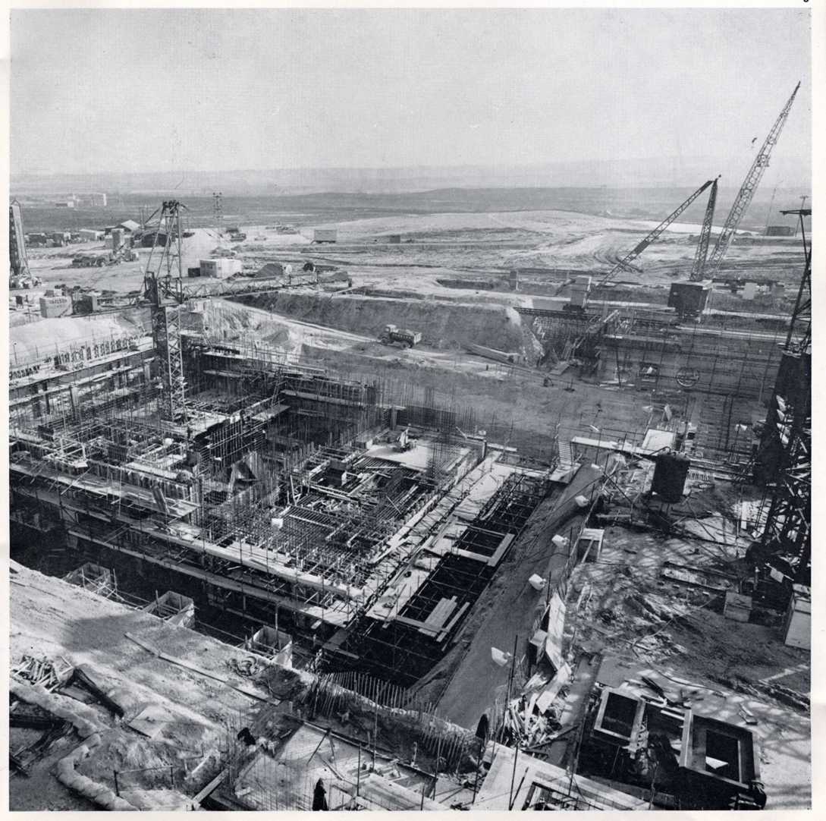
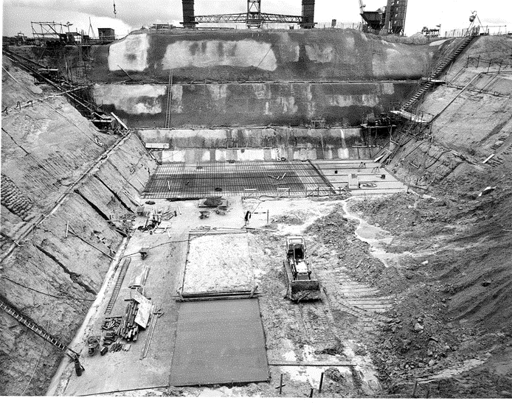
Example 1 – Steam Generating Heavy Water Reactor
SGHWR
  Large, deep and complex structure
  Low levels of radioactive contamination
  Next land use – heathland
Multi-year and multi-stage options appraisal with community input
In-situ and ex-situ management options considered
  Attributes used to assess options aligned with UN SDG and nuclear decommissioning standards
  Relative levels of importance of attributes defined by internal and external stakeholders

Slide 7
Options available
On-site disposal
Leave sub-surface concrete structures in-situ
Backfill with radioactive and non-radioactive demolition arisings
Demonstrating safety and environmental protection (including climate change)
Public acceptability
Long-term management of disposals
Deliver ‘Heathland with public access’
Ex-situ management
Remove above ground structures
Excavate and remove below ground structures
Transport and dispose of waste off-site in radioactive waste disposal
Import material and reinstate land surface
Deliver ‘Heathland with public access’

Slide 8



Optimised approach – on-site disposal
Risk to workers
Carbon footprint
Impact on local communities
Road transport
Impact of protected habitats
Use of raw materials and national disposal capacity
Long term liability
Environmental risk
Reputation
REMOVAL
IN-SITU DISPOSAL

Slide 9
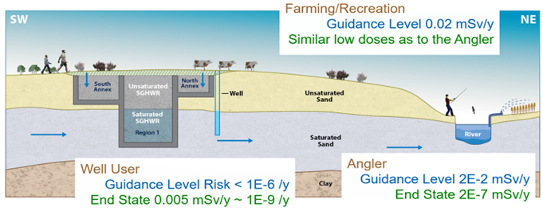
Assuring safety of on-site disposals
Radioactivity levels in structures are generally low (<200Bq/g)
Radiological risks and doses assessed in comparison to regulatory threshold for a variety of site evolutions and scenarios including
  Next land use, climate change impact, well users, farmers, anglers, wildlife
  Human intrusion doses assessed against regulatory thresholds
Non-radiological risks
  Prevent impact on groundwater and protected habitats
  Key issues surround pH (hydroxide ion) from concrete demolition wastes

Slide 10
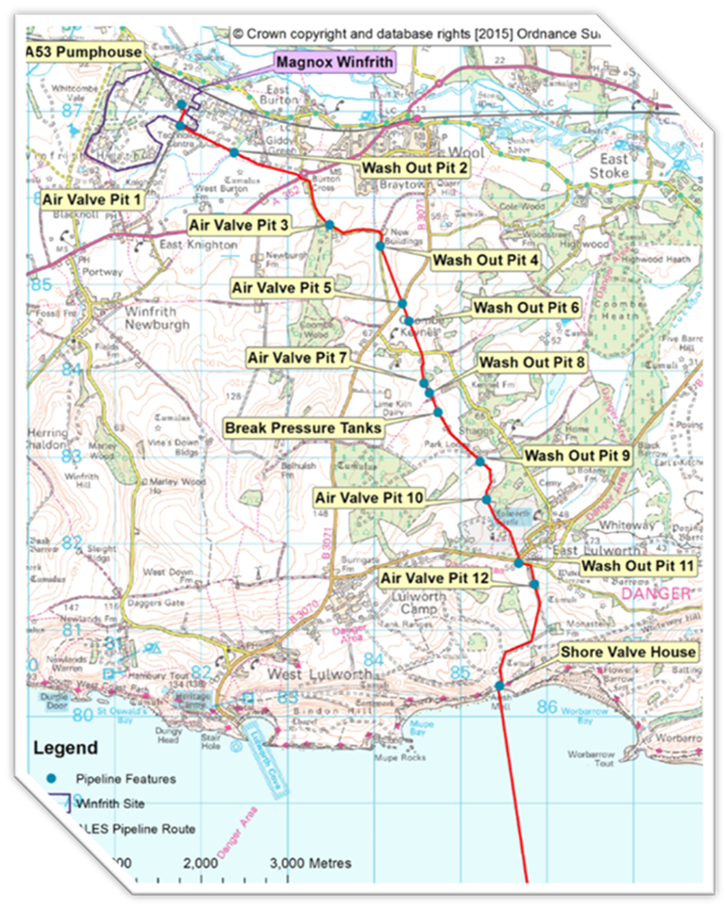
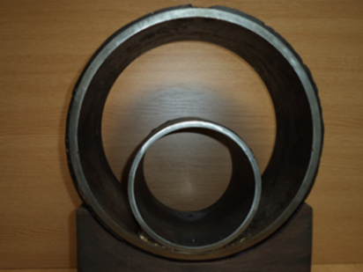
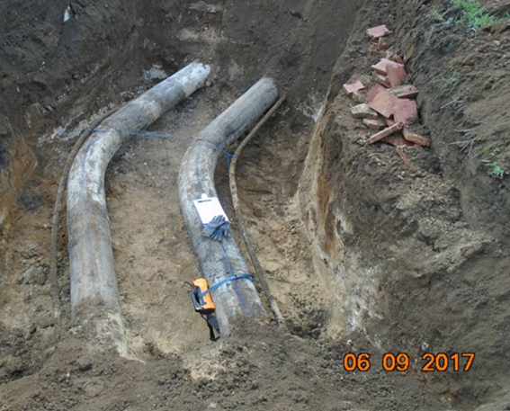
Example 2 – Sea Discharge Pipeline
Terrestrial Pipeline = 9.7km, marine 3.7km
Varied current land use
  Agricultural, roads, business park, historic park,
Next planned land use… ?
  ~500 homes in local plan
  Continued farming / ploughing
  Road maintenance etc
18-month options assessment including landowners, wildlife groups regulators and non-nuclear operators
In-situ and ex-situ management options assessed

Slide 11
Options available
Ex-situ management
Excavate, package waste, transport, disposal at suitable site
Based on
  Transport of radioactive wastes between 300 and 500 miles by road for disposal in suitable facilities
  Transport of non-radioactive waste less than 10 miles
  Material imported is from local source for reinstatement
  Allows any future land use
In-situ disposal
Range of approaches for leaving in-situ - current configuration, grouted, remove inner pipe
Risk assessment over different scenarios for varying land uses
Based on:
  Achieving acceptable characterisation in-situ
  Demonstrating safety and environmental protection (including climate change)
  Public acceptability
  Long term management of disposals and land use restrictions

Slide 12


Optimised approach – removal
Road transport
Carbon footprint
Use of national disposal capacity
Worker safety
Restricted land use
Long term liability
Environmental risk
Human health risk (asbestos)
Reputational risk
REMOVAL
IN-SITU DISPOSAL

Slide 13
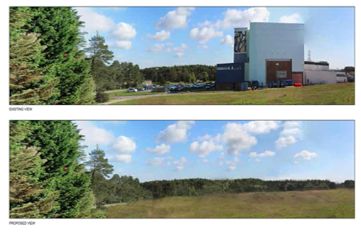
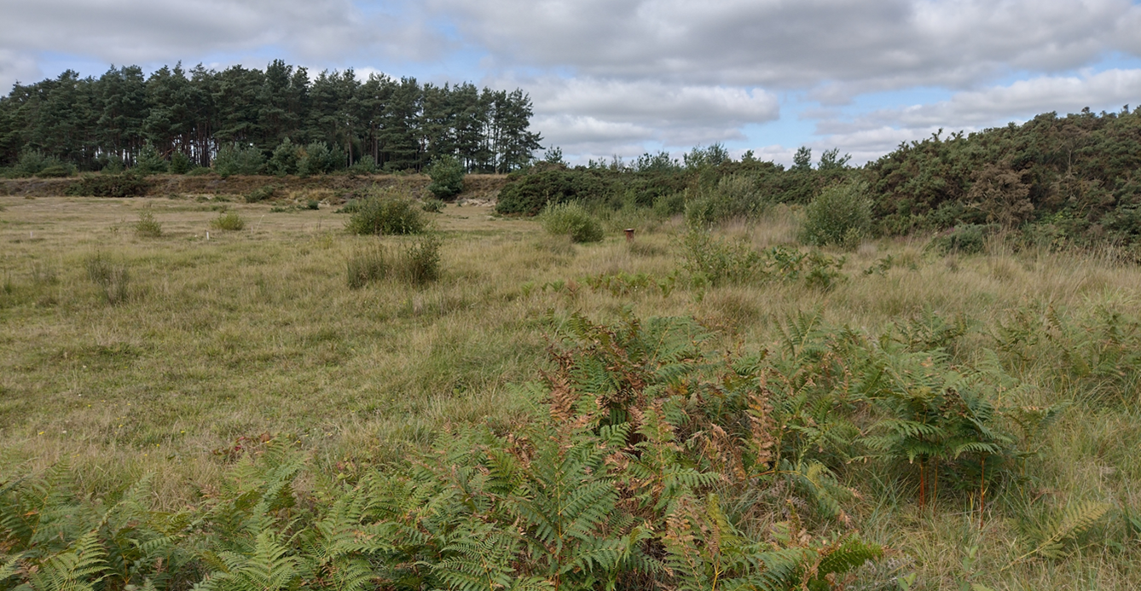
Challenges and Lessons learnt
Stakeholder and community engagement:
  ‘Nuclear timescales’ between decisions and delivery
  Early strategy decisions may not be reflected in changing communities
  Scope of community input potentially restricted by regulatory and technical constraints
Integrated regulation:
  Changes to policy and regulation required to access sustainable options
  Good recognition of need to change / proportionality
  Complex and overlapping regimes for same waste disposal operation
  Difficulties on former nuclear facilities becoming disposals

Slide 14
Thank you

