Slide 2
Korea Radioactive Waste Management Status and Future
November, 2023
Sungwook Hong
heart@korad.or.kr

Slide 3
CONTENTS
I. Status of Radioactive Waste Management in Korea
II. Wolsong Low and Intermediate-Level Radioactive Waste Disposal Facility
III. HLW Management Policy and Plans
Ⅳ. Communications with stake holders for ensuring safety

Slide 4
Ⅰ. Status of Radioactive Waste Management in Korea

Slide 5
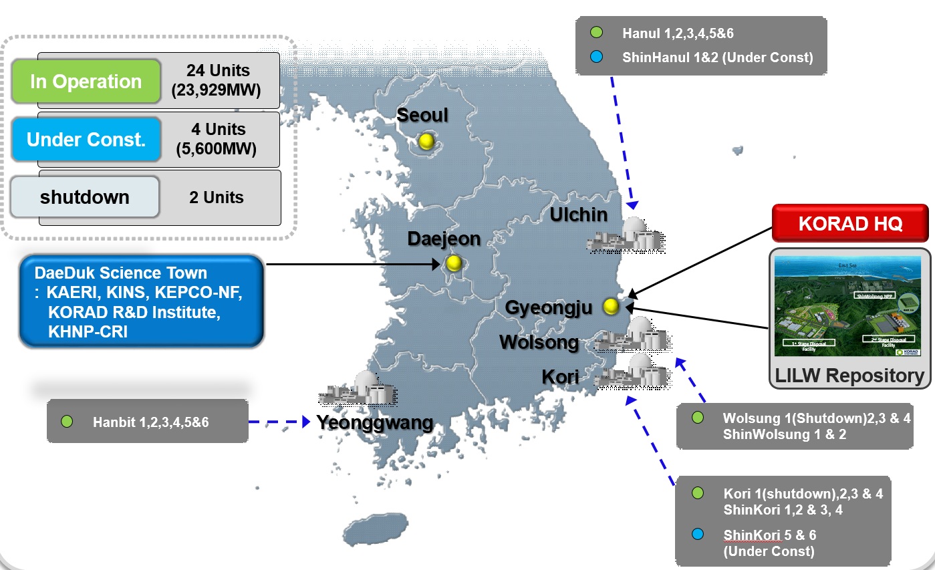
Ⅰ. Status of Radioactive Waste Management in Korea
□ Nuclear Industry in Korea

Slide 6
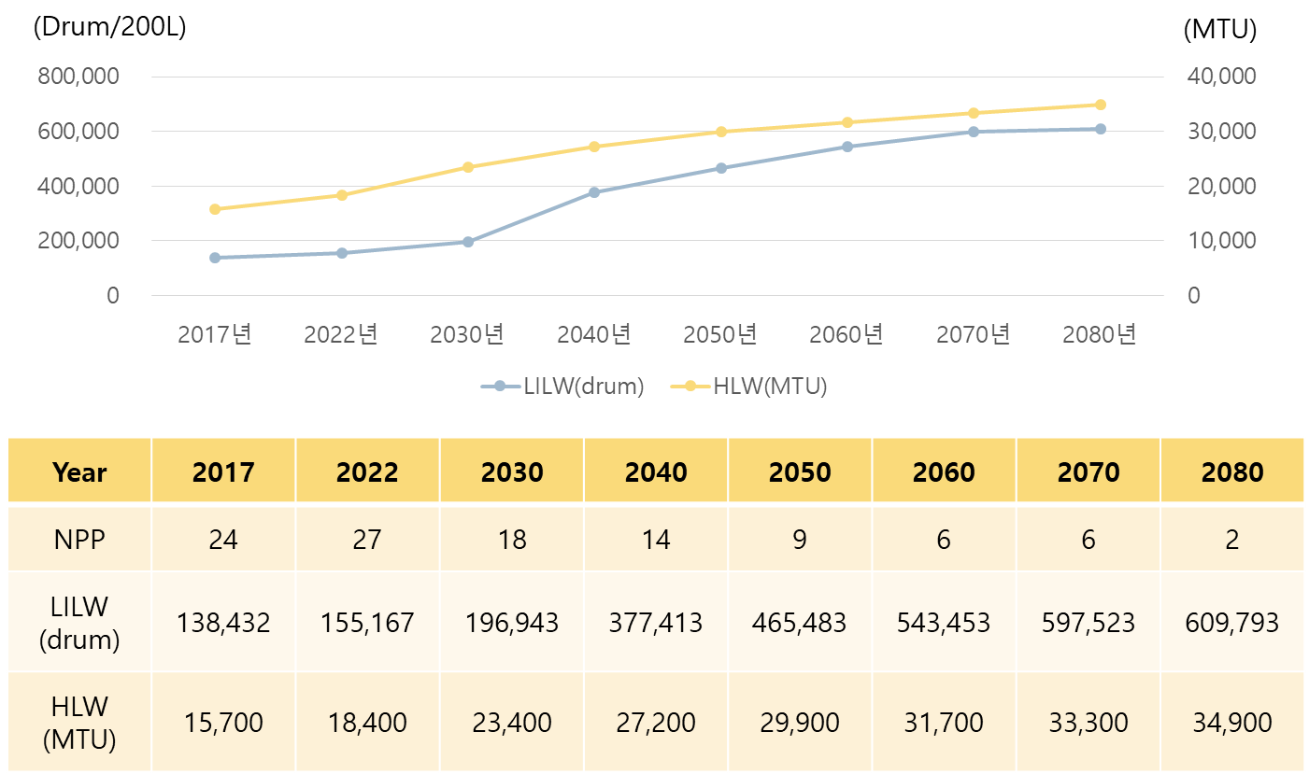
Ⅰ. Status of Radioactive Waste Management in Korea
□ Radioactive Waste Volume Estimation
2017
2022
2030
2040
2050
2060
2070
2080

Slide 7
Ⅰ. Status of Radioactive Waste Management in Korea
□ Regulatory Structure in Korea (After Oct. 2011)
President
Prime Minister
NSSC
AEC
1
2
MEST
MOTIE
3
4
KINAC
KINS
KAERI
KORAD
KHNP
5
6
7
8
9
1. NSSC (Nuclear Safety And Security Commission)
2. AEC (Atomic Energy Committee
3. MEST (Ministry of Education, Science and Technology)
MOTIE (Ministry of Trade, Industry & Energy)
KINAC (Korea Institute of Nuclear nonproliferation and Control)
6. KINS (Korea Institute of Nuclear Safety)
7. KAERI (Korea Atomic Energy Research Institute)
8. KORAD (Korea Radioactive Waste Agency)
9. KHNP (Korea Hydro & Nuclear Power Co., Ltd.)

Slide 8
Ⅱ. Wolsong Low and Intermediate-Level Radioactive Waste Disposal Facility

Slide 9
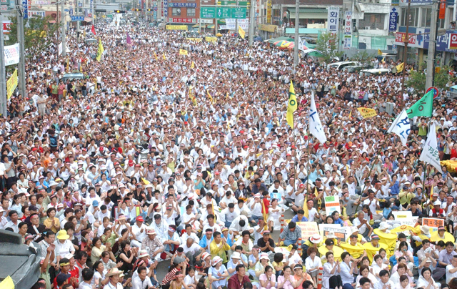
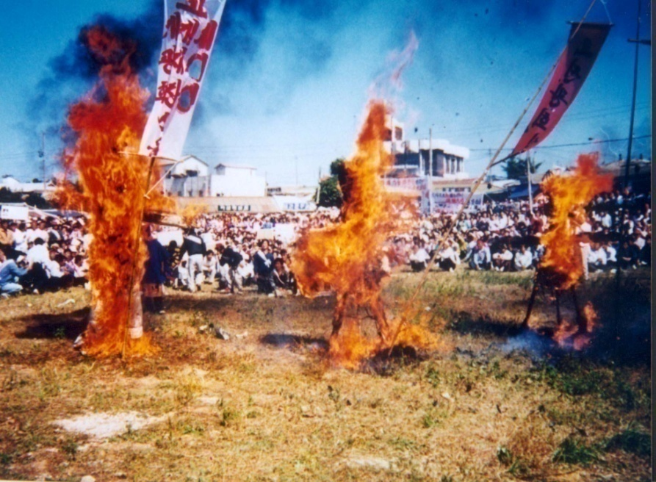
Ⅱ. Wolsong L&ILW Disposal Facility
□ Site Selection for LILW Disposal Facility
Painful Past Experiences
  A ‘Hot Potato’ for nearly two decades(1986-2005)
    Overall Five Times by MOST / KAERI (1986 – 1996)
    Four Times by MOCIE / KHNP (1997 – 2004)
    Nine attempts from 1986 have all failed

Slide 10
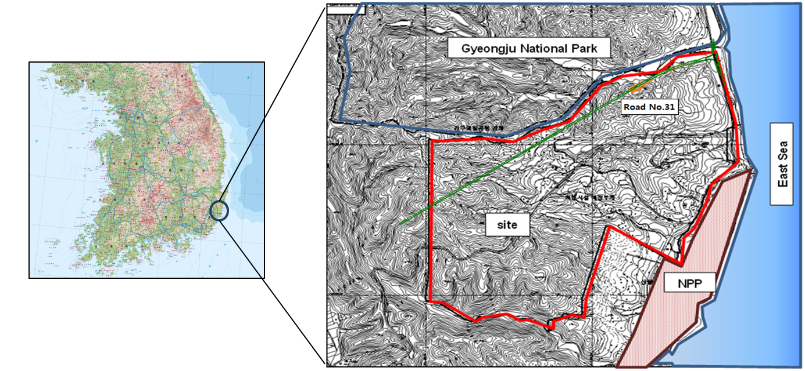
Ⅱ. Wolsong L&ILW Disposal Facility
□ Site Selection for LILW Disposal Facility
Site Selection Committee (Mar. 2005)
  Open forums and discussions for the local residents
  The host area is to be selected through resident voting

Slide 11
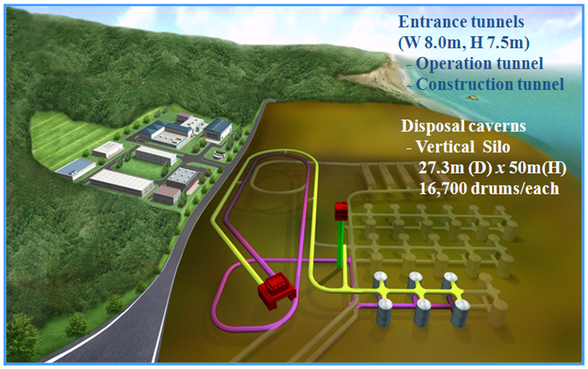
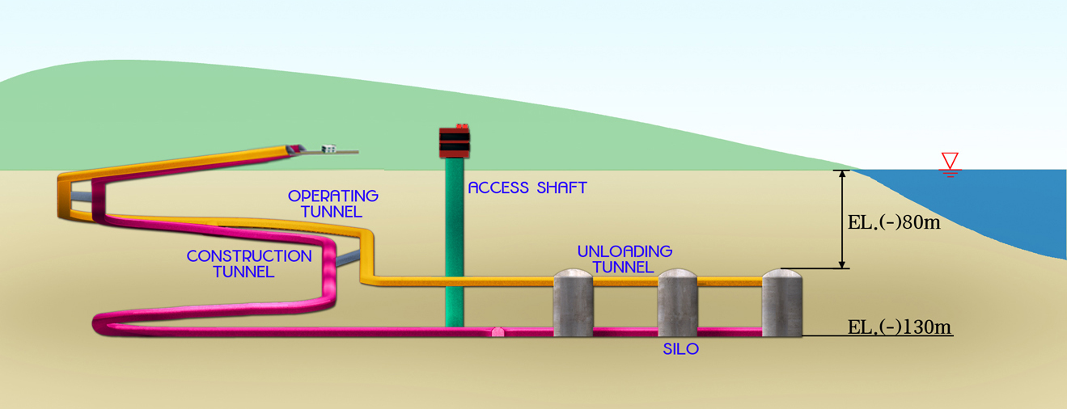
Ⅱ. Wolsong L&ILW Disposal Facility
□ History of 1st Stage Disposal Facility Program
Site selection
(Nov. ‘05)
Approval of the implementation plan
(Jul. ‘07)
Construction & Operation License/
Start to construction
(Aug. ‘08)
Completion of construct
(July ‘14)
Start to operate
(‘14)

Slide 12
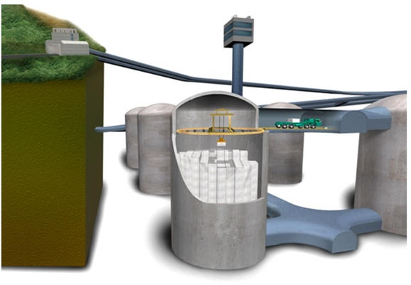
Ⅱ. Wolsong L&ILW Disposal Facility
□ Operation of 1st stage disposal facility

Slide 13
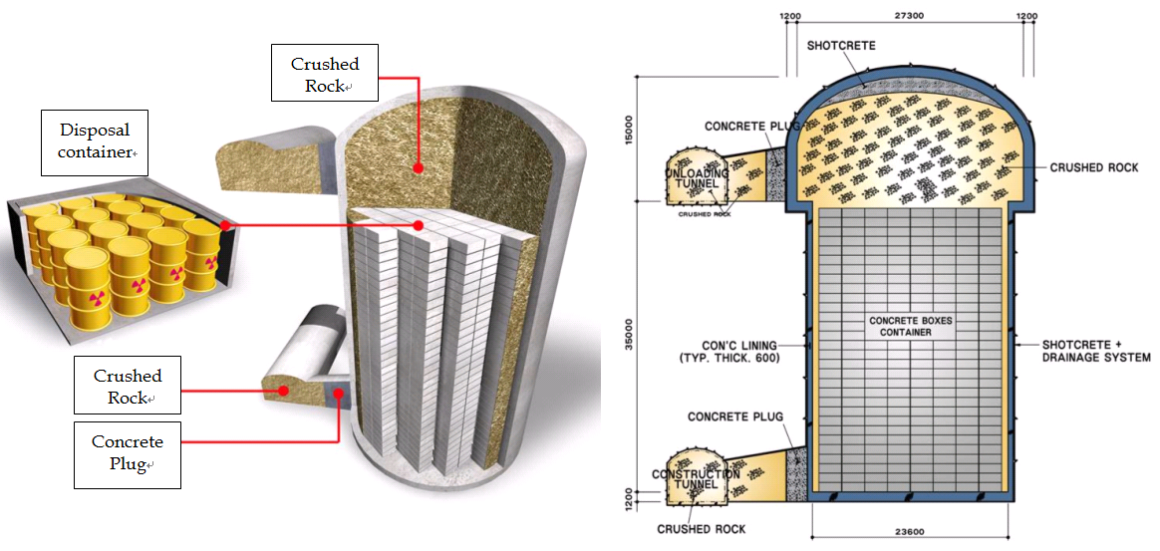
Ⅱ. Wolsong L&ILW Disposal Facility
□ Closure of 1st stage disposal facility
(mm)
(mm)
(mm)

Slide 14
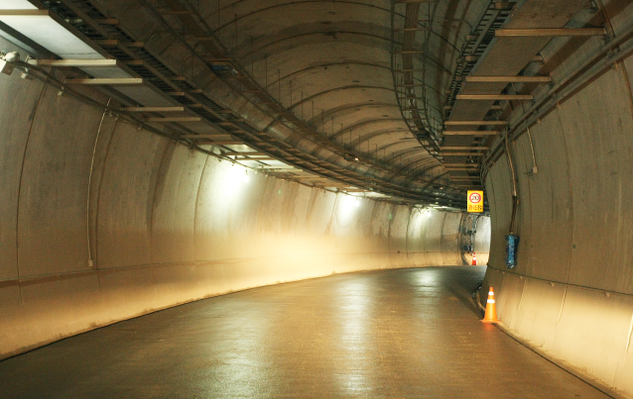
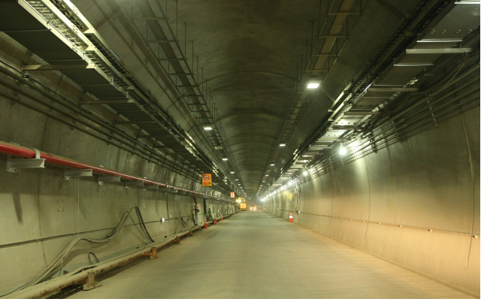
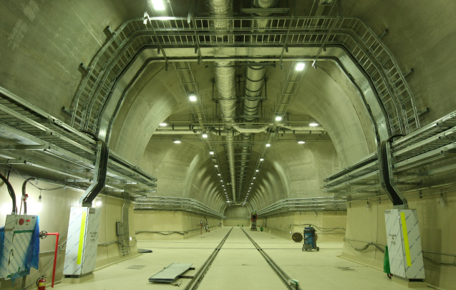
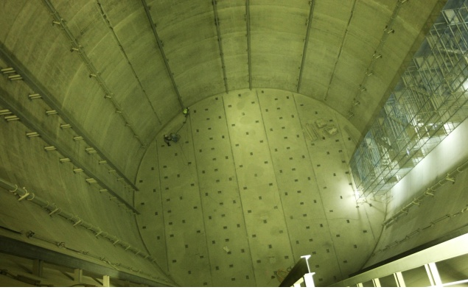
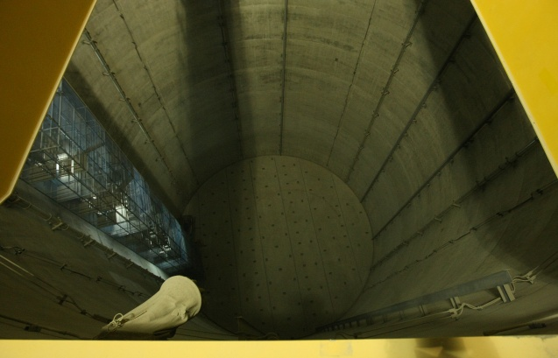
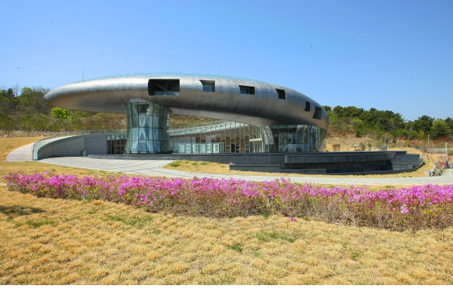
Ⅱ. Wolsong L&ILW Disposal Facility
□ 1st Stage Disposal Facility (Construction completed)
<Construction tunnel>
<Operational tunnel>
<Waste loading tunnel>
<Disposal Silo>
<Disposal Silo>
<Visiting Center>

Slide 15
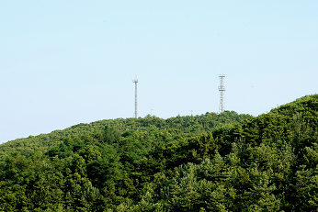
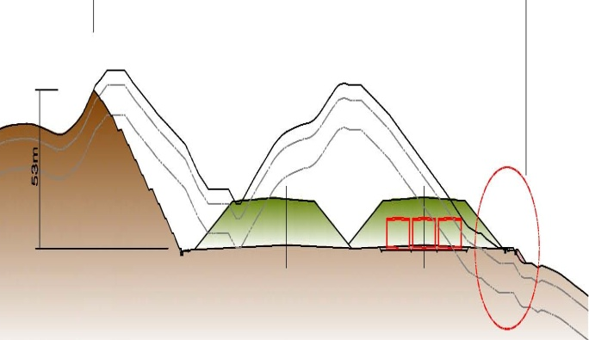
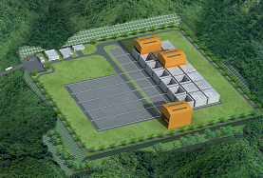
Ⅱ. Wolsong L&ILW Disposal Facility
□ Schedule for the 2nd Stage Disposal Facility
Site Characterization
(Jan.‘12~Jul.‘15)
Detailed Design
(May’14~Dec.‘16)
Apply for the implementation plan approval
(Aug. ‘15)
Start to the Construction
(Jul. ‘16)
Construction Completion
(Dec. ‘23)
Apply for the Construction & Operational License
(Sep. ‘15)

Slide 16
III. HLW Management Policy and Plans

Slide 17
III. HLW Management Policy and Plans
□ Basic plan on HLW management in 2016
The Korean government issued a basic plan on HLW management in 2016. The basic plan reflects recommendations of the Public Engagement Commission on Spent Fuel Management (PECOS).
The basic plan contained development of a deep geological repository, generic underground research laboratory (URL), and an interim storage facility.
Timeline for implementing a deep geological disposal programe
+12 years
+24 years
Siting Process
Repository Development
Repository Operation
Post-Closure
Site Specific URF
(+14 years)
Repository Construction
(+10 years)
Repository Operation
Post-closure Monitoring

Slide 18






III. HLW Management Policy and Plans
□ The 2nd Basic Plan on HLW Management
However, the basic plan is reviewed by various stakeholder who are the general public, experts and NPP host communities by the SNF Management Policy Review Committee.
The Government issued the 2nd Basic Plan on HLW Management in 2021. The 2nd Basic Plan on HLW Management reflects recommendations of the various stake holders.
Advanced RWM principles of 2nd Basic plan
1
Securing interim storage facilities and final repository on the same site
2
Evaluating reversibility of decision-making
3
Outlining recoverability of disposed waste

Slide 19
Ⅳ. Communications with stake holders for ensuring safety

Slide 20
Ⅳ. Communications with stake holders for ensuring safety
□ Successful disposal inspection with Radioactive waste generator
KORAD inspected 1754 radioactive waste drums sent by the radioactive waste generator, and the inspection by KORAD showed that all wastes was disposable.
Also, the inspection by Regulator showed that all wastes was disposable. This is the result of ongoing discussion with radioactive waste generators.
□ Safety construction of the 2nd disposal facility with the Citizen
Participation and Innovation Group
During the construction of the two-stage disposal facility, the safety requirements of the Citizen Participation and Innovation Group suggested some safety requirements. KORAD accepted some safety requirements by the Citizen Participation and Innovation Group and the quality of safety was improved.
Furthermore, KORAD obtained a permission to construct and operate the second stage surface disposal facility.

Slide 21
Ⅳ. Communications with stake holders for ensuring safety
□ Beginning of the discussion about a special high level waste
management law with the Council for the Regional Development
of Nuclear Power Plants
The Council for the Regional Development of Nuclear Power Plants pointed out the deficiency of the public’s knowledge about high level waste managements. KORAD provided the public with information on high-level waste management. This is a point of view of the Council for the Regional Development of Nuclear Power Plants.
As the public's knowledge of high-level waste management improved, the National Assembly of
the Republic of Korea started discussing a special high level waste management law.

Slide 22
Thank you
for your attention!

