Slide 1
ATTAINING SUSTAINABLE DEVELOPMENT THROUGH THE APPLICATION OF RADIOACTIVE SOURCES AND SAFE MANAGEMENT OF THE WASTE THEREFROM
ABDALLAH M. A. DAWOOD^{1*} | ERIC AKORTIA² | OSCAR K. ADUKPO³
Radiation Protection Institute
Ghana Atomic Energy Commission
www.gaec.gov.gh

Slide 2
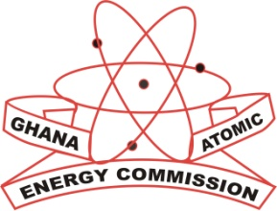
Attaining Sustainable Development Through the Application of Radioactive Sources and Safe Management of the Waste Therefrom
Outline:
Introduction
Nuclear applications in Ghana
Public & expert engagement
Impact on sustainable development
Radioactive waste management
Socio-economic impact
Lessons learned (from public engagement)
Conclusion

Slide 3
Introduction
Depletion of the global natural resources, degradation of the ecosystem, and the changing global climate are attributable to the unsustainable mode of production and consumption of the world’s material goods.
Extreme weather conditions due to climate change will further exacerbate food security challenges in Africa in particular. Currently, about 70% of Africa’s population are directly affected making them food insecure [1].
Paradigm shift towards sustainable development borne out of sustainable exploitation of our natural resources and industrial processes is needed now than ever before.
Nuclear technologies have proven to be sustainable methods that can help restore our changing climate, depleting natural resources, and degrading environment. They promise clean, affordable, and efficient energy to drive our industrial processes for sustainable development.

Slide 4
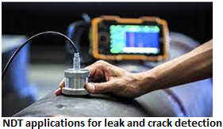
Nuclear applications in Ghana
Whilst nuclear technologies promise to yield sustainable development, there is the need to develop a robust system to safely and securely manage the waste generated therefrom.
Ghana is a nuclear power prospect; one that exploits radioactive sources in various sectors of its economy:
Health
Industry
Research
Agriculture etc.

Slide 5
Nuclear applications in Ghana
The Ghana nuclear power programme is steadily progressing with series of programmes within the siting and environment thematic areas.
Through the Ghana Nuclear Power Programme Organisation (GNPPO), stakeholders including experts, civil service organizations, and the general public are being engaged periodically on the various themes of the programme.
The purpose is to build public confidence, acceptability, and consensus among all stakeholders in decision-making.
Coordination and collaboration among state and private agencies involved in the programme will also ensure smooth execution, and early identification and rectification of challenges at every stage of the project.

Slide 6
Impact on sustainable development
The IAEA is assisting Ghana and other countries in the African region to characterize shared water resources using isotope hydrology [2].
The technique is helping to track water movement, trace the origin as well as contaminants throughout the hydrological cycle.
New knowledge and vital skills are being acquired to help address the changing precipitation patterns in Ghana and other African countries.
The acquired knowledge and skills will enable Ghana to address the reductions in both quality and quantity of surface and ground waters, and to form a network with other countries to effectively solve water crises and quality problems in the African sub-region.

Slide 7
Impact on sustainable development
Gamma irradiation technique has the potential to overturn the quotidian problem of post-harvest loss and the looming food security in Ghana and other parts of Africa.
Interest in the application of radiation science and technology is growing steadily among the youth. Our government is showing more commitment.
The Ghanaian public is much aware of nuclear activities now than before and this is attributed to the regular public engagement through various print and electronic media, professional platforms and social media.
Strengthening public confidence and acceptability.

Slide 8
Radioactive waste management - RWM (1)
Management of radioactive waste generated in Ghana is the responsibility of the Radioactive Waste Management Centre (RWMC).
Users/ facility operators have the primary responsibility of safety and security when the sources are still in use.
The regulator has an oversight responsibility over all nuclear/radioactive materials in the country.
The law mandates users of nuclear/radioactive materials to put in place a temporary storage facility for disused sources until their repatriation to the country of origin or retrieval to the waste management facility for further and proper management.

Slide 9
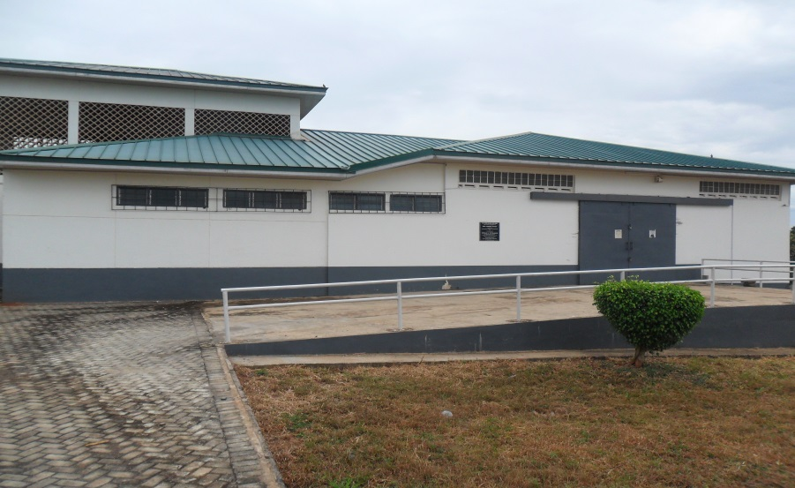
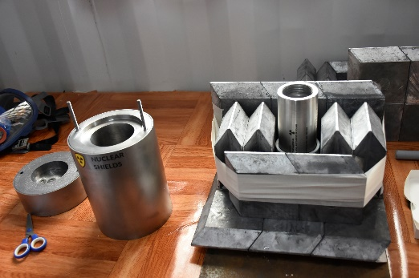
Radioactive waste management (2)
The RWMC operates the only authorized radioactive waste management facility known as the Centralized Radioactive Waste Management Facility (CRWMF).
CRWMF operates in compliance to national and international regulatory requirements that guarantee safety, and security against theft, sabotage, unauthorized access and use of radioactive source.

Slide 10
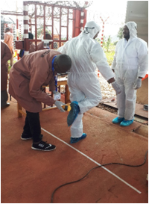
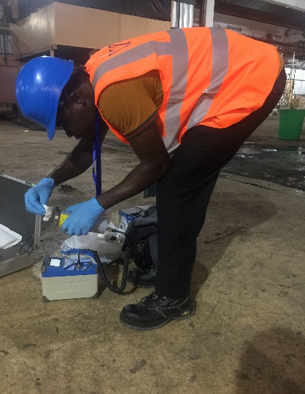
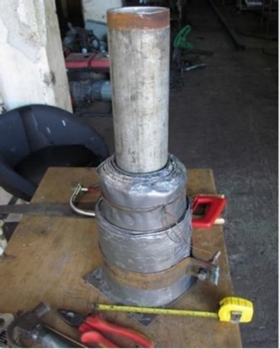
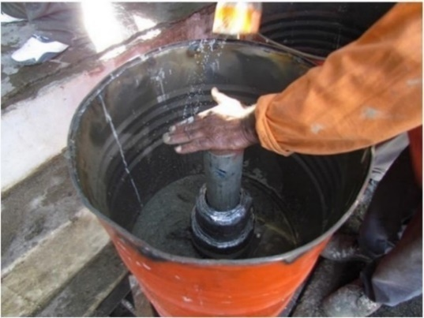
Radioactive waste management (3)
Operations conform with the IAEA’s waste acceptance criteria which enables the waste management facility to specify waste packages in terms of radiological, mechanical, physical, chemical, and biological characteristics.
Typical pre-disposal activities at the facility include leak testing, source characterization, dismantling and conditioning, storage, and environmental radiation monitoring.

Slide 11
Impact of RWM
Ghana’s waste management system ensures:
Radiation safety from radiation exposure
occupational, public, or environmental.
Source security (prevention and/or deterrence of):
Theft, sabotage, unauthorized access & use of sources.
Prevention of loss: 24/7 surveillance, easy tracking & tracing of sources in the likelihood of loss.
Building public confidence that the waste are properly, safely and securely managed.
Notes:
Physical and electronic safety and security barriers in Ghana’s waste management system has contributed to zero incidence of theft, sabotage, and unauthorized access that could lead to malicious application of radioactive sources and facilities. Nonetheless, there is a lot of room to improve the system.

Slide 12
Lessons Learned (from public engagement)
Civil Service Organizations, the middle and highly educated class of the society were found to be well-informed about the key issues due to their ability to access, read and comprehend the data/ information on the nuclear power programme and waste management processes. The concerns of this group largely bordered on safety, security, and radioactive waste management capability.
Traders, mainly women, craftsmen/artisans, and generally the lower income class expressed concerns ranging from safety to the impact of possible relocation on their economic activities.
Expert views in particular helped in revising the strategies and mechanisms of the waste management processes so as to make the management system sustainable, environmentally friendly, safe, and secured.
Expert engagement emphasized on physical protection involving high technology that monitors outsider as well as insider threats.

Slide 13
ACKNOWLEDGEMENT
The International Atomic Energy Agency (IAEA), Department of energy of the United States, and the Japan International Corporation Agency (JICA) are key collaborators who assist logistically in the Ghana nuclear power programme and waste management activities.
REFERENCES
[1] INTERNATIONAL ATOMIC ENERGY AGENCY (2022). Nuclear Technologies and Climate Adaptation in Africa.
[2] BRADY, E., STEVENSON, S., BAILEY, D., LIU, Z., NOONE, D., NUSBAUMER, J., OTTO‐BLIESNER, B.L., TABOR, C., TOMAS, R., WONG, T., ZHANG, J., The connected isotopic water cycle in the community earth system model version 1, J. Adv. Model. Earth Syst. 11 8 (2019) 2547-2566.
[3] INTERNATIONAL ATOMIC ENERGY AGENCY (2006), Geological Disposal of Radioactive Waste, IAEA Safety Standards Series No. WS-R-4, IAEA, Vienna.

Slide 14
Thank you
We are opened for more collaboration
www.gaec.gov.gh

