Slide 2
Radioactive waste management during CNE life extension and sustainability considerations
Maria Laura Brenlla
Nucleoeléctrica Argentina SA
Carolina Celeste Muñiz
Nucleoeléctrica Argentina SA
Elvira Rosa Maset
Comisión Nacional de Energía Atómica

Slide 3
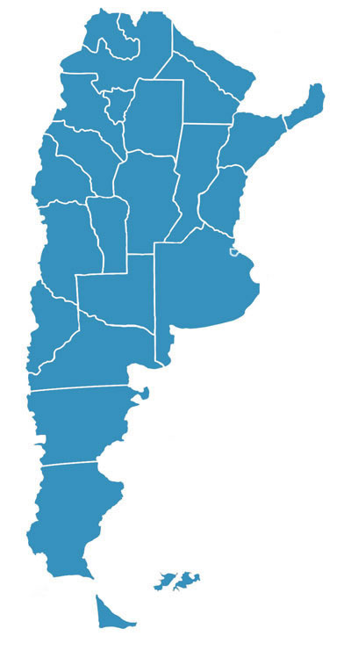
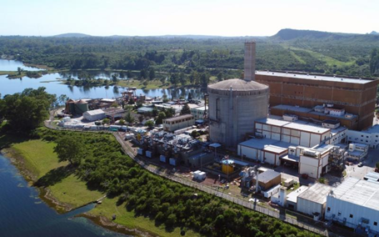
CNE brief introduction
EMBALSE NUCLEAR POWER PLANT (Embalse NPP)
CNE, located in Córdoba province
PHWR - 656 MWe
Operating since 1984
Life Extension process (2016 ~ 2018)
In January 2019 CNE started its second operation cycle
Argentina has 3 NPPs in operation: 4.06% of the installed capacity of the national electrical system.

Slide 4
Sustainability considerations related to National Interested Parties (IP) engagement for decision making process
Before accomplishing the first operation cycle, Nucleoeléctrica Argentina SA analysed the viability of the Embalse life extension and presented the required documents to the National Nuclear Regulatory Body (ARN).
After getting the Parliament approval, the Government declares by law CNE life extension project implementation as a matter of national interest:
-CNE's life extension ensures energy matrix diversity with reliable production,
-Employment for more than 1,000 local families for the second operation cycle,
-In addition to energy, CNE produces Co-60 for medical, research and industrial application, which is a sustainable social and economic benefit.
First decision- making process that shows the interrelation between Safety and Sustainability

Slide 5
Sustainability considerations related to National and Local IP engagement for decision making process
National and Local authorities: The legal framework required the Operating license from the Nuclear Regulatory Body) and the Social-Environmental license (by the local environmental Authority). The Environmental Impact Assessment contemplated the comparison of the extension of life project with the construction of a new state of art Combined Cycle Power Plant.
Those licensing processes were managed in this context situation:
-it was the first NPP life extension in the country
-and the first Public Hearing related to an Argentine NPP.
So, a strategy was defined to achieve those licences through stakeholders involvement.
Although this citizen participation procedure is non-binding, through this tool, those potentially affected by the project could be part of the Environmental Impact Assessment process, expressing their opinions and arguments

Slide 6
Sustainability considerations related to Radioactive Waste Management
For the core retubing, Argentina used a methodology developed by Candu Energy Inc. based on the experience of CANDU-6 power plants and following IAEA guidelines. An Integrated Radioactive Waste (RW) Management Program, was elaborated to establish the categorization and characterization of RW in order to define the temporary storage conditions to be complied in accordance with ARN and CNEA (Argentine Atomic Energy Commission, the national waste management organization, among other functions).
The retubing storage facilities, as well as steam generators storage facility, were designed so that their integrity is guaranteed during a period of not less than 50 years. The design of the Silos was acquired from Candu Energy Inc. and the other two storages facilities were national designs (considering opex).
Competing priorities were addressed according to finite resources to ensure safety while enabling sustainable development.

Slide 7
Sustainability considerations related to RW Management
Besides the retubing of the reactor, CNE accomplished the replacement of the four steam generators. The steams generators were conditioned so that they can be handled like sealed sources. In this way, the worker and public protection is guaranteed, avoiding the possibility of contamination.
The retubing and the steam generators storage facilities are located within a wire perimeter fence that includes part of the supervised area. Therefore, it guarantees a low rate of occupational exposure.
Those radiological wastes that, after decontamination, could be released from radiological control were used as inputs for other processes, re-entering in the production system.
Besides addressing safety conditions in waste management, a sustainable production model in favor of the circular economy was considered.

Slide 8
Sustainability considerations: key messages
CNE life extension project was one of the most important projects accomplished in Argentine nuclear field. Since the workforce was mostly national, the project enabled the national production of nuclear goods and services instead of considering international suppliers, improving national economic and social conditions.
It was the first time that the steam generators were replaced in a CANDU 6 type plant. The experience acquired in such replacement allowed Nucleoeléctrica Argentina SA to export its knowledge and sign contracts to collaborate in similar tasks at other NPP under refurbishment. The steam generators and inner tubes of the heat exchangers were constructed by national companies.
During the refurbishment outage, safety improvements arising from the experience from Fukushima Daiichi accident were incorporated.
The Integrated Radioactive Waste Management Program allowed to achieve the minimization of waste generation objective. Radioactive waste generated during the life extension was in line with the prospective estimated volume.

Slide 9
Sustainability considerations: key messages
The reconnection of CNE to the grid played an essential sustainable goal providing access to affordable, reliable, clean, energy for more than 3 million inhabitants, avoiding 44 million tCo2 emissions (compared to a Combined Cycle Power Plant).
The company's management system was strengthened over the years in accordance with good practices and regulations compliance. This system allowed the company to achieve the proposed milestones and complete access to the UN Global Compact in 2019 (CNE 2nd operation cycle). Being a nuclear company requires, more considerations than any other industry, not only to ensure operational safety but also demonstrate the benefits for society and the environment by implementing actions beyond those established by regulations, in other words also enabling sustainability.
The interested parties engagement is a process that benefits everyone. A remarkable profit of this process is the balance that is achieved between safety requirements and the additional sustainability aspects of the activity.

Slide 10
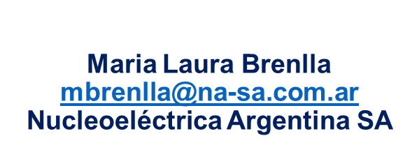
THANK YOU!!

