Slide 2




Advancing Sustainability Practices Through Innovation in LILW Pre-Disposal Radioactive Waste Management: Outcomes from the Euratom PREDIS Project
Erika HOLT, VTT Technical Research Centre of Finland
Maria OKSA, VTT Technical Research Centre of Finland
Anthony BANFORD, National Nuclear Laboratory, UK
This project has received funding from the European Union’s Horizon 2020 research and innovation programme under grant agreement No 945098.

Slide 3
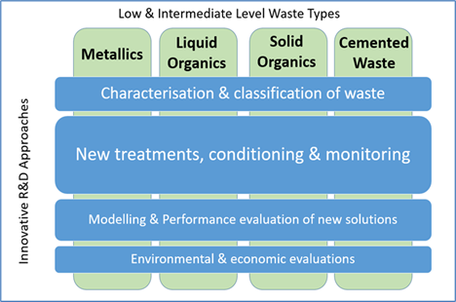
PREDIS − “Predisposal management of radioactive waste” project scope
To develop predisposal activities on treatment and conditioning methodologies
→ use of new materials and processes, evaluated also with life-cycle assessment (environmental and economics)
To develop monitoring techniques of cemented waste and to implement digitalization
avoiding construction of new storage on sites
safer, cheaper or more effective alternative processes
Duration: September 2020-August 2024

Slide 4
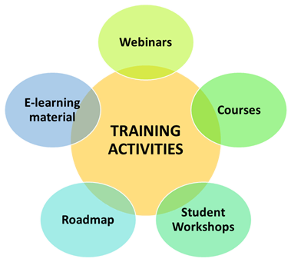
PREDIS to share knowledge by fostering cooperation
EU project with 47 Partners
17 European Countries
23.7 M€ investment (14 M€ EC)
Strategic Research Agenda (SRA)
Knowledge Management
EURAD EJP cooperation
  → SRA and Roadmap of radwaste management
16 public webinars
28 public reports, so-far
Online training courses to come
Over 35 students
Over 20 mobilities
https://predis-h2020.eu
Notes:
4-year project, started in September 2020

Slide 5
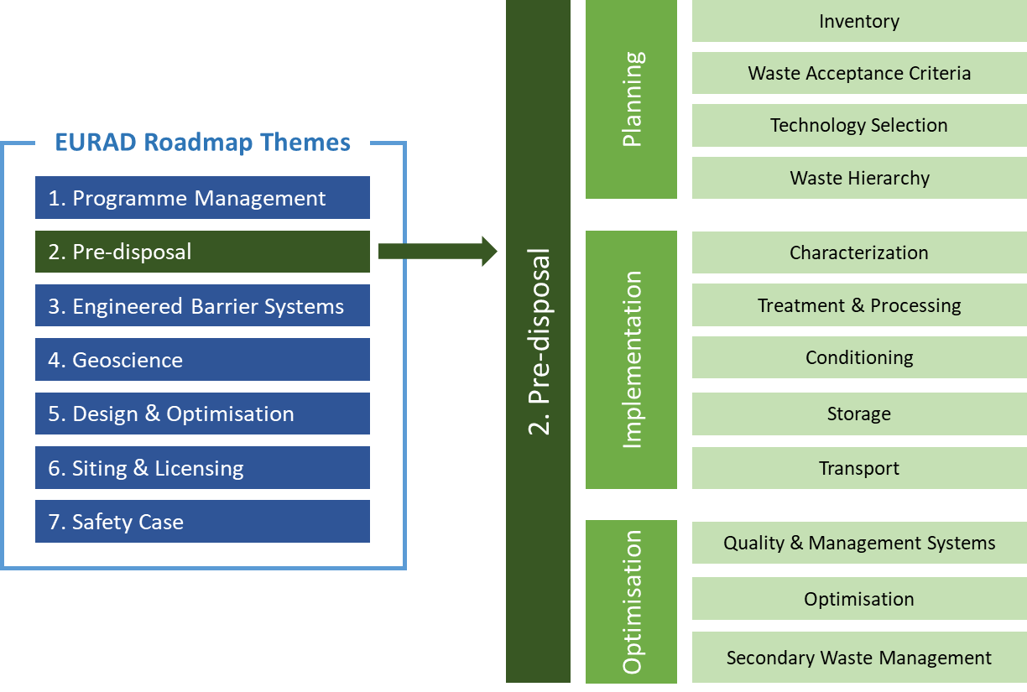
PREDIS context of EURAD Roadmap
Roadmap is a key document for access to current knowledge
Theme overviews,
Domain Insights,
State-of-Knowledge
See https://www.ejp-eurad.eu/roadmap

Slide 6
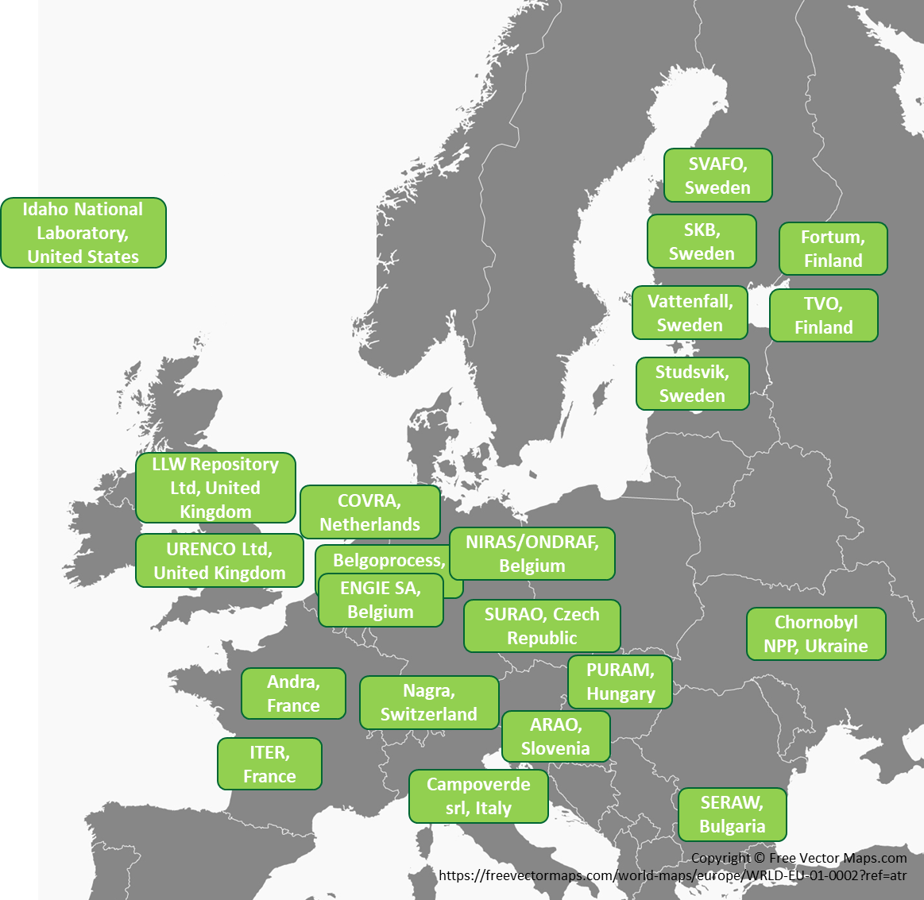
Uptake of the project results
PREDIS End User Group with 24 organisations
  Nuclear power plant operators and research reactor owners
  Radioactive waste producers (RWP) & waste owners
  Waste management organisations (WMOs)
Contribution to initial Gap Analysis and SRA
Sharing during PREDIS workshops & webinars
Sharing of data, materials, modeling scenarios, case studies, value assessment report; hosting technology demonstrations
Additional 175 Stakeholders from 33 countries worldwide who follow project activities (newsletters, public events)
(see additional PREDIS paper/presentation by Elke Jacops, SCK CEN)

Slide 7
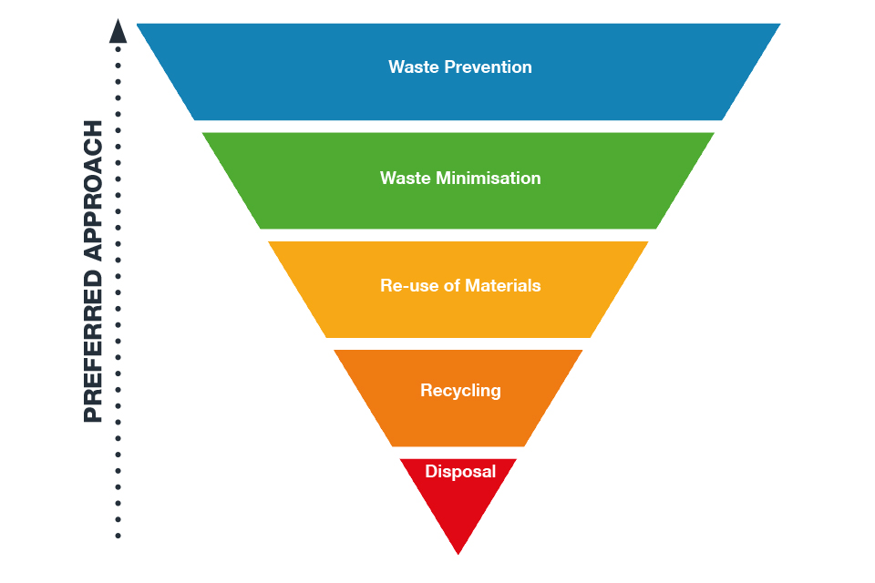
Providing guidance and support
Insights for process development and strategic decision making
Focus on waste hierarchy to support sustainable practices
Waste acceptance criteria (WAC)
  Practical guidance for qualification across MS
  Report on international approaches to establishing waste acceptance system
Life cycle assessment and cost (LCA/LCC)
  Development of new models for comparing material and process/treatment choices
  (see additional PREDIS paper/presentation by Kirk, Clayton, Stamford (Univ. of Manchester) and Banford (NNL))

Slide 8
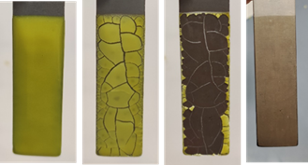
Metallic waste treatment and conditioning
Research highlights
  Creation of datasheets for metal treatment and decontamination technologies
  Performing of decontamination tests with chemical solutions and gel technology
  Secondary waste treatment focusing on electrochemical behaviour of ionic liquids
  Characterization and sorting of metallic waste in different management routes
Impacts
  Improving problematic metallic waste management routes safer and more economically efficient
  Decontamination of Ni-alloys (from EDF steam generator), demonstrating potential for material free-release or varying deposition waste class
  Reduction of waste management and disposal cost, minimisation of volumes and increased waste incorporation rates
Decontamination of non-oxidized stainless steel using corrosive gels
Notes:
22 partners, 14 countries

Slide 9
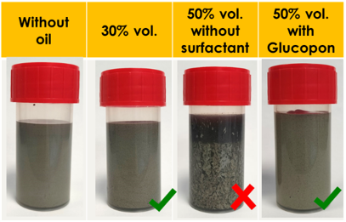
Treatment and conditioning of liquid organic waste (RLOW)
Research highlights
  Three reference geopolymer matrix formulations have been identified as candidates for direct conditioning solutions
  Robustness and optimization studies performed
  The target is to develop geopolymer formulations that could be scalable to different countries in Europe by using local raw materials
Impacts
  Developed treatment and conditioning process TRL 6 (prototype verified)
  Demonstrated performances of the final waste materials in long-term storage and disposal conditions allowing to assess disposability.
  A shared view of predisposal solutions translated into management strategies applied at national or European scales.
Nevastane EP100 oil as RLOW surrogate (30% vol.) could be easily incorporated without surfactant
Notes:
19 partners, 10 countries
Studies focused on four waste types: oils, decontamination solvents, tributyl phosphate/dodecane and scintillation cocktails.
TRL 6 = Prototype System Verified

Slide 10
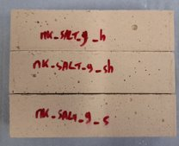
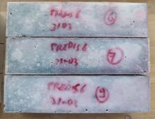
Innovations for treatment and conditioning of solid organic waste
Target is to demonstrate reliability of alkaline binders for conditioning of residues and secondary wastes and verify the matrix performance of conditioned waste
Research highlights
  Substantially higher loading (more than 90 % volume reduction) into the geopolymer without loss of matrix strength or cohesion with gasification and immobilization in a novel metakaolin geopolymer
  Successful design and development of geopolymer and cement matrices to immobilize residues
Impacts
  Increasing the confidence of the thermal treatment based on secondary waste subsequent solidification / immobilisation and hence the long-term stability of the reconditioned wastes
  Increasing the disposability, volume reduction and cost of waste treatment and storage
Top: Metakaolin geopolymer prisms; Bottom: Alkali-activated Blast furnace slag prisms; both with 10 wt% salt & converted by Ca(OH)₂).
Notes:
14 partners, 9 countries

Slide 11
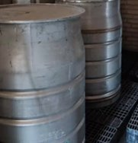
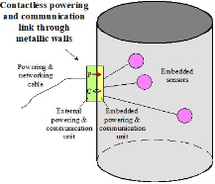
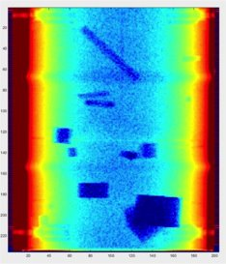
Concrete waste packages − monitoring and digitalisation
Research Highlights
  Identification, evaluating and developing various radiation detection tools for radwaste characterization and monitoring
  Adapting and demonstrating digital twin technology and digital decision framework
Impacts
  Demonstration of more versatile and reliable condition monitoring technologies, which are made available to end users
  Improved accuracy in predicting the behaviour of waste/packages in storages, increased safety for personnel and environment and reduced cost (avoiding need for retreatment or repackaging)
Embedded sensors (top) and tomography x-ray image (left) of 250 l mock up drum (at UJV)
Notes:
17 partners, 12 countries

Slide 12

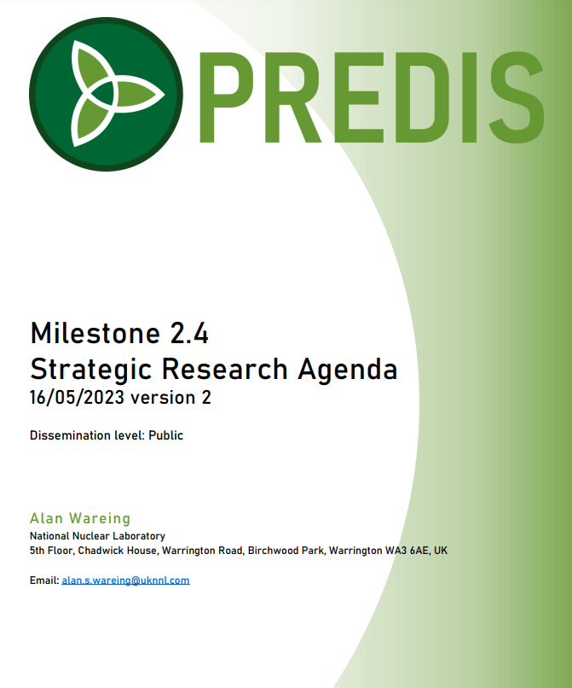
Summary and way forward
Fourth and final project year on-going until August 2024
Final Conference in Avignon, France, 3-7 June 2024 (public!), hosted by CEA and VTT (travel via Marseille air or train)
Interested parties are always welcome to join the Stakeholders Group to receive information https://predis-h2020.eu/end-user-group/
Consortium of 47 partners develop techniques for improved predisposal management of metallic, RLOW and RSOW and cemented waste packages
Support to strategic research and knowledge management – downnload over 50 relevant documents!

Slide 13
Looking ahead to EURAD-2
EURAD-2 proposal to be submitted 8 November 2023
Joint Programming will fulfil expectations of end-users
  Help Member States in their timely implementation of RWM activities
  Joint research work creates new knowledge, educates scientists and broadens capabilities
  Existing knowledge is made available & accessible in an efficient manner
  Trust and mutual understanding exists between the partners
Added value of and step change with PREDIS is recognised : follow-up programme on RWM with integration of EURAD-1 programme
Starting October 2024, 5 year duration

Slide 14
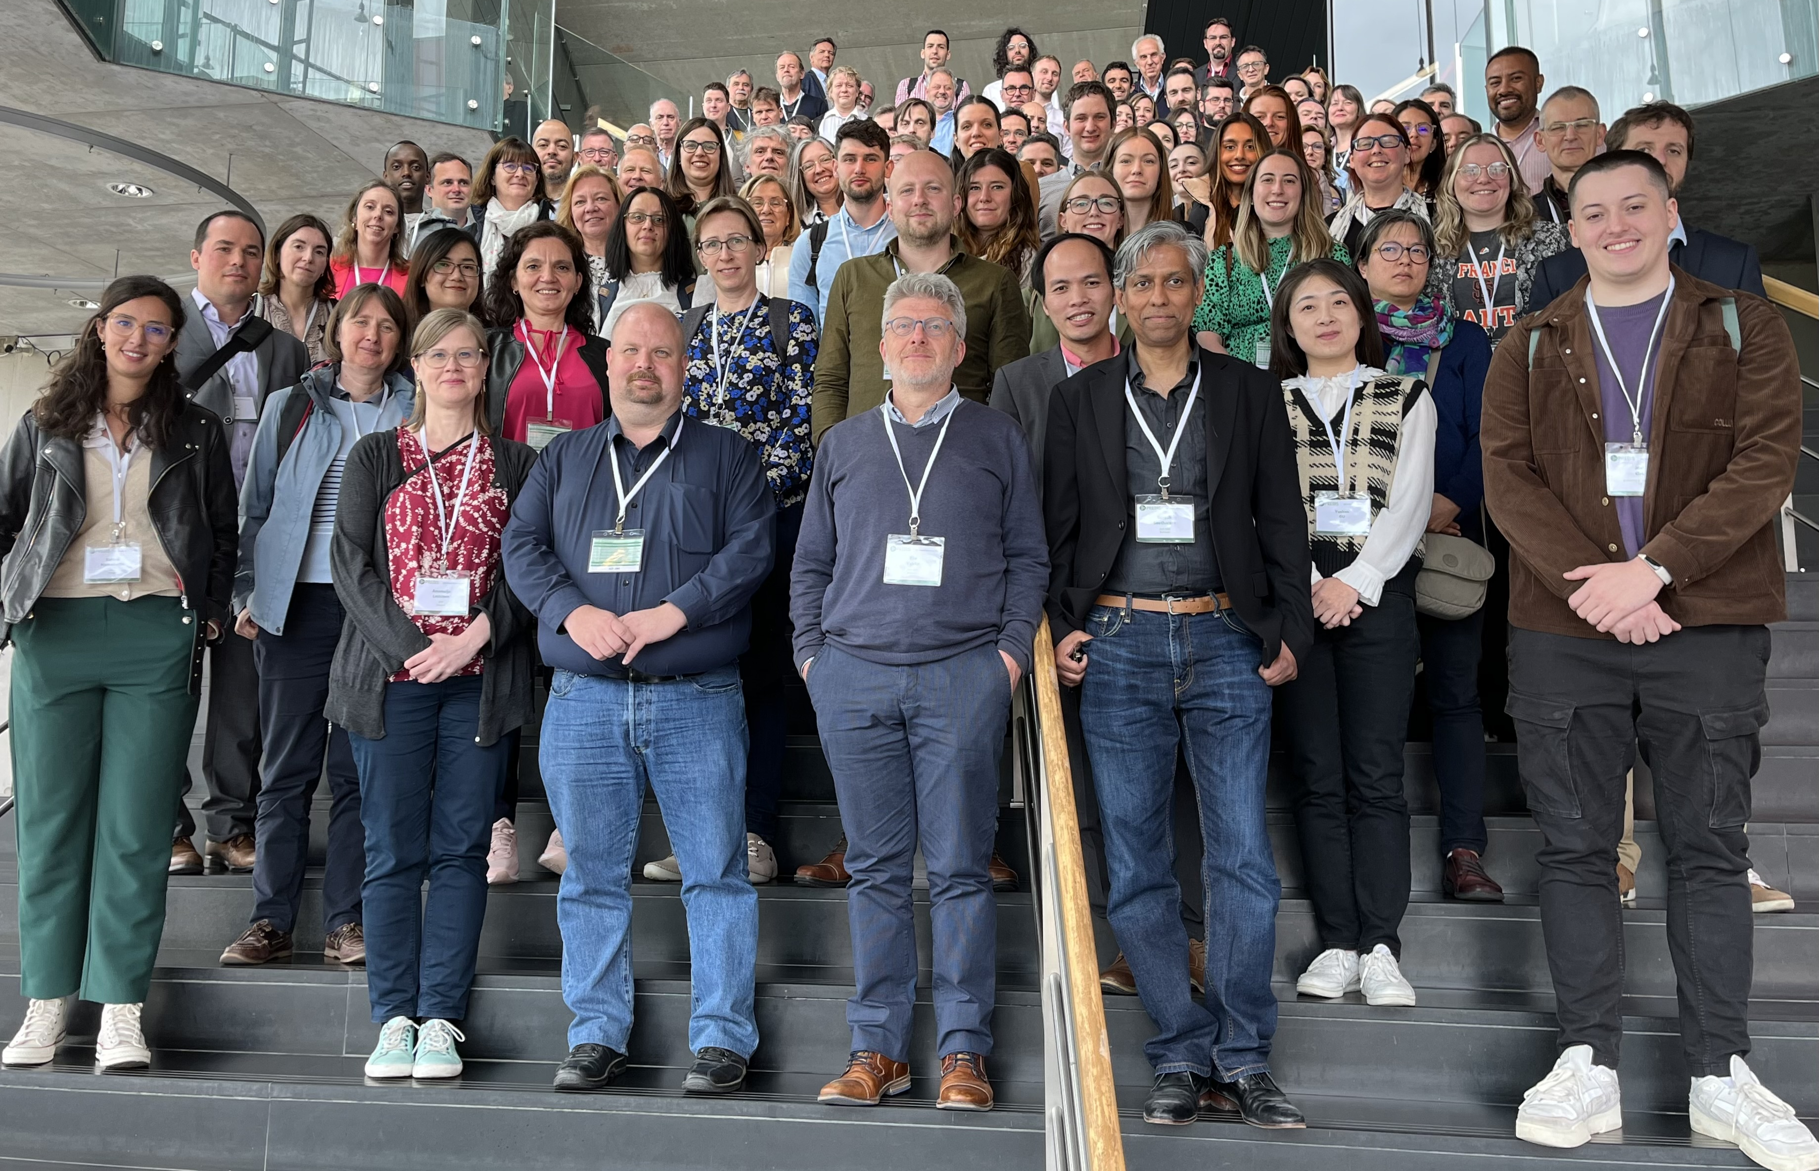
Acknowledgements
Thanks to the whole PREDIS consortium
More information: https://predis-h2020.eu
This project has received funding from the Euratom research and training programme 2019-2020 under grant agreement No 945098.

