Slide 1
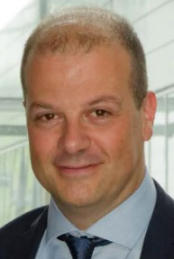
Attract, develop and retain talents
M. Fabrice PUYADE
Director of Human Resources & CSR Division
French National Radioactive Waste Management Agency
Vienna, November 28th 2023

Slide 2
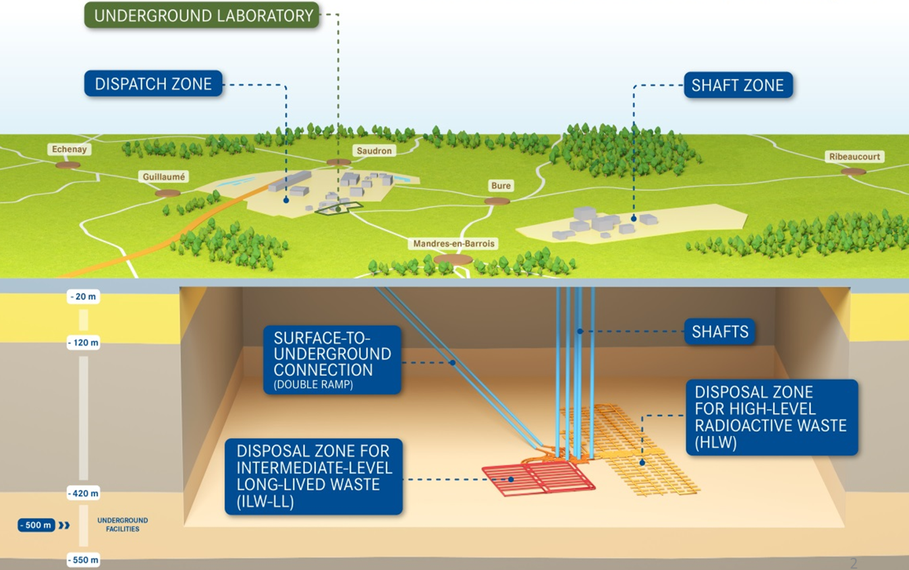
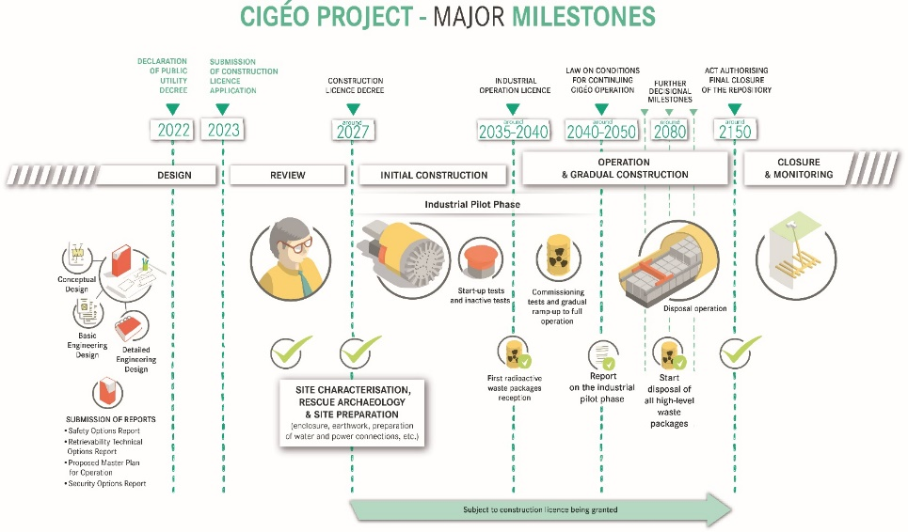
Background
Andra is a 700 people agency managing a 25 billions$ project : Deep Geological Repository Cigéo
Cigéo’s construction time scales are not yet totally in hand → step-by-step process that can take time at each stage
Challenge : manage the paradox of a long-time scale project with short-time scale HR plans (maximum 5 years)
Aims : to attract, retain and renew the skills we will need for the construction of Cigéo
Strategy : simultaneously forward-looking, proactive and pragmatic

Slide 3
Summary
◆ HR uncertainties we are facing
❖ Method for attracting, developing and retaining core competencies
⬥ Need for a more forward-looking HR vision

Slide 4
◆ HR uncertainties we are facing
Long term uncertainties and issues :
Lifetime of projects that lasts much more than an individual career
Lack of information of engineering school / university students about opportunities and careers in Radioactive Waste Management
→ Too few interest in nuclear job opportunities and especially in RWM
Not enought specific nuclear training courses in education systems (undergraduate, post graduate)
Opposition groups that are lobbying
Loss of capability in engineering, in technicality,
→ Disapearing of some core trades. Ex : safety engineer, welder…

Slide 5
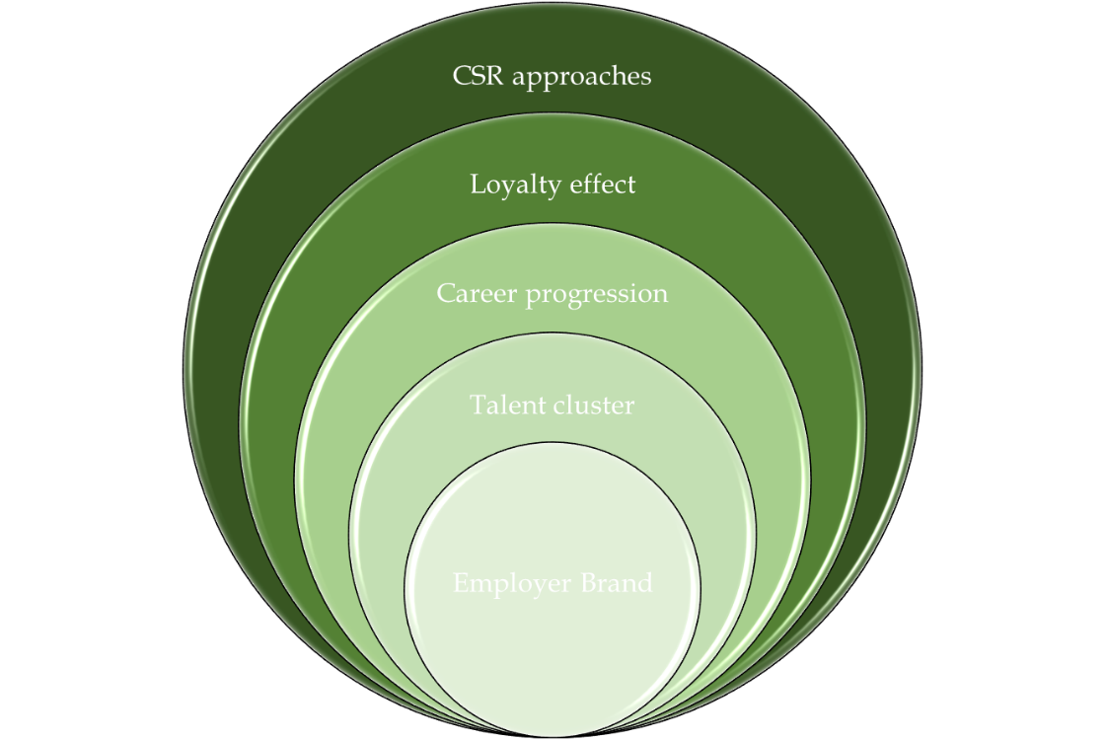
❖ Method for attracting, developing and retaining core competencies
Andra’s 5C method to increase our capability to face uncertainties

Slide 6

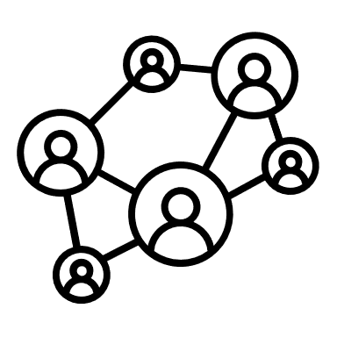
❖ Method for attracting, developing and retaining core competencies
Remaining attractive in the employment market by developing the employer brand by :
 Strong and pragmatic communications towards universities and social networks
 Valuing the project which is great opportunity for the country
 Anticipating societal issues
 Proposing wages in line with the market
Becoming competitive as a cluster and a talent training center by :
 Developing proactive and high standard internship and apprenticeship policy,
 Building career bridges with your parent company in dual courses and/or universities or other branches like construction, civil engineering or military industry…

Slide 7
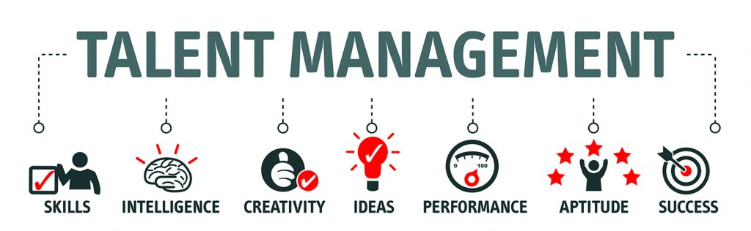
❖ Method for attracting, developing and retaining core competencies
Implementing a programme of prospective exploration of human capital and offer career progression prospects by :
 Building a talent management policy and programme
 Exploring each year your human capital
 Organizing high-valued paths inside your organization and the parent company or some partners
 Anticipating the future trades
 Identifying and securing the rare skills
 Developing a knowledge management programme
Increase the loyalty effect by :
 Investing in non-financial remunerations
 Building premium training
 Increasing internal mobility to offer opportunities for career progression (hierarchical, functional)
 Mobilisation and fostering of responsibility of line managers
 Continuing professional development : acquire knowledge and skills (up-skilling)
 Sharing opportunities : encouraging employees to take part in international events or to teach
 Giving greater meaning to your activities

Slide 8

❖ Method for attracting, developing and retaining core competencies
Developing CSR approaches
Protecting employees’ health and well-being: quality health insurance, annual well-being programme…
Promoting a good work/life balance: home office possible up to 120 days/year, promotion of parenthood, negotiation of an agreement on caregivers, …
Encouraging internal innovation and new working methods: participatory management, calls for ideas, co-working spaces, transformation programmes
 Integration of sustainable development concerns: organic food, management of waste and consumption, protection of biodiversity

Slide 9
❖ Method for attracting, developing and retaining core competencies
As a result, so far :
➔ 126 people have embraced new career path inside the agency for the last 30 months despite pandemic issues. It is more than 15% of the entire workforce reoriented in just more than 2 years
➔ 80% of the job opportunities opened in 2022/2023 concerning the new CIGEO organization were filled with internal movements
➔ Less than 5% (average basis) people have dismissed since 2020

Slide 10
⬥ Need for a more forward-looking HR vision
The long-scale project Cigéo → Need to a more forward-looking HR policy
On-going development of a new HR product called CEDRE
CEDRE to anticipate the future scripts and future needs in professions and skills
Set a time scale of 5 to 10 years
Being carried out by combining ressources and knowledge on each business division
 Being carried out with work market trends, collective sociological behaviour and educational issues

Slide 11



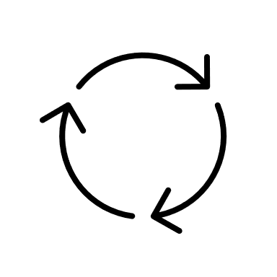

Conclusion
The CEDRE will be :
An iterative and pragmatic observatory
Re-evaluated each year
Refining our vision in recruitment, training needs
Helping in HR decision-making
The forecast will be communicated to employees
➔ A tool to help facing the challenges ahead of us

Slide 12
Conclusion
Thank you very much

