Slide 1
Practical Safety and Sustainability Decisions in Australia’s Radioactive Waste Facilities
International Conference on
The Safety of Radioactive Waste Management,
Decommissioning, Environmental Protection
And Remediation
Ensuring Safety and
Enabling Sustainability
6-10 November 2023
Vienna, Austria
Mani Bhushan Krishnagiri Thoopal
Duncan Kemp

Slide 2
Introduction
Safety and Sustainability:
  Times when there are compromises
  Times when they are congruent
Safety will always play a larger role in these decisions
Sustainability decisions have to work within the safety requirements

Slide 3
Examples of Safety and Sustainability Showing Congruence

Slide 4
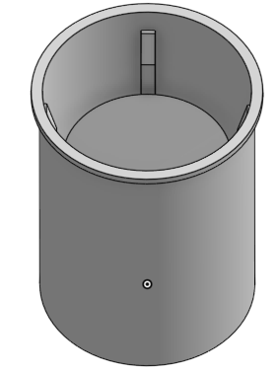
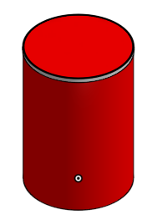
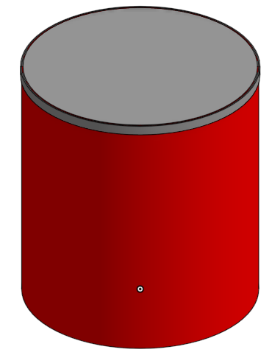
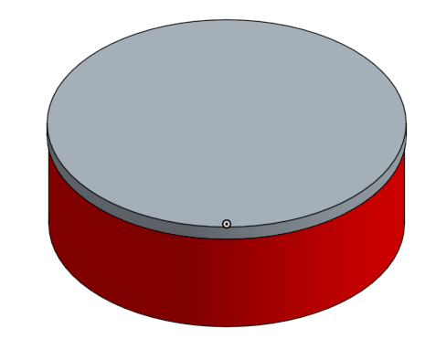
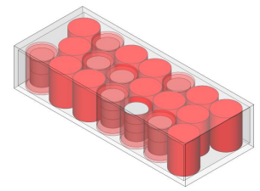
Waste Minimisation at ANSTO - Compaction
Puck A Puck B
400L Overpack
200L Drum
Grouting & Storage
At NRWMF
Storage in Half Height ISO Container

Slide 5
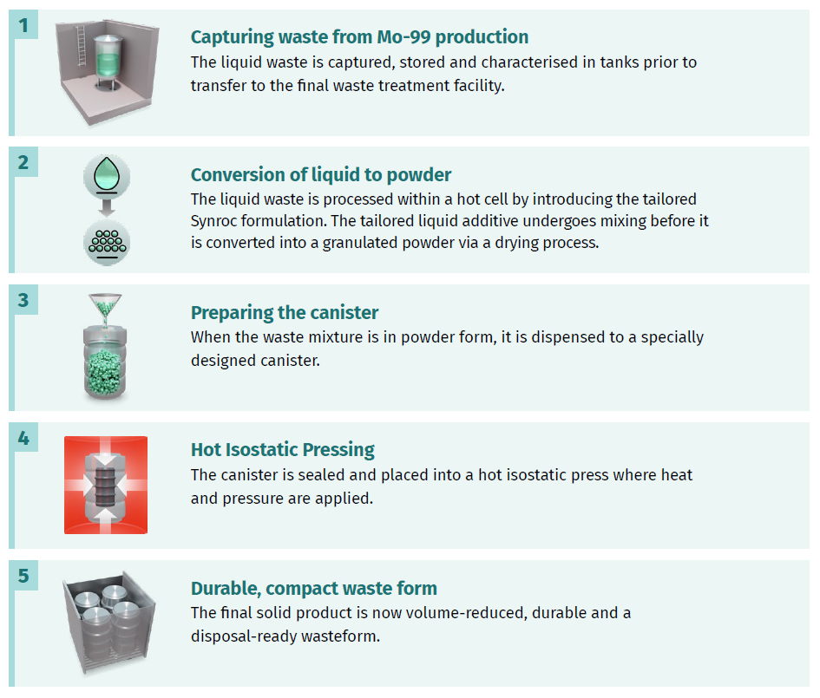
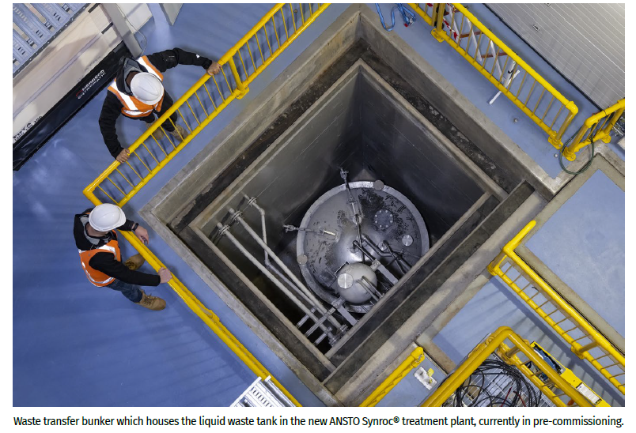
Synroc® Processes

Slide 6


ANSTO Synroc® advantage for Mo-99
~112m³
5m³
~2.5m³
Cement
encapsulation
Intermediate-level
liquid waste
Synroc

Slide 7
Examples of Safety and Sustainability Showing Divergence

Slide 8
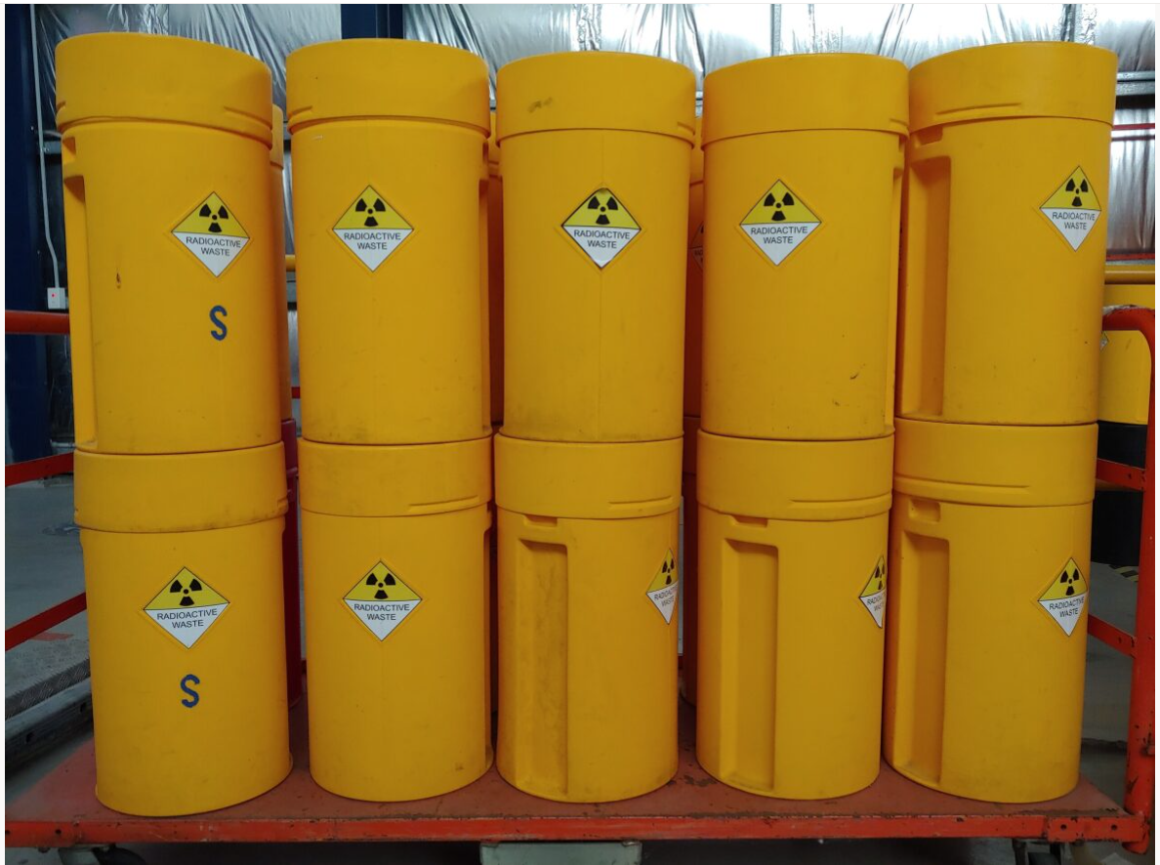
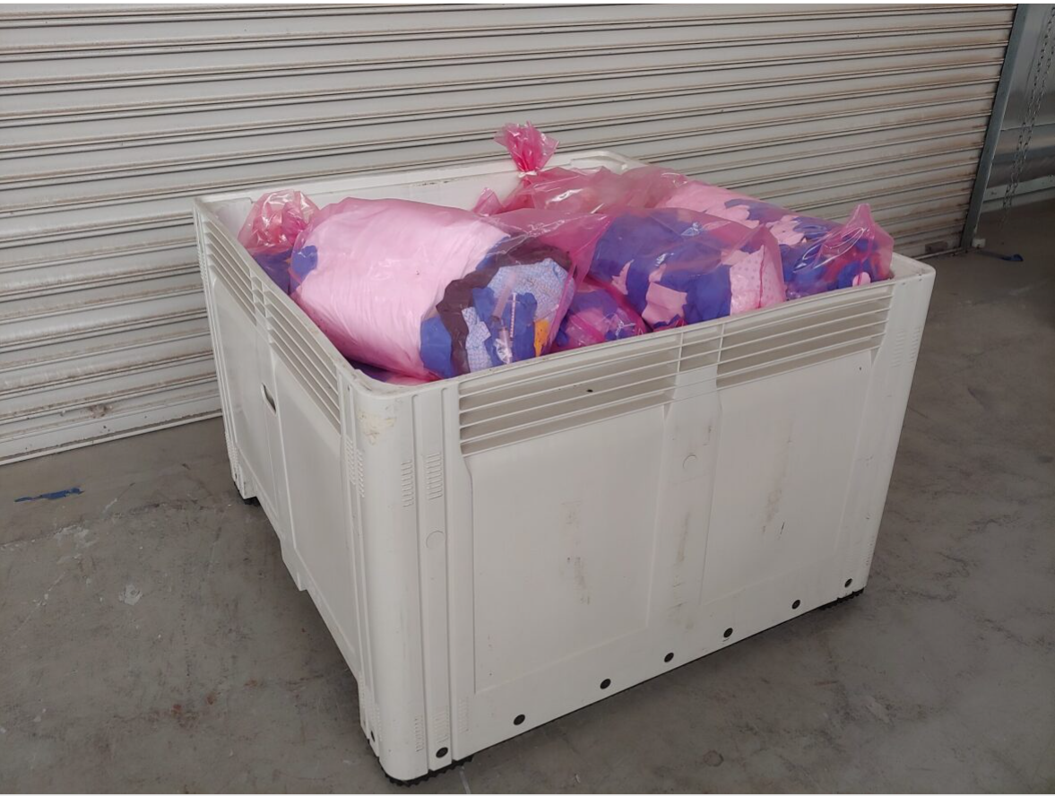
Generation of Waste in Radiopharmaceutical Manufacturing –Patient safety taking precedence over environmental sustainability
Use of disposable items in the radiopharmaceutical and the healthcare industries involves a balance between patient safety and environmental sustainability considerations.
Patient safety requires disposable items to interact with the radioactive material to prevent cross contamination, thereby generating a lot of waste such as ion exchange columns, connecting hoses, vials and some tools.

Slide 9
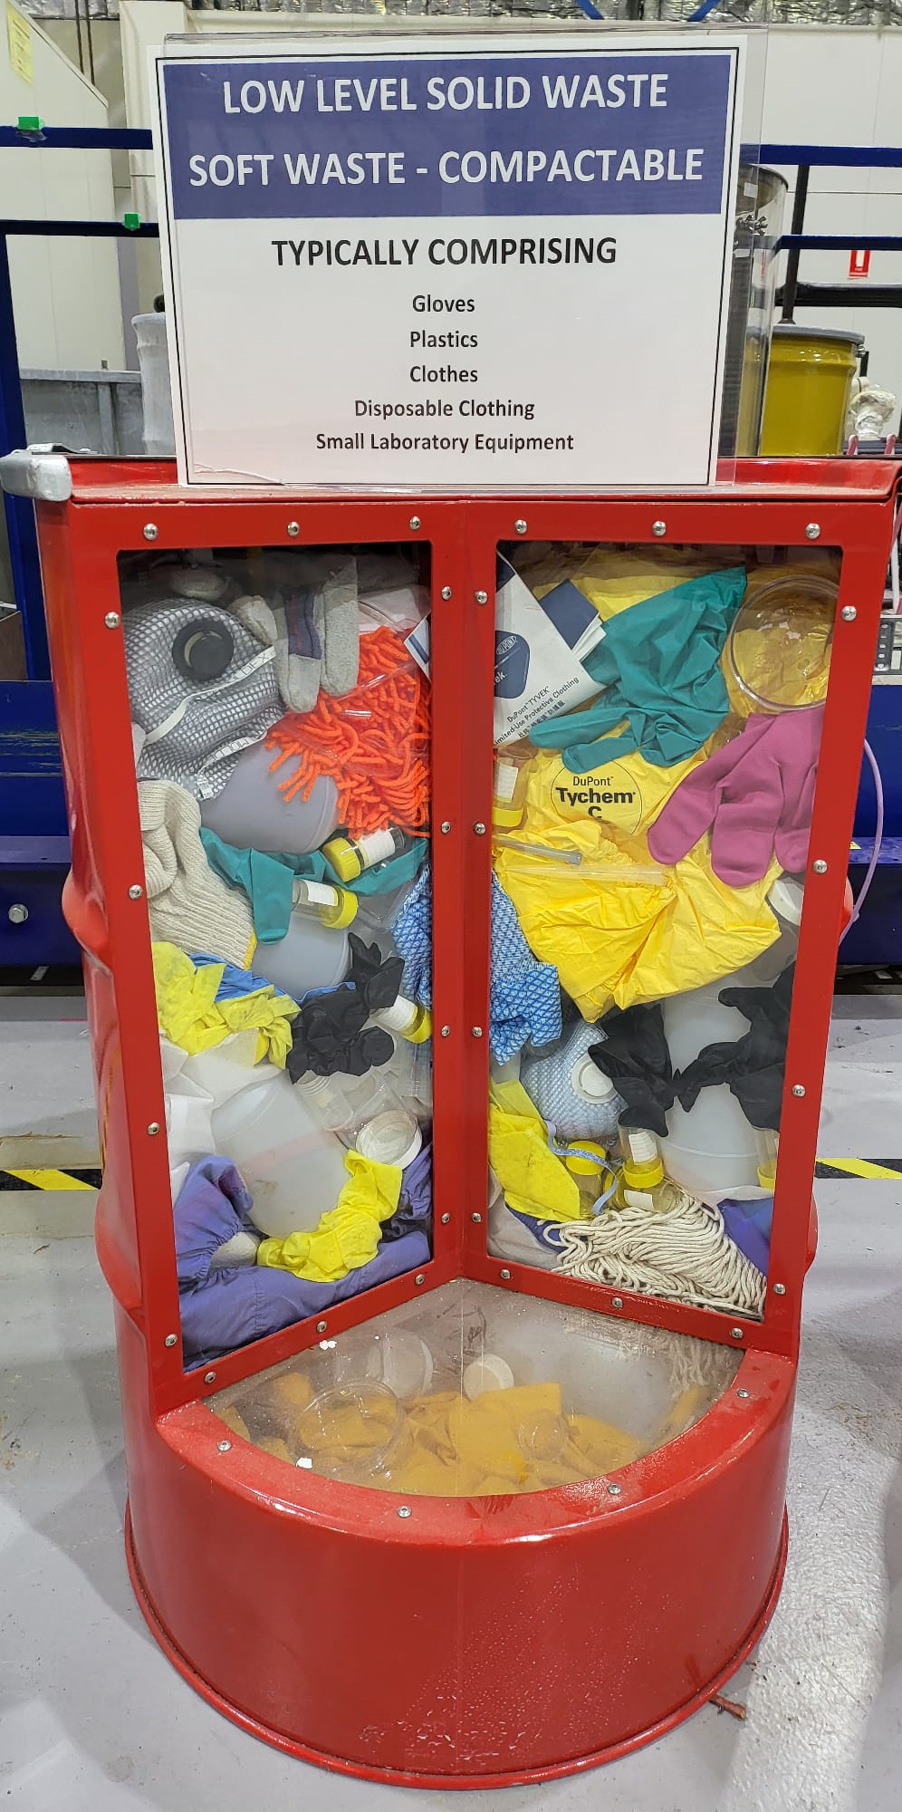
Generation of Waste in Radiopharmaceutical Manufacturing –Patient safety taking precedence over environmental sustainability
Single use nature however raises concerns about the environmental impact of increased waste generation.
Usage of disposable items as opposed to reusable ones eliminates the risk of cross contamination in those scenarios, thus better ensuring patient and healthcare worker safety at the slight cost of sustainability
Facilities can minimise waste generation by providing adequate training, establishing efficient protocols and by optimising the delivery and consumption of radiopharmaceuticals.

Slide 10
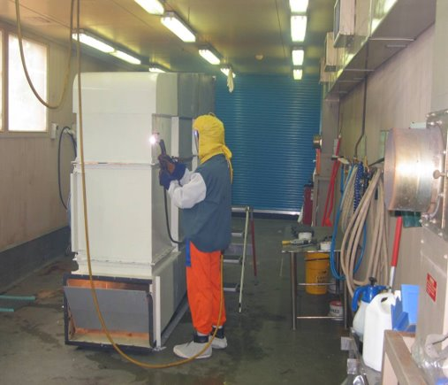
Decontamination of Tools and Equipment
Safety risk optimisation vs elimination
Decontamination of tools and equipment as opposed to their disposal - Reduces the likelihood of contamination to an acceptable level.
Significantly reduces the environmental impact while only slightly increasing the radiological risks.
E.g. drip trays found in transport flasks that ANSTO uses to move radioactive items between buildings as part of the production and waste management processes
Drip trays are routinely decontaminated and inspected by qualified personnel prior to being reused.

Slide 11
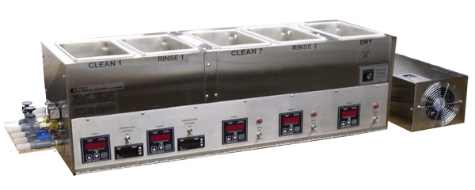
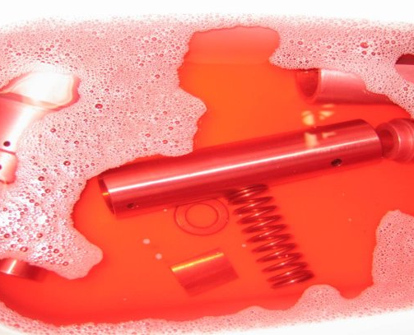
Decontamination of Tools and Equipment
Transport of liquids during rain – Not permitted
Reduces the environmental impact of the process but slightly increases the radiological risks to operators due to the decontamination steps involved.
ANSTO uses a variety of chemical, mechanical and laser surface ablation methods for decontamination
Size reduction techniques to reduce the quantity of material that enters solid radioactive waste stream.
Example Ultrasonic decontamination setup. Source: Stainless Steel Passivation Equipment | Passivation Machine (besttechnologyinc.com)
Decontamination of Stainless Steel & Aluminium components in 10% Citric Acid Solution

Slide 12








Alignment with UN SDGs
Compaction
Synroc
Decontamination
Source: THE 17 GOALS | Sustainable Development (un.org)

Slide 13
Conclusion
All work must be optimised for safety and safe and appropriately controlled.
The justification for any undertaking requires considerations and decisions on many factors including priorities, environmental sustainability, worker safety or patient safety.
There is no one rule - Each circumstance leads to different priorities and optimisation favouring requirements. There are times when the balance between safety and sustainability needs additional consideration; times when there are compromises and times when they are congruent.

Slide 14
Thank you

Slide 15

Questions?
Notes:
Thank you please let us know how we can answer your questions.

