Slide 2
Radiological characterization, risk assessment and selection of preferred remedial option for the Veselivske legacy trench site in Ukraine
Dmitri BUGAI¹, Oleg NASVIT², Eric HOWELL³, Volodymir RUDKO⁴, Rodolfo AVILA³, Serhiy KOVALENKO⁵
1 - Institute of Geological Sciences, Kyiv; 2 - AFRY-Ukraine LLC, Kyiv; 3 - ÅF-Industry Sweden, (AFRY Group), Stockholm; 4 - Institute for Safety Problems of Nuclear Power Plants, Kyiv; 5 - Executive Committee of Kropyvnytskyi City Council, Ukraine

Slide 3
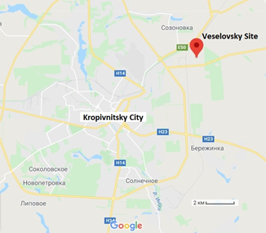
1. Veselovsky legacy trench site - overview
In 1985 a radiological accident involving industrial IRS with Cs-137 occurred at the construction enterprise in Kropivnitsky City in Central Ukraine
As result of mitigation of the accident in 1988, 224 containers with clean-up wastes with dose rate up to 3.5 µSv/hour (as of 1988) were buried in 4 trenches in abandoned clay quarry “Veselovsky” at outskirts of the city
With time, institutional control and memory about the site was lost

Slide 4
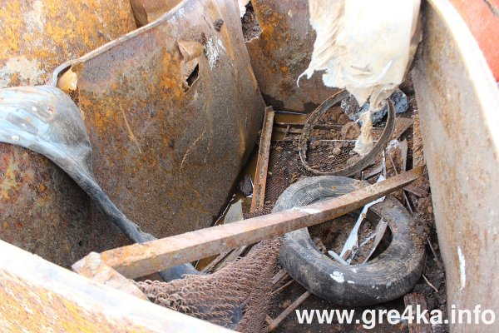
2. Intrusion of “metal hunters” to the site in 2017
Contents of excavated container with waste (2017)
In July 2017 scrap metal hunters partially excavated 3 from 4 trenches using heavy machinery
The excavation was discovered and stopped
The hastily carried out mitigation works (bulldozing of radioactive materials back to trenches) has left residual surface “hot spots” with the dose rate up to 0.7 μSv/h

Slide 5
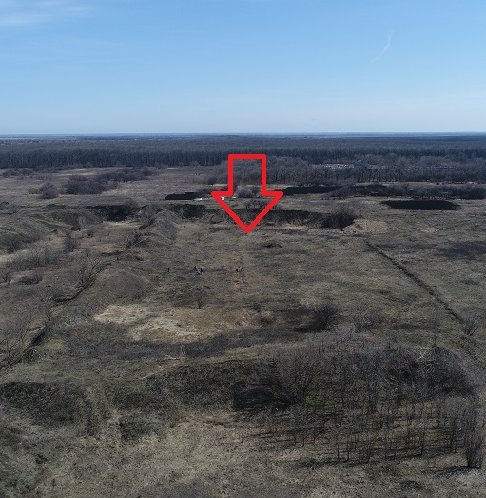
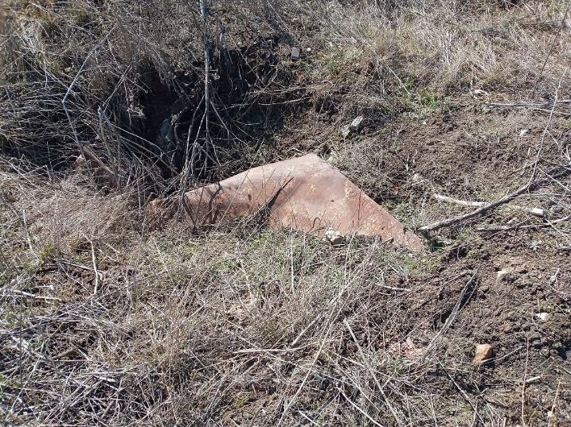
3. Current day conditions at the site
View on Veselovsky site from the drone (2021)
Exposed waste container in the looted trench
The local authorities lacked good understanding of radiological risks posed by this site
The site was of interest for local investors to construct a solar farm, but this project was not realized because of concerns of possible radiological hazard

Slide 6
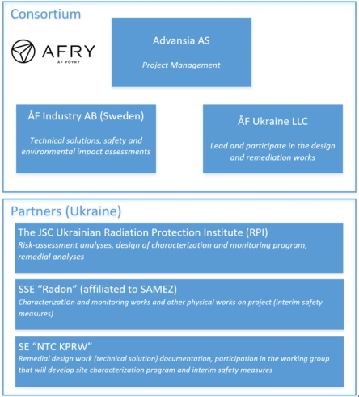
4. Project on developing remedial design for Veselovsky Site
Consortium participants and their role
The project “Risk assessment and development of remedial design for the “Veselovsky” legacy radioactive waste storage site in Kirovograd Region” has been supported by Norwegian Gov. in 2021
The project funded by the program: Nuclear Safety and Security, The Norwegian Government’s Action Plan 2018–2022
The project is supervisd by the Norwegian Nuclear Safety Authority (DSA)
Project End User: Executive Committee of the City Council of Kropyvnytskyi
Project leader: Dr Eric Howell (ÅF-Industry Sweden)

Slide 7
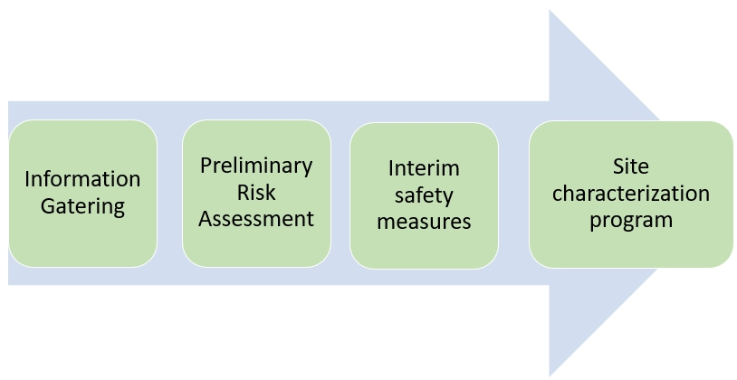
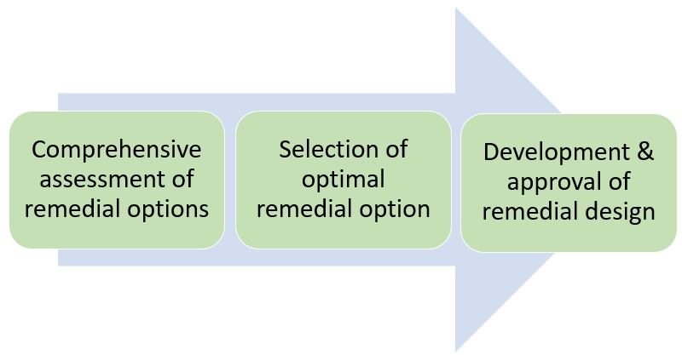
5. Sequence of project tasks
Project tasks - 2021
Project tasks – 2022 - 2023
Video surveillance system & radiation danger signs
Radiological & Geophysical survey

Slide 8
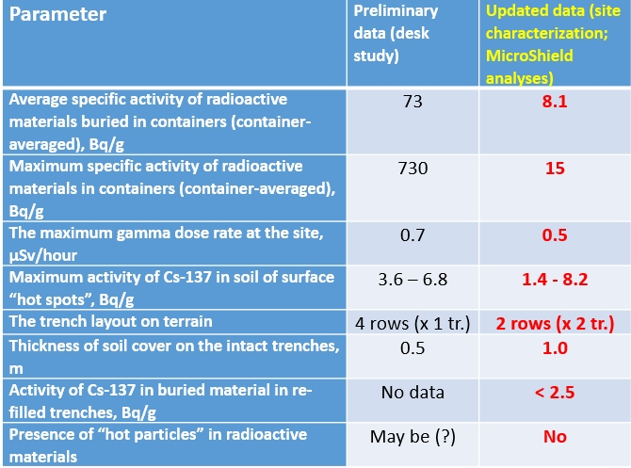
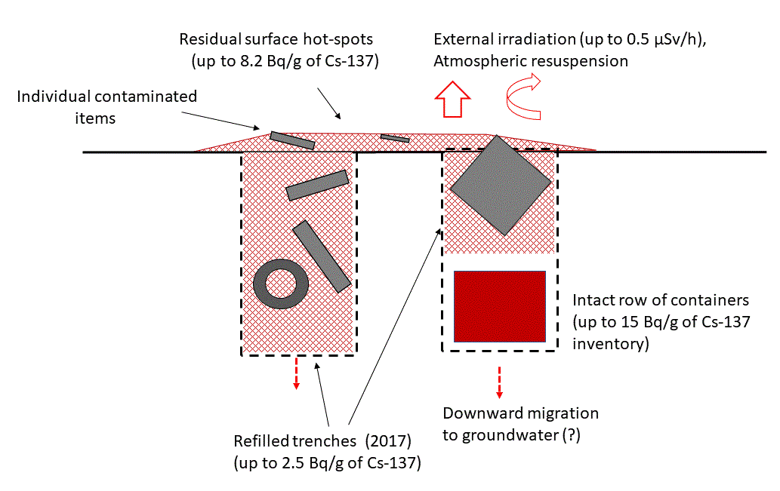
6. Site characterization results: updated radiological parameters and revised CSM
Results of site characterization suggest that Veselovsky is a lower inventory and radiological risk site compared to the desk study assessment

Slide 9
7. Looking for a sustainable solution for Veselovsky site
The project was seeking to identify a sustainable remedial solution for the Veselovske site where sustainability is defined as (UK Sustainable Remediation Forum ):
“the practice of demonstrating, in terms of environmental, economic and social factors, that the benefit of undertaking remediation is greater than its impact and that the optimum remediation solution is selected through the use of a balanced decision-making process”
In particular, defining of sustainable remedial solution correlates with its optimization with regard to safety, cost, economic benefits, waste generation and social aspects
Since 24 February 202Ukraine has become an arena of aggressive war, which was waged against the country by Russian Federation. In such conditions, the local authorities of Kropyvnytskyi City carried a heavy load of economic and societal problems caused by the war. The listed problems are competing for limited budget allocations of the local community for societal and environmental issues

Slide 10
8. Identified and agreed with the End User remedial options for further evaluation
Main identified and agreed with the End User remedial options for evaluation:
Option I. In-situ radioactive material storage with interim security measures (video-survey system, radiation danger signs).
Option II. Isolating hot spots above the trenches by means of an engineered soil cover, which allows economic use of the site (with restrictions on certain activities)
Option III. Retrieval of radioactive materials, sorting according to activity concentration and off-site disposal. Release of the site from control
Evaluation criteria
Technical feasibility
Safety for public (short term, long-term)
Safety of remedial workers
Remedial costs (investment, operational)
Waste (retrieved material) management issues and disposal routes
Need for a long-term stewardship
Possibility for economical use of the remediated site
Societal aspects

Slide 11
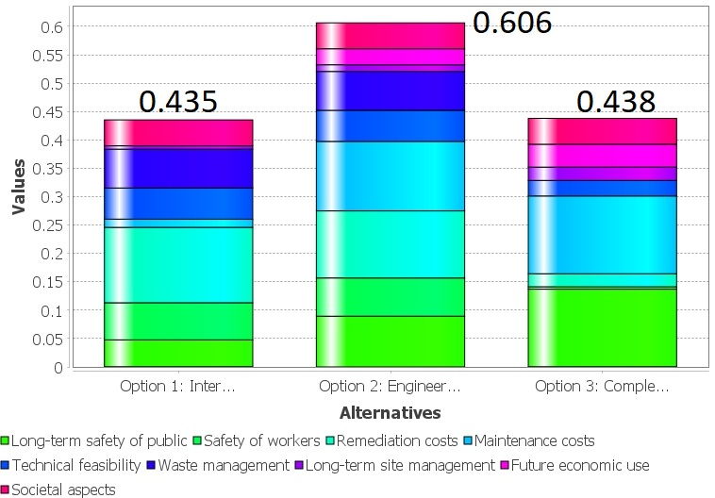
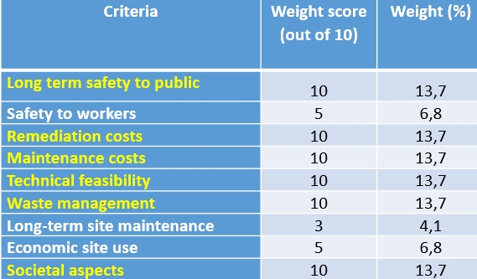
9. Inter-comparison of remedial options using the multi-criteria decision analysis (MCDA)
Remedial option scoring results
The optioneering analysis was performed using the MCDA-KIT software tool developed in the Karlsruhe Institute of Technology (https://portal.iket.kit.edu/projects/MCDA)
Relative weights of each criterion
Sensitivity analysis has shown that the even significant changes to the assumptions and input values likely will not result in a change to the recommended option

Slide 12
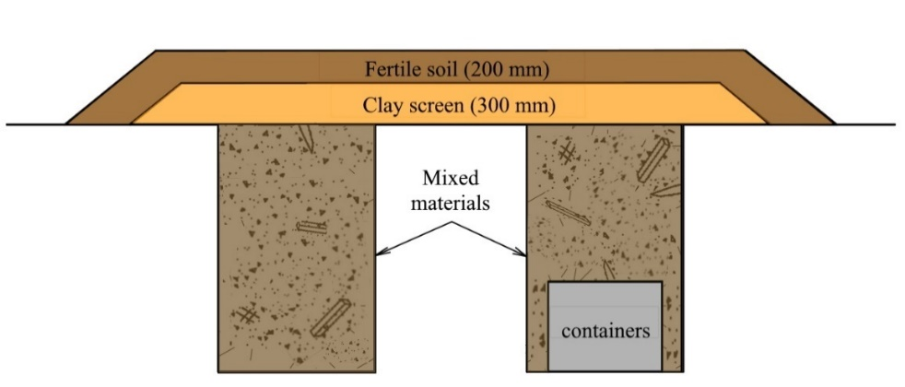
10. Highest score remedial approach – Option 2
The following advantages of Option 2 (in-situ storage of waste with the engineered soil cover) have contributed to its highest score:
adequate level of safety (to public, remedial workers);
reasonable remedial costs;
simple technology;
possibility of future economic use of the site (with restrictions); and
additional waste not generated
Option 2. Scheme of the engineered soil cover over trenches
The site area with “hot spots” requiring remediation using engineered soil cover is estimated at 2000 m²
With Option II there is still a possibility to retrieve radioactive materials sometime in future (in the event the situation requires it, when a disposal route becomes available etc.)

Slide 13
11. Process of approval of recommended remedial option
The approval process included a sequence of steps:
Informal consultations with the End User (work group level);
Approval by the End User at the Project work group level;
Distribution of Executive summary and relevant technical reports to all interested parties for review and comments;
Presentation and approval by Project Steering Committee (which includes representatives of responsible state ministries, regulators and local authorities);
Approval by Commission on Environmental Safety and Emergencies of the City Council of Kropyvnytskyi City; and
Approval by Executive Committee of City Council (June 27, 2023)
The project design for the preferred remedial option 2 has been completed by Consortium in September 2023, and is submitted for approval to Ukrainian Regulator

Slide 14
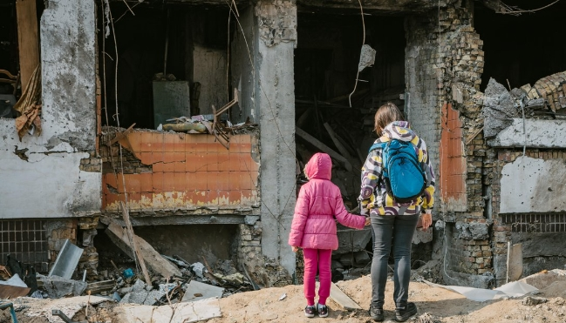
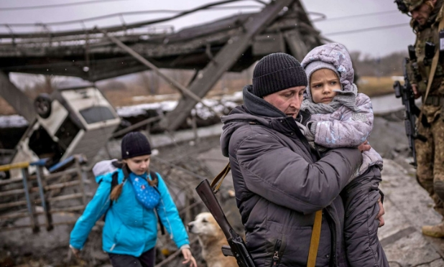
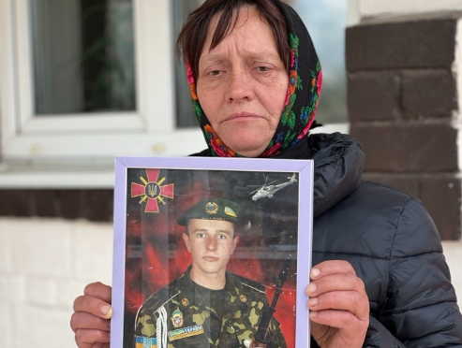
Difficulties caused by war situation in Ukraine
Missile strikes on city infrastructure
Support to families of defenders
Refuges from South- East regions
… and many, many other urgent and difficult war-related problems
Still Kropyvnytskyi City authorities are determined to complete remediation and resolve the long-lasting problem of the Veselovsky site, and also they believe the Ukraine will withstand the aggressive war, and are looking forward to post-war reconstruction in the country
THANK YOU FOR ATTENTION!

