Slide 1

Remediation of uranium legacy sites in Portugal. Perspectives and challenges for long-term post-remediation management
International Conference on
The Safety of Radioactive Waste Management,
Decommissioning, Environmental Protection and Remediation
Edgar Carvalho
Catarina Diamantino
6 – 10 November, 2023
Vienna, Austria

Slide 2
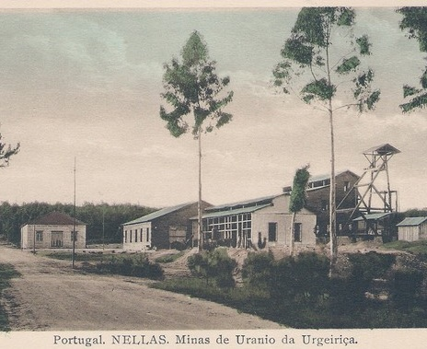
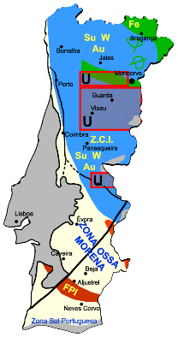
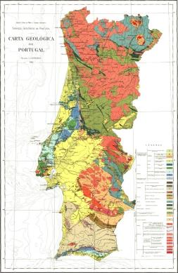
Uranium mining in Portugal
high geological, geotectonic and geodynamic diversity, which generate specific conditions for the formation of mineral resources
Sn W Au
Granitic formations
Hercynian-age
(Beiras Region)
Sn W Au
Tin-Wolframitic Province
(Sn-W)
Iberian Pyritic Belt
Mainland Geology Map of Portugal
1:1000.000 LNEG Edition
Metallogenic Portuguese Belts
Abandoned Mine Legacy, DGEG & EDM Edition

Slide 3
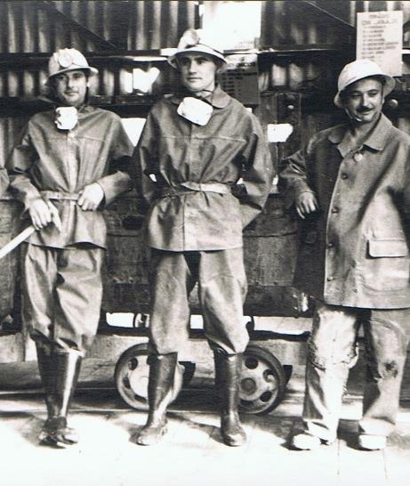
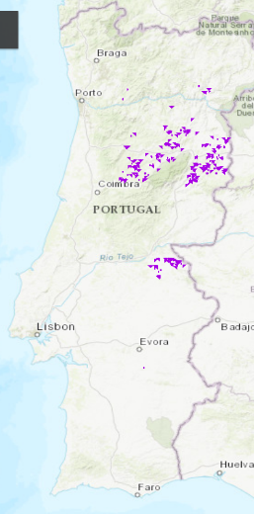
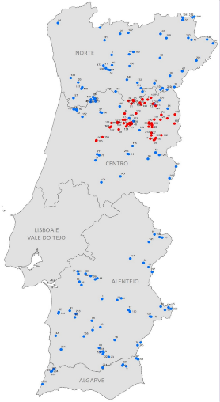
Uranium mining in Portugal
  Operation from 1907-1991
  286 uranium occurrences
  62 radium/uranium
  mining sites
  50 g Ra until 1944
  5500 ton U₃O₈ until 1991
  Exploration methods:
  Underground mines,
  open pits, both
  In situ leaching with acidic solutions
199 mining sites
Uranium ocurrences
Source: dgeg.gov.pt

Slide 4
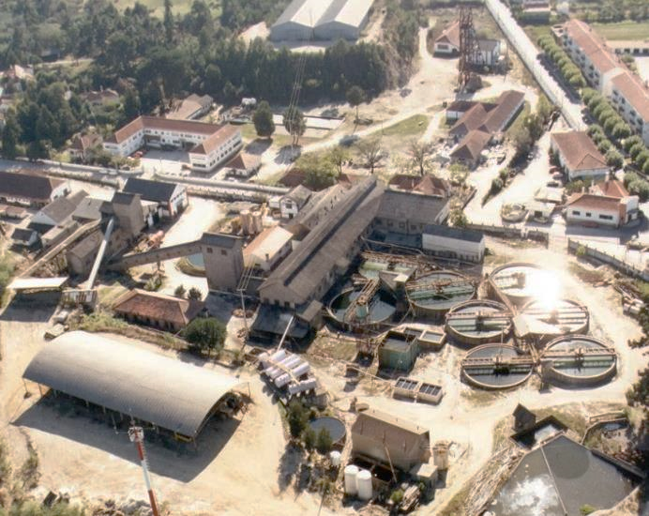
Remediation of uranium legacy sites in Portugal
Starting point
  Uranium exploitation since 1907
  Villages grew around mines
  Existing exposure situations above recommended limits
  Environmental liabilities
  Degraded mining infrastructures
  Complex social situation after mine “closure”
  Social Pressure on “old workers” vindications
  Mistrust about “remediation” process
Main environmental impacts
  Waste dumps, tailing ponds and heap leaching ponds
  Excavation/exploitation works – open pits
  Effluent mine and acid drainage
  Physical stability/security conditions
  Soil, water and air contamination

Slide 5
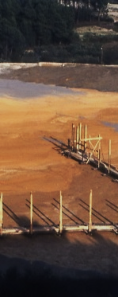
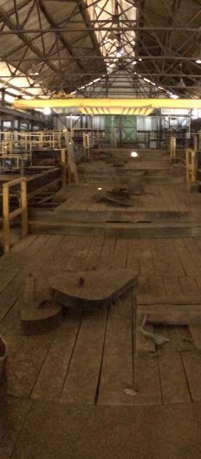
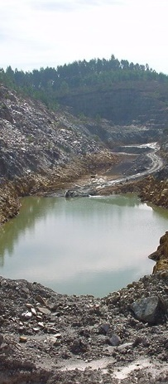
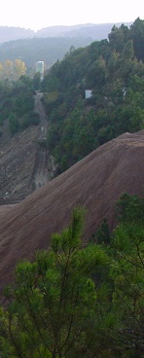
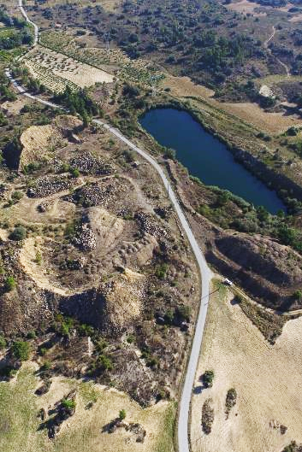
Remediation of uranium legacy sites in Portugal
In the majority of the areas explored, the environmental liabilities contained practically all the problems mentioned above, which posed major environmental and safety problems for both the environment and the population. Intervention was and is unquestionably necessary

Slide 6
Remediation of uranium legacy sites in Portugal
Since 2001, EDM – Empresa de Desenvolvimento Mineiro, S.A. (EDM)
has been granted the responsibility for the environmental remediation of all mining legacy sites in Portugal, including 62 radium and uranium legacy sites.
Applicable conditions to mine legacy sites:
Abandoned /“orphan” sites
Past mining activities explored not according to current standards (operation ceased until 1990 DL)
Radioactive mines in relation to which the public interest of the State intervention is recognized
“Polluter Pays Principle” is not applicable
That aims to:
Eliminate the risk factors for public health and safety, resulting from water pollution, soil contamination, heaps and any unprotected areas;
Rehabilitate the surrounding landscape and natural conditions of development in accordance with the previous habitat;
Ensure the preservation of significant heritage of old mines, both economic and archaeological and the valorization of archaeological remains related to mining activity;
Provide conditions for future use of reclaimed areas such as agricultural or forestry use, tourist and cultural promotion, or another that promotes the community development.
The concession contract signed on September 5, 2001, was recently renewed for 8 years until 2031, thus reaffirming, the Portuguese government the interest in the continuation of the Environmental Remediation of Legacy Mining Sites.

Slide 7



Remediation of uranium legacy sites in Portugal
After two decades of remediation 45 radioactive mining sites are remediated, 8 are undergoing remediation (in 2023) and 9 are planned to be remediated until 2030.
Results for radioactive mines:
  45+8 mining areas remediated until 2023
  9 mining areas planned to remediate until 2030
  Total investment for radioactive mines :
  Aprox. 96 M€ investment between 2001-2023
Main funding sources:
  EU Cohesion Funds / Portuguese mining royalties
  Planned investment 2024-2030
  Aprox. 30 M€ investment in remediation projects
  Aprox. 1.5 to 2.0 M€ annually in Post-remediation
Legacy sites | Planning | Implementation | Post-remediation | Total
Radioactive | 9 | 8 | 45 | 62
Polymetallic | 73 | 1 | 63 | 137
Total | 82 | 9 | 108 | 199

Slide 8
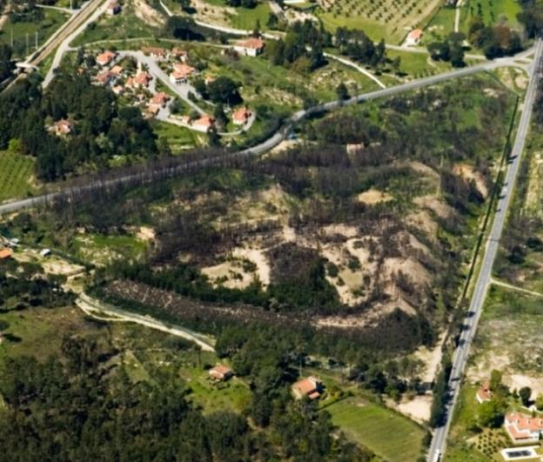
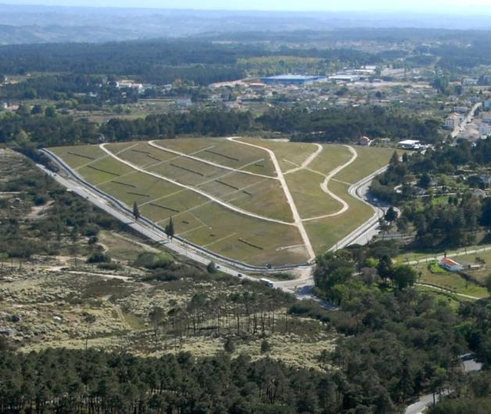
Remediation of uranium legacy sites in Portugal
Before and after remediation works

Slide 9
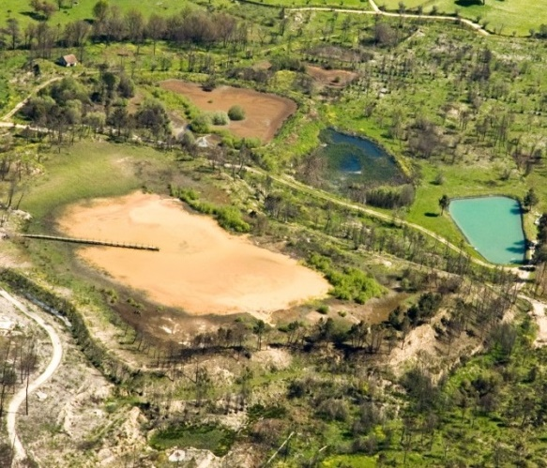
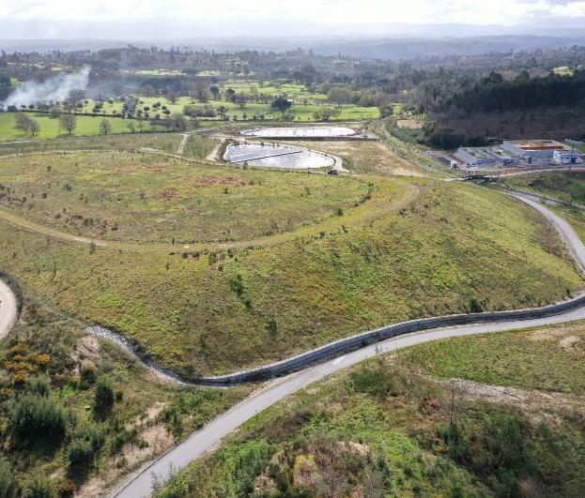
Remediation of uranium legacy sites in Portugal
Before and after remediation works

Slide 10
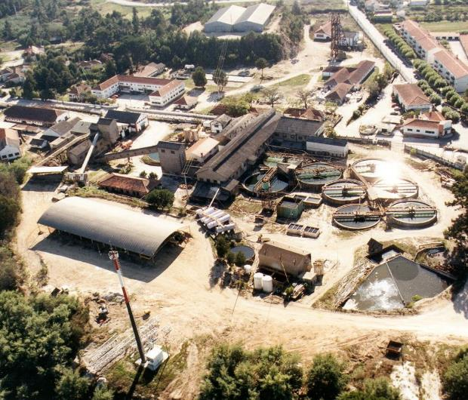
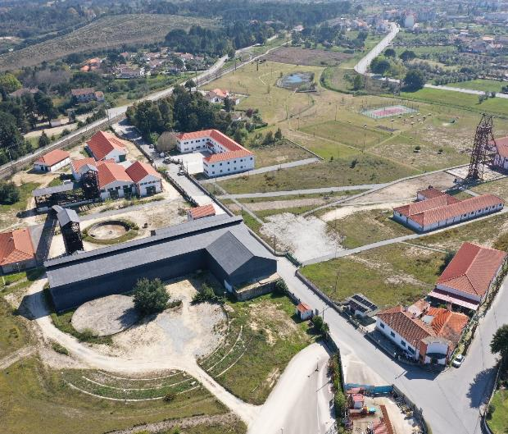
Remediation of uranium legacy sites in Portugal
Before and after remediation works

Slide 11
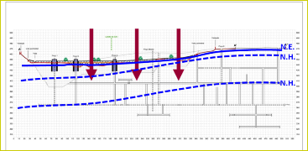
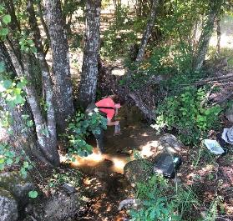
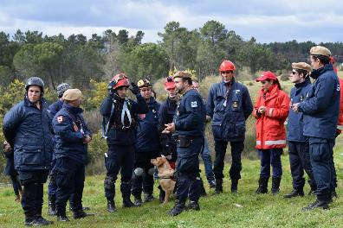
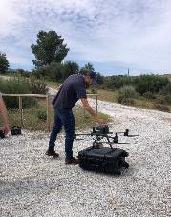
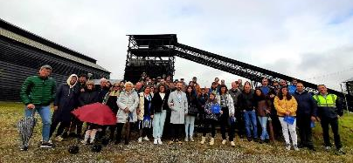
Post-Remediation Management
Why Post-Remediation Management?
  integrity and performance of the remedies may degrade
  often residual contamination remains
  assess natural attenuation processes
  new pathways may be generated
  extreme weather and unexpected events
  Other insidious risks may develop…
“Ensure long-term protection to public and the environment”

Slide 12
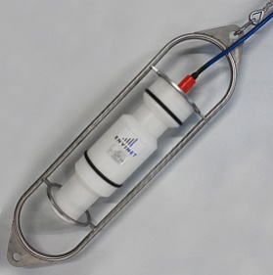
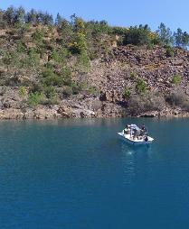
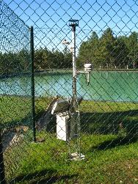
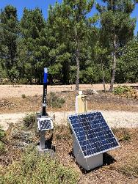
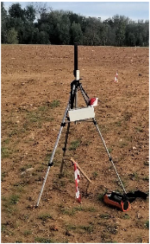
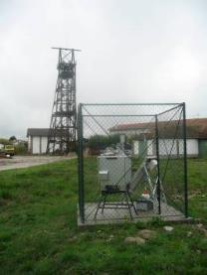
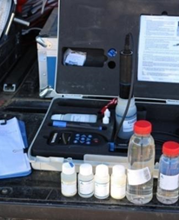
Post-Remediation Management
Monitoring
  Water resources
    Water quality
    Water flows
    Piezometric levels
  Meteorological monitoring
  Radiological monitoring
    Radiological air and airborne dust quality monitoring with alpha site dosimeters
    Ambient gamma dose rate online monitoring
    Online radon concentration probes monitoring in Urgeiriça tailing dam disposal cell
    Indoor radon monitoring in mine water treatment operation facilities

Slide 13
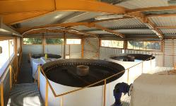
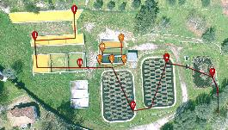
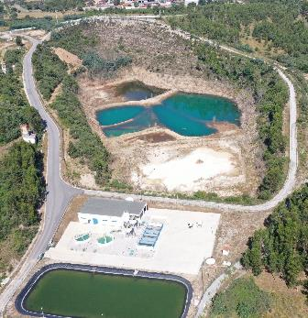
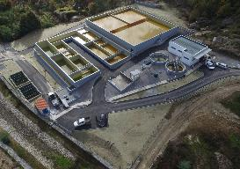
Post-Remediation Management
Care & maintenance;
  Inspection checklists and records;
  Preventive maintenance;
  Corrective maintenance;
    Water treatment systems
    Fencing
    Vegetation and covers
    Drainage systems
Mine water management:
  Active treatment systems (uranium mining areas)
  Passive treatment systems

Slide 14
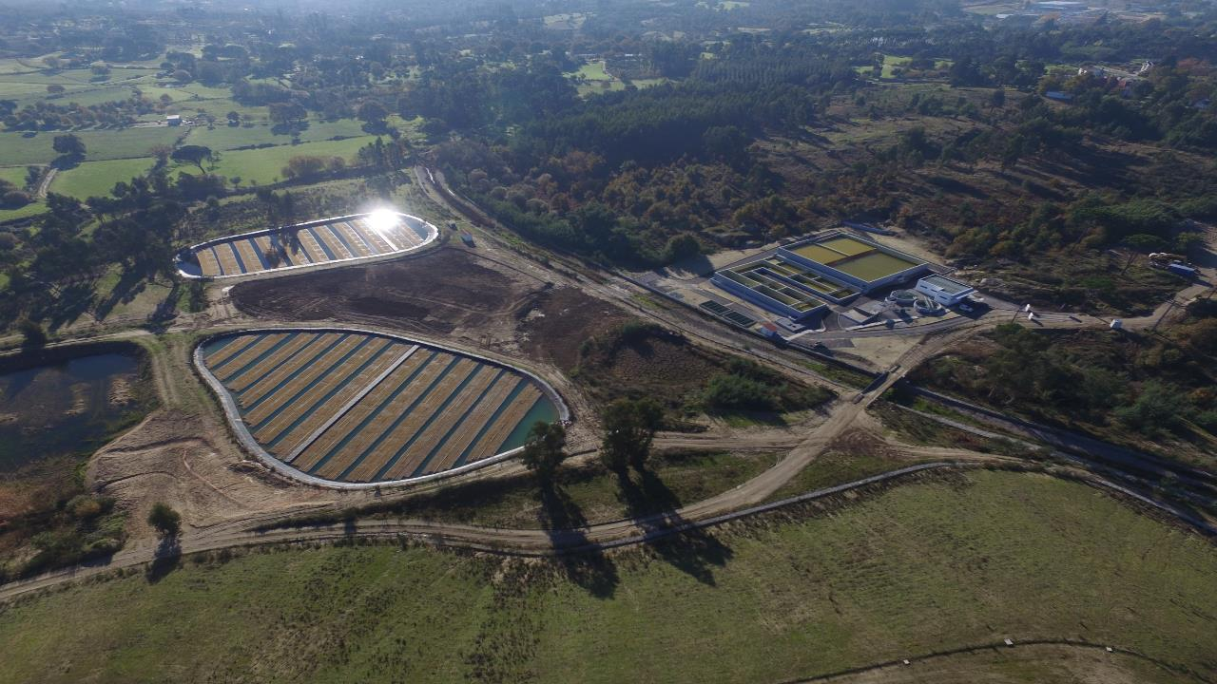
Urgeiriça Mine Water Treatment Plant: Active and Passive treatment

Slide 15



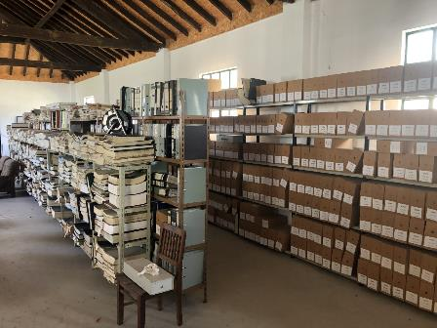



Post-Remediation Management
Records keeping
  Historical records
  Environmental monitoring
  Characterization reports
  Remediation projects, EIA, licensing processes
  Supervising reports during remediation
  Final remediation report
  Photographic evidences
  Inspections checklists
  Maintenance reports
  Stakeholder´s interactions
  Financial reports
ENU Historical Archive

Slide 16
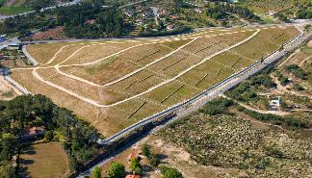
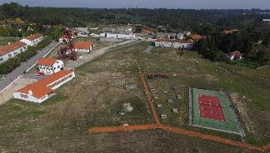
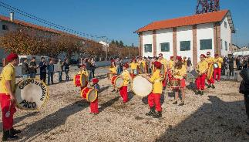
Post-Remediation Management
Land use restrictions and site reutilization:
  Restricted use (e.g. remediated radioactive waste dumps and tailings dams)
  Limited use, with specific end-uses defined or subject to EDM opinion
  (e.g. remediated areas with residual contamination):
    Forestry or renaturalized areas;
    Public parks for recreational use;
    Industrial areas.
  Unrestricted release, when residual contamination or end-state conditions are similar to background levels that do not pose risks.
  Ownership of easement on properties
  Land planning instruments (legal municipal instrument)
  “Imposed” by the regulatory body (under DL 108/2018)

Slide 17
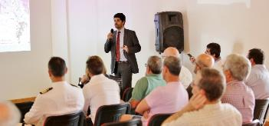
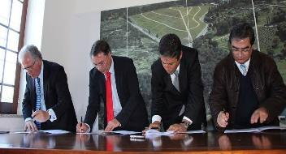

Post-Remediation Management
Stakeholder engagement:
  Public presentation and discussion of the Remediation Projects and End-Uses with local communities
  Maintain regular meetings with stakeholders (e.g. NGO, schools)
  Providing information (e.g. website)
  Cooperation with municipalities
  Sharing results and benefits
  Visits from schools and civil society organizations
“fosters a sense of ownership and responsibility, promotes the education of the communities about the mining history and the site´s remediation”
Notes:
Maintain the trust and community relationships
Keeping stakeholders informed
Preserving awareness of existing residual risks
Anticipate and prevent conflicts.

Slide 18
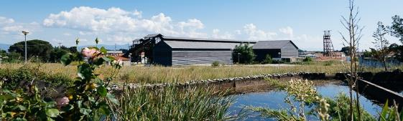
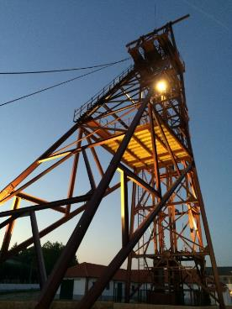
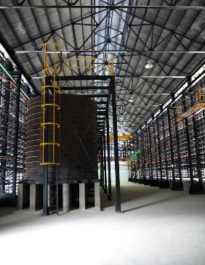

Perspectives for sustainable post-remediation management
Promoting “Industrial Tourism”:
  Identified end-use for relevant historical sites
  Guide to the Portuguese Geological and Mine Sites (www.roteirodeminas.pt)
  Contribute to preservation of mining heritage infrastructures
  Contributes to preservation of history of uranium mining and milling in Portugal
  Promote socio-economic development of affected areas
  Fosters sense of ownership and community
  Honors the effort and sacrifice of uranium mining community
  Creation of the Uranium Mining Museum (Urgeiriça)

Slide 19
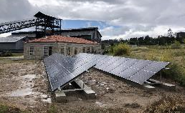

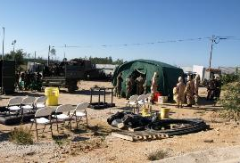
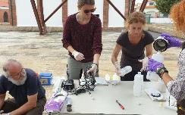
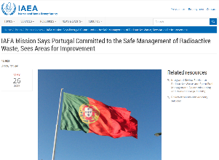
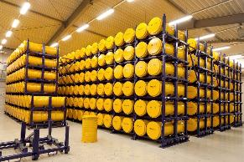
Perspectives for sustainable post-remediation management
Generation of renewable energy (e.g. solar)
  Auto-consumption
  Renewable energy communities
  Injection in the national grid
Promotion of a “Research Centre” in Urgeiriça
  Collaboration with universities
  R&D Projects
  Training Activities
  Laboratories
  Start-up companies
  Industrial/institutional beneficial reuse
  Future pre-disposal and disposal RW facilities
Seibersdorf Interim Storage (Photo: NES GmbH)
Notes:
Advantages of renewable energy
Beneficial reuse of restricted areas
Reduce energy costs
Generate income
Reduce carbon footprint
Shared benefits with the community
Foster “community ownership”
Promotes sustainable development
Advantages: of Research Center
Benefit from existing infrastructures
Benefit from existing know-how
Generate capacity and train experts
Promote innovative mining and remediation solutions
Contribute to social and economic development in the affected areas
ARTEMIS Review Mission Recommendation:
“Further developing a comprehensive national policy that sets out the preferred options for radioactive waste management.”

Slide 20
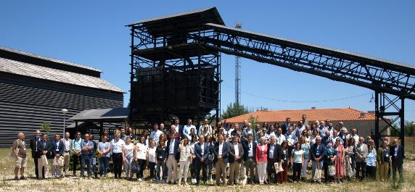
Challenges for sustainable post-remediation management
Clear mandate for long-term post-remediation management:
  Concession contract and Decree-law 108/2018 (legal framework of radiological protection) establish a clear legal framework and allocation of responsibilities
  Medium term concession contract (extended until 2030)
Securing funding for future remediation and post-remediation:
  Funds allocated for remediation projects under Portugal 2030 Strategy
  3 years investment plan with yearly approval of Royalties from mining operators
  Retaining human resources and technical
  know-how and capacity:
  Increasing difficulty to retain trained and
  capacitated staff
  Limited capacity to contract experts in
  mining and remediation
  Implementing effective knowledge transfer
  between retiring and new experts

Slide 21









Challenges for sustainable post-remediation management
  Impacts of climate change on effectiveness of remediation works:
  Increased frequency of extreme weather events
  Compromise the integrity of the remedies
  Increasing maintenance and re-remediation costs
  Increasing costs on adaptation and adoption of resilient solutions
Advances in technology and knowledge:
  Identification of emergent contaminants
  Innovative remediation solutions
  “new uses” for legacy mining waste
  Pro-active adaptation and risk management
  Maintaining stakeholder engagement / social license

Slide 22


Final Considerations
Remediation in Portugal contributed to effective reduction of risks to public and the environment, promoting mining heritage preservation and SAFE beneficial reuse of former degraded areas.
Promote and maintain effective stakeholder participation throughout the remediation process.
Post-remediation is essential to ensure the effectiveness of remediation in the long-term.
Adoption of collaborative, pro-active and holistic approach, considering technical, social, economic aspects to address challenges and seize opportunities.
Contribution to UN Sustainable Development Goals of protection of life on land and below water.

Slide 23

Contents

