Slide 1
REIMAGINING THE NUCLEAR CYCLE AS A CIRCULAR ECONOMY: CHALLENGES AND OPPORTUNITIES
Matthew Clark, Hopegill Associates
International Conference on the Safety of Radioactive Waste Management, Decommissioning, Environmental Protection and Remediation: Ensuring Safety and Enabling Sustainability
6–10 Nov 2023
IAEA, Vienna

Slide 2
Introduction
Case Study: UK LLW Management
Where next?
Integrated Waste Management
Circular Economy
Thinking in Systems
Achieving a balance

Slide 3
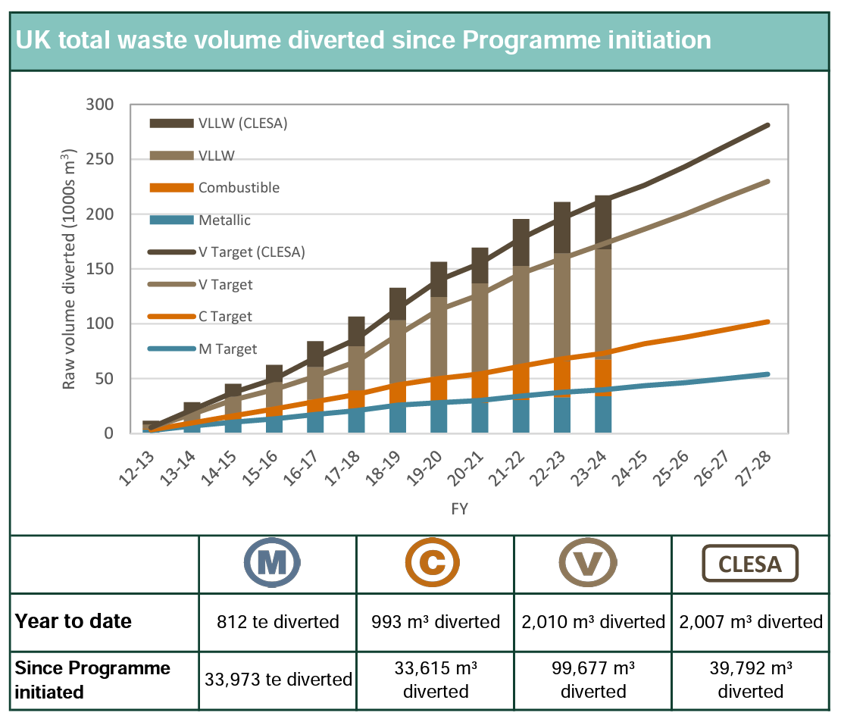
UK LLW Management
Urgent driver: disposal capacity
Policy to Strategy to Programme to Delivery
Clear messages:
Waste Hierarchy
Best use of assets
New waste routes
Incredible results
However, reliance on alternative disposal:
~ 50% commercial
~ 20% dedicated on-site disposal facilities
NUCLEAR WASTE SERVICES, Waste Metric Dashboard: August 2023
https://www.gov.uk/government/publications/waste-metric-dashboard-may-2022

Slide 4
Where next?
UK LLW example of what can be achieved – good outcomes, but work to do:
Reduce reliance on disposal
Reduce resource consumption
Reduce emissions
Maintain safety record
Manage cost
Sustainable Development Goals
Integrated Waste Management
Circular Economy
Optimisation, lifecycle decisions, ‘value’ not ‘cost’
Alignment of goals

Slide 5
Integrated Waste Management
Not a single process or system
Principles and practices that create a framework
Connectivity, coordination and collaboration
Benefits:
Value for Money, resilience, efficiency, clarity of message, reduce environmental burden, etc.
Principles & Practices
Possible settings
Alignment (message, goals, targets)
Policy to Delivery
Framework for delivery
?
Organisations
Coordination & leadership
?
Nuclear industry
Knowledge & information
?
Risk management
Other uses of nuclear technology
Collaboration & communication
?
Waste lifecycle
Culture

Slide 6
Circular Economy
“materials never become waste and nature is regenerated… products and materials are kept in circulation through processes like maintenance, reuse, refurbishment, remanufacture, recycling, and composting.”
Deliverable within the industry?
Ownership: whole industry e.g. re-use opportunities
Design: products, facilities, even industries
Specifications
Three Principles
Eliminate waste and pollution
Three aspects of design
Repairability
Refurbishment
Remanufacture
Circulate products and materials
Regenerate nature
ELLEN MACARTHUR FOUNDATION, Circular economy introduction, (2023) https://ellenmacarthurfoundation.org/topics/circular-economy-introduction/overview

Slide 7
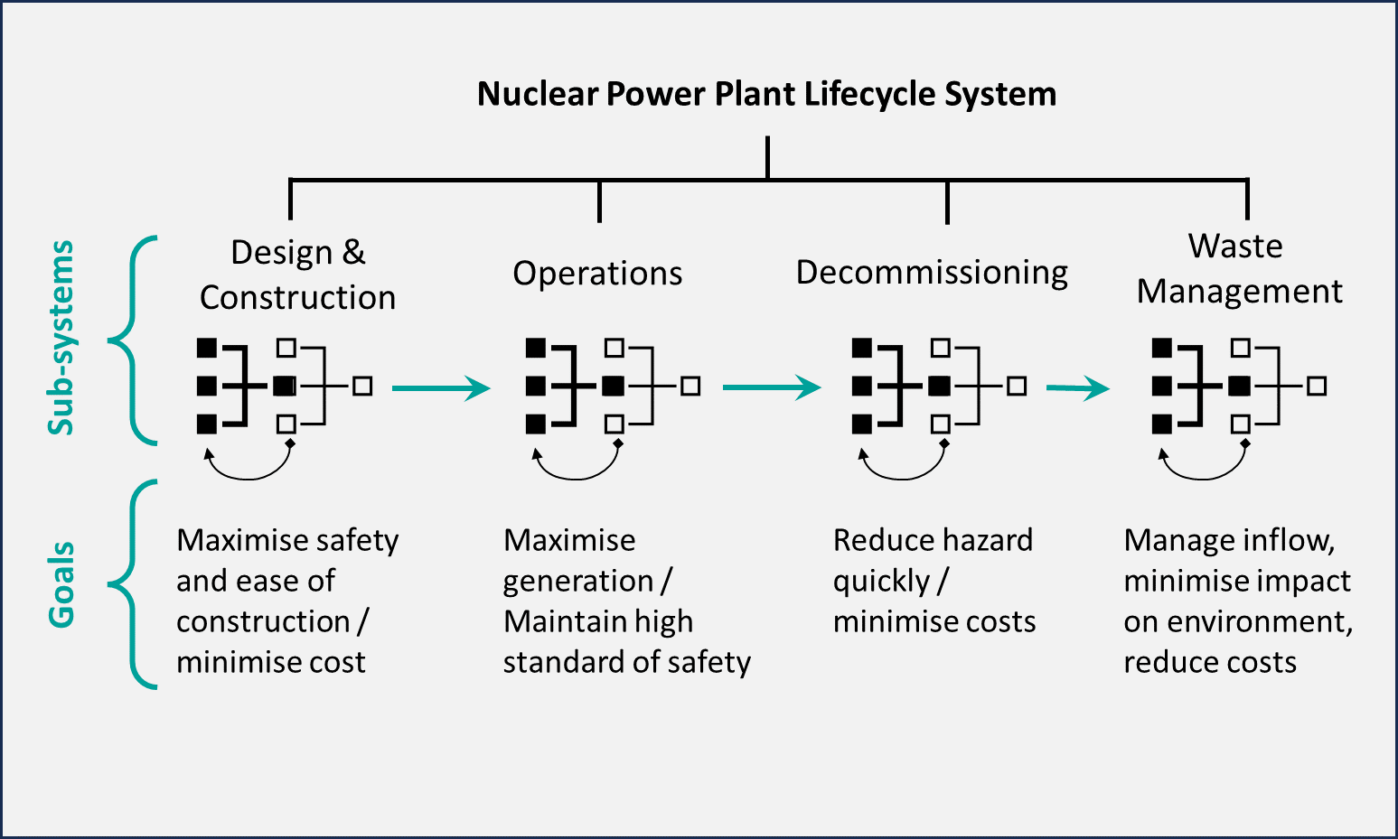
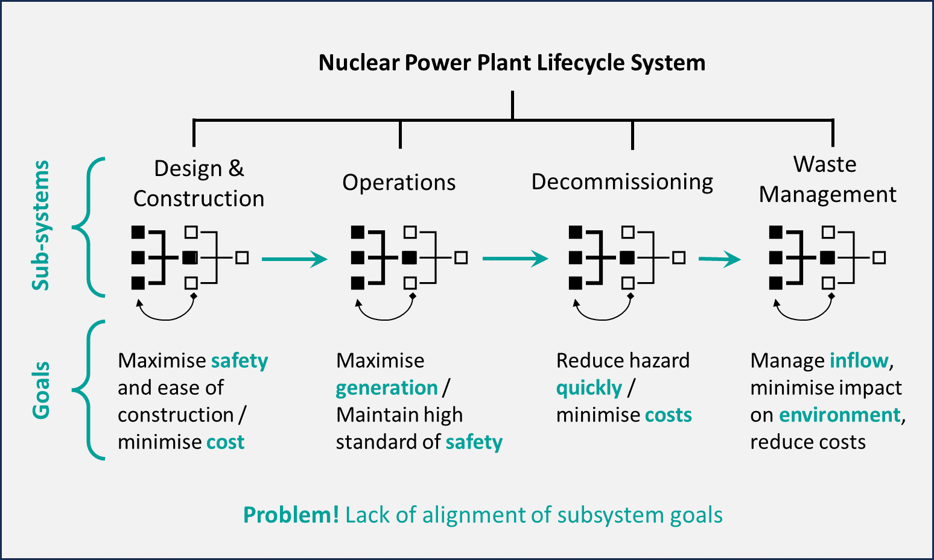
Systems Thinking - Alignment
Complex resilient systems: comprise sub-systems, can be difficult to manage, but can be very adaptive
When sub-system goals aren’t aligned, problems arise… e.g.
Inefficiency
Legacy waste management challenges
“becquerel chasing” in remediation projects
MEADOWS, D.H., Thinking in systems: a primer, White River junction, Vermont, Chelsea Green Publishing (2008)

Slide 8
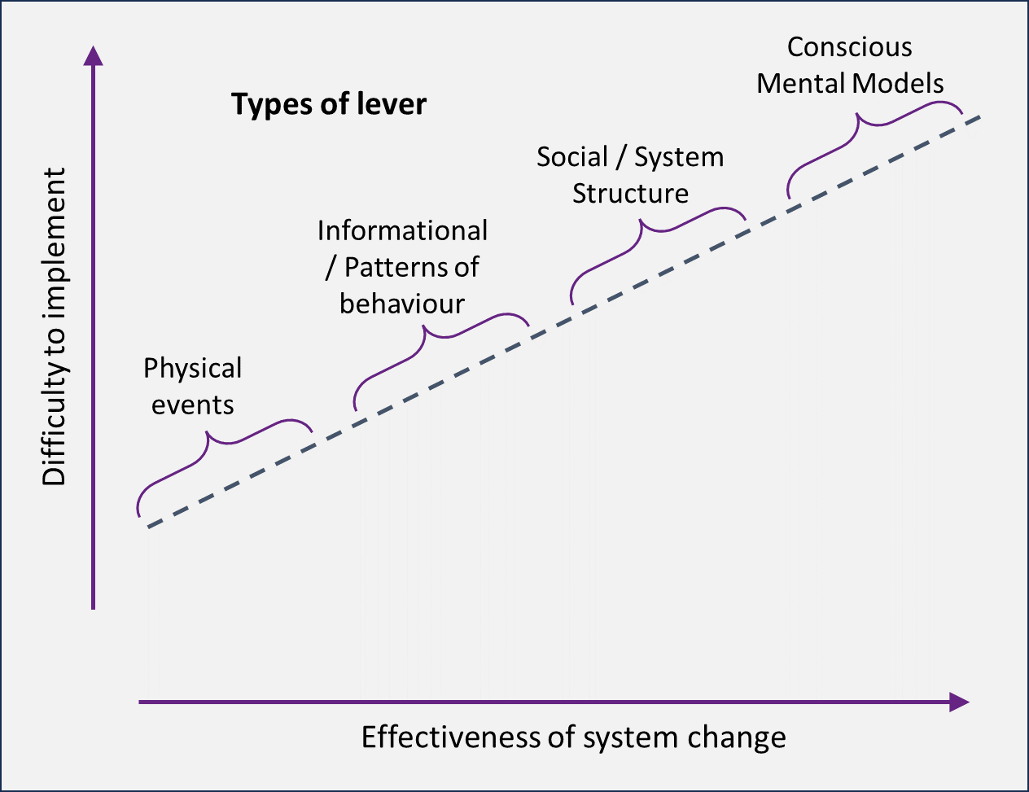
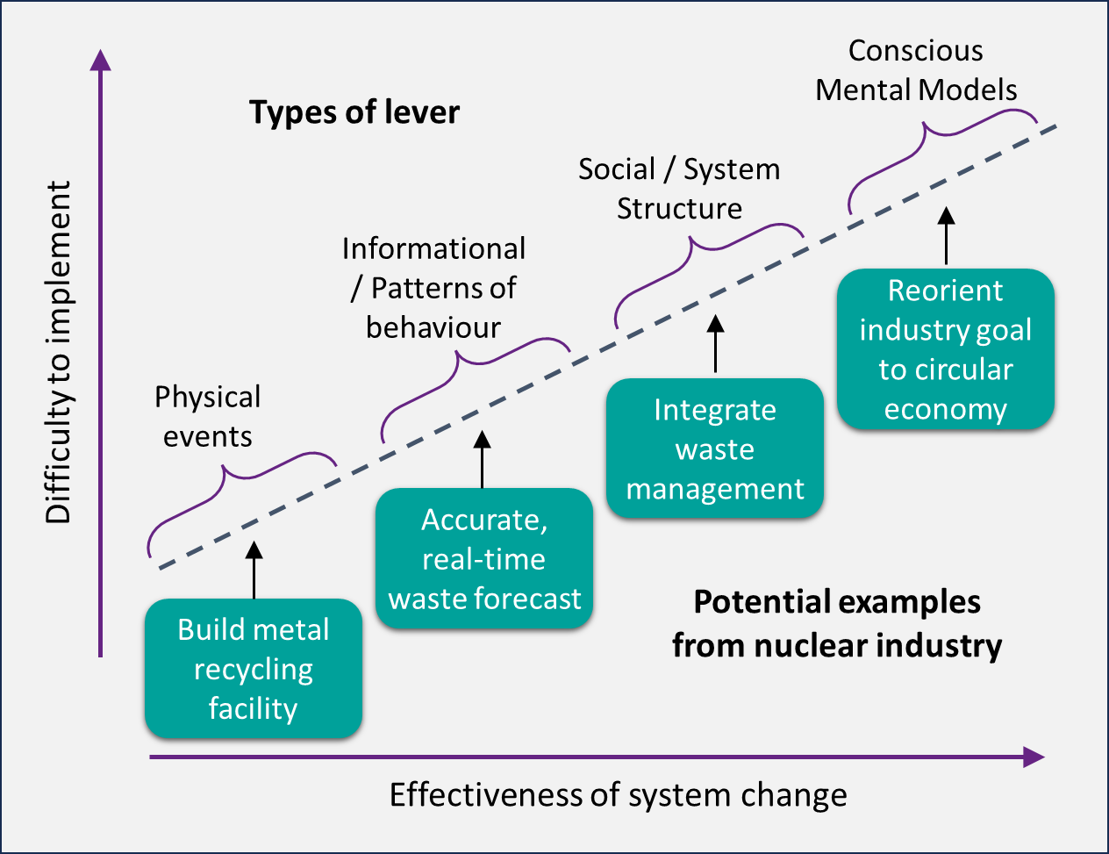
Systems Thinking - Levers
Plan change carefully
Ask a lot of questions
Understand what levers you have
Consider level of effort and level of return:
Whole lifecycle
Value, not cost
Align your change round an agreed goal
MEADOWS, D.H., Thinking in systems: a primer, White River junction, Vermont, Chelsea Green Publishing (2008)

Slide 9
Achieving a balance…
Change dependent on:
Alignment of goals
Industry wide response
Connectivity, coordination and collaboration
Safety
Key to maintaining confidence
One factor amongst many
Genuine optimisation = taking account of economic, social and environmental factors
Mindset is key
Dose limit
Dose constraint
Zone of optimisation (zone of opportunity!)
No benefit from further dose reduction measures
Adapted from IAEA WS-G-5.1

Slide 10
Matthew Clark Hopegill Associates
www.hopegill.uk

