Slide 1
Notes:
10 mins slides/ speaking; 10 mins Q’s and Panel discussions

Slide 2
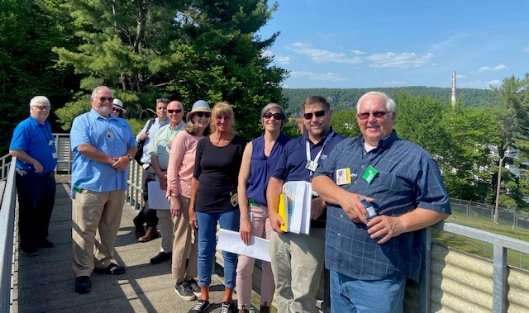
Ms Renee Silke
Job/Position: Environmental Evaluation Specialist
Organization and Country: Canadian Nuclear Laboratories; Canada
PROFILE PICTURE
Honours B.Sc. specializing in Environmental Toxicology
Almost 20 years of experience in the nuclear industry
Primary focus areas:
Planning for the cleanup of Canada’s most complex nuclear legacy site: Chalk River Laboratories
Environmental Risk Assessment of Chalk River Laboratories
Active proponent for effective risk communication and meaningful stakeholder and Indigenous engagement
EXTRA PICTURE to illustrate your work (project, robot, reactor, team…)
[not mandatory but nice to have]
Notes:
Renee Silke is an environmental professional with an honours B.Sc. specializing in Environmental Toxicology and almost 20 years of experience in the nuclear industry. Her primary focus is currently on planning for the cleanup of Canada’s most complex nuclear legacy site: Chalk River Laboratories. She has a strong background in Environmental Risk Assessment, including modelling for current and long-term impacts of radiological and non-radiological contamination. Ms. Silke is an active proponent for effective risk communication and meaningful stakeholder and Indigenous engagement to support sound decision-making and improve transparency and trust in the nuclear industry.

Slide 3
Incorporating Land Use Considerations into the Cleanup of a Complex Nuclear Site in Canada
An Integrated Approach
Notes:
Good day everyone, I am so pleased to be here today to speak with you on how Canadian Nuclear Laboratories is applying the UN Sustainable Development Goals and IAEA’s Fundamental Safety Principles into our work Incorporating Land Use considerations in Planning the cleanup of a complex Nuclear research site in Canada, Chalk River laboratories.

Slide 4
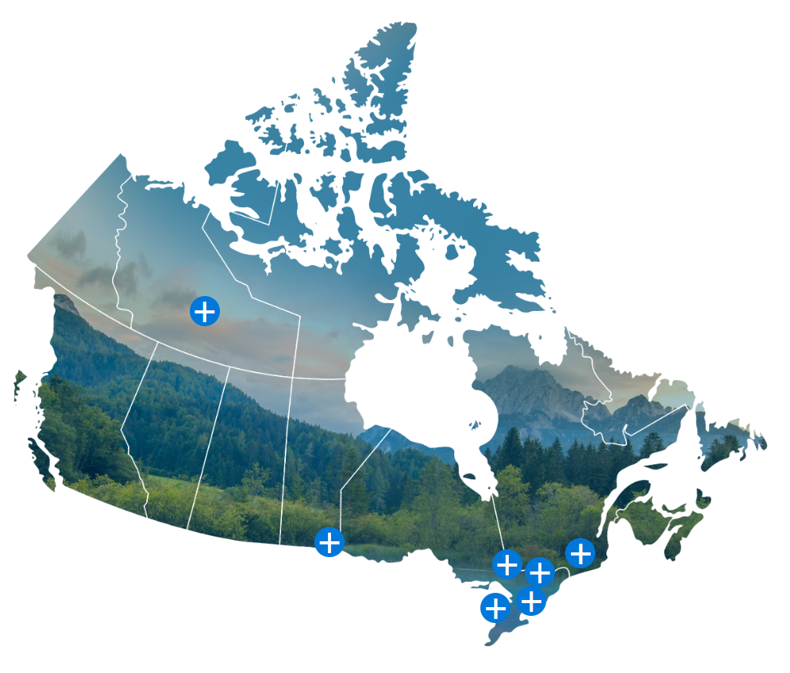
Agenda
Fundamental Safety Principles and the Sustainable Development Goals
Company-Wide Land Use Program
Site-Specific Screening and Cleanup Criteria
Soil Re-Use, Waste Management and Disposal Prioritization
Next Steps
Conclusions
Notes:
We will go through how we’ve applied these International principles and goals to the:
Implementation of a Company-Wide Land Use Program;
Use of Site-Specific Screening and Cleanup Criteria;
Optimization of Soil Re-Use, Waste Management and Disposal Prioritization; as well as some
Next Steps, and
Conclusions
This map shows the sites across Canada where Canadian Nuclear Laboratories manages Nuclear Legacy Liabilities on behalf of Atomic Energy of Canada Limited. The yellow star is the location of Chalk River Laboratories, where we will focus today. It is on the Ontario – Quebec boarder, about 200 km northwest of the capital city of Ottawa.
+++
Northern transportation route
Whiteshell Laboratories
Nuclear Power Demonstration Site (prototype)
Douglas Point Reactor (prototype)
Port Hope Area Initiative
Gentilly-1 Power Reactor (prototype)

Slide 5
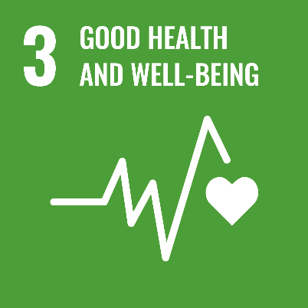
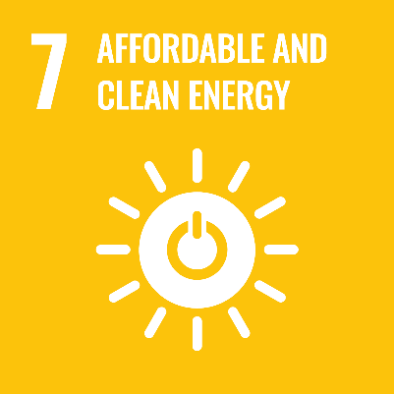
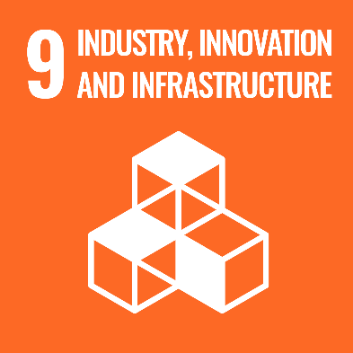
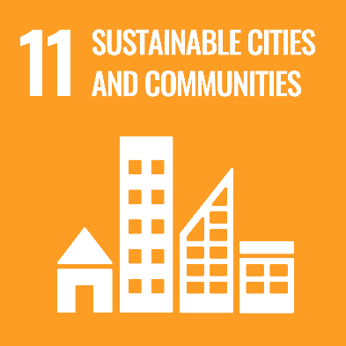
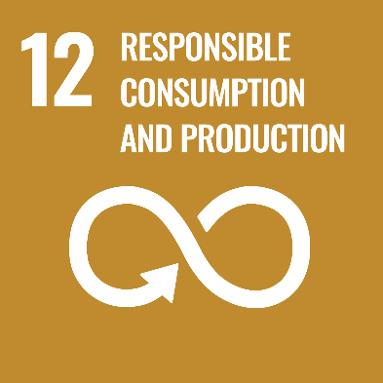
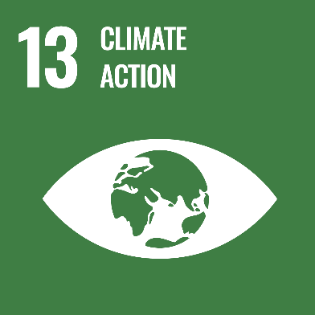
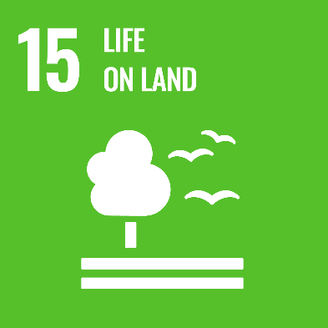
Application of Fundamental Safety Principles and the SDGs
IAEA Safety Fundamentals Principle 7:
Protection of present and future generations
People and the environment, present and future, must be protected against radiation risks.
Notes:
Canadian Nuclear Labs is directly and indirectly applying a subset of the UN SDGs, shown here, as well as Safety Fundamentals Principle 7 into our work to consider Land Use in a recently improved approach to Planning the cleanup of the Chalk River site.
The Chalk River site is somewhat unique to many nuclear research sites in North America in that it is NOT a closure site. We are planning cleanup here in concert with ongoing sustainable development to support future research in nuclear science and technology.
This cleanup is reducing the Canadian government’s nuclear legacy liability and is protecting future generations against hazardous contamination and radiation risks.
+++
SF-7 - 3.27. Radiation risks may transcend national borders and may persist for long periods of time. The possible consequences, now and in the future, of current actions have to be taken into account in judging the adequacy of measures to control radiation risks. In particular:
— Safety standards apply not only to local populations but also to populations remote from facilities and activities.
— Where effects could span generations, subsequent generations have to be adequately protected without any need for them to take significant protective actions.
3.2.8 Whereas the effects of radiation exposure on human health are relatively well understood, albeit with uncertainties , the effects of radiation on the environment have been less thoroughly investigated. The present system of radiation protection generally provides appropriate protection of ecosystems in the human environment against harmful effects of radiation exposure. The general intent of the measures taken for the purposes of environmental protection has been to protect ecosystems against radiation exposure that would have adverse consequences for populations of a species (as distinct from individual organisms).
3.29. Radioactive waste must be managed in such a way as to avoid imposing an undue burden on future generations; that is, the generations that produce the waste have to seek and apply safe, practicable and environmentally acceptable solutions for its long term management. The generation of radioactive waste must be kept to the minimum practicable level by means of appropriate design measures and procedures, such as the recycling and reuse of material.

Slide 6
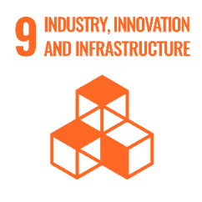
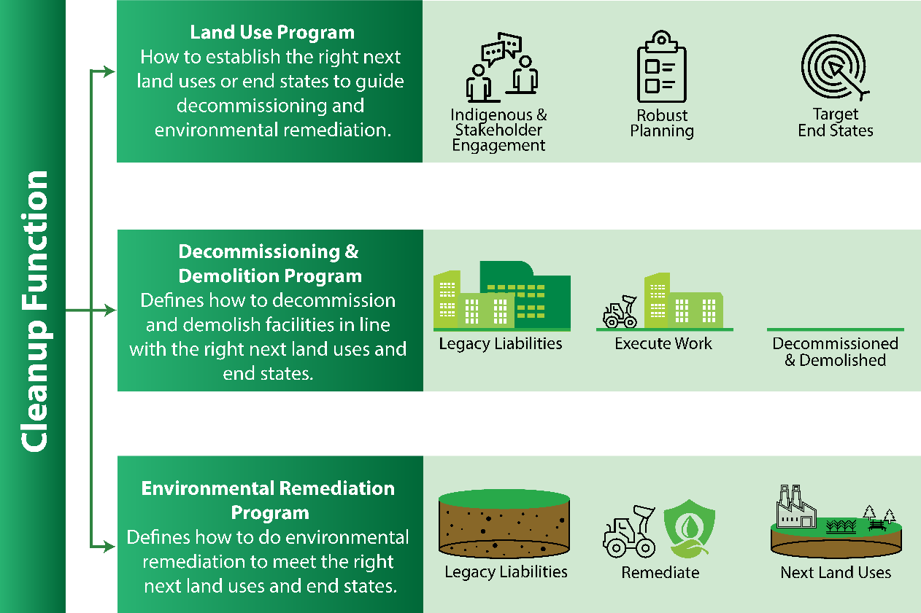
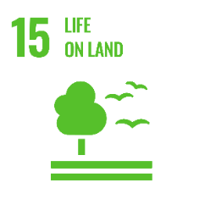
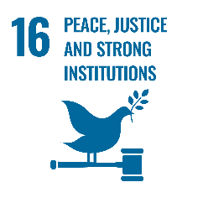
Implementation of a Company-Wide Land Use Program
Notes:
The company’s Cleanup Function, supports the Safe & sustainable Cleanup of all our sites.
The 3 programs: Land Use, Decommissioning and Demolition and Environmental Remediation - work in parallel toward achieving the right next land uses and end-states. Through these Programs we focus on incorporating science-based principles that are protective of human health and the environment (SDG 15 – Life on Land) into decisions that are incorporating the necessary engagement with stakeholders and Indigenous Nations, communities and organizations (SDG 16 – Peace, Justice and Strong Institutions).
A required output is a Preliminary Decommissioning Plan that considers the entire site.– which for Chalk River we call the Overview Decommissioning and Cleanup Plan. As we execute the Decommissioning and Environmental Remediation– we fill identified gaps, through the characterization of buildings and the affected environment, which informs our understanding of the clean up required, which in turn informs updates to the Overview Decommissioning and Cleanup Plan.
The Plan is iterative – updated every 5 years at a minimum. It integrates our approach to cleaning up old, redundant buildings, infrastructure and contaminated lands with our sustainability goals and other site priorities and projects. And it optimizes this cleanup with current and future waste management and disposal options (supporting SDG 11 – Sustainable Cities and Communities and SDG 9 – Industry, Innovation and Infrastructure).
These programs helps us conduct work in a technically sound, defensible manner to ultimately demonstrate to the regulator that target end-states have successfully been met, thereby reducing the management burden on future generations, as per Principle 7. This may include eventually releasing an area of site from regulatory control.
In the recent updates to the Plan, we have expanded the list of proposed potential land uses at Chalk River to include a parkland use category in addition to the industrial and unrestricted land uses that were under consideration before. This better considers the status of much of the site - natural forests, lakes and wetlands - which I’ll show on the next slide. Disposal is also being considered as a land use in the case of the proposed Near Surface Disposal Facility project, which we will also discuss further in a few slides.

Slide 7
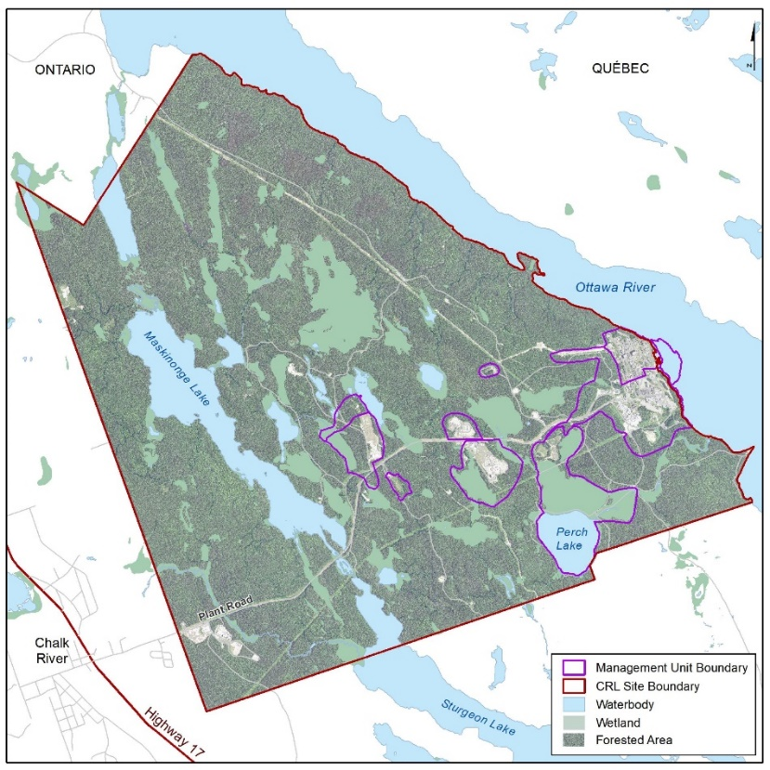
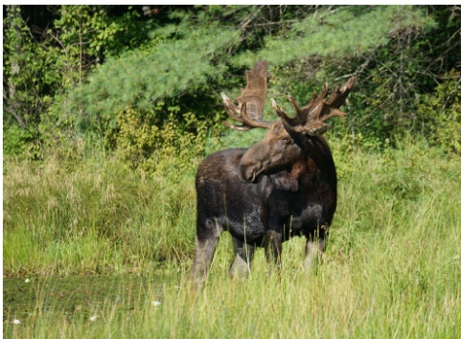
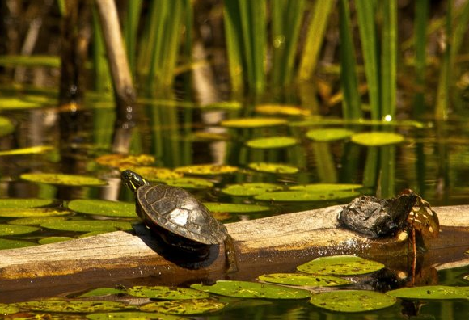
Use of Site-Specific Screening and Cleanup Criteria
IAEA Safety Fundamentals Principle 7:
“…protect ecosystems against radiation exposure that would have adverse consequences for populations of a species…”
A map of the Chalk River site showing how much of the land is untouched
Some of the species inhabiting the Chalk River site
Notes:
Because much of the site has not seen operations or significant impacts, it is a haven for many species, included several that are considered species at risk.
This map shows the extent of the site, with the areas where cleanup may be required outlined within these purple boarders.
Safety and the protection of Life On Land (SDG 15) are integrated into planning through the use of risk-based exposure and dose objectives for non-radiological and radiological contamination. These are used to model human exposure scenarios (like the parkland and industrial uses I noted on the previous slide) and ecological exposure scenarios (for species like the ones on this slide) to develop screening and cleanup criteria. These criteria will be targeted during environmental remediation.
Principle 7 states that we must “protect ecosystems against radiation exposure that would have adverse consequences for populations of a species”. Chalk River’s screening criteria are protective of the ecological receptors on site and the protection of biota is emphasized regardless of the planned future human land use. So, if the cleanup level required to protect biota is lower than that needed to protect humans, we use the biota criteria.

Slide 8
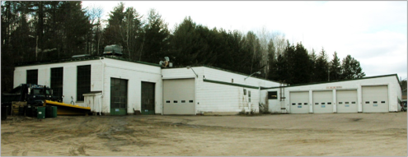
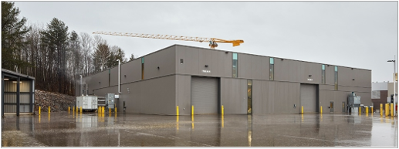
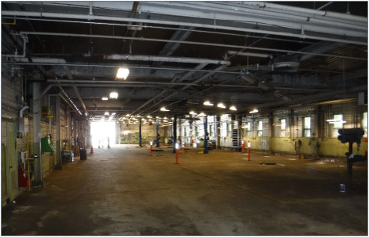
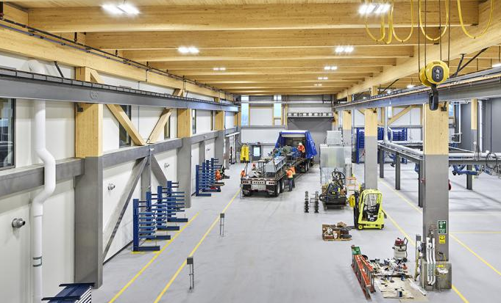
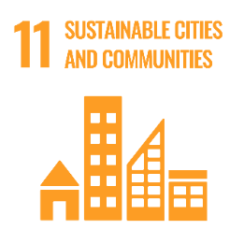
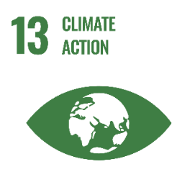
Use of Site-Specific Screening and Cleanup Criteria
The former vehicle maintenance shop (left) was replaced by the new Support Facility (right), sustainably built using mass timber construction
Notes:
The modelling used to develop the criteria also considers that there may be potential exposure to residual contamination in the future to ensure that subsequent generations are adequately protected in line with Safety Fundamentals Principle 7. We are applying soil screening criteria for the potential future land uses to more than sixty distinct Areas of Potential Environmental Concern at the site to evaluate which areas will require cleanup and in what order of priority. This is also documented in the Overview Decommissioning and Cleanup Plan.
As we reuse the land freed up by taking down old buildings, we are using sustainable Canadian mass timber construction for new buildings and are upgrading the site’s support infrastructure (SDG 9 – Industry, Innovation and Infrastructure, SDG 11 – Sustainable Cities and Communities, SDG 13 – Climate Action). One example of cleaning up a previously impacted area for beneficial industrial reuse is shown here - A 1960’s-era vehicle maintenance shop (shown on the left) was decommissioned and the land was remediated to industrial reuse for the new site support facility (shown on the right).

Slide 9
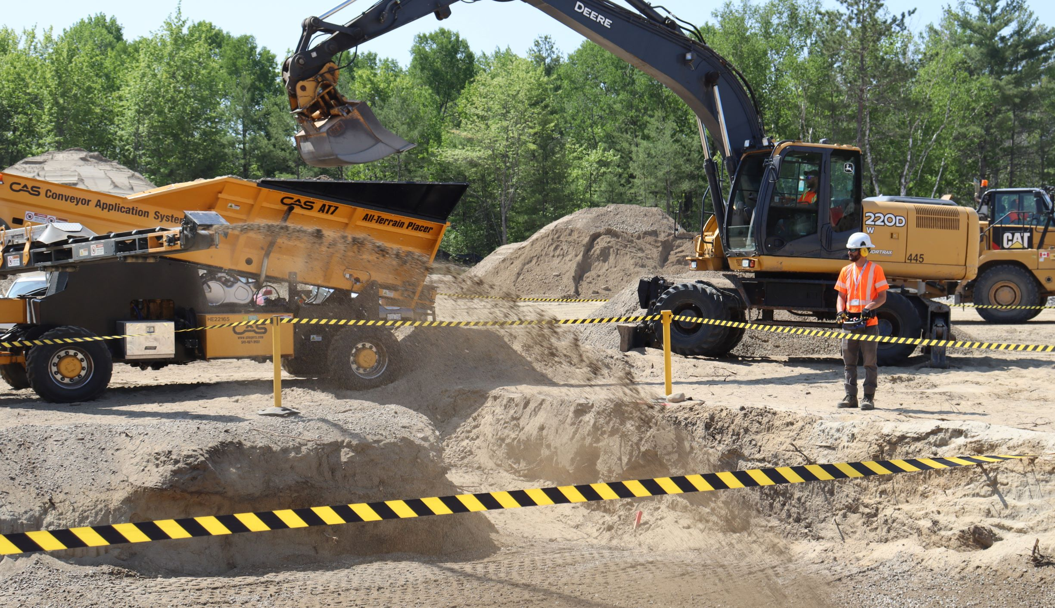
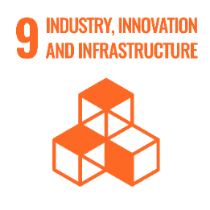
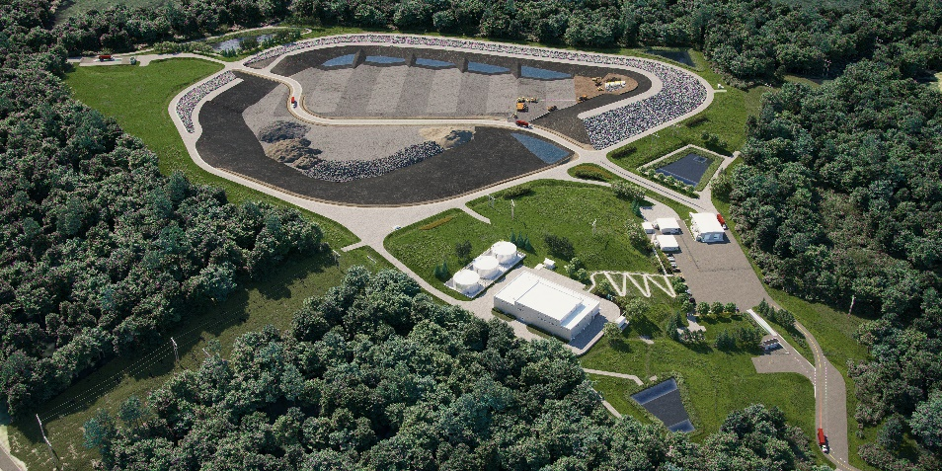
Optimization of Soil Re-Use, Waste Management and Disposal Prioritization
By considering the environmental implications of conservative radiation protection decision-making, risk reduction, social and economic costs, and safety can all be achieved while also furthering sustainability goals.
- AMBROSE, K., Conservatism versus sustainability: recognising the interconnectivity of ALARA and sustainability, Radiat Prot Dosimetry, 199 8-9 (2023) 747–753,
Soil management in action
IAEA Safety Fundamentals Principle 7:
“The generation of radioactive waste must be kept to the minimum practicable level by means of appropriate design measures and procedures, such as the recycling and reuse of material.”
Artistic rendering of the proposed Near Surface Disposal Facility
Notes:
As I already noted, because of the ongoing operational mission there is no closure date for the Chalk River site, so cleanup is occurring alongside current operations and a significant amount of construction that is underway to support site revitalization. Principle 7 implores us to keep the generation of radioactive waste to the minimum practicable level.
Our Environmental remediation specialists are working with our Radiation Protection Program to re-think conservative ALARA-based culture by putting more emphasis on “taking economic and social factors into account" and thinking innovatively to reuse resources and reduce waste.
As Ambrose points out, in the paper Conservatism vs Sustainability - these ideals do not need to be at odds : By considering the environmental implications of conservative radiation protection decision-making, risk reduction, social and economic costs, and safety can all be achieved while also furthering sustainability goals.
CNL is developing soil management standards considerate of circular economy principles to sort, stockpile and re-use clean native soil and aggregate materials to support SDG 9 – Industry, Innovation and Infrastructure and SDG 12 – Responsible Consumption and Production. This will help reduced waste volumes, and support the responsible, sustainable use of our limited waste management and disposal resources. The Near Surface Disposal Facility is currently a proposed Environmental Assessment Project and is under regulatory review with the Canadian Nuclear Safety Commission. It will be the first licensed radioactive waste disposal facility in Canada. It will be used primarily for low-level waste already existing in out-dated waste management facilities on site, providing safe, long-term management (SDG 15 – Life on Land), however it will be a finite resource, and therefore must be used responsibly.
===
¹The Near Surface Disposal Facility (or NSDF), will be an engineered containment mound built at the Chalk River Laboratories site to safely dispose of low-level radioactive waste. This is currently a proposed project and is under regulatory review with the Canadian Nuclear Safety Commission.

Slide 10
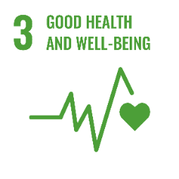
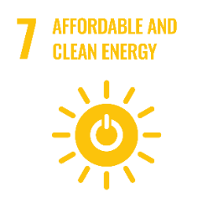
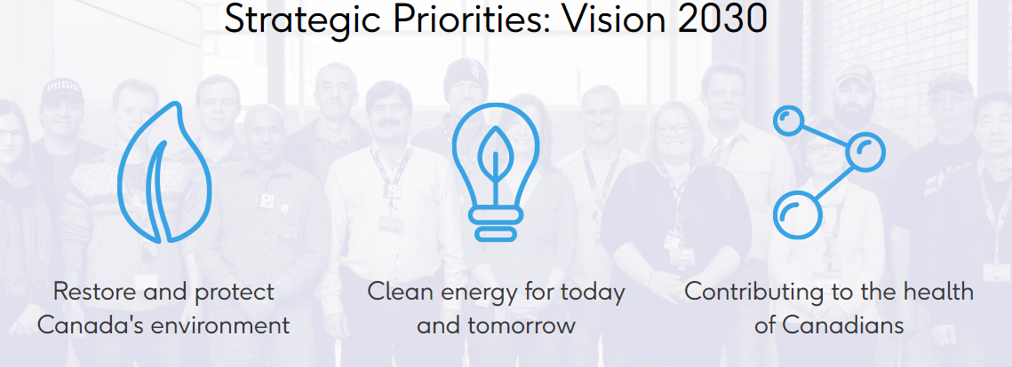
Next Steps
Indigenous Ceremony at Pointe au Baptême
Notes:
We recognize the importance of meaningful engagement and are striving to build strong, purposeful relationships with our stakeholders and Indigenous Nations, communities and organizations. Chalk River is located on the unceded and unsurrendered territory of the Algonquins of Anishnaabe Nation. One location at the site that holds strong historical and Indigenous significance is Pointe au Bapteme (shown in photo above).
In June of 2023, the site’s owner AECL, CNL and the Algonquins of Pikwakanagan First Nation signed a historic long-term, formal relationship agreement. Through this effort we are establishing a new Neya Wabun (or Guardian) Program to augment environmental monitoring at the site while fostering healing and reconciliation (SDG 16 – Peace, Justice and Strong Institutions).
Finally, Our cleanup work supports all 3 of CNL’s strategic priorities. By restoring impacted land so new, innovative facilities can be built which will promote Affordable and Clean Energy (SDG 7) and Good Health and Well-Being (SDG 3). Through partnerships with companies from around the world we will host Small Modular Reactors at the Chalk River site and produce a promising new weapon in the fight against cancer – Actinium-225.
+++
Canadian Nuclear Laboratories strives to advance nuclear S&T for a clean and secure world and to undertake the following missions at the CRL site:
We will restore and protect Canada’s environment by reducing and effectively managing nuclear liabilities
We will provide the world with sustainable energy solutions including the extension of reactor operating lifetimes, hydrogen energy technologies, and fuel development for the reactor designs of tomorrow
Together, with partners, we will demonstrate the commercial viability of advanced reactor designs including Small Modular Reactor (SMR)
We will work collaboratively with medical/educational institutions and pharmaceutical companies to pioneer new alpha therapies for cancer treatments that save countless lives
We will leverage all of our capabilities for commercial success in Canadian and international markets
Advancing nuclear S&T for a clean and secure world is CNL’s purpose. New infrastructure and refurbishment of existing infrastructure to support this S&T mission will be extensive. Cleanup planning will support these missions at CRL by providing a safe and effective framework to reduce the environmental liabilities through decommissioning and remediation allowing for the development of the new, revitalized S&T campus.

Slide 11
Conclusions
The plan is protective of ecological life as well as human health and safety.
The plan incorporates a new land use category option of parkland.
CNL is using sustainable Canadian mass timber construction for new buildings being constructed at the site.
The programs consider circular economy principles to reduce waste volumes and aim to use and current and future waste management and disposal resources responsibly.
CNL is working to build strong relationships with our stakeholders and Indigenous Nations, communities and organizations as we plan for future cleanup at the Chalk River site in support of advancing Nuclear technology for the benefit of human health and the environment.
Notes:
We have covered how this subset of the United Nations Sustainable Development Goals (SDG) as well as IAEA Safety fundamentals Principle 7 have been used to provide a strategic approach to planning the Chalk River site cleanup.
To sum up,
the plan is protective of ecological life as well as human health and safety.
It incorporates a new land use category option of parkland.
we are using sustainable mass timber construction for new buildings being constructed at the site.
The programs consider circular economy principles to reduce waste volumes and aim to use and current and future waste management and disposal resources responsibly.
Finally, and perhaps most importantly,
we are working to build strong relationships with our stakeholders and Indigenous Nations, communities and organizations as we plan for future cleanup at the Chalk River site in support of advancing Nuclear technology for the benefit of human health and the environment.

Slide 12
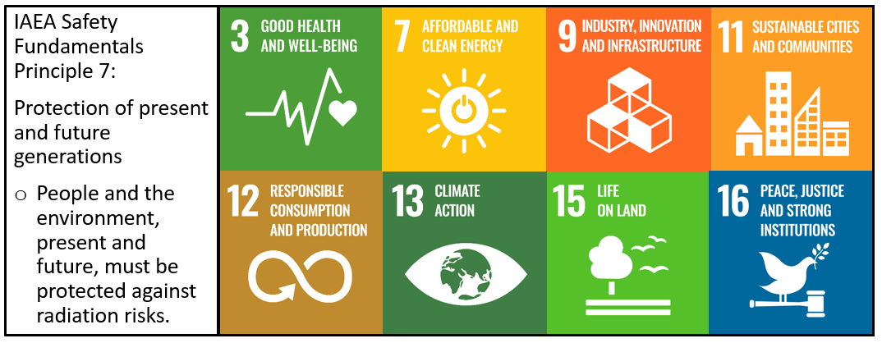
Thank-you!
Questions?
Primary Author: Renee Silke – renee.silke@cnl.ca
Coauthors: Rachel Chennette, Scott Clemow, Luc Robitaille,
Samantha Scott, Grace Snell
Notes:
Thank-you for attending!

