Slide 2

First approach comparing cement and geopolymer as immobilization matrixes for radioactive waste using Life Cycle Assessment
Presenting author: Valeria Cuccia
Cuccia, V.; Almeida, R.S.S.P.; Castro, L. L.C.
Nuclear Tecnology Development Center (CDTN), Brazil
November, 2023
Paper ID 54

Slide 3
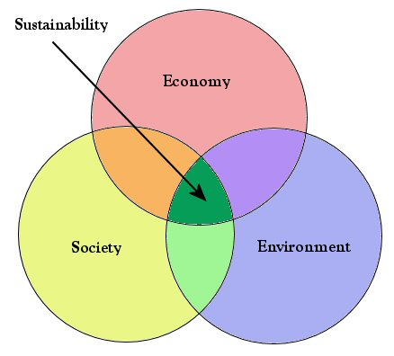
Motivation
Methodology to adress sustainability in a cientific manner in radioactive waste management
  Transparency, realiability
Environmental and social aspects must be part of a multicriteria decision making
Source: https://en.wikipedia.org/wiki/Sustainability

Slide 4
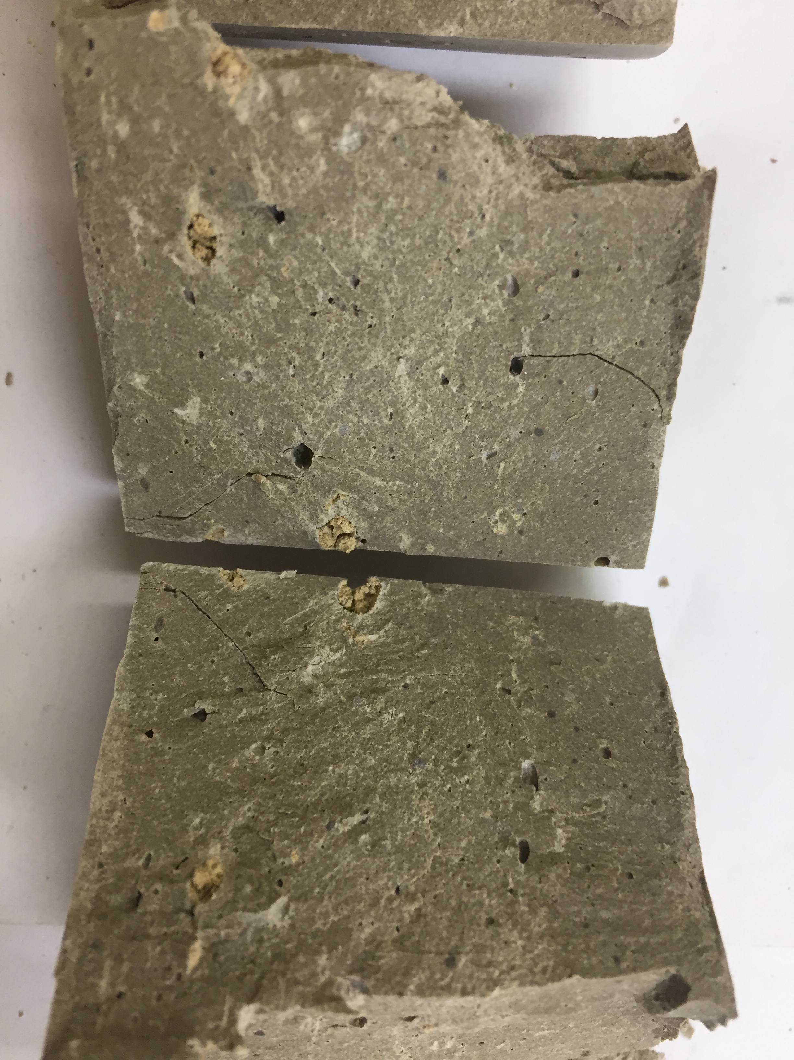
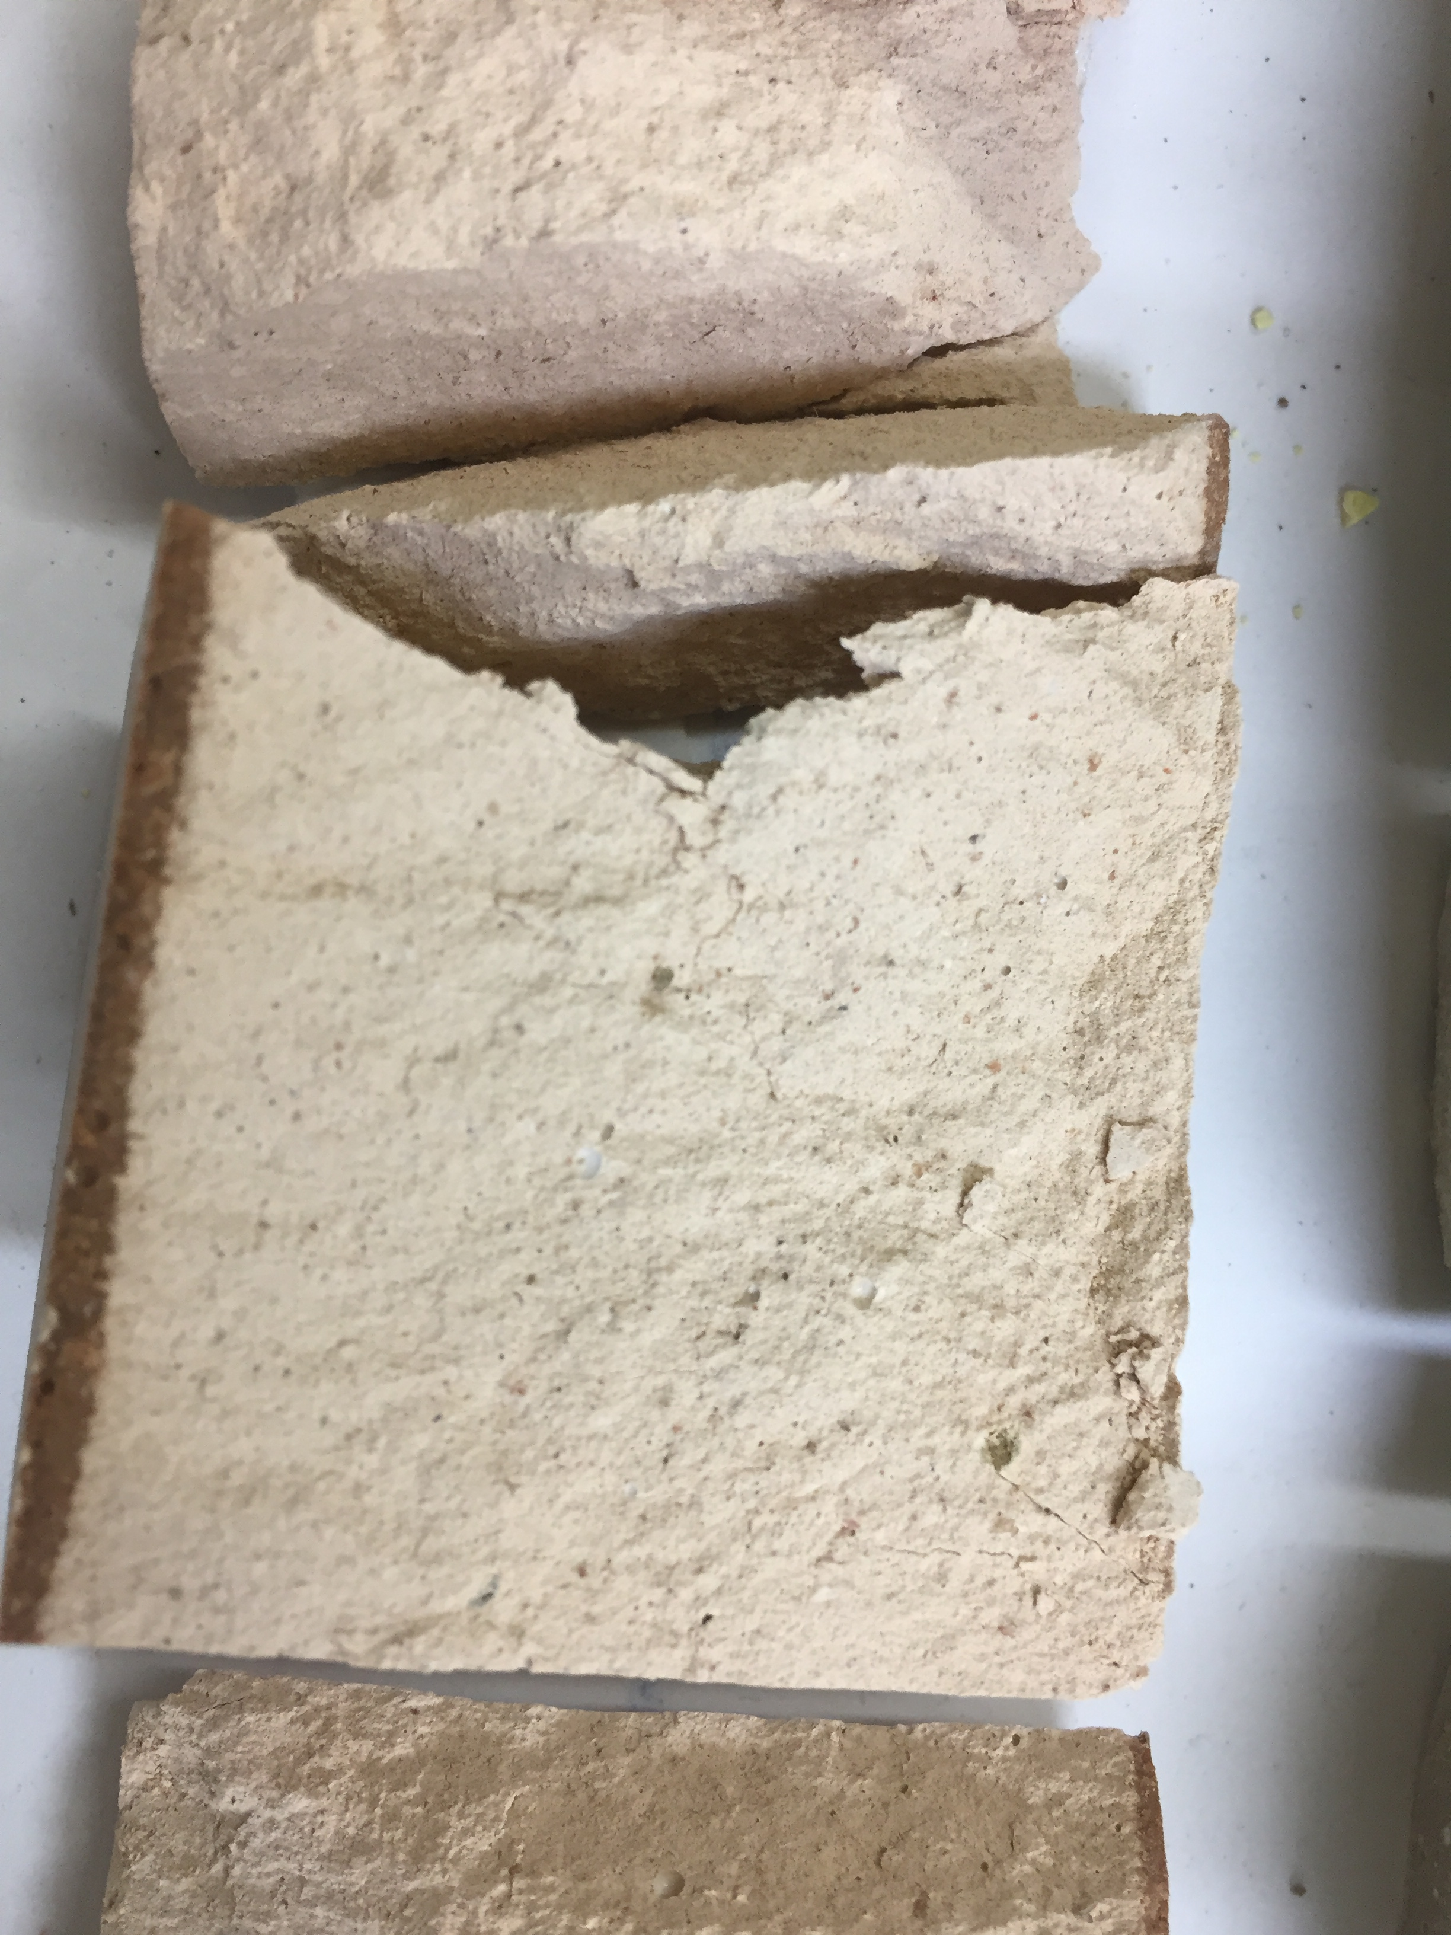
Geopolymer x cement for radioactive waste immobilization
CEMENT
Consolidated matrix for radwaste immobilization
Elevated footprint and carbon emmissions
GEOPOLYMER
Sinthesis with no heating: less emission of greenhouse gases
Good mechanical properties; resistance to fire and acids.
Can be produced from waste material reducing ecological footprint
Cement
Geopolymer
In the literature, comparisons using LCA, considering only climate change, not applied to radwaste immobilization
Environmental aspects: polemic issue
Comparison of sustainability aspects - LCA

Slide 5
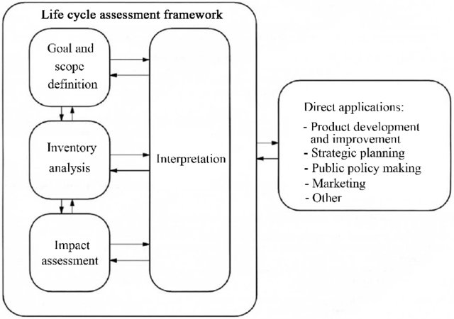
Methodology: LCA – Life Cycle Assessment
ISO 14040: compilation and evaluation of the inputs, outputs and the potential environmental impacts of a product system throughout its life cycle.
  #Atoms4Climate COP27 pavilion:
  LCA cited by a pannelist as a methodology to show that nuclear Energy in already constructed plants is a low carb energy source.
Software OpenLCA
Social and
economic impacts may be evaluated
Source: ISO 14040: 2006

Slide 6
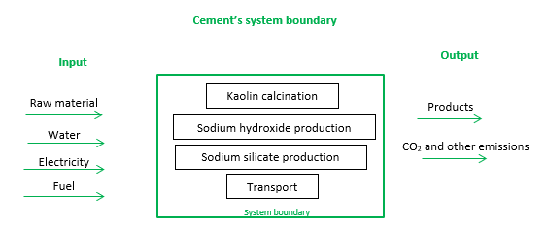
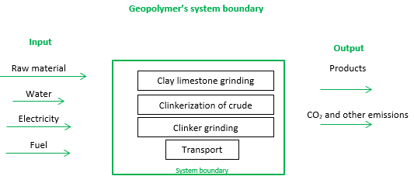
Geopolymer x cement for waste immobilization
System boundaries
Kaolin calcination:
Pilot level
Industrial level
Best available technology (BAT)
Geopolymer
Methods
EN 15804 +A2 Method
EF 3.0 Method (adapted)
ILCD 2011 Midpoint+
Available Water Remaining (AWARE)
Cumulative Energy Demand
Cement
Geopolymer x cement for 1kg of waste
Notes:
LCA study follows the ISO 14040 and ISO 14044. This is a method for evaluating the environmental load of processes and products during their life cycle [16], [17]. This item describes the steps for the implementation of the study in the software OpenLCA®: firstly, the establishment of a functional unit and system boundary (item 2.1), secondly, the inventory data (Life Cycle Inventory - LCI), for the identification and the quantification of all input and output from the considered system (item 2.2). Finally, the Life Cycle Impact Assessment (LCIA) methods and the environmental impact categories have to be defined (item 2.3).
Functional unit and system boundary
In this study, the immobilization of 1kg of radioactive waste in cement or geopolymer is considered. The radioactive waste is assumed as bentonite oily waste. The proportions are according to previous studies as shown in 2.2. All resources, products, emissions and energy consumption levels are based in this functional unit.
The system boundary was defined as the material already in the place of immobilization of the waste, assuming that cement and the raw material for the geopolymer would have regular distribution in the south eastern region of Brazil, where a near surface repository would be implemented, due to the vicinity to the current nuclear power plants in the country. FIG 1 shows the system boundary and the flow of major inputs and outputs, the raw material for each system is showed in item 2.2.
Life cicle inventory (LCI)
TABLE 1 shows the composition of cement and geopolymer matrixes for the waste immobilization considered in this study, based in previous studies [6], [23].
TABLE 1 - Raw material for cement and geopolymer matrixes
Cement matrix composition
Geopolymer matrix composition¹
Cement
3.636kg
Metakaolin
2.759kg
Bentonite
0.640kg
Sodium silicate solution
1.600kg
Water
2.576kg
Sodium hydroxide solution
1.000kg
Bentonite oily waste
1.000kg
Water
0.412kg
Bentonite oily waste
1.000kg
The database for sodium silicate was for a 37% sodium silicate solution, but the solution uses for the waste was 47.7% [6]. To compensate, the amount of water added to the geopolymer matrix was reduced.
The production processes of cement, sodium hydroxide, activated bentonite and sodium silicate were collected from databases IDEMAT and Agribalyse®, considering their diversity in the origin of the data and for having the necessary information for the immobilization matrixes targeted. Databases for LCA that complied with the limits delimited by the system boundary were then used for the modelling [24].
Preliminary studies showed an important contribution of the metakaolinite, raw material for geopolymers. Metakaolinite producers were not allowed to share their industrial parameters for this modelling. For this reason, the production of this input was considered in three levels of technology, each of it with different energy consumption levels, as shown in TABLE 2.
For the bentonite oily waste, a product-type flow was created. Nevertheless, this work intends to evaluate the matrixes for the immobilization of radioactive waste, so this parameter was created for recording, because as the study is comparative, the impact of this input will not influence in the analysis of the environmental impacts of the matrixes analysed.
TABLE 2 - Energy consumption for the calcination of 390 kg of kaolinite in Cuba (adapted from [25])
Energy for calcination
Unit
Pilot level¹
Industrial level²
BAT level³
Crude oil
kg
31
23
-
Gas
kg
-
-
5
Waste oil
kg
-
-
14
Electricity
kWh
20
16
5
Pilot level: The clay calcination was carried out at existing facilities of a blended cements company produced industrially in Cuba.
Clay calcining technology was the wet rotatory kiln [25], [26].
Industrial level: Retrofitting of wet cement kiln into a clay calciner. The metakaolinite was produced by a more efficient technology
than pilot level [25].
Best Available Technology (BAT) –Kaolin was calcined through a flash calciner. In this case, after a pre-treatment, it is air-dried, then
transported and crushed and finally dried. The kaolin spends only a few tenths of a second in the calciner, just enough time to reach
the ideal temperature to be transformed into metakaolinite [25], [27].
Transport is usually a very significant input for LCA analysis. For this reason, the transport of raw materials was considered as if the research institute CDTN, in Belo Horizonte, Brazil, was the location where the waste would be solidified. Distances from the closets suppliers were chosen and calculated using the Google Maps tool, selecting the shortest routes. TABLE 3 presents the distances in km considered for this study.
TABLE 3 - Distance between the suppliers and CDTN
Suppliers of cement
Input
Distance
InterCement - Pedro Leopoldo/MG
CP II F32 / E32
36.5km
Bentonit União
Bentonite
615km
Suppliers for geopolimers
Input
Distance
Diatom - São Paulo
Sodium silicate
613km
Sabará Químicos - São Paulo
Sodium hydroxide
613km
Metacaulim do Brazil (mining and processing) - Lavras/MG
Kaolin
243 km
For transport input, it is considered typical road transport for cement in Brazil by simple medium-sized trucks that reach a maximum of 14 tons per trip [28]. Thus, IDEMAT database chosen was "C.060.01.103 Truck+container, 28 tons net (min weight/volume ratio 0.41 ton/m3" and for Agribalyse® database, the transport chosen was "transport, freight, lorry 7.5-16 metric ton, EURO5". It assumed that the chemicals are transported by the same car models.
Descriptions of the processes used for each database can be checked with the authors. The databases IDEMAT and Agribalyse® for specific flows (kaolin production, sodium silicate solution and sodium hydroxide) were combined due to the greater detail of the input information.
Methods
The LCIA was calculated using six different methods: EN 15804 +A2 Method, EF 3.0 Method (adapted), ILCD 2011 Midpoint+, Cumulative Energy Demand and Available Water Remaining (AWARE). The environmental indicators analysed were Climate Change, Ozone Depletion, Water Use and Resource use, fossils, calculated in the OpenLCA® software. The use of more than one method is important to verify the robustness of the study and avoid specific variations due to the different methods specificities [18], [29]. Their choice is related to the Brazilian context and to the expected indicators chosen for the study, such as climate change, ozone depletion, water use and use of fossil resources.

Slide 7
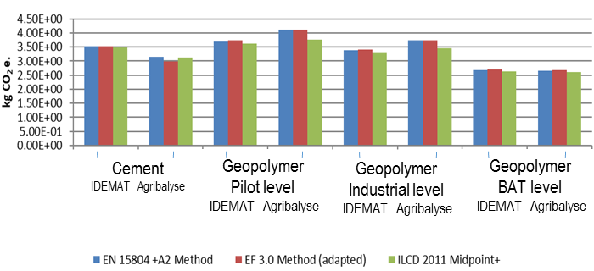
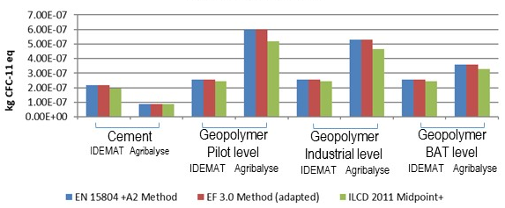
Results
Climate change
Geopolymer ☑
  BAT (both databases)
  optimize use of energy for calcination of kaolin
Ozone depletion
Cement ☑
  Both databases
  Transport: similar contributions
Notes:
Climate Change Indicator
The results for climate change indicator for each data base, IDEMAT and Agribalyse. Comparing geopolymer with cement for each database separately, using IDEMAT geopolymer is better at the industrial-technological level (average reduction = 4.17%) and BAT level (average reduction = 24.13%). For the database Agribalyse®, only the BAT technological level showed better environmental performance for the production of geopolymer (average reduction = 14.31%).
At all technological levels for the metakaolinite production and in both databases, the sodium silicate production process is the major contributor to the climate change indicator. For the cement matrix, the major contributor is the cement production process (>90%), according to EN 15804 +A2 Method (results not showed graphically in this paper).
The contribution of transport to the geopolymer for the IDEMAT (average < 8%) and Agribalyse® (average < 15%) compared with cement (IDEMAT < 1% and Agribalyse 2%) was more significant. This result was expected because the distance between suppliers for geopolymer and CDTN was considerably higher than for cement and this indicator is closely related to the emission of greenhouse gases
Ozone Depletion Indicator
The results for ozone depletion indicator are shown in
, for each data base, IDEMAT and Agribalyse. For both databases and all methods, the geopolymer matrix showed higher emission of CFC-11 eq, for all the kinds of metakolinite production (Pilot, Industrial and BAT level).
For the BAT technological level, in both databases, the production process of sodium silicate was the biggest contributor to the Ozone depletion indicator, followed by the production of kaolin. For the industrial and pilot calcination level, in the IDEMAT database the production of sodium silicate contributes the most to the Ozone depletion indicator, followed by kaolin, hydroxide and petroleum. Meanwhile, in the Agribalyse® database, the use of petroleum was more significant for both technological levels, followed by silicate, kaolin, transport and hydroxide.
Analysing the relative contributions, the transport for geopolymer raw materials did not show more impact than cement. With IDEMAT, for both matrixes the contribution was <<1% and with Agribalyse® the values were close to 20%.

Slide 8
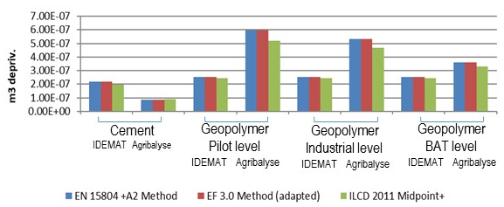
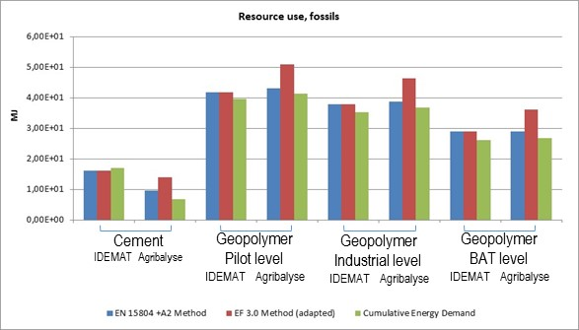
Results
Water use
Cement ☑
  Both databases
  Sodium silicate – major contribution
Resource use, fossils
Cement ☑
  Both databases
  Sodium silicate – major contribution
Notes:
Water use Indicator
The results for water use indicator are shown in FIG 4, for each data base, IDEMAT and Agribalyse. Geopolymer matrix showed a higher water use than cement, for all types of production level of metakaolinite and both databases.
Only in the Agribalyse® database the cement production process contribute to the consumption of water. In the IDEMAT database, there were no steps that used water in the Portland cement production cycle. This is the main factor that causes the discrepancy between the cement matrix data for the analyzed databases.
For IDEMAT database, the data for the three technological levels of geopolymer were the same, and the production of sodium silicate was the biggest consumer of this natural resource. Although, in the Agribalyse® database, there was a minimal variation between the technological levels mainly motivated by the consumption of oil in the production cycle of the matrix. As with IDEMAT database, for the Agribalyse® database, the main consumer of water was the production of sodium silicate. The contribution of transport to both matrices for the water use indicator was minimal at the IDEMAT and Agribalyse® database (≤3% for all).
Resource use, fossils indicator
The results for resource use, fossil indicator are shown in FIG 5, for each data base, IDEMAT and Agribalyse. The geopolymer matrix was more consuming of such resources when compared to the cement matrix. Furthermore, EN 15804 +A2 Method and EF 3.0 Method (adapted) resulted in similar values for the analysed matrixes with IDEMAT database. The reason for this discrepancy was the impact factors considered in each methodology for the production process of the sodium silicate solution, the production of kaolin and cement production.
For the geopolymer matrixes, for pilot level in both databases, the largest contributor to the indicator Resource use, fossil was oil (not a direct raw material, but implicit in the process). Meanwhile, for the industrial level and BAT level, the biggest contributor was the production process of the sodium silicate solution.
The transport for geopolymer, when analyzed the relative contributes, did not show more impact despite the greater distances between the geopolymer matrix input companies and the CDTN. In the IDEMAT, for both matrixes, the contribution was ≤3% and in the Agribalyse® the values were close to 15%.

Slide 9
Conclusions
Geopolymer (BAT): best for climate change indicator (reduction of CO₂ emission)
Depletion of the ozone layer
Water consumption → cement better
Use of fossil resources
Transport not relevant compared to raw materials contribution
Main contributor for geopolymer: sodium silicate
First approach – further work on going!
  Partnerships and enhance robustness
  New formulas for geopolymers
Step towards UN development goals for RWM
Notes:
Conclusions:
The immobilization of 1kg of waste (assuming oily bentonite waste) in portland cement and geopolymer were used as a functional unit for comparison of both matrixes using the LCA Methodology, to evaluate if geopolymer is a more sustainable alternative to cement for radioactive waste immobilization. Due to the lack of data and apparently high impact of the metakaolinite production (raw material) in the geopolymer results, three technological levels for the production of metakaolinite - namely pilot, industrial and best available technology (BAT) were modelled and compared.
The results showed that geopolymers are a better choice than cement in terms of reduction in CO₂ emission. However, geopolymer showed a worse performance than cement for the indicators Depletion of the ozone layer, Water consumption and Use of fossil resources. The more significant impact from raw material for the geopolymer was of sodium silicate. The difference between three technologies level for production of metakaolinite analyzed was the origin of energy consumption. Therefore, optimize energy consumption and enable clean energy sources in the production chain is necessary. For transport, with the exception of the climate change indicator, all indicators did not result in significant relative transport contributions.
Further work will be carried out to enable the refining of this analysis, sensitivity analysis and the evaluation of other geopolymer formulations. Given the scarcity of databases covering Brazilian production routes, the authors keep seeking partnerships with national companies to collect data, as well as partnerships with institutions in the area of LCA, to assure reports more reliable to the Brazilian scenario.
This is a preliminary study applying the Life Cycle Assessment Methodology to the immobilization of a low level radioactive waste. As far as the authors’ knowledge, there is no published study on sustainability matters for the radioactive waste immobilization. Obtaining input data and databases according to real industrial processes is a challenge, and the authors remark this possible weakness in this study. Nevertheless, the application of this well-established methodology in this field is desirable and may represent a big step towards the United Nations Sustainable Development Goals for the radioactive waste management issues.

Slide 10

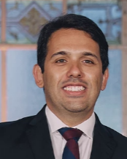





Thank you!
vc@cdtn.br
www.cdtn.br
Cuccia, V.; Almeida, R.S.S.P.; Castro, L. L.C.

