Slide 2
Application of AGILE project Management Methodology in R&D to ensure the Safe and Sustainable Disposal of Legacy Waste
W. Wacquier (ONDRAF/NIRAS)
J. Denul (Threon)

Slide 3
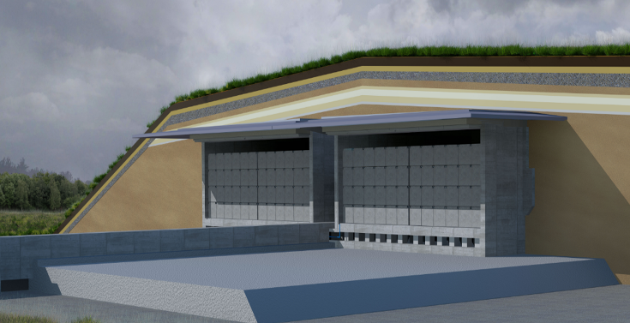
Context
ONDRAF/NIRAS plans to build and operate
a surface disposal facility for LLW in Dessel
License application is underway
  Royal Decree creation & operating licence (05/2023)
  ➔ Start of the Construction
  Royal Decree for confirmation (expected ~ 2029)
  ➔ Start of the Operation
License with the License conditions
Demonstrate that we are compliant with the License conditions
  Construction
  Waste ➔ Demonstration of the “Disposability” of the waste
= Big challenge for legacy waste
(many uncertainties and high risks) ➔ AGILE approach

Slide 4



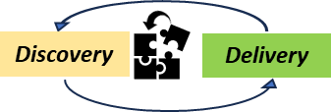

Our fine-tuned AGILE approach:
Key elements of way of working
Slicing and decoupling of problems
Learning by doing
Identify small parts of big challenge
→ to start working on it
→ to get quickly first preliminary results!
Discover not only by just thinking, calculating but by doing: Make / Build /Test to visualise ideas
Incremental discovery and delivery
Create incrementally a concept for
a part of the big challenge
→ Gain a deeper understanding (Studies, experiments, feedback loops with stakeholders, emergence of new problems)
→ Develop multiple options
→ Combine options and assess partial solutions
→ Develop concept(s)
Risk management with options
Reduce the uncertainties & risks by identifying options that sufficiently cover a priority risk
Provide a clear framework to work:
Nested feedback and learning loops
Team autonomy within clear boundary

Slide 5
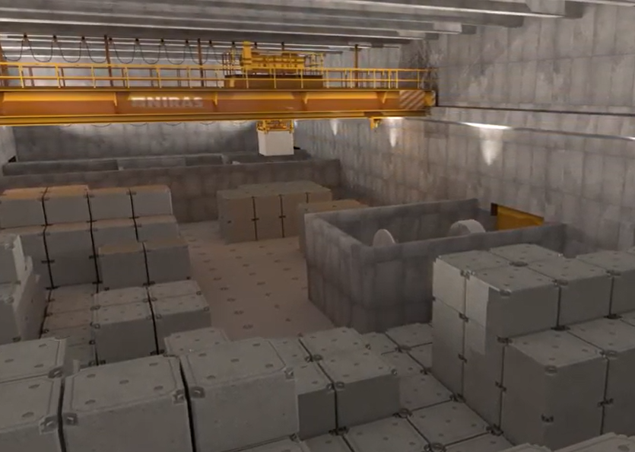
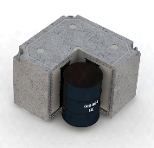
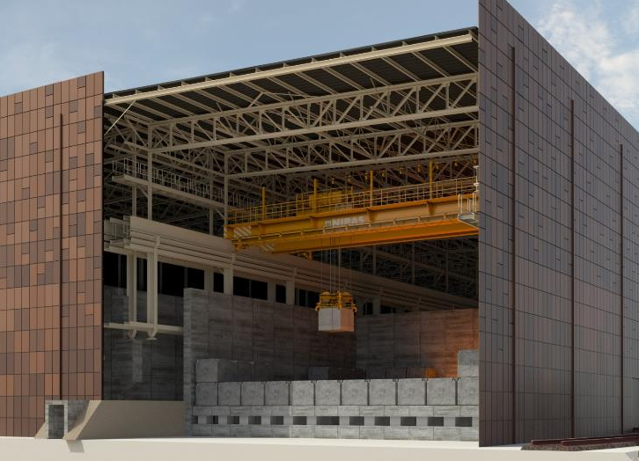
Application of AGILE to incrementally develop solutions
Post-conditioning (IPM)
Existing waste
Safety Authority
Safety Authority
Is Waste conform?
Yes
Is Waste admissible?
Yes
Conformity files
Physical Controls
Loading plan
Future waste (operation)
No
No
Disposal
Future waste (dismantling)
Adaption
Safety Report
Define specific measures
Non conform/
Non admissible
Safety Authority

Slide 6
Application of our AGILE approach
Conformity files
How to fill the missing information of all legacy waste to assess the conformity?
Based on the available knowledge, a slicing was performed in three steps:
  Exclusion of the waste packages that are the least likely to conform (e.g. old historical waste with very limited information)
  Categorise the legacy waste based on waste producer & potential non-conformities
  Identify the legacy waste expected to conform easily
We start working on conformity files despite the complexity
We identify the top priority for non-compliant waste: development of a solution for concrete potentially sensitive to ASR (swelling reaction)

Slide 7
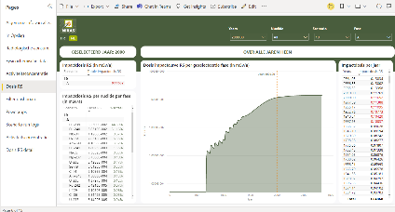
Application of our AGILE approach
Loading plan
How to load the modules taking into account the production and the characteristics of the waste ?
Development of a more robust IT tool
First loading plan by hand (spreadsheet)
V0.1
V0.2
V1.0
Set global objective & Identification of Functionalities
Use increments of the tool & validation of the tool in parallel
  ➔ No need to establish detailed tech. spec. to start development of
  IT tool thanks to close day-by-day collaboration users & developers

Slide 8
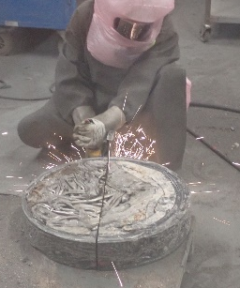
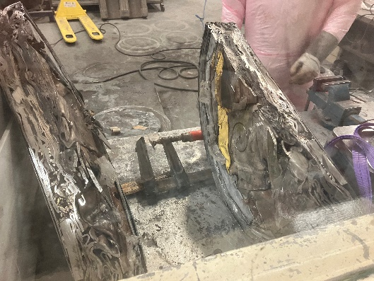
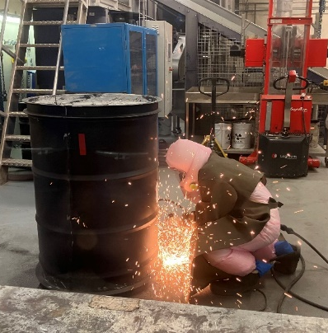
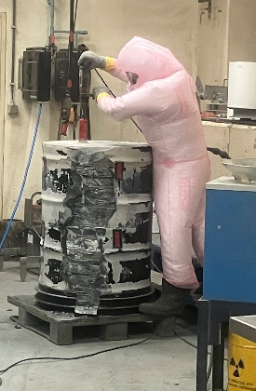
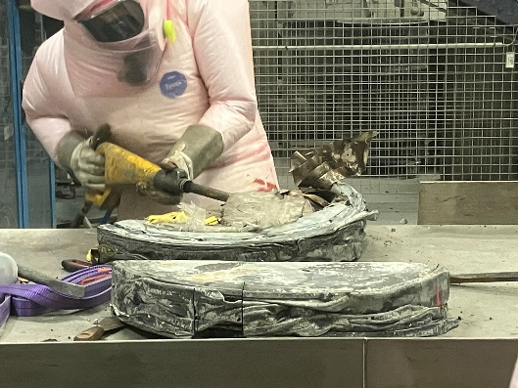
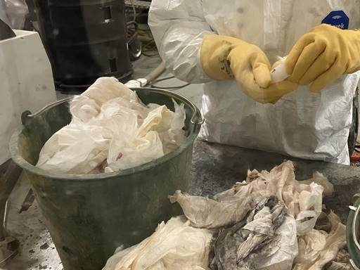
Application of our AGILE approach
Physical Controls
Pilot project to control the content of the legacy waste
(11 waste packages)
➔ Building knowledge on adequate techniques for the controls on an industrial scale & on the nature on legacy waste
Removal of drum
Core drilling
Cutting & dismantling of pellets
Sorting & characterisation of waste materials

Slide 9

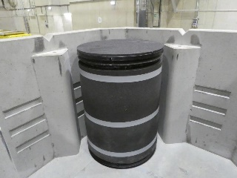
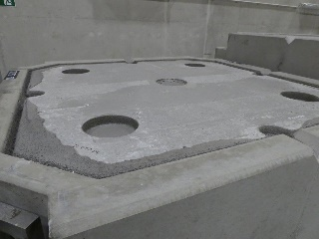
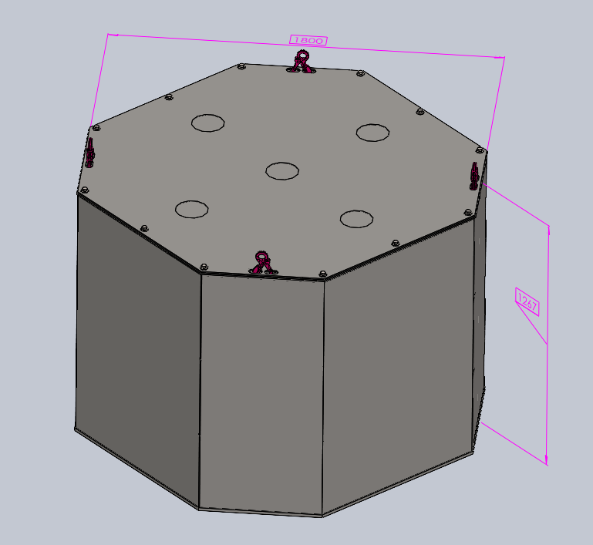
Application of our AGILE approach
Define specific measures
Monolith Type I
with PE foam (R&D studies ongoing on degradation & impact on the sorption)
Monolith Type III
with a box
Monolith Type III
with RVC foam (carbon “inert”)
Several conceptual prototypes to be tested to develop a solution for concrete potentially sensitive to ASR
Caisson
Non-explosive cracking agent (waste)
Compressible material
Mortar
Metallic container
Notes:
BETONAMIT® | The non-explosive demolition agent
for the simple and targeted demolition of rock and concrete
Betonamit is an explosion-free demolition agent which enables relatively accurate demolitions without the need for special conditions or equipment. After a reaction time of only a few hours Betonamit develops an enormous expansion pressure, which is soon so powerful that every hard rock and even reinforced concrete is broken apart.

Slide 10
Conclusion:
Many advantages of AGILE approach
Allow a combination of focus & flexibility
Fast learning & understanding
  By doing
  Shared learning within the teams & with stakeholders
Allow to get started (by slicing the big & complex challenge)
We changed our mindset
  Efficient project management → how to get fast results
  Find the perfect solution → identify multiple options to maximise the chances of success

