Slide 1
Embedding sustainability into decommissioning: participative systems mapping
Kezia White & Tracy Braithwaite
Environment Agency - Nuclear Regulation Group.
November 2023

Slide 2
Tracy Braithwaite
Kezia White
26 years regulating nuclear and non-nuclear sites, latterly leading on integrated waste management and decommissioning nuclear sites. Programme Manager for Environment Agency’s decommissioning and clean-up programme which includes responsibility for sustainability.
16 years with the Environment Agency including environment management, project management for the new Hinkley Point C power station and the project manager for sustainability in the Environment Agency’s Decommissioning and Clean Up programme

Slide 3
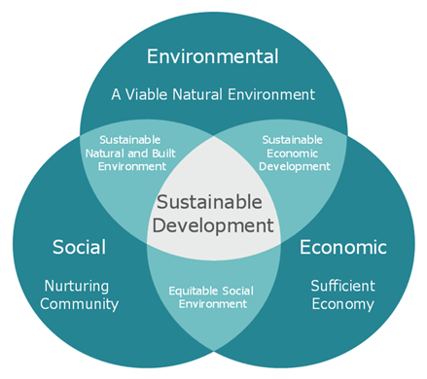
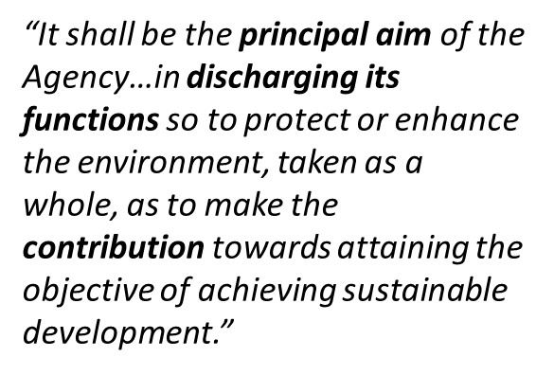
Influencing Sustainability
Achieving the Government 25-year plan and Environmental Improvement Plan
Our EA strategy (EA2025) provides a clear direction to engage and influence improvements to deliver sustainable growth

Slide 4
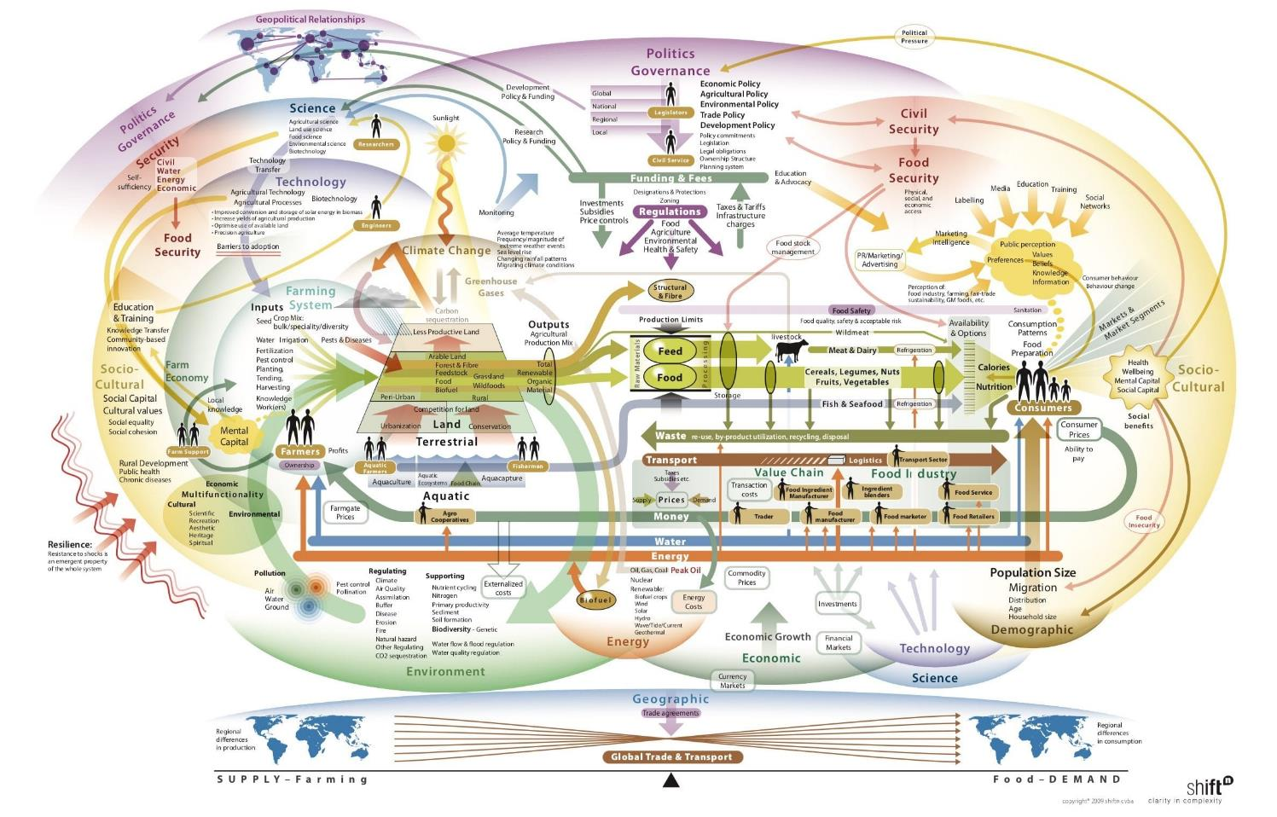
Solving problems / making decisions
Linear Thinking
Linear Thinking
Complex Problem
=
Ineffective situation worsen
Simple
Problem
+
+
=
Solution
Linear thinking often makes the situation worse.
The world is complex as are the key political and scientific challenges of the day

Slide 5
Why would you use a systems map?
Implementing The UN 2030 agenda brings many facets together for consideration in everything we do from how to protect our marine life to how we ensure everyone has enough to eat.
Managing the UKs nuclear legacy in a sustainable way that maximises benefits to all now and into the future presents a significant and complex challenges to decision-makers as they seek to identify long term solutions that reconcile competing interests.
It requires a collaborative approach and agreement of how systems work and integrate with each other to embed the principles of sustainability.
Identifies need to explore potential unintended impacts

Slide 6
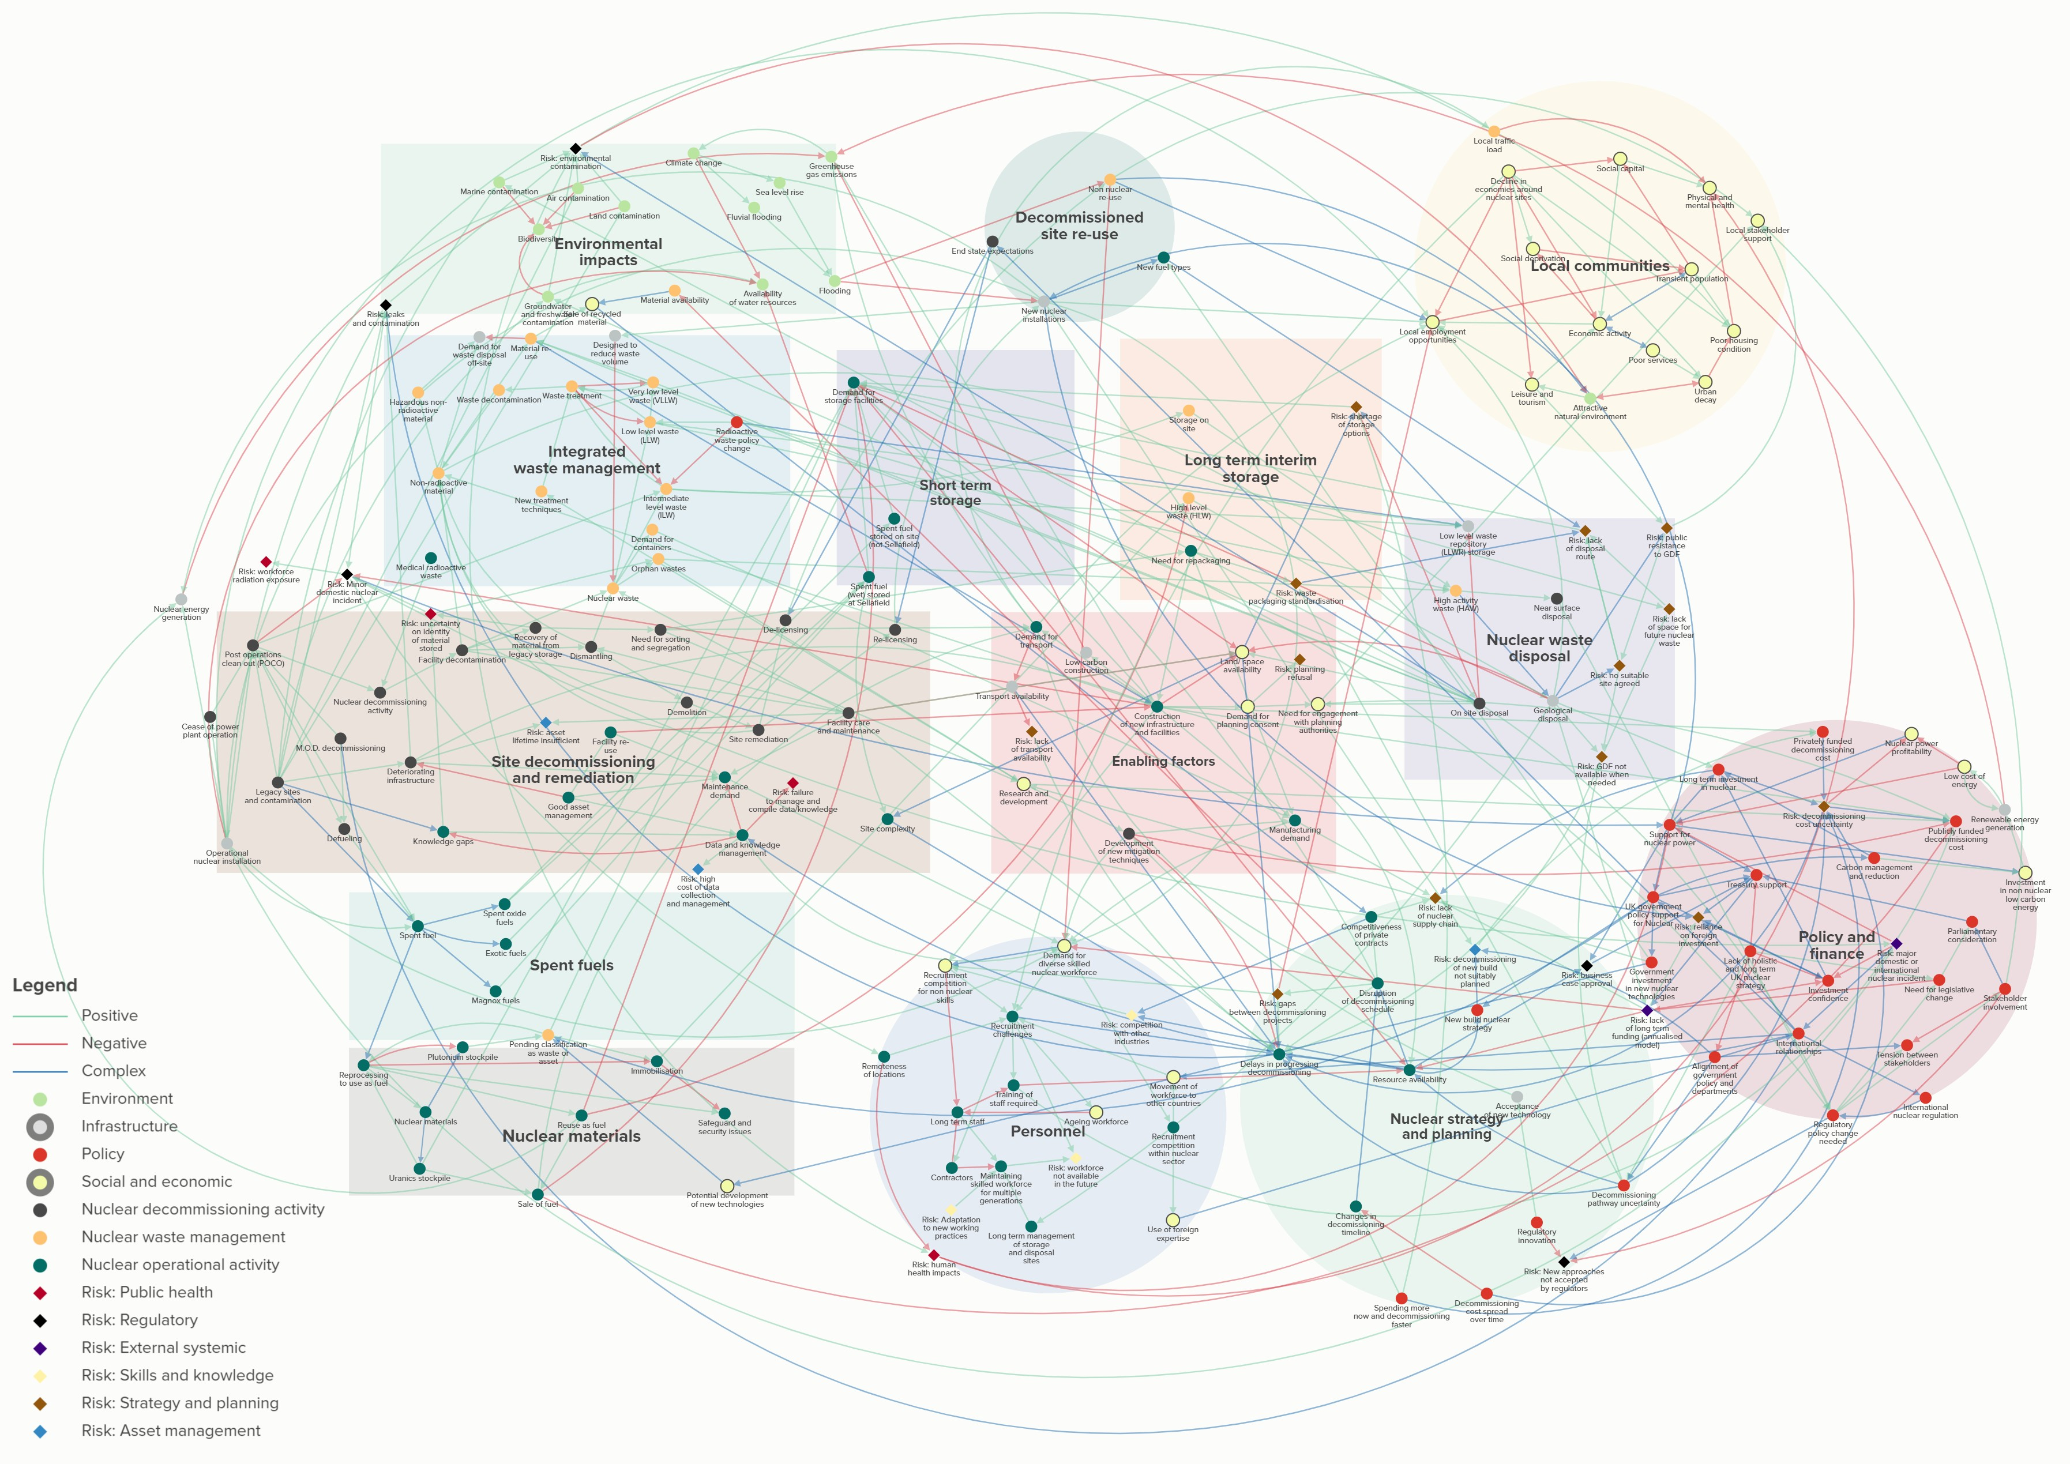
Decommissioning and Clean Up Participative Systems Map
Map view: Selection of all layers – ‘Select all’ on layer menu

Slide 7
Case Study 1 - Long term management options
Integrated
Waste Management
Nuclear Waste
Disposal
Policy and
Finance
Personnel
Nuclear Materials
Map view: Selection of Topic: long term management options on sub-system filter

Slide 8
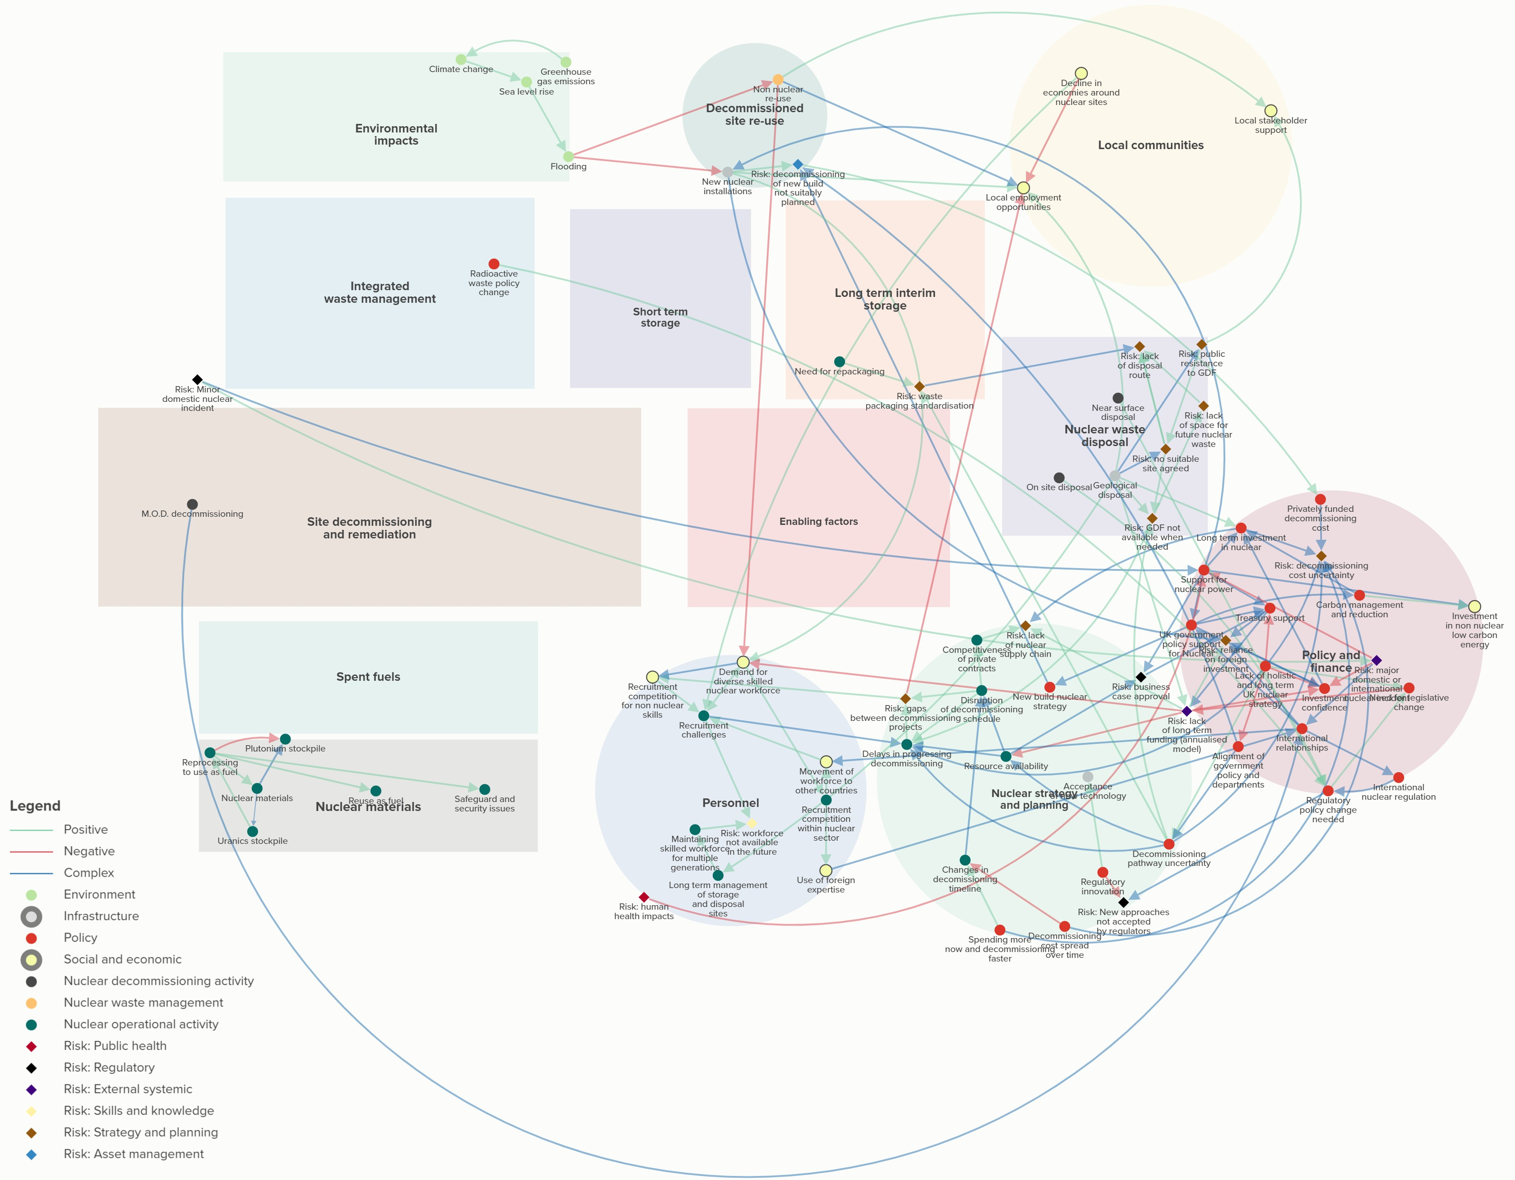
Case study 2 - Long term decommissioning strategy
Nuclear Waste
Disposal
Policy and
Finance
Personnel
Nuclear Strategy
& Planning
Nuclear Materials
Map view: Selection of Topic: long term decommissioning strategy on sub-system filter

