Slide 2
Applying a life cycle environmental perspective to the development of radioactive waste treatment technologies
J. Kirk, R. Clayton, A. Banford, L. Stamford
E: Laurence.stamford@manchester.ac.uk

Slide 3
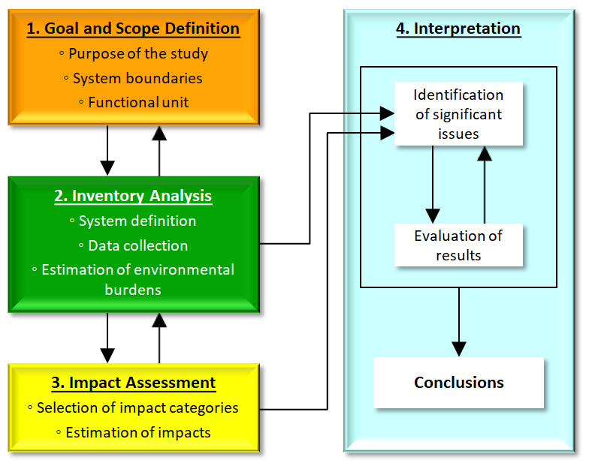
What is Life Cycle Assessment (LCA) ?
Quantification of environmental burdens
Translating burdens into potential impacts
Identification of opportunities for environmental improvements – 'hot spots'
ISO 14040/44
Figure 1: The four phases of life cycle assessment as defined in ISO 14044

Slide 4
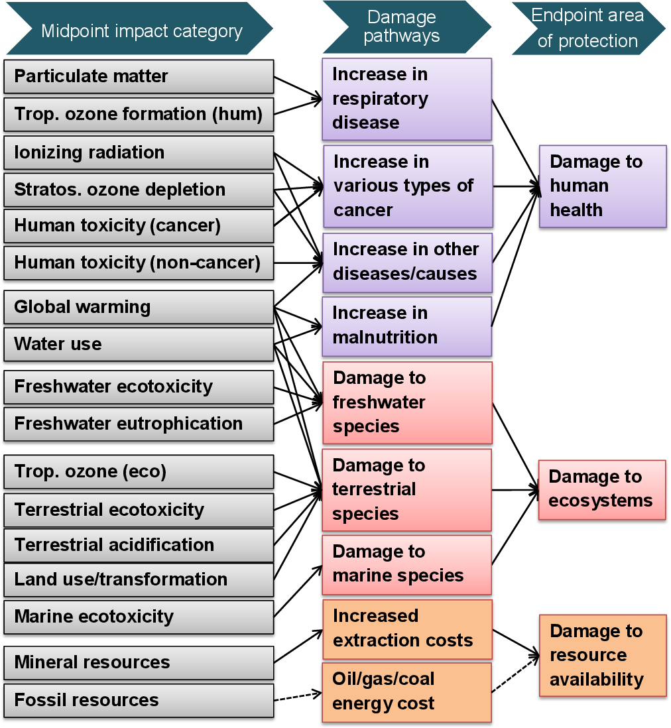
LCA Methodology
Defining Goal and Scope
System boundaries and functional units
Inventory Analysis
System definition – Process modelling
Data collection – Ecoinvent database
Estimation of burdens
Impact Assessment
Impact assessment methodology selection – ReCiPe 2016
Impact categories I.e., Climate change potential, human toxicity, metal depletion
Estimation of Impacts
Interpretation
'hot spot' identification
Sensitivity analysis
Conclusions
Figure 2: ReCiPe impact assessment methodology

Slide 5
LCA and Life Cycle Costing (LCC) in PREDIS
Capital cost (production of materials/components)
Fixed operating costs
Variable operating costs
Waste management costs
End-of-Life costs
Transport costs
LCC is less standardised but a general method exists (from the Society of Environmental Toxicology and Chemistry, SETAC)
PREDIS incorporates LCA and LCC into the development of treatment options for metallic wastes, liquid organics and solid organics, as well as waste store monitoring technology.
All LCC aligns with the LCA models with each flow having a cost attached
Protocol for the use of LCA/LCC: https://predis-h2020.eu/wp-content/uploads/2021/09/PREDIS_MS14_T2.5-LCA-protocol-guidance_31.8.2021.pdf
Figure 3: LCC methodology

Slide 6
LCA/LCC in Nuclear Sector
Literature review 2021-2022: established the very small pool of radioactive waste treatment LCA, few papers considering decommissioning or back end nuclear fuel cycle
Over 120 papers screened
Nuclear Treatment Technologies/Methods
Minimal Crossover
Nuclear LCA Studies

Slide 7
Case Study - Decontamination using Gel
Application of a self-drying cracking gel (SDC gel) which incorporates surface contamination
Collaboration on inventory data with CEA
FU is the treatment of 10 m² of planar stainless steel surface
System boundary:
production of reagents and equipment → removal of the treatment gel
Figure 4: Impacts of treating 10 m² of planar stainless steel surface using SDC gel

Slide 8
Case Study - Decontamination using Gel
Once treated the stainless steel can be recycled/free-released
The carbon footprint of decontaminated stainless steel is 99.8% lower than that of virgin stainless steel, even before savings in disposal space are accounted for:
(Note that this assumes only surface decontamination was present, with no subsurface contamination/activation.)
Figure 5: SDC gel treatment compared to stainless steel production

Slide 9
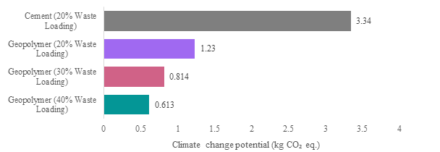
Case Study - Geopolymer Encapsulation
Tuff geopolymer encapsulation of radioactive solid organic waste (RSOW)
Collaboration on inventory data with Politecnico di Milano
FU: the pre-disposal processing of 1 kg of intermediate level RSOW surrogate
System Boundaries: receipt of waste at the treatment facility to the handoff of a conditioned waste drum to a final repository
Varying waste loading scenarios based on R&D compared to OPC encapsulation
Figure 6: Climate Change potential of tuff geopolymer encapsulation

Slide 10
Conclusions
LCA and LCC can be useful tools to identify the most effective and efficient routes for waste treatment R&D. Currently they are underutilised.
Gel decontamination of planar steel surfaces appears highly beneficial from an environmental perspective.
Impacts are dominated by the gel and vacuum cleaner → alternative oxidants and minimisation/reuse of vacuum cleaners are the best strategy
Geopolymer encapsulation can outperform cementation by >60%.
Costs and optimisation of waste loadings are key focal points
joel.kirk@postgrad.manchester.ac.uk rachael.clayton@postgrad.manchester.ac.uk laurence.stamford@manchester.ac.uk anthony.w.banford@uknnl.com

