Slide 2
HOW NUCLEAR DECOMMISSIONING CAN BE MADE COMPATIBLE WITH A NET ZERO CARBON TRAJECTORY
H. Pantelidou, N.J. Barron
Arup

Slide 3
Contents
Context
Decommissioning and the 2050 milestone
Carbon management principles
Systems-thinking decarbonisation
No-regrets carbon opportunities

Slide 4
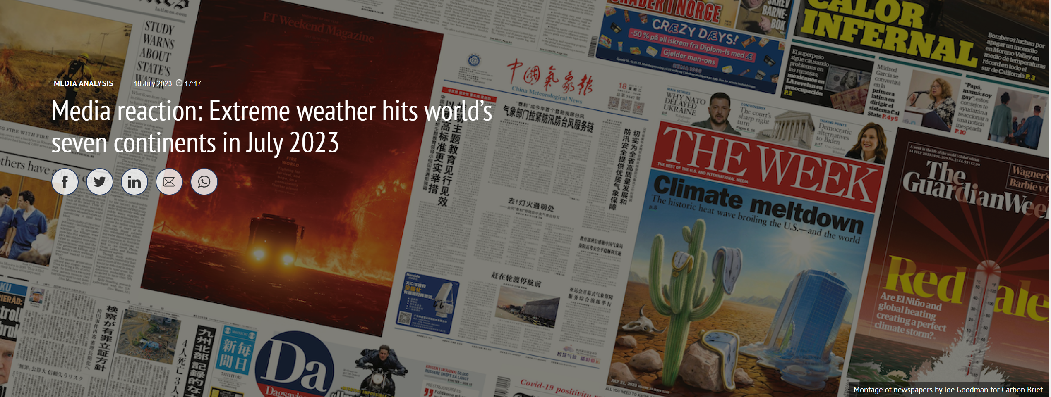
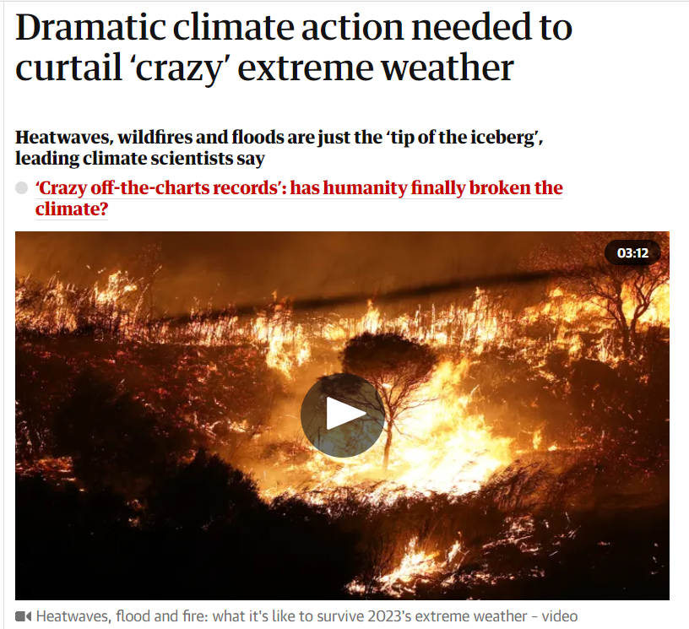
Global context Changing life as we know it…

Slide 5
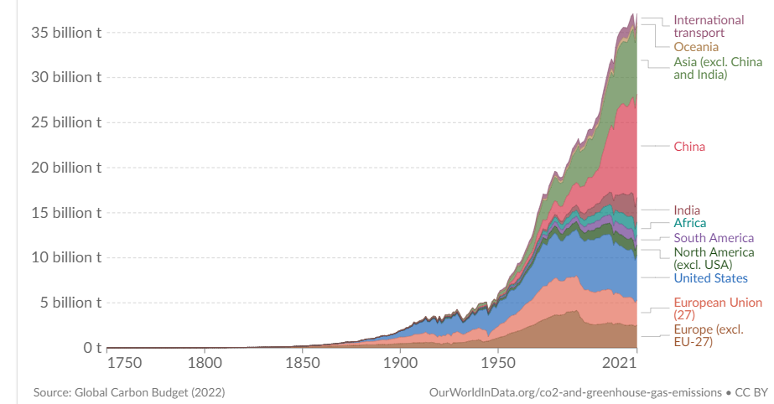
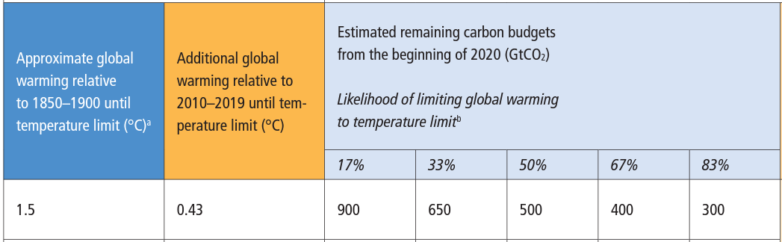
Global context Annual historical emissions and remaining carbon budget
https://www.ipcc.ch/report/ar6/wg1/downloads/report/IPCC_AR6_WGI_SPM_final.pdf
https://ourworldindata.org/co2-and-other-greenhouse-gas-emissions
Notes:
What are we dealing with and why it is urgent: historically, UK, Europe and the US had the lion’s share of carbon emissions but in recent years the weight of carbon emissions has shifted towards the emerging economies – irrespective, the annual carbon emissions continue to rise across the globe.
[click] The IPCC estimates that we can only spend another 500Gt overall by 2050 for a 50% chance to remain at 1.5oC global temperature increase ; or better, 300Gt for a more comfortable 83% chance.

Slide 6
National context Example: UK electricity mix & nuclear activity waste arising
Decommissioning ~1MtCO₂e
Nuclear generation ~0.3MtCO₂e
Figures compiled from multiple sources. https://ukinventory.nda.gov.uk/the-2022-inventory/2022-uk-data/; https://www.neimagazine.com/features/featureberkeley-starts-60-year-wait; https://www.edfenergy.com/energy/power-stations/heysham-2; https://www.edfenergy.com/energy/power-stations/sizewell-b#:~:text=The%20lifetime%20output%20of%20Sizewell%20B%20is%20243TWh%2C,power%20every%20home%20in%20Suffolk%20for%20178%20years; https://www.power-technology.com/projects/hinkley-point-c-nuclear-power-station/
Notes:
The estimated annual carbon footprint of nuclear decommissioning is of the order of 1 MtCO2e/a (Nuclear Decommissioning Authority, 2021), and equivalent to circa 3 TWh (terawatt hour)
of electricity generated from CCGT (combined cycle gas turbine)
Figures on the right:
Although the latest generation reactors is orders of magnitude more efficient in waste (top graph), the total electricity output will significantly increase and hence the total estimated waste is significant and will have to be accommodated in the long term disposal facility

Slide 7
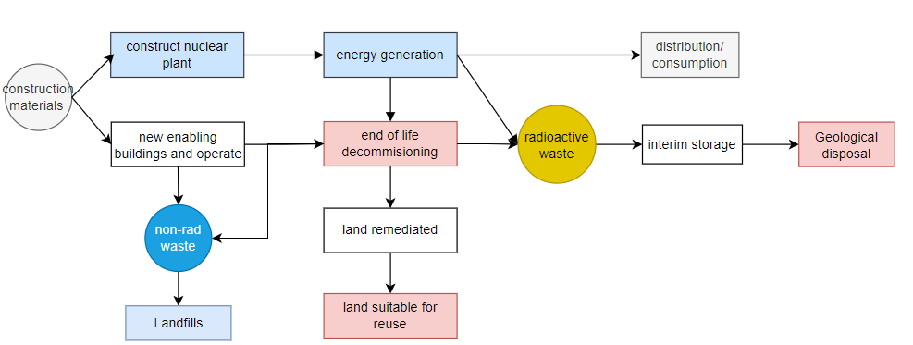
Whole life carbon and systems thinking
Decommissioning/ disposal are integral to the nuclear energy
A high carbon decommissioning sector may dilute the low carbon credentials of nuclear generation

Slide 8
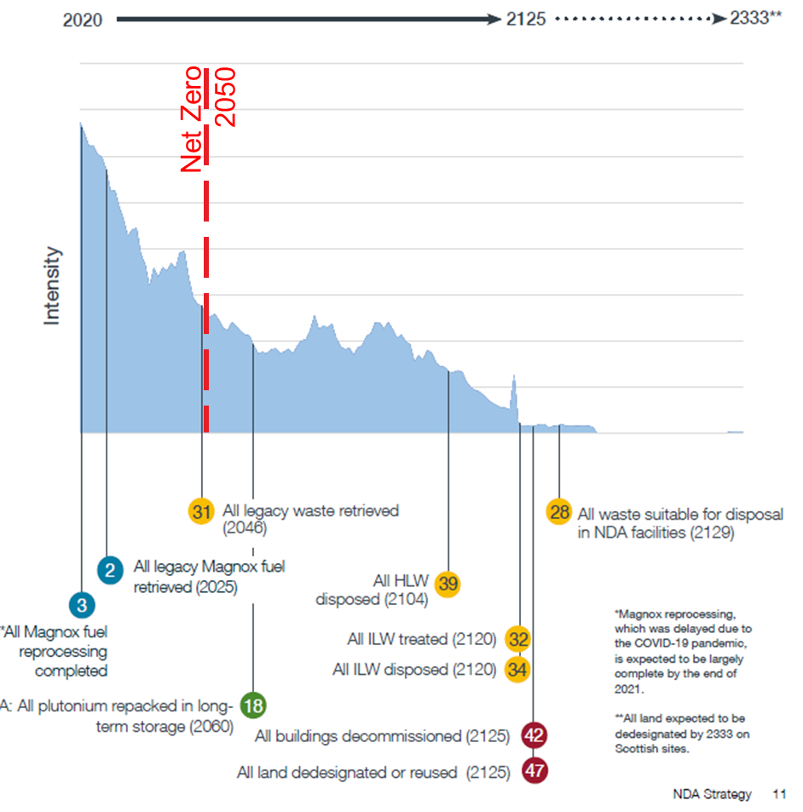
Decommissioning and the 2050 milestone
COP21 Paris Agreement: Net Zero by 2050
Nuclear generation part of the low carbon energy mix
Legacy and safe disposal reduce the carbon benefits if not managed
Figures from “Nuclear Decommissioning Authority Strategy (SG/2021/48), March 2021

Slide 9
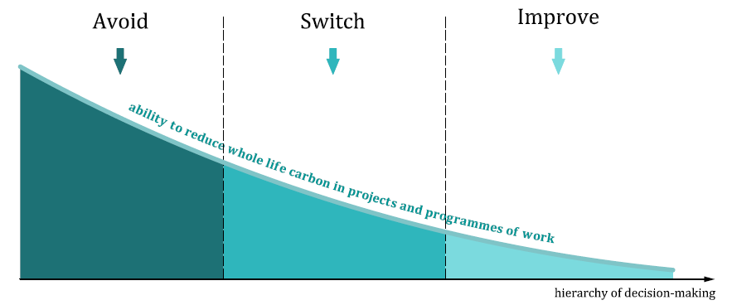
Carbon management principles
Systems-thinking
Carbon hierarchy
Prioritise nature
Integrate resilience
Collaboration
https://www.bsigroup.com/en-GB/standards/pas-2080/
Notes:
This is the infographic that illustrates the whole carbon management process - PAS-on-a-page.
to emphasise the iterative nature of the process of assessment, reporting and continual improvement at every stage of the project development – starting with the strategic need. The process is centred around the importance of integration of carbon in the decision-making, with the appropriate governance in place that encourages the realisation of carbon opportunities through innovation and challenging the traditional approach to project delivery.
At the front of the management process is the need for Leadership and setting ambitious targets that are compatible with the net zero transition of the system. And the project outcomes are driven by the 5 decarbonisation principles.

Slide 10
No-regrets carbon opportunities for nuclear Not an exhaustive list
 | No regrets interventions
Avoid | Disposal, retrofit, resilience | Re-visit and eliminate avoidable interim storage – focus on fast-tracked long term disposal implementation
 |  | Re-use existing assets for diverse and new functions
 |  | Prioritise nature-based interventions to avoid flood/ drought related carbon from extreme events
Switch | Optimise design | Challenge standards and accelerate uptake of innovative techniques
 |  | Risk management: eliminate conservatism-related carbon
 |  | prioritise nature; also as part of the site-end states
Improve | Innovate | Integrate carbon reduction targets with the local / regional decarbonisation strategies; implement in a collaborative and inclusive way
 |  | Accelerate approvals for low carbon innovation in time for the biggest volume of interim storage

Slide 11
A call to action
Carbon Governance
Integrate the 2050 milestone into the decommissioning missions
Site end states: prioritise nature - bring earlier
Climate resilience: pro-actively integrate into mission
Interim storage: re-visit the carbon implications of protracted strategy
Accelerate low carbon innovation aligned with safety & security critical
Notes:
Governance “for carbon” in place
Integrate into 2050 milestone into decommissioning missions
Pro-active with site end states, in particular environmental regeneration
Integrate climate resilience into mission pro-actively rather than re-actively.

