Slide 2

Environmental remediation and waste management following a nuclear accident
Léa Pannecoucke, Thierry Doursout, Isabelle Dublineau, Arnaud Mangeret – IRSN

Slide 3

Introduction and context
Post-accidental doctrine defined by the Steering committee for the management of post-accidental situation (CODIRPA)
“Contamination reduction and waste management” working group
  Studies about environmental remediation strategies and waste management options following a major nuclear accident
  Aiming at comparing several remediation strategies and providing decision makers with food for thought
IRSN’s work based on a study case consisting in modeling a major nuclear accident and estimating waste volumes generated by several remediation strategies in urban and agricultural areas
  Steps to build the study case
      Simulation of atmospheric discharge and ground deposit
      Definition of remediation strategies
      Estimation of waste volume
  Waste management options

Slide 4
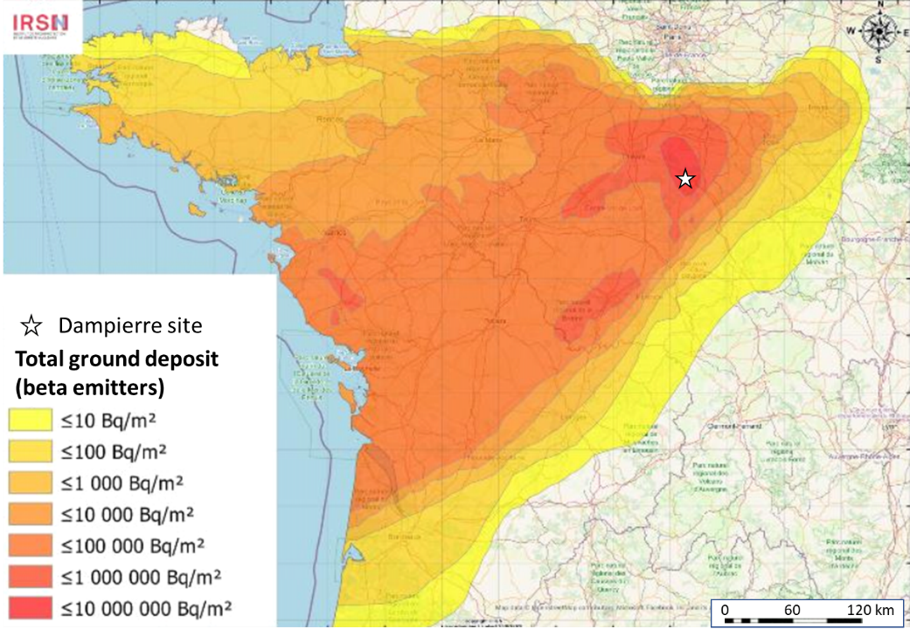
Step 1: simulation of atmospheric discharge and ground deposit
Nuclear power plant along the Loire River
Source term: same order of magnitude as Fukushima accident
Ground deposit computed based on meteorological conditions on the French territory (April 12th - 15th, 2020)

Slide 5
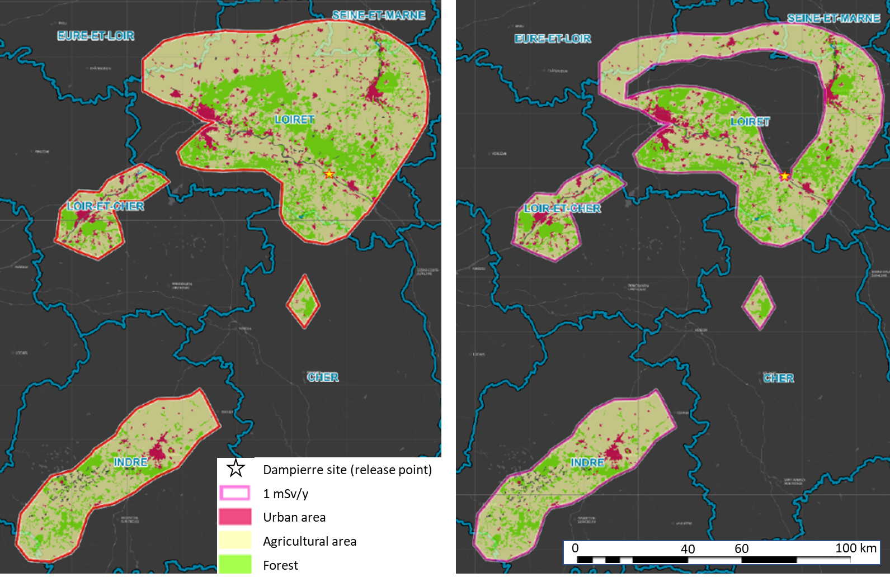
Step 2: definition of remediation strategies
Perimeter in which remediation actions are implemented
Perimeter 1
Perimeter 2
Total dose (excluding voluntary ingestion of contaminated food) ≥ 1 mSv/y (between the 3rd and 15th month following the end of discharge)
  With (Perimeter 1) or without (Perimeter 2) the “relocation perimeter” (≥ 20 mSv/y)
Perimeter 1 = 7 962 km²
  493 km² of urban area
  5 350 km² of agricultural area
Perimeter 2 = 6 511 km²
  429 km² of urban area
  4 323 km² of agricultural area

Slide 6

Step 2: definition of remediation strategies
Sets of remediation actions
Actions based on feedbacks from remediation actions in the territories affected by Chornobyl and Fukushima nuclear accidents
  Related to specific land cover (urban and agricultural areas) and materials (roads, roofs, lawns, etc.)
  Specific data per processed square meter: waste volume, workforce, efficiency, cost
Three sets of actions, each including a dozen of remediation actions
  “Chornobyl feedback” and “Fukushima feedback”:
      Similarities: high pressure hosing (walls, windows, roofs, roads), removing soil, grass, and plants (private gardens and public parks) → same actions, but specific data from each feedback
      Differences in agricultural land:
        ploughing for “Chornobyl feedback”
        thin-layer soil stripping for “Fukushima feedback”
  “Maximum surface dose rate reduction” designed to maximize the global efficiency of actions to reduce the ambient external dose rate, without considering other factors (waste volume, cost, feasibility at large scale, etc.): e.g., recovering grass surface with asphalt (private gardens and public parks) or skimming and burial ploughing (agricultural land)
No reproduction of the strategies actually implemented (but data from those feedbacks)

Slide 7
Step 2: definition of remediation strategies
Time frame & summary
3 months
1 year
End of atmospheric discharge
Beginning of actions implementation
End of actions implementation
Summary : comparison of six strategies
Perimeters | Sets of actions | Time frame
Perimeter 1 (≥ 1 mSv/y) Perimeter 2 (without the relocation zone) | Fukushima fb. Chornobyl fb. Max. surface DR reduction | 1 year
Actions are implemented on the whole perimeters disregarding the contamination level

Slide 8
Step 3: estimation of waste volumes dewaX
dewaX: numerical tool developed by IRSN to compare remediation strategies in urban and agricultural areas, mainly based on estimated waste volume
Map of ground deposit
Strategies
  Perimeter
  Set of actions
  Timeframe
Land cover (roads, gardens, etc.)
Data for each action per processed m² (waste/m², workforce/m², etc.)
+
Waste (volumes and activity)
Workforce
Cost
Efficiency

Slide 9
Step 3: estimation of waste volumes
Results
Solid waste generated in perimeter 1 (in 10⁶ m³)
  More solid waste generated by “Fukushima fb.” set of actions: mainly due to soil stripping in agricultural lands (disregarding the contamination level)
  Less solid waste generated by “Max. surface DR reduction” set of actions: use of exposure mitigation practices such as ploughing or surfaces covering
  For ~95 % of waste, activity <100 Bq/g (VLLW)
In perimeter 2 (relocation perimeter not included)
  Reduction of waste volume in relation with the reduction of treated surfaces
  Reduction of waste activity since the most contaminated area is not subject to remediation actions
 | Soil | Solid incinerable waste | Other solid waste | TOTAL
Chornobyl fb. | 12 | 0.1 | 0.1 | 12.2
Fukushima fb. | 273 | 1.3 | 0.2 | 274.5
Max. surface DR reduction | 0 | 1.2 | 6.3 | 7.5

Slide 10
Waste management options (French context)
Storage (short-term): sites available near the locations of waste production
  Possible accordingly to the dedicated regulatory framework in France
Waste treatment and volume reduction especially for incinerable and putrescible waste
  Capacity of existing radioactive waste incineration facility not sufficient
  Construction of dedicated incineration facilities or use of existing incineration facilities for conventional waste, after adaptation to the treatment of radioactive waste (or both)
Interim storage and disposal
  Volumes exceeding capacities of existing disposal facilities, especially for VLLW
  Interim storage awaiting the design and construction of a disposal facility adapted to the waste volumes and natures
Conditional clearance (related to a specific use, a type of materials, etc.), given the large volume of VLLW, even if it is not the usual way to manage VLLW in France
  Reuse and recycling
  Disposal in facilities designed for industrial hazardous waste

Slide 11
Conclusion and perspectives
The study underlines the impact of remediation strategies on the waste volumes and natures
Other criteria must be considered in decision-making regarding remediation strategies, in order to find an adequate balance between safety and sustainability
  Such as acceptance, feasibility, adverse effects, impact on living conditions (recovering lawns, removing plants, etc.)
  Multi-stakeholder and multi-criteria analysis: help answer questions such as “which strategy enables a safe and quick return of population, with living conditions as close to before the accident as possible (maintaining social and economic activity, agriculture, transports, leisure facilities, etc.)?”
  → Integrating such criteria and analysis could enrich the current comparison between the strategies and help future decision-making
Waste volumes largely exceed the capacities of French treatment and disposal facilities. Sustainable waste management options may consist in:
  Reducing waste volumes, based on an optimized choice of remediation strategies
  Reflections on some possible developments in the current radioactive waste management system to facilitate decision-making, reserved for the post-accidental context (defining generic concepts for treatment, storage or disposal facilities; evaluating the possibility to introduce
  clearance levels, etc.)

