Slide 1
Addressing Sustainability Considerations in Strategies for Nuclear Decommissioning
International Conference on
The Safety of Radioactive Waste
Management, Decommissioning,
Environmental Protection & Remediation
Simon CARROLL & Deborah OUGHTON
Vattenfall & the Norwegian University of Life Sciences
IAEA, Vienna, Austria, 6-10 November 2023

Slide 2
Time for a new framing
Decommissioning seen as the final stage of a linear nuclear facility life-cycle model.
Such a framing is incomplete and likely to be insufficient to fully address sustainability considerations.

Slide 3
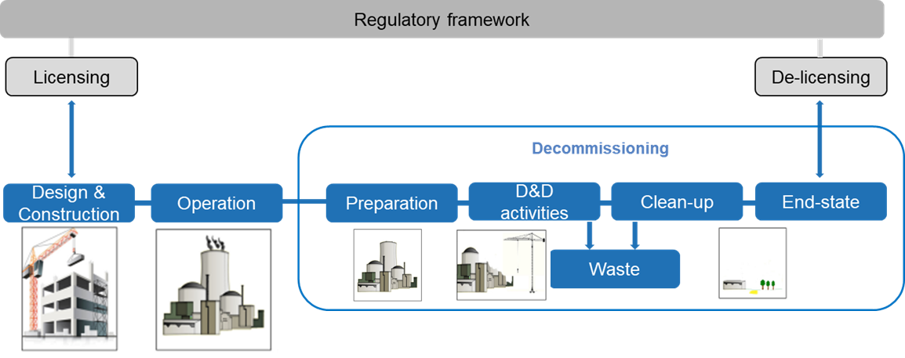
A more complete life-cycle framework
Future uses ?
Decisions made at each stage have the potential to impact decommissioning.
This includes decisions about potential future uses.

Slide 4
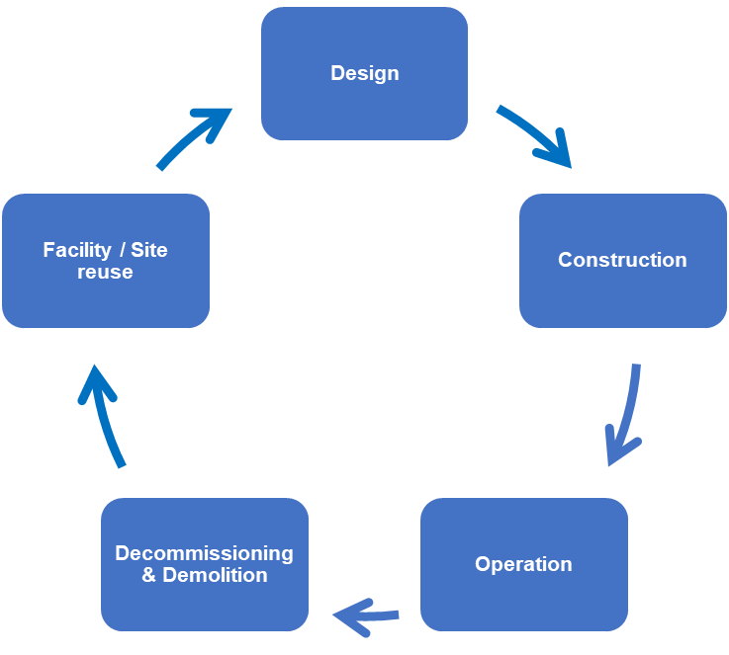
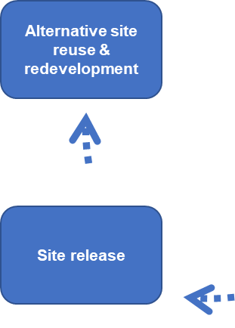
A circular lifecycle
Could we use a more circular approach to transform the linear nuclear facility life-cycle?
What might it imply …
For decommissioning?
For facility and site reuse after decommissioning?
Encourages genuine integration of decommissioning from the outset and throughout
Encourages the integration of consideration of the future uses of a facility or site
Notes:
Buildings embody a large amount of resource use in their pre-use lifecycle stages, i.e., from raw material extraction, manufacture, transportation, and construction
Lifetime extension is a critical strategy for sustainability, as keeping structures in use for as long as possible avoids unnecessary additional resource extraction, energy use and waste generation associated with replacing them
Reuse of an existing industrial site, also offers additional potential overall reduced environmental impacts compared to development of new sites.
Facility and equipment reuse in a cyclical model, e.g., through refurbishment and renovation, offers potential benefits, especially when associated with material “re-looping” as part of an overall circular economy approach

Slide 5
Why a new way of thinking is needed
Increased extraction for construction
To 78 Gt per year
Raw materials in building construction
3 Gt per year
Waste from building demolition
293 Gt solid waste in 20th century
Construction and demolition waste (CDW) accounts for more than a third of all waste generated in the EU

Slide 6
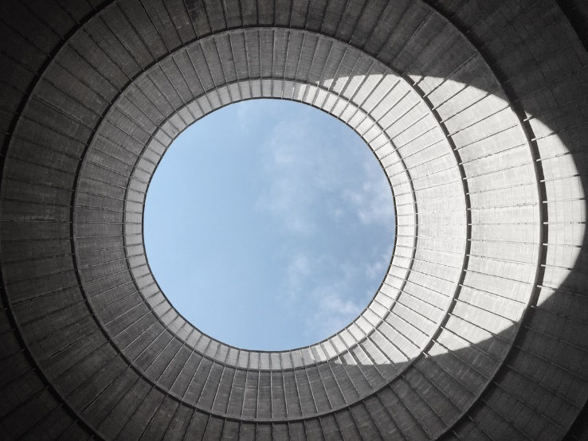
A design workflow for a circular approach
Design for Adaptability
Design for Deconstruction
Circular Material Selection
Overall Resource Efficiency
Notes:
A circular economy design workflow summarises principles which should be considered to maximize circularity, provides details of each principle & justifies their order of consideration
Design for Adaptability – extend the facility’s lifespan, allow refurbishment and renewal with the least additional resource and new material inputs
Design for Deconstruction – reuse of the components and materials inbuilt, if necessary recycle
Circular Material Selection – what you select, how you procure it, options such as leasing and buyback
Resource Efficiency – incorporating the above steps most efficiently when implementing the brief, even incorporates reuse and recycled materials and components in new build
THIS EXPLAINS IN PART WHY CAN ONLY BE IMPLEMETED SO FAR FOR EXISTING FLEET

Slide 7
Legal & Regulatory Issues
Current legal & regulatory framework for nuclear decommissioning does not sufficiently address sustainability. No inherent contradiction or fundamental barriers, but some further development needed
GRS Part 6 could include need to consider sustainability (as it does other issues)
Additional guidance needed to incorporate a more cyclical lifecycle approach
Adjust provisions for waste/material to facilitate reuse and recycling
Financing for nuclear decommissioning may be problematic area
Restrictions on activities that are permitted to be financed through funds
Transfer of liabilities and funds through several generations of site/facility use and re-use
Taxation issues & incentives to promote sustainability in decommissioning

Slide 8
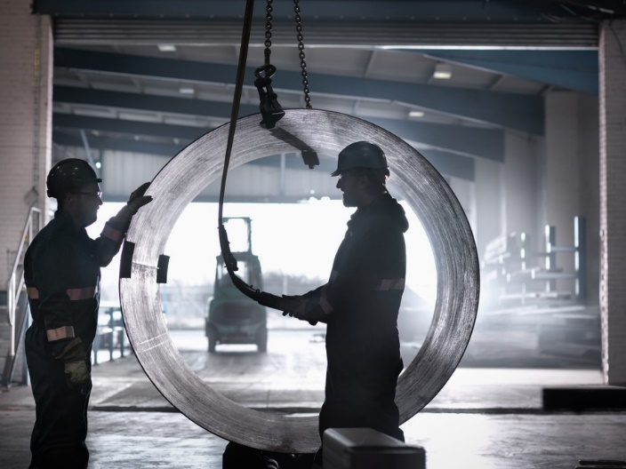
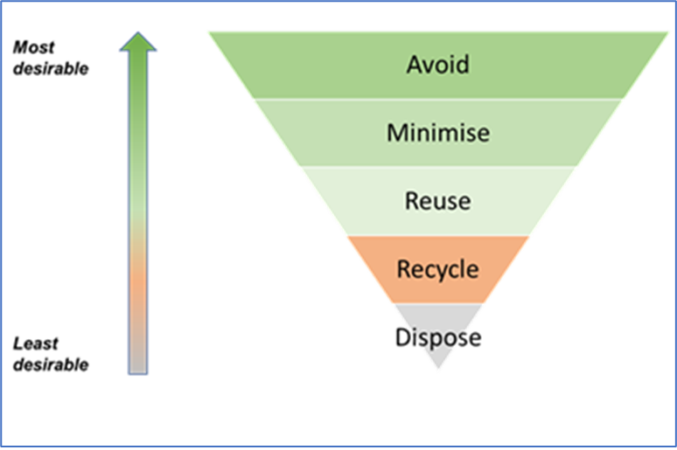
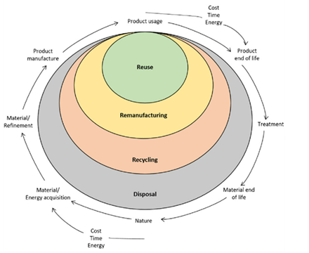
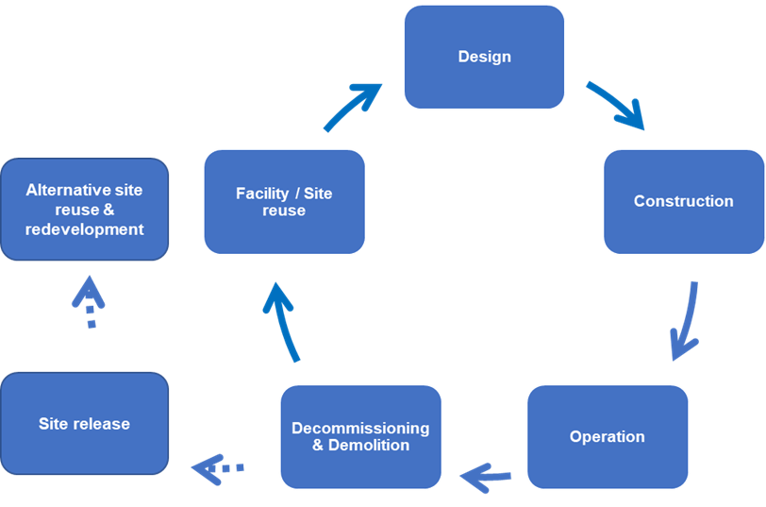
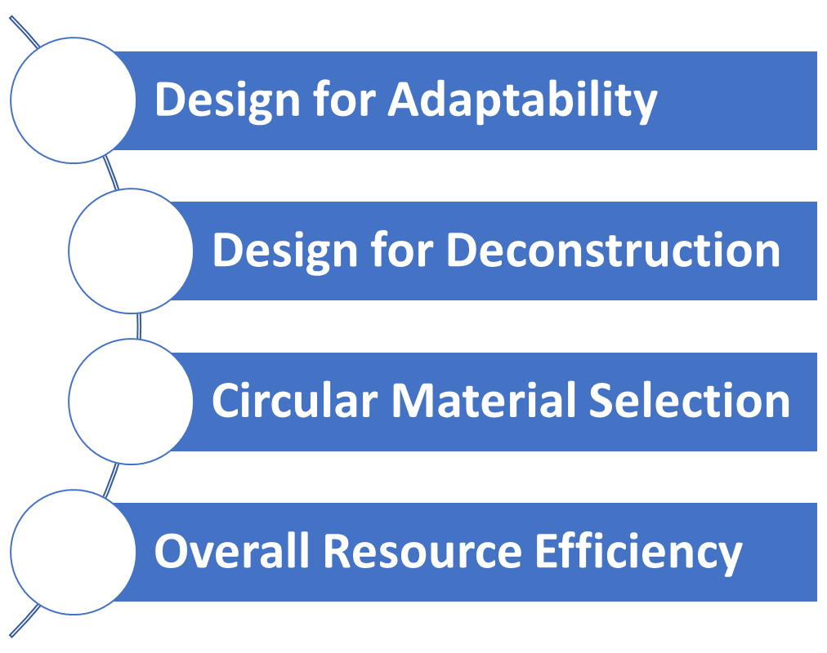
Towards a more circular framework
Continue
Strengthen
Adapt
Current projects can be used to develop & refine approaches for more sustainable nuclear decommissioning
Crucial to address decommissioning sustainability now at the design stage for new reactor designs (ANRs/SMRs)
Develop
Notes:
Continue with current approaches to reducing the environmental footprint of decommissioning activities
Strengthen these by integrating circular economy considerations through the facility life-cycle
Adapt the design workflow and apply to the design of nuclear facilities
Continue to develop sustainability initiatives in current decommissioning projects with the aim of testing and further refining circular economy approaches

Slide 9
Thank you!
Simon Carroll
Associated Scientist
Center for Environmental Radioactivity (CERAD)
Norwegian University of Life Sciences (NMBU)
simon.roy.carroll@nmbu.no
Senior Adviser and
BU Nuclear Decommissioning
Vattenfall AB
simon.carroll@vattenfall.com

