Slide 2


Sustainable remediation in Brazil:
Development, controversies, and future perspectives
Juliana G. Freitas, Stela Cota

Slide 3


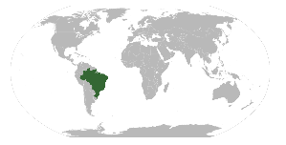

Contaminated sites management
Beginning…
1st generation
3rd gen
2nd gen
4th 5th gen?
Risk based approach
Sustainable management
- Nature based Solutions
- Prevention / Control
Complete removal pollutants
Slenders et al., 2017
DOI: 10.1002/rem.21509
1970
1980
1990
2000
2010
2020
Beginning…
3rd gen
2nd gen
Federal legislation
Risk assessment spreadsheets
State guideline values
First contaminated sites identified
First regulations and guidelines
4th 5th gen?

Slide 4
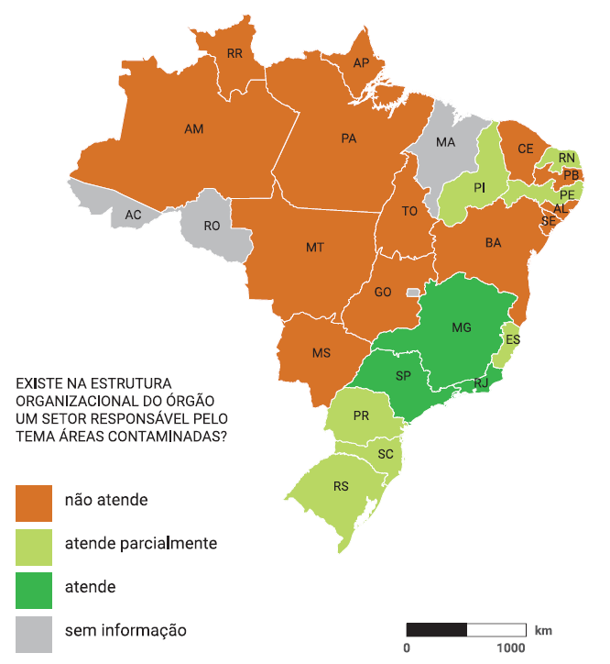
Contaminated sites management in Brazil
Strategies and actions are very heterogeneous in Brazil
Half of the Brazilian states did not have a methodology for contaminated site management 5 years after federal legislation
Only 3 states have a register of contaminated sites
Number of contaminated sites in the country is still largely unknown
Is there an organizational structure for contaminated sites management?
no
partially
yes
???
Texeira et al., 2016
(Panorama GAC - IPT)

Slide 5
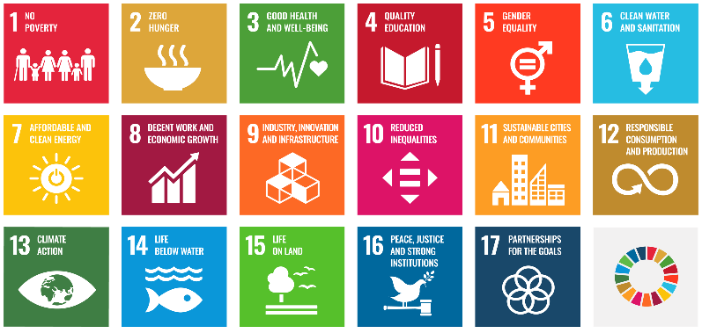
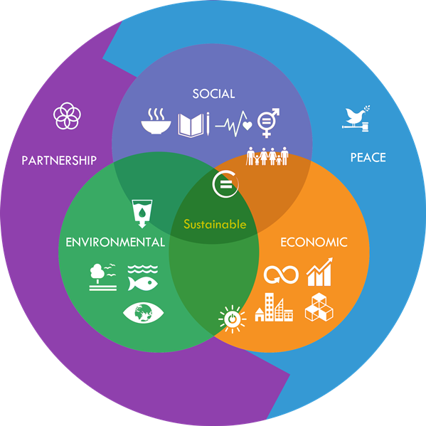
Sustainable remediation
Remediation
2^{ary} impacts
Sustainable Remediation
  ‘‘that eliminates and/or controls unacceptable risks in a safe and timely manner, and which maximize the overall environmental, social, and economic benefits of the remediation work’’ (Surf-UK, 2010).
  “one that represents the best solution when considering environmental, social, and economic factors - as agreed by the [project] stakeholders” (Nicole, 2011)
UN, 2016

Slide 6
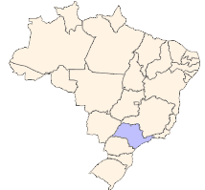
Sustainable remediation in Brazil
Remediation in São Paulo State
Total in 2023: > 6800 sites
Thermal: 2 in 2017, 11 in 2023
MPE
Pump and treat
MNA
Excavation
Chemical
SVE
Air sparging
Is sustainability playing a role in technology selection?
Bioremediation

Slide 7
Remediation end-point
  Safe
  ×
  Sustainable
How much should we remediate?
  Total removal
  General maximum acceptable values
  Site-specific risk assessment
  Compensation for contaminants left?
What is an acceptable risk?

Slide 8
Remediation end-point
How much is acceptable?
  Probabilistic approach
    carcinogenic compounds: 10⁻⁵
    hazard quotient for non-carcinogenic: 1
    dose limit criteria for radionuclides: 1 mSv yr⁻¹
Who decides?
“what is acceptable should be defined by those who experience the risk”

Slide 9
At which step we consider sustainability?
Nowadays
Technology selection
Deciding how to apply the selected technology
  Example: using solar panels to operate a remediation system instead of the energy supplied by the power company

Slide 10

How we evaluate / compare sustainability
Different sustainability assessment tools
  developed by consultant companies
  industry, academy? Validation?
Indicators
  Environmental
  Economic
  Social?
No national or state guidelines available
UN, 2016

Slide 11
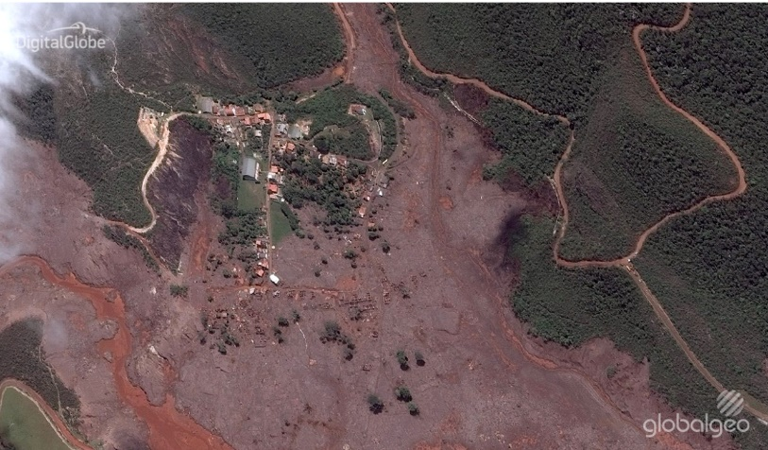
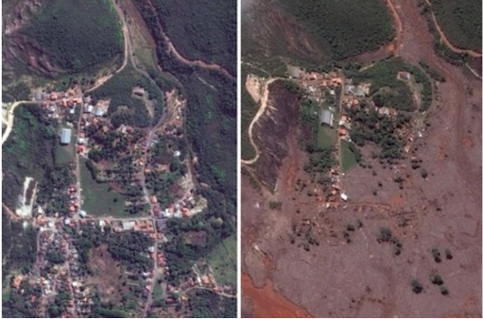
Stakeholders engagement
All stakeholders should be involved
Stakeholders must be listened to during the first steps of contaminated site management
Risk communication: mentioned in national and state regulations, but no clear definitions on how and by whom
Lack of transparency
Mariana dam disaster
CBH Rio das Velhas

Slide 12
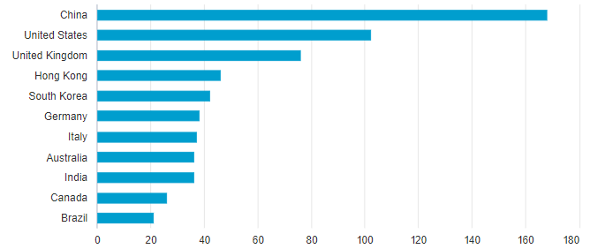
Lack of local studies
Lack of research and studies on sustainable remediation in Brazil
Low number of publications on sustainable remediation by developing countries, particularly Brazil
Sustainability assessments and comparison tools → majority developed in Europe and the US
“Sustainable remediation”
Peer reviewed articles
Scopus

Slide 13
Future perspectives
Some good news…
Initiatives:
  NICOLE Latin America – Work group on Sustainable remediation
  CETESB
    Review of the Contaminated Sites Management Guidance
    São Paulo State Environmental Chamber for Contaminated Sites Management
  Nature-based Solutions

Slide 14
Future perspectives
Discussions in different settings, institutions and groups of stakeholders are happening
  Rarely involve the ones affected or potentially affected by the risks…
  Unidirectional communication: experts → impacted community
For contaminated sites, sustainability should:
  Be considered from the start
  Involve all stakeholders
We need an integrated perspective considering ecological and societal settings

Slide 15



Acknowledgements
Thank you!

