Slide 2
Improvement of the Regulatory Framework in the Field of Radioactive Waste Management in the Republic of Armenia։
Challenges in Implementation of Radioactive Waste Management Program, Policy and Strategy
Presenter: Satine VARDANYAN
Co-author: Armen AMIRJANYAN
“Nuclear and Radiation Safety Center” CJSC
Email: s.vardanyan@nrsc.am

Slide 3
Content
Main Involved Bodies in Radioactive Waste Management in Armenia;
RAW Management Facilities:
Armenian Nuclear Power Plant (ANPP);
Institutional RAW Management Facility (RADON type);
Safety and Sustainability in RAW Management;
Legal Framework;
Main Regulations:
Laws;
Government Decrees;
International Cooperation.
National Policy and Strategy for Safe Management of SF&RAW in Armenia:
Overall Strategic Routes.
Pillars Towards Ensuring Sustainability;
Balance Approach in Applying the Sustainability in Upgrading the Legal Framework;
Challenges in achieving the balance;
Overall Challenges.

Slide 4

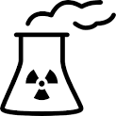

Main Involved Bodies in RAW Management in Armenia
RA Government
ANRA
State Authority empowered to regulate the nuclear and radiation safety in the atomic energy utilization field.
NRSC
Research company providing technical support to ANRA in the field of nuclear and radiation safety. NRSC is actively involved in review and development of national regulations in the field.
MTAI
State Competent Authority empowered with Radioactive Waste and Spent Fuel management, as well as Armenian NPP Decommissioning strategy/policy development related issues.
Prime Minister
Bodies Under the Government
(11 bodies)
(12 Ministries)
Ministry of Environment
Ministry of Territorial Administration and Infrastructure (MTAI)
(includes the former Ministry of Energy)
Armenian Nuclear Regulatory Authority (ANRA)
…
“Nuclear and Radiation Safety Center” CJSC
“Rendering Harmless of Radioactive Waste” CLSC
Armenian NPP

Slide 5

RAW management facilities _ Armenian NPP
Armenian NPP
Reactor type: WWER 440
Installed Capacity: 407.5 MW/unit
Model: V-270
Unit 1:
- Commissioned in 1976;
Shut down in 1989;
Long-term shut down mode.
Unit 2:
Commissioned in 1980;
Shut down in 1989;
Restarted after 6.5y shut-down in 1995;
License was extended up to 2026;
2nd LTE is planned for additional 10 years.
Spent Nuclear Fuel (SF) is not considered as a RAW in Armenia;
SF are stored at NUHOMS-56 type DSFSFs, operated in accordance with separate licenses issued by ANRA;
The new storage capacity and the use of dual purpose casks for SF storage/transportation are envisaged;
There is no RAW disposal facility in RA.
There are no atomic energy objects under decommissioning in RA.

Slide 6
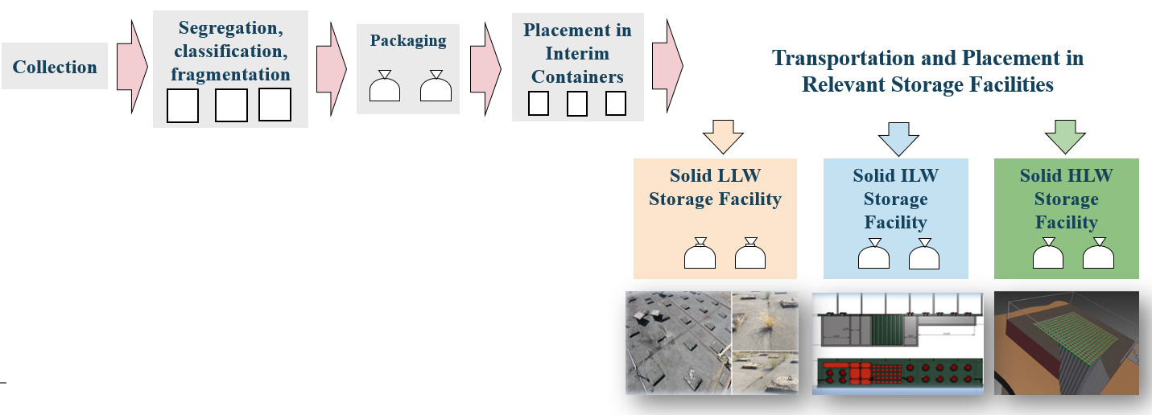
RAW management activities at ANPP _ Solid RAW
(!) Since processing and long-term management of RAW was not foreseen in the design of WWER-440/270 (1st generation of WWER-440), no treatment or conditioning technologies for solid RAW processing are implemented at ANPP.
Main radionuclides present at ANPP RAWs are: Cs-134, Cs-137, Co-58, Co-60, Mn-54, Ag-110m.

Slide 7
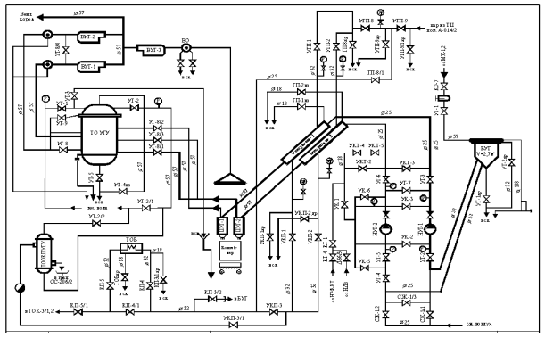
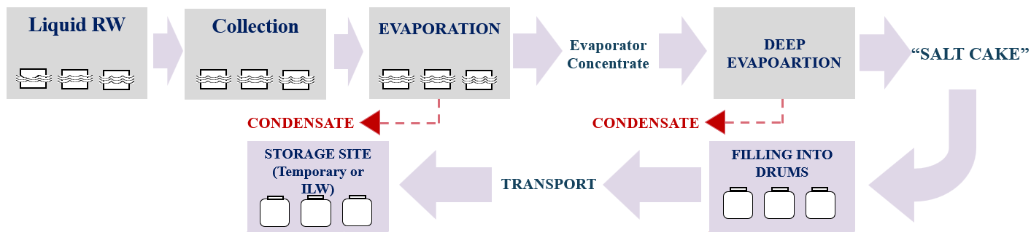
RAW management activities at ANPP _ Liquid RAW
Liquid RadWaste undergoes:
Evaporation,
Ion exchange,
Deep Evaporation.

Slide 8
RAW storage systems at ANPP
Storage systems for solid RAW:
  Storage system for solid LLW – about 42% full;
  Storage system for solid ILW – about 49% full (incl.1735 “salt cake” drums);
  Storage system for solid HLW – about 48% full;
  Temporary storage module with “salt cake” drums – is 100% full, and the solid ILW storage facility is used as an interim solution for their disposition.
  Storage system for liquid RAW:
Storage facility | Total storage capacity (m³) | Accumulated RAW |  | Content & type of RAW
 |  | m³ | Fullness (%)
ECTs (1 – 6) | 2820 | 2194 | 80 | Evaporator concentrate
HLST-1 * | 350 | 170 | 49
HLST-2 * | 350 | 214 | 76 | Spent Ion Exchange Resins (sorbents)
* Since liquid HLW is not generated at the ANPP, HLST-1 & HLST-2 are used for storage of liquid ILW.

Slide 9
RAW Management PROGRAM at ANPP in frame of LTE of Unit 2
NEW FACILITIES PLANNED
---------------------------------------------
New DEF;
Areas for extracting, sorting, fragmentation, characterization & conditioning of liquid & solid RAW;
Buffer storage facilities for conditioned & non-conditioned RAW;
New storage facility for conditioned RAW;
Processing facility for solid RAW;
Auxiliary objects/facilities.
The document foresees the upgrade of existing RAW management system at ANPP by implementation of certain projects, e.g.:
  Project 1: Development/upgrade of the RAW accounting & control system.
  Project 2: Modernization of the liquid RAW processing system.
  Project 3: Modernization of the solid RAW processing system.
  Project 4: Establishment of capacities for storage of the conditioned RAW.

Slide 10
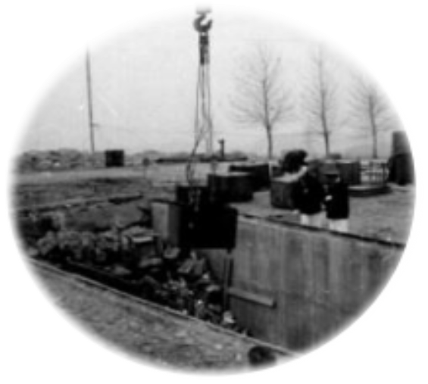
Institutional RAW management facility _ RADON type
  Commissioned in 1980;
  Replacing the old one from 1950ies at the Sovetashen site /for the threat of landslip of the territory/;
  Located in 0.3 km North of Armenian NPP;
  Designed as a near surface disposal facility for solid & liquid RAWs, however has a license for storage of solid L&ILW-SL, granted by ANRA since 2009;
  Consists of 3 identical buildings – total volume of 2268 m³
each building has 7 double layered concrete underground vaults covered with concrete slab;
two boreholes with helical tubular devices were designed for high level DSRS, however were never operated due to the deficiencies of mechanical manipulators;

Slide 11
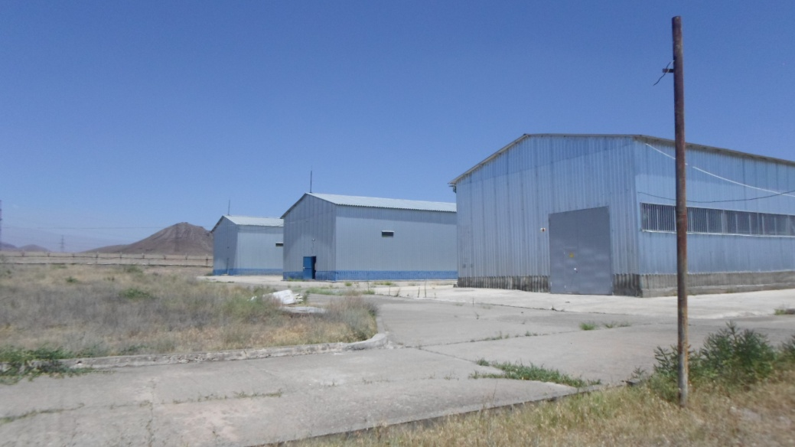
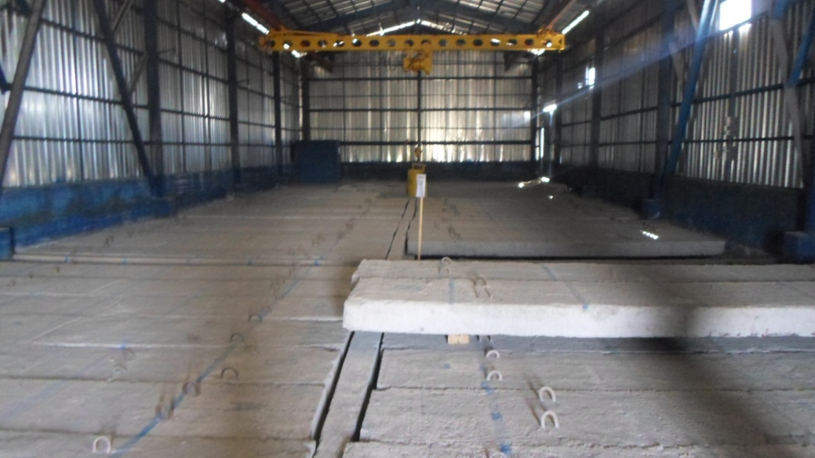
Institutional RAW management facility _ RADON type
  All RAW from the Sovetashen site were retrieved and transported to the “new disposal facility” and the vaults №1&2 in of the disposal facility 1st building were immediately filled with the retrieved RAW.
The RAWs were grouted into standard drums (200l) bringing them to a suitable safety condition for their disposal, placed into reinforced concrete vault and once the 1st layer was full the empty space between drums was filled with grouting. This process was repeated for the 2nd layer.
  Currently all expenses connected with institutional RAW management are covered by the State.
  The main radionuclides presented: C-14, Ni-63, Pu-238, Pu-239, Ra-226, Th-232, U-236, U-238, Ba-133, Cd-109, Cl-36, Cs-137, Co-60, Eu-152, Fe-55, H-3, Na-22, Pm-147, Sr-90, Tc-99, Am-241, Ir-192, Pu-Be (neutron source).

Slide 12
Safety and Sustainability in RAW Management
  The RA Government considers the use of nuclear energy and technology as one of the pivotal elements towards having sustainable economic development in the future, which is highlighted also in the “Armenian development strategy” document.
  Thus, for having a safe, secure and flexible RAW management infrastructure there should be a comprehensive and complete Legal Framework, to facilitate the sustainable planning of the management of all types of RAW in integrated manner.
  International cooperation and experience exchange is very important !!!
  Armenia is the member of the IAEA since 1993.

Slide 13
Legal Framework
Laws*
Guides
Government Decrees
Ministerial Acts
Constitution
* The Intentional Treaties of the RA are the integral part of the legislative framework and also belong to the first level.
As stipulated by the “Law on Safe Utilization of Atomic Energy for Peaceful Purposes” (Atomic Law):
If the International Treaties ratified by the National Assembly of the RA stipulate provisions other than the ones stipulated in the Law, the provisions of the ratified International Treaties are applied.
The Government and State Authorities of the RA within the normative legal regulation process implemented in atomic energy utilization field shall ensure the compliance of legal acts related to atomic energy utilization field with requirements of International Treaties of the RA and Safety Standards of the IAEA.

Slide 14
Main Regulations _ Laws
Law on Safe Utilization of Atomic Energy for Peaceful Purposes (Atomic Law)
  (01.02.1999, HO-285) _ in the process of amendment
Basic legal document for settling relations in the field of atomic energy utilization;
Establishes provisions on accounting for and control of nuclear materials, radioactive waste and ionizing radiation sources.
Law of the RA on Licensing
  (30.05.2001, NO-193)
Establishes types of practices subject to licensing in the atomic energy utilization field and settles relations related to licensing.
Specifies also provisions for extension of license validity period.
Each specific type of practice has a separate license and respective licensing procedures, which are adopted by the RA Government.

Slide 15
Main Regulations _ Government Decrees
Radioactive waste management procedures
  (GD №631-N, 2009) _ in amendment process
  Specifies requirements to RAW management;
  Designates the MTAI as the state competent authority empowered with RAW related issues.
Radiation Safety Rules (RSR)
  (GD №1489-N, 2006) _ in amendment process
  Defines safety rules for protection from sources of ionizing radiation;
  Sets classification of RAW and requirements on the radiation safety of RAW.
  Radiation Safety Norms (RSN)
  (GD №1219-N, 2006) _ in amendment process
  Applies to planned, emergency and existing exposure situations;
  Specifies the practices/sources within practices subject to exemption from the regulatory control;
  Sets clearance/conditional clearance levels from regulatory control for moderate and bulk amount of materials.

Slide 16

International Cooperation _ EU
Armenia signed the Comprehensive and Enhanced Partnership Agreement (CEPA) with EU (entered into force in 2021). ANRA/NRSC is in process of approximation of the legal regulatory infrastructure in conformity with the following 5 EU Directives:
COUNCIL DIRECTIVE 2006/117/EURATOM on the supervision and control of shipments of RAW&SF;
COUNCIL DIRECTIVE 2011/70/EURATOM establishing a Community framework for the responsible and safe management of SF&RAW;
COUNCIL DIRECTIVE 2009/71/EURATOM establishing a Community framework for the nuclear safety of nuclear installations;
COUNCIL DIRECTIVE 2013/51/EURATOM of 22 October 2013 laying down requirements for the protection of the health of the general public with regard to radioactive substances in water intended for human consumption;
COUNCIL DIRECTIVE 2013/59/EURATOM laying down BSS for protection against the dangers arising from exposure to ionizing radiation.
ACTIVITY | GAOL | FUTURE ACTIONS
Development of a New “Atomic Law” | To bring in line with the req-s of EU relevant Directives, IAEA Safety Standards. | International expertise is envisaged.
Development of a new “Armenian BSS” | To replace the Radiation Safety Norms and Radiation Safety Rules. To bring in line with the req-s of EU relevant Directives, IAEA Safety Standards.
Upgrade of “RAW management procedures” | To bring in line with the req-s of EU relevant Directives, IAEA Safety Standards; Includes req-s on decommissioning, WAC development, req-s for performing RAW accounting and control, etc

Slide 17
National Policy and Strategy for Safe Management of RAW in Armenia _ Action Plan
  National Strategy on SF&RAW management was approved in 2017. It follows “two level strategy” formulation approach - i.e. sets key issues in general terms and its detailed implementation is delegated to the SF&RAW managing companies.
Main Strategic Routes
  Control of RAW generation;
  Introduction of “polluter pays” principle;
  Personnel recruitment/training;
  Implementation of activities for disposal of VLLW, LLW and ILW-SL RAW in a near surface formations;
  Implementation of R&D on feasibility of RAW disposal in geological formations;
  Establishment of RAW accounting & control system.
Implementation Action Plan Steps
  Establishment of centralized WMO on the basis of RADON type storage facility, for RAW long-term management issues;
  Establishment of a National Electronic Database System for RAW;
  Opening of a special “off-budget” account for RAW management;
  Personnel recruitment/training activities;
  Upgrading the Legal Framework.

Slide 18
Overall Strategic Routes
Type of Liability | Long-Term Management Policy | Funding of Liabilities | Current Practice / Facilities | Planned Facilities
Nuclear Fuel Cycle Wastes | Conceptual endpoints based on the Strategy: VLLW, LLW, SL ILW - disposal in near surface repository; LL ILW and HLW - disposal in geological repository. | Operational RAW – ANPP Decom. RAW – Decom. Fund | Liquid RAW - treatment by DEF and storage Solid RAW - pre-treatment and storage | L&ILW processing facility; VLLW storage facility Storage facility for processed L&ILW
Application Wastes |  | State Budget | Storage at near surface institutional RAW management facility. | Final decision – Centralized RAW management organization (WMO)
Decommissioning | ANPP – based on approved Decommissioning Strategy. | Decommissioning Fund | No nuclear facility is in decom. ANPP Decom. Strategy, Initial DP and the preliminary cost estimate are developed. | Final decision – Centralized WMO
DSRS | Final decision – Centralized WMO | DSRS from NPP - ANPP DSRS from other applications - State Budget | DSS from NPP stored at NPP site DSS from other applications stored at RADON facility | To be specified by the Centralized WMO

Slide 19
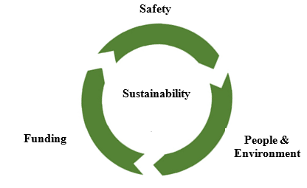
Pillars Towards Ensuring Sustainability
In the context of having balance approach in having sustainable and flexible infrastructure in RAW management, the following 3 pillars has been selected:
All these pillars should be integrated in all aspects of RAW management planning and implementation activities, and be adequately strong and sustainable to handle it.

Slide 20
Balance Approach in Applying the Sustainability in upgrading the Legal Framework
In upgrading the legal acts, the following approach was used:
  Assessing Armenia's current status and needs;
  Identifying the gaps, taking into account also IRRS findings;
  Analyzing the req-s of IAEA Safety Standards, EU Directives, WENRA safety ref. levels, International experience and best practices, ect.;
  Developing comparative matrixes and analyzing compatibility with RA current situation and country needs/specifics, without compromising the safety;
  The output - introducing 'new requirement' at specific levels of RA legal hierarchy.
Absolute Priority = Safety of People & the Environment
  Safe and Complete Legal Framework

Slide 21
Balance Approach in Applying the Sustainability in upgrading the Legal Framework
  Introduction of “polluter pays” principle;
  Responsibility of Government to finance the management of legacy/historical institutional RAW;
  Opening of special account for accumulation of funds for RAW long-term management;
  Relevant requirements on RAW management funding, requirements on reusing/recycling of RAW, on minimization of RAW generation are added in the new drafted “Atomic law” and several legal acts, including the National Strategy on SF&RAW management.
  Minimization and justification of RAW generation.
  Avoiding long-term environmental risks and imposing a burden on future generations.

Slide 22
CHALLENGES in achieving the balance…
In development/upgrade of Legal Framework main challenges are:
To find a balance between imposing “too restrictive” or “ too general” type requirements;
To find a balance in setting requirements, which satisfy today’s “needs”, but which will not close the future options;
To consider already operating facilities during imposing “up to date” requirements;
Etc.

Slide 23
Overall CHALLENGES
  Harmonization/upgrade of relevant Legal Framework in compliance with req-s of IAEA and EU Directives under CEPA Agreement;
  Implementation of “new” requirements – both for the regulatory body and for the operators;
  Lack of human resources;
  Implementation of provisions stipulated in “Strategy on safe management of RAW&SF in RA”. Particularly:
Establishment of centralized WMO on the basis of “RADON” type facility;
Introduction of the “polluter pays” principle;
Implementation of measures for personnel recruitment/training.

Slide 24
Thank you for attention!!!

