Slide 2

SAFE ENERGY MANAGEMENT
FOR
SUSTAINABLE NUCLEAR ENERGY
Dr. Sibel GEZER
Middle East Technical University, Türkiye

Slide 3

World Overview
Countries all over the world are increasingly recognising the value of using nuclear techniques to combat various challenges faced by climate change.
Discovering first-hand how beneficial the technologies promoted.
Nuclear power is cost competitive with other forms of electricity generation, except where there is direct access to low-cost fossil fuels.
Fuel costs for nuclear plants are a minor proportion of total generating costs, though capital costs are greater than those for coal-fired plants and much greater than those for gas-fired plants.
What do they tell us?

Slide 4


Slide 5
Nuclear Energy Rising
Climate change is one of the most important issues facing the world today.
Nuclear power can make an important contribution to reducing greenhouse gas emissions while delivering energy in the increasingly large quantities needed for global economic development.
Nuclear power plants produce virtually no greenhouse gas emissions or air pollutants during their operation and only very low emissions over their full life cycle.
  The advantages of nuclear power in terms of climate change are an important reason why many countries intend to introduce nuclear power or to expand existing programmes in the coming decades.
  All countries have the right to use nuclear technology for peaceful purposes, as well as the responsibility to do so safely and securely.

Slide 6
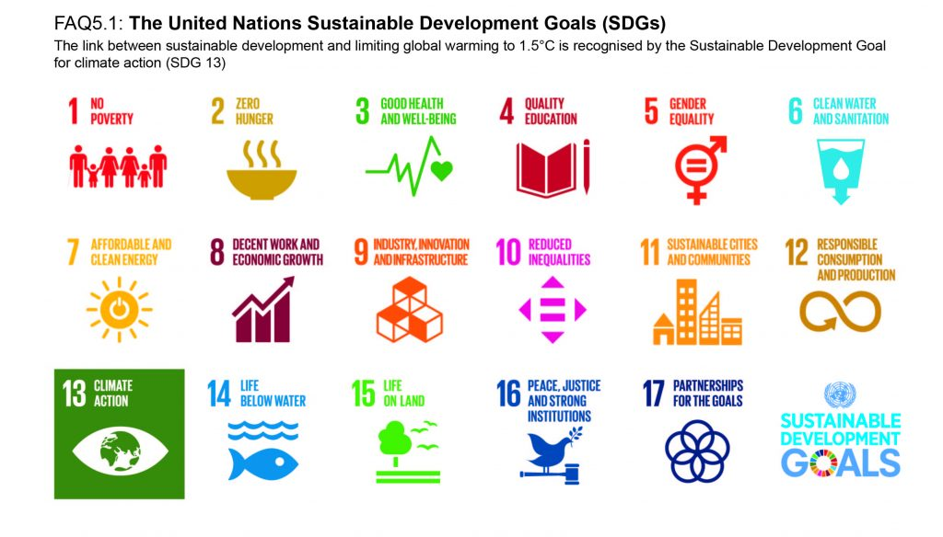
Sustainable Development Goals (SDGs)

Slide 7
Need for a nuclear energy policy and strategy
Aftermath of the Fukushima Daiichi accident of March 2011,
  international efforts to strengthen nuclear safety, regulation, research and radiological protection. The safety of nuclear power plants around the world was assessed in national and international peer reviews, and operators have since been implementing safety upgrades wherever it was deemed necessary to meet new safety requirements.
The potential for using nuclear power to address the challenges of energy demand, energy security and climate change issues is considerable.
on decision processes and assessments in IAEA member countries and beyond as well as on, among other things, the success of nuclear operators, nuclear regulators and organizations such as the NEA and others in their efforts to ensure high levels of nuclear safety, effective radioactive waste disposal and the competitiveness of investments in nuclear energy compared to other forms of electricity generation.

Slide 8
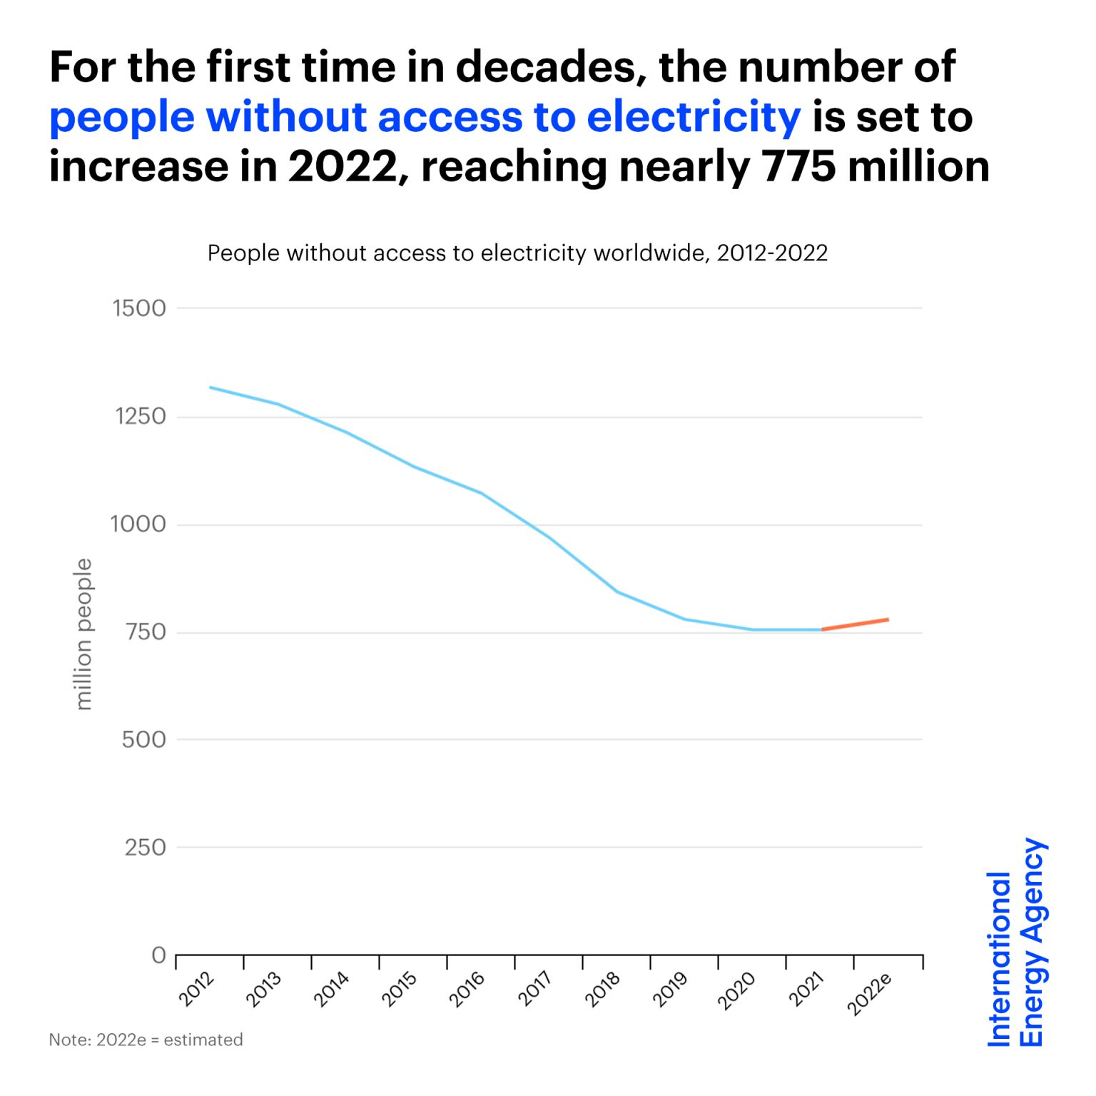
Nuclear community address
No electricity
the impacts of climate change & combat global warming

Slide 9
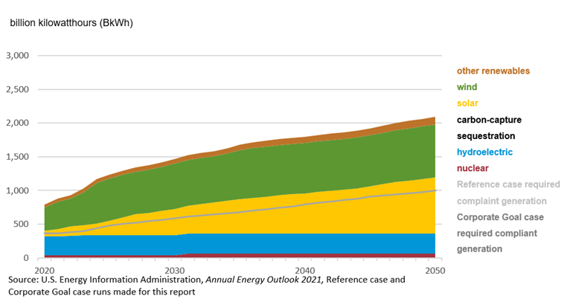
Global demand for energy increasing
Total qualifying carbon-free required for state renewable portfolio standards and projected total generation 2020-2050

Slide 10
NPP Programs
Several countries have already embarked on new nuclear energy programs, while others are studying the possibility or floating ideas (wait and see approaches,...)
Questions ??? however, as to whether nuclear power is able to shake off public concerns about safety, security, waste management and proliferation concerns to permit a significant revival.
Much will depend on the attractiveness and price of the energy alternatives and the fight against climate change, but also on the nuclear industry demonstrating that it has answers to the critical safety, security and waste management questions.
Vital to have an “effective global governance” of the nuclear power industry to restore the public’s trust in the sector.

Slide 11
Climate change – an accelerating global problem
The United Nations has identified climate change as "the defining issue of our time", with the central aim of the 2015 Paris Agreement is to keep the rise in global temperatures to well below 2 °C compared to pre-industrial levels, to limit the rise to 1.5 °C.
Carbon dioxide emissions related to energy continue to rise – reaching 33.1 billion tonnes in 2018, a record high, and have increased by more than 40% since 2000.
Concerted international efforts over the past 20 years have increased the amount of electricity generated by wind, solar and other renewable sources, but have failed to displace fossil fuels from the mix.
Global Warming of 1.5 °C, Intergovernmental Panel on Climate Change (IPCC) warned that we are likely to breach the 1.5 °C threshold by as early as 2030.

Slide 12
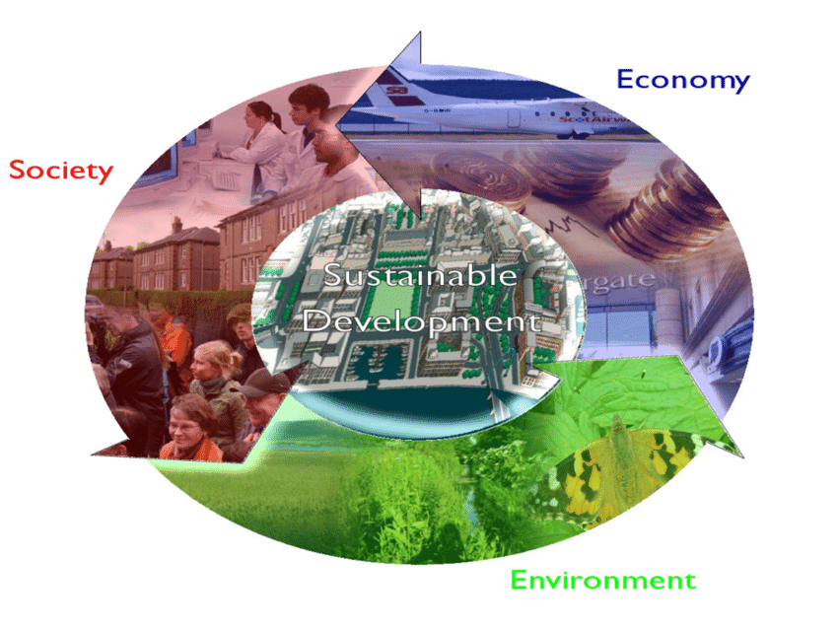
Breaking through to a better future for all
UN General Assembly adopted the 2030 Agenda for Sustainable Development, a dedicated and stand-alone goal on energy, SDG 7, calling to "ensure access to affordable, reliable, sustainable and modern energy for all".
Energy lies at the heart of both the 2030 Agenda for Sustainable Development and the Paris Agreement on Climate Change. Achieving SDG7 will open a new world of opportunities for millions of people through new economic opportunities and jobs, empowered women, children and youth, better education and health, more sustainable, equitable and inclusive communities, and greater protections from, and resilience to, climate change.
The Global Roadmap for Accelerated SDG 7 Action Global Roadmap for Accelerated SDG 7 Action resulting from the High-level Dialogue on Energy 2021 provides a guide for collective action on energy across sectors.

Slide 13
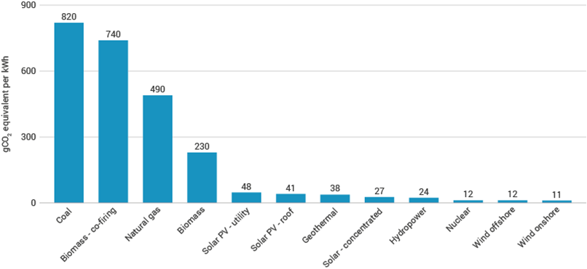
Nuclear is low-carbon
Nuclear power plants produce no greenhouse gas emissions during operation, and over the course of its life-cycle, nuclear produces about the same amount of carbon dioxide-equivalent emissions per unit of electricity as wind, and 1/3 of the emissions per unit of electricity when compared with solar.

Slide 14
Overall
To achieve the deep decarbonisation required to keep the average rise in global temperatures to below 1.5°C, combating climate change would be much harder, without an increased role for nuclear.
  Nuclear power is reliable and can be deployed on a large scale,
  Nuclear directly replace fossil fuel plant, avoiding the combustion of fossil fuels for electricity generation.
  The use of nuclear energy today avoids emissions roughly equivalent to removing one-third of all cars from the world’s roads.
Modern society is becoming more and more dependent on electricity, with demand steadily increasing as transport, domestic heating and industrial processes are increasingly electrified. Whilst electricity is clean at the point of use, its generation currently produces over 40% of all energy-related carbon emissions. Decarbonising the electricity supply, whilst providing affordable and reliable electricity to a growing global population, must be central to any climate change strategy.
Nuclear energy has shown that it has the potential to be the catalyst for delivering sustainable energy transitions, long before climate change was on the agenda.

Slide 15

Save our planet…
Thanks for your kind attention
sgezer@metu.edu.tr

