Slide 2
“14 YEARS IMPLEMENTING CLEARANCE IN ARGENTINA”
M.Cecilia Bossio
Nuclear Regulatory Authority
mbossio@arn.gob.ar
Argentina

Slide 3
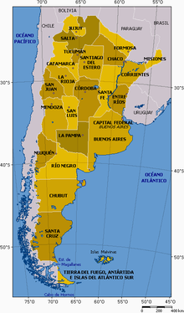
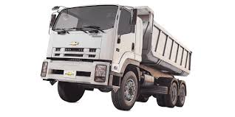
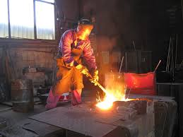
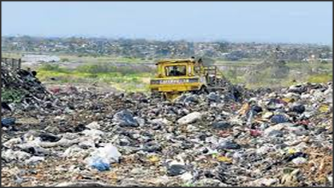
BACKGROUND
Application of clearance concept is important to manage large volumes of materials with traces of radioactivity, ensuring the protection of public and the environment and reducing unnecessary excessive costs, both with impact on sustainability.
In 2006, the Nuclear Regulatory Authority (NRA) evaluated two worldwide used concepts: Clearance and its associated Generic Clearance Levels” (GCL).
Dust concentration in air
Density of materials Exposure times
Dilution factors
Working hours
Load truck
Capacity Landfill sites
Are Generic Clearance Levels applicable in Argentina?

Slide 4
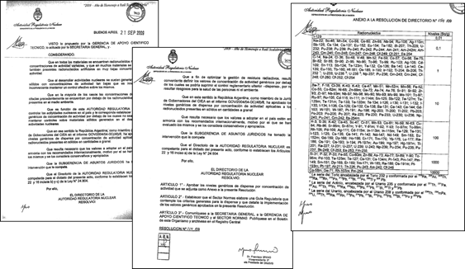
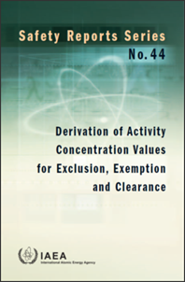
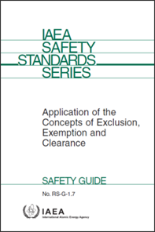
ADOPTION OF GENERIC CLEARANCE LEVELS
A positive conclusion. Generic Clearance Levels, could be applied in Argentina without the need of developing its own clearance levels.
As a result, in the year 2009, the NRA Director´s board approved by the Resolution Board N° 154/09 the adoption of the Generic Clearance Levels recommended by the IAEA into its standards.
APPROVED BY THE COUNTRY

Slide 5
TRAINING COURSES TO OPERATORS, USERS, INSPECTORS
Several training courses were developed for personnel of the “National Radioactive Waste Management Program” of CNEA, NPP´s operators, research centers, research reactors, nuclear medicine centers, and also inspectors form the NRA.

Slide 6
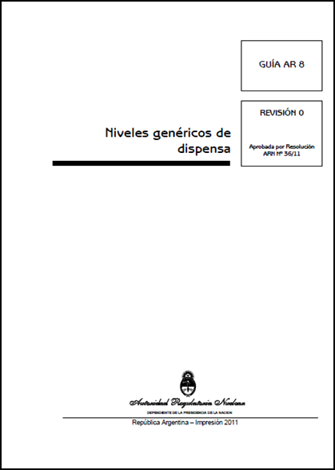
DEVELOPMENT OF A CLEARANCE GUIDE - AR 08. Revision 0 -
The GUIDE AR8-Rev 0, consisted of 8 sections and an Annex, namely:
Preface
Explanation of terms
References
Scope
Clearance of Radionuclides of natural origin
Clearance of Radionuclides of artificial origin
Mixture of radionuclides of natural and artificial origin
Determination of the activity concentration in the material.
Annex: Table with the clearance values ​​in terms of activity concentration Bq/g for 300 Radionuclides of common use.
Conditional clearance not addressed
Only approved based on a case by case study.
Notes:
Available in ARN´s website

Slide 7
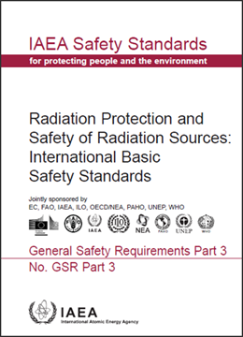
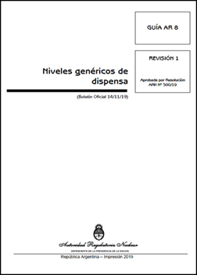
UPDATE OF GUIDE “GENERCIC CLEARANCE LEVELS” ARGUIDE 08-REVISION 1
In 2016 the NRA developed the instructive: “Content of Clearance Requests”
In 2019 the Guide AR-08 was updated.
In line with the requirements of GSR part 3.
Includes surface contamination values in terms of Bq/cm^{2.}
Includes conditional Clearance

Slide 8
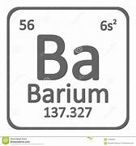
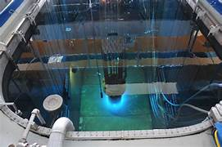
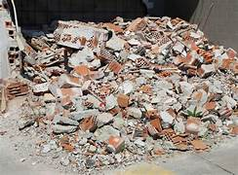
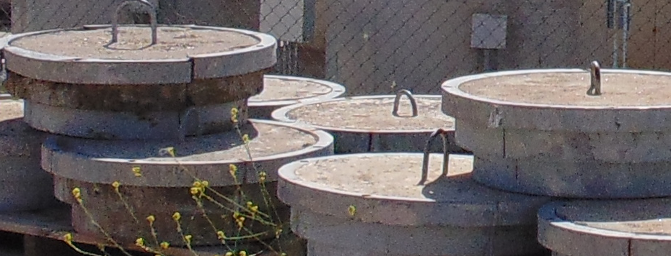
EXAMPLES OF CLEARANCE REQUEST ANALYZED BY THE NRA
Clearance of radioactive Sources such as, Ba-131, Ba-133, Cs-137, Na-22
Conditional clearance of liquids from a cementation plant
Conditional clearance of water samples from a research reactor pool
Clearance of compactable waste from a Radioisotope Production Plant
Clearance of liners caps which contained filters form NPP´s
Clearance of debris with natural uranium
Clearance of compactable waste contaminated with C-14
Clearance of contaminated soil with Co-60

Slide 9
KEY ASPECTS CONSIDERED FOR THEIR EVALUATION
Material was subject to unconditional or conditional clearance
GCL/ Dose Criteria
Radionuclides present in the material
Activity concentration of the material
Type of material, volume, mass
The amount and representativeness of the samples taken from the material
For disused radioactive sealed sources, total activity
The implementation of clearance procedures,
The use of adequate equipment and calibrated equipment for performing the measurements

Slide 10
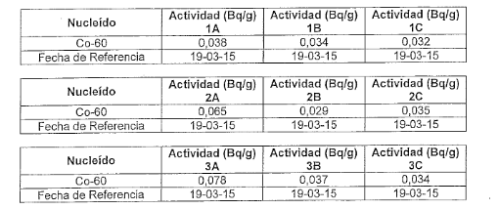
CASE STUDY: Clearance of contaminated soil
Co-60 clearance level : 0,1 Bg/g
1400dm3 of soil contaminated with Co-60
Generated during the modification of a sector of a sealed radioactive source production plant.
The soil was divided into 3 mounds
3 samples of 0,5dm3 were taken from each mound
Analyzed with a multichannel detector (sodium iodine)
Then a gamma spectrometry with GeHP detector for sample of each mound was performed in the Metrology Lab from CNEA
Activity Concentration Measurements

Slide 11
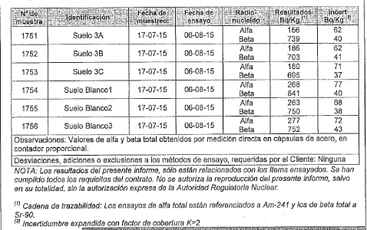
CASE STUDY: Clearance of contaminated soil
Metrology Lab Results - Gamma Activity-
Alpha and Beta measurements in samples from each mound and in witness samples
Comparison between gamma spectrometer and (iodine sodium) multichannel detector
Material cleared. Destination: soil was used within activities of ground leveling of a new facility in the premises of the nuclear atomic center

Slide 12
CONCLUSIONS
Since 2009, the NRA can proudly conclude that an important progress has been done concerning clearance of radioactive material.
The Regulatory Guide regarding clearance is continuously updated to keep it in line with IAEA Safety Standards, worldwide experience and knowledge. New update according to GSG-18.
It is expected that more clearance requests will be presented to the NRA, with the objective of minimizing the radioactive wastes generated in Argentina.
The continuous implementation of clearance in Argentina will allow for a better allocation of human and economic resources, in accordance to radiation protection measures to the public and the environment.
The application of clearance fosters sustainability, given that materials can be reused, recycled or manage as conventional waste.

Slide 13
Thank You For Your Attention
M.Cecilia Bossio
Nuclear Regulatory Authority
mbossio@arn.gob.ar
Argentina

