Slide 2
Nuclear Waste Services​ ​ Developing a Sustainability Strategy that Ensures Safety and Enables Sustainability
Simon Hunter, Environmental Management – Nuclear Waste Services
Daniel Bunn, Strategy & Sustainability – Nuclear Waste Services​
​
Paper #243 ​
November 2023​

Slide 3
Our Vision, Mission, Objectives

Slide 4
Our Sustainability Goal
Develop a sustainability strategy that reflects the views of our workforce, community and regulators

Slide 5
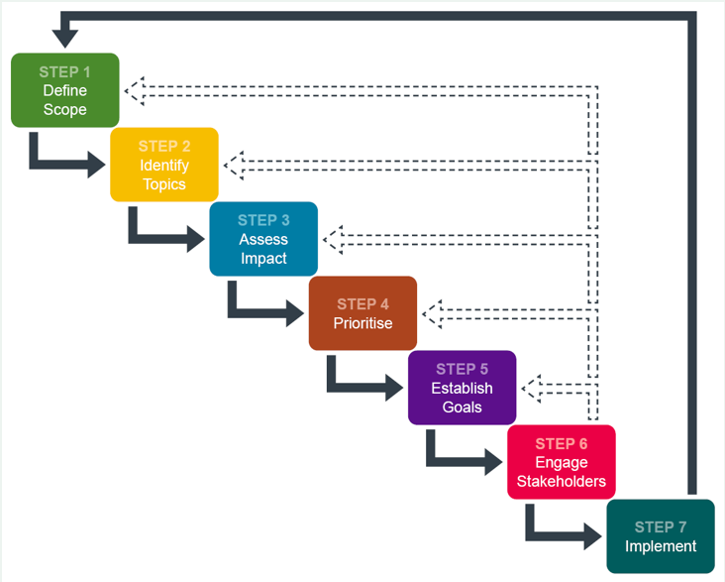
Materiality Assessment Tool
A tool to help organisations identify the key sustainability aspects for their situation and consider the expectations of all key stakeholders.

Slide 6
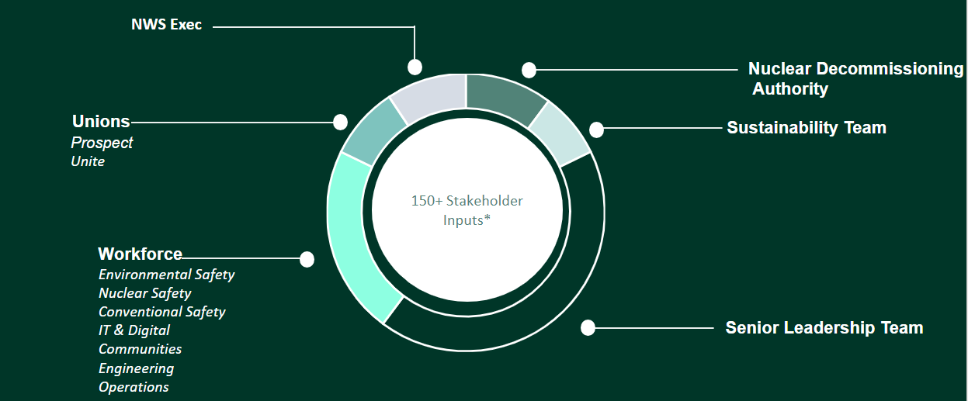
Our Stakeholders

Slide 7
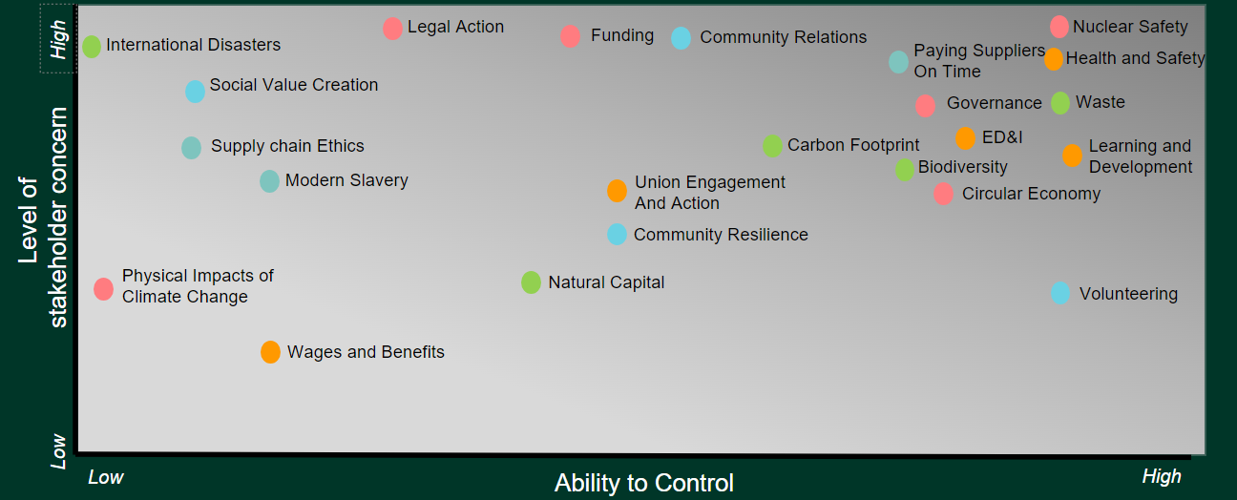
Views of our Stakeholders

Slide 8
Key Themes
Safety & Security will always be centrally important to our mission (and this is part of our sustainability approach)
Culture and leadership – making NWS a great place to work through leadership, career pathways and a clear sense of purpose
Alignment with the NDA Legacies - golden thread between the UN SDGs, Government policy, NDA strategy and NWS strategy
Commitment to Net Zero and carbon reduction targets
Making the Economic case for sustainability
Our Social Impact – Being good neighbours, personal responsibility and communicating the impact of our social funding
Waste as an asset – Circular economy principles and innovation
Transparency and governance – drive performance with clear targets and metrics for our sustainability commitments
Trust – our reputation as a responsible operator of the LLWR is fundamental to NWS being trusted to deliver a GDF and be the one stop shop for UK radwaste management
Societal responsibility - we have a responsibility to deliver the NDA’s environmental mission to the benefit of the public and future generations.

Slide 9
Mapping to the UN SDGs
Greatest Impact
Direct Impact
Enabling Impact
All –
Encompassing
Each of the SDGs have a multitude of targets and metrics associated with them. Our Sustainability Team conducted a comprehensive mapping exercise to identify the most relevant SDGs.
We analysed which of the targets NWS is contributing to, and categorised the SDGs based on our organisation's highest contribution.

Slide 10
Sustainability at the heart of waste & decommissioning
Thank you

