Slide 1
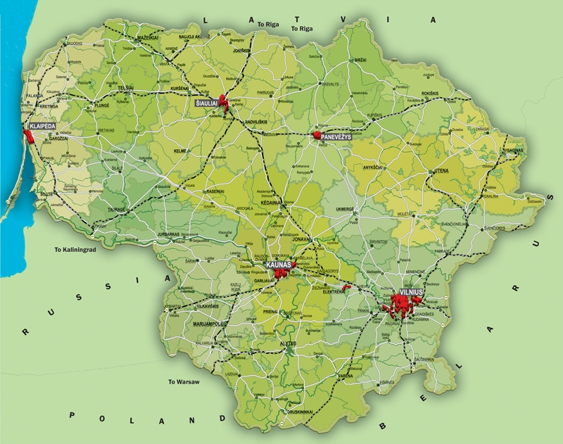
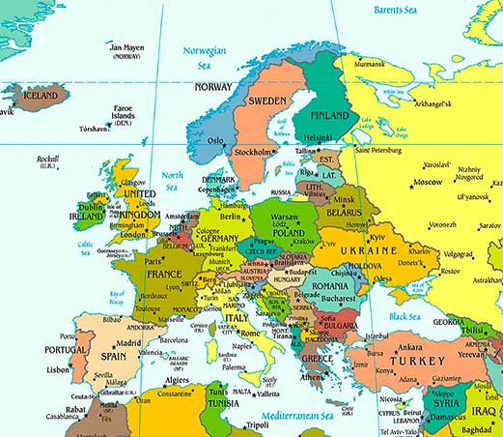
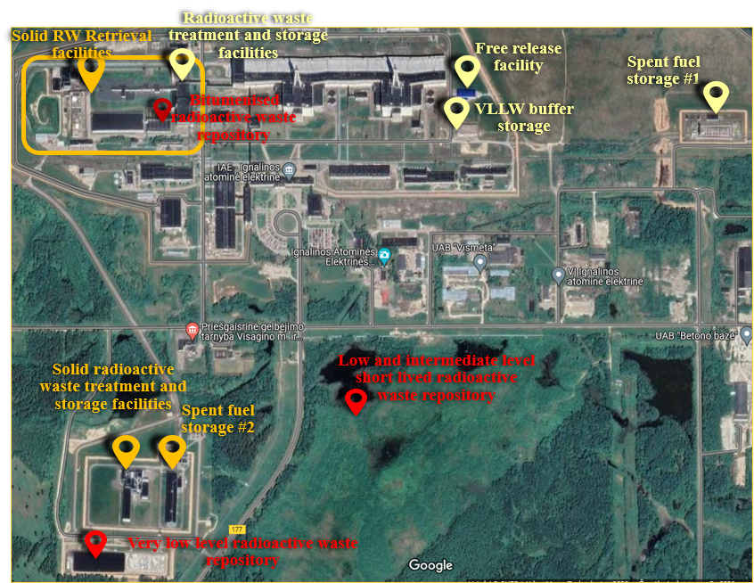
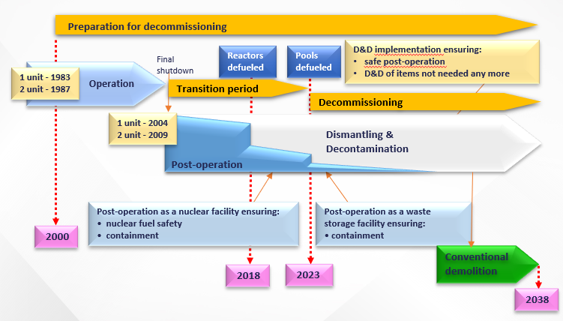
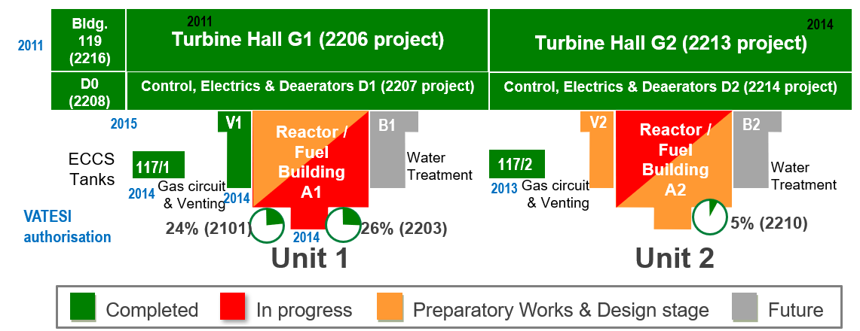
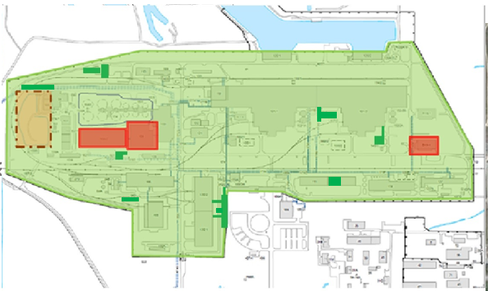
Lithuanian legislative framework on decommissioning of nuclear facilities Saulius Stravinskas State Nuclear Power Safety Inspectorate (VATESI), A. Goštauto str. 12, LT-01108 Vilnius, Lithuania saulius.stravinskas@vatesi.lt
Nuclear facilities
Ignalina INPP has two units with RBMK-1500 reactors. Unit 1 was shut down in 2004 and Unit 2 – in 2009. Pursuant to the provisions of the Law on Nuclear Safety the Ignalina NPP Units operation licences are valid as long as nuclear fuel is there. All spent nuclear fuel is removed from the Unit 1 and Unit 2 storage pools to a dry storage facilities in 2022.
Maišiagala radioactive waste storage facility which was constructed in 1963. It is located in Bartkuškis forest, 40 km from Vilnius. The waste at Maišiagala RWSF was collected until 1989. After that, it was decided to decommission this storage facility, because it did not meet the actual environmental protection requirements. Maišiagala RWSF decommissioning proces started in 2022.
Existing nuclear power facilities at Ignalina NPP site
Maišiagala radioactive waste storage facility
The State Enterprise Ignalina NPP (thereinafter – SE Ignalina NPP) during transition period from operation to decommissioning undertake activities to prepare for decommissioning as well as building necessary infrastructure for radioactive waste management.
Implementation of a number of dismantling and decontamination (D&D) projects related to equipment no more needed started at this transition period as well. State Nuclear Power Safety Inspectorate (thereafter – VATESI) developed legislative framework allowing to proceed dismantling activities within the frame of operational licence. Hence, authorisation of decommissioning activities is implemented by the granting of the licence for decommissioning as well as granting permissions for individual dismantling and decontamination projects.
In accordance with the Law on Nuclear Safety of the Republic of Lithuania, VATESI issues the licence for carrying out decommissioning of a nuclear facilities as well as permits for carrying out decommissioning projects, that include dismantling of any contaminated part of an NPP. The Law Nuclear Safety provides VATESI the leading role in the overall process.
Nuclear Safety Requirements BSR-1.5.1-2015 “Decommissioning of Nuclear Facilities„ sets the requirements for performing safety assessment of the decommissioning and submitting safety analysis report; carrying out activities during the transitional phase (during the permanent shutdown of the facility the licensee shall implement the measures helping to decommission the facility, to prepare for carrying out decommissioning of the facility and (or) to reduce the duration of decommissioning of the facility (for example, to unload and take away all nuclear fuel from the energy block of the nuclear power plant, to isolate, decontaminate and dismantle all unnecessary systems, to dispose of radioactive waste produced during operation); performing radiological (including final surveys) in support of decommissioning; submitting final report for revocation of decommissioning license (this report shall include information in order to confirm that the decommissioning of the nuclear facility has been carried out in accordance with the conditions set out in the final decommissioning plan and the safety analysis report of the nuclear facility and shall demonstrate that the end state of the facility as specified in the approved final decommissioning plan has been reached).
Approval of final decommissioning plan (FDP) of Ignalina NPP
Approval of 2 leading decommissioning projects and safety analysis reports for INPP Unit 1 and 2 during defueling phase: U1DP0 and U2DP0
Separate authorisation (approval, permit) is required for each dismantling and decontamination project of Ignalina NPP: B9-0, B9-1, B9-2, B9-3, B9-7...
Approval of one safety analysis report for INPP Unit 1 and 2 after defueling phase:
INPP SAR
Safety evaluation is a key issue for authorisation of decommissioning activities. Aspects of a safety assessment for granting of decommissioning licence as well as authorisation of dismantling and decontamination projects (e.g. overview of content of safety analysis reports)
Conducting final radiological surveys
Structures for which the final radiological surveys have been completed, or based on historical assessment, they are not affected
VATESI established procedures for authorization of release of buildings and site from regulatory control, including site and buildings investigation process and required VATESI agreements on radiological characterization programmes and reports.
Nuclear Safety Requirements BSR-1.5.1-2015 “Decommissioning of Nuclear Facilities„ is saying that during the final shutdown and decommissioning of nuclear facility, non-operational and unnecessary structures may be demolished at the NF site, where preparations are being made for NF decommissioning and/or NF decommissioning is being carried out, if all the following conditions are met:
1. activities with nuclear fuel cycle materials are not planned or carried out in these facilities;
2. these structures and the facilities located in these structures are not designed to ensure NF nuclear, radiation and physical safety;
3. these structures do not contain equipment, systems and communications that are still in use and necessary for the decommissioning of the NF;
4. these structures are not planned to be used both for the further decommissioning of the NF, including ensuring physical safety, fire safety and emergency preparedness, and after the completion of the NF decommissioning;
5. in these structures, the concentration of radionuclide activity does not exceed the unconditional out-of-control radioactivity levels and surface activity values, when only surface activity is tested.
According to Nuclear safety rules BST-1.5.1-2016 „The evaluation of compliance with free release criteria of buildings and site of nuclear facilities“ prior to start demmolish buildings documents has to be submited to VATESI for agreement:
1. Methodologies for the radiological characterisation of RW packages (including determination of scaling factors).
2. Framework programme of radiological surveys. The major stages of the framework radiological survey programme are as follows:
2.1 a historical assessment;
2.2 scoping radiological surveys;
2.3 characterization radiological surveys;
2.4 final status radiological surveys.
3. Historical assessment reports.
4. Final status radiological surveys programes and reports.

