Slide 1

严·慎·细·实
EVT2204904-Technical Session 2.3:
Accident Analysis and Experimental Programs for LFR
Development of drift-flux correlations for vertical forward bubble column-type gas-liquid lead-bismuth two-phase flow
WANG Di(王迪)
2023.03.13

Slide 2
Content
01.Introduction
02.Evaluation of existing correlations
03.Theoretical analysis of drift-flux parameter
04.Development of new correlation
05.Conclusion
Notes:
Now my presentation is divided into following 5 parts

Slide 3
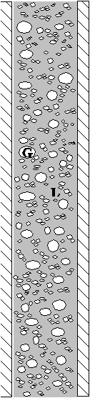
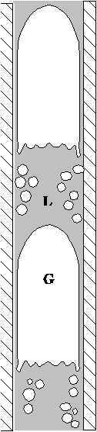
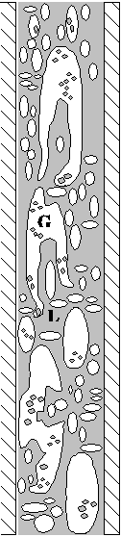
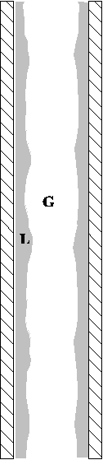
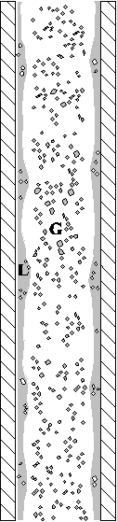
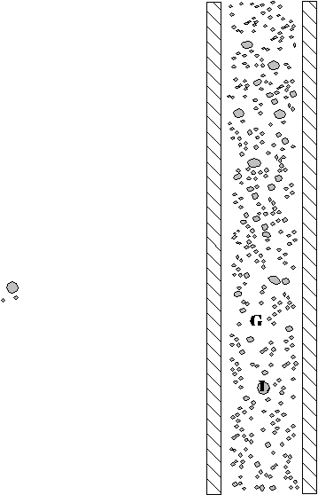
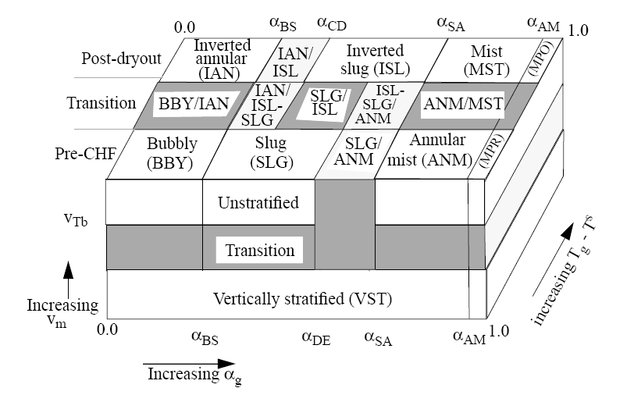
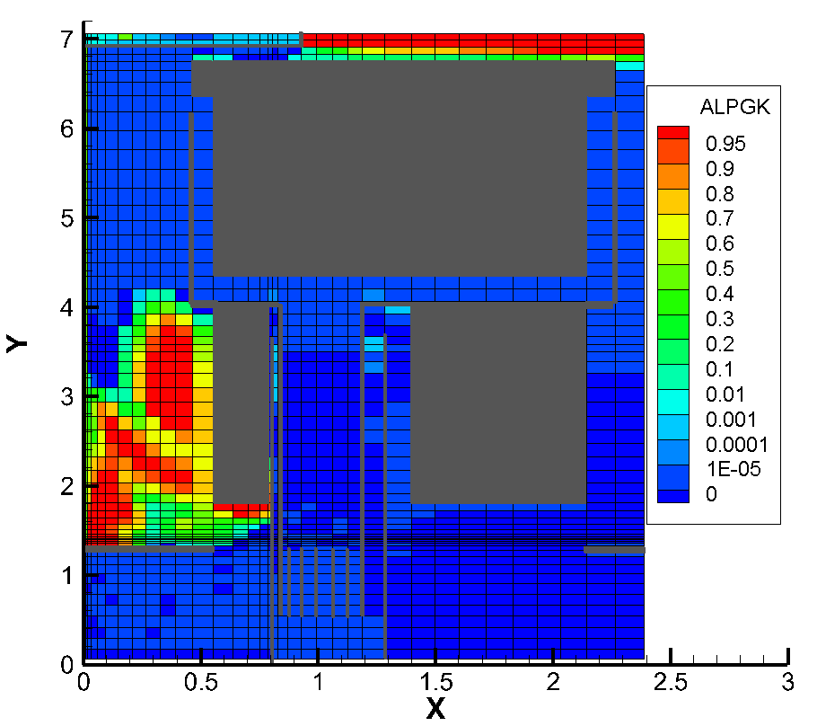
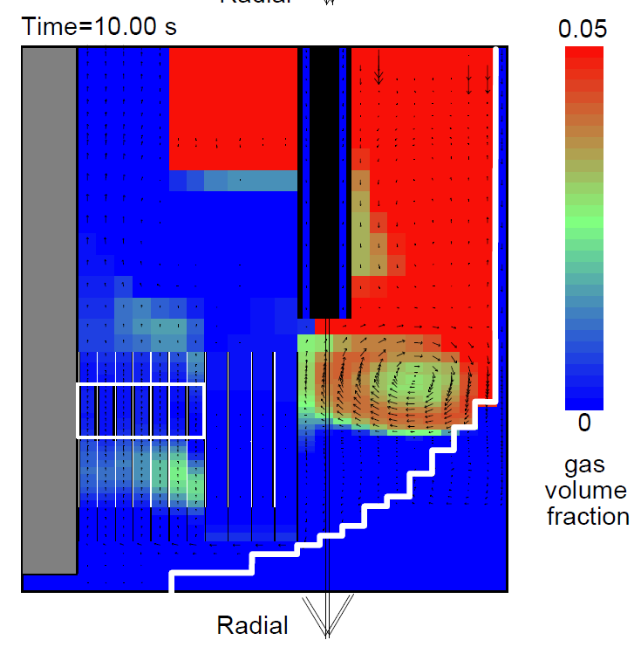
01.Introduction
Gas-liquid two-phase flow is typical phenomenon in accident scenario in NPP
CCFL in LOCA
Flow regime in vertical tube
Momentum equation
Flow regime evaluation
Bubble column-type gas-liquid two-phase flow
Extreme condition：Velocity of liquid phase is near zero and gas bubble is driven by buoyancy
Typical Bubble Column Flow in
LFR
（1）SGTR anlysis(The main pump is shutdown)
Steam bubble may transport into the core
Insert additional reactivity and threanten the safety of reactor
（2）FP transportation in LBE pool during DEC
Core
SG
break
void fraction prediction
reactivity calculation
evaluation of accident
SGTR analysis of EFIT
Several bubbles transport into the core channel，α=0.01
Bubble transportation path
Notes:
In long-term stage of steam generator tube rupture (SGTR) of lead-bismuth eutectic (LBE) alloy cooled fast reactor, steam released from the break of tube into reactor vessel may transport upwardly through the active section from the bottom inlet of reactor core and introduce additional activity due to moderation effect of water so that reactor safety is threatened. During severe accident scenario in FBRs, the gas generated from the melting and boiling of fuel, cladding, liquid metal coolant, may also form multi-phase flow in static liquid metal pool and relocate the fuel to cause the risk of re-criticality in molten core. Meanwhile, gas-phase fission product may transport upwardly through the liquid metal into cover gas and cause the risk of radioactivity release. The basic characteristic of all above phenomena during accident is bubble column-type gas-liquid two-phase flow. Therefore, to determine the core activity introduced by gas bubble and evaluate accident consequence, void fraction in the vertical flow channel of reactor core should be obtained firstly. Reliable prediction of void fraction is necessary.

Slide 4
01.Introduction
Prediction of void fraction：drift-flux model
Predict the void fraction
In code: calculate the drag force
Distribution parameterC₀
Correlations based on gas-H2O two-phase flow
Gas drift velocityv_{gj}
Problem of application：
Many correlations are based on the assumption of 1.2, which is applied in the gas-two phase flow with large liquid velocity.
Property of LBE is different with Water.
The distribution parameter depends on several effect factor, not only density ratio
The limitation of existing study on LBE two-phase flow
LBE is not transparent so the visual observation is difficult
Correlations applied to gas-LBE two-phase flow is lack
Based on theoretical analysis+experiment data, develop new model
Notes:
WE can use drift-flux model to predict the void fraction,

Slide 5
02.Evaluation of existing correlations
Developer
Correlations
Characteristics
Bubbly flow
Slug flow
Gas-H2O
for small/medium tube
1~3 Ishii
Churn flow
4 Kataoka & Ishii
Gas-H2O
for large tube
5 Kocamustafaogullari & Ishii
Gas-H2O
6 Hibiki & Ishii correlations
（for bubbly flow）
Gas-H2O
7 Hibiki & Ishii correlations
（for cap bubble）
Gas-H2O
Notes:
Seven correlations based on gas-water two-phase flow are collected.

Slide 6

02.Evaluation of existing correlations
Developer
Correlations
Characteristics
Gas-Liquid metal
8 Mikityuk(for pool)
Gas-Liquid metal
9 Mikityuk(for loop)
10 Shi
Gas-Liquid metal
Gas-Liquid metal
high wettability wall
11 Shen
low wettability wall
Notes:
And 4 based on gas-liquid metal are collected

Slide 7
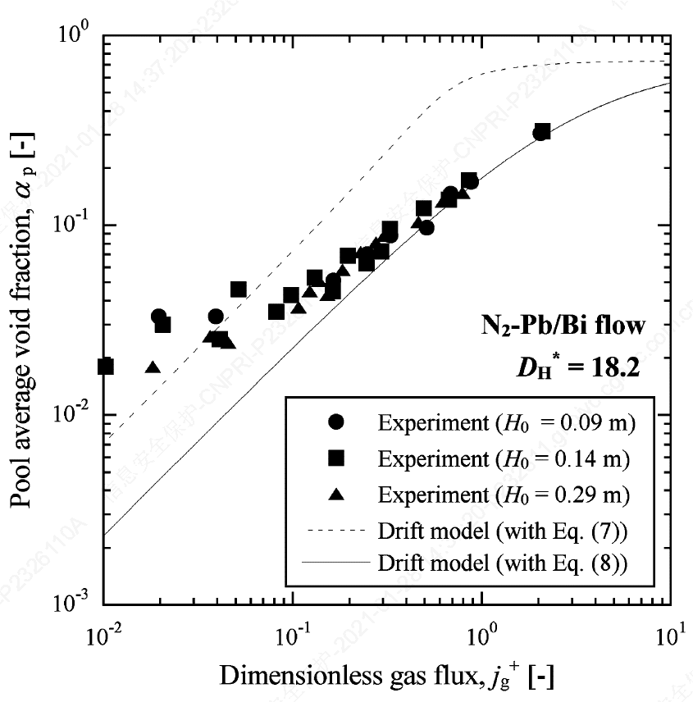
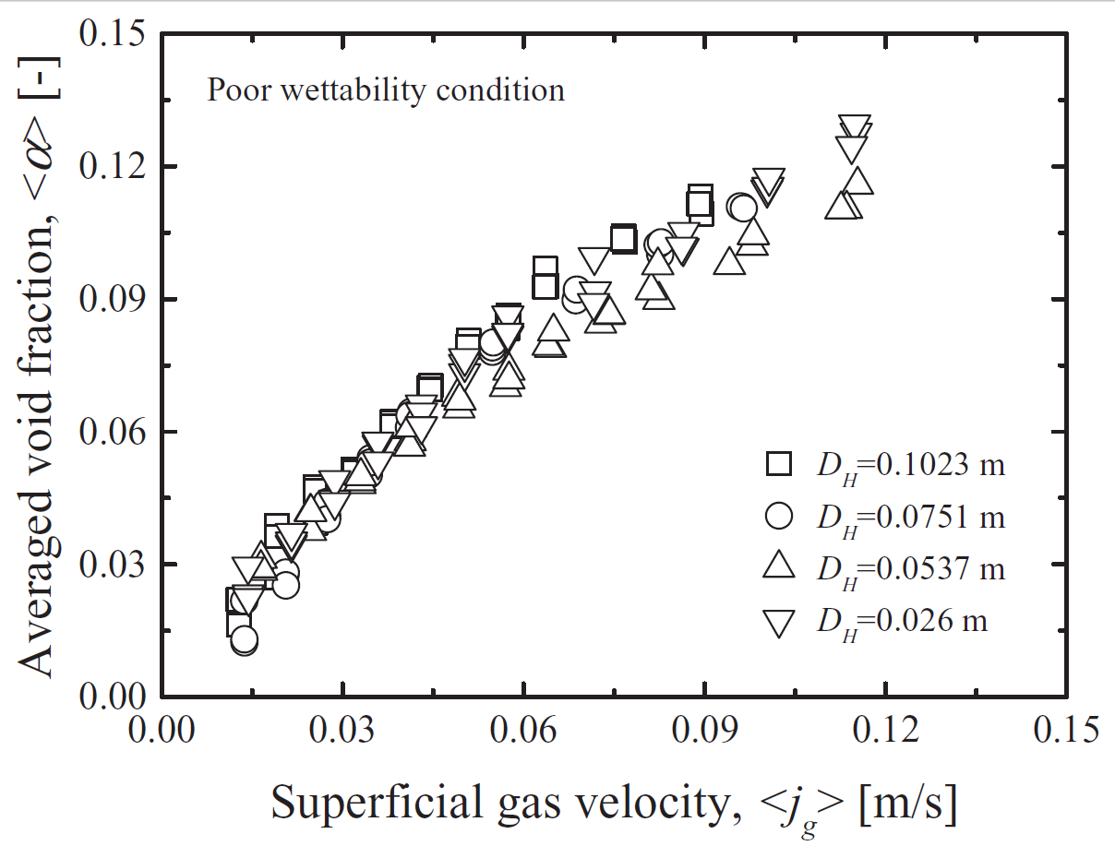
02.Evaluation of existing correlations
Developer
Test facility
Characteristics
void fraction is measured by neutron radiography
N2-LBE
for evaluation and verification of correlations
1 JNC & Kyoto University Experiment
void fraction is measured by pressure diffenerce gauge
N2-Gallium & N2-H2O
for evaluation and verification of correlations
2 Saito Experiment
void fraction is measured by conductivity probe
N2-LBE
for development of correlations
3 Ariyoshi Experiment
Notes:
The available experiment is JNC, Saito and Ariyoshi‘s experiment. The JNC and Saito’s data are used for evaluation and verification, Ariyoshi’s data are used for development of new correlations

Slide 8
02.Evaluation of existing correlations
1~3
Obvious deviation is observed for void fraction prediction by most correlations based on gas-water two-phase flow
4
5
6~7
Notes:
Obvious deviation is observed for void fraction prediction by most correlations based on gas-water two-phase flow

Slide 9
02.Evaluation of existing correlations
1~3
4
5
The void fraction prediction in Saito-Ga test is consistent with it in N2-LBE test
6~7
Notes:
The void fraction prediction in Saito-Ga test is consistent with it in N2-LBE test

Slide 10
02.Evaluation of existing correlations
Kataoka
H2O
Ishii
H2O
Koca
H2O
Kataoka
Ga
Ishii
Ga
Koca
Ga
The correlations based on gas-water two-phase flow data give better prediction in Saito-H2O test
Notes:
The correlations based on gas-water two-phase flow data give better prediction in Saito-H2O test

Slide 11
02.Evaluation of existing correlations
8~9
10
Mikityuk (pool) and Shen correlations can give good agreement with test data
11~12
Notes:
Mikityuk (pool) and Shen correlations can give good agreement with test data

Slide 12
02.Evaluation of existing correlations
8~9
10
Summary：
Among 12 correlations
Only Hibiki’s correlations, Mikityuk, and Shen correlations can give good prediction
11~12
Notes:
Summary：
Among 12 correlations
Only Hibiki’s correlations、Mikityuk、and Shen correlations can give good prediction

Slide 13
03.Theoretical analysis of drift-flux parameter
Step1:Theoretical model
Get the α and velocity distribution along radius
Calculate C0 by definition
Step2：Influence factor
Change input parameter in theoretical model
Analysis the influence
Step3：new correlation
quantify the effect by fitting
get new correlation
Clark’s theoretical model for bubble column
get liquid velocity
get C0

Slide 14
03.Theoretical analysis of drift-flux parameter
Step1:Theoretical model
Get the α and velocity distribution along radius
Calculate C0 by definition
Step2：Influence factor
Change input parameter in theoretical model
Analysis the influence
Step3：new correlation
quantify the effect by fitting
get new correlation
In the center of the flow channel, the liquid metal is entrained by rising bubbles and flows upward. Correspondingly, liquid metal near the wall flows downward to fill the vacancy after the fluid in center area leaves.
A flow circulation over radius forms. Because the liquid metal is contained in a static pool during experiment, the overall volume flux over channel cross section and the liquid Reynolds number based on average velocity are zero.
Input Ariyoshi‘s test parameter
With Ga increasing, C0 increases
Ga>100000，C0 keeps constant
Ga number of liquid heavy metal is larger than water

Slide 15
03.Theoretical analysis of drift-flux parameter
Step1:Theoretical model
Get the α and velocity distribution along radius
Calculate C0 by definition
Step2：Influence factor
Change input parameter in theoretical model
Analysis the influence
Step3：new correlation
quantify the effect by fitting
get new correlation
With Re decreasing（to Bubble Column）,C0 increase greatly
With Frincreasing，C0 decrease
For Saito or JNC&KU’s pool-type test，Re of liquid metal nears 0，C0>>1
For loop-type test， C0 is smaller than it in pool-type test

Slide 16
03.Theoretical analysis of drift-flux parameter
Step1:Theoretical model
Get the α and velocity distribution along radius
Calculate C0 by definition
Step2：Influence factor
Change input parameter in theoretical model
Analysis the influence
Step3：new correlation
quantify the effect by fitting
get new correlation
With averaged void fraction increasing，C0 decrease
In summary, the influence factor include
Reynolds number（liquid velocity, channel diameter）
Froude number（channel diameter）
Void fraction（gas superficial velocity）

Slide 17
03.Theoretical analysis of drift-flux parameter
Step1:Theoretical model
Get the α and velocity distribution along radius
Calculate C0 by definition
Step2：Influence factor
Change input parameter in theoretical model
Analysis the influence
Step3：new correlation
quantify the effect by fitting
get new correlation
Ishii correlation
1、Introduce new relation about Re and Fr
Fitting with Ariyoshi’s test data
2、Introduce the modification of α
3、Compound with Vgj to get new correlations

Slide 18
04.Development of new correlation
Comparing with test data（left：JNC right：Saito-Ga）
void fraction predicted by the new correlations agrees well with test data

Slide 19
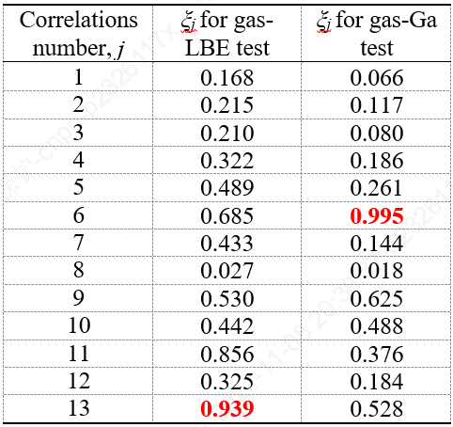
04.Development of new correlation
(1-Ishii for bubbly, 2-Ishii for slug, 3-Ishii for churn, 4-Kataoka & Ishii, 5-Koca & Ishii, 6-Mikityuk for pool
7-Mikityuk for loop, 8-Shi, 9-Shen(high wettability), 10-Shen(low wettability), 11-Hibiki for bubbly,
12-Hibiki for cap, 13-New developed model)
Statistical evaluation
New model
New model
(1) Gas-LBE test data
(2) Gas-Ga test data
Comprehensive index：relative error+RMS
New correlations：
The prediction is better than other correlations for LBE
From 0 to 1，the larger value means the better prediction

Slide 20
05.Conclusion
Based on one-dimensional modified theory analysis, the distribution parameter is estimated and the effect on which is quantitatively discussed, then a new correlation considering is developed. The obtained conclusions and prospects are as follows:
Analysis result based on modified Clark’s theoretical model shows that distribution parameter is assuming very high values at low Re number. Besides, with Froude number increase, distribution parameter tends to decrease. At lower void factions, distribution parameter is also assumed to be high values. It indicates that the pipe size, flow rate and void fraction can all influence distribution parameter.
Considering the quantitative laws of above influence factors obtained by theoretical analysis and fitting the data of Ariyoshi’s test, a new correlation for gas-LBE two-phase flow is developed and evaluated with JNC & KyotoU and Saito’s test. The new correlation gives the good prediction for gas-LBE two-phase flow in the void fraction range of 0~30%.

Slide 21
Thank you
严·慎·细·实
Thank you!

