Slide 1
Towards an integrated FRENCH software platform for Severe Accident simulation in SFR Modelling, Validation and Applications
P. GUBERNATIS, R. CLAVIER

Slide 2
Motivations and background

Slide 3
Motivations and background
Safety requirements for Gen-IV such as formulated by the french regulation or by ESNI+ H2020 program =>
Take into the Severe Accidents (S.A) at the design level => Prevention (design provisions to prevent feared events) & Mitigation (specific features to mitigate their consequences)
Use a methodology that integrates at best the deterministic way and the probabilistic way
The SFR background (PhX, SPX, ASTRID) has led to 2 classes of simulation tools:
Best Estimate tools: mechanistic, detailed, time consuming.
Physico-statistical tools: simpler modelling, parametric, fast running.
13-17 March 2023

Slide 4
Motivations and background
In continuity of this background, we aim at renewing, completing and organizing our tools in a platform that meets at best the targets above.
In what follows,
We briefly describe what these two classes of tools are made of, to date.
Then, we state the needs and principles of the platform we target.
We list the technical and quality requirements linked to these needs,
Present a brief review of the existing technics we use,
Show some realisations and conclude
13-17 March 2023

Slide 5
Actual state of fast-running simulation tools

Slide 6
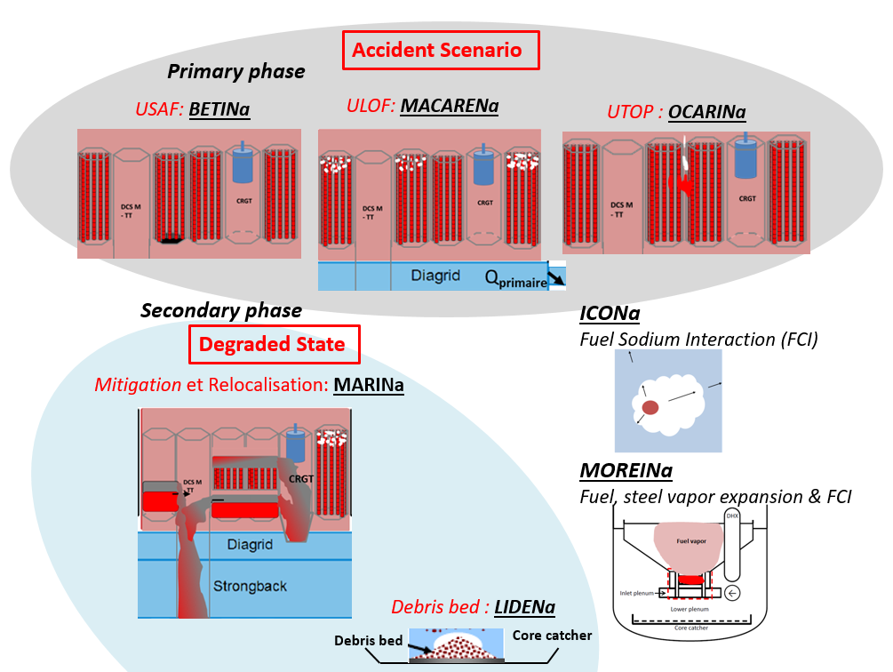
Actual state of the fast-running simulation tools
Development started in 2011 → 7 tools dedicated to:
specific sequences of the primary phase:
USAF transients → BETINa
ULOF transients → MACARENa
UTOP transients → OCARINa
…or to the mitigation of degraded states
Corium transfert → MARINa
…or to late phase situations:
FCI → ICONa
Bubble Expansion → MOREINa
Debris Bed → LIDENa
Ad hoc chainings of these tools have been realised to perform simulations of an entire accidental sequence
presented in details elsewhere in the Tech. Meeting

Slide 7
Actual state of the mechanistic tools

Slide 8
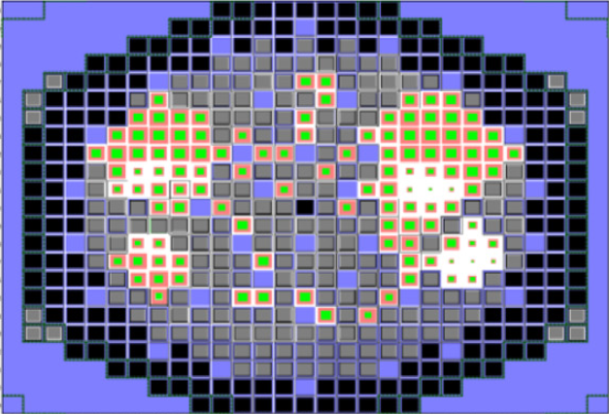
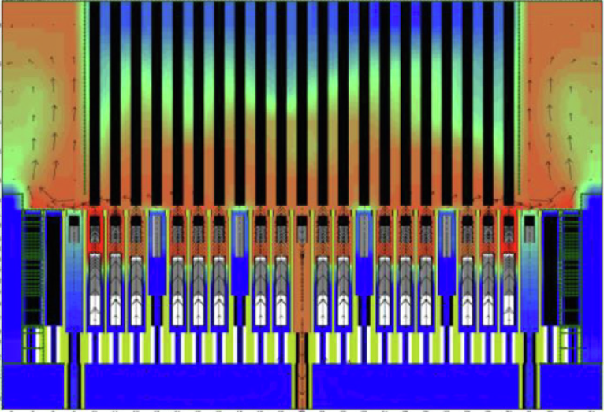
Actual state of the mechanistic tools: SIMMER-V
SIMMER (JAEA). A specific version SIMMER-V has been developed in a CEA-JAEA co-development => Main component of our mechanist tools for the S.A analysis.
The CEA-JAEA co-development has recently produced an enhanced version, i.e:
Dynamic memory management,
Domain decomposition (parallelism)
Detailed pin degradation model
Boundary coupling
Object Oriented encapsulation to facilitate interoperability
13-17 March 2023

Slide 9
Actual state of the mechanistic tools: others
Many other CEA mechanistic tools are used and are operational:
GERMINAL V2: Fuel aging => initial state of the degradation sequence
PARIS (ERANOS) or APOLLO3: Spatial neutronics with parallel flux solvers
CATHARE: Dedicated to the system representation
EUROPLEXUS (EPX): high rate dynamic mechanics
Some of the necessary coupling and chaining done in SEASON
SEASON=1st version of CEA SFR-SA platform (detailed in an other presentation)
At the current stage, it is dedicated to the core representation, in nominal state and in degradation => must be extended to the whole system.
13-17 March 2023

Slide 10
Actual state of the mechanistic tools: others
Interoperability of SIMMER-V in the current version of SEASON
INTEROPERABILITY | CODE | TECHNICS
Upstream chaining of SIMMER-V with a fuel performance code. | GERMINAL V2 [3] | SQL* queries to a DB containing a set of various irradiated states for the core pins.
In-time coupling of SIMMER-V with an external 3D neutronics spatial code | PARIS (ERANOS) | Initial σ, counter-reactionsfeedback coefficients. MPI exchanges => PCQM or IQM* kinetics schemes
Tight thermal-hydraulic boundary coupling of SIMMER-V with itself. | SIMMER-V | “Exact” SIMMER-V-SIMMER-V coupling based on an extension of the domain decomposition. (in progress)
Loose thermal-hydraulic boundary coupling (coupling with the complete circuit) | CATHARE | Use of C3PO, ICoCo, MedCoupling (in progress)
*Predictor-Corrector and Improved Quasi-static method
*Structured Query Language
13-17 March 2023

Slide 11
Needs and principles for a SFR SA integrated platform

Slide 12
Need for an integrated platform
We need to improve the quality and the robustness of our calculation process:
Complete the phases of the scenario, extend the topology to the full system,
Integrate the whole sequence in a same process: degradation, relocation towards the core catcher, FCI in the lower plenum together with the dynamic response of the structures.
More generally, question the chaining processes used with the simplified codes, as some of the phases should be coupled (rather than just chained) :
e.g, the behavior of the core onto the core catcher could affect the corium relocation through the transfer tubes (=> coupling)
e.g, the deformation of the structures under the impact of the rapid expansion of a bubble (FCI) affects the behavior of the degraded core (=> coupling)

Slide 13
Need for an integrated platform
strengthen the inter-codes processes (data transfer during serial computations and coupling) and the management of the time sequence for the various coupling, in function of the bifurcation of the scenarios.
Improve the coherency between the two classes of tools (B.E and ‘simplified’ ones)
Improve the V & V and the quality insurance of the codes.

Slide 14
Platform Technical and Quality requirements

Slide 15
Platform Technical requirements
All the previous needs can be broken down into a list of technical requirements:
Architecture which integrates in its structure the possibility of mixing mechanistic codes and simplified (fast running) codes,
Data centralization to reduce the redundancies (reference geometries, material properties).
Dynamic coupling graph and Scenario events,
Enhanced user interactivity (allows the user to reconfigure online the parameters of a simulation)

Slide 16
Platform Quality requirements
State-of-the-art code quality management: version control, complete test policy (unitary and global), automatic testing
Validation: benchmarks, experimental validation (when available),
Uncertainty evaluation: complementary to the validation, necessary to control the qualification domain of the system (an external is to add to the platform)
Documentation and Formation: essential requirement to ensure the knowledge transmission over long decades.
Versatility and long term maintenance: The long term development process imposes to be capable or replacing any component by a new one. The platform must be modular and robust enough to face these evolutions.

Slide 17
Already available technical elements

Slide 18
Some available technical elements: PROCOR
Set of tools for the simulation of S. A. (PWR, SFR) made of 2 boxes:
A first toolbox: individual physical models
Library of physical models (fast calculation ODE models)
Library of material properties
A second toolbox: Dynamic Model management module for designing an application
Manages the PROCOR models, or any model implementing ICoCo interface (defined later)
Aggregates the physical models into Partitioned Models and physical Applications
Dynamic (event-driven) management of the coupling scheme of the models of a simulation
The existing fast-running simulation tools described previously are intended to be implemented into the PROCOR Platform as ICoCo compliant components

Slide 19
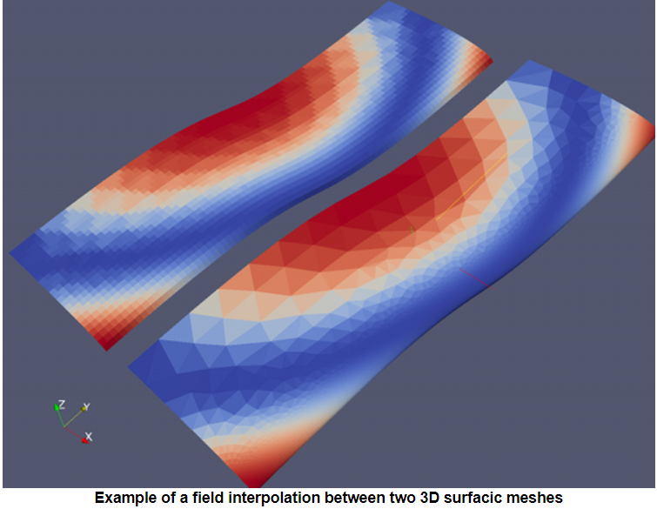
Some available technical elements: MedCoupling
MedCoupling is a powerful C++ & Python library for manipulating geometries, meshes and physical fields (CEA +EDF)
Mapping, interpolation and various mesh and field manipulation tools.
It offers services to create, modify and exchange physical data between codes
It is fully compliant with MPI & handles domain decomposition and is a standard visualisation format.
NB: This standard library has been developed by CEA-EDF and is freely distributed

Slide 20
Some available technical elements: ICoCo
Standard Interface for COde COupling (CEA)
= Code Interface prescription: a set of methods to implement that confers the ICoCo standard to a simulation code. Made of 2 parts:
All the common services needed for the control of the computation (initialisation, time-step control, time-step computation, restart, output…)
A set of exchanges methods, specifically designed for exchanging MedCoupling objects (defined later).
NB: The C++ and Python templates of ICoCo (developed for the CEA-DEF SALOME environment) is freely distributed.

Slide 21
Some available technical elements: C3PO
C3PO: Collaborative Code Coupling PlatfOrm (CEA)
Recall: Advanced simulation environments consider 2 separate levels: that of the calculation codes themselves and that of their supervision. Supervision consists in writing scripts that manipulate the high level interfaces of the codes.
In practice, and with complex codes, some pitfalls appear while supervising:
risk of long and unclear scripts, when writing complex time coupling algorithms
Direct manipulation of MedCoupling fields which would benefit from being encapsulated
...
Consequently, the C3PO specific library has been developed to handle this script writing, by providing the user with a library (Python classes module)
NB: The C++ and Python templates of ICoCo (developed for the CEA-DEF SALOME environment) is freely distributed.

Slide 22
All these technics are compliant
USER ENVIRONNEMENT
Application scripts and simulation monitoring, visualisation
Coupling and code management: C3PO* (+ PROCOR)
ICoCo
ICoCo
ICoCo
ICoCo
CATHARE
SMMER-V
PROCOR Simpl. Co.
APOLLO3

Slide 23
All these technics are compliant
USER ENVIRONNEMENT
Application scripts and simulation monitoring, visualisation
Coupling and code management: C3PO* (+ PROCOR)
Codes with their ICoCo API
(python)
ICoCo
ICoCo
ICoCo
ICoCo
CATHARE
SMMER-V
PROCOR Simpl. Co.
APOLLO3

Slide 24
All these technics are compliant
Multi-physics
Simulation building and control
USER ENVIRONNEMENT
Application scripts and simulation monitoring, visualisation
Coupling and code management: C3PO* (+ PROCOR)
ICoCo
ICoCo
ICoCo
ICoCo
CATHARE
SMMER-V
PROCOR Simpl. Co.
APOLLO3

Slide 25
All these technics are compliant
Possibility to handle in a same simulation, the two classes of codes:
Best Estimate and
‘simplified’ ones’
USER ENVIRONNEMENT
Application scripts and simulation monitoring, visualisation
Coupling and code management: C3PO* (+ PROCOR)
ICoCo
ICoCo
ICoCo
ICoCo
CATHARE
SMMER-V
PROCOR Simpl. Co.
APOLLO3

Slide 26
Some realisations

Slide 27
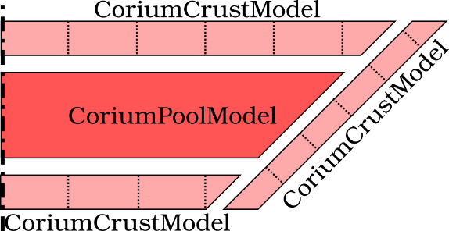
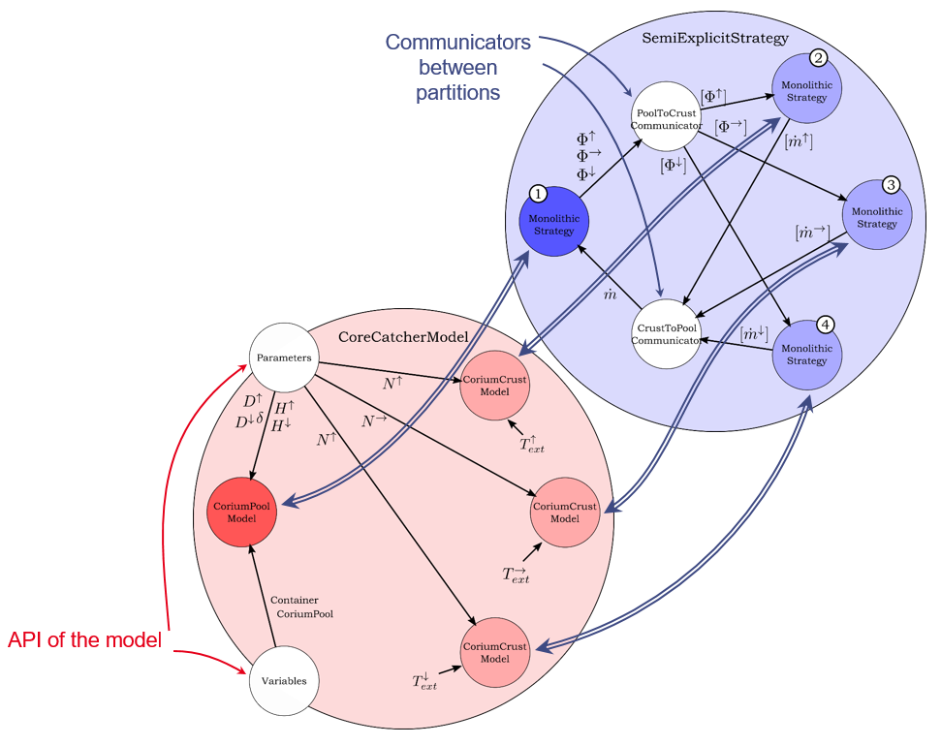
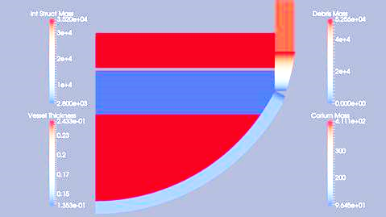
PROCOR: Corium pool surrounded by its crusts
An aggregate model made of 4 partitions
1 “ Corium Pool Model ” →
+ 3 “ Corium Crust Model ”
Its coupling resolution strategy provides individual models with instructions for the time stepping ( $t^{n}$ → $t^{n+1}$), resolution order, data exchange instructions.

Slide 28
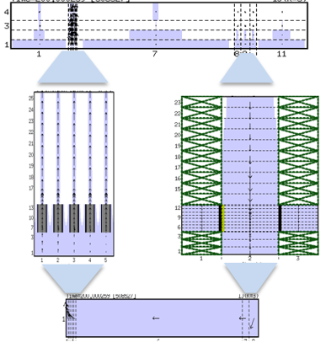
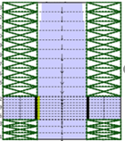
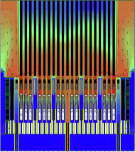
SIMMER-V Boundary Coupling:
As stated, 2 developments for improving the interoperability of SIMMER-V are in progress:
An ‘exact’ boundary coupling (based on an extension of the domain decomposition) => we can couple (initially) independent computations by their boundaries and get the same result as a stand-alone one.
Gain in modularity (the meshes, the domain decomposition and the setting of the domains are independent)
The simple case (conform meshing at the boundary) is solved with a regular MPI exchange. The general situation (non conform meshing) is solved with the exchange of MedCoupling fields.
Development to come = full embedding of one domain into another

Slide 29
SIMMER-V ICoCo interoperability:
The 2nd development has consisted in adding the ICoCo interface to SIMMER-V
SIMMER-V Fortran code => a C++ API has been added to the code.
The ICoCo interface has been implemented into this object.
The MedCoupling Field exchanges process have been added to the code (being verified).
This makes it possible to use, in the medium term, SIMMER in a coupled C3PO application with the CATHARE-ICoCo components for example.

Slide 30
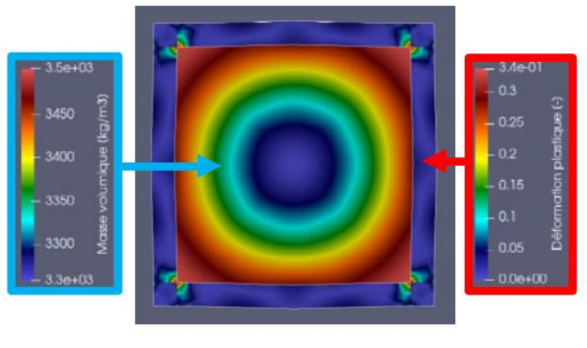
Other realisations
APOLLO3 – Europlexus coupling: Transient Of Power that generates a shock wave in EPX (PWR case) + Vessel plastic deformation
To be adapted to SFR.

Slide 31
Conclusion
This presentation cannot be conclusive as it mainly presents guide lines for the future version of the SFR S.A CEA platform.
These guide lines encompass the 2 ways of computing : B.E and simplified tools in a coherent framework.
Besides, we take advantage of an important maturity in terms of coupling tools: PROCOR, MedCoupling, ICoCo, C3PO, and in terms of computing platforms (SALOME)
Finally, we rely on an important experience and mastery of the degradation calculation topic, acquired during the development of SIMMER-V with JAEA.
All these considerations pinpoint the interest and the opportunity to lay the foundations for the next generation of the SFR S.A platform, in the wake of SEASON.

Slide 32
THANK YOU

