Slide 1
The Simplified Radionuclide Transport (SRT) Code for the Source Term Assessment of pool-type metal fuel sodium fast reactor severe accidents
March, 2023
Matthew Bucknor, Dave Grabaskas, Tyler Starkus, Dong Hoon Kam, Shayan Shahbazi
Argonne National Laboratory

Slide 2
Phenomena
SRT Overview
Models
Example
SQA

Slide 3
Phenomena
SRT Overview
Models
Example
SQA

Slide 4
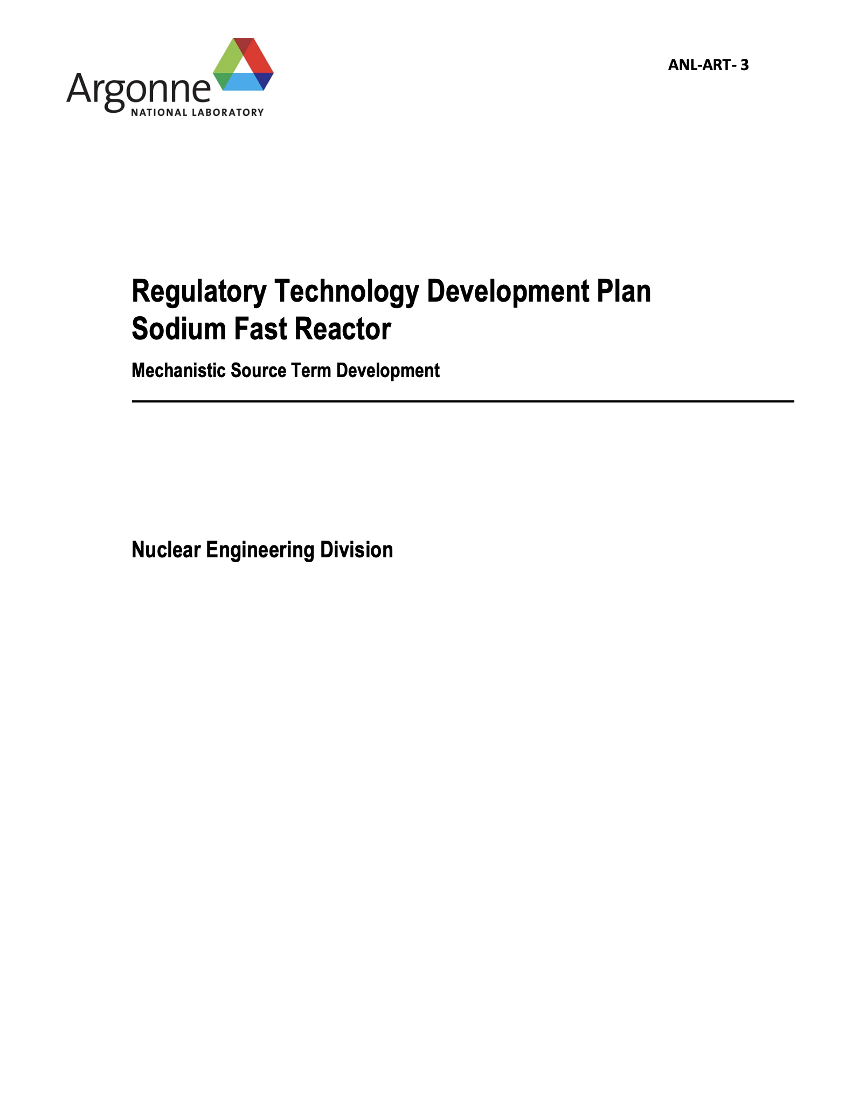
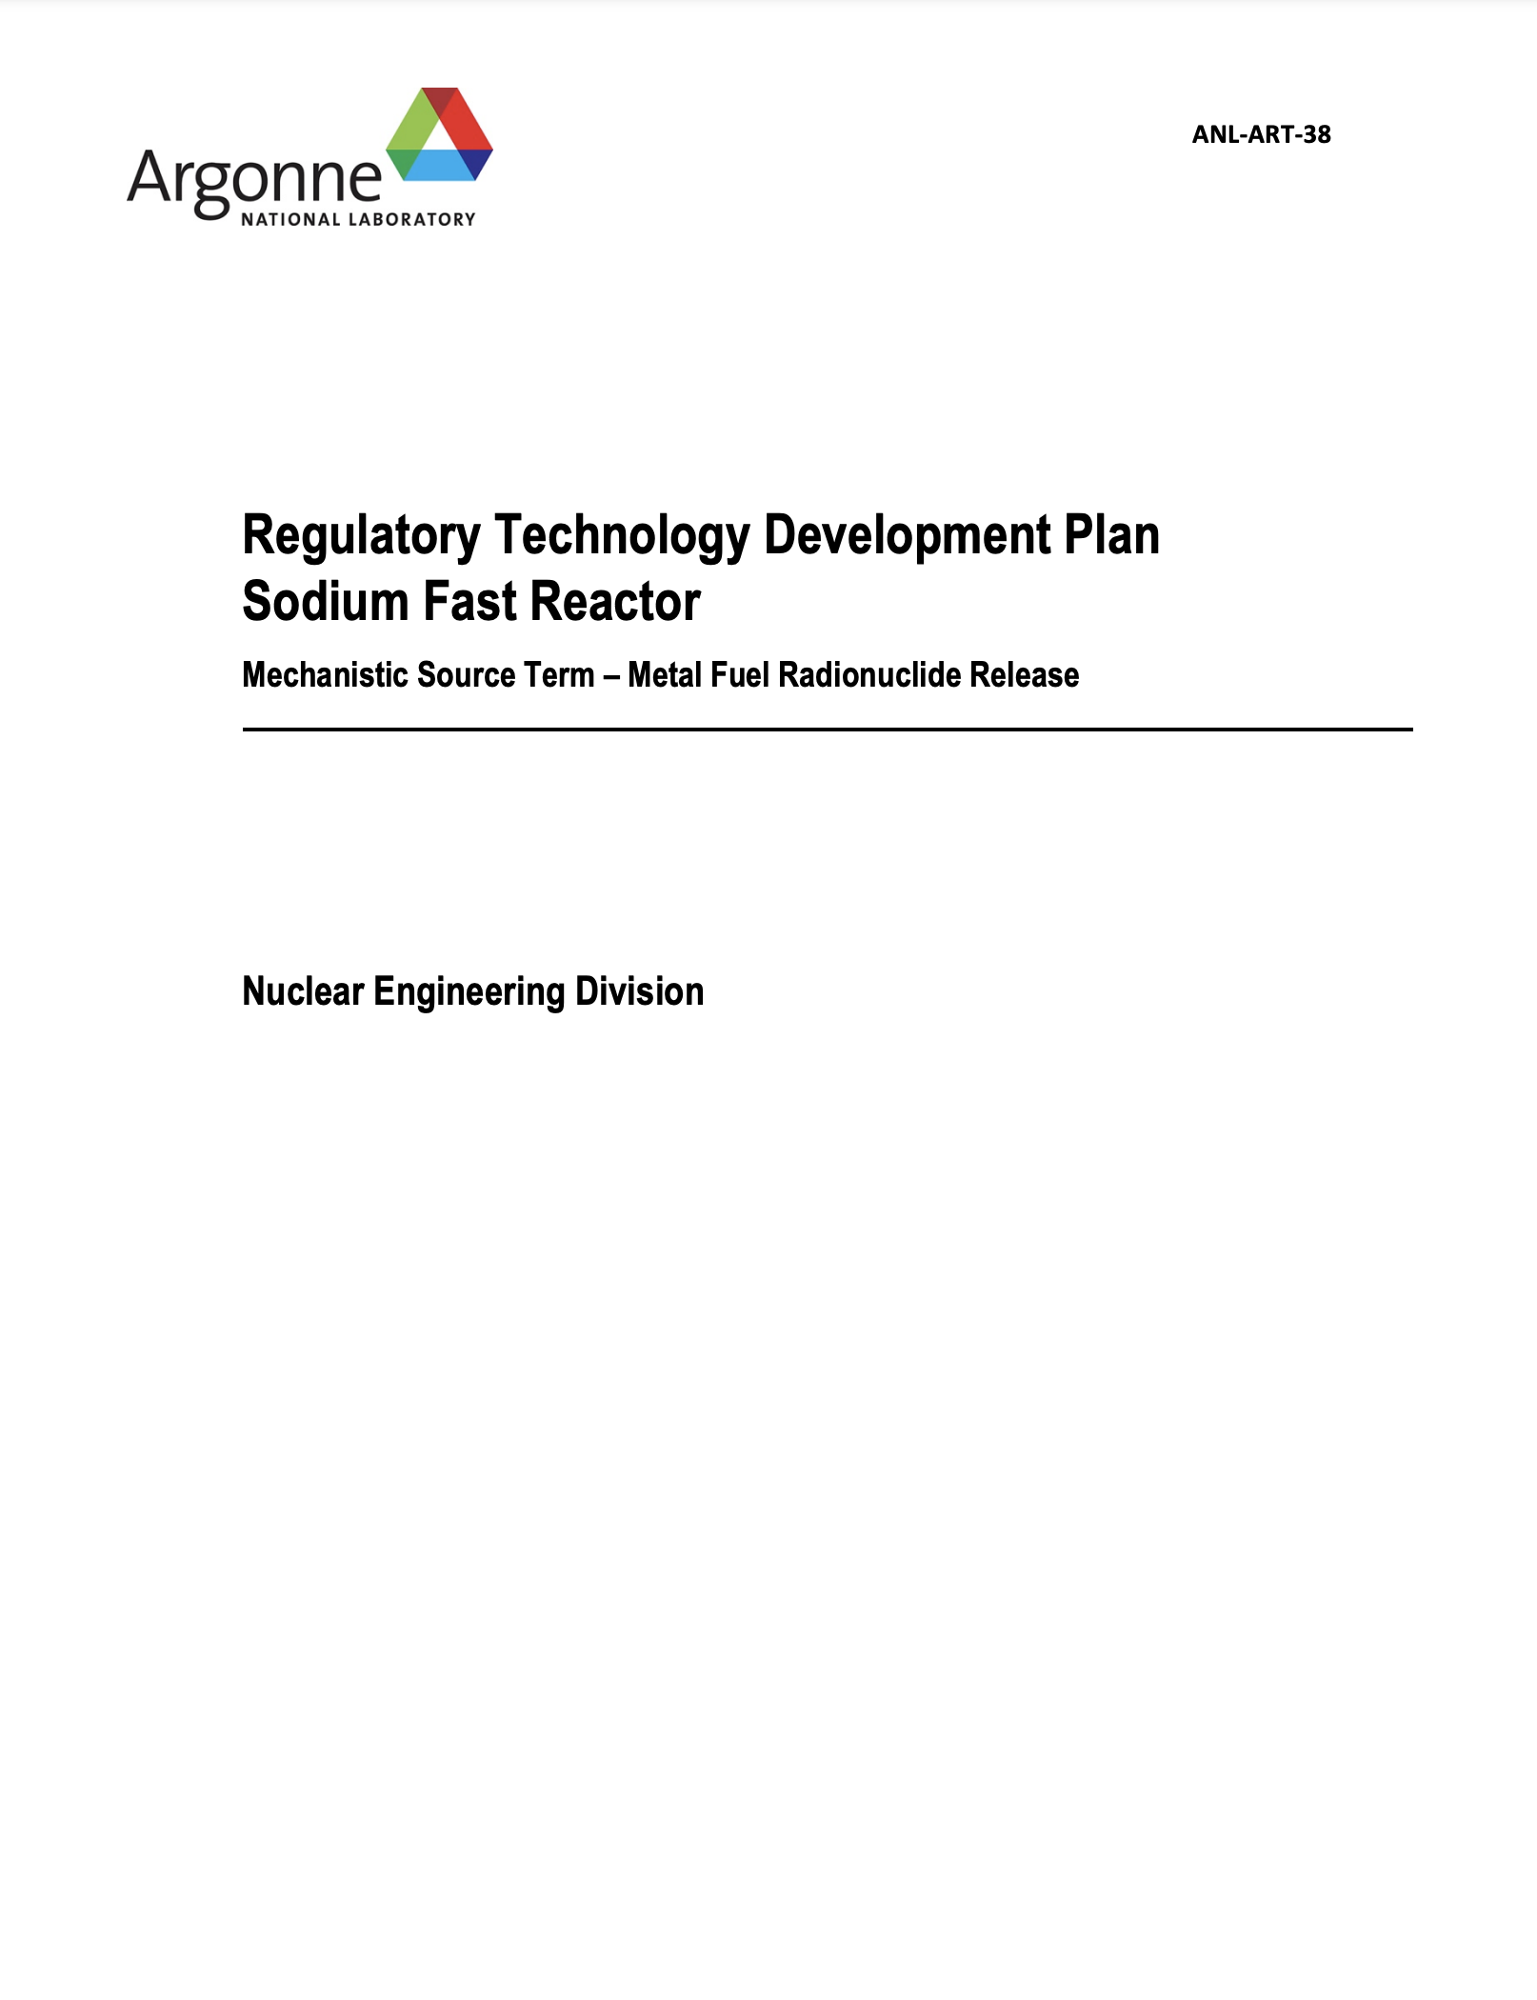
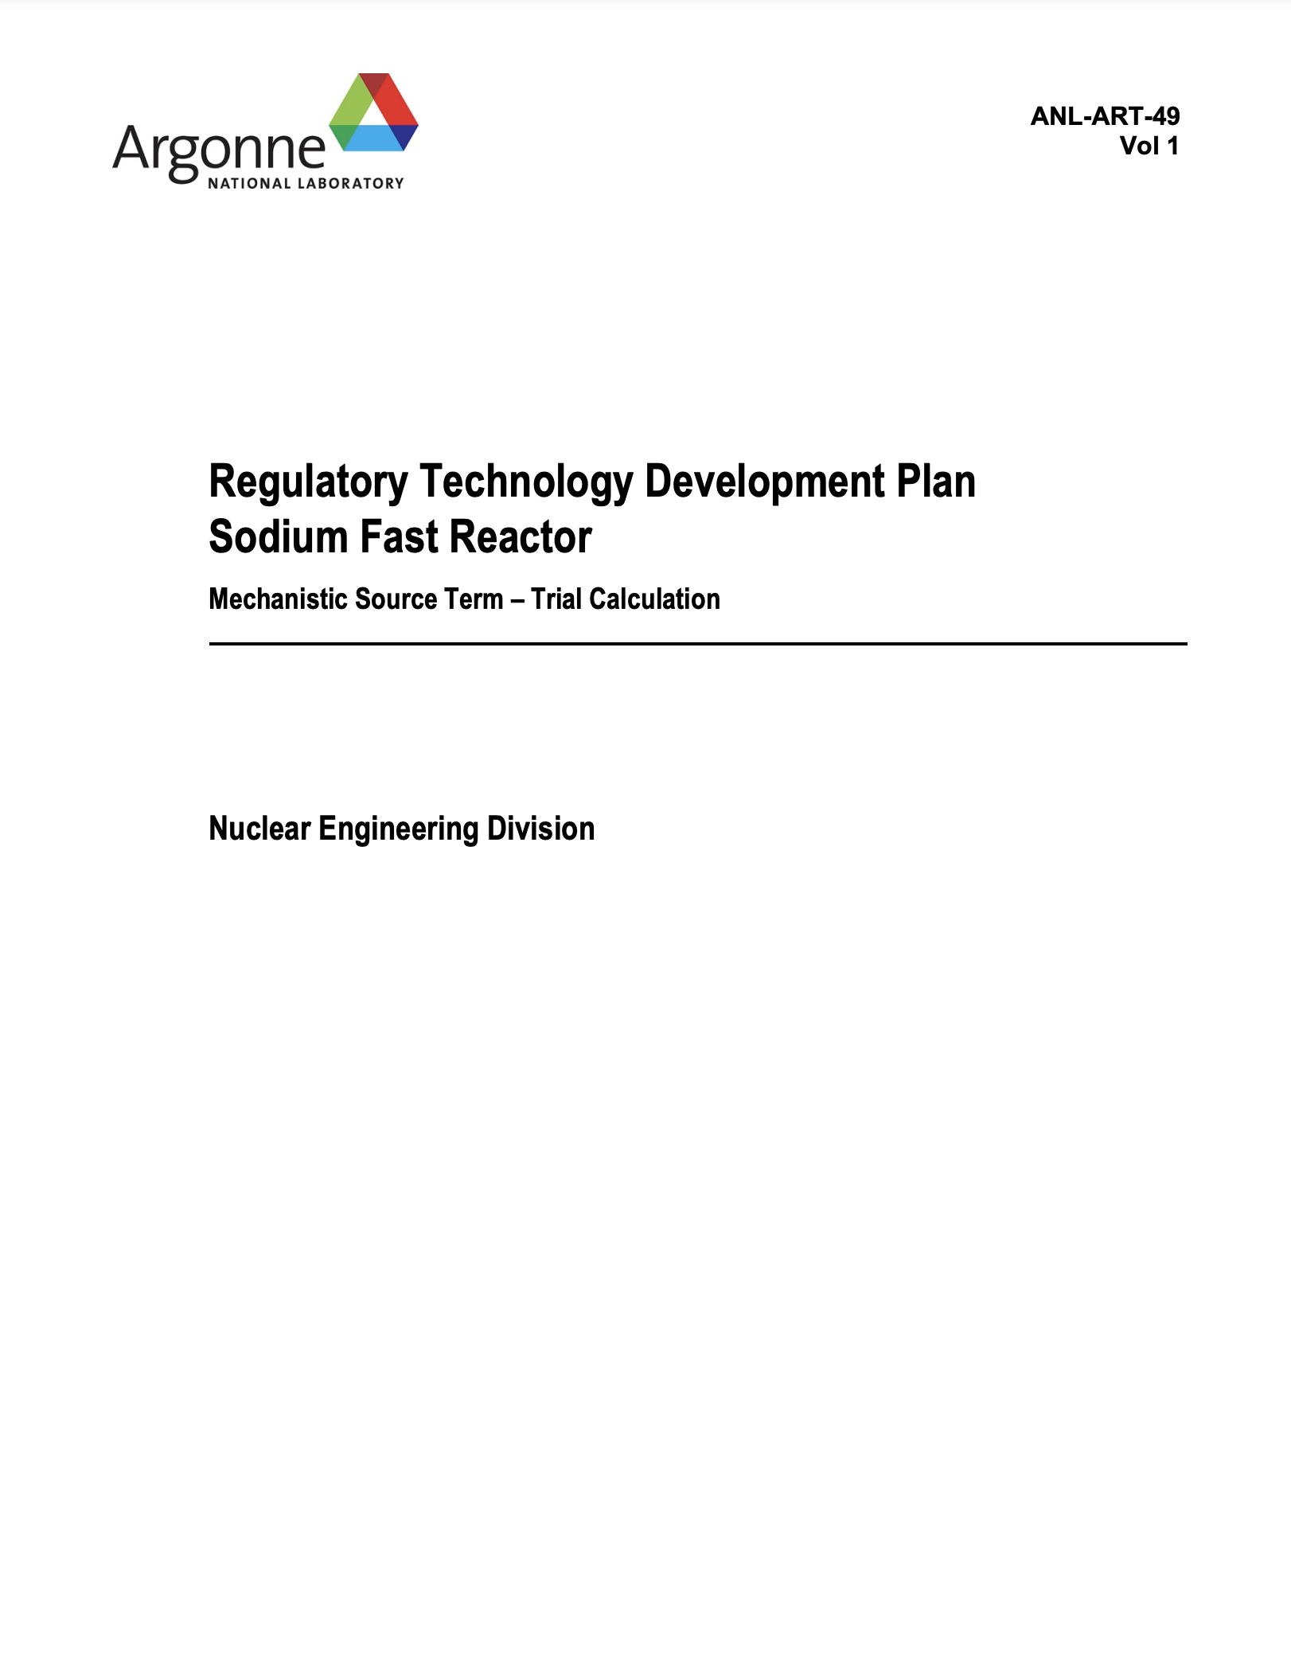
Pool-Type Metal Fuel Phenomena
Key Differences
There are significant differences in severe accident behavior and fuel failure phenomena between oxide and metal fuel for SFRs
Recent Studies
Argonne studies explored the most “credible” fuel damage scenarios for pool-type metal fuel SFRs.
Scenarios included extended protected loss-of-heat sink events (eutectic cladding failure without fuel melting) and severe transient overpowers or localized fuel blockages (localized, short-term fuel melting)
ANL-ART-3
ANL-ART-38
ANL-ART-49

Slide 5
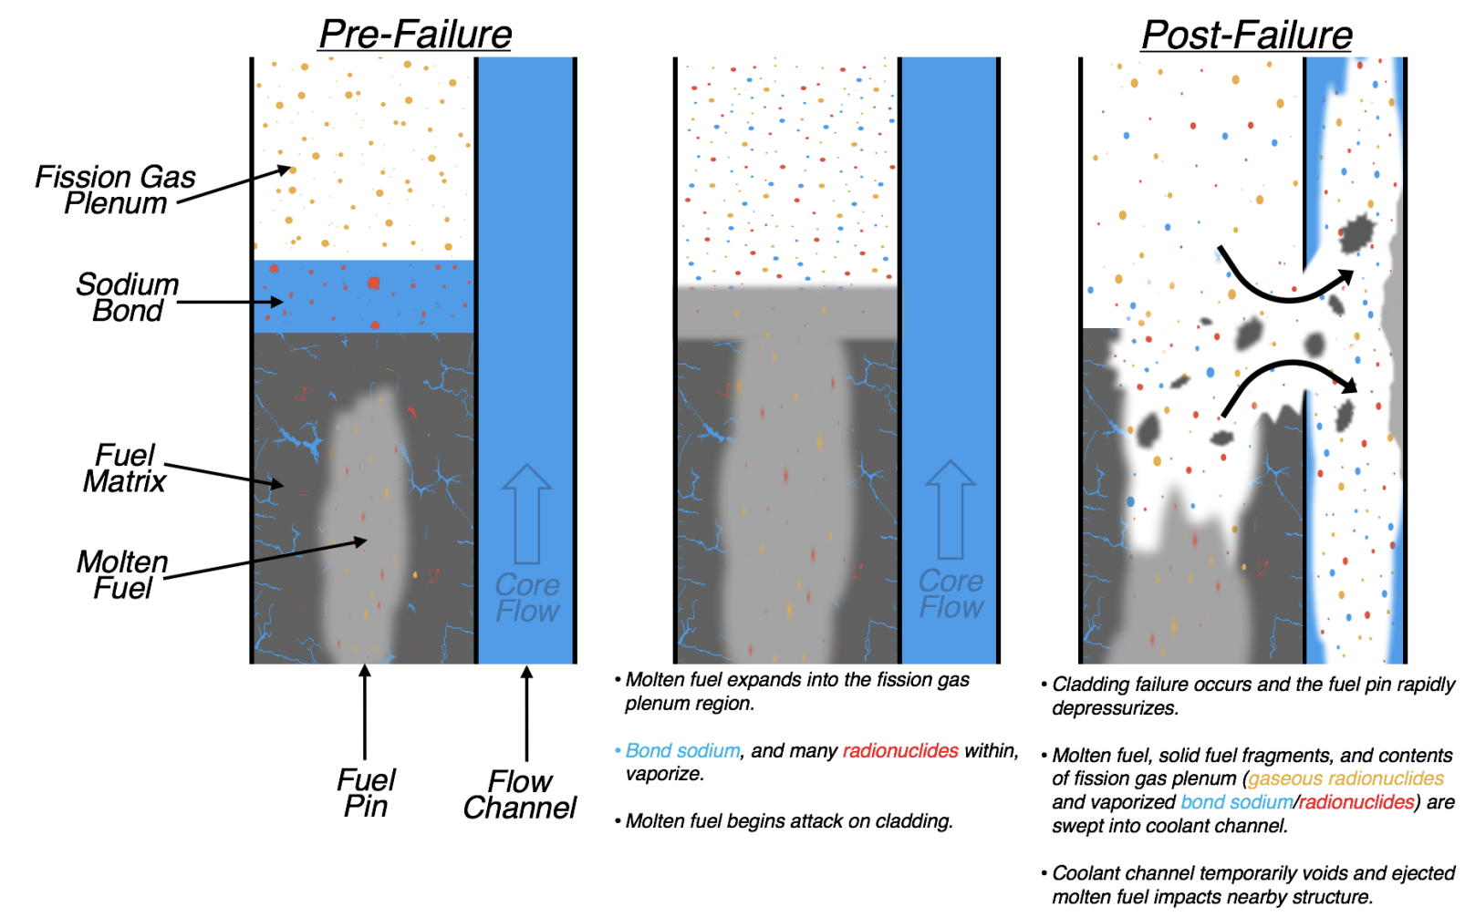
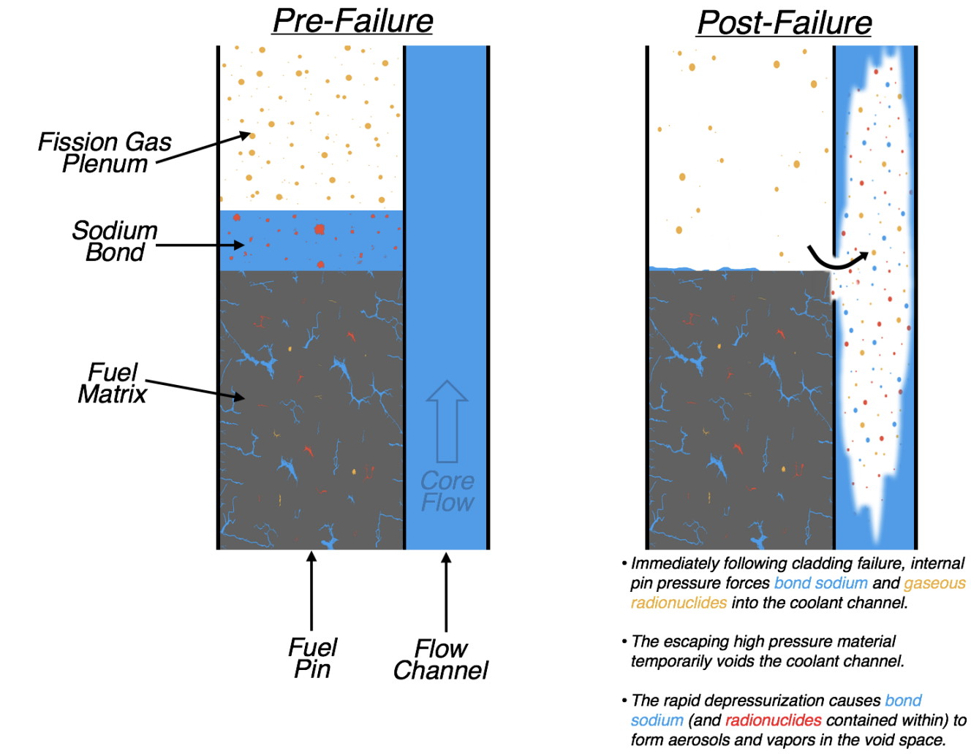
Pool-Type Metal Fuel Phenomena
Eutectic Failure without Fuel Melting
Failure with Fuel Melting

Slide 6
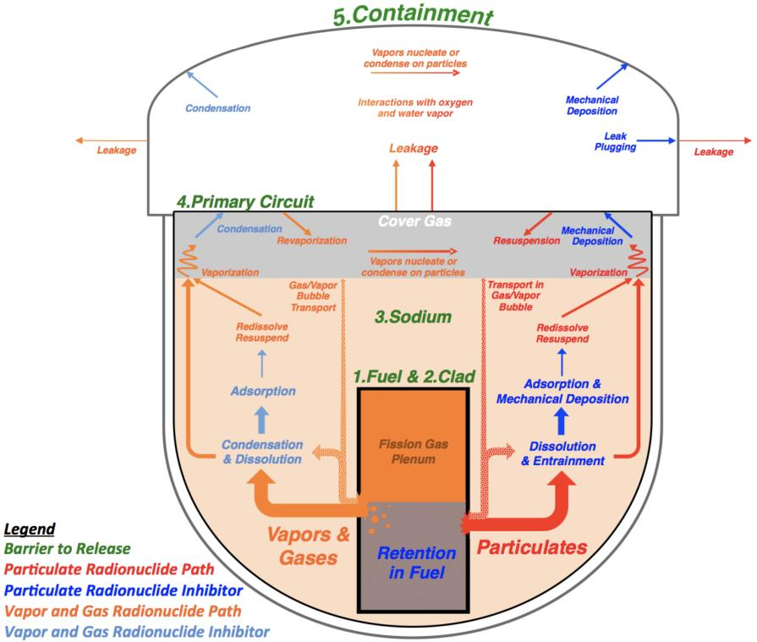
Pool-Type Metal Fuel Phenomena

Slide 7
Phenomena
SRT Overview
Models
Example
SQA

Slide 8
SRT Overview
Purpose: Conduct rapid source term analyses and uncertainty/sensitivity analyses of radionuclide transport phenomena for SFR and microreactor source term analyses
Scope: SRT assesses the release and transport of radionuclides through the reactor system and to the environment for designated accident sequences
Goal: Provide simplified phenomena models that are easily modified by the user (primarily data-driven), with option to utilize more detailed model (or create your own)

Slide 9
SRT Overview
Capabilities
Performs a time-dependent analysis of radionuclide transport from the fuel through the reactor system and to the environment
Contains both an SFR and microreactor model, with a focus on metal fuel designs
Includes models for many different transport/retention phenomena, allowing an integral analysis
Does not model the transient itself, such input information can be provided by a system-level code (like SAS4A/SASSYS-1) or postulated
Structure
Code is a mix of fuel release/transport models and 0-D compartment model
Variable timestep: 1 sec to 1 hour
Currently tracks 770 separate isotopes of the elements in NUREG-1465 plus U and Na. Includes stable isotopes also, which may be important for chemistry
Accounts for radionuclide decay (with daughter products of short-lived noble gases)

Slide 10
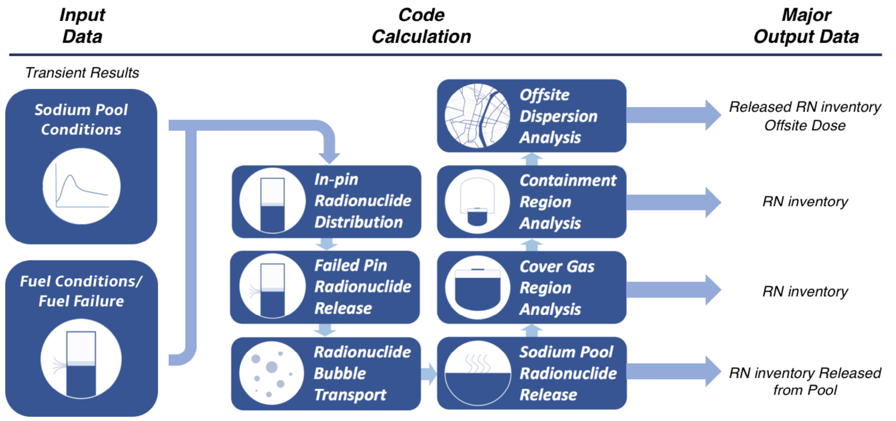
SRT Overview

Slide 11
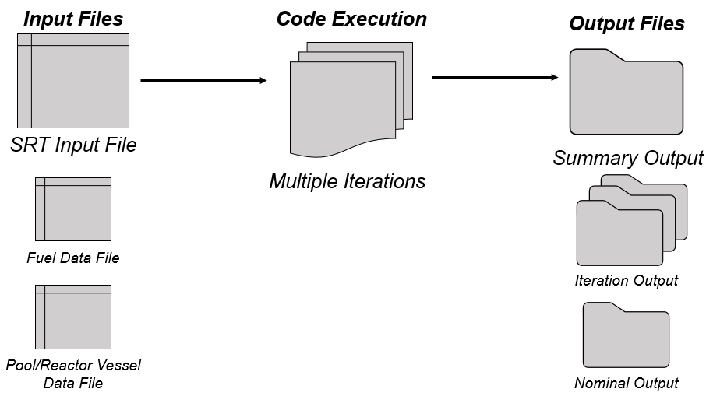
SRT Overview
Uncertainty/Sensitivity Analysis
Almost all input parameters can be specified as uncertainty distributions. The code will sample from the uncertainties and perform multiple “iterations.”

Slide 12
Phenomena
SRT Overview
Models
Example
SQA

Slide 13
SRT Models
Radionuclide Migration In-pin During Irradiation
RN migration to bond/plenum based on user input burnup-dependent functions per RN class
Radionuclide Release from Fuel Pin
RN release based on migration and user input burnup/temperature-dependent functions per RN class
Radionuclide Bubble Transport in Pool
Two models available
Simple model: User specifies bubble decontamination factor (DF)
Detailed model: Calculates bubble DF based on Brownian diffusion, inertial deposition, gravitational settling, and condensation

Slide 14
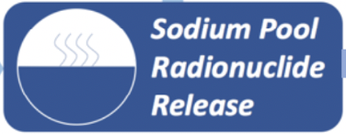
SRT Models
Pool Vaporization
Response surfaces for each element based on HSC calculations (temperature and pool size dependent)
Cover Gas Region and Containment
RNs separated into vapor/gases and aerosols
RNs may switch classes depending on user-input (or when moving between cover gas and containment)
Several aerosol deposition options
Constant decay constant (per RN class or universal)
Custom concentration-dependent power function
Henry Fauske correlation
Can use different aerosol deposition options in cover gas region and containment
Can set minimum aerosol concentrations
Leakage based on user input (vol% per day)

Slide 15
SRT Models
Offsite Dispersion
Performs simple 𝛘/Q calculation utilizing user input values
Calculates whole body dose, thyroid dose, CEDE, and TEDE
Can do segmented or integral doses
Contains DCFs from FGR 11/12 but can use other values
Time-dependent RN mass release also available for input into other codes (such as MACCS)

Slide 16
Phenomena
SRT Overview
Models
Example
SQA

Slide 17
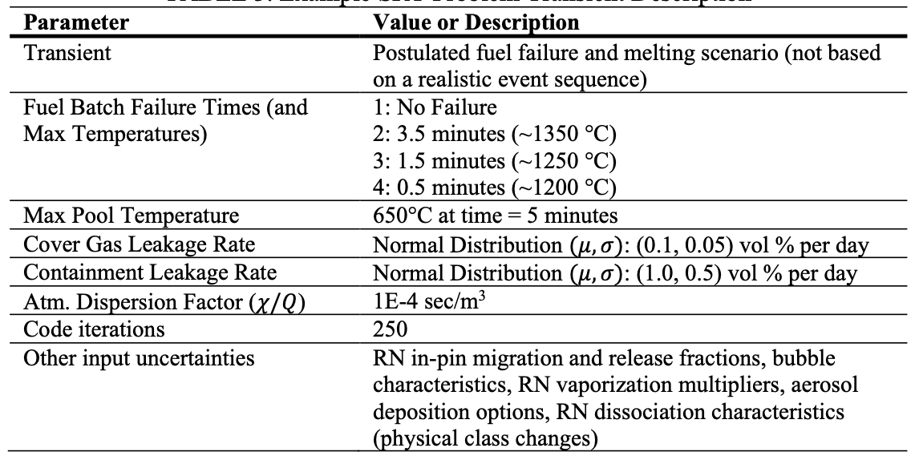
Example
Example Analysis
Purpose to demonstrate code capabilities, not representative of an actual accident scenario

Slide 18
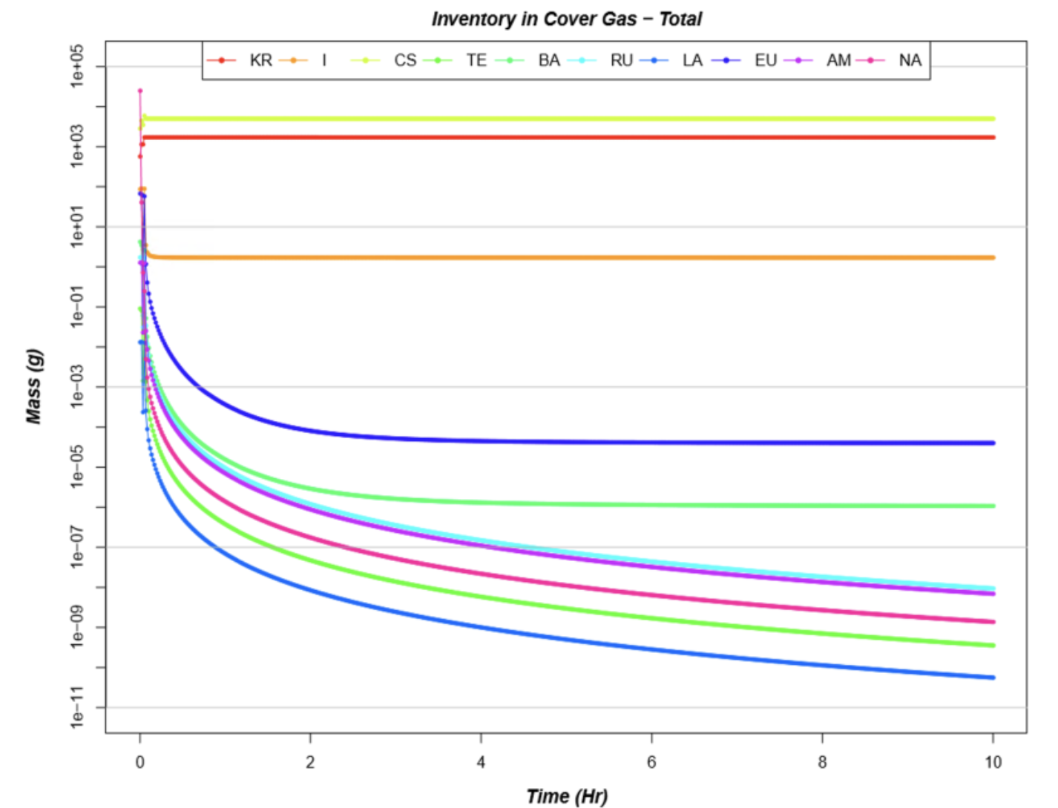
Example

Slide 19
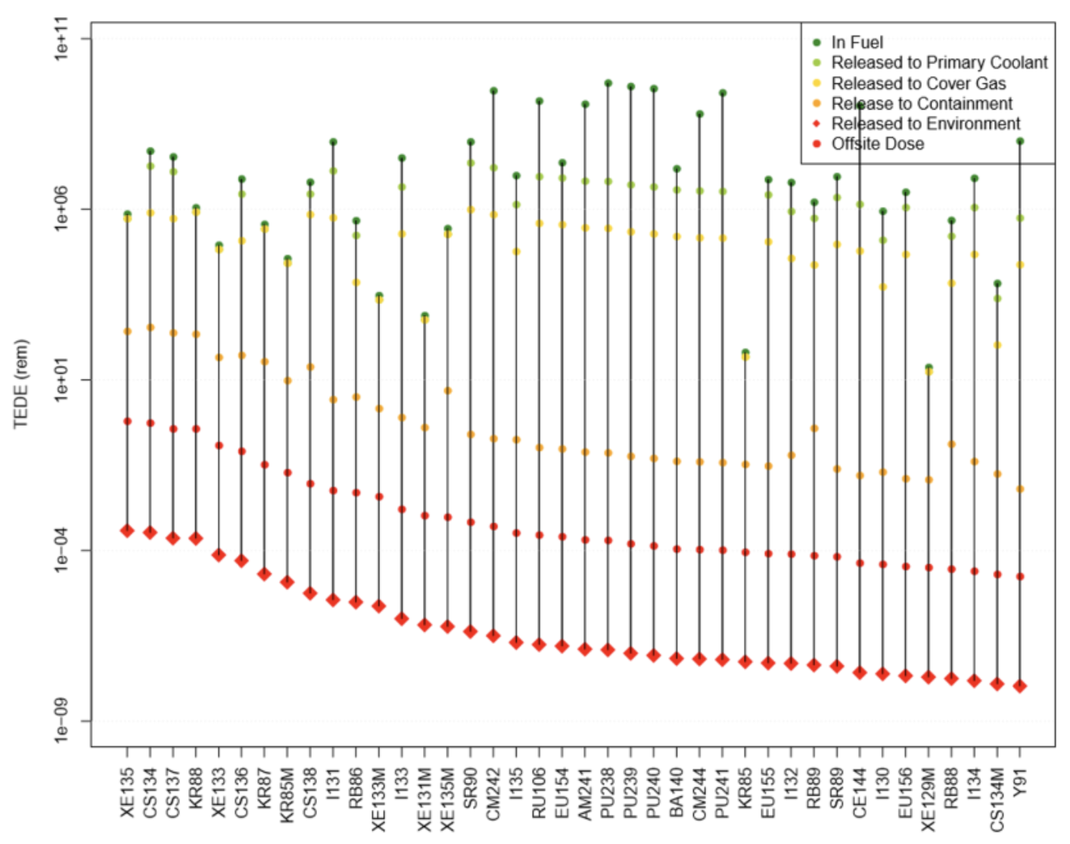
Example

Slide 20
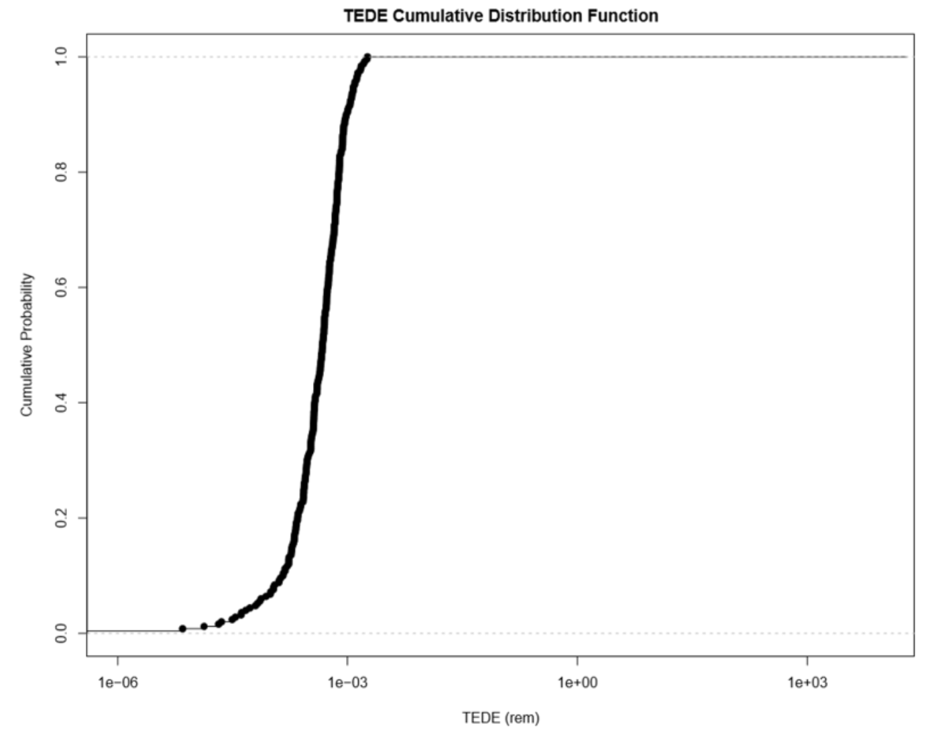
Example

Slide 21
Phenomena
SRT Overview
Models
Example
SQA

Slide 22
Software Quality Assurance (SQA)
SQA
The SQA program includes version control, ticket system, and a suite of SRT SQA docs (software requirements, code description, users manual, verification tests, validation cases).
Verification
Verification tests are conducted on the individual functions and integral code performance. Many of the verification tests are provided to licensed users to be utilized as regression tests.
Validation
Depending on the model, different validation approaches are utilized. For data driven models utilizing user-supplied data, validation focuses on underlying assumptions of the model. For mechanistic models utilizing physical or chemical calculations, direct comparisons to experimental data are performed.

Slide 23
Conclusions

Slide 24
Conclusions
SRT provides integral mechanistic source term calculations for metal fuel pool-type SFRs, with a focus on sensitivity/uncertainty analyses
To support design and licensing calculations, significant efforts to support code SQA and V&V
SRT has now been licensed by multiple U.S. SFR vendors and was used for calculations performed as part of the conceptual phase of the USDOE Versatile Test Reactor (VTR) project.
VTR calculations included those contained within the Conceptual Safety Design Report (CSDR), which was approved by the authorization body.

