Slide 1
Sodium Fast Reactor Severe Accident Prevention and Mitigation Strategy:
U.S. Perspective
March, 2023
Matthew Bucknor, Dave Grabaskas
Argonne National Laboratory

Slide 2
Background
  Early U.S. Sodium Reactors
  Clinch River Breeder Reactor
  Metal fuel and IFR/ALMR
Current Perspective
  Risk-Informed Approaches
  SFR Accident Prevention
  Modsim Capabilities & Experimental Programs

Slide 3
Background
  Early U.S. Sodium Reactors
  Clinch River Breeder Reactor
  Metal fuel and IFR/ALMR
Current Perspective
  Risk-Informed Approaches
  SFR Accident Prevention
  Modsim Capabilities & Experimental Programs

Slide 4
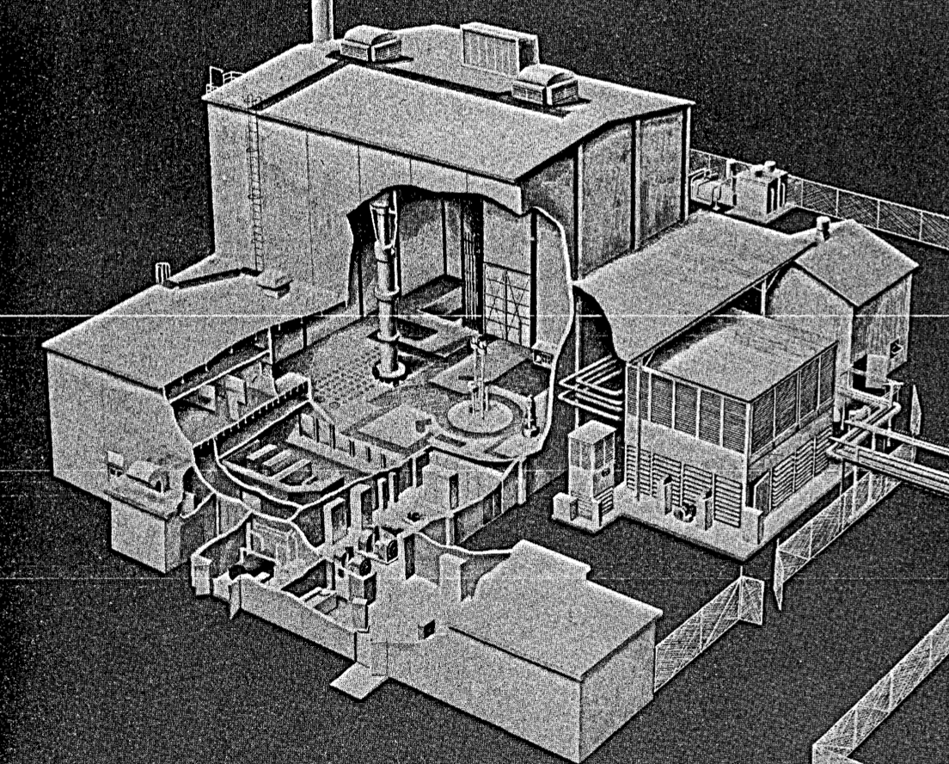
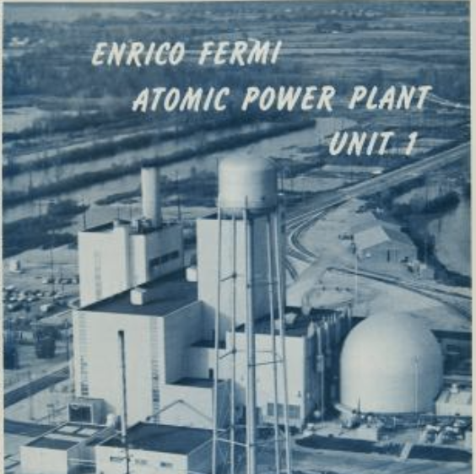
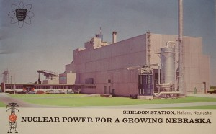
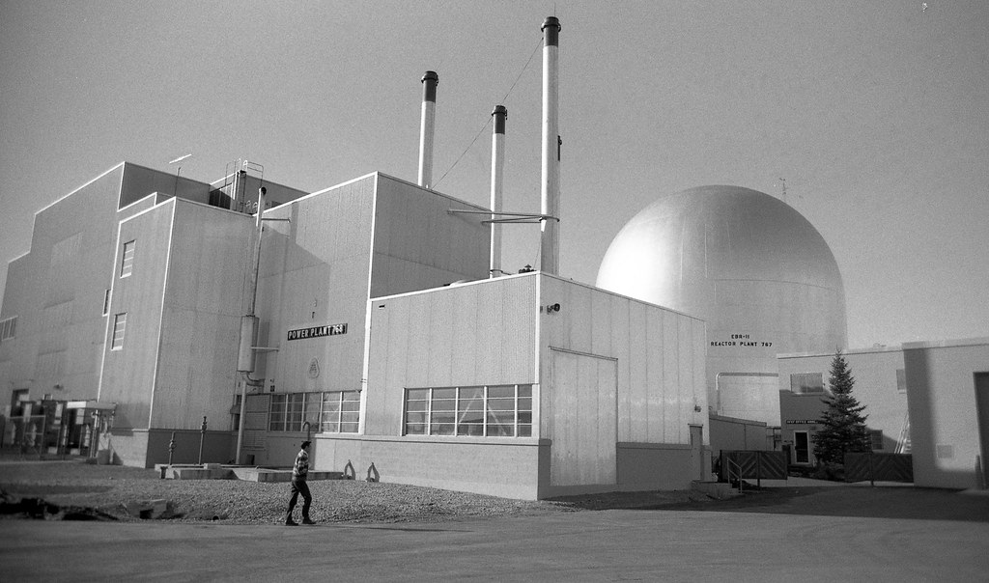
Early U.S. Sodium Reactor Experience
Thermal and Fast Reactors
  The U.S. explored both thermal (graphite moderated) and fast sodium reactor designs in the 1950s and 1960s.
Metal Fuel
  Early U.S. liquid metal reactor development focused on the use of metal fuel (EBR-I, SRE, Fermi-1, EBR-II, HNPF).
  However, difficulties were encountered in achieving higher burnup levels, with cladding stress limiting fuel burnup to 1-2%
Sodium Reactor Experiment (SRE)
1957-64
Fermi-1
1963-72
Hallam Nuclear Power Facility
1963-64
EBR-II
1963-92

Slide 5
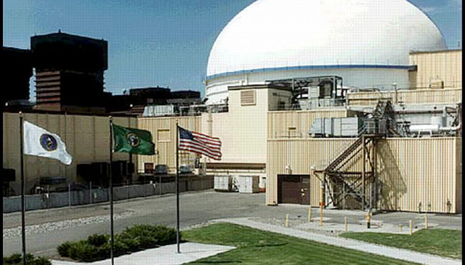
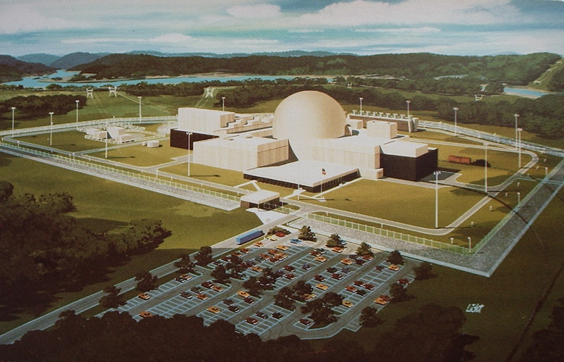
FFTF and Clinch River Breeder Reactor
Switch to Oxide Fuel
  Further U.S. sodium reactor development switched to oxide fuel, based on experience from the LWR operating fleet and naval reactors.
Fast Flux Test Facility (FFTF)
  A loop-type, oxide-fuel SFR operated successfully from 1980-1992.
Clinch River Breeder Reactor (CRBR)
  Following FFTF experience, CRBR was to be a large loop-type, oxide-fuel commercial SFR. Significant licensing challenges were encountered (described on the next slide), which contributed to the project’s eventual cancellation in 1983.

Slide 6
CRBR Licensing Challenges
Hypothetical Core Disruption Accidents (HCDAs)
  Severe accident concerns were a major impediment to CRBR licensing and consumed significant project resources.
  After much effort, the USNRC eventually excluded HCDAs from the design basis:
    “It is our current position that the probability of core melt and disruptive accidents can and must be reduced to a sufficiently low level to justify their exclusion from the design basis accident spectrum. We will therefore not consider CDAs as design basis accidents.”
  However, certain CDA considerations, such as vessel head and containment functional requirements to mitigate energetic events, were still mandated.
- Letter from the NRC to the CRBR project, 1976

Slide 7
Shift Back to Metal Fuel
Advanced Liquid Metal Reactor (ALMR) & Integral Fast Reactor (IFR)
  Following the cancellation of CRBR, U.S. SFR research in the 1980s shifted to pool-type metal fuel designs to address the regulatory concerns regarding severe accidents that were raised during the CRBR process.
  Further metal fuel testing demonstrated that the previous burnup limitations could be overcome through fuel design changes to accommodate swelling, such as the addition of large fission gas plenums and increased fuel-cladding gap size.
  Pool-type designs were adopted to eliminate the possibility of large primary sodium piping breaks outside of the reactor vessel.
  Focus on prevention: The U.S. SFR safety approach shifted to primarily demonstrating the extremely low likelihood of fuel damage events, and benign termination of such events, based on the inherent properties of metal fuel (discussed in later slides).

Slide 8
Background
  Early U.S. Sodium Reactors
  Clinch River Breeder Reactor
  Metal fuel and IFR/ALMR
Current Perspective
  Risk-Informed Approaches
  SFR Accident Prevention
  Modsim Capabilities & Experimental Programs

Slide 9
Overview
Current U.S. Perspective
  All current U.S. SFR vendors utilize metal fuel pool-type designs (TerraPower, GE-Hitachi, Oklo, etc.)
  Risk-informed approaches are utilized to demonstrate that severe accidents are within the “residual risk” category due to the use of inherent and passive design features. Since such events are outside the design basis and dedicated severe accident mitigation systems are not required.
  “Credible” fuel damage events result in benign termination due to inherent properties of metal fuel and associated reactor design features.
  Modsim capabilities and experimental testing campaigns are utilized to demonstrate and support the above points.

Slide 10
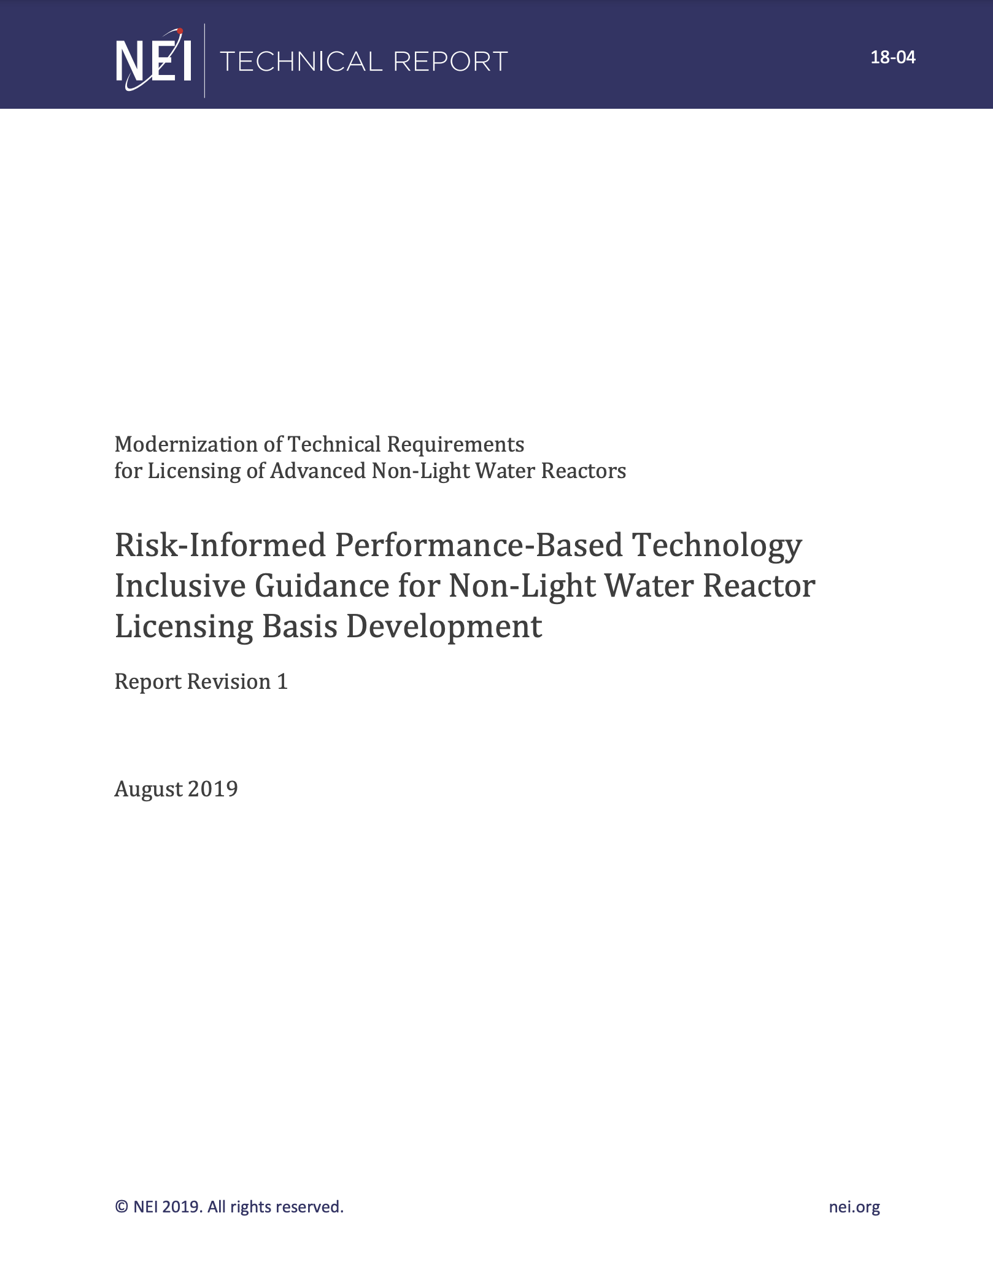
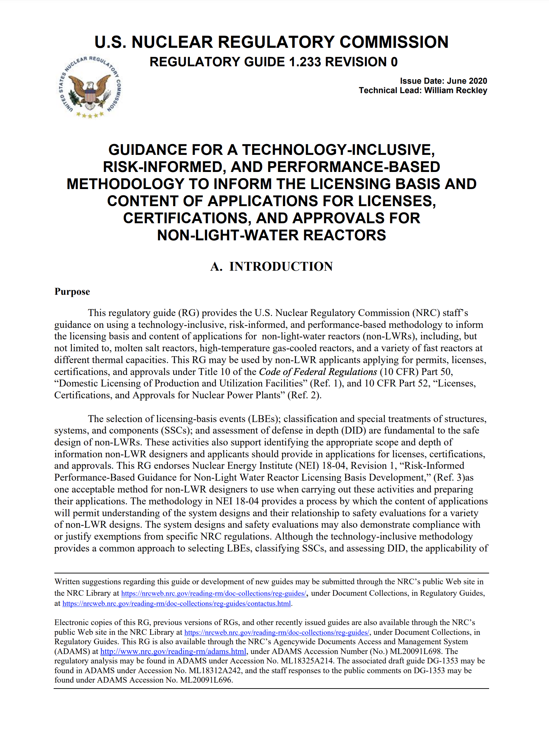
Risk-Informed performance-Based (RIPB)
Licensing Modernization Project (LMP):
  The USDOE, in collaboration with industry, have recently developed the LMP approach for advanced reactor licensing
  LMP is a technology-inclusive, RIPB licensing pathway that utilizes results from the PRA to inform the following aspects of the safety basis:
    Event categorization
    SSC classification
    Evaluation of defense-in-depth adequacy
  The LMP approach was recently endorsed by the USNRC (RG 1.233)

Slide 11
Risk-Informed performance-Based (RIPB)
Licensing Modernization Project (LMP):
  Event sequence families from the PRA are categorized into different licensing basis events (LBEs) based on frequency of occurrence*:
    Anticipated Operational Occurrence (AOO)
    Design Basis Event (DBE)
    Beyond Design Basis Event (BDBE)
  A frequency versus consequence curve (right) is used to provide guidance regarding the importance of specific LBEs and SSCs.
  Design basis accidents (DBAs) are derived from DBEs and assessed using conservative criteria
*Based on 95th percentile

Slide 12
Risk-Informed performance-Based (RIPB)
Importance to SFRs:
  As highlighted in the CRBR licensing experience, the USNRC stated that:
  “…core melt and disruptive accidents can and must be reduced to a sufficiently low level to justify their exclusion from the design basis accident spectrum.”
  A risk-informed approach is one method of demonstrating the above and the LMP approach provides a USNRC-endorsed RIPB process.
  LMP is not the only possibility though, and the USNRC is currently drafting a new 10 CFR Part 53 licensing pathway that provides alternative avenues (such as the use of a mix of risk-informed and deterministic analyses)

Slide 13
SFR Severe Accident Prevention
Focus on Prevention of Severe Accidents:
  Current SFR designs require multiple failure events for fuel damage to occur, resulting in very low frequency of potential occurrence.
  For “credible” fuel damage events, propagation of fuel failure needs to be prevented or limited.
Examples:
  Loss-of-Coolant: Highly unlikely given pool-type design and utilization of a guard vessel
  Loss-of-Heatsink: Large thermal inertia of pool and both active and passive decay heat removal systems
  Loss-of-Flow: Typically requires designed short-term, minimal coastdown to successfully transition to natural circulation (dependent on design)
  Transient Overpower: Highly reliable reactor protection system and inherent negative reactivity feedback

Slide 14
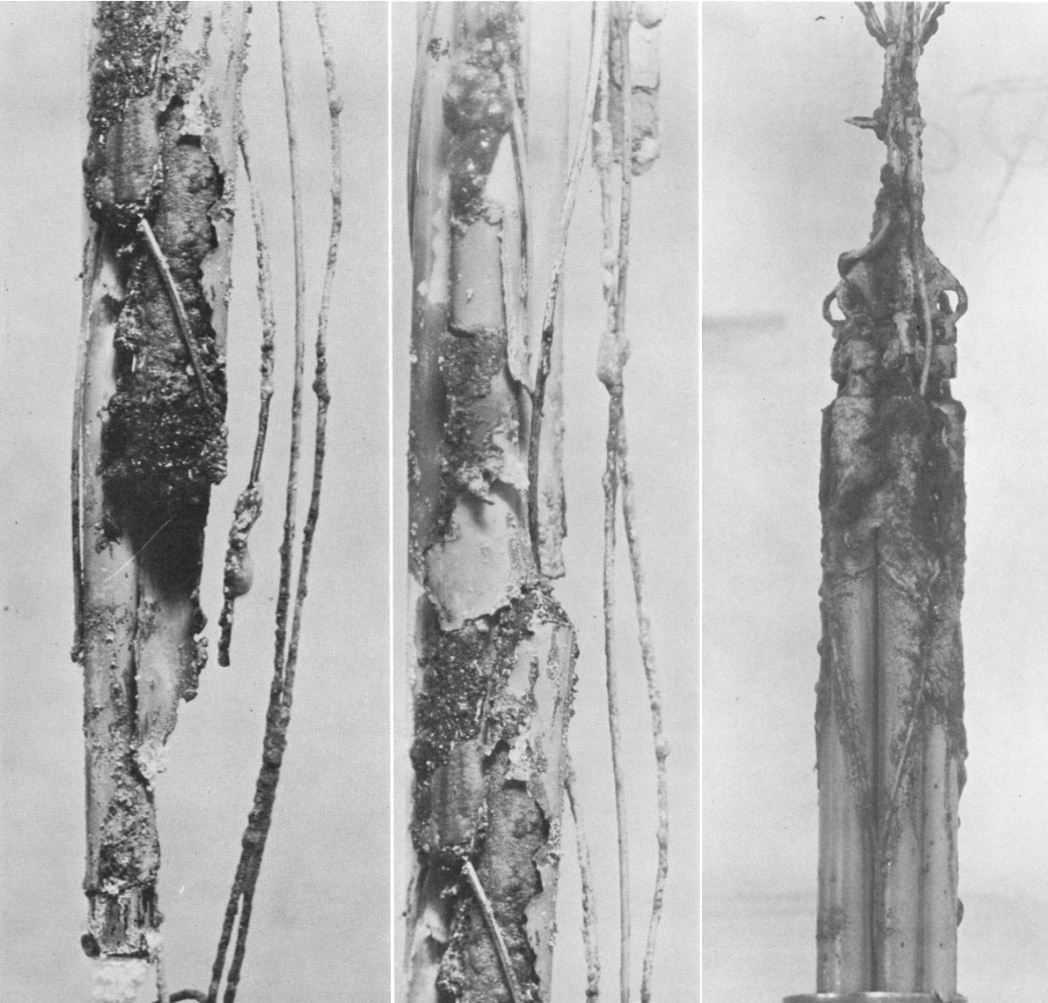
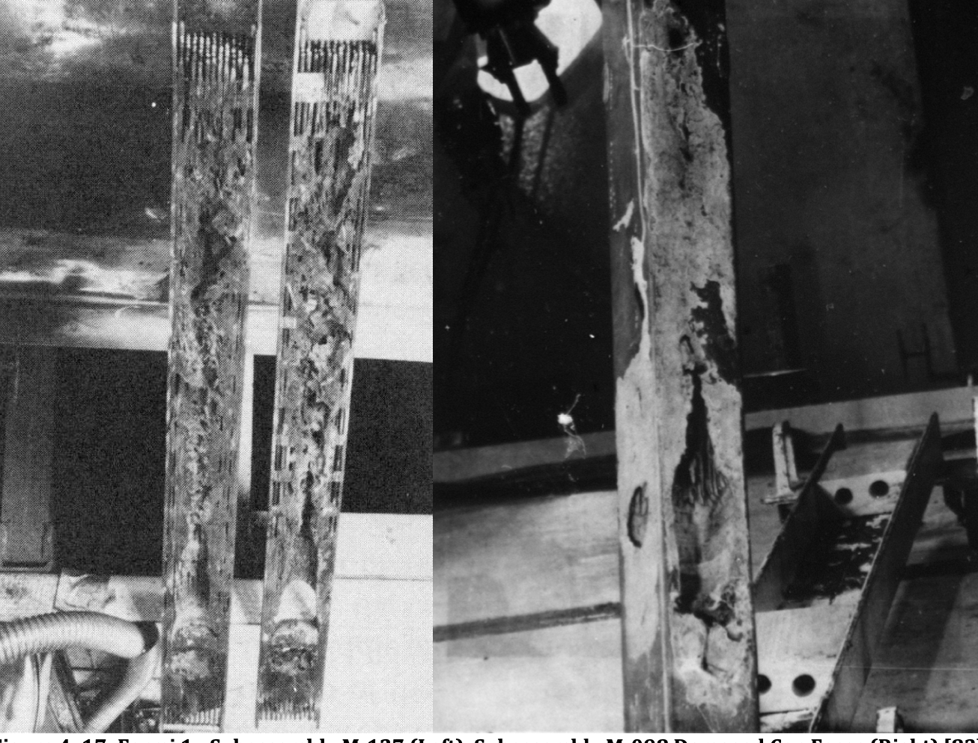
SFR Severe Accident Prevention
Flow Blockages
  Valuable experience gained from two early metal-fuel sodium reactor flow blockage events:
  SRE: Ingress of tetralin (hydrocarbon) pump coolant into the primary sodium, reducing core flow paths and leading to eutectic failure of 13 of the 43 fuel elements
  Fermi-1: Two pieces of “meltdown liner” dislodge and restrict flow to several assemblies, resulting in fuel damage in 4 assemblies with no further propagation

Slide 15
SFR Severe Accident Prevention
Flow Blockage Lessons Learned:
  Inlet nozzle designs include multiple coolant inlet passages
  Inlet plenum design to ensure coolant flow distribution and assembly supply
  Instrumentation design to facilitate detection (multiple thermocouples, delayed neutron detectors, gas tags)
  Considerable research and testing of both external and internal blockages have been performed to understand and quantify the damage mechanisms and limits
  Above items support the case that total instantaneous blockage events are not credible for current SFR designs.

Slide 16
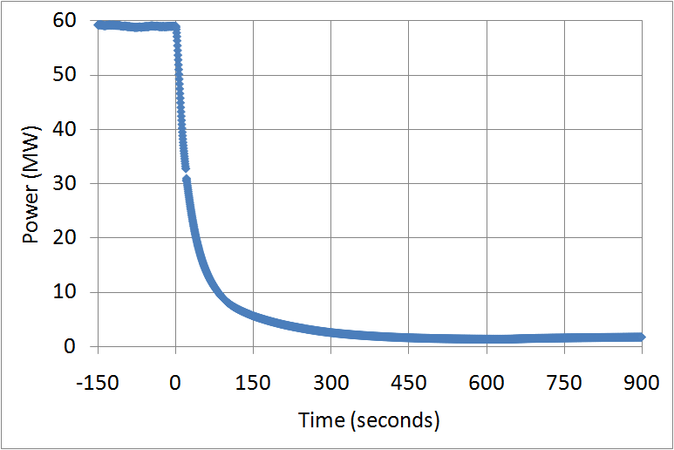
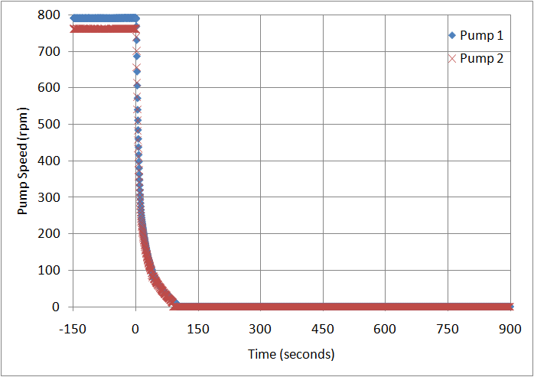
Experimental Support
  EBR-II Shutdown Heat Removal Tests (SHRT)
    SHRT-45R, unprotected (no SCRAM) loss of flow tests
    Many additional whole-reactor tests conducted
  No challenge to fuel integrity
    Power reduction due inherent reactivity feedbacks
Power
Pump Speed

Slide 17
Experimental Support
  Cladding Breach Experiments
    Failed fuel performance
    Leaker tests – 1960s
    Run Beyond Cladding Breach (RBCB) – 1980s
  Fuel Behavior Test Apparatus (FBTA)
    Examined FCCI rates and temperatures for liquid phase formation
    Radiant furnace
    Heated irradiated pin segments (U-10Zr, U-Pu-Zr)
    Examined cladding failure margin at elevated temperatures
    Radiant furnace
    Heated irradiated whole pins (U-Zr, U-Pu-Zr)

Slide 18
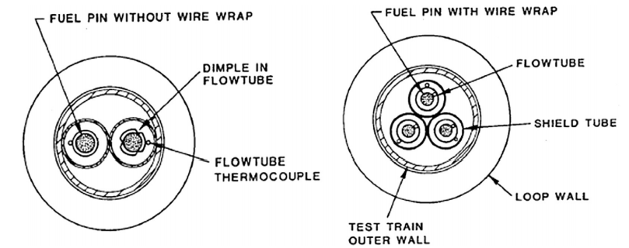
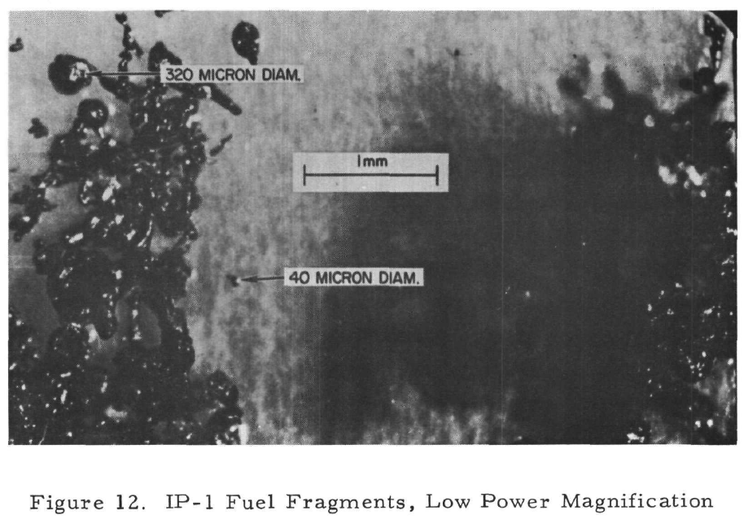
Experimental Support
  TREAT M-Series
    Examined fuel melting and relocation, clad failure
    Whole irradiated EBR-II pins U-5Fs/SS, U-10Zr/HT9, U-19Pu-10Zr/D9
    Utilizing flowing sodium loops
    Subjected to extreme transient overpowers (>4x nominal)
  Metal Fuel Quenching
    Examined fragmentation/coolability
    Molten fuel dropped into sodium
  Melt Tests
    Assessed radionuclide release
    Melt refining EBR-II fuel
    ORNL, Hanford, Atomics International
    Typically in inert or air environment

Slide 19
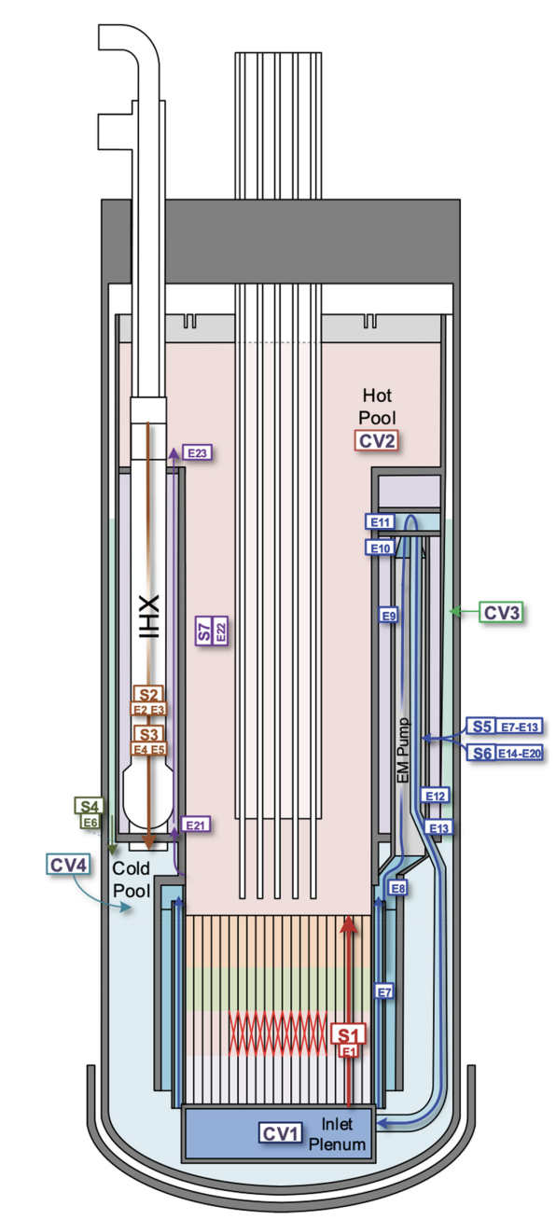
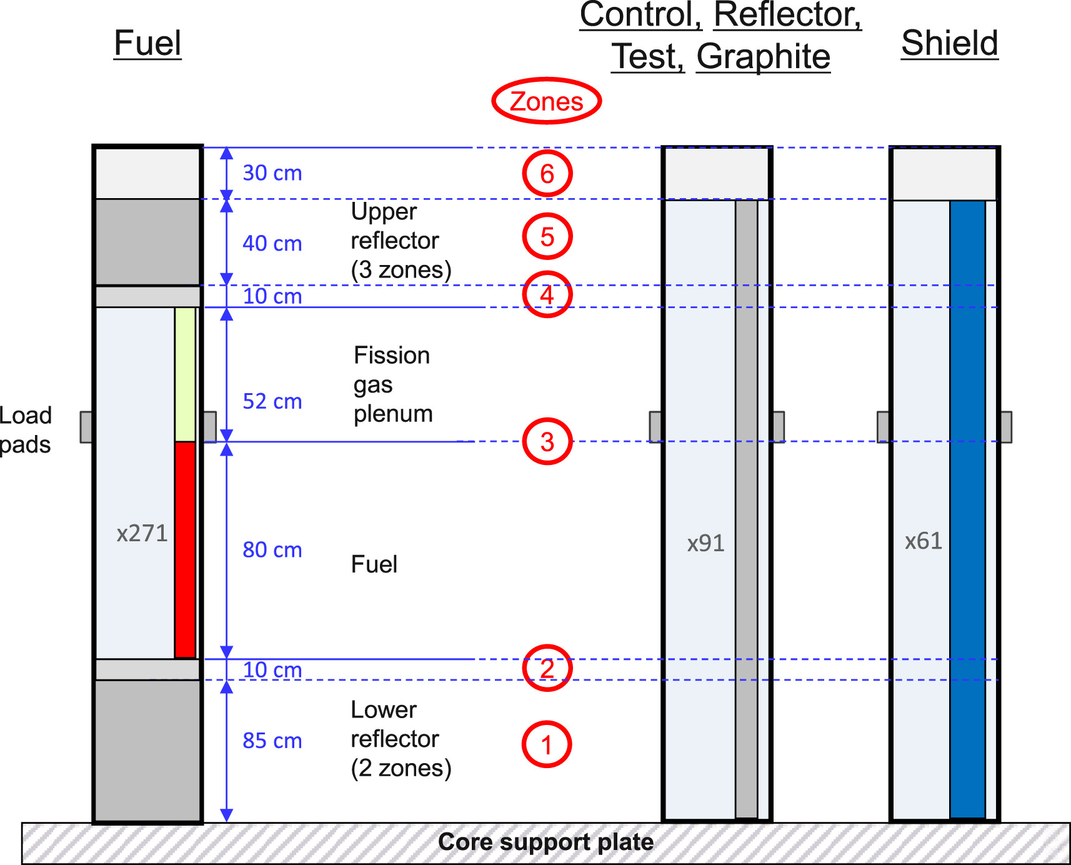
SAS4A/SASSYS-1 Modeling Capabilities
Accident Prevention
  The neutronic and thermal-hydraulic models in SAS4A/SASSYS-1 are fundamental to demonstrating the performance of the SFR design in preventing conditions where fuel damage could occur.
  In continuous use and development since the 1960s, SAS4A/SASSYS-1 is utilized throughout the U.S. SFR industry.
  SAS4A/SASSYS-1 has been validated utilizing numerous experimental programs and tests (such as EBR-II and FFTF) including both protected and unprotected transient scenarios.

Slide 20
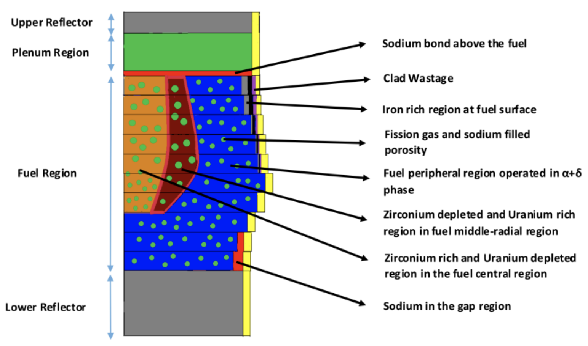
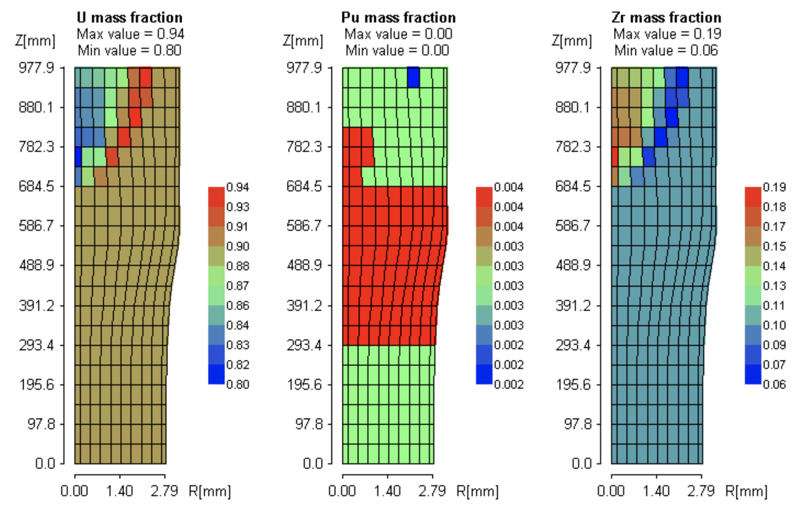
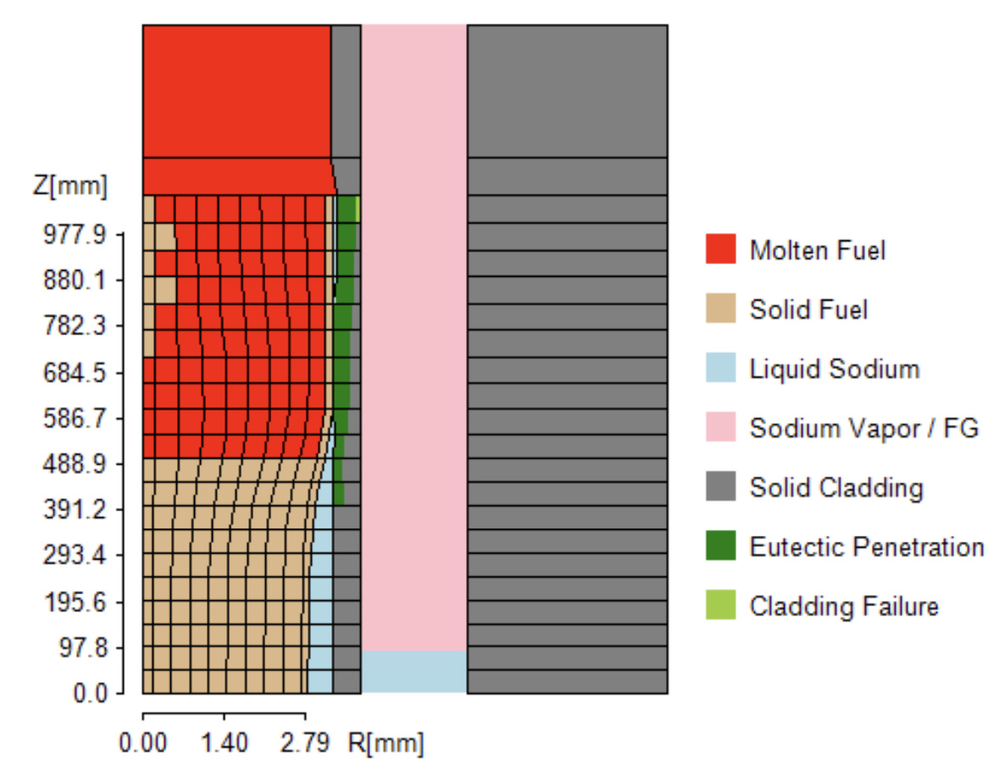
SAS4A/SASSYS-1 Modeling Capabilities
Severe Accident Models
  SAS4A/SASSYS-1 contains detailed models regarding fuel behavior during transient scenarios, with ongoing updates to the metal fuel modeling capabilities.
  Metal fuel phenomena modeled include:
    Pre-transient constituent redistribution
    Fuel-cladding interaction
    Fuel movement and relocation (in-pin and ex-pin)
  SAS4A/SASSYS-1 metal fuel models:
    SSCOMP: pre-transient metal fuel characterization
    DEFORM: transient metal fuel pin mechanics
    PINACLE: pre-failure in-pin metal fuel relocation
    LEVITATE: post-failure metal fuel relocation

Slide 21
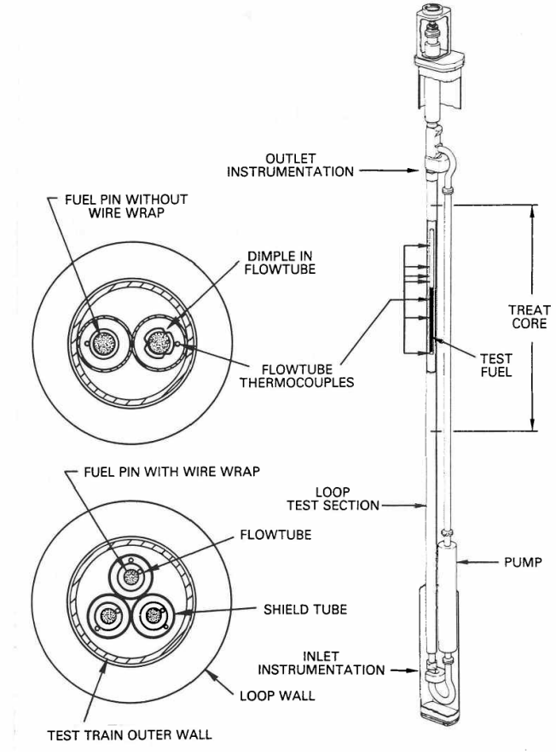
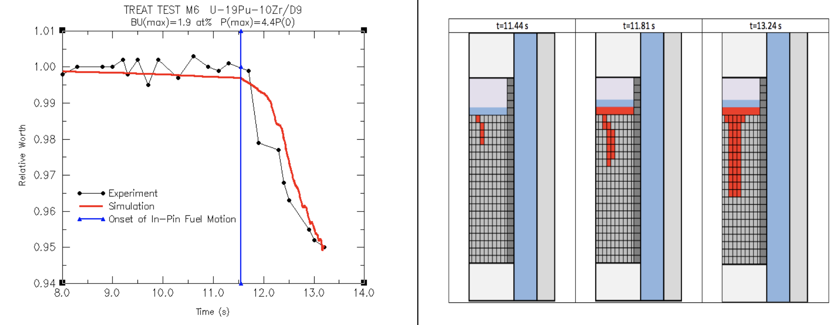
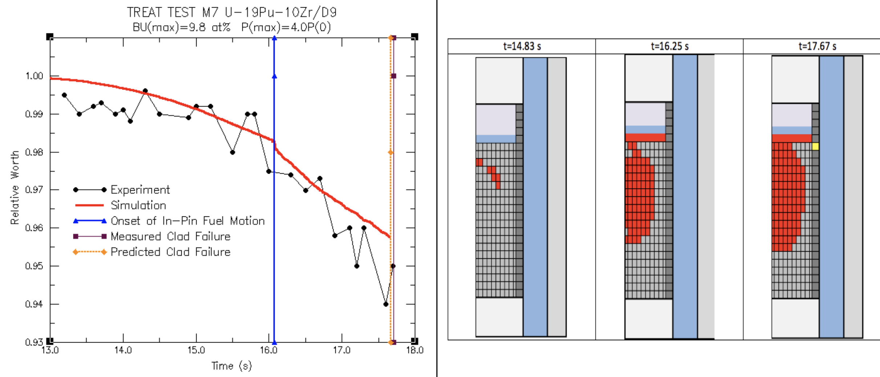
SAS4A/SASSYS-1 Modeling Capabilities
Severe Accident Models
  Validation of the updated SAS4A/SASSYS-1 metal fuel severe accident models was performed utilizing the TREAT M-Series TOP tests.
  The updated metal fuel severe accident models are currently being integrated into the main version of the SAS4A/SASSYS-1 code.

Slide 22
Conclusions

Slide 23
Conclusions
Current U.S. SFR severe accident strategy focuses on prevention through the utilization of passive and inherent reactor design features and risk-informed design/licensing approaches
Pool-type designs and the use of metal fuel are central to achieving this goal, with significant experimental data to support mod/sim capabilities
The new generation of U.S. SFR designs are now entering the licensing process.

Slide 24
