Slide 1
RECENT DEVELOPMENTS IN MODELING OF SEVERE ACCIDENT ANALYSIS CODE PREDIS
Anuraj V L, T. Sathiyasheela, K. Devan
Indira Gandhi Centre for Atomic Research, India.

Slide 2
Safety analysis Code system
PREDIS
Pre-disassembly Phase calculation
Reactor power and system temperature changes with time
Disassembly phase calculation
Coupled point kinetics hydrodynamics code
MERC
Mechanical work potential of the core estimated
VENUS

Slide 3
Molten clad relocation
melting
Upward motion
freezing
Flow reversal
slumping
Clad melts soon after a local dryout of coolant.
High sodium vapor velocity leads upward motion of molten clad
Molten clad reaching the blanket (low temperature) region freezes
Flow blockage leads to flow reversal and draining down the channel
The molten clad can finally slump into the liquid sodium

Slide 4
The model
Coolant channel is assumed to be voided.
Reentry of the upper liquid sodium into the hot core will not take place.
Molten clad moves as film rather than as entrained droplets.
The vapor phase of coolant is assumed to be incompressible.
No source of gas either from fission product gas or steel vaporization.
Molten Clad Motion Model for Fast Reactor Loss-of-Low Accidents
M. Ishii, W. L. Chen, and M. A. Grolmes, Nuclear Science and Engineering: 60, 435-451, 1976

Slide 5
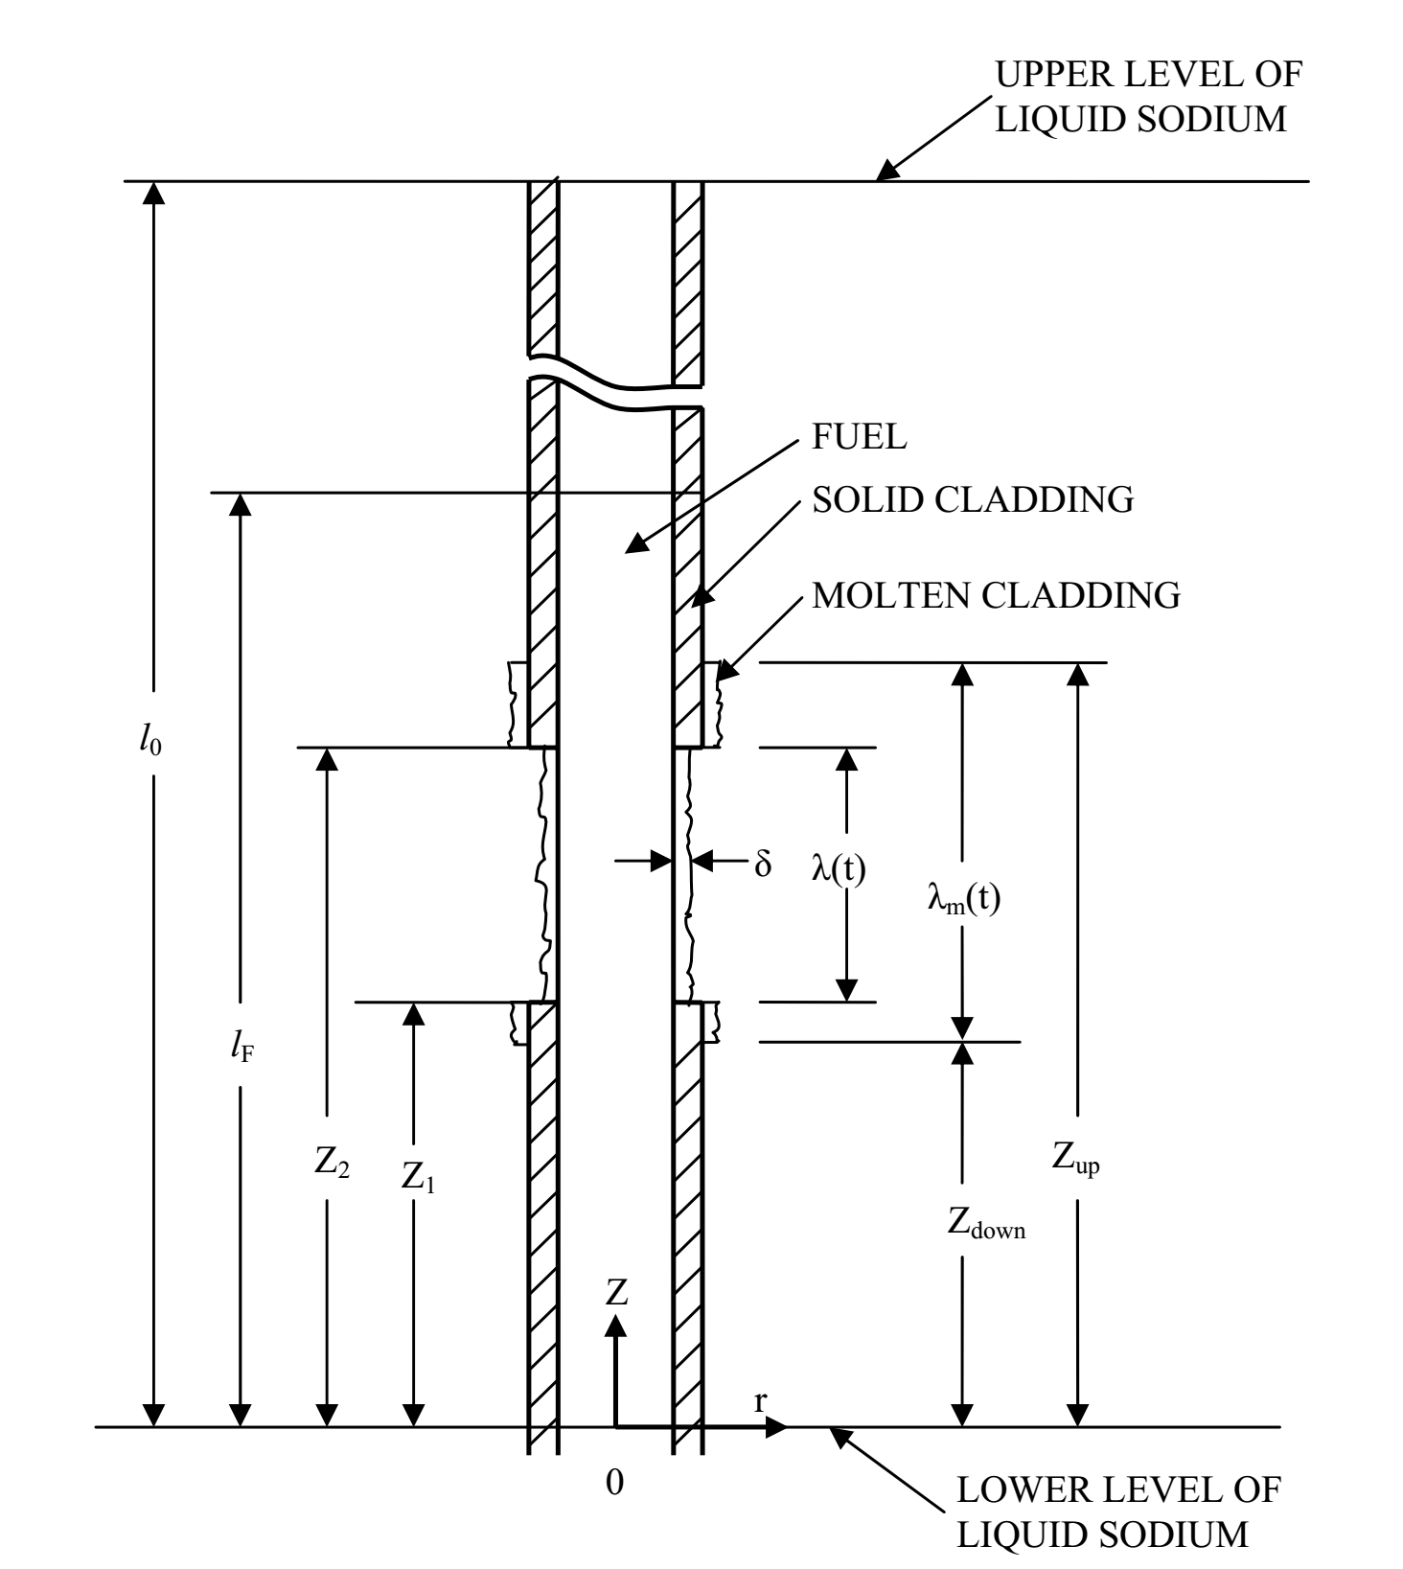
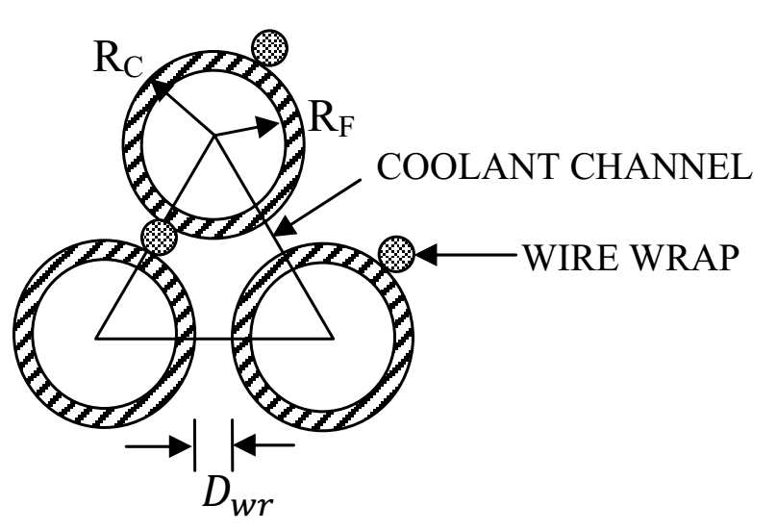
The model

Slide 6
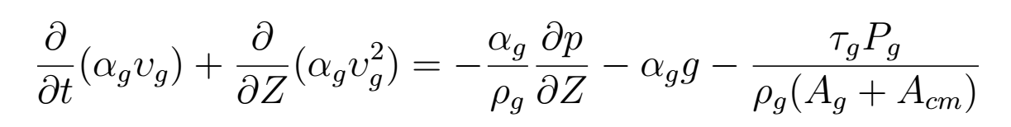
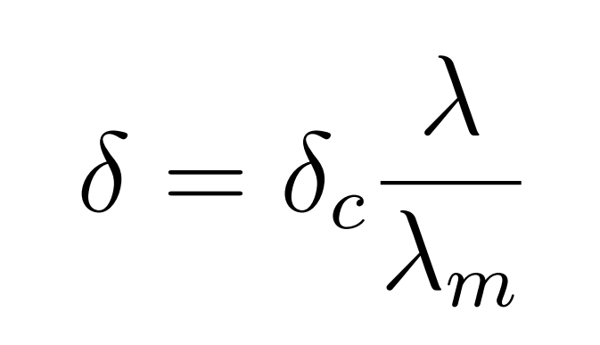
The model
Theory
One –dimensional equation of motion for sodium vapor and molten clad
Assuming the film thickness is uniform over the molten part, conservation of mass gives

Slide 7
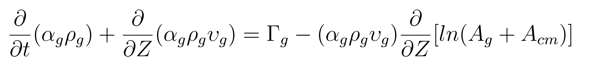
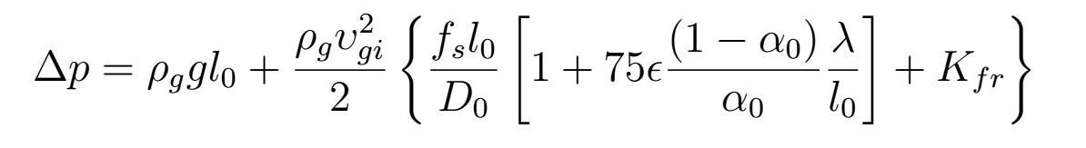
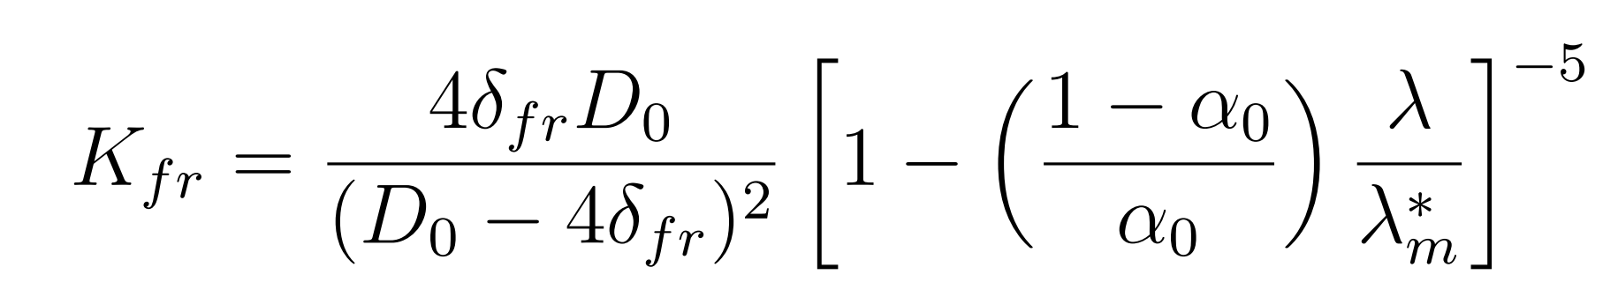
The model
Theory
One –dimensional vapor continuity equation
The integrated form of the vapor momentum equation equation
The blockage resistance coefficient

Slide 8
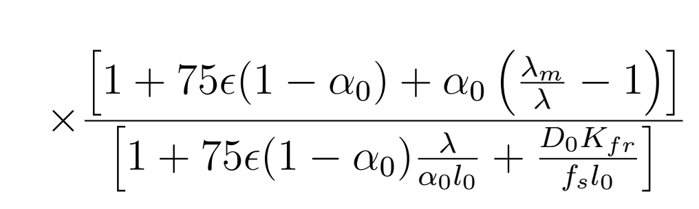
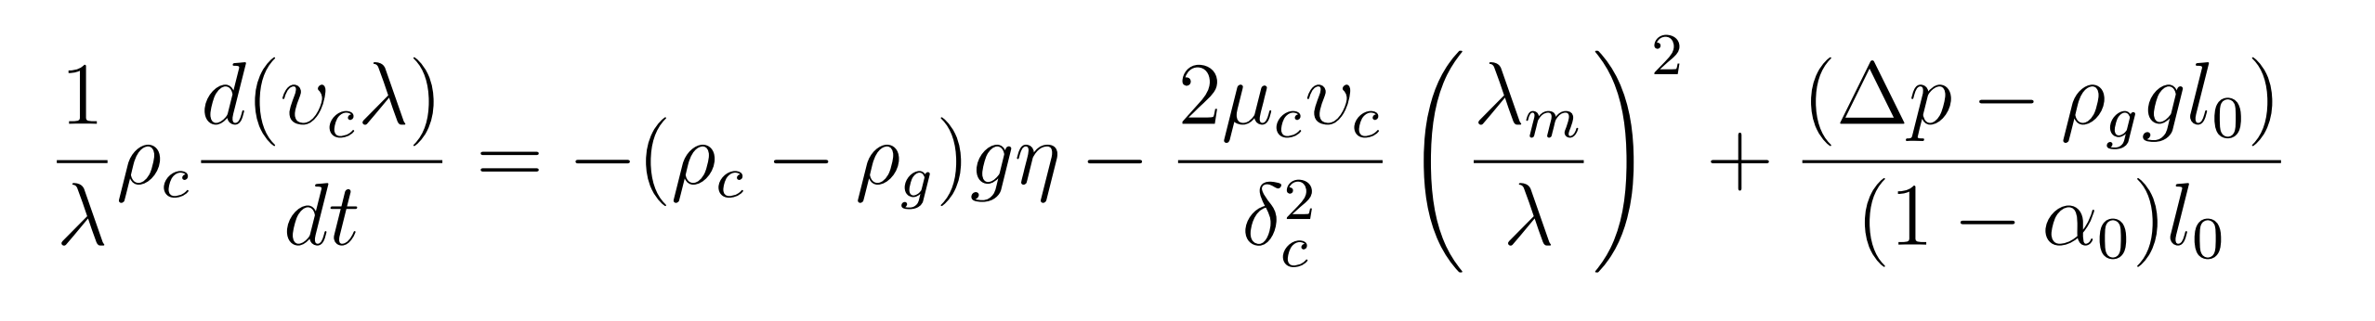
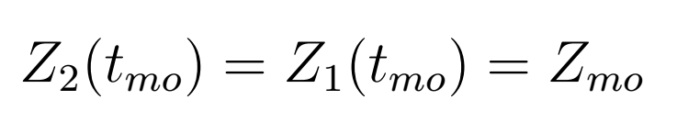
The model
Theory
The integral momentum balance equation for molten clad is
The molten steel film velocity is calculated solving this equation using Euler method
If t_{m0} is the time when clad motion starts

Slide 9
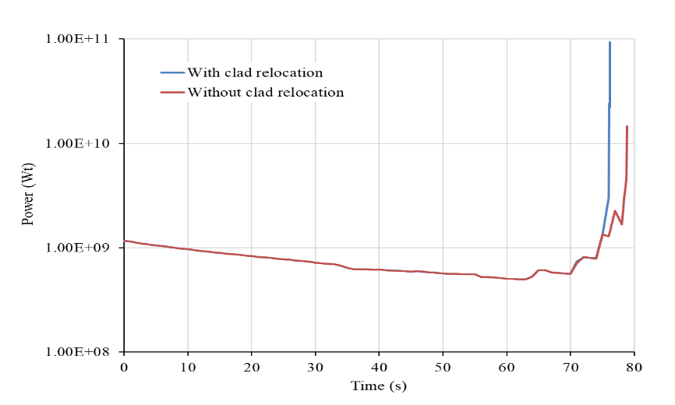
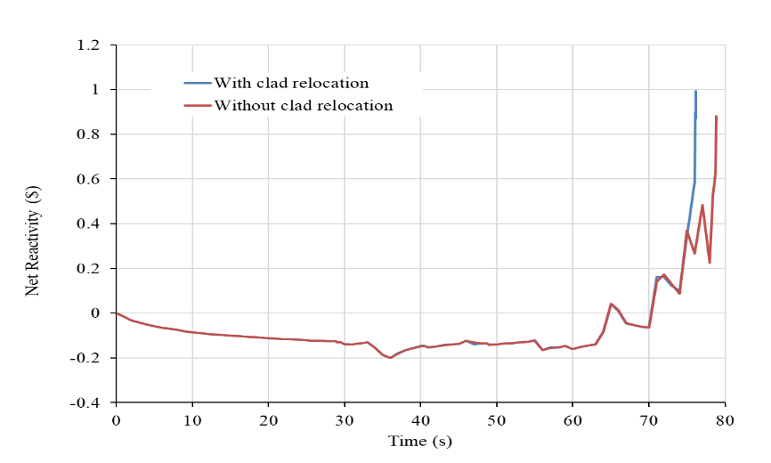
PFBR ULOFA analysis
Reactor power with time
Net reactivity with time

Slide 10
results

Slide 11
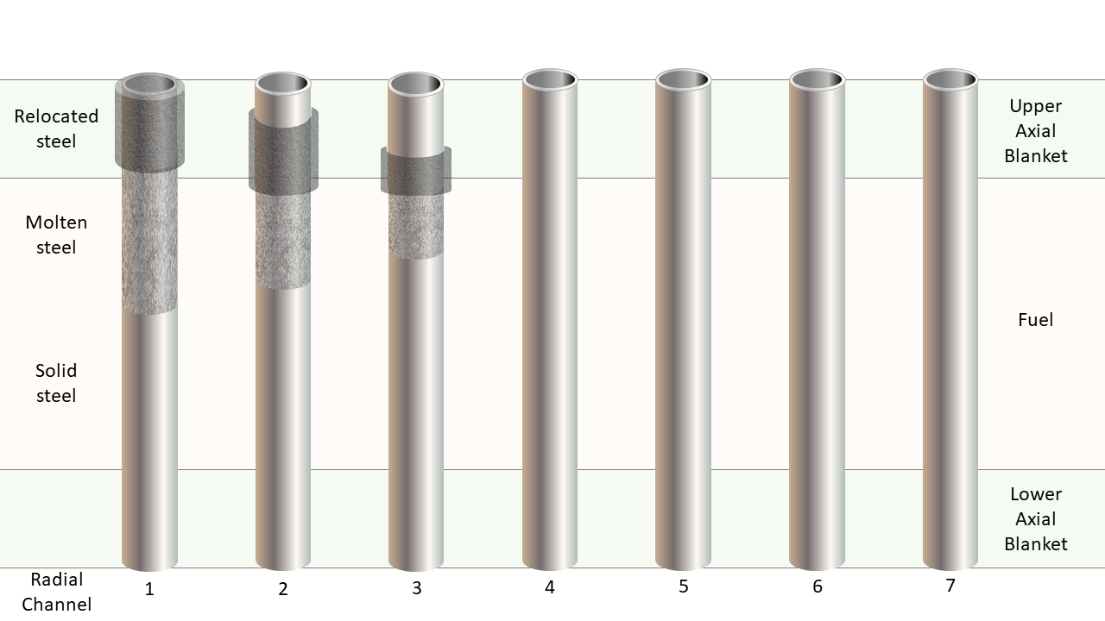
Status at the end of pre-disassembly phase

Slide 12
RESULTS
Parameter | Without clad relocation feedback | With clad relocation feedback
At the end of pre-disassembly phase
Reactor power (W) | 14.56 x10⁹ | 93.42 x 10⁹
Net reactivity ($) | 0.881 | 0.993
Phase duration (s) | 78.84 | 76.17
At the end of disassembly phase
Input reactivity addition rate ($/s) | 65.6* | 65.6
Phase duration (ms) | 10.81 | 8.15
Fuel vapor fraction (%) | 39.8 | 34.9
Thermal energy release (MJ) | 5544 | 5107
Mechanical energy release (MJ) | 100 | 103
* 65.6 $/s is the reactivity addition rate corresponds to 100 MJ of energy release

Slide 13
fuel expansion MODULE
FEXPAN models a time-dependent hydrodynamic expansion of a homogeneous fluid medium in spherical geometry.
The model simulates the core expansion surrounded by a compressible medium.
The model is adapted in the present analysis and a study of post disassembly hydrodynamic expansion for FFTF geometry is performed.
The output provides the temporal and spatial pressure distribution in the fuel bubble following disassembly.

Slide 14
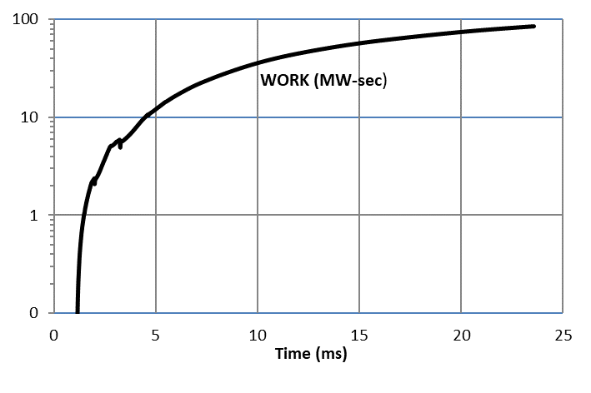
fuel expansion MODULE
PREDIS
REFERENCE

Slide 15
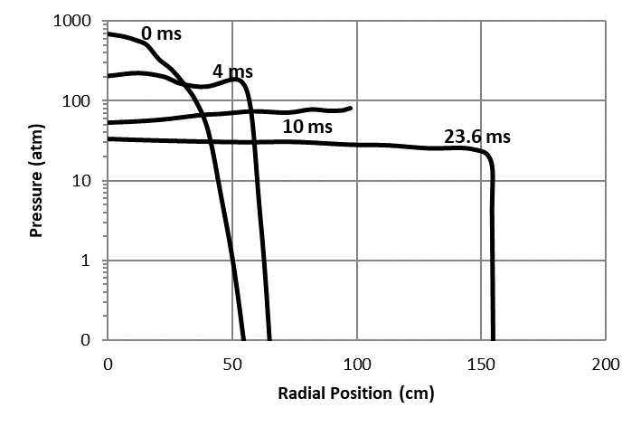
fuel expansion MODULE
Pressure (bar)
PREDIS
REFERENCE

Slide 16
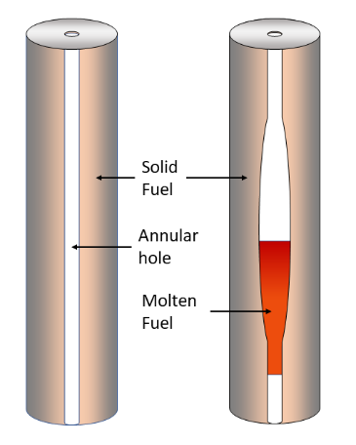
IN-pin fuel motion
In-pin fuel motion is a hydrodynamic movement of molten fuel inside the fuel pins of a fast reactor under UTOPA without pin failure.
UTOPA analysis of a medium sized MOX fuelled fast reactor of rated power 600 MW is carried out.
With melting the melt radius increases and the molten fuel is relocated to the central hole
Once it is relocated it is dropping down due to gravity, and when it reaches the lower portion it solidifies.

Slide 17
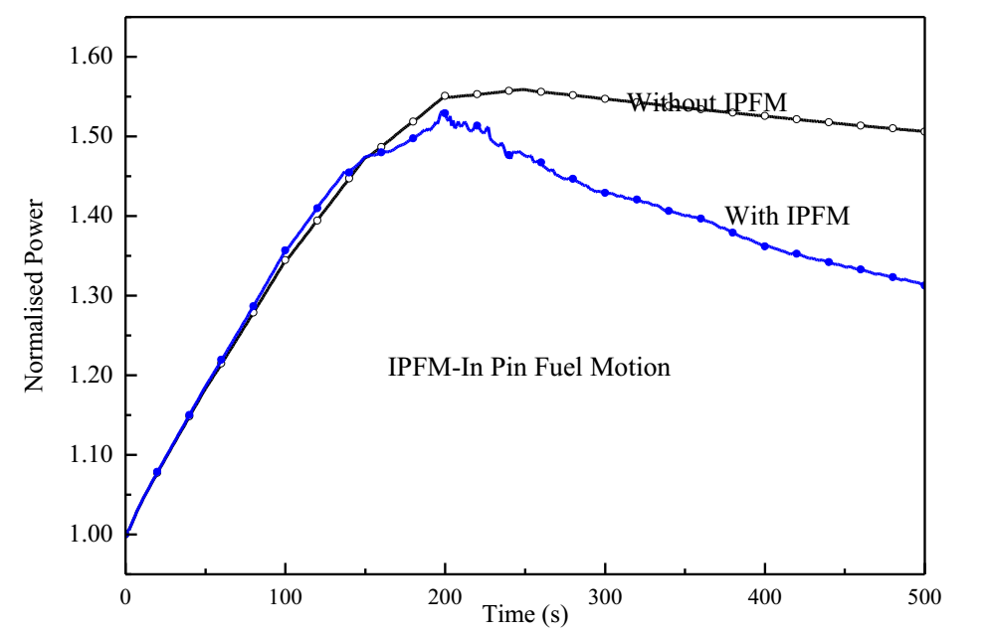
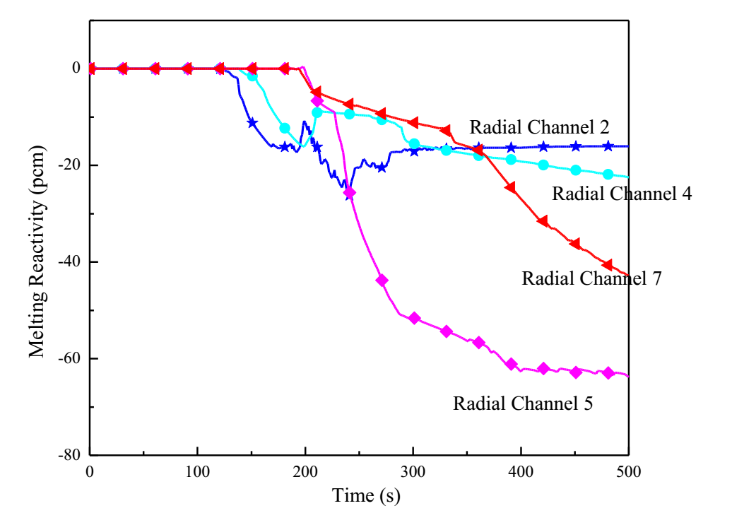
IN-pin fuel motion
Reactor power with time
Melting reactivity with time

Slide 18
IN-pin fuel motion
Considering in pin fuel motion feedbacks not only reduces the power at the end of the transient, it also reduces the hot spot clad, coolant temperature and also the number of radial channels undergo melting.
Parameter (at 500 s) | UTOPA without IPFM | UTOPA with IPFM
Power (%) | 150 | 131
Peak clad temperature (⁰C) | 819 | 758
Peak coolant temperature (⁰C) | 817 | 756
Clad hotspot temperature (⁰C) | 863 | 796
Coolant hotspot temperature (⁰C) | 855 | 789
Inlet coolant temperature (⁰C) | 492 | 471

Slide 19
fFTF LOFWOS TEST simulation with PREDIS
PREDIS code is benchmarked against FFTF Loss of Flow Without Scram (LOFWOS) test.
The test was initiated at 50% power and 100% flow with all three primary sodium pumps tripped simultaneously.
Gas Expansion Modules (GEM) was introduced to demonstrate their effectiveness.
Transient analyses are carried out with PREDIS code and the evolution of power is compared, net reactivity in the core is compared with the ANL result.
The code could predict the net reactivity change and power evolution fairly well.

Slide 20
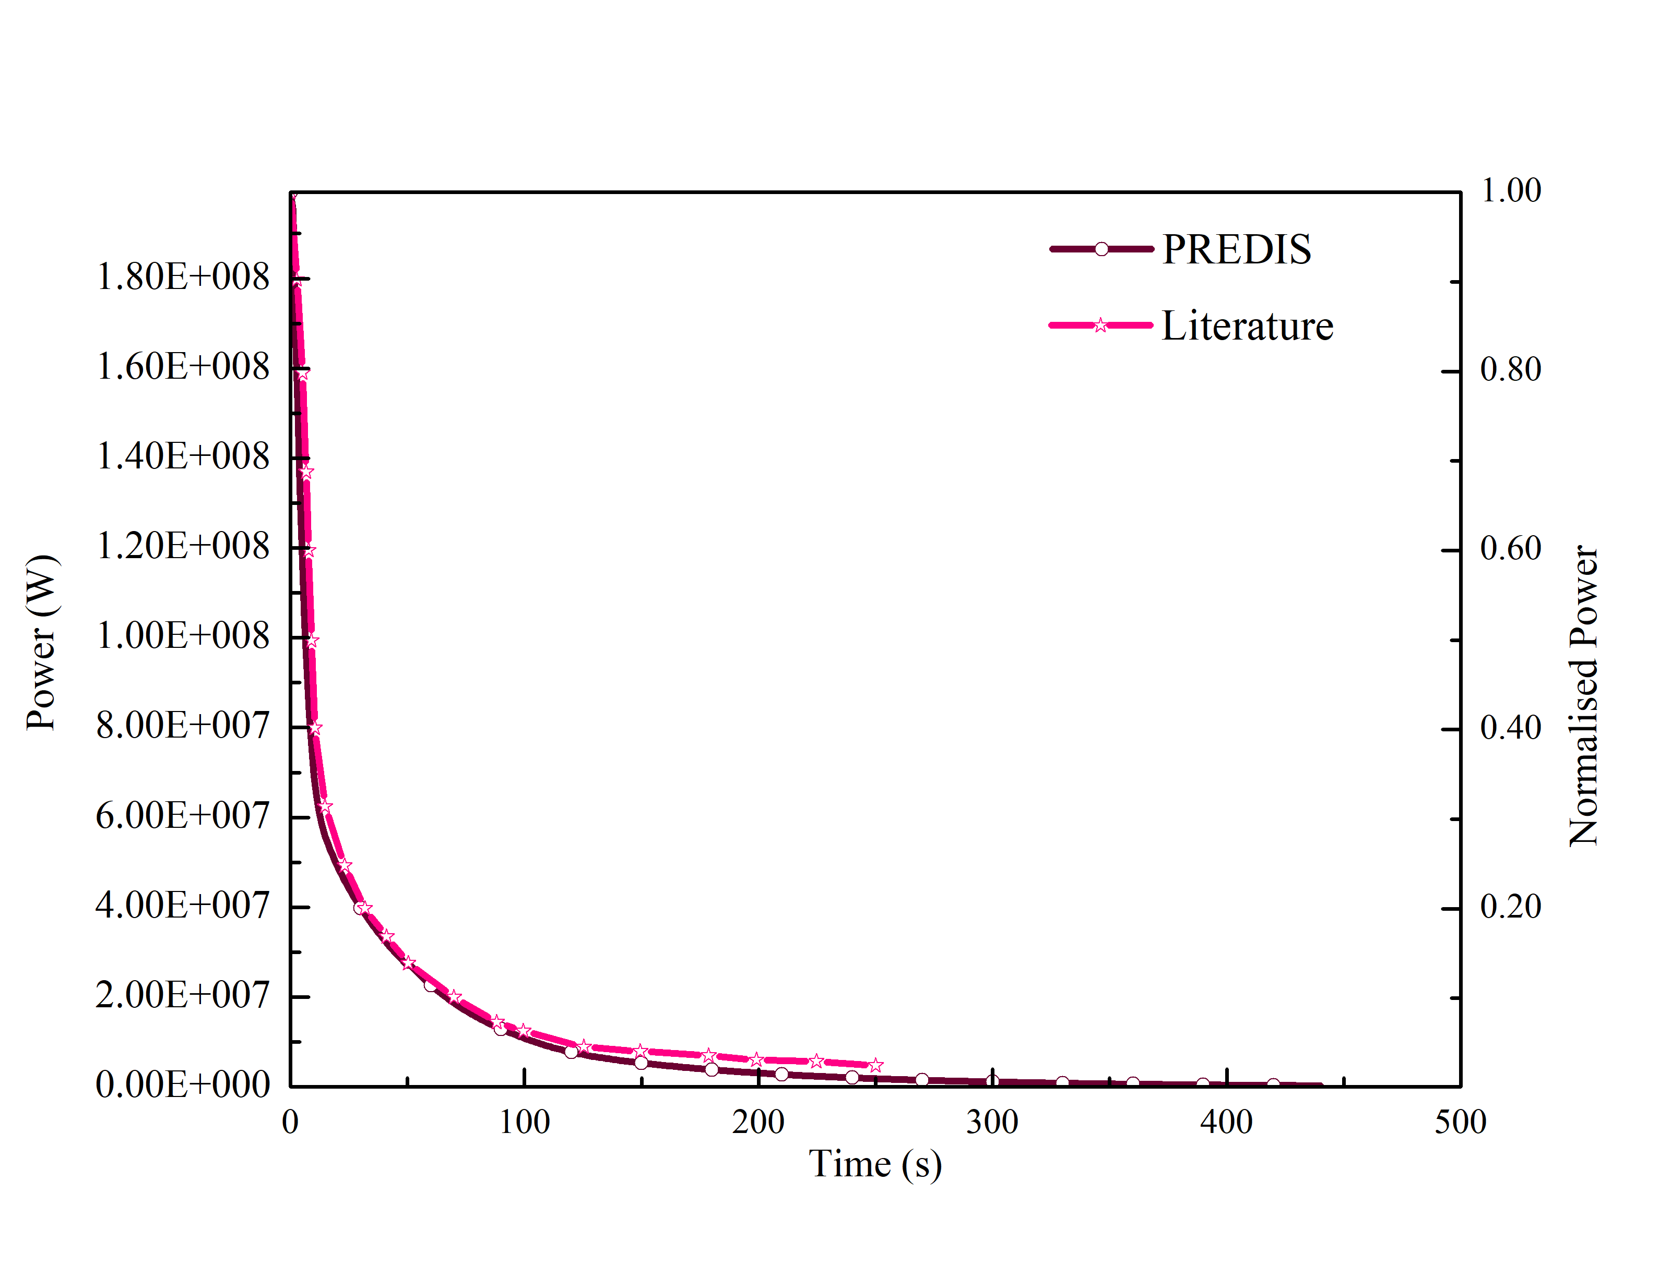
fFTF LOFWOS TEST simulation with PREDIS
Net reactivity with time
Reactor power with time

Slide 21
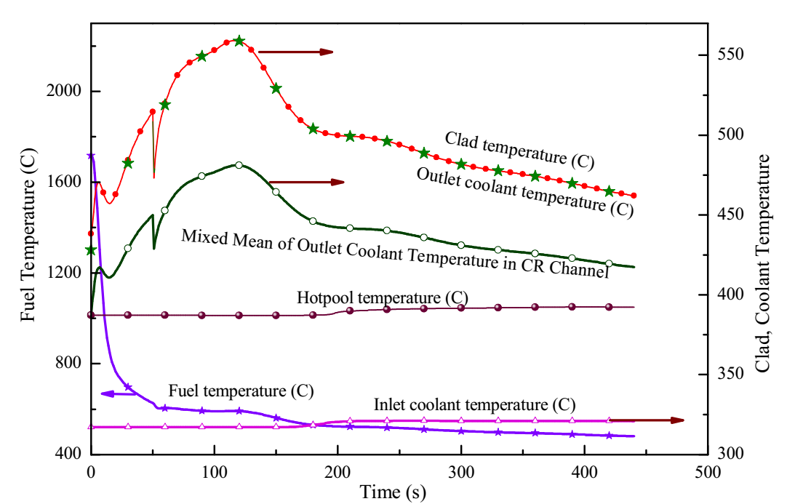
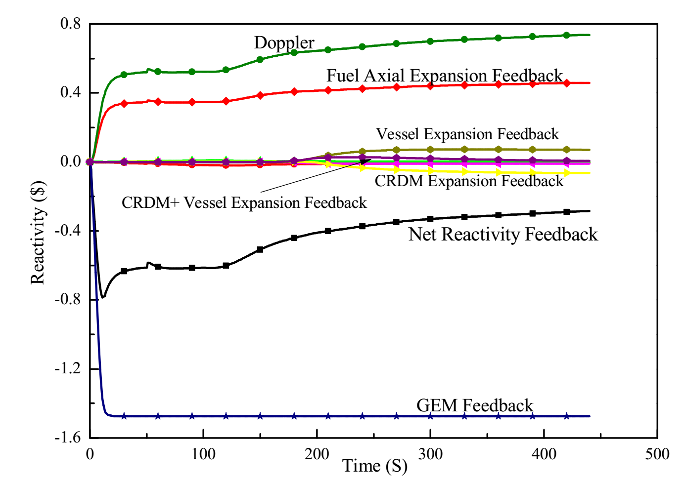
fFTF LOFWOS TEST simulation with PREDIS
Variation in temperature with time(PREDIS)
Feedback reactivity components (PREDIS)

Slide 22
conclusions
Clad relocation model and in-pin fuel motion models are implemented in the safety analysis code PREDIS and the effect of those phenomena in the severe accident characteristics of fast reactors are studied.
A benchmark analysis for PREDIS code is carried against the FFTF LOFWOS test #13.
The models on clad relocation, in-pin fuel motion and the fuel expansion helped in simulating fast reactor severe accidents in more detail.

Slide 23

Thank you
Dr. Anuraj V L
Indira Gandhi Centre for Atomic Research, INDIA
anuraj@igcar.gov.in

