Slide 1
3D THERMALHYDRAULICS-NEUTRONICS SIMULATION OF SFR CORE DEGRADATION WITH THE SEASON FRENCH PLATFORM
Emmanuelle DUFOUR, Pierre GUBERNATIS, Laurent TROTIGNON
CEA, DES, IRESNE, DTN, SMTA, LMAG, Cadarache, F-13108 Saint-Paul-lez-Durance, France
Technical Meeting on the Safety Approach for Liquid Metal Cooled Fast Reactors and the Analysis and Modelling of Severe Accidents, 13-17 March 2023, IAEA

Slide 2
Content
Introduction
Description of the SEASON platform (version 4.2)
Application case : 3D calculation of an ULOF transient on a simplified SFR core
Perspectives

Slide 3
Introduction
1

Slide 4
Introduction (1/2)
SEASON is a new platform
Developed by the French Alternative Energies and Atomic Energy Commission (CEA)
Dedicated to the simulation of SFR core degradation during severe accident transients, from the initial state of the irradiated core until the relocation phase of the corium towards the core catcher
Based on a multi-channel formulation of the SIMMER-V thermalhydraulics and core degradation code
Involving
the chaining of SIMMER-V with a fuel performance code : GERMINAL or SAS-SFR
the coupling of SIMMER-V with a spatial neutronics code : PARIS which uses SNATCH, PARTISN or IDT flux solver
the coupling of SIMMER-V with a code modelling the primary circuit : SIMMER-V or CATHARE in preparation

Slide 5
Introduction (2/2)
Contrary to the former computational scheme based on the chaining of the SAS-SFR and SIMMER codes for calculating a severe accident transient, SEASON allows to calculate the initiating phase and the generalized degradation phase of the accident with the same SIMMER-V code :
Initiating phase→ multi-channel description of the core (offering a good computing performance as long as the channels evolve thermalhydraulically independently)
Generalized degradation phase→ full core description
This allows to perform a more easily achievable transition between the multi-channel calculation of the initiating phase and the full core calculation of the generalized degradation phase, and offers at the same time a better coherency of the whole sequence treatment.
Historical and new computational schemes for calculating a severe accident transient in a SFR

Slide 6
Description of the SEASON platform
2

Slide 7
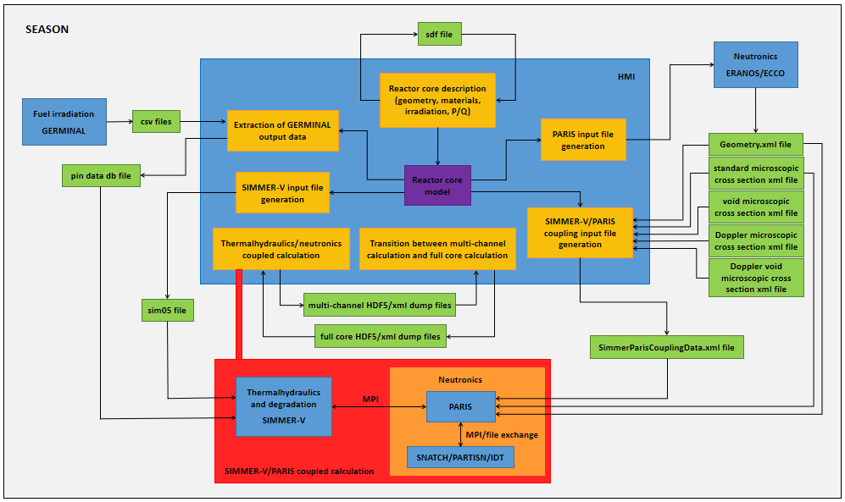
Description of the SEASON platform (1/8)
SIMMER-V
Fundamental component of the SEASON platform
Three-dimensional multi-velocity-field, multiphase, multicomponent, Eulerian, fluid dynamics code coupled with a fuel pin model and a space- and energy-dependent neutron transport kinetics model
Property of JAEA
Co-developed by CEA and JAEA within the framework of the implementing arrangement between CEA, FRAMATOME, JAEA, MHI and MFBR (2020-2024)
Derived from SIMMER-IV with the objective of improving numerical performance and addressing in a more precise and consistent way the whole severe accident sequence from the initiating phase
Architecture of the SEASON platform (version 4.2)

Slide 8
Description of the SEASON platform (2/8)
SIMMER-V
Benefiting from:
an in-development detailed model of fuel pin degradation, called DPIN3, coupled to a complete Pu isotope vector, in order to describe irradiated fuel and general behaviour of in-pin fuel motion
a MPI (domain decomposition) thermalhydraulics parallelization
an OpenMP neutronics parallelization
a dynamical memory allocation
in-development standardized interfacing capabilities allowing the code to dialog and get coupled with other codes
Within SEASON, the SIMMER-V internal neutron kinetics and transport model is not used, but an external neutronics code (PARIS which uses a flux solver that can be SNATCH, PARTISN or IDT) is coupled to SIMMER-V.
Architecture of the SEASON platform (version 4.2)

Slide 9
Description of the SEASON platform (3/8)
Multi-channel formulation of SIMMER-V
Calculation of the initiating phase of the accident by considering a multi-channel modelling of the core :
The core is represented by a partition of the core into several thermalhydraulics channels.
These channels are thermally independent and each channel is computed separately by a different run of the SIMMER-V code.
The geometry of a channel can correspond either to a single subassembly containing an average or several fuel pins (‘simple channel’), or to a group of contiguous subassemblies with one or more representative fuel pins per subassembly (‘extended channel’).
The channels are simulated with user-imposed conditions at axial core boundaries.
Architecture of the SEASON platform (version 4.2)

Slide 10
Description of the SEASON platform (4/8)
SIMMER-V/PARIS coupled calculation
Coupling of the different channel degradation calculations performed with SIMMER-V to a single spatial neutronics calculation, performed by the PARIS code, using a MPI environment :
PARIS initially used the SNATCH flux solver. Then, the parallelized neutron flux solver PARTISN was implemented in SEASON.
The introduction of the high-performance parallel flux solver IDT in SEASON is currently underway and a first operational version of the coupling between SIMMER-V and PARIS/IDT using a file exchange is available and being tested.
Only the shielding process is missing in SEASON. This point is under investigation together with the question of the on-the-fly update of the cross sections during the degradation.
Architecture of the SEASON platform (version 4.2)

Slide 11
Description of the SEASON platform (5/8)
Irradiation-degradation chaining
Consideration of the state of irradiation of the fuel pins (as initial condition before degradation) using the GERMINAL code :
The irradiation phase is externally calculated by GERMINAL for each representative fuel pin of the core.
The chaining between irradiation and degradation is managed by a SEASON functionality that processes the GERMINAL results and stores in a SQL database the properties of the fuel pins for different states of irradiation.
This database is then directly read by SIMMER-V to initialize the degradation phase.
The extension of the irradiation-degradation chaining to the irradiation module of the SAS-SFR code was done in order to possibly replace GERMINAL.
Architecture of the SEASON platform (version 4.2)

Slide 12
Description of the SEASON platform (6/8)
Graphical user interface
Central module specifically designed for the reactor core representation constructed on a serializable specific data model
Definition of the core :
geometry and materials at a given reference thermal state
irradiation
power
flow rate
Partitioning of the core into channels based on several criteria :
subassembly geometry
subassembly cycle number
power over flow rate ratio in the subassembly
Architecture of the SEASON platform (version 4.2)

Slide 13
Description of the SEASON platform (7/8)
Graphical user interface
Pre-processing of the SIMMER-V/PARIS coupled calculation :
Creation of the irradiated fuel pin database from GERMINAL results
Calculation of the neutronics cross sections for the nominal core geometry using the ECCO/ERANOS code
Generation of large parts of SIMMER-V input files for the various channel calculations
Generation of the input file for the coupling between thermalhydraulics and neutronics
Run of a multi-channel or full core SIMMER-V/PARIS coupled calculation
Management of the transition between the multi-channel calculation of the initiating phase and the full core calculation of the generalized degradation phase
Architecture of the SEASON platform (version 4.2)

Slide 14
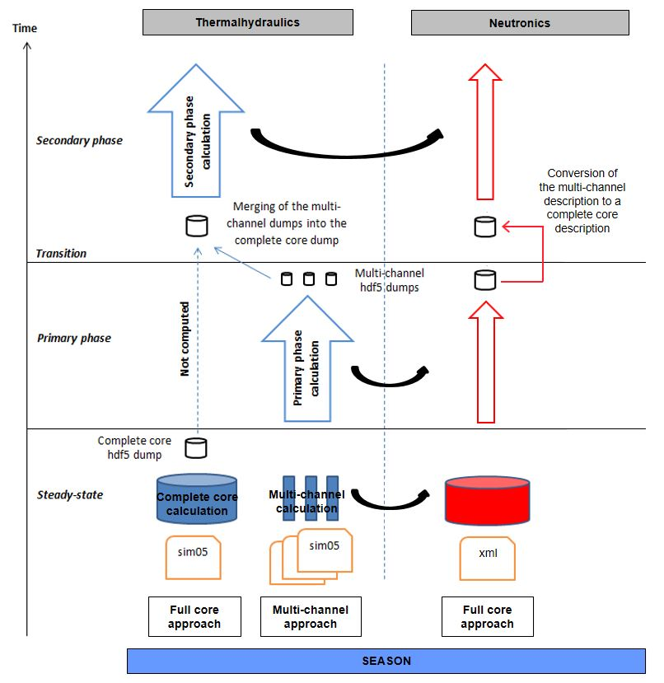
Description of the SEASON platform (8/8)
Transition between multi-channel (MC) and full core (FC) calculations
Principle
Generation of input data files for MC and FC calculations
Run of steady-state MC and FC calculations
→ Generation of a HDF5 dump file of the FC calculation
Run of the MC calculation of the initiating phase until the stopping criterion (break-up of one of the can walls located on the periphery of the simulated domain in one of the SIMMER-V channels)
→ Generation of the HDF5 dump files of the different channels shortly before the first subassembly can-wall break-up
Merge of the different HDF5 dump files of the multi-channel calculation into the corresponding full core HDF5 dump file
+ Rearrangement of the unique neutronics dump file from a multi-channel description of the core to a full core description
Run of the FC calculation of the generalized degradation phase
Transition procedure currently operational for simple channels having meshes that match exactly the full core mesh
Functionality that allows to run the full core calculation of the generalized degradation phase in a multiprocessor mode after the transition under development
Principle of the transition between the multi-channel calculation of the initiating phase and the full core calculation of the generalized degradation phase

Slide 15
Application case : 3D calculation of an ULOF transient on a simplified SFR core
3

Slide 16
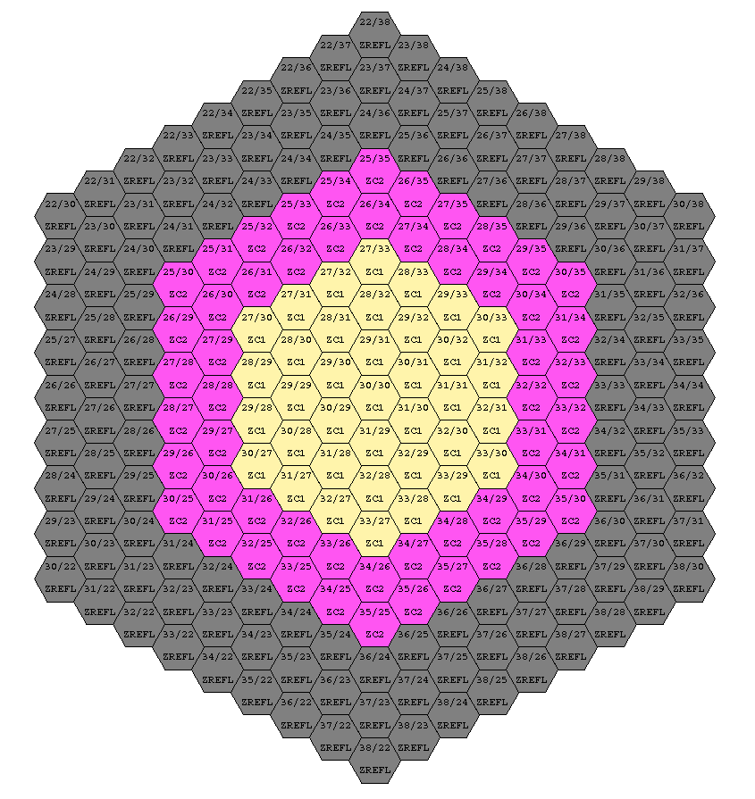
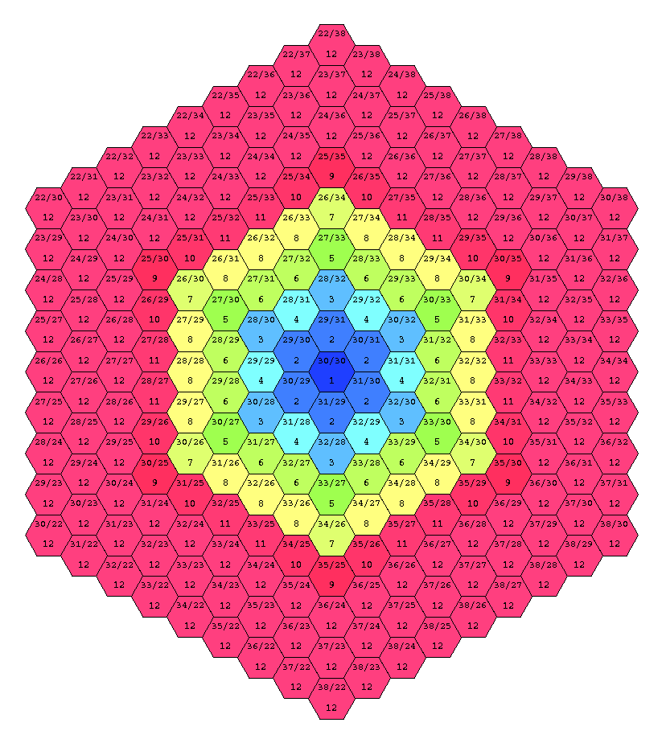
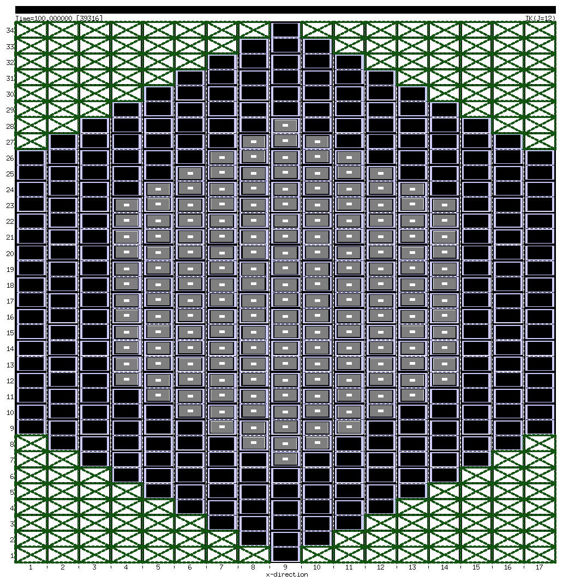
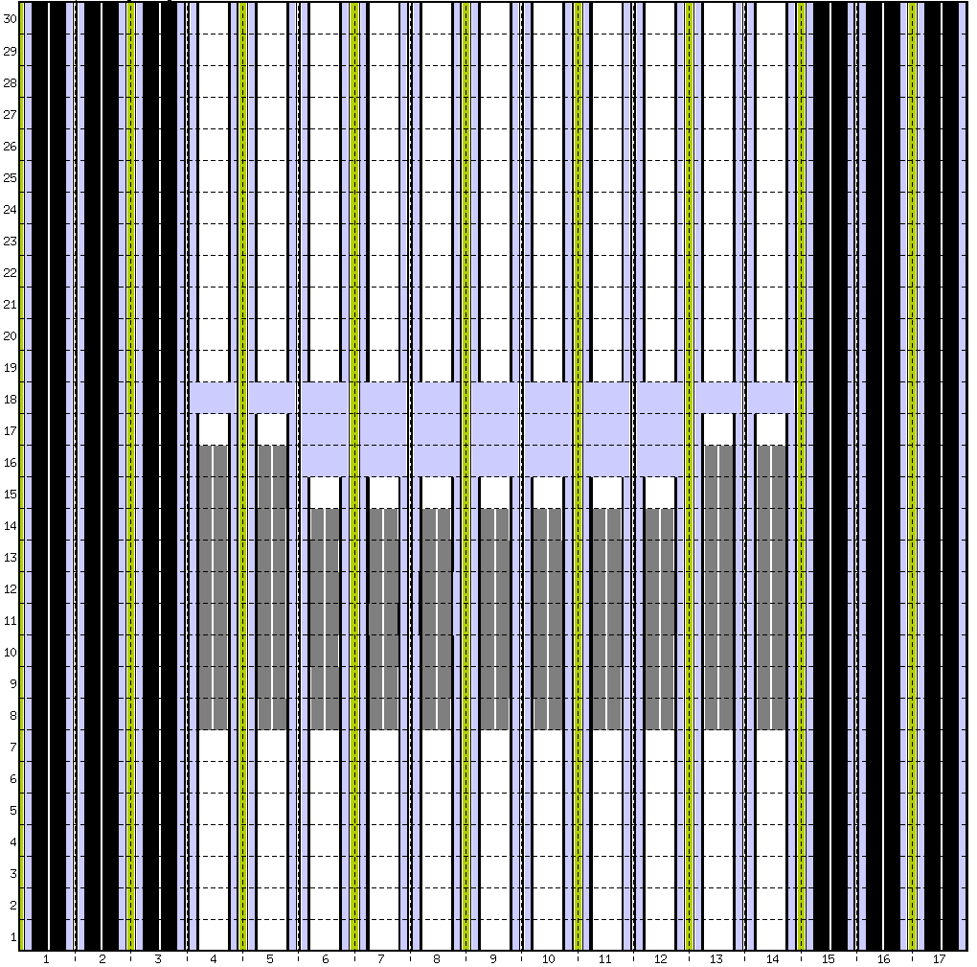
Application case (1/2)
Complete sequence of an ULOF transient in a simplified SFR core in 3D Cartesian geometry :
217 subassemblies → 2 types of axially homogeneous fresh fuel subassemblies + reflector subassemblies
Multi-channel calculation → core partitioned into 12 simple channels
Meshing : ortho-hexagonal approach → meshes of channels that match exactly the full core mesh (17x34x30 mesh cells)
Coupling with neutronics using the SNATCH flux solver
Steady state with constant nominal conditions of power and sodium flow
ULOF transient simulated by a sodium flow decrease at the core inlet with a pump halving time of 10 s
Ortho-hexagonal approach
Radial-azimuthal cut
Axial-radial cut
Radial cut of the core
Partitioning of the core
Discretization of the full core

Slide 17
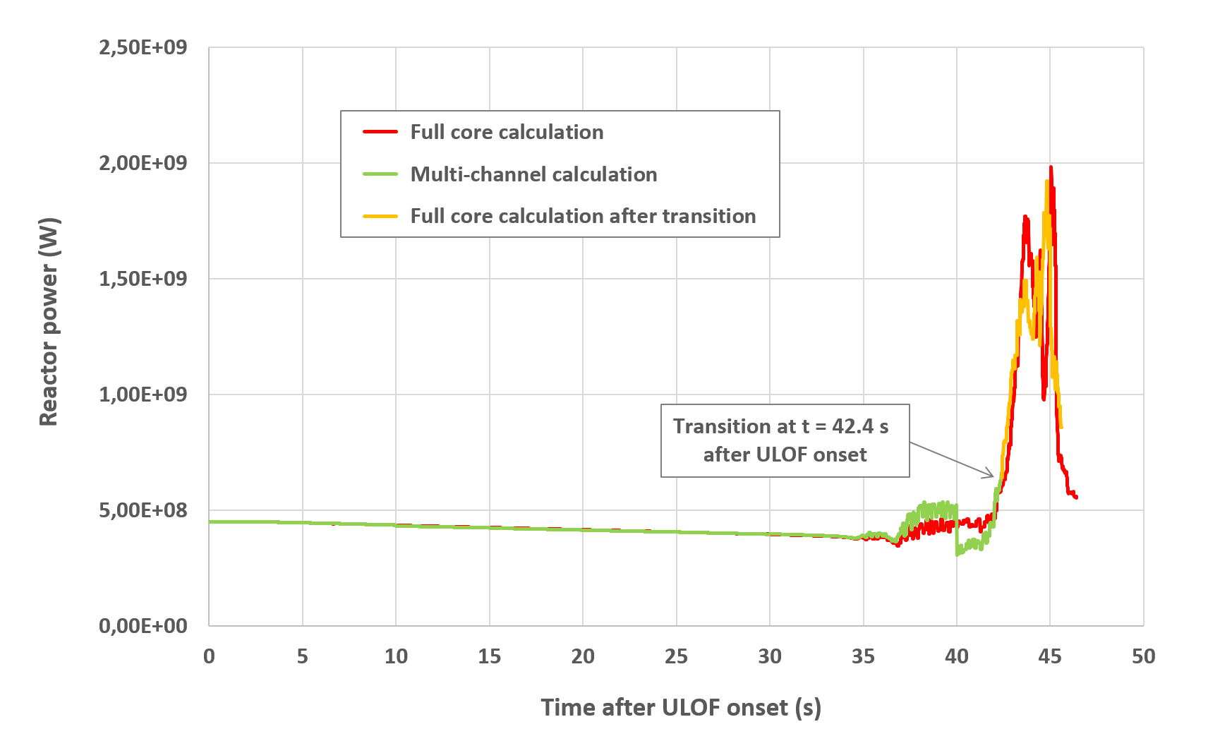
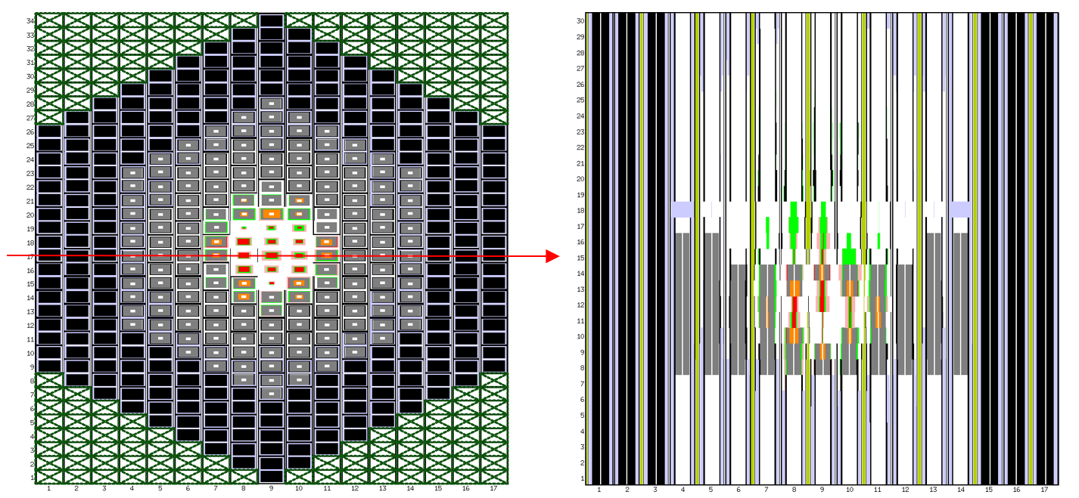
Application case (2/2)
Realization of 2 simulations of the ULOF transient in order to validate the procedure of transition between the multi-channel calculation of the initiating phase and the full core calculation of the generalized degradation phase :
a full core calculation of the whole sequence of the transient
a multi-channel calculation of the initiating phase of the transient followed by a full core calculation of the generalized degradation phase (with a transition performed an instant before the first subassembly can-wall break-up in the central channel)
Regression bug of the multi-channel calculation under correction
Transition between multi-channel and full core calculations well managed
Core power variation during ULOF transient
Core state after the power peak in the full core calculation

Slide 18
Perspectives
4

Slide 19
Perspectives
Short term perspectives for the future developments of SEASON :
Adaptation of the irradiation-degradation chaining to the detailed pin model DPIN3 of SIMMER-V
Extension of the transition procedure to the case with extended channels
Implementation of the two types of thermalhydraulics boundary coupling of SIMMER-V :
a inner (SIMMER-V/SIMMER-V) boundary coupling (using MPI exchanges and the MEDCoupling library), which will allow to embed a domain inside another one with the possibility of local mesh refining (for example, a core finely meshed into a vessel coarsely meshed)
a hybrid (SIMMER-V/another code) boundary coupling (using ICoCo/MEDCoupling exchanges), which will allow to couple SIMMER-V to a code modelling the primary circuit as CATHARE
Implementation of the on-the-fly update of the macroscopic cross sections during the degradation
Longer term perspectives :
Introduction of a simplified model describing the axial extension of the structures of the core
Improvement of the neutron computing by introducing a shielding module (from the neutronics platform APOLLO3) and taking into account the transport of fission products and their delayed neutrons
Introduction of an advanced modelling of cross sections in case of degraded geometry (from APOLLO3)

Slide 20
Thank you for your attention
CEA, DES, IRESNE, DTN, SMTA, LMAG
Cadarache
F-13108 Saint-Paul-lez-Durance
France
emmanuelle.dufour@cea.fr

